Slide 1
Streamlining the Silos
Collaboration with Curators and Using Alma to Conquer Multiple Workflows

Slide 2
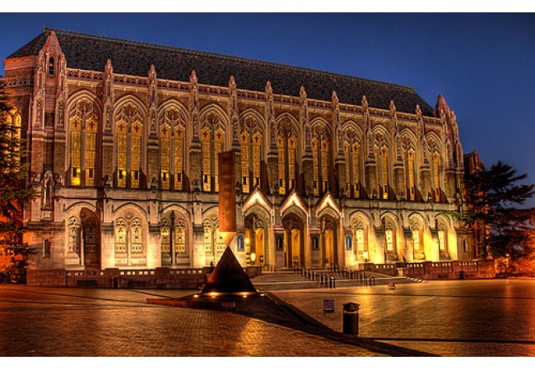
Who are we?
Suzzallo Library
Seattle, Washington
Charlene Chou
Coordinator for Technical Services, Distinctive Collections
Whitney Buccicone
Special Collections Cataloging Librarian
Notes:
Whitney - do introductions; Charlene is the Coordinator for Technical Services for DC and is responsible for managing all technical services over three units in one division. She is the liaison between DC and central technical services, including my department CAMS, ARCS, and preservation. I am the Special Collections Cataloging Librarian and am responsible for the original cataloging for all materials in SC. We joined forces two summers ago to reconcile the divide between different TS workflows in SC and that is why we are giving this presentation today.

Slide 3
Goals of this presentation:
Discuss steps taken to reach collaboration across multiple departments to create one uniform workflow for special collections print materials
Steps taken from first draft to final
Timeline - how long did this take us
Forms, work orders, etc.
Notes:
What we will be speaking about today is the process of getting from multiple workflows to a single one and everything that we dealt with along the way.

Slide 4
Original workflows
Different curator, different workflow
Curator 1: Curator → Student processor → Cataloger → Student processor → Shelf
Curator 2: Curator → Processor → Curator → Cataloger → Curator → Cataloger → Curator → Processor → Curator → Shelf
Curator 3: Curator → Staff processor → Cataloger → Staff processor → Shelf
Curator 4: Curator → Cataloger → Curator
Different material, different workflow
Print vs. archival
Notes:
As you can see, before we started, each curator had very different workflows and each had a different processor (or not) to help. The first thing to point out is that print materials have separate workflows from the archival. The first bullet point has the different print processes. As you can see, some were more complicated than the others. So our first step was to figure out which curator had the most streamlined and efficient. Each workflow had its positives and negatives but we dicded that the first curator listed here would work best.

Slide 5
Goals for new workflow
One workflow for printed material, one for archival material
In compliance with state regulations for acquisitions
One workflow for both print (published) & manuscripts/archives: gifts & purchased items
Cross department collaboration: Special Collections and International Studies
In sync with UW policies (acquisition, cataloging, and preservation)
Cross system communication
ALMA and Asana
Set the stage for backlog project
Notes:
-Technical processing: one for printed and one for archival collections
-For acquisitions, one workflow is for both gifts and purchased items for print and archives.
-SC did not follow certain UW written policies for technical processing
- We’ll be discussing this later in the presentation but we wanted to have an efficient workflow for when we began processing materials from our rather large backlog.

Slide 6
Step by tedious step
Create one flag - reduce print-outs
Comply with acquisition guidelines
Collaboration with Financial Services and Acquisitions departments
Get curatorial buy-in
Alma work orders
With help from other departments
Share written documentation for implementation
Pilot project
Start small
Collect data
Scale up
Ongoing evaluation

Slide 7
Challenges
Curator concerns
Mentality shift to learn Alma work orders
Technologically adverse co-workers
Keeping vendor relationships at personal level
Receiving item(s) within Special Collections
Not at other location within Libraries
Lack of written procedures to share online
Encouraging transparency, not oral histories
Acquisitions
Not to state guidelines
Ethics violations
Lost materials
Cataloging maintenance (ALMA clean-up)
Post-cataloging/materials processing
Multiple processors, all part-time
Timeline
All told, this took over 1 year to complete
Notes:
I am not going to lie and say that this has gone off without a hitch. We’ve encountered a lot of blockers on this. First off, we had to get our curators on board. As you can see, they had a lot of issues. First off, we had to talk to them about using Alma in the first place and explaining how this was going to benefit them. We had to show them multiple times taht this was not adding more time to an already complicated workflow and that using Alma was going to benefit them in the long wrong. A big concern was that by including technology, they would lose that personal relationship with book sellers/vendors. The biggest concern was that this new workflow would mean that SC materials would be received at a place outside of curator control, i.e. at central TS and that some unknown damage would incur to the item. We also dealt with the fact that none of the separate workflows had any written policies. Our acquisitions workflow was not up to state guidelines and curators, unknowningly, were creating ethical violations. The curators themselves were not accepting of change and did not understand why these changes were important. We also had some t

Slide 8
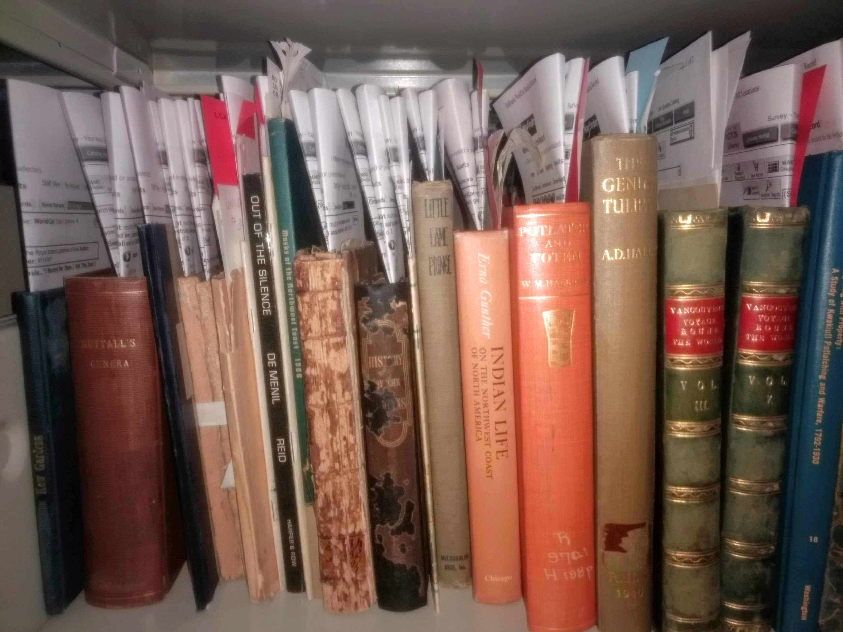
Count the number of print-outs!
Notes:
For every item sent to a cataloger, there would be a minimum of 3 items tucked in the book itself: a donor flag, printouts from OCLC listing holdings, and any other notes on a separate piece of paper that the curator felt important. These were lost consistently and often the catalogers were not given everything the curator felt the cataloger needed. What Charlene and i did was condense the printouts into one flag.

Slide 9
PROCESSING
ALMA
Do we own?
Yes
Call # ___________
Location: ­­­
No
Brief bib?
Yes No
OCLC/WORLDCAT
Searched by:
Title Author
Publisher Date
Other:
OCLC # __________
Cataloging needed:
Copy Original
Final shelving location: __________
Priority: Y/N
Needed by:
Additional notes:
Curator’s initials:
CATALOGING FINISHED
Cataloger:
Date:
Final shelving location:
Notes:
Barcode:
Notes:
This is our processing flag. It includes everything the curator wanted the cataloger to know and gave the cataloger only one paper flag tucked into a book. After these were implemented, we have not received any complaints about these being lost. The front of the flag includes a checklist of whether or not we own the item, whether these is a record in OCLC, and where the item will end up. These is even an area for curators to leave notes about the importance of the item, whether that is donor info, etc.

Slide 10
Benefits
Ability to track the status of each item
One processing flag to replace multiple flag and printouts
Reduce missing items
Increase productivity and efficiency
Notes:
Before this happened, where a book was was really a guessing game. By implementing workflows and work orders, we can easily track an item is at anytime by looking it up in ALMA. We’ve reduced all of those flags and printouts to one flag which means we’re not killing trees at the rate we used to be. All of this has lead to less time being spent guessing where a book was, were it needed to go, etc. THis is a win-win for everyone involved.

Slide 11
Implemented New Acquisitions Workflow
Comply with UW and national procurement practices--separation of duties: for auditing
Collaboration with the Acquisitions and Financial Services managers
Goal and challenges: to separate fiscal roles with limited manpower
Enormous meetings to communicate and decide the procurement chart and division of labor
Decision: Special Collections needs an acquisitions liaison to implement the new workflow and communicate with the Acquisitions Department
Receive SC new items by the SC Acquisitions liaison and Near East & SEA items for IS
Follow-up for archival collections
Use Asana for workflow management
To link workflows between Asana and Alma for acquisitions data
Notes:
-This new workflow has a major impact on smaller TS units with less manpower. Distinctive Collections consists of East Asia, International Studies and Special Collections.
-For International Studies, Charlene helps receiving the new items of Near East and Southeast Asia materials in compliance with the procurement chart.
-Asana is a workflow management tool but cannot replace ILS/Library management system, especially for acquisitions data.

Slide 12
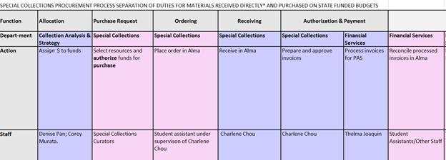
Procurement Chart: a partial view
Notes:
-To ensure proper separation, duties are separated by color. Employee(s) carrying out duties in pink boxes may not participate in duties in purple boxes, and vice versa.
-One student assistant works for me and I review his work.

Slide 13
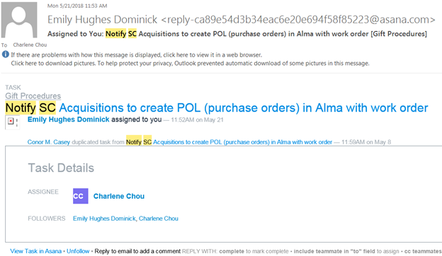
Asana to Alma: email notification for purchase orders
Notes:
A task is created for me in Asana and an email notification is sent to me for action.

Slide 14
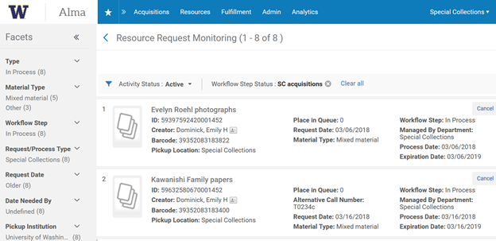
Monitor Acquisitions requests in Alma
Notes:
-My student can monitor the requests in Alma for POL creation.

Slide 15
Using Alma Work Orders to Track Item Status
Notes:
-Due to non-circulated collections, SC staff did not track any item leaving shelving location before fall 2017.
-During Alma migration in 2013, SC did not really implement work orders in Alma. Some paged items are in still not processed before fall 2017.

Slide 16
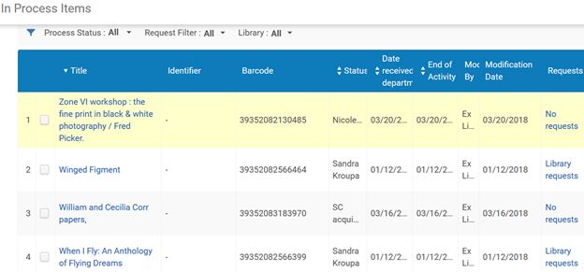
Alma work orders to track status
Notes:
-For implementing new acquisitions procedures, SC needs its own workflow step status such as SC cataloging, acquisitions and accessioning for receiving new item in the receiving workbench.
-For in-process status, new SC work orders were created and tested. Now, each item can be tracked for each workflow step or in-between two persons.
-You can sort by its status.

Slide 17
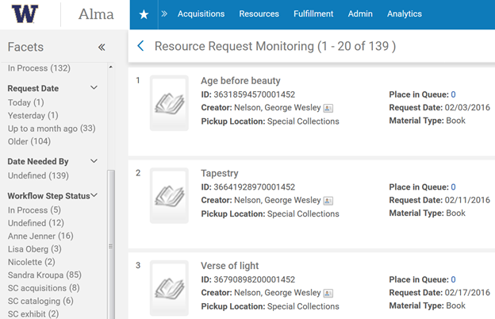
Special Collections Workflow Step Status
Notes:
-See all items tracked and not processed yet
-See the amount of items tracked under each status/curator
-Make items more discoverable and process more transparent

Slide 18
Assessment
How do we know this is working?
People have stopped complaining!
Increased efficiency
Increased productivity
Happy catalogers
We can track the amount of time each item spends at each step of the workflow
Re-evaluation every 6 months
Notes:
Whitney -- We know that this is working because we can track it in Alma. We keep ongoing reports that list what is still in transit. We can also go back to each item and see when something was checked into different parts of the process. At the beginning, we had some things in transit for over 6 months. Now we tracking things for less than a month or two. We know if an item sits for along period of time and since we know what curator each item is for, we know where to find the item before it’s placed on the shelf. The curators are happy, the catalogers are happy, and we hope our users are happy knowing that materials are available to them at a quicker rate. So where do we go now?

Slide 19
Applying the new process to our backlog
Notes:
Whitney-- we are using this on newly purchased and gift materials but we also want to apply this to our backlog.

Slide 20
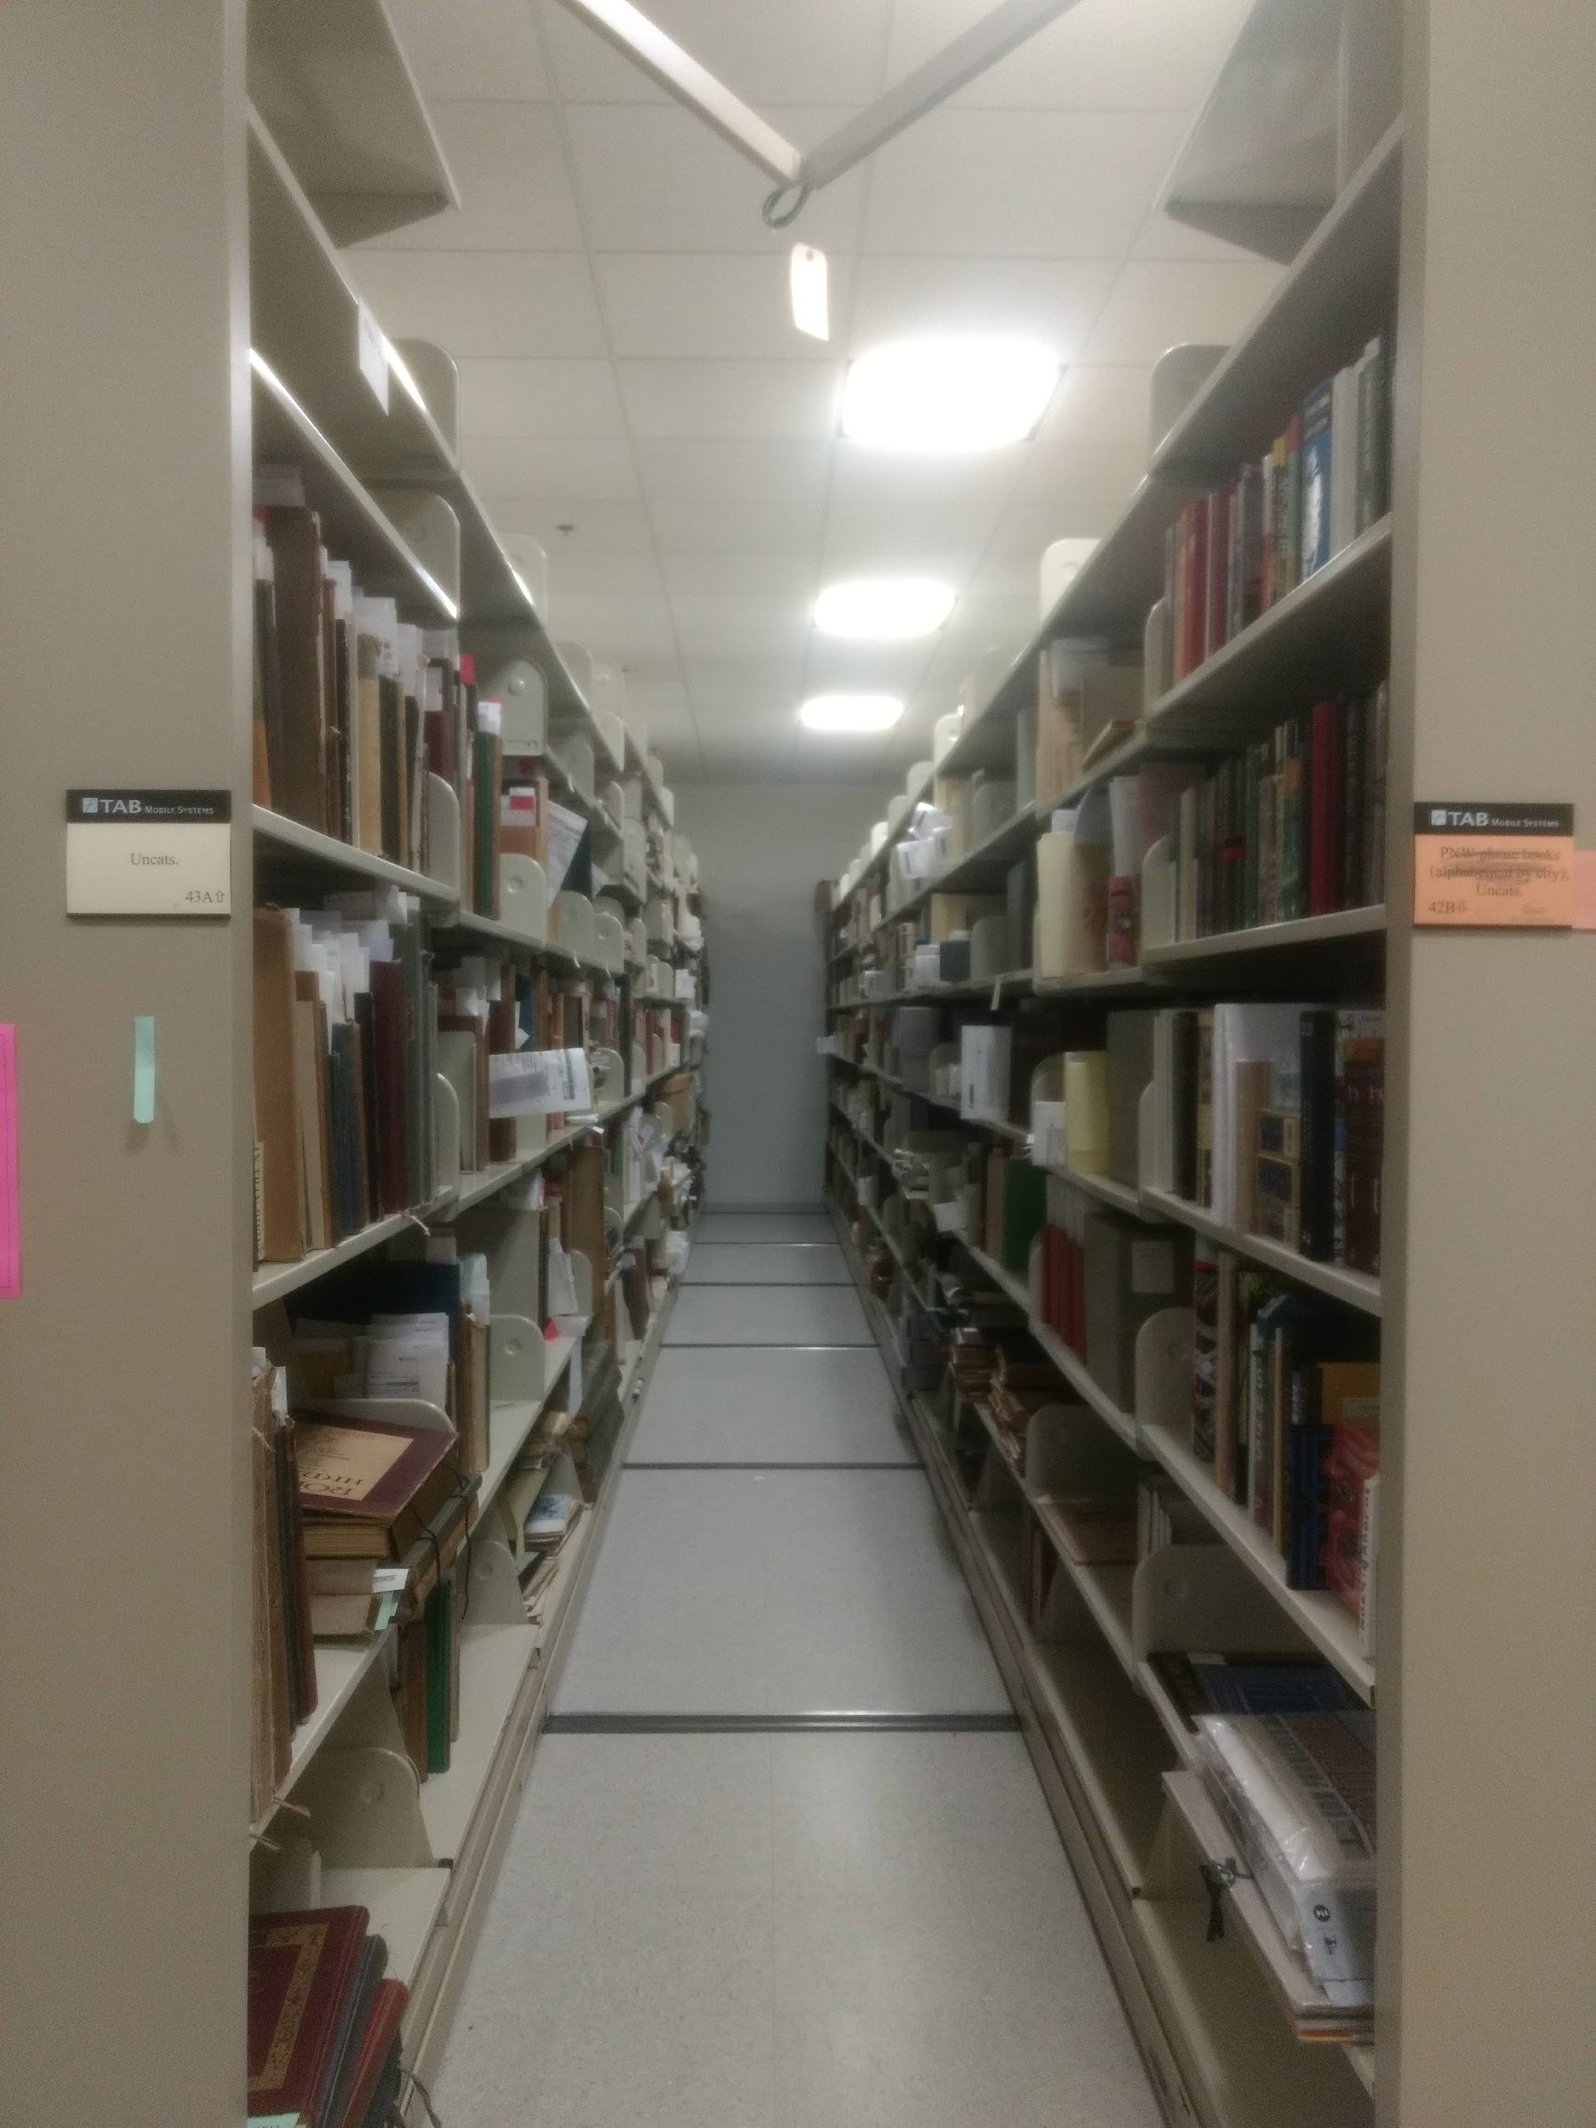
Backlog @ UW Special Collections
Current estimate:
60,000 print materials
6,000 archival materials
30,000 digital images
Plan for print materials:
Fill out new flag
Create brief bib for each
Every item gets barcode
Set location code SC_Backlog
Available in the catalog by title
Can be requested by user
Moved into cataloging queue after use by user
Notes:
Whitney - the most important reason we did all this is due to the fact UW Special Collections has a rather large backlog. Our hope is that with the new workflows and processing flags, we will be able to begin a backlog reduction pilot project in the coming months. Our goal is the steps above: each print item will receive a complete processing flag, barcode, and brief bib in Alma. The item record will include a location code so, if an item is requested by a user, our retrieval students can get it from the stacks. After use, we will put the item in the cataloging queue where it will receive full cataloging, a call number, and finally a new home home in our book stacks.

Slide 21
Thank you!
Questions or comments?
E-mail us:
bucciw@uw.edu
cc83@uw.edu

