Slide 1
March 11
2022
Xiaoli Ma
Scale Up Digital Collection Building with a Cross-Unit Database

Slide 2
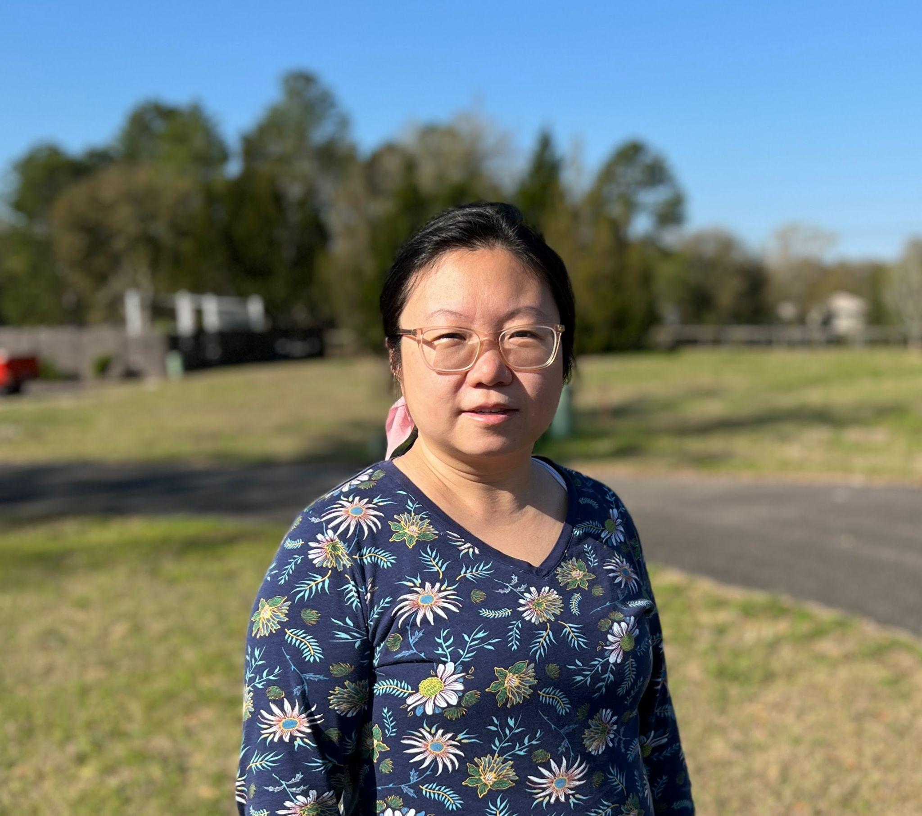
Xiaoli Ma
Metadata Librarian
George A. Smathers Libraries
‹#›

Slide 3
People
Overview
The Samuel Proctor Oral History Program of Liberal Arts and Science (SPOHP)
The Digital Support Services of the George A. Smathers Libraries (DSS)
D O C U M E N T T I T L E | S E C T I O N T I T L E

Slide 4
SPOHP digital collection hosted by the University of Florida Digital Collections (UFDC)
Overview
15 years’ collaboration
over 4000 available interviews
D O C U M E N T T I T L E | S E C T I O N T I T L E

Slide 5
Oral History
Overview
“Oha Core Principles.” Oral History Association, Oral History Association, https://www.oralhistory.org/oha-core-principles/.
D O C U M E N T T I T L E | S E C T I O N T I T L E

Slide 6
Oral History in Digital Collection
Overview
+
Metadata
+
Collection structure
D O C U M E N T T I T L E | S E C T I O N T I T L E

Slide 7
Poor Discoverability
Duplication of Efforts
Problem Statement
“You have to know what you are looking for, like who did the interview on which date, in order to find the interview in the digital collection ”--from an end user.
The same interview was processed and described multiple times, creating duplicate records in UFDC.
D O C U M E N T T I T L E | S E C T I O N T I T L E

Slide 8
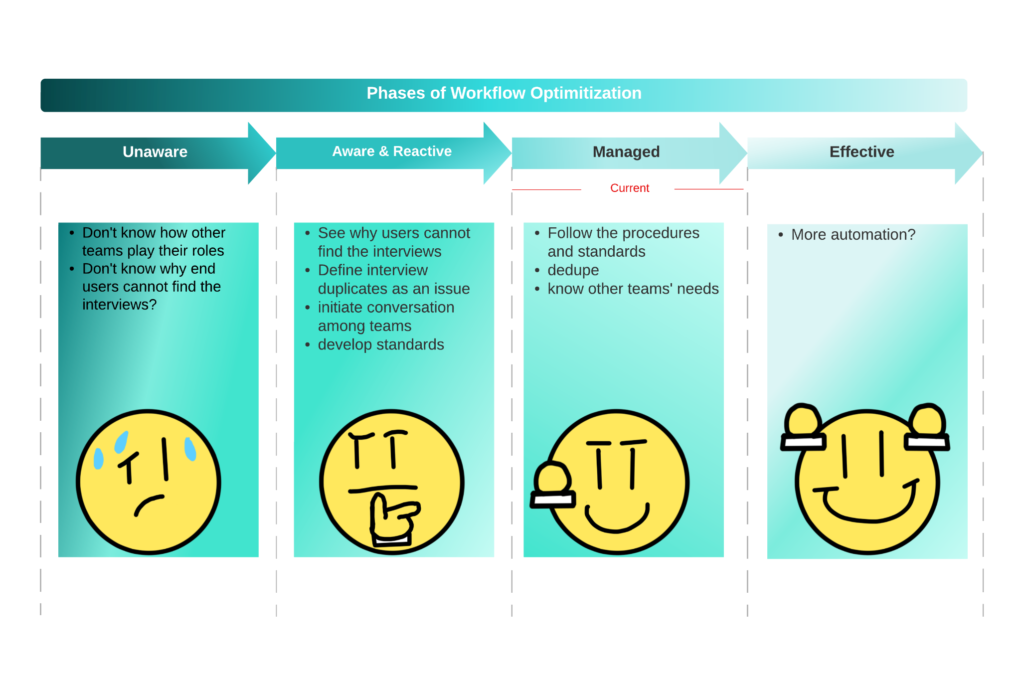
Phases of Workflow Optimization
Special thanks to Noah Wong for the emoji design
D O C U M E N T T I T L E | S E C T I O N T I T L E

Slide 9
Unaware--Workflow
Organize media files
Available on UFDC
batch
Interview
Fill in metadata template
Ingest metadata and upload media files
batch
Transcribe interviews
SPOHP
Original Steps
DSS
D O C U M E N T T I T L E | S E C T I O N T I T L E

Slide 10
Unaware--Workflow
Organize media files
Available on UFDC
batch
Interview
Fill in metadata template
Ingest metadata and upload media files
batch
Transcribe interviews
No tracking:
which has been sent to DSS ?
which has been transcribed ?
which has video ?
which has audio ?
No metadata content standard
SPOHP
Original Steps
DSS
D O C U M E N T T I T L E | S E C T I O N T I T L E

Slide 11
Poor Discoverability
Duplication of Efforts
Problem Statement
“You have to know what you are looking for, like who did the interview on which date, in order to find the interview in the digital collection ”--from an end user.
The same interview was processed and described multiple times, creating duplicate records in UFDC.
D O C U M E N T T I T L E | S E C T I O N T I T L E

Slide 12
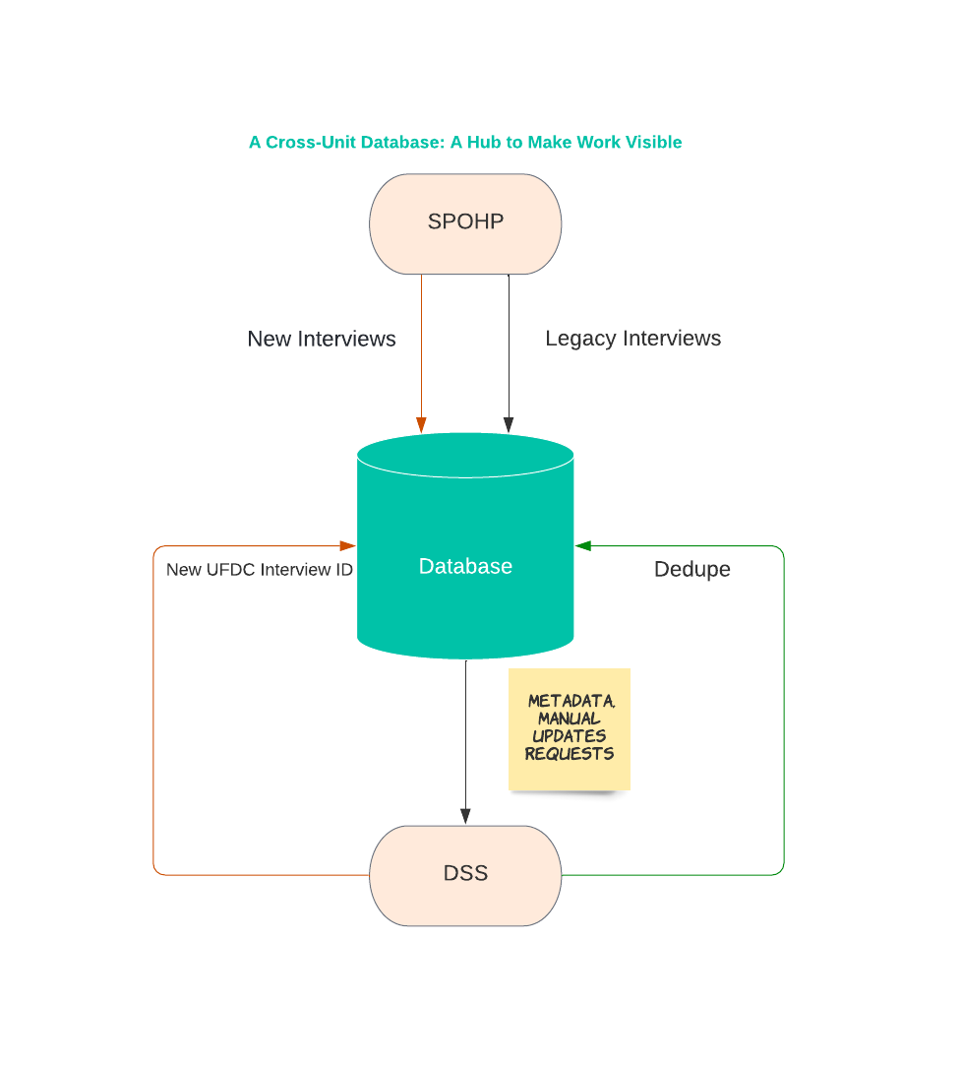
Managed: a Cross-Unit Database
An inventory list
A shared working environment
Upon the launch of the database, over 500 interviews were added to UFDC, about a 10% increase in total in half a year.
Special thanks to Noah Wong for the emoji design
D O C U M E N T T I T L E | S E C T I O N T I T L E

Slide 13
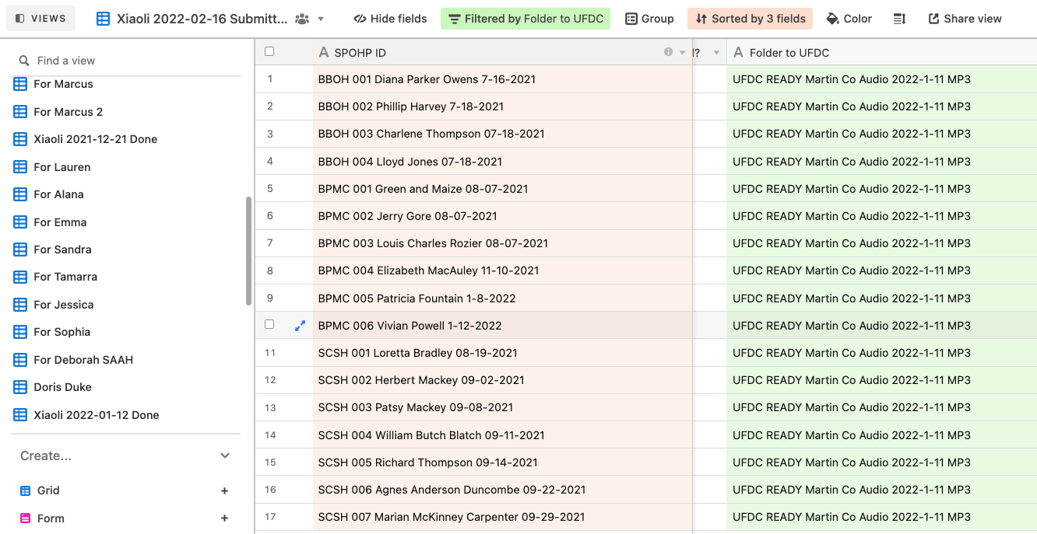
Managed: a Cross-Unit Database
1 interview 1 SPOHP ID, 1 UFDC record → 1 row in the database
Use the “Folder to UFDC” to group interviews
D O C U M E N T T I T L E | S E C T I O N T I T L E

Slide 14
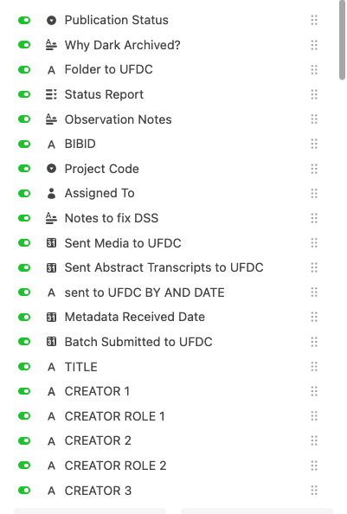
Managed: a Cross-Unit Database
Fields: Collected from all spreadsheets in use
Views: Members can group selected fields together on one view
D O C U M E N T T I T L E | S E C T I O N T I T L E

Slide 15
Criteria for Database
Easy to integrate into the workflow
Managed: a Cross-Unit Database
At a shared location
Easy to learn
Easy to customize
Easy to search
Multiple people can update simultaneously
Other project specific requirements
D O C U M E N T T I T L E | S E C T I O N T I T L E

Slide 16
When to consider?
Managed: a Cross-Unit Database
The work is ongoing
The process is the same but lengthy
Too many spreadsheets
Missing a big picture of the continuous efforts: what has been done? what needs to be done?
Special thanks to Noah Wong for the emoji design
D O C U M E N T T I T L E | S E C T I O N T I T L E

Slide 17
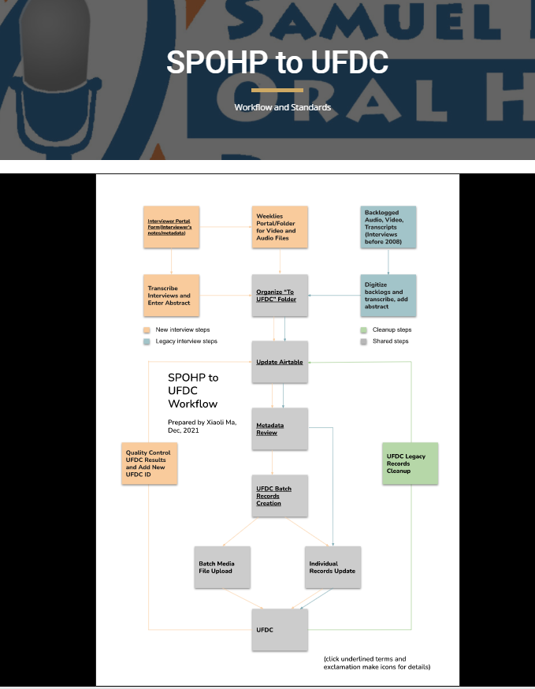
Beyond Database
Managed: a Cross-Unit Database
Organize media files for “Folder To UFDC”
Dump the data
Track the team work
List all the standards and procedures
D O C U M E N T T I T L E | S E C T I O N T I T L E

Slide 18
Questions?
xiaolima@ufl.edu
‹#›

