Slide 1
LGBTQAI+ Classification and Cataloging in the Elementary School Library
Linda Garrison
Librarian, Canterbury School of Florida, St. Petersburg
PhD Candidate
Texts and Technology
University of Central Florida
Notes:
Hello
I am Linda Garrison, I want to say thank you for allowing me to present remotely and I am sorry that I cannot be at the conference in person. I am sure I am missing excellent presentations; I will watch them later. My research interest is LGBTQAI+ Classification and Cataloging in the Elementary School Library.
I will be skipping discussions about some slides, for the sake of time, but I am leaving them in in case someone wants to view them later. Also, I have not narrated all of the slides – I am happy to provide full narration upon request.

Slide 2
Overview
Why are LGBTQAI+ Classification and Subject Headings important in school settings?
Where did we come from? Where are we now? Why is there still a disconnect between LGBTQAI+ lives and classifications and subject headings?
What can we, as librarians, do to provide safe, supportive library where students feel accepted.
Notes:
Today I will discuss why classifications and subject headings are important in the school setting; very briefly touch on the progress we have made in this area but also point out that there is still work to be done.

Slide 3
LGBTQ Students/School Environment
77% Depressed or down over the past week
95% Trouble sleeping at night
70% Felt worthless and hopeless in the past week
26% Always feel safe in their school classrooms
42% Could find information about LGBT-related issues in the library
Notes:
What piqued my interest in this research were the daily reports in the news about the extreme amount of discrimination that this community experiences. The statistics on this slide are heartbreaking – depression, trouble sleeping, feelings of worthlessness. That less than half of students could find LGBT information in the library is a clarion call to librarians.
GLSEN Survey uses “LGBTQ”
Formerly the Gay, Lesbian & Straight Education Network
3-10% Students, Family, Staff identify as members of LGBTQ student population identify .
2017 GLSEN National School Climate Survey – 23k students, 50 states and DC, all 5 territories. Available at https://www.glsen.org/article/2017-national-school-climate-survey

Slide 4
Notes:
The statistics are even worse for transgender students:
As an ally, it was natural for me to ask what is going on in our society and our libraries, and how can we help?
GLSEN 2017 National School Climate Survey https://www.glsen.org/article/2017-national-school-climate-survey

Slide 5
School Library’s Role
Libraries Mandated by ALA and AASL:
Provide safe, supportive environments
Provide diverse, inclusive collections
Flores et al study: exposure to transgender persons images reduces transphobia,
But are we? Research suggests not.
Notes:
Libraries are mandated to provide safe, supportive environments and to provide diverse, inclusive collections that tell everyone’s stories
Research has shown that simply exposing people to images of transgender persons decreases transphobia (Flores et al.).
School libraries are well positioned to provide those images and stories, but are we? Research suggests not so much. And when we do, the classifications are not always affirming, and the subject headings that make this material discoverable are sometimes missing.

Slide 6
Why are Subject Headings and Call Numbers Important to Children?
We classify to understand, collocate, and organize; it is how we:
Learn about ourselves and each other
Learn normal/abnormal
Structure reality
Classification: an almost invisible political and ethical power (Bowker and Star)
Notes:
Why are subject headings and call numbers so important to young students? Yes, literature must be discoverable, but it goes deeper than that, and we have to ask what does classification, in the broad sense of the word, do? As librarians, we understand that classification allows us to to understand, to co- locate, and to organize; but in a school setting, it is also how students learn about themselves and each other. It’s how they learn normal vs abnormal. Classifications help structure reality; but those classifications are an almost invisible political and ethical power, especially in a school setting where students rarely question their catalogs.
Adler (normal) Olson (structure reality) Bowker and Star (invisible political and )
1 - classification is applying a system of classificatory principles to a given set of objects; 2 – an object can reside in one and only one category; 3 – all objects are accounted for within the classification

Slide 7
We’ve Come a Long Way …
DDC 13th edition 1932
132.754 6 Mental Derangements
Sexual perversions
– Homosexuality
Notes:
BUT we have come along long way from this Dewey classification, as we no longer classify LGB under Mental Derangements.
https://asexualagenda.wordpress.com/2018/11/28/asexuality-in-the-library-ddc/

Slide 8
Subclass HQ HQ1-2044 The Family. Marriage. Women HQ12-449 Sexual life
HQ19-30.7 Sexual behavior and attitudes. Sexuality
HQ31-64 Sex instruction and sexual ethics
HQ71-72 Sexual deviations
HQ74-74.2 Bisexuality
HQ75-76.8 Homosexuality. Lesbianism
HQ77-77.2 Transvestism
HQ77.7-77.95 Transexualism
HQ79 Sadism. Masochism. Fetishism, etc.
HQ101-440.7 Prostitution
HQ447 Masturbation
HQ449 Emasculation. Eunuchs, etc.
HQ450-472 Erotica
Notes:
Unfortunately, all of these terms still fall under the same LCC Subclass: Sexual life: Sexual deviations. And while catalogers may understand that this list is not hierarchical, a student searching the shelves may not. Further, Transexualism is not an issue of sexuality. Prostitution, eunuchs, etc. are beyond the purview of this research, but are problematic in similar ways.

Slide 9
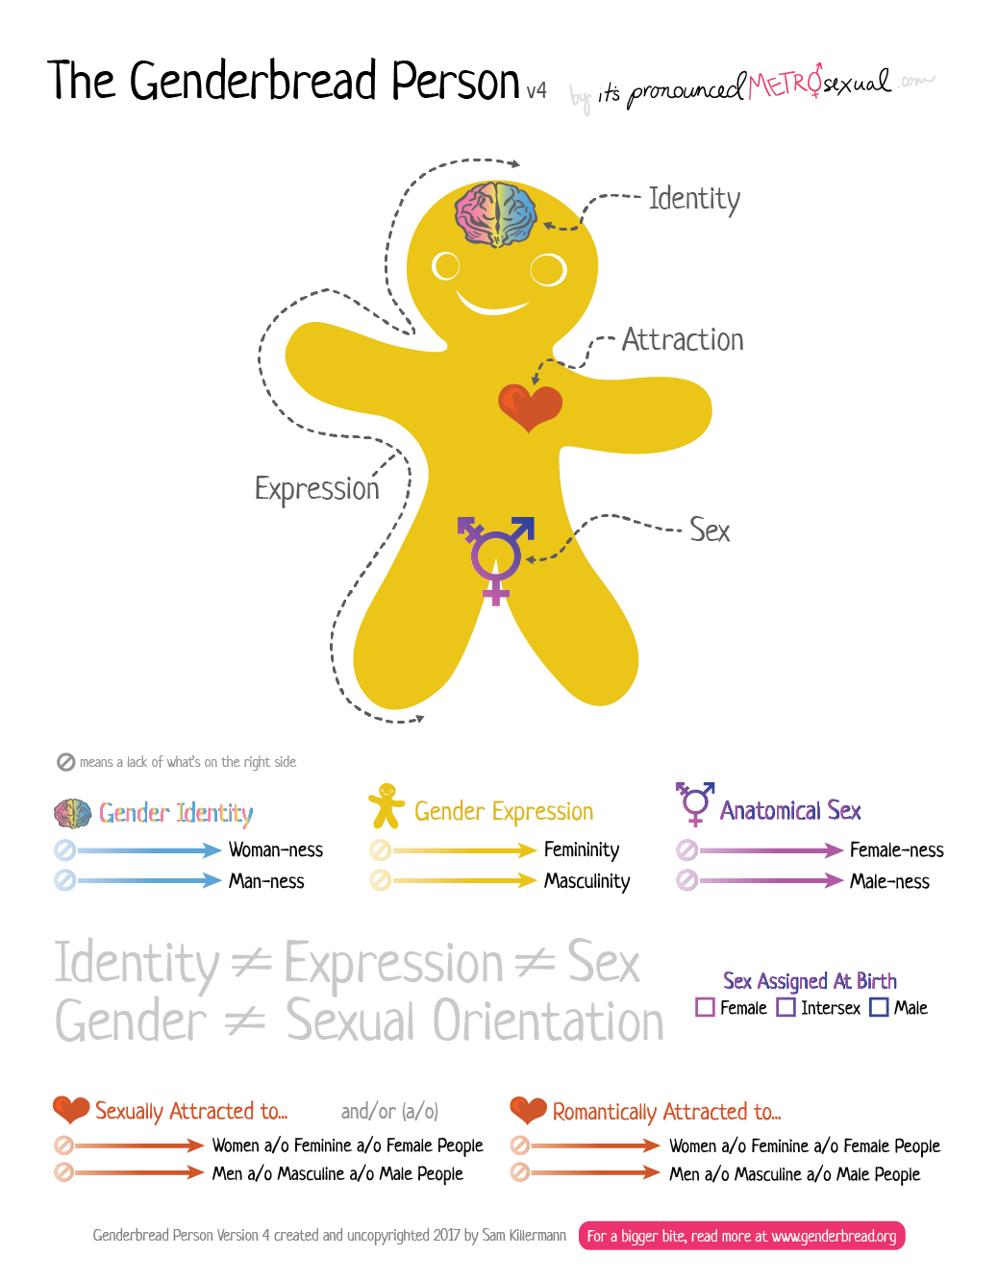
LGBTQAI+ Acronym
Lesbian
Gay
Bisexual
Transgender
Queer/Questioning
Asexual
Intersex
+ umbrella term
Notes:
I love this image – it articulates the differences in gender expression and identity, sex, and sexuality,
The arrow points to the disconnect between LGBT community and the cataloging community. For the sake of time, I will not discuss it further, except to say that transgender and intersex should not fall under the LCC umbrella classification of Sexual Life.
Killerman, Sam. “The Genderbread Person v4.” It’s Pronounced Metrosexual. https://www.itspronouncedmetrosexual.com/2018/10/the-genderbread-person-v4/#
Gender Identity: how you understand and define your gender; “woman”-ness/”Man”-ness (song “I feel like a natural woman”)(roles and expectations: jobs, hobbies)
Gender Expression: femininity/masculinity (as society allows you to express it: dress, pants, make-up, heels, hair; actions; demeanor; voice)
Sexual Orientation: who you are romantically/sexually attracted to
Sex: physical traits, anatomical sex (usually what you are born with, or develop through medical care – body hair, wide hips or shoulders, sexual organs, hormones, chromosomes)
ASK: are you all comfortable with these acronyms?
+ An umbrella term respectfully encompasses other gender/sexuality categories (two-spirited, pangender (a member of all genders).
It can be confusing. I purposely wanted to make the a, I, and + culturally visible in our hyper-sexualized environment.

Slide 10
Library Activism: Destabilize and Trouble Binary Subject Headings and Classifications
Assumed user: white, heterosexual, Christian, male- still vestiges (Bowker and Star)
Terminology and classification can pathologize sexuality
1960s Activism: Berman, Marshall – worked within system
Contemporary activists: Deconstruct Dewey and Cutter
Question warrant/authority
Taxonomies, thesauri, and folksonomies/social tagging created to augment (or replace) LCSH’s
Notes:
A LOT of good work has happened in the last 60 years. And is still happening today. - SKIP

Slide 11
Gender/Cultural Studies: Destabilize Binaries
Feminist Theory
Epistemic authority – Code
Situated Knowledge/ Objectivity - Haraway
Intelligibility of bodies - Butler
Who can speak for whom? - Alcoff
Queer Theory
Refuses classifications and hierarchical Reasoning
Logic of domination: “Subtle but powerful” use of everyday language – Marinucci
Whiteness Studies:
White skin provides privilege
All others are marked
Notes:
And gender theory and cultural studies helps us do this work - SKIP

Slide 12
Making Progress
 | The Family. Marriage. Woman Human sexuality. Sex
[HQ76.97-77.2.Z] | Transvestism CANCEL
[HQ76.97-77.2.Z] | Cross-dressing. Transvestism
 | Index:
 | Cross dressing: HQ76.97-77.2.Z
Notes:
LIBRARY OF CONGRESS CLASSIFICATION TENTATIVE LIST 02 (February 12, 2021)
https://classweb.org/tentative/

Slide 13
Daily Life of Elementary School Librarians (Thank you, professional catalogers!)
We copy catalog
We can sometimes make local changes – very important!
We can teach critical cataloging to our students – if we have time
May not be able to afford global updates
May not have time for professional development about cataloging and classification
Notes:
So, the last slide was a nice segue to subject headings. Let me say here – we could not do our work without the incredible dedication and effort of the professional catalogers; we know you have worked tirelessly to improve our tools and models. I always like to emphasize that I am NOT a professional cataloger, but a school librarian with an interest in LGBT material representation.
Most school librarians only copy catalog. I have learned through my research that many librarians are not allowed access to change records, or they simply do not have time. We DEPEND on LC records.

Slide 14
OPAC Search: Transgender
Notes:
My research discovered that there are myriad reasons LGBT material is not discoverable, many beyond catalogers’ control. For example, I do have inclusive material in my library, including transgender books, but…

Slide 15
“Hiding” the Books in PTC or PRO Section
Self Censorship:
Call # PRO
(Professional Collection)
Notes:
Due to self-censorship, students would not have access to these books, both of which are appropriate for elementary age students, because I have hidden LGBT material in the professional collection.

Slide 16
Self Censorship
Despite efforts to improve LGBTQAI+ collections, their classification and cataloging, librarians are still practicing self-censorship:
Fear of challenges
Personal choice
Budget
Notes:
SKIP
We are still practicing self-censorship, often because of fear of challenges.
But also budget – it’s difficult to justify purchasing for 3-10% of population –
Of the 323 book challenges reported to the ALA Office for Intellectual Freedom for 2016, five of the top 10 challenged books for 2016 included titles that LGBT characters including two with transgender children. Adams, Helen. “June Is GLBT Book Month.” Knowledge Quest: American Association of School Librarians 1 June 2017

Slide 17
Omitting LGBT Subject Headings
Notes:
Self-censorship is beyond your control. But incomplete records are not. Red: A Crayon’s Story is a picture book that addresses the complexities of being transgender, but is not returned when I enter the term “transgender” into my OPAC. I need to add Transgender as a subject heading to this imported recorded. As I mentioned before, not all librarians have this ability and must use records as is.
A solution is to have a thorough understanding of the book-in-hand and to not rely only on CIP information. Catalogers can also use language that students would: transgender (not transgenderism), or LGBT.

Slide 18
Windows and Mirrors
“When children cannot find themselves reflected in the books they read, or when the images they see are distorted, negative, or laughable, they learn a powerful lesson about how they are devalued in the society of which they are a part.”
~ Rudine Sims Bishop, from her 1990 seminal essay “Mirrors, Windows and Sliding Glass Doors”
Notes:
That was a very brief overview of my research. I leave you with one of my favorite quotes from educator Rudine Bishop. I am going to add to Bishop’s sentiment and say that where a book is placed on the shelf also teaches children where they belong in a society.

Slide 19
Windows and Mirrors and Sliding Doors, cont.
“Children from dominant social groups … need books that will help them understand the multicultural world they live in, and their place as a member of just one group, … If they see only reflections of themselves, they will grow up with an exaggerated sense of their own importance and value in the world – a dangerous ethnocentrism.”
~ Rudine Sims Bishop
Notes:
SKIP
UNLESS you believe in Bishop’s windows as well as her mirrors, in which she states that children from dominant social groups must see other lives, or they think their lifestyle is the only one that matters.

Slide 20
Expectations of Research
My research will hopefully encourage elementary school librarians to:
think deeply about their cataloging and classification tools and practices
Be transparent about biases and choices
Make the library a safe, inclusive place for LGBTQAI+ students
Create space for conversation and understanding
Notes:
SKIP
My research questions - skip

Slide 21
Thank You!
Questions? Comments?
Please email me at Garrison@Knights.UCF.EDU
Notes:
Thank you very much. If you have any questions, or more importantly, comments or suggestions, or you would like a copy of this PowerPoint, please contact me at Garrison@knights.ucf.edu

Slide 22
Works Cited
Please email Garrison@Knights.ucf.edu for complete list.
Flores, Andrew R., et al. “Transgender Prejudice Reduction and Opinions on Transgender Rights: Results from a Mediation Analysis on Experimental Data.” Research & Politics, vol. 5, no. 1, Jan. 2018
Graff, Lisa. The Great Treehouse War. NY: Philomel Books, 2017.
Hall, Michael. Red: A Crayon’s Story. NY: Greenwillow Books, 2015.
Herthel, Jessica. I am Jazz. NY: Dial Books for Young Readers, 2014.
Killerman, Sam. “The Genderbread Person v4.” It’s Pronounced Metrosexual. 2018. https://www.itspronouncedmetrosexual.com/2018/10/the-genderbread-person-v4/
Kosciw, J. G., Greytak, E. A., Zongrone, A. D., Clark, C. M., & Truong, N. L. (2018). The 2017 National School Climate Survey: The experiences of lesbian, gay, bisexual, transgender, and queer youth in our nation’s schools. New York: GLSEN, 2018.
Lang, Suzanne. Families, Families, Families. NY: Random House, 2015.

