Slide 1
A Holistic Approach to the Planning and Implementation of Metadata Inclusiveness
Charlene Chou
Head of Knowledge Access, New York University Libraries
ALA Core Role of the Professional Librarian in
Technical Services Interest Group
ALA Midwinter Conference, February 3rd, 2021
Notes:
This presentation is to summarize some examples of our metadata inclusiveness work at NYU in 2020. All of these stories is absolutely team work, and I’m simply a story teller.

Slide 2
Agenda
NYU stories
Libraries’ Senior Leadership Team: strategic priorities: IDBE renamed to the IDBEA (Inclusion, Diversity, Belonging, Equity and Accessibility) Steering Committee in Jan. 2021
IDBE in Collections Working Group report in fall 2020
Knowledge Access & Resource Management Service: Technical Services with four departments
Authorities Working Group: reconfigured in summer 2020
“Change the Subject” events in fall 2020
Anecdotes
Authorities Working Group: hybrid approaches
One Community: communication & collaboration
Notes:
-IDBEA = Inclusion, Diversity, Belonging, Equity and Accessibility
-The IDBE in Collections Working Group is charged with researching and proposing processes, initiatives, recommendations and best practices designed to help the NYU Libraries assess and increase the diversity of their collections.

Slide 3
How do technical services respond to many voices from various communities?
“Change the
Subject” Film
NYU IDBE in Collections WG Report
Local Contexts:
to support Indigenous communities
“Change the
Subject”
NYU screening & events
Canadian Subject Headings for Indigenous Peoples
SAC Working Group on Alternatives to LCSH "Illegal aliens“ Report
Special Collections harmful language feedback
Inclusive terminology:
Gender identity
Homosaurus
Research group: students’ feedback
SUNY reports on “illegal aliens”;

Slide 4
Authorities Working Group: reconfigured to meet emerging demands
The Authorities Working Group, reporting to the Metadata Policy & Implementation Committee, was reconfigured to create and maintain holistic policies around authority control and identity management, ensuring that we center the values of inclusion, diversity, belonging, and equity in our work with metadata.
Metadata
Archives
Authorities WG
I
ILS data
Notes:
AWG scope is expanded from assessing ILS authorities data to including metadata inclusiveness and the membership consists of a joint force from KA (Knowledge Access—cataloging and metadata librarians) and ACM (Archival Collections Management—archivists).

Slide 5
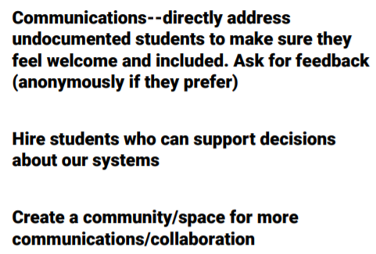
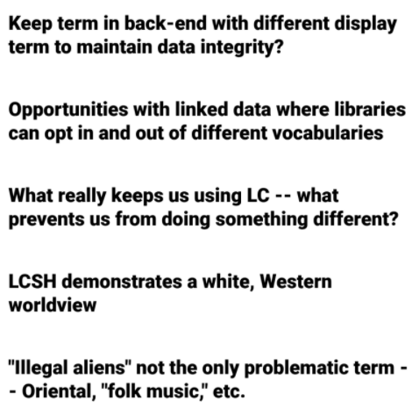
“Change the Subject” events organized by the IDBE in Collections Committee & AWG
Viewed the film, had a conversation with the filmmaker/filming team and Slack discussion
A brainstorm session with four breakout rooms
Ideas from small groups, e.g. communication and relationships (with users, across library with colleagues)
Active discussions in the entire NYU library & university communities
Notes:
Just a few screenshots of small group’s ideas!

Slide 6
A Subject Librarian’s Message with subject--Change the Subject updates: latest LC subject heading changes
Dear colleagues,
I am very happy to share with you a few most recent changes made to LC Subject Headings:
Replacing Armenian massacres, 1915-1923 to Armenian Genocide, 1915-1923.
In recognition of today's Transgender Day of Remembrance, a subject heading is added for that: Minority transgender women.
LC also approved to change the subject heading Tulsa Race Riot, Tulsa, Okla., 1921 to Tulsa Race Massacre, Tulsa, Okla., 1921.
Notes:
After the “Change the Subject” events, a subject librarian (co-chair of IDBE in Collections WG) sent this message to the entire library community. I’ve received very positive feedback from some colleagues.

Slide 7
A Response from the Communications
“I'm curious about these subject headings, and I love the changes!
Is there a place where I can find more information about how these changes happened and why? Is there a LibGuide available?”
Message forwarded to the Knowledge Access; then the Authorities Working Group
Notes:
After these email correspondences, the formal communication channels have been established between AWG and the Communication department.

Slide 8
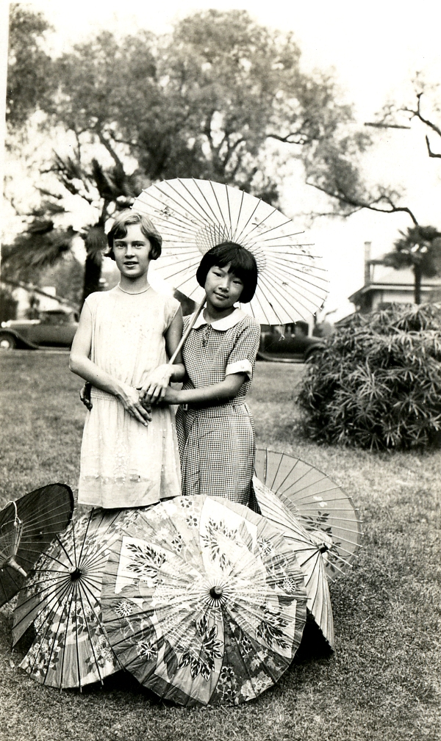
Righting (and Writing) Wrongs:
Reparative Description for
Japanese American Wartime Incarceration
by Shannon O’Neill, Curator for Tamiment-Wagner Collections, and Rachel Searcy, Accessioning Archivist.
“Language evolves over time. Think about
words or phrases that you once utilized that
are no longer popular, or have since been
critiqued as being harmful or offensive.
… archivist Rachel Searcy noticed euphemistic terms like internment and relocation were used in the
collection’s finding aid to describe the experiences of Japanese Americans during World War II. These
deliberate, bureaucratic euphemisms downplay the
reality of state-sanctioned violence that Japanese
Americans faced as a result of President Franklin D.
Roosevelt’s Executive Order 9066.
Photograph of two girls with umbrellas, undated; Midori Shimanouchi Lederer Papers; TAM 596; box 1; folder 5; Tamiment Library/Robert F. Wagner Labor Archives, New York University

Slide 9
Local Descriptive Decisions on Japanese American Incarceration
Euphemism | Accurate Term
assembly center | temporary detention facility
evacuation | forced removal
internment | incarceration
internment camp | concentration camp; American concentration camp
non-aliens | American citizens of Japanese ancestry
relocation | incarceration
relocation center | concentration camp; American concentration camp

Slide 10
Authorities Working Group: a subgroup to do collaborative work on new LC subject heading proposals
Reviewed the existing LC subject headings
Propose new LC subject headings
Research and citations
Possible revisions to propose
Notes:
A joint force of KA and ACM

Slide 11
Research Services Anecdote: Gender & Sexuality Studies
(Inter)disciplinary terminology has implications for metadata production, evaluation, and management. Take, for example, a Boolean search strategy to find literature on transgender identity formation:
(trans OR transgender* OR transsexual* OR transman OR transmen OR "trans man" OR "trans men" OR transwomen OR transwoman OR "trans woman" OR "trans women" OR FTM OR MTF OR “sexually fluid” OR “sexual fluidity” OR “gender fluid*” OR queer* OR genderqueer* OR androgeny OR androgenous OR “gender expansive” OR “gender diverse” OR “gender diversity” OR “gender variant” OR “gender nonconforming” OR GNC OR (non-binary OR nonbinary) AND gender)) AND …
Explore more G&S terminology here: https://guides.nyu.edu/genderandsex/terminology
Notes:
Subject-specialized terminology is a type of (inter)disciplinary vocabulary, which is particularly salient in Gender & Sexuality Studies, where language is constantly evolving to reflect new understandings of social identities and experiences. The language of G&S is dynamic, nuanced, and often (politically) contested. This complicates the application of metadata, which often function as fixed, concrete, and universally understood/applied entities. TENSION.
The Gender Studies Librarian has received feedback from students in the research group. This is simply one of great examples.

Slide 12
ONE COMMUNITY
Authorities Working Group
Hybrid approaches; four subgroups; work in progress
We communicate and collaborate to fulfill the same goal as ONE community!
Notes:
AWG: Four subgroups: Communications, Primo user stories, LCSH and community engagement

Slide 13
Special Thanks to
Authorities Working Group
Weatherly Stephan, Archival Collections Management (Chair)
Everett Allgood, Knowledge Access
Anna Björnsson McCormick, Archival Collections Management
Alexandra Provo, Knowledge Access
Rachel Searcy, Archival Collections Management
Gioia Stevens, Knowledge Access
Charlene Chou, Knowledge Access (ex-officio; Metadata Policy & Implementation Committee, Chair)
Jill Conte, Head, Humanities & Social Sciences
Aruna Magier, Librarian for South Asian Studies & International Relations
Nina Servizzi, Associate Dean, Knowledge Access & Resource Management Services

