Slide 1
Collection Development and Interlibrary Loan: Open Communication
Roundtable Facilitator: Alison M. Armstrong
Collection Management Librarian
amarmstro@radford.edu
ALCTS Creative Ideas in TSIG Midwinter 2019
January 26, 2019

Slide 2
ILL Project:
Books we could not ILL.
Books we would have to spend more than $20 to ILL.
Books we had interlibrary loaned multiple times in a few years.

Slide 3
“The single biggest problem in communication is the illusion that it has taken place.”
-George Bernard Shaw

Slide 4
Actions:
Identify the issue(s)
Determine stumbling blocks
Find common ground
Document procedures
Work toward shared goal
Circle back and assess

Slide 5
Discussion Questions
Open Communication (Broad):
How well do your ILL and C.D. departments/units work together or do you have a similar situation (need for open communication) in other areas?
What do you see as impediments to open communication between areas?
Are there ways in which you can use clear procedures to achieve the desired result?
What are some tactics you have used toward more open communication?
What would you say are some of the hallmarks of open communication?
ILL Project (Narrow – ILL):
Do you have a purchase practice for ILL requests? If so, tell us about it.
If you don’t, are you interested in trying it and what would you try?
What do you foresee as stumbling blocks?
Do you have questions about our project?

Slide 6
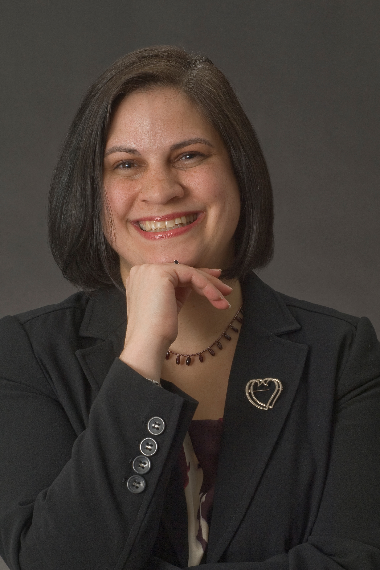
Thank you!
Alison M. Armstrong
amarmstro@radford.edu

