Slide 1
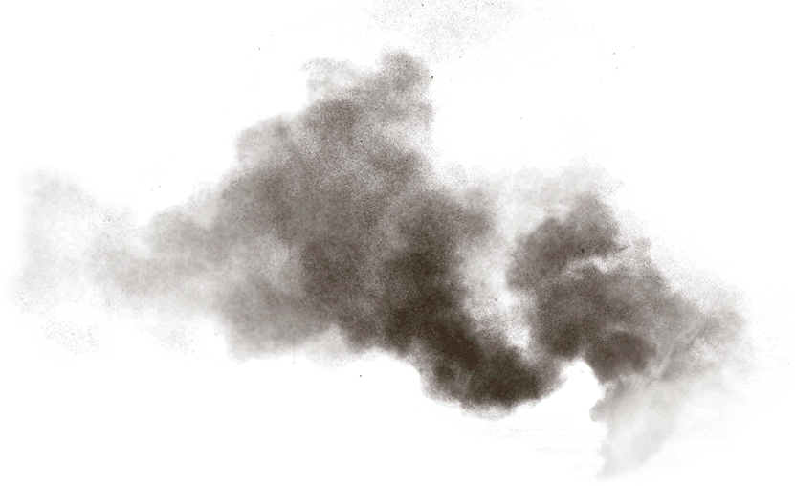
MPMP!:
Implementing a Multiphase Metadata Production Model and Workflow in DSpace
Emily Crawford (she/her/hers)
Digital Collections Associate
MIT Libraries Technical Services
Contact
ecrawfor@mit.edu
LinkedIn

Slide 2
DSpace at MIT Libraries
MIT Dspace instance hosts many collections created by MIT-affiliated corporate entities across MIT
Today focusing on the MIT Open Access Articles Collection
OAAC consists chiefly of articles written by MIT-affiliated authors
Items made available under the MIT Faculty Open Access Policy or related publisher agreements
Established and maintained by MIT Libraries and Libraries staff

Slide 3
The Challenge
Backlog of several thousand deposits dating back to when production was on pause following a 2019 DSpace version upgrade
Various efforts
Reassessing and adjusting workflows
Introducing an expedited workflow for items
Outsourcing

Slide 4
The Solution
Conceptual model inspired by the archival concept of “iterative processing”
Multiphase Metadata Production (MPMP) conceptual model:
Task Queue
Archived/Public
Minimum Viable Record
Intermediate Record (2 parts)
Complete

Slide 5
MPMP Workflow Model
Task Queue
Archived/Public
Phase 2A :
Authority Work
Phase 1:
Minimum Viable Record
Phase 3:
Final Review
Phase 4: Complete/
Remediation*
Phase 2B:
Publication Information
*Remediation may be needed for items post final review.

Slide 6
Predicted Benefits
Flexibility for targeted descriptive work
Improved metadata quality
Reduction of current backlog
Expedited availability of content
Prevention of significant future backlog

Slide 7
Development
Repository Services Strategist worked with service provider to customize MIT test instance of DSpace
Customization included changes to the interface to allow versioning of item records while consolidating them at a single url
Adding a button for creating a version of record
A form for providing an explanation why the new record version created
New field in records to indicate MPMP workflow status
Trials on MIT test instance
Production freeze from June to October 2021

Slide 8
Ready for the Road
Wrote new wiki and training documentation for MPMP workflow
Batch cleanup and archiving of 4000+ item records, manually edited 2000+ records to prepare them for MPMP Phase 2
After months of testing in development, service provider ready to deploy MPMP modifications to production instance in October 2021
2 week period after implementation in production instance to monitor if functionality was ok
Staff training in October 2021, production meetings resumed

Slide 9
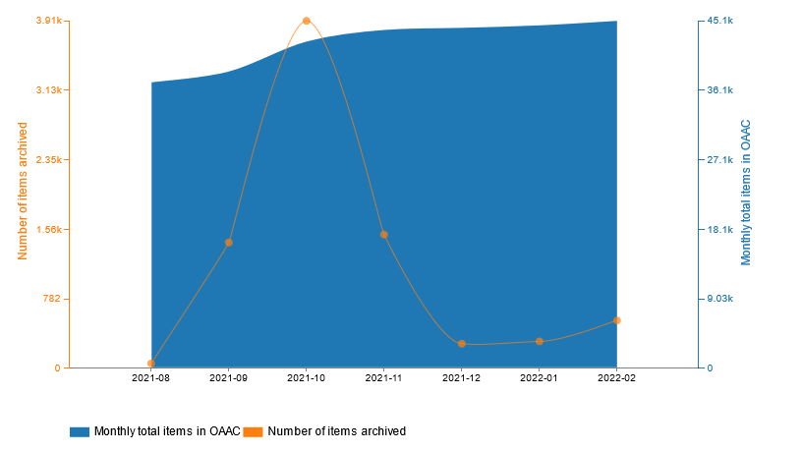
MPMP Milestones
Number of items archived vs Total items in OAAC

Slide 10
MPMP Outcomes
Significant reduction of backlog
Improved access to content
Improved metadata
Faster metadata production

Slide 11
The Road Ahead
Testing batch editing capabilities for phases 2b and 3
Developing batch editing workflows for phase 2b and 3

Slide 12
Questions?
OR
?
This Photo by Unknown Author is licensed under CC BY-NC-ND

