Slide 1
Adapting to the Crisis: Changing Cataloging Processes during the Pandemic
Fang H. Gao, Chief, Library Technical Services
Donna J. Kraemer, Supervisory Librarian
Stephen Kharfen, Supervisory Librarian
Library Services and Content Management (LSCM)
U.S. Government Publishing Office (GPO)

Slide 2
Who We are and What We Do
U.S. Government Publishing Office (GPO)
Mission: Keeping America Informed
Vision: an informed nation that has convenient and reliable access to their government’s information through GPO’s products and services

Slide 3
Government Publishing Office Public Information Programs
Library Services & Content Management (LSCM) administers four Congressionally-mandated programs:
Federal Depository Library Program (FDLP)
Cataloging & Indexing Program (C&I)
International Exchange Service (IES)
By-Law Program
44 U.S.C. §1710-1711 and 44 U.S.C. §4101(a)

Slide 4
Federal Depository Library Program (FDLP)
GPO partners with more than 1,100 libraries nationwide
that are committed to helping the public discover government information.
Depository libraries:
Ensure the American public has no-fee access to its Government’s information.
Assist library patrons in finding and using Federal Government information, which supports research and education.
Provide increased visibility of Federal Government information, which benefits agencies.

Slide 5
FY 2021 Statistics (October 1, 2020 – September 30, 2021)
Distributed 2,708 titles.
Distributed 474,139 copies of materials to FDLP libraries.
Added 16,544 new cataloging records to the CGP, of which 12,299 (74%) contained PURLs to full-text publications.
Checked in 6,086 serial issues to the CGP and created 85 publication patterns for serial titles.
Identified 1,727 previously-uncataloged Serial & Integrated Resource (IR) titles and created new bibliographic records.
Resolved 7,918 askGPO inquiries.

Slide 6
Access to Federal Government Information through the Catalog of U.S. Government Publications (CGP)
A comprehensive index of Federal Government public information
Search tool for print and electronic titles of the National Bibliography of U.S. Government information
Over one million bibliographic records generated since July 1976
More than 240,000 links to official full-text electronic titles

Slide 7
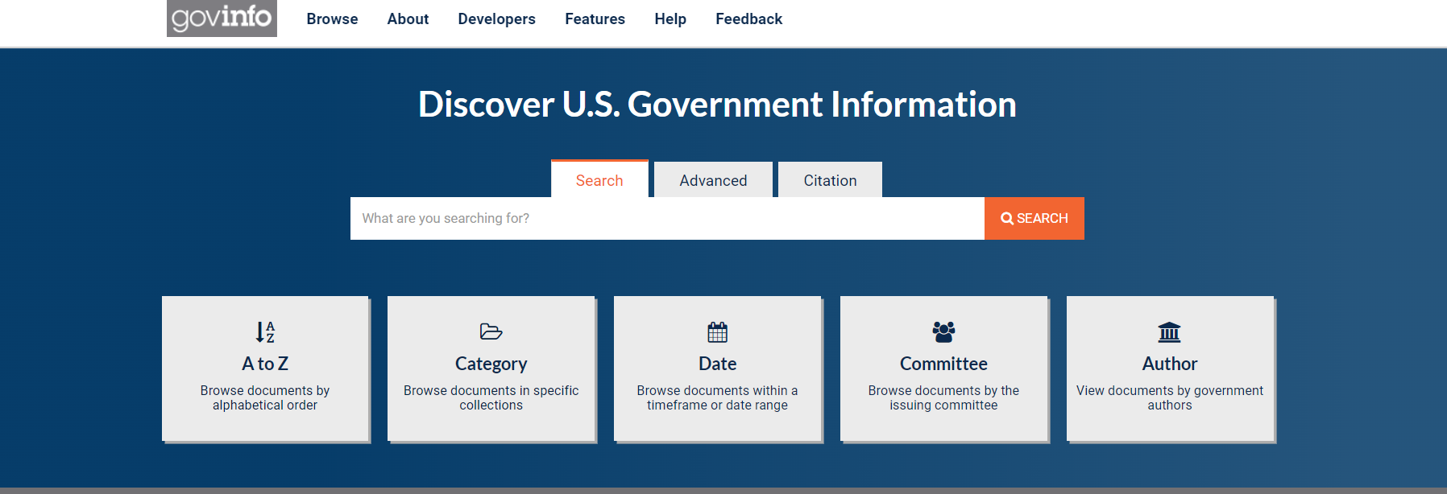
govinfo
Content Management System
Preservation Repository
Public Access Website
Historic and Current Federal Government Publications

Slide 8
Authority in cataloging Federal Government Publications
Member of OCLC since 1976
Active participant of PCC
Metadata freely available from CGP on GitHub

Slide 9
March 16th, 2020-Everything you thought you knew has changed
Work Schedules
including Maxiflex
100% telework to hybrid work schedule based on positions
In-house work vs remote work

Slide 10
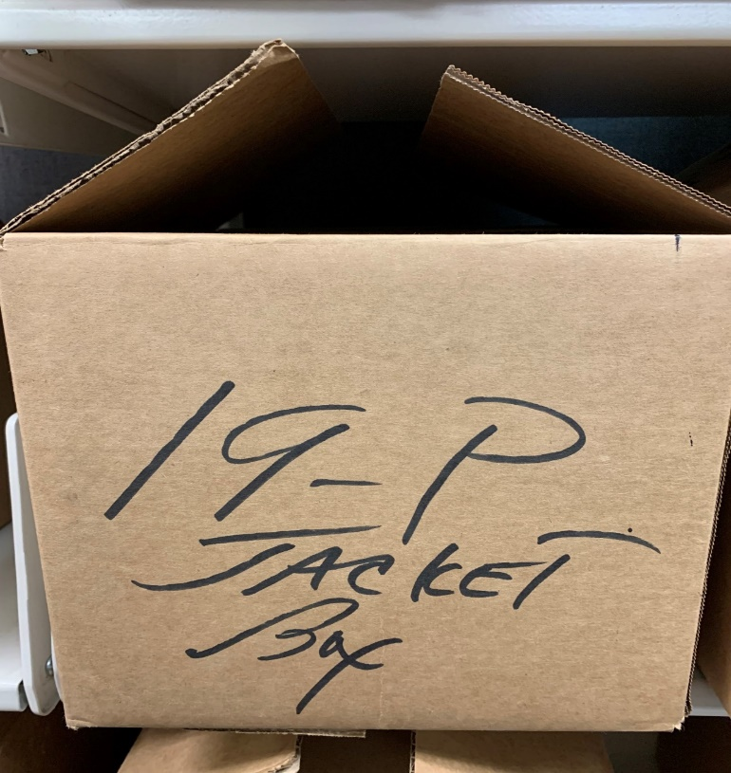
Depository Library Shipping Box of Federal Government Publications
One of 1,031 boxes with different publications based on depository library collection development selections
LTS provides near-shelf-ready materials for each publication in the box

Slide 13
Shipping list: 2021-0019-P
Shipping date: March 17, 2021
Number of Titles: 15

Slide 14
The Federal Depository Library Program, the Pandemic, and LSCM’s Library Technical Services
FDLP materials processed by LTS staff in office; changed to a hybrid environment.
Critical parts of FDLP publications scanned and sent as attachments.
Bibliographic, and other metadata entered onto a shared tracking sheet.
Tangible publications mailed directly from GPO’s Distribution Facility.
LTS staff classify, catalog, and return ILS system numbers for each item completed.
PCC review/authentication previously performed on-site, but now…

Slide 15
GPO’s Cataloging/Metadata Approach
Create separate records for each publication format.
Generally, print and online versions or print, online, and microfiche versions of the same publication.
Try to authenticate as many records as possible for Program for Cooperative Cataloging.
The following data are approximate.

Slide 16
GPO Bibliographic Records, 2012-2021
Category | Number | Percentage | Average
All Records | 200,500 | - | 20,050
Monograph Records | 182,000 | 91% of All Records | 18,200
BIBCO Records | 129,000 | 71% of Monographs | 12,900
Tangible & Online Versions | 57,000 | 31% of Monographs | 5,700
Tangible & Online Versions BIBCO | 41,000 | 73% of BIBCO Records | 4,100

Slide 17
Request for a BIBCO Surrogates Policy
Consider aligning BIBCO policy on “piece in hand” with CONSER policies by permitting the use of surrogates.
GPO is the publisher of many of the publications that we catalog.
Online versions are available for a large percentage of the materials that we catalog.
Checked approximately 2,000 publications for BIBCO authentication from late 2020 to late 2021.

Slide 18
Main Elements of the Surrogates Policy
Section F3. Use of Surrogates, BIBCO Participants’ Manual: https://www.loc.gov/aba/pcc/bibco/documents/bpm.pdf
Concept of reliable surrogates.
Records must meet the Bibliographic Standard Record requirements.
Addition of 588 Source of Description, Etc. Note to record the use of a surrogate.
Update records if physical copies become available.

Slide 19
Benefits of the Policy for GPO
From early December 2021 to early February 2022, authenticated more than 200 records using surrogates.
Expedites our cataloging/metadata workflows and operations.
Reduces the number of publications sent to staff members for cataloging.
Need to examine tangible publications only when necessary.

Slide 20
Thank You! Fang H. Gao: fgao@gpo.gov Donna J. Kraemer: dkraemer@gpo.gov Stephen Kharfen: skharfen@gpo.gov

