Slide 1
Culturally rich name authority records in rda for puerto rican artists
Dinah M. Wilson Fraites
Cataloging Librarian​
Library System
University of Puerto Rico, Río Piedras Campus
March 10, 2023

Slide 2
Introduction
This presentation will explore the attributes for culturally-rich metadata for name authority records in RDA for Puerto Rican artists. The creation or enhancement of name authority records for Puerto Rican artists stems from the need to support metadata creation in ongoing digitization projects led by the University of Puerto Rico, Río Piedras Campus, that focus on preservation and access of unique Puerto Rican and Caribbean Studies collections.
With this presentation we aim to encourage community discussions regarding challenges and best practices for the creation of culturally-rich name authority records.

Slide 3
Discussion points
Name authority control and user tasks: basic concepts
Context: Name authority control in Puerto Rican & Caribbean special collections
Attributes for name authority records for Puerto Rican artists in RDA
Outcomes

Slide 4
Name authority control
Basic Concepts

Slide 5
Name authority control
Authority control is the result of the process of maintaining consistency in the verbal form used to represent an access point in a catalog, such as names, titles, and subjects (Joudrey, Taylor & Miller, 2015).
Libraries have performed authority control for decades. Authority records establish the form of the name that serves as the authorized access point and provide a record of changes to the authorized form of the name, alternative forms of the name, cross-references, and evidence for the decisions made about the form of the name (Tillett, 2004, as cited in Downey, 2018). Authority control can also be achieved through Uniform Resource Identifiers (URIs) that link together the different forms of the same name across different languages (Virtual International Authority File).
The purpose of authority control is to make possible the functions of the catalogue: identifying, collocating, and evaluating information resources.

Slide 6
FRAD | Definition | IFLA LRM | Definition
Find | Find an entity or set of entities corresponding to stated criteria, or to explore the universe of bibliographic entities using those attributes and relationships. | Find | To bring together information about one or more resources of interest by searching on any relevant criteria.
Identify | Identify an entity (confirm that the entity represented corresponds to the entity sought and distinguish between two or more entities with similar characteristics). | Identify | To clearly understand the nature of the resources found and to distinguish between similar resources.

Slide 7
FRAD | Definition | IFLA LRM | Definition
No equivalent |  | Select | To determine the suitability of the resources found; accept or reject specific resources.
No equivalent |  | Obtain | To access the content of the resource.
Contextualize | Place a person, corporate body, work, etc., in context; clarify relationships. | Explore | To discover resources using the relationships between them.
Justify | Document the data creator’s reason for choosing the form of name on which a controlled access point is based. | Out of scope

Slide 8
Authority control for puerto rican special collections

Slide 9
Context
The University of Puerto Rico, Río Piedras Campus, is developing a one-year project, funded by the National Endowment for the Humanities, for the digital preservation and access of unique Puerto Rican and Caribbean Studies collections held by the José M. Lázaro Main Library and the seminar centers in the Humanities Faculty. Funding will support the revitalization and dissemination of these items as digital objects to make them available for college students, professors, researchers and scholars at large.
A coherent digitization plan is led by the Center of Digital Humanities of the University of Puerto Rico-Río Piedras. The center is an initiative aiming to revitalize, reuse and recover primary and secondary sources, as well as artifacts, all related to the Caribbean.

Slide 10
Puerto rican & Caribbean special collections
The digital preservation project encompasses four different collections:
Alfred Auguste Nemours Collection: The collection, hosted by the UPR Río Piedras Main Library, centers mainly on the figure of Haitian military strategist Toussaint Louverture and the Haitian revolutionary process. The bulk of the material, from the 16th-18th centuries, is of great importance for scholarship in areas related to Puerto Rican and Caribbean studies.
José Emilio González Collection: Located at the Multidisciplinary Seminar Room of the Humanities Faculty, it is composed of 20 boxes with 300 hundred unique objects related to the figure José Emilio González, one of the most important Puerto Rican cultural scholars and literary critics of the twentieth century.

Slide 11
Puerto rican & Caribbean special collections
Collection Census Bureau, Special Censuses of Puerto Rico, 1935: The 1935 Special Censuses of Puerto Rico consists of microfilm publications containing the Social and Population Schedules (M1881), as well as Agricultural Schedules (M1882) which was conducted by the Puerto Rico Reconstruction Administration, with technical supervision by the Census Bureau. The collection is held by the Center for Historical Research.
Puerto Rican Art Catalogs Collection: As part of its bibliographic collection, the Art History Seminar Room holds a collection of over 1,000 art catalogs that documents Puerto Rican artists and their creative work. Art catalogs are considered cultural objects that help researchers to document and contextualize art production. They constitute unique academic tools since they include, but are not limited to, academic essays, bibliographies, secondary literature on the objects and the artists who created them, among other things. They also generally provide quality pictures of art objects, reliable descriptive information and timelines.

Slide 12
Puerto rican & Caribbean special collections
Metadata creation:
The digitization plan includes metadata creation to allow for resource description and discovery across digital repositories. We are following the Dublin Core metadata standard and incorporating controlled vocabularies for elements such as subjects and names of creators and contributors. Subject vocabularies are chosen from the Library of Congress Subject Headings (LCSH) and authorized forms of names are chosen from the Library of Congress Name Authority File (NAF).
However, Puerto Rican artists are not well represented in NAF. Many artists do not have authority records or the records that are available lack important information. Authority work is needed to provide visibility and access to resources related to Puerto Rican arts. The Library System of UPR-Río Piedras is a member of the Library of Congress Name Authority Cooperative Program (NACO) and creates authority records that are added to NAF.

Slide 13
Name authority records for puerto rican artists

Slide 14
Authority work
During this project, over a hundred name authority records were created or enhanced with RDA attributes:
120 artists
46 new records
74 enhanced records
The editing of existing records required extensive research in order to create a culturally-rich record. One of our main sources was the Artist Directory, created by the Museum of Art of Puerto Rico.

Slide 16
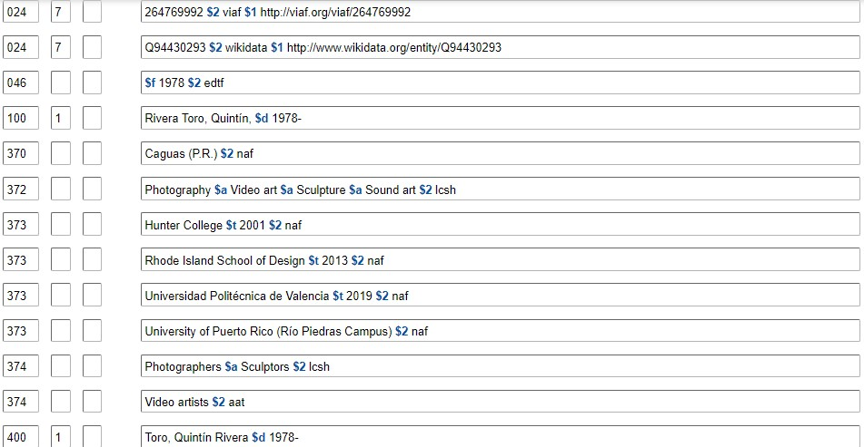

Slide 17
RDA attributes
MARC fields | Attributes | Values
024 | Identifiers | VIAF, Wikidata
046 | Coded dates | Extended Date/Time Format
100 | Authorized form of name | Form of name chosen as authorized access point
370 | Associated places | LC Name Authority File
372 | Fields of activity | LC Subject Headings Getty Art & Architecture Thesaurus
373 | Associated groups | LC Name Authority File
374 | Occupations | LCSH, AAT
400 | Cross-references | Variant forms of name
500 | Related names or corporate bodies | LC Name Authority File
670 | Sources | Sources of information, URL

Slide 18
024 Identifiers
The use of identifiers in MARC records may help in the transition towards a linked data catalog. We chose to include identifiers from VIAF and Wikidata.
It is important to follow the guidelines established by the Program for Cooperative Cataloging (PCC) for the use of identifiers in MARC 21: Formulating and Obtaining URIs: A Guide to Commonly Used Vocabularies and Reference Sources, 2020-01-15.
When registering information from VIAF and Wikidata, the URI is recorded in subfield $1:
024 7# $a 140312226 $2 viaf $1 http://viaf.org/viaf/140312226
024 7# $a Q7086530 $2 wikidata $1 http://www.wikidata.org/entity/Q7086530

Slide 19
370 Associated place
This field registers all the places related to a person: place of birth, place of death, associated country, place of residence, and other associated places.
The names of countries and cities were selected from the LCNAF, in order to maintain consistency across forms of geographical names. The use of controlled vocabularies also helped to register specific municipalities in Puerto Rico in a standardized manner.
This attribute permits us to include geographical information about Puerto Rican artists who developed their careers outside the island, or about foreign artists who developed their careers in Puerto Rico or had great cultural impact, like the case of Ukrainian American photographer and filmmaker, Jack Delano.
100 1 $a Delano, Jack, $d 1914-1997
370 ## $a Ukraine $b San Juan (P.R.) $c United States $e Philadelphia (Pa.) $e Puerto Rico $2 naf

Slide 20
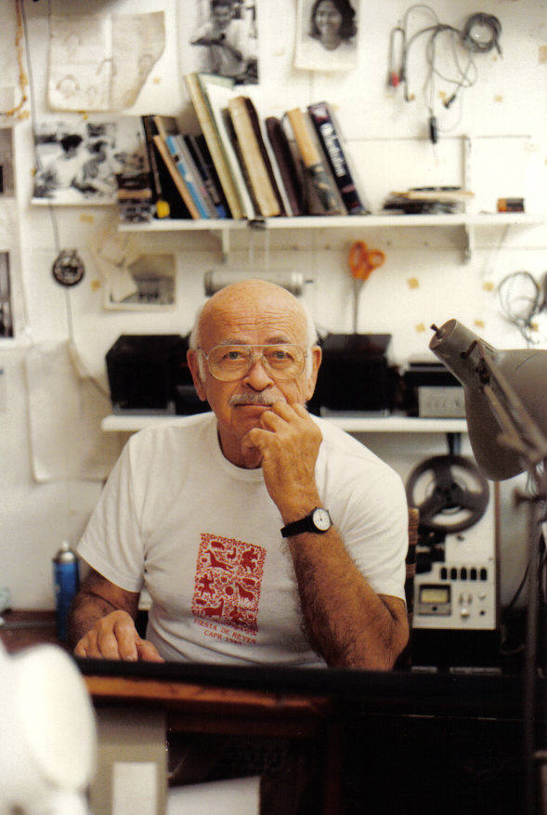
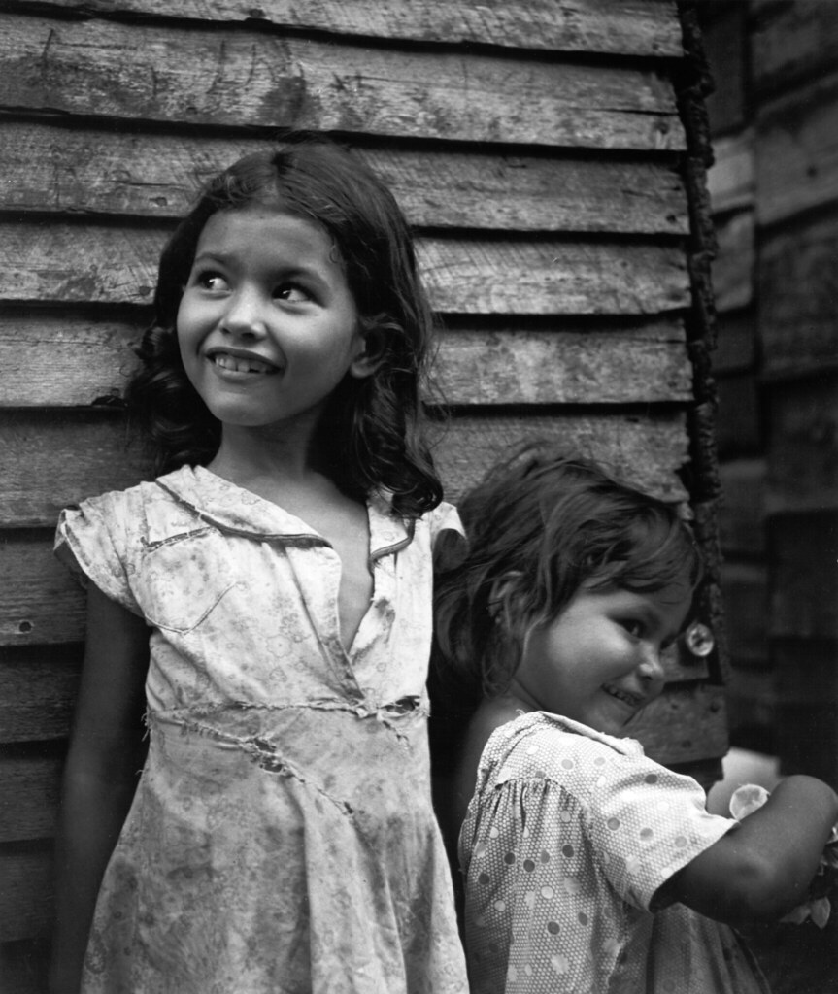
Jack delano: documenting Puerto Rico in the 1940’s

Slide 21
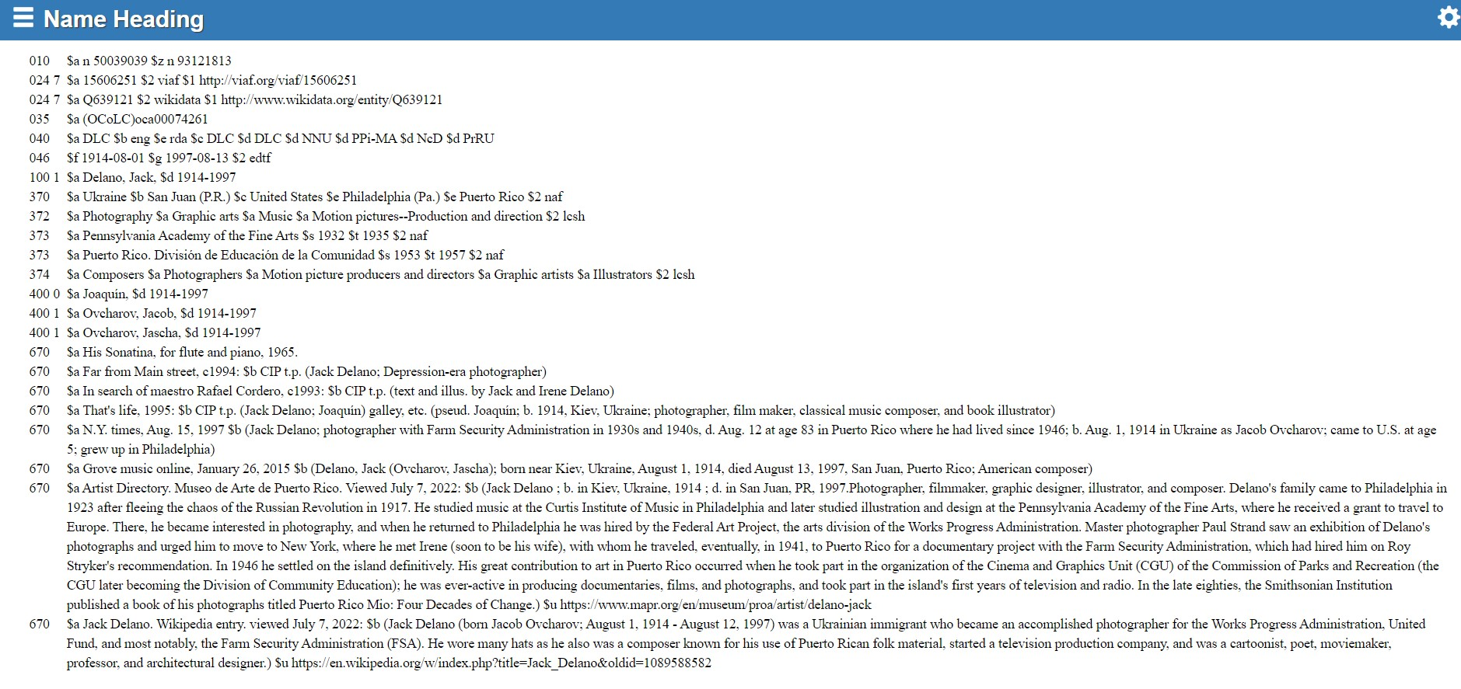

Slide 22
372 field of activity
This attribute allows us to register the variety of disciplines, techniques, and genres of an artist’s career: painting, printmaking, sculpture, or drawing, among others. We also included other activities not directly related to the arts, but are important in the life or career of the artist.
We used terms from the Library of Congress Subject Headings and the Getty Art & Architecture Thesaurus. One of the main challenges when registering information in this field is the need for specialized knowledge regarding artistic techniques, particulary for those artists who work with printmaking, in order to assign the corresponding controlled vocabularies.
100 1 $a Vega, Rafael, $d 1979-
372 ## $a Painting $a Drawing $a Art, Abstract $a Chemical engineering $2 lcsh
100 1 $a Somoza, María Emilia, $d 1936-2016
372 ## $a Graphic arts $a Etching $a Engraving $a Museums--Management $2 lcsh

Slide 23
María Emilia Somoza: “Aguafuerte”, etchings
Fullana Acosta, M. (2016). La huella de María Emilia Somoza. El Nuevo Día. https://www.pressreader.com/puerto-rico/el-nuevo-dia1/20160708/282149290640670

Slide 24
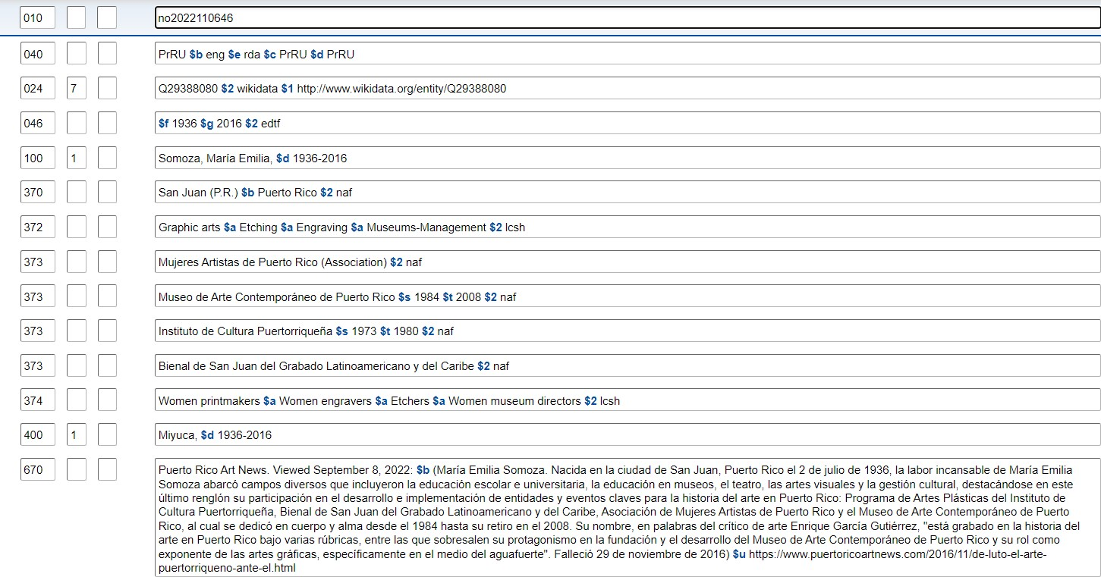

Slide 25
373 associated group
The use of this attribute establishes relationships between the artist and various groups or institutions, including educational institutions, galleries, museums, or government agencies, among others.
We included authorized corporate names from the LCNAF. This presented a challenge, since many local institutions and associations do not have an authority record. This issue was common with the various workshops and departments that formed part of the Institute of Puerto Rican Culture during the 1950s-1970s. Although we are aware that this field does not prescribe the use of controlled vocabularies, it has underscored the need for more authority work with Puerto Rican institutions.
We also noted that subfields $i and $4 cannot be used with field 373. This discussion can be found on MARC Discussion Paper No. 2022-DP04: Adding Subfields $i and $4 to Field 373 The use of these subfields could facilitate linked data applications if the institutions have other related URIs, like Wikidata identifiers. Also, this field can include coded dates, information that cannot be registered in fields 5xx.

Slide 26
Lorenzo Homar: Institute of puerto rican culture & Division of community education (divedco)
Rúa de Mauret, M. (2016). La trayectoria de Lorenzo Homar. El Adoquín Times https://eladoquintimes.com/2016/08/12/la-trayectoria-de-lorenzo-homar/

Slide 27
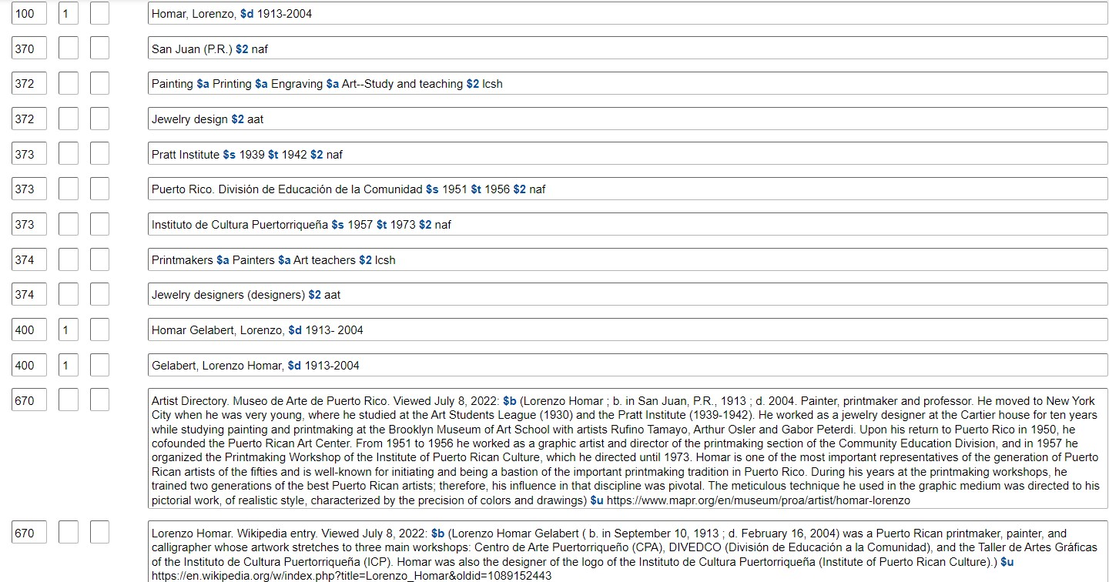

Slide 28
374 occupation
This field allows us to register the occupations that define the multifaceted careers of many artists, including occupations that are not directly related to the arts.
We applied terms from the LCSH and the Getty AAT. The combined use of these vocabularies was useful when describing artists that work with video art and installations, since the LCSH and the LCDGT do not have terms for “video artists” or “installation artists”, although there are terms for “video art” and “installations (art)”.
We also found that this field can be used to explore relationships between artists and politics, particularly for artists whose life and work were inextricably linked with their support for Puerto Rico’s independence.
100 1 $a Escobar, Elizam, $d 1948-2021
374 $a Painters $a Art teachers $a Poets $a Political activists $a Political prisoners $2 lcsh

Slide 29
Elizam escobar: painter, poet, teacher, political prisoner
“Heuristic One”, 1992. Museo de Arte de Puerto Rico. https://www.mapr.org/en/museum/proa/artist/escobar-elizam

Slide 30
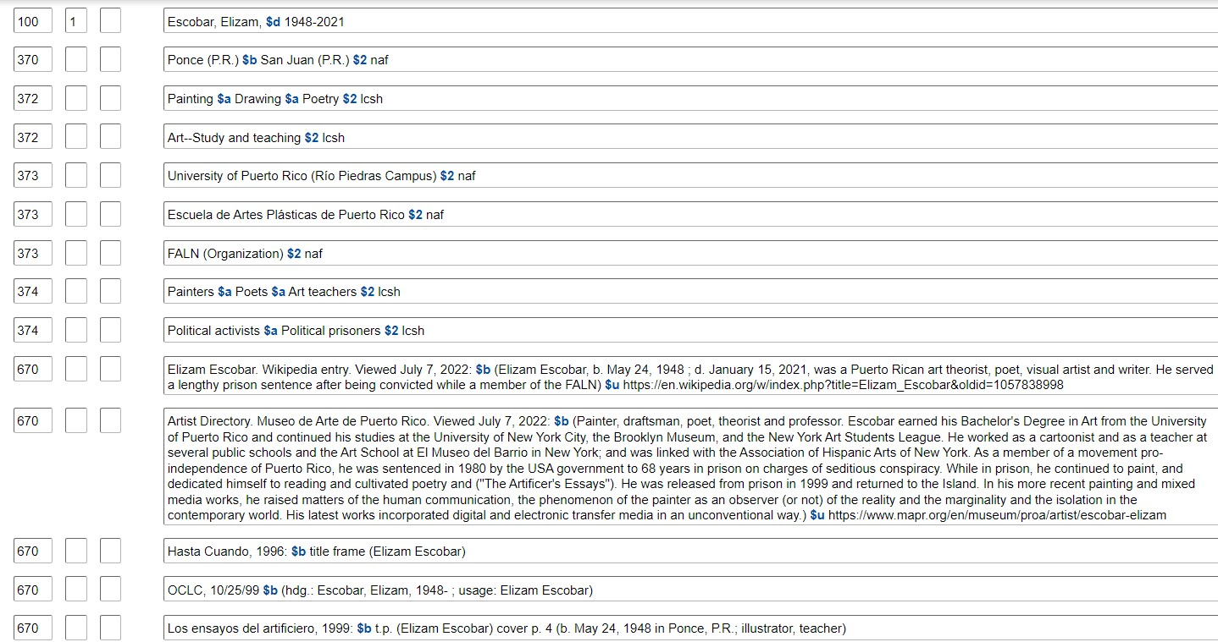

Slide 31
375 gender
We are not using field 375 to record gender related attributes and have deleted this field from edited records, in accordance with recent policies issued by the PCC in the document “Revised Report on Recording Gender in Personal Name Authority Records”, April 2022. For the moment, there no guidelines on the use of gender related information in other fields, including authority field 374 occupations/professions.
For our purposes, we have decided to include gender related attributes in field 374 for women artists, including women painters, women printmakers, women potters, and women sculptors, among others. These attributes could be useful for the search and retrieval of information, particularly in linked data environments.
It is also important to note that in this report, the PCC states that “[t]he primary goal of authority data is for disambiguation, not contextual biographical information”. However, the IFLA LRM user tasks emphasize the importance of contextual information for improved discovery and exploration of resources. This is just one of the ethical issues that must be accounted for in the creation of authority records.

Slide 32
5xx see also
The use of 5xx fields was mainly used to establish relationships between artists and collectives or between artists and artist couples. In these cases, we created an authority record for the corporate body and name authority records for each artist.
The use of subfield $i is allowed for the recording of relationship information, and subfield $w with code “r”.
This fields prescribes the use of controlled vocabularies. The name string in subfield $a must be associated with an authority record.

Slide 33
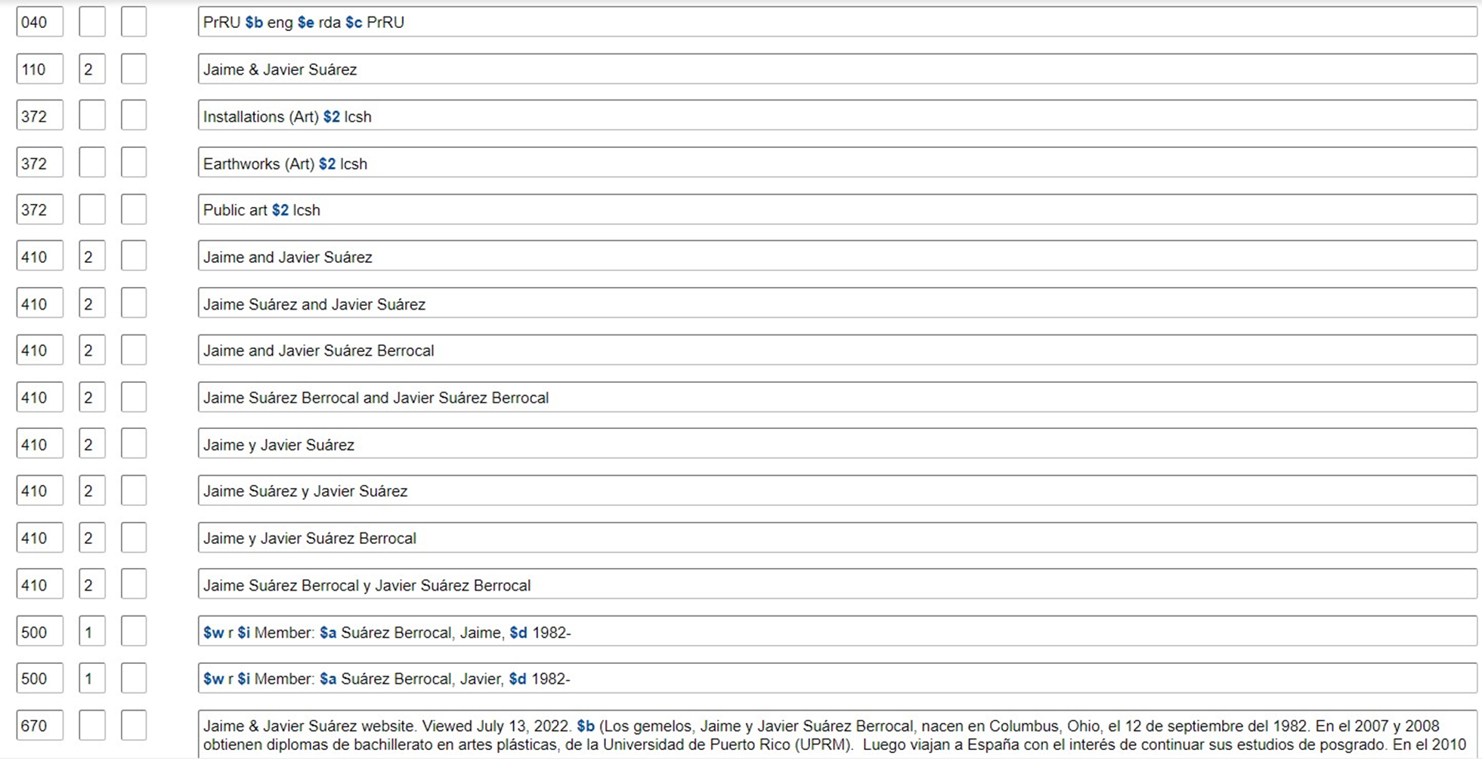

Slide 34
outcomes
The participation of librarians in digitization projects is an opportunity to implement the use of controlled vocabularies and authorized forms of names in metadata for digital collections, and to contribute to the creation and enhancement of authority records.
RDA enables the creation of culturally rich authority records that represent the multifaceted careers of Puerto Rican artists. The main challenges consist in the use of fields 373 and 5xx to establish relationships and the need for more authority work, particularly for Puerto Rican institutions.
The inclusion of other identifiers in field 024 and the use of controlled vocabularies that have their own URIs (see the Library of Congress Linked Data Service) promote the creation of authority records that can be adapted to linked data environments.

Slide 35
References
Downey, M. (2018). A New Who's Who: Using URIs in a Linked Data Approach to Name Authority Control. https://doi.org/10.17615/3w3k-pz20
Joudrey, D. N., Taylor, A. G., & Miller, D. P. (2015). Introduction to cataloging and classification, 11th edition. ABC-CLIO, LLC.
OCLC. (2022). WorldCat validation release notes, September 2022. https://help.oclc.org/Metadata_Services/WorldShare_Record_Manager/WorldCat_Validation_release_notes_and_known_issues/2022_release_notes/090WorldCat_Validation_release_notes_September_2022?sl=en
Program for Cooperative Cataloging. (2022). Revised Report on Recording Gender in Personal Name Authority Records. https://www.loc.gov/aba/pcc/documents/gender-in-NARs-revised-report.pdf

Slide 36
References
Program for Cooperative Cataloging. (2020). NACO Participants’ Manual, 4th edition. https://www.loc.gov/aba/pcc/naco/documents/NACOParticipantsManual.pdf
Program for Cooperative Cataloging. (2020). NACO 024 Best Practices Guidelines. https://www.loc.gov/aba/pcc/naco/documents/NACO-024-Best-Practices.pdf
Resource, Description & Access. (n.d.). Complete examples of authority records. https://www.rdatoolkit.org/sites/default/files/examples_of_rda_authority_records_041113.pdf
Riva, P., Le Bœuf, P., and Žumer, M. (2017). Transitional Mappings: User Tasks, Entities, Attributes, and Relationships in FRBR, FRAD, and FRSAD mapped to their equivalents in the IFLA Library Reference Model. https://www.ifla.org/wp-content/uploads/2019/05/assets/cataloguing/frbr-lrm/transitionmappings201708.pdf

Slide 37
THANK YOU
Dinah M. Wilson Fraites
dinah.wilson@upr.edu

