Slide 1
Library Consulting Interest Group
Welcome! Please enter into chat:
Your city/state
If you are a consultant, your website and/or area of expertise
What type of information or advice would be most beneficial to you?
Facilitators Val Edwards - Lead Consultant, P2G Consulting Laura Rose Taylor - Assistant Dean, Cline Library, Northern Arizona University
March 8, 2022

Slide 2
About Core Interest Groups
Interest group members do not need to be members of Core, or even of ALA.
Anyone with an ALA account (free!) can join a Core interest group in ALA Connect.
Conveners must be Core members, but anyone can join or leave an interest group at any time.

Slide 3
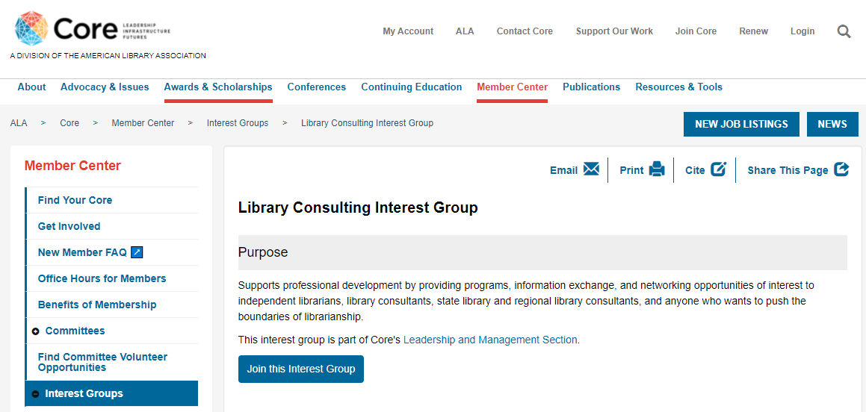
Visit Our Interest Group’s Webpage to Join
https://www.ala.org/core/member-center/interest-groups/library-consulting

Slide 4
Attend Our Meetings
Our bi-monthly meetings are open and all are welcome. View the Google doc where we track our discussion and projects.
Next meeting: Friday, March 11, 1 - 2 pm ET Login info on the Events page in our ALA Connect space.

Slide 5
Upcoming Events
Friday, June 24 8 am – 4 pm ET | Preconference Workshop at ALA 2022 Washington, DC Assembling a Consulting Toolkit: What You Need to Know to Be a Successful Library Consultant Martha Kyrillidou and Claire Dygert
Sunday, June 26 1 – 2 pm ET | Member Meeting/Discussion Group at ALA 2022 Washington, DC and online

Slide 6
Today’s Panel
Carolyn Norman Planning, grantsmanship, policy development
Maryam Phillips Technology, strategic and business planning
Marie S.A. Sorensen, AIA Architecture, planning and engineering coordination; workflow and space use analysis for renovation planning; participatory design workshops, interviews and surveys
Carson Block Technology assessments and planning, recruitment, library master planning and construction
Claire Dygert Library consortium assessment, management, and planning, workflow analysis and organizational change
Vera Keown Coaching, training, and facilitation
Joe Matthews Strategic planning, evaluation of library services, and technology planning

Slide 7
We asked panelists to…
1. Provide a quick overview of their work as a consultant
2. Address one or more of these topics:
What was the most recent library job you held and what prompted you to switch to (or add) consultancy to that role?
What has been the biggest challenge in building your consultancy?
How did you start networking and collaborating with other consultants?
What is one piece of advice you’d have for current or aspiring consultants?
…in five minutes or less.

Slide 8
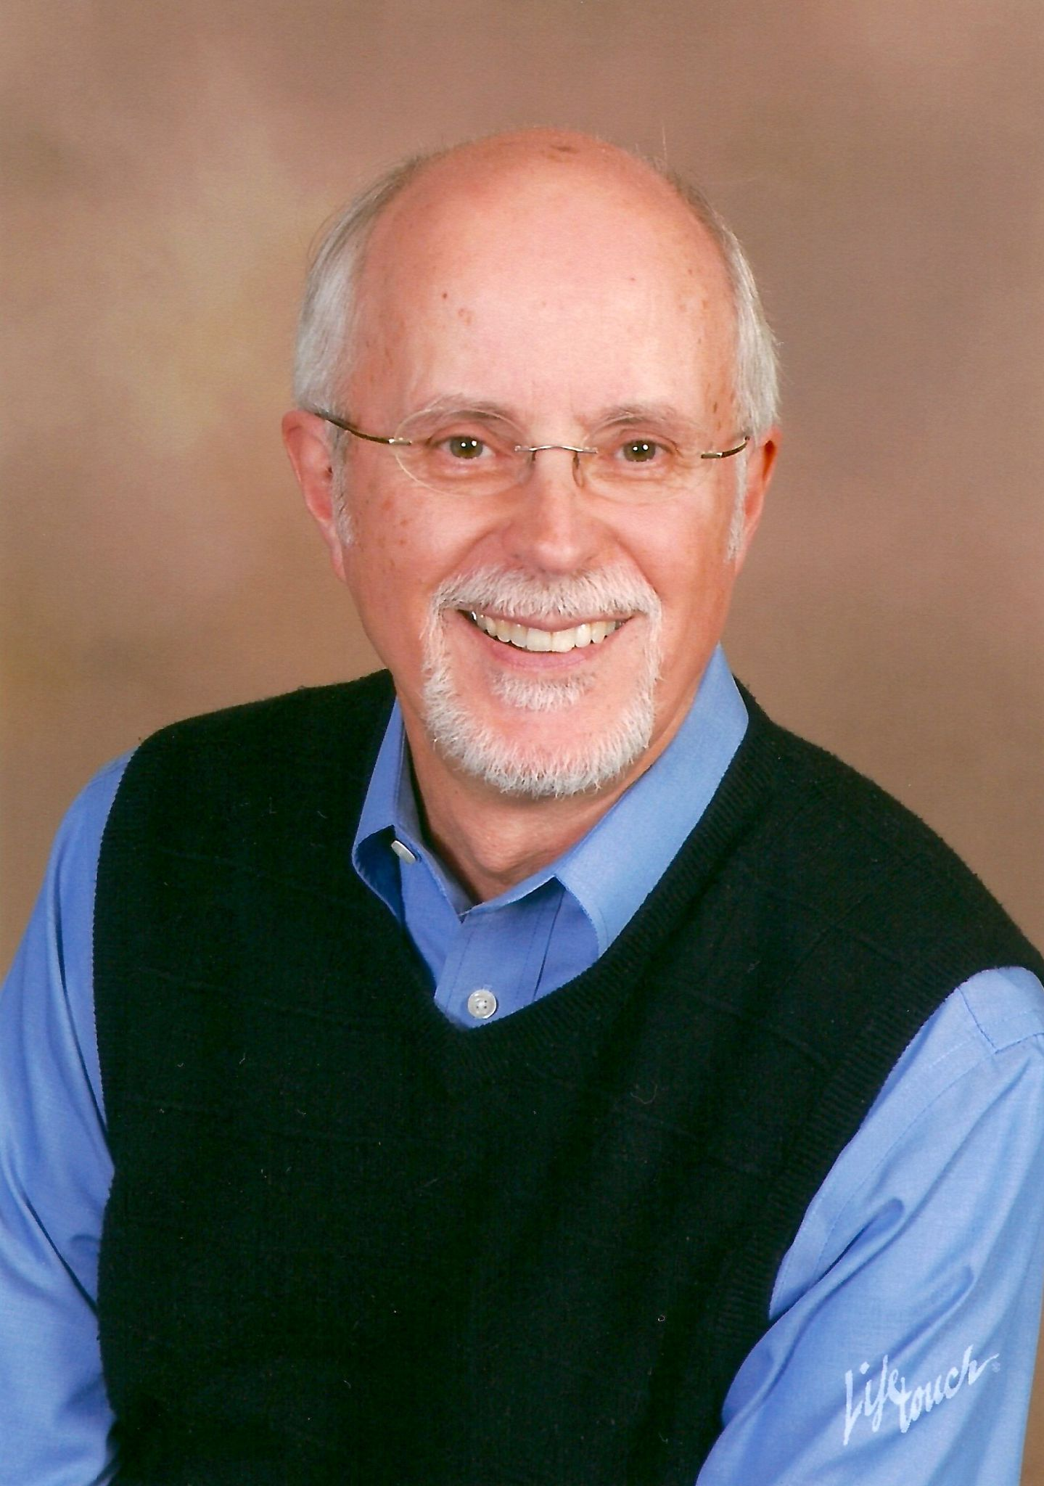
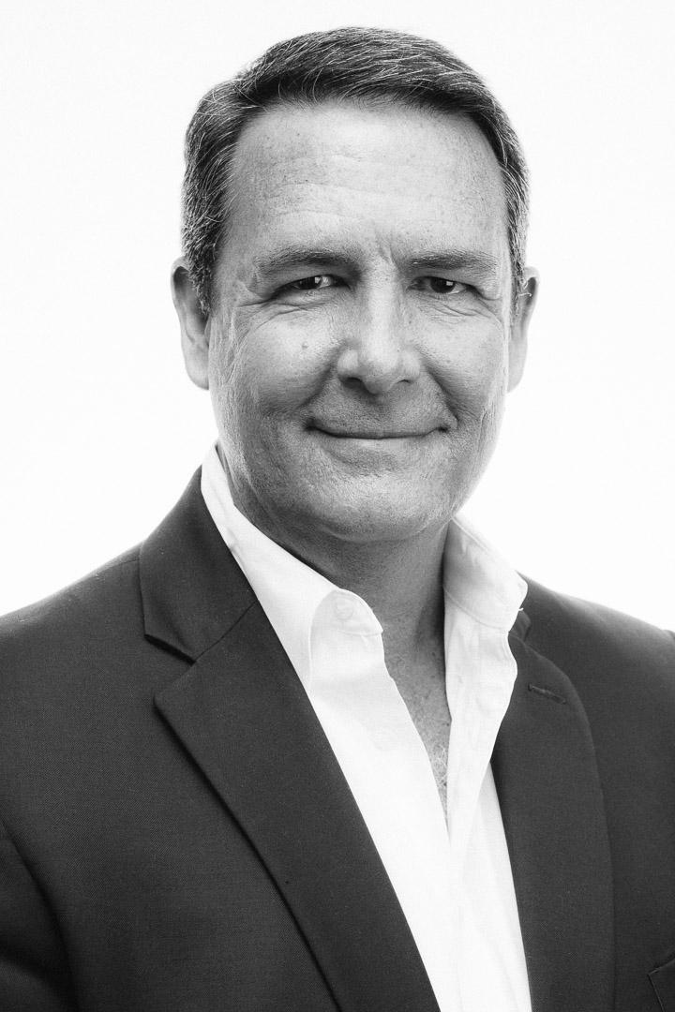
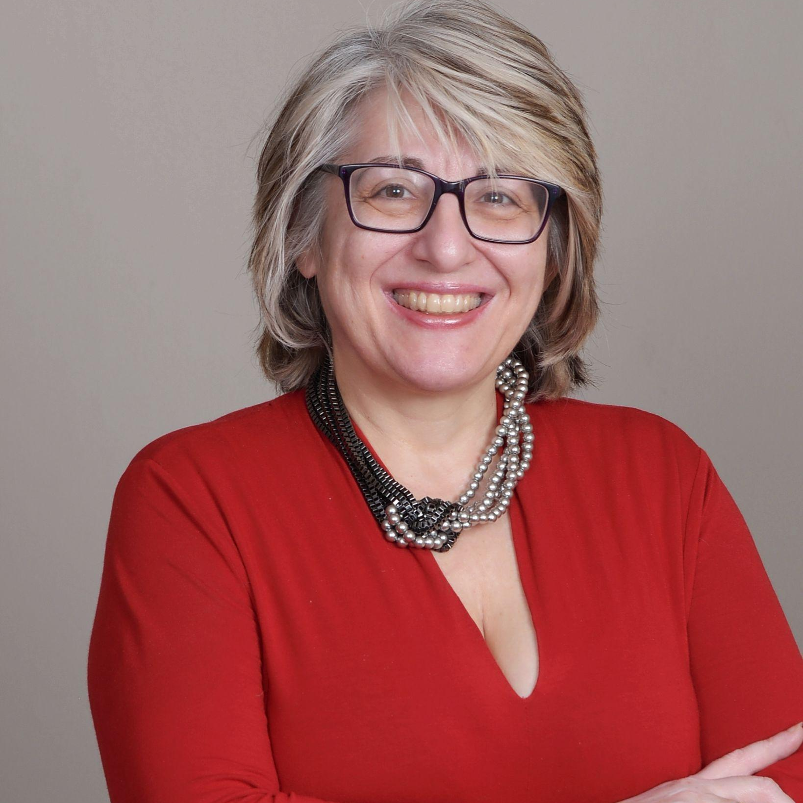
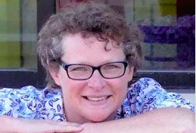
Ready for more?
The consultants below shared how they came to consultancy in our 2021 IG Week session. View the recording.
Val Edwards
P2G Consulting
Charles Forrest 21st Century Libraries Consulting, LLC
Martha Kyrillidou Quality Metrics LLC
Curtis Rogers
Curtis Rogers Consulting

Slide 9
Your Turn
We invite you to introduce yourself in our ALA Connect space.
Questions about the Core Library Consulting Interest Group? Contact co-chair Val Edwards val@p2gconsulting.com

