Slide 1
Machining metadata for discovery
Terry Reese
Head of Digital Initiatives and Infrastructure Support
The Ohio State University Libraries

Slide 2
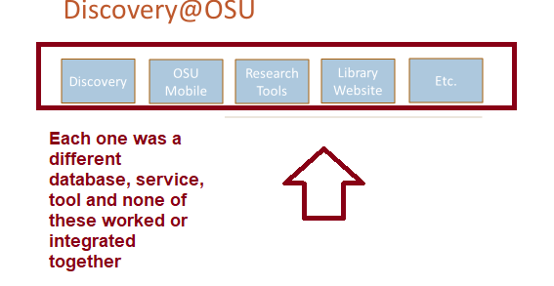
Mandate: Make things easy to find

Slide 3
What I heard

Slide 4
Expanding the Box
Simplifying Discovery was our mandate, we didn’t want to build just another tool that would consume data.
What we really needed was:
“The One Ring” – a data source that would allow use to centralize development and allow remediations to have the biggest impact
A portal for campus’s Mobile First initiatives to extract data that hid (or removed) the librarisms that exist within our data
A data source for researchers, who are turning to the Libraries large digital data resources to support or drive research projects/data processing

Slide 5
Libraries as the box

Slide 6
Building the Library Lexicon
Notes:
If we were going to do this right, we needed to develop a set of gateways that would allow the Libraries’ to aggregate all it’s metadata and services together, while at the sometime, introduce machine based processed into the aggregating/processing step that could be shared across all applications and data portals.

Slide 7
Dealing with the metadata problem
Notes:
The immediate problem that we had to address then was how to normalize metadata across multiple domains. In considering the Libraries as a platform, we made the decision that metadata remediation at the source would be nice, but to be successful, remediation had to be largely automatic and done on ingest. This meant finding solutions for a number of issues:
Normalizing meeting between different metadata schemas
Normalizing character encodings across multiple metadata sources
Normalizing entry/search points for discovery while protecting granularity for researchers
Proactively capturing data outside the Libraries to enhance discovery and support researcher needs

Slide 8
Lexicon In Two Parts
Aggregator
Gateway

Slide 9
Aggregation API

Slide 10
Aggregation
Supports normalizing all metadata into a common, data model for search/index
Handles data normalizations
Encodings
Dates (as possible)
OCR extraction
Link Resolution
Expanding to include reconciliation
Ingesting identifiers and characteristics about data if provided

Slide 11
Example from our catalog
Source Record

Slide 12
Reconciled Entry

Slide 13
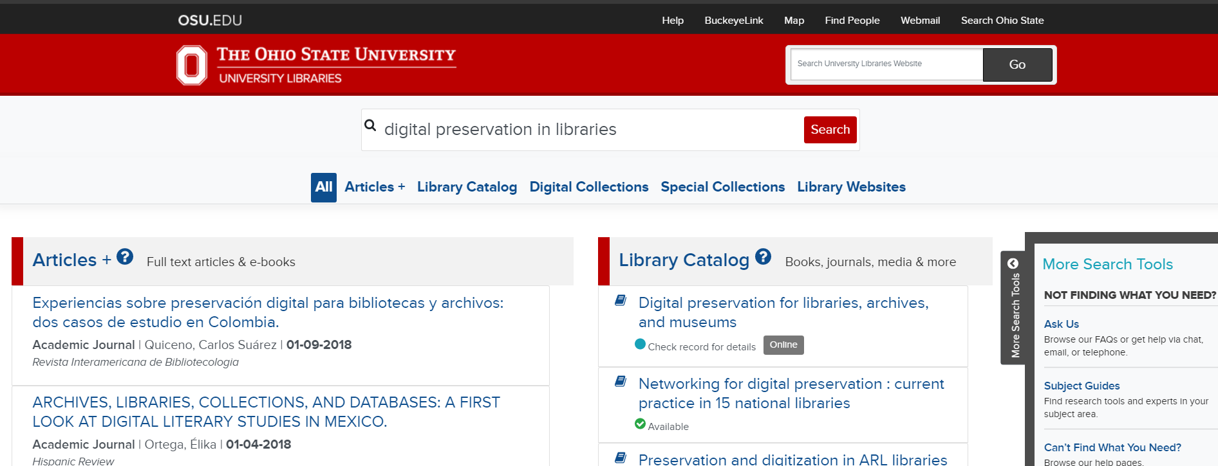
Search API
Notes:
Here’s the UI of the search API -- but like the aggregator, provides data in simple json, and returns records from the various information buckets found in the Libraries.

Slide 14
Work still to do
Improving Linked Data reconciliation
Exposing more data from the indexes
More public API of our “Discovery Indexes”
Quarterly Data dumps of “reconciled” data for researchers

Slide 15
Questions

