Slide 1
eReserves and Controlled Digital Lending: An Evolution
Florida SouthWestern State College Richard H. Rush Library 2022

Slide 2
eReserves Team
Peter Van Leeuwen Electronic Resources Coordinator
Krista Biasella Library eReserves Associate
Florida SouthWestern State College Library

Slide 3
Florida SouthWestern State College
Established in 1962
Student population: 16,672
Serve a 5-county area in SW Florida
Associate, Bachelor’s & Certificate Programs
70,207 degrees / certificates awarded

Slide 4
Controlled Digital Lending (CDL)
01
02
03
04
05
06
Ensure titles are obtained lawfully
Only titles that are owned and not licensed
Maintain an "owned to loaned ratio"
A digital version to one person at a time
Limit loan period time
Use digital rights management to be copyright compliant

Slide 5
Impact of CDL
01
02
03
04
24 / 7
access
Enhanced functionality
Preservation purposes
Reduces environmental
footprint

Slide 6
Timeline
August 2020 Library re-opened No access to reserve titles
February 2021 Scanning initiated with test run
August 2021 eReserves delivered via MyDocs
March – July 2020 Library closed
January 2021
BookEye5 scanning station installed
March – July 2021 50 titles uploaded to eReserves
March 2022
100 eReserve titles milestone attained

Slide 7
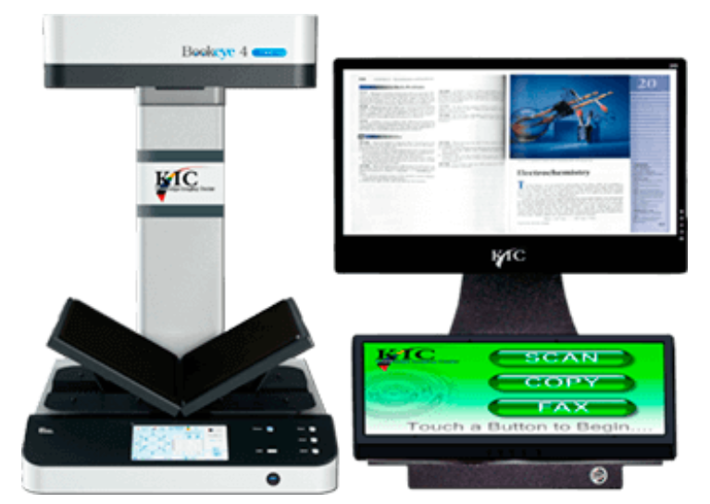
The Scanning Process

Slide 8
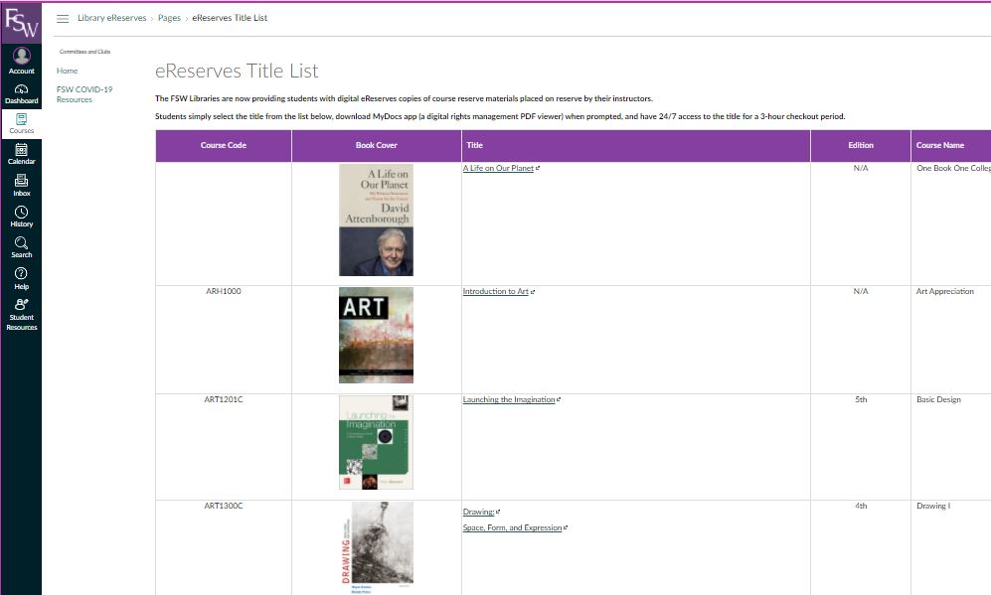
eReserves Title List

Slide 9
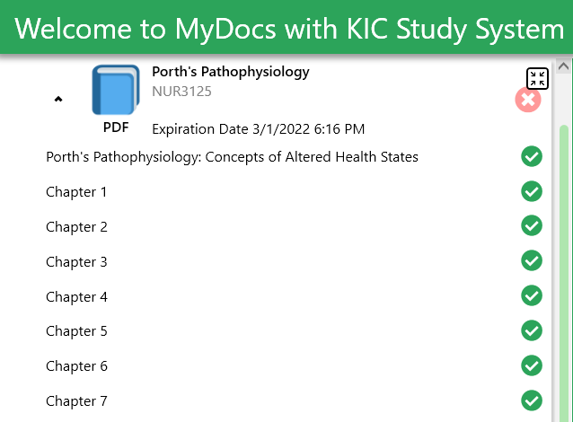
MyDocs

Slide 10
Reserves vs eReserves
 |  |  | Title Count | Total Checkouts | Average Number of Checkouts per Title
Reserves | 2016-2017 | 12 months | 1,236 | 8,220 | 7
Reserves | 2017-2018 | 12 months | 1,248 | 6,229 | 5
Reserves | 2018-2019 | 12 months | 1,344 | 5,556 | 4
Reserves | 2019-2020 | 8 months | 1,356 | 2,805 | 2
 | 2020-2021 | 16 months
eReserves | 2021-2022 | 7 months | 100 | 1,787 | 18

Slide 11
Top 10 eReserve Titles
 | Title | Course Code | Number of Checkouts
1 | A Life on Our Planet | OBOC | 389
2 | They Say / I Say | ENC1101 | 249
3 | The Ethical Life | PHI2600 | 157
4 | Philosophy Here and Now | PHI2010 | 154
5 | The Little Seagull Handbook | ENC1101 / 1102 | 75
6 | Psychology of Success | CLP1001 | 45
7 | World History, Volume II: Since 1500 | WOH1030 | 44
8 | The Humanities Through the Arts | HUM2020 | 41
8 | Human Growth and Development | DEP2004 | 41
9 | Essential Biology | BSC1005 | 40
10 | Literature and the Writing Process | ENC1102 | 36

Slide 12
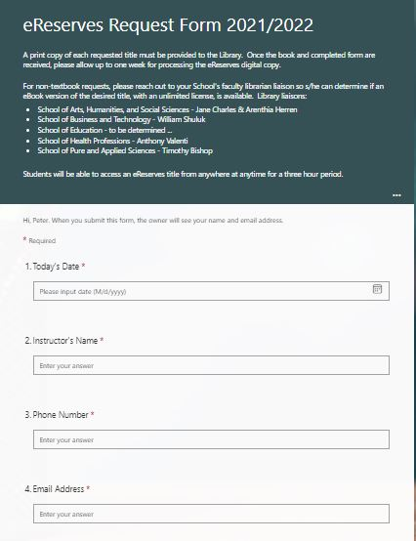
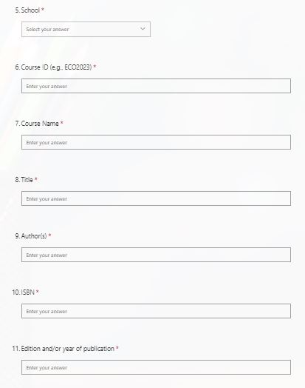
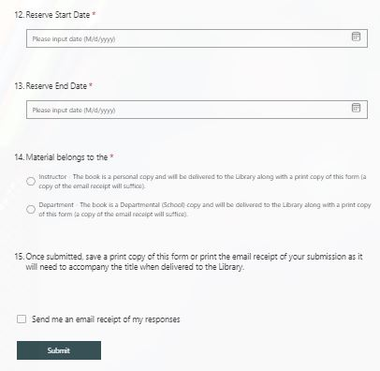
eReserves Request Form

Slide 13
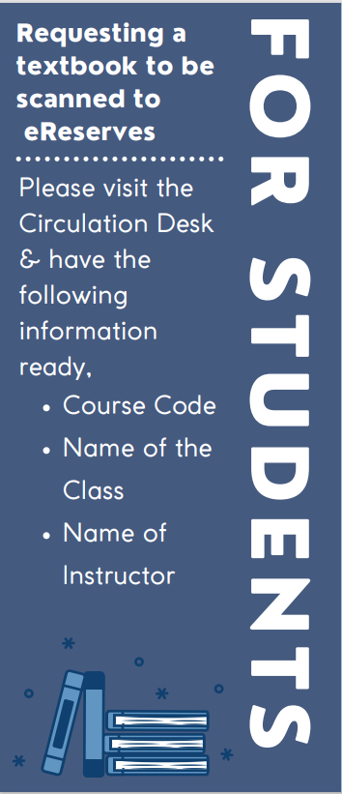
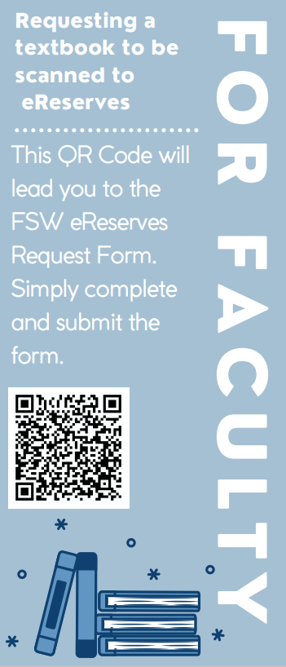
Engagement

Slide 14
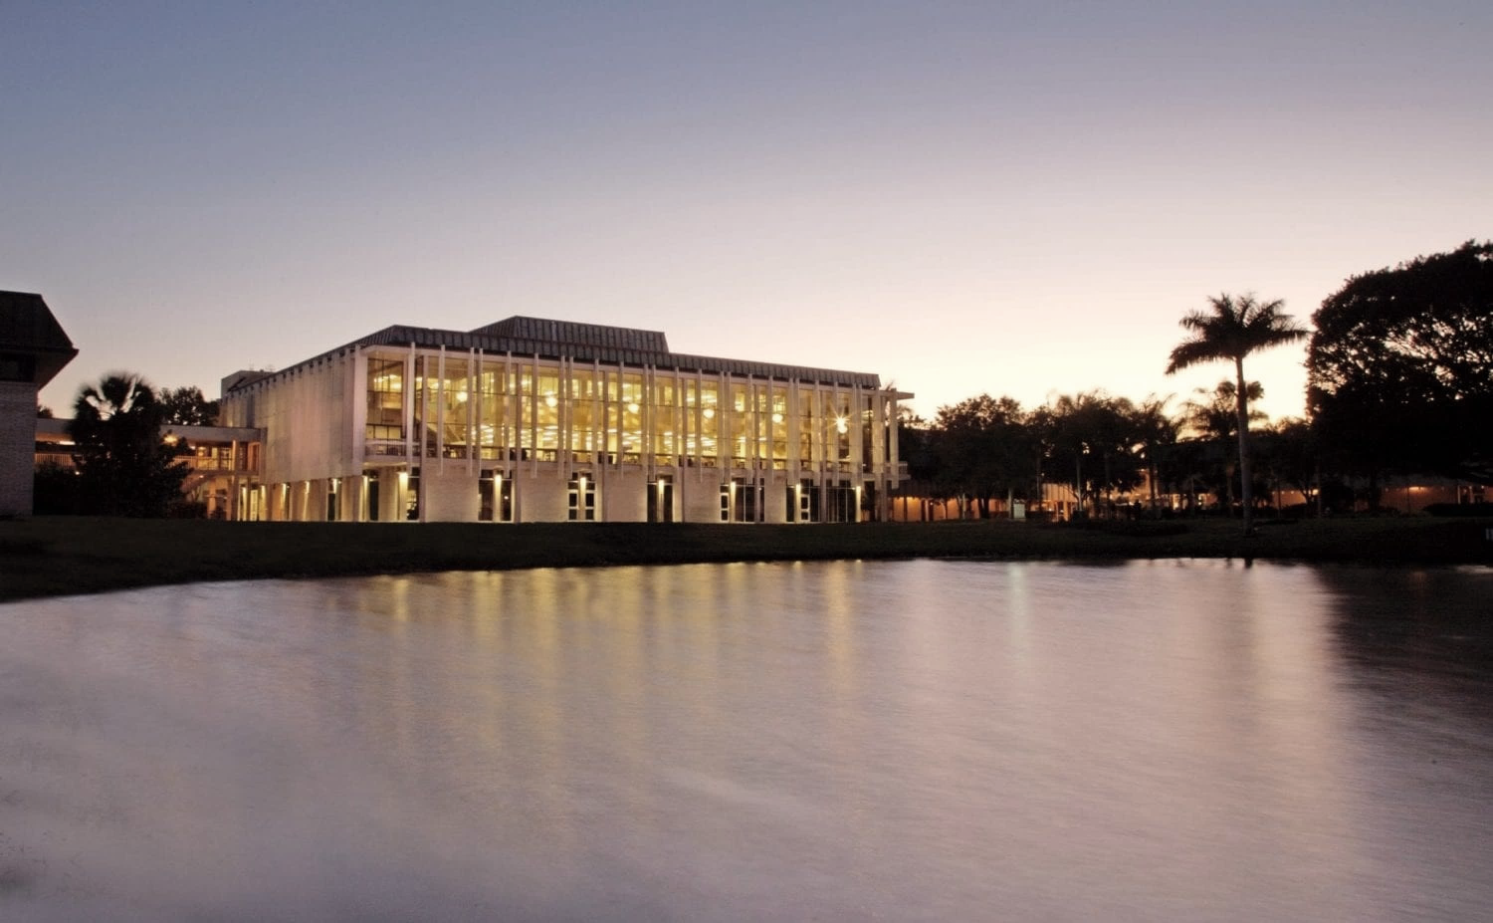
Q&A

Slide 15
References
Courtney, K., & Hansen, D. (2018, September 24). A white paper on controlled digital lending of Library Books. DASH Home.
Ex Libris, P. of C. (2021, December 15). Implementing controlled digital lending responsibly and effectively. Library Journal.
Freeland, C. (2021, June 10). Frequently asked questions about controlled digital lending [Video]. Internet Archive.
Future Thinking: ASERL's Resource Guide to Controlled Digital Lending for Research Libraries. Association of Southeastern Research Libraries. (2021, March).

Slide 16
THANKS!
THANKS

