Slide 1
FAST Headings for ETDs at Brown
Jeanette Norris, Head of Metadata Services
Joseph Rhoads, Digital Repository Manager

Slide 2
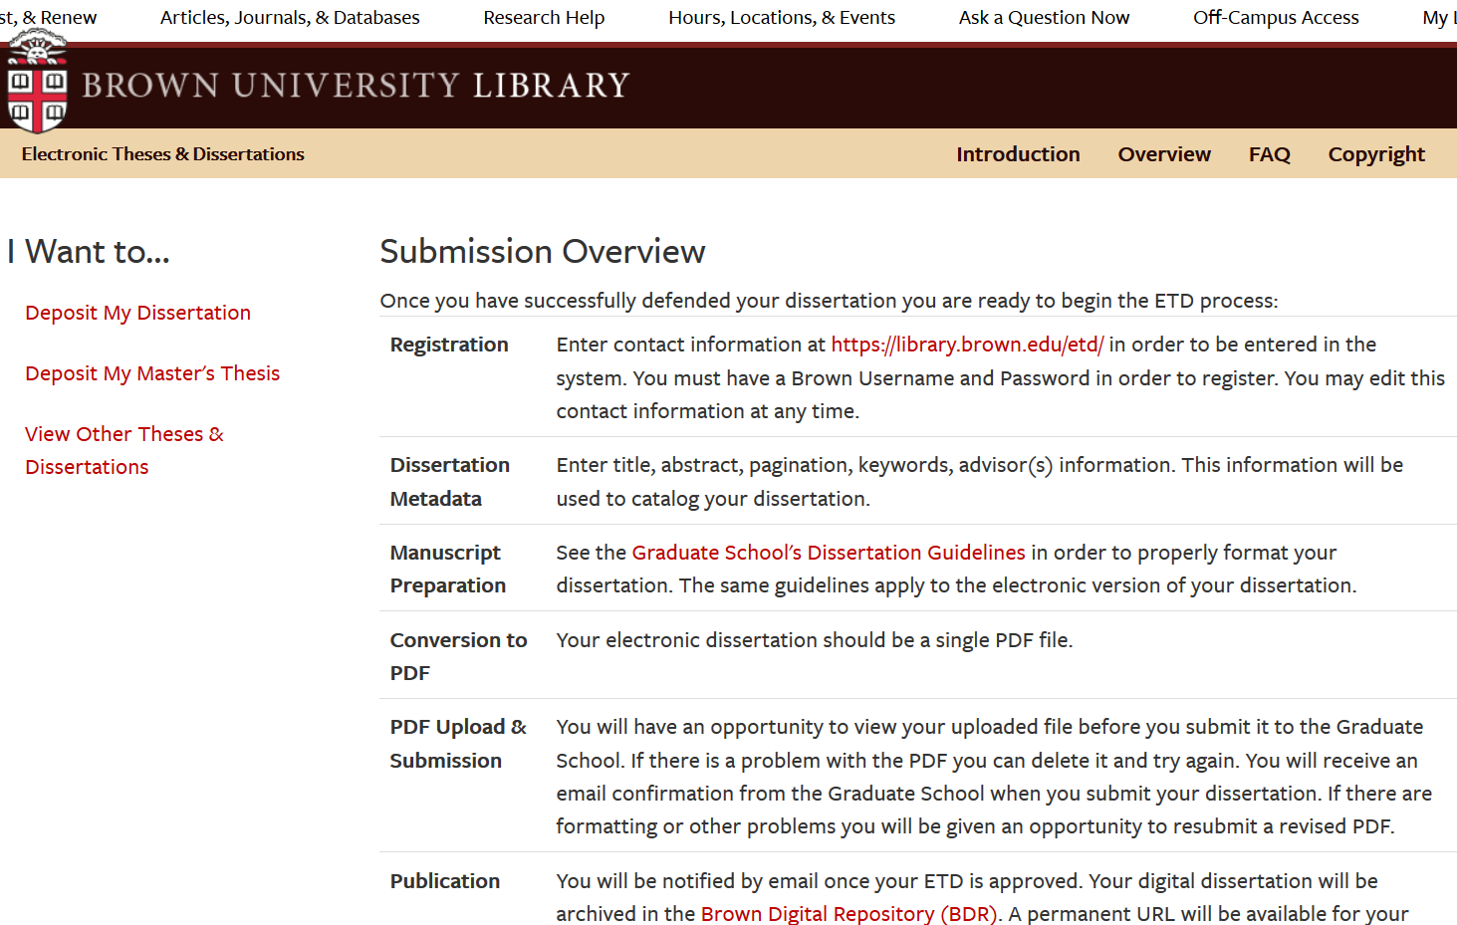
Context
Notes:
Since 2008 - only electronic dissertations
Do not submit dissertations to Proquest
Graduate school is primary stakeholder - part of their review process
Integrated discovery of print and electronic dissertations collection desired

Slide 3
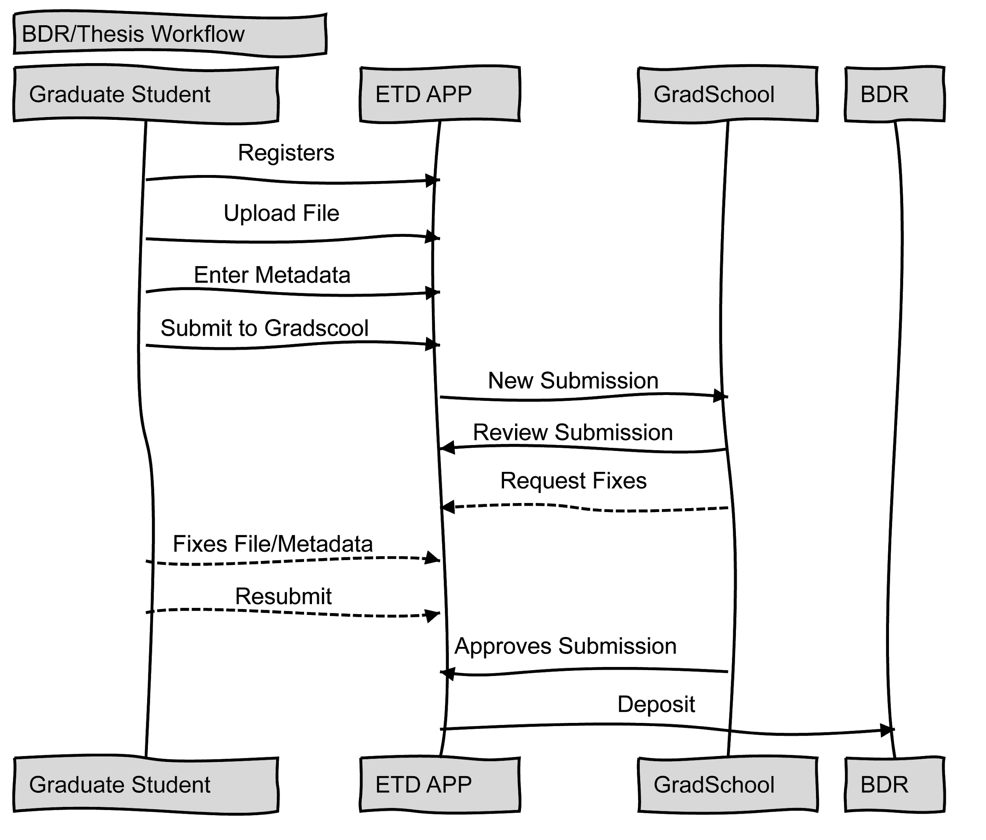
Workflow

Slide 4
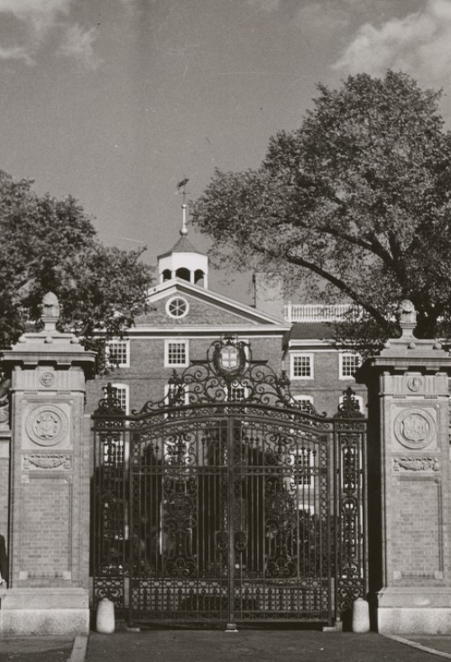
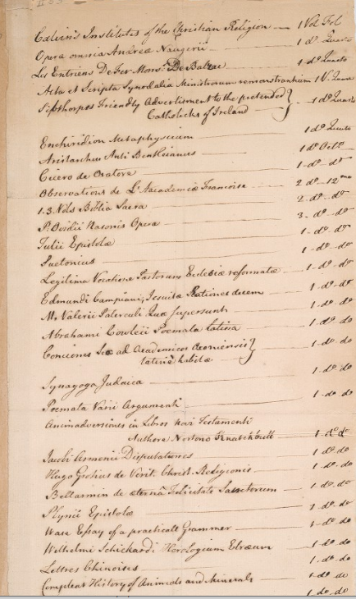
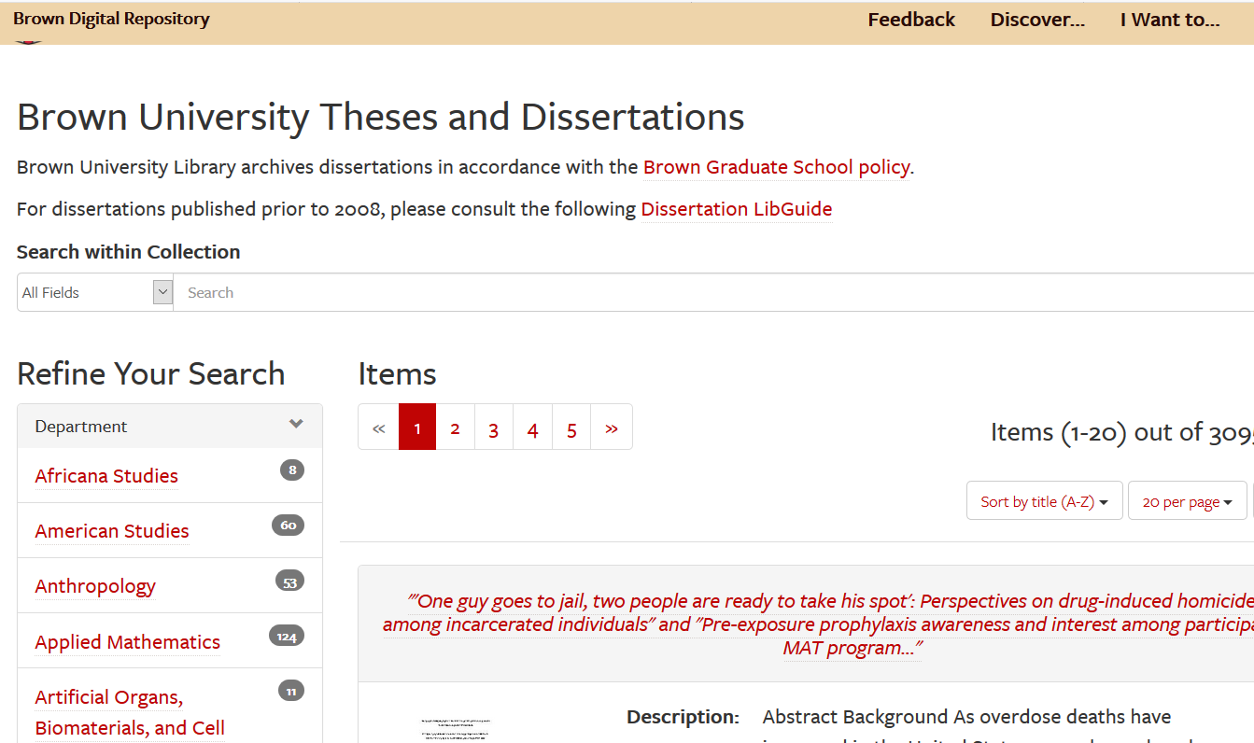
Balancing multiple roles
Notes:
"Van Wickle Gates" Images of Brown. Brown Digital Repository. Brown University Library. https://repository.library.brown.edu/studio/item/bdr:64696/
"List of books from the College Library" (1782). Brown Olio. Brown Digital Repository. Brown University Library. https://repository.library.brown.edu/studio/item/bdr:216633/

Slide 5
Goals for redesign
Easy for authors
Enhanced data
Improved discoverability

Slide 6
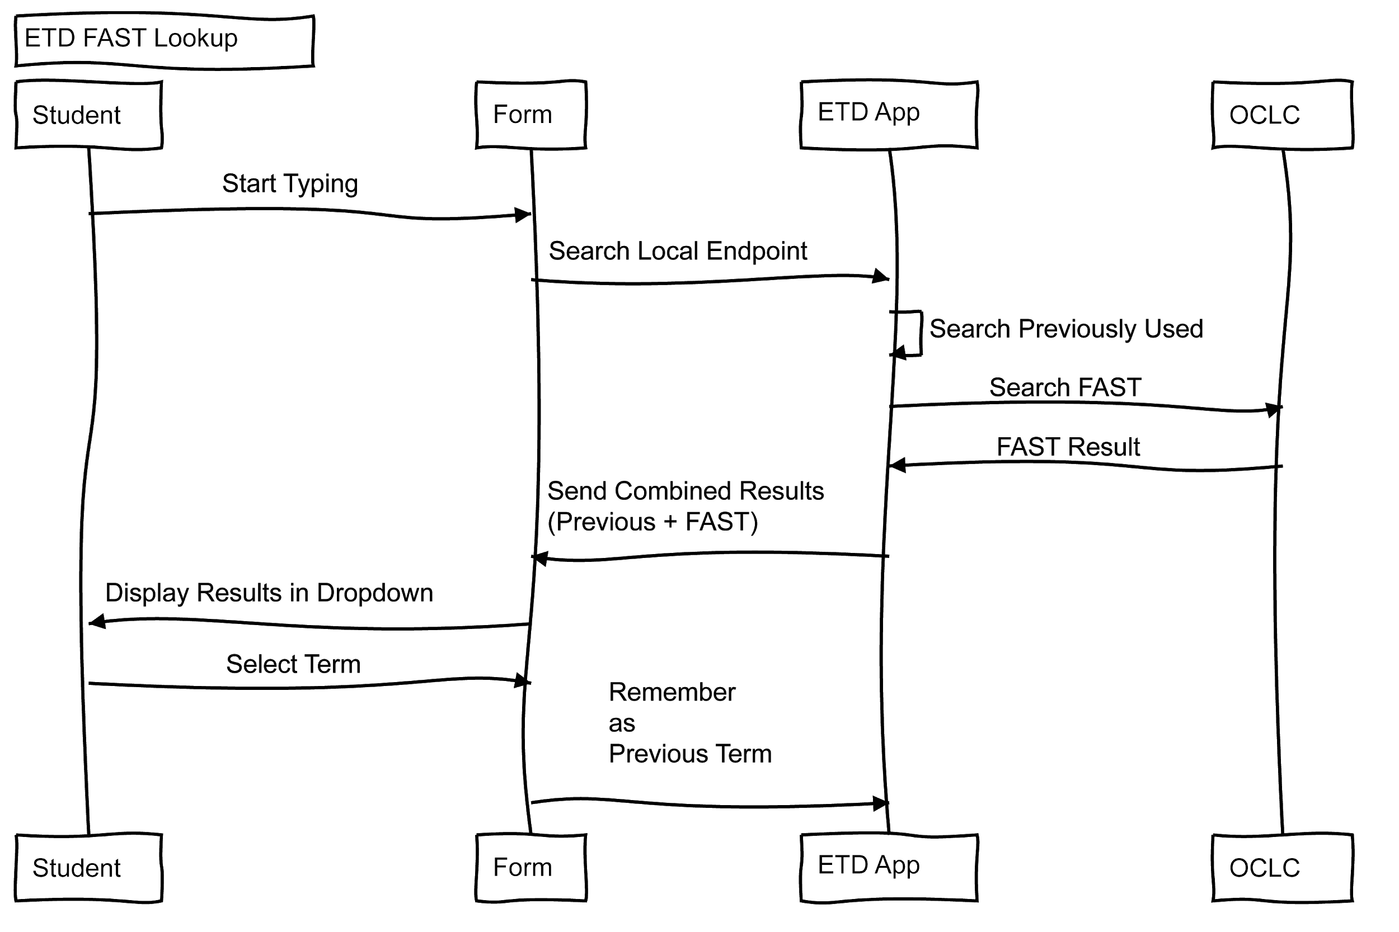
FAST as a solution - technical design

Slide 7
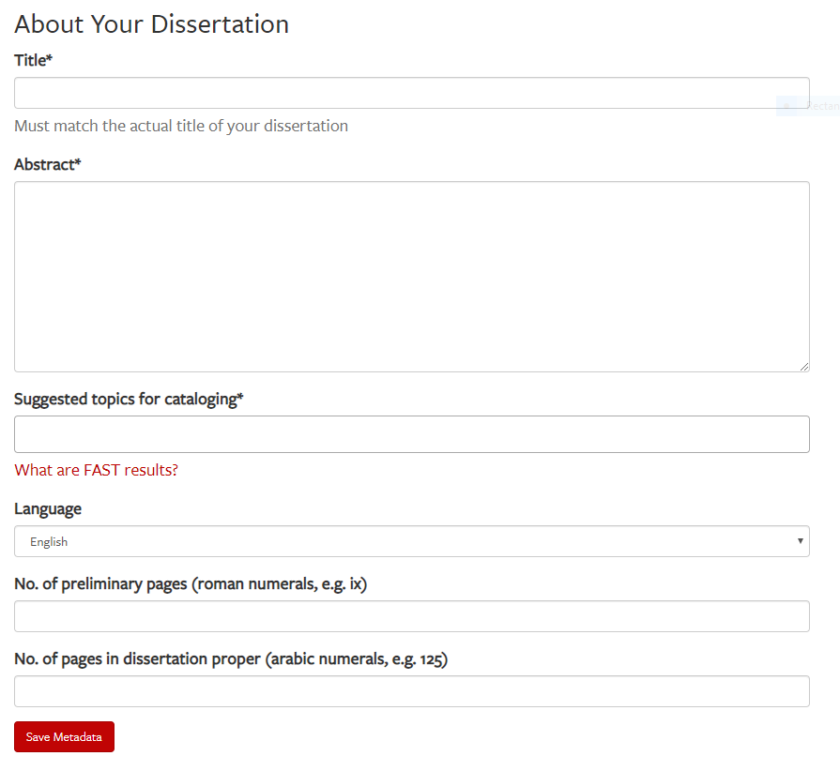
Forms and function

Slide 8
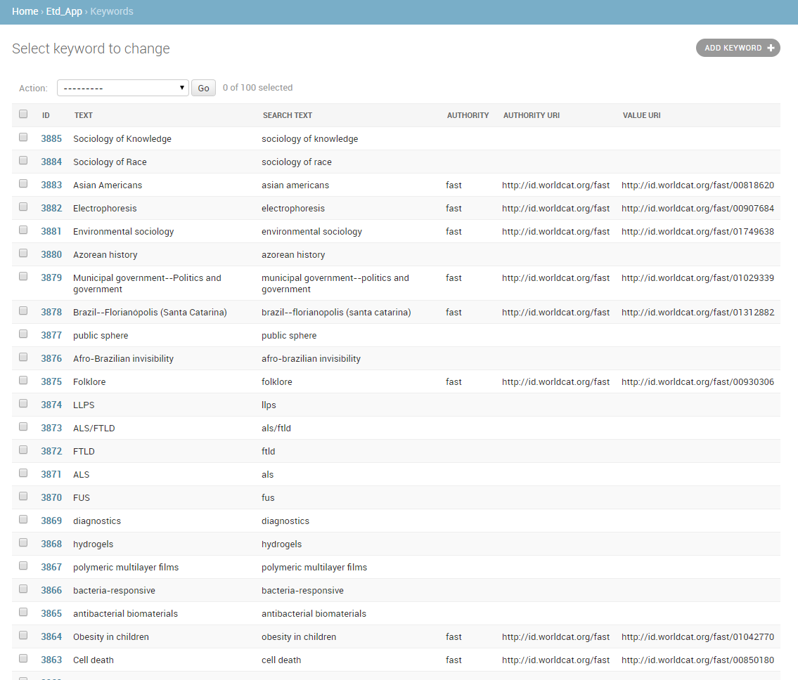
Stored terms

Slide 9
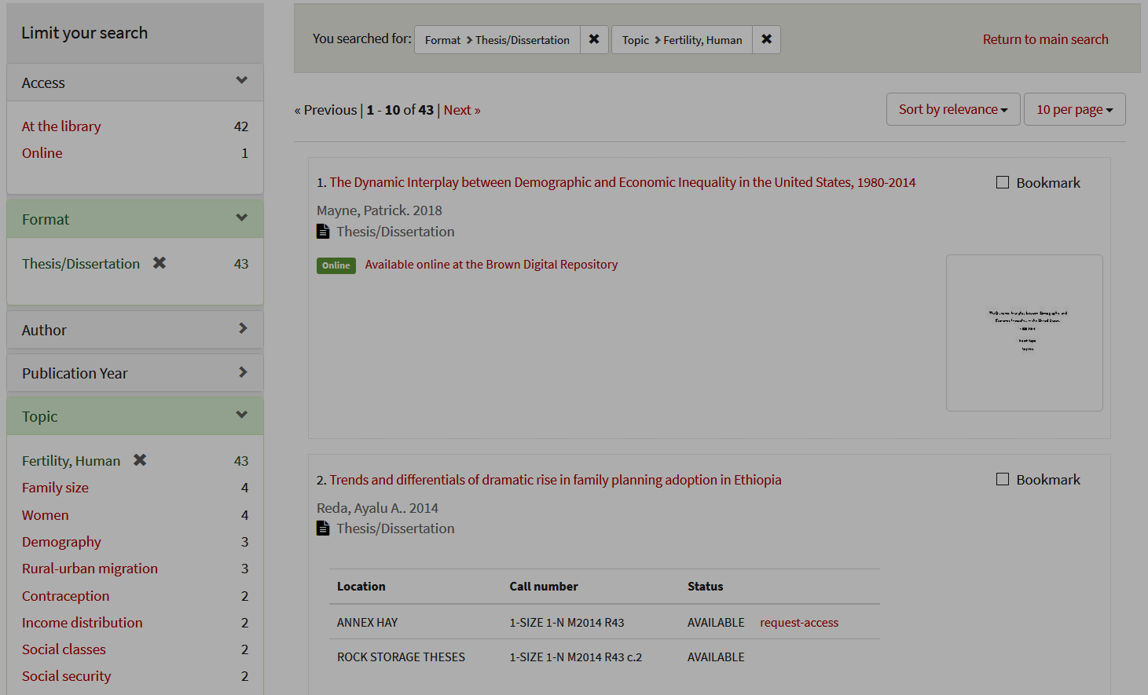
Outcomes

Slide 10
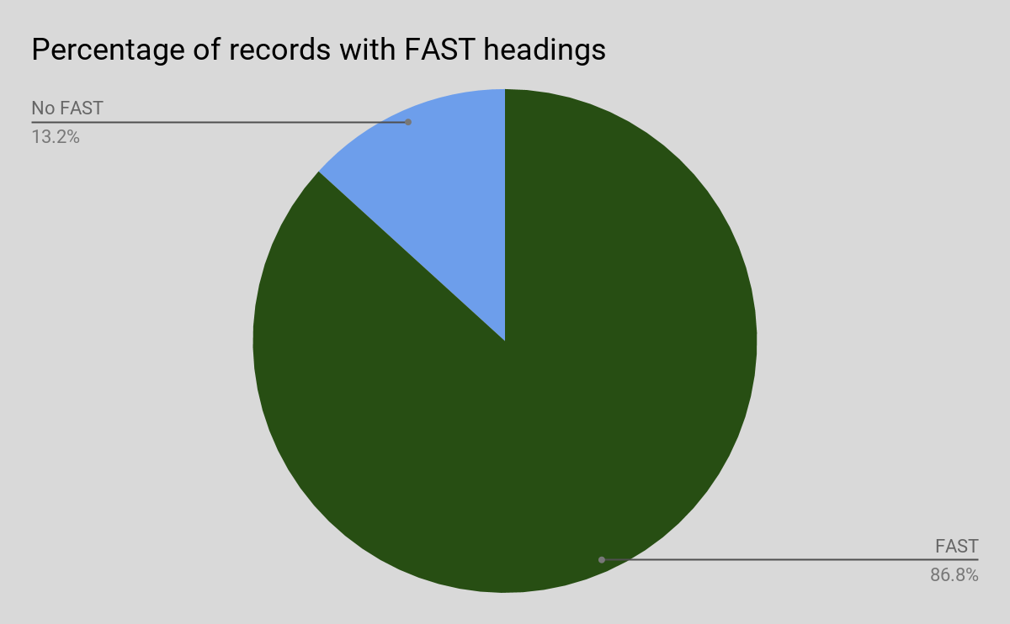
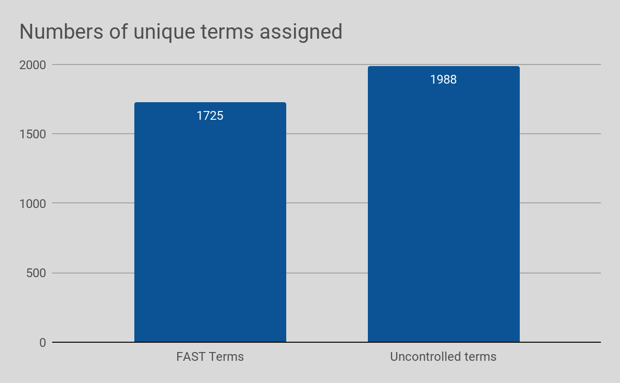
Are FAST terms being used?
Notes:
https://docs.google.com/spreadsheets/d/1DjIw_EwzWWF5YuryLpWhyo9F5l5iWweOSv7wS-4nDR4/edit#gid=1654711040
https://docs.google.com/spreadsheets/d/1bq8iysoMVh6G6EqI3are7SATcewrYFNDJh2ioHCowRw/edit#gid=509368585

Slide 11
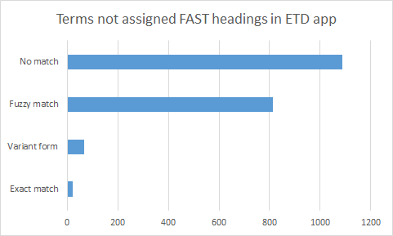
How well does the lookup work?

Slide 12
Analysis of a sample:
Sample: 25 records
Departments in sample: 18
Repeated: 0%
Average number of subject terms: 5.8
Average number of FAST headings: 2.7
Applicable FAST terms chosen: 98%

Slide 13
Next steps
Assess FAST lookup from a technical perspective
Identify and evaluate options for greater metadata quality control
Explore options for expanding service for vocabularies beyond FAST
Leverage the FAST facets more thoroughly

Slide 14
Thanks!
Want to hear more?
joseph_rhoads@brown.edu
bdr@brown.edu
https://github.com/Brown-University-Library/etd_app

