Slide 1
Modelling sequential relationships beyond MARC 21
Mapping preceding and succeeding entity relationships for Continuing Resources
Bibliographic Conceptual Models Interest Group, March 10th, 2022
Abigail Sparling, Charlene Chou, Ian Bigelow, & Julian Everett Allgood
Notes:
Thank you for joining us today to discuss the modelling of sequential relationships for continuing resources beyond MARC21

Slide 2
CONTEXT
Share-VDE (Virtual Discovery Environment) & the Sapientia Cluster Knowledgebase
“Share-VDE pulls together MARC authority and bibliographic data from 26 member libraries, enriches it with authoritative entities and clusters data into BIBFRAME entities”, the result is the Sapientia Cluster Knowledgebase¹
Sapientia Entity Identification Working Group (SEIWG)
Review use of entities, identifiers, and associated modelling in Sapientia
Review and refine processes for Sapientia entity clustering
Review MARC to BIBFRAME and BIBFRAME to MARC conversion of elements related to Sapientia entities²
Notes:
https://wiki.share-vde.org/w/images/e/ea/Share-VDE_Statement_2021.pdf
https://docs.google.com/document/d/1khG-XpDfx2Kpja8LMebzuf3MoOwCl3KmH-mUlE60nf8/edit
Today’s presentation stems from work on the Share virtual discovery project. Share-VDE is an initiative led by an international community of participating libraries, with the aim of setting up linked data-based workflows. One of the primary outputs of this initiative is the Sapientia Cluster knowledgebase which brings together MARC bibliographic and authority data from member libraries, enriches it with authoritative linked data entities, and then clusters the data into BIBFRAME entities. The Sapientia Cluster knowledgebase, or CKB, forms the backbone of the Share-VDE discovery portal. The working group responsible for overseeing the development of the Sapientia data model and clustering processes is the Sapientia Entity Identification Working Group (SEI Working Group, for short).

Slide 3
CONTEXT
The Share-VDE 2.0 roadmap for late 2021 and early 2022 included:
Discovery: Search Interface and Search APIs
Cluster Knowledge Base 2.0 refactoring
J.Cricket Cluster Knowledge Base editor release
Testing of authority services
Ongoing updates of the PCC data pool
Ongoing work on Sinopia/QA interaction
SEIWG Project: As part of a wider review of entity identification in advance of the CKB 2.0 refactoring, defining BIBFRAME entity creation and relationship management rules for the MARC 21 Bibliographic linking fields (76X-78X)
Notes:
Specifically, today’s presentation is the result of a recent SEI Working Group Project to review entity identification in advance of a refactoring of the Sapientia cluster knowledgebase (CKB). Within this project particular attention was given to the identification of entities and the assignment of relationships for data contained within the MARC 760-787 linking fields.
Now, as serials cataloguers will know, the MARC linking fields are an integral component of continuing resource description, and information contained within these fields often represents complex title history data as well as relationships with other title entities.

Slide 4
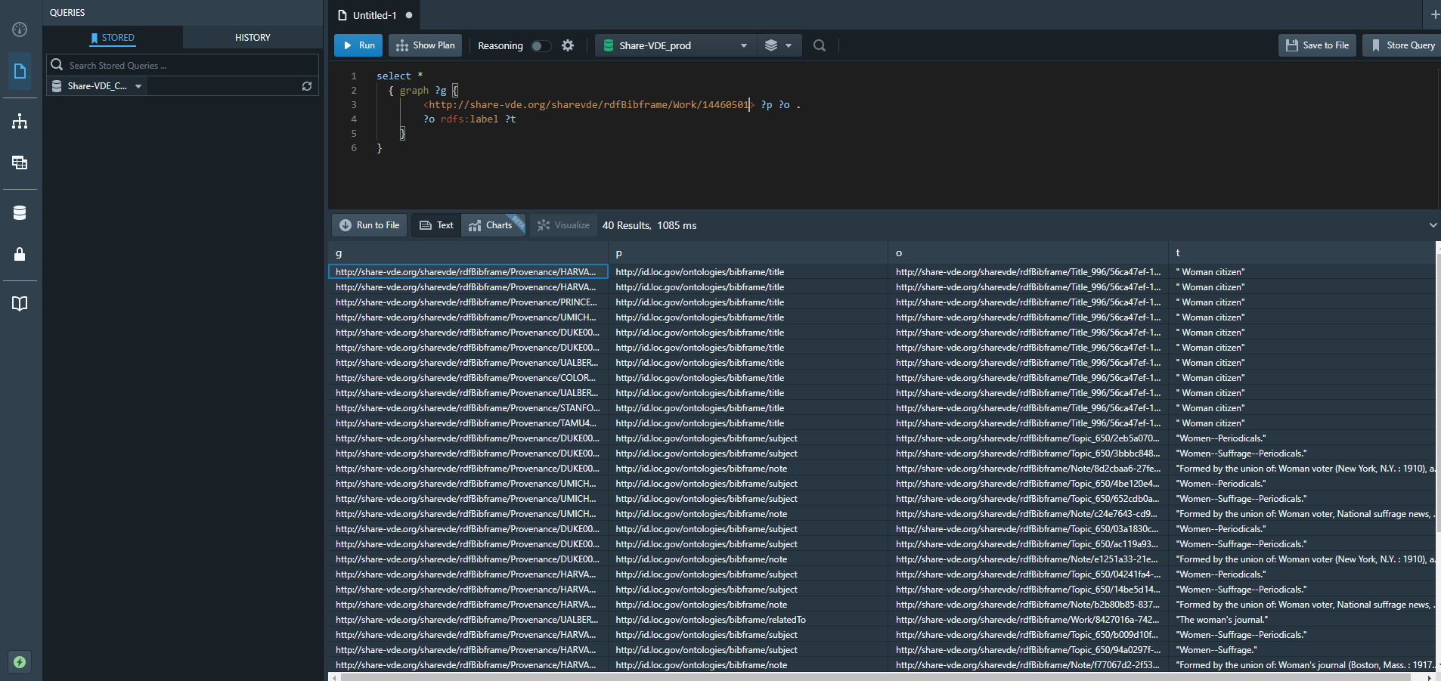
Notes:
This image illustrates part of a serials title example from the Share-VDE Stardog production triplestore (i.e., the Share VDE backend). Though difficult to parse in this slide, the image highlights that the Share-VDE project involves the mapping of MARC authority & Bib data from many large library databases into BIBFRAME. Classes and properties need to be clearly specified because these models must be translated into real world data. This modelling work must then be translated into code for conversion and clustering processes within the Share-VDE systems.

Slide 5
Leverage linked data’s ability to clearly express relationships between entities and to encode these relationships more explicitly for machines, users, and catalogers
Notes:
When it comes to sequential title history data contained within the MARC 780 and 785 fields, there are many nuances and historical practices that need to be accounted for when converting these relationships into Linked Data. Our group of serial enthusiasts formed in order to ensure that these fields, the complicated relationships they encode, and the legacy Continuing Resource data they contain are given the attention they deserve.
Just as a quick refresher regarding Successive Entry cataloging …
Since the 1970s, libraries following the Anglo-American Cataloging Rules (AACR) – and now RDA – content standards have applied Successive Entry guidelines to capture sequential Bibliographic relationships.
Catalogers describing Continuing Resources create separate Bib descriptions for resources that experience Major Change(s). These separate, successive Bib descriptions are then “linked” to one another with Preceding/Succeeding (780/785) MARC 21 linking fields. Continuing Resource catalogers select carefully-defined 780/785 indicator values in order to accurately describe a range of relationships these Bib entities share.
Refining the conversion and modeling processes necessary to capture the range of sequential relationships Continuing Resource Bib records exhibit will allow library catalogs to leverage Linked Data’s ability to clearly express relationships between entities and to encode these relationships more explicitly for machines, for catalogers and for Library Users.

Slide 6
Approach
Map to bf relationships where possible and appropriate
Where gaps exist
Utilize relationships from RDA/RDF where suitable and available in order to enrich the data
Where no suitable alternative exists, decide whether the loss of information is acceptable, or whether a new bf relationship should be established
Where complexity exists in the source (MARC data), apply logic that can support additional code development to identify the appropriate relationship where possible
Notes:
Again, the purpose of our WG analysis was to inform processes for acting on real world data, to describe actual use-case Continuing Resources – we therefore needed to both identify concerns and suggest a path forward.
Consulting and reviewing PCC CONSER and Serials Community documentation & best practices …
And based on the data and examples we studied, the following approaches were utilized:
Where possible, map 780-785 MARC relationships to existing BibFrame properties;
Where no appropriate BibFrame relationship existed, map instead to RDA/RDF unconstrained relationships ;
When no workable alternative currently exists, distinguish when this loss of specificity may be okay, and when the library & serials community may instead need to request new BibFrame relationship properties ;
For complicated, outlier examples, determine cases for which creative applied logic may provide extensible solutions (with the clear understanding that this may not always be possible)
Slide content*

Slide 7
Successes
Many 780/785 relationships can currently be mapped to BIBFRAME without a loss of information
Notes:
The good news is … that in many cases current MARC 21 780 and 785 fields may be mapped cleanly to existing BibFrame relationship properties.

Slide 8
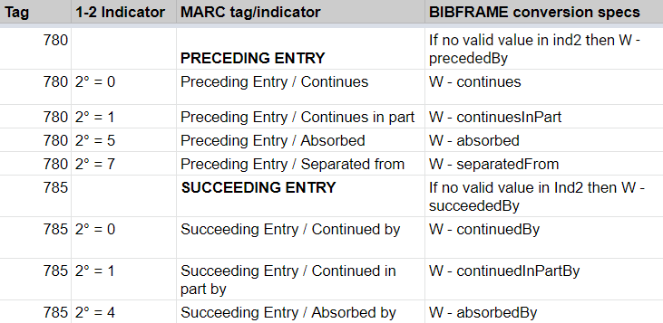
SUCCESSFULLY MAPPED 780/785 RELATIONSHIPS
Notes:
Using the library of Congress’s MARC to BIBFRAME conversion specifications as a starting point, our group found that many preceding and succeeding entity relationships could be mapped to existing BIBFRAME relationships. In particular, straightforward, one-to-one relationships, such as continues/continued by, absorbed/absorbed by required no further analysis.
The group agreed that of 17 possible Continuing Resource relationships, 7 could be fully represented as outlined in the LC conversion specs (listed in the slide), while an additional 4 options could be captured, but will require additional consideration.
The remaining 6 options require new relationships; either re-workings of existing BibFrame relationships, or new relationships altogether.
-----------------------
(Among the 4 that need additional tweaking: ex. Also capturing lateral relationships between merged/split titles)
(Among the 6 that require new accommodation(s): ex. Updating to inPart, specifying continuedBy/continues instead of precededBy/precedes,).

Slide 9
CAPTURING RELATIONSHIPS
Mapped Relationships
Example: 785 00 (Continued by)
022 0# $a 0730-5567 $l 0730-5567 $2 1
245 00 $a Preliminary seismological bulletin / $c Tennessee Earthquake Information
Center, Memphis State University.
260 ## $a Memphis, Tenn. : $b The Center, $c -1982.
785 00 $t TEIC quarterly seismological bulletin $x 0741-1898
Notes:
Analysis and recommendation: One to one Bib entity relationships, such as continuedBy/continues which have an equivalent BibFrame relationship property can be mapped from MARC to BIBFRAME without a loss of information.
For example, in the straightforward one-to-one MARC ceased serial Bib title illustrated above, Title 1 represented in the 245 field changes to become the highlighted Title 2 in the 785 field.

Slide 10
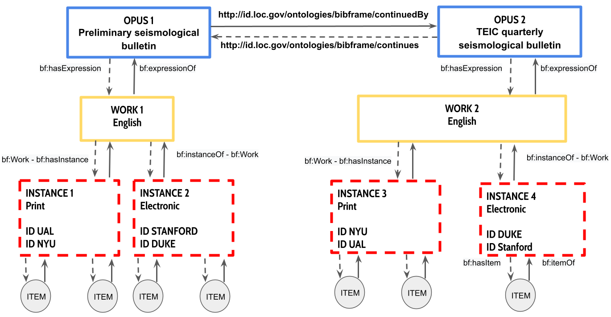
Notes:
This is what the MARC 21 Bib record from the previous slide looks like within the Share-VDE data model.
Please NOTE: Within the Share-VDE model, Opus-Work-Instance-Item terminology aligns with what the Library Reference Model (LRM) labels as: Work-Expression-Manifestation-Item.
For more information on Data Model in Share-VDE
… and with that, I will pass this along to Abigail who will cover the really complicated, really challenging bits …

Slide 11
Challenges
Capturing complex relationships:
One-to-many relationships
Lateral relationships
Capturing sequential relationship data beyond 780/785 (e.g., 247 field, 580 notes, etc.)
Notes:
Thanks Everett. Though there were certainly successes, the group did encounter many complexities and challenges in the course of mapping sequential MARC relationships to BIBFRAME. The challenges we’re going to highlight today are those related to capturing lateral and one-to-many relationships, and challenges extracting and representing sequential relationship data when it is encoded in MARC fields outside of the 780 and 785 fields.
To demonstrate these challenges we’re going to provide real world examples. As you’ll see, these examples represent the complex reality of this work, because most examples contain more than one mapping challenge.

Slide 12
CAPTURING COMPLEX RELATIONSHIPS
One-to-many Relationships
Example: 785 05 (Absorbed in part by)
022 0# $a 2691-526X $2 1
245 04 $a The Metal worker, plumber, and steam fitter.
780 00 $t Metal worker $x 2691-5898
780 05 $t Engineering review of heating-ventilating-plumbing-metal working-lighting $g Oct. 1912 $x 2691-5235
785 00 $t Plumber and steam fitter $x 2691-5588
785 05 $t Sheet metal worker $x 0096-9249
Note: No 580 note in the Bib record; Sheet metal worker absorbed the sheet metal and furnace departments of the Metal worker, plumber, and steam fitter, Oct. 1920. ⇨ This is an “absorbed in part” relationship ; that is, both publications continued on following this Bib absorption event in Oct. 1920.
Notes:
A complexity we encountered frequently was capturing one-to-many relationships. In the example provided, only some sections (sheet metal and furnace department) of the target title Metal worker, plumber, and steam fitter are absorbed by the later title, the Sheet Metal Worker. This is an “in part” relationship, represented by the “absorbed in part” second indicator five in the 785. The remaining portion of the target title is continued by the Plumber and Steam Fitter, represented in the first 785 field.

Slide 13
Notes:
Mapped out, here is what this title history looks like. In trying to represent this relationship in BIBFRAME we found that LC MARC2BF use bf:absorbedBy to describe this absorption, which suggests that the whole of The Metal worker, plumber, and steam fitter is continued in the Sheet metal worker. The Bibframe ontology does not contain equivalent absorbedInPart or absorbedInPartBy relationships (though it does contain continuedInPart and continuedInPartBy relationships). To accurately capture this MARC data in linked data the group recommended using the RDA/RDF unconstrained relationships "is absorption in part of work" (RDA/RDF) and "is absorbed in part by work" (RDA/RDF).
For the serialists in the room you may have also noted that this MARC example had incorrectly coded the second later title, the Plumber and steam fitter as a continued by relationship, when it should be a continued in part by relationship (given that some parts of the title were absorbed into a different later title). These kinds of inconsistencies are just another component to think about in mapping relationships from MARC to BIBFRAME
----------------------------
The link: https://docs.google.com/drawings/d/1ZYO_f1yrzazpD6mOw__TIVlXkIQwpBHqveyxbotLxc8/edit

Slide 14
CAPTURING COMPLEX RELATIONSHIPS
Many-to-one Relationships
… 580 Notes & Lateral Relationships
Example: 785 17 (Merged with ... to form…):
022 0# $a 0226-0883 $l 0226-0883 $2 4
110 1# $a British Columbia. $b Ministry of Provincial Secretary and Government Services.
245 10 $a Annual report - Ministry of Provincial Secretary and Government Services.
580 $a Part of this title merged with: British Columbia. Ministry of Tourism, Recreation and Culture. Annual report, ISSN 0843-8080; and: British Columbia. Ministry of Government Management Services. Annual report for the fiscal year ended ... to become: British Columbia. Ministry of Tourism and Provincial Secretary. Annual report, ISSN 0847-4710.
785 17 $a British Columbia. Ministry of Government Management Services. $t Annual report for the fiscal year ended ... $x 0847-4281
785 17 $a British Columbia. Ministry of Tourism, Recreation, and Culture. $t Annual report $x 0843-8080
785 17 $a British Columbia. Ministry of Tourism and Provincial Secretary. $t Annual report $x 0847-4710
Notes:
Now we’re going to look at the Merged with .. to form.. succeeding relationship, which is recorded in the 785 field, second indicator 7. This field captures relationships between titles that merge together to become a new title. It’s worth noting that when it comes to encoding these types of relationships in MARC, a sizeable subset of serial records utilize the precise sequence and placement of Linking Fields in order to encode the proper relationships among titles. With merged with to form, the title(s) the target item merged with are listed in the first 785 fields, with the title they merged to form, listed in the last 785 field.
Often when describing these kinds of granular relationships among serials, catalogers will use the 580 linking complexity note, which will make the relationships between these titles clear for the user and other cataloguers. However, as we know, note fields are not machine actionable and do not make these relationships explicit. It’s clear that the encoding of merged with to form relationships in MARC is not ideal, but mapping them to BIBFRAME introduces new complexity since we don’t believe the concept of field ordering is retained.
The Library of Congress’s BF2MARC conversion uses the bf:mergedToForm for all 785 fields with second indicator 7, assigning each 785 field the same relationship without identifying the succeeding title. Our preliminary recommendation to address this concern is to establish logic to identify the succeeding title based on field position (typically the title in the last 785 note), and then assign the title in this field the mergedToForm relationship. However, further analysis on a set of real world data is required to determine feasibility. Mining the accompanying 580 note field was also discussed, but again, would require complex logic.

Slide 15
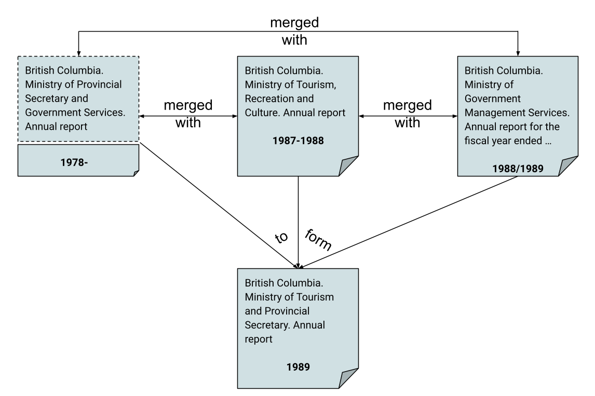
Notes:
If we are able to identify the succeeding title in a set of “merged with…to form…” linking fields, we would also want to capture the lateral relationships between the merging titles. Looking at these kinds of relationships visually makes it clear that the relationships between merging titles and the titles they become are not the same.
These merged with relationships are what we have termed lateral relationships, and no existing relationship was identified (In BIBFRAME or RDA) to represent them. If we want to explicitly capture the relationships between merged entities, it’s likely a new relationship would need to be established or other linked data ontologies investigated. In this investigation we might also want to consider what level of granularity is used to express these relationships. For example, can we differentiate between titles where the entire title merged to form a new title, and titles where only part of the title merged to form a new title, such is the case with the example here.
-------------------------------------
Drawing link: https://docs.google.com/drawings/d/14gEksNMmAGOCDiMuvnAaV2lCszb-11I-I95be8jzWTI/edit

Slide 16
CAPTURING SEQUENTIAL RELATIONSHIP DATA BEYOND 780/785
Legacy Data: Former titles
Example: A hybrid record with both latest and successive entries (i.e., Previous title entities encoded in both 780 AND 247 fields)
S/L = 1 BibLvl = s
245 04 $a The Holston messenger.
247 00 $a Holston conference messenger. ǂf Vol. 1, no. 1-no. 19? no
247 00 $a Messenger for the Holston conference. ǂf Vol. 1, no. 20? - v.2, no. 47?
260 00 $a Knoxville, Tenn. : ǂb T. Springfield, ǂc 1827-29?
780 02 $t Western Arminian, and Christian instructor.
Notes:
The last examples we’re going to look at are capturing and mapping legacy data. Since Share-VDE works with many different libraries, we want to account for legacy content standards and historical cataloguing practices, as many serial records of member libraries may predate RDA and even AACR2. This slide illustrates a hybrid record, using latest entry conventions and fields, but also using a preceding entry relationship field. While latest entry convection and the use of the 247 former title field is still a valid practice for integrating resources, it is no longer used for serials.
Our group recommended that, where possible, relationships between earlier titles recorded in the 247 former title field of latest entry records for serials be captured and mapped in BIBFRAME as formal relationships using bf:continues/continuedBy. Creating entities and relationships from these fields will make sequential relationships among serial titles more explicit and help map entities created under different cataloguing standards when there are multiple records available for them.

Slide 17
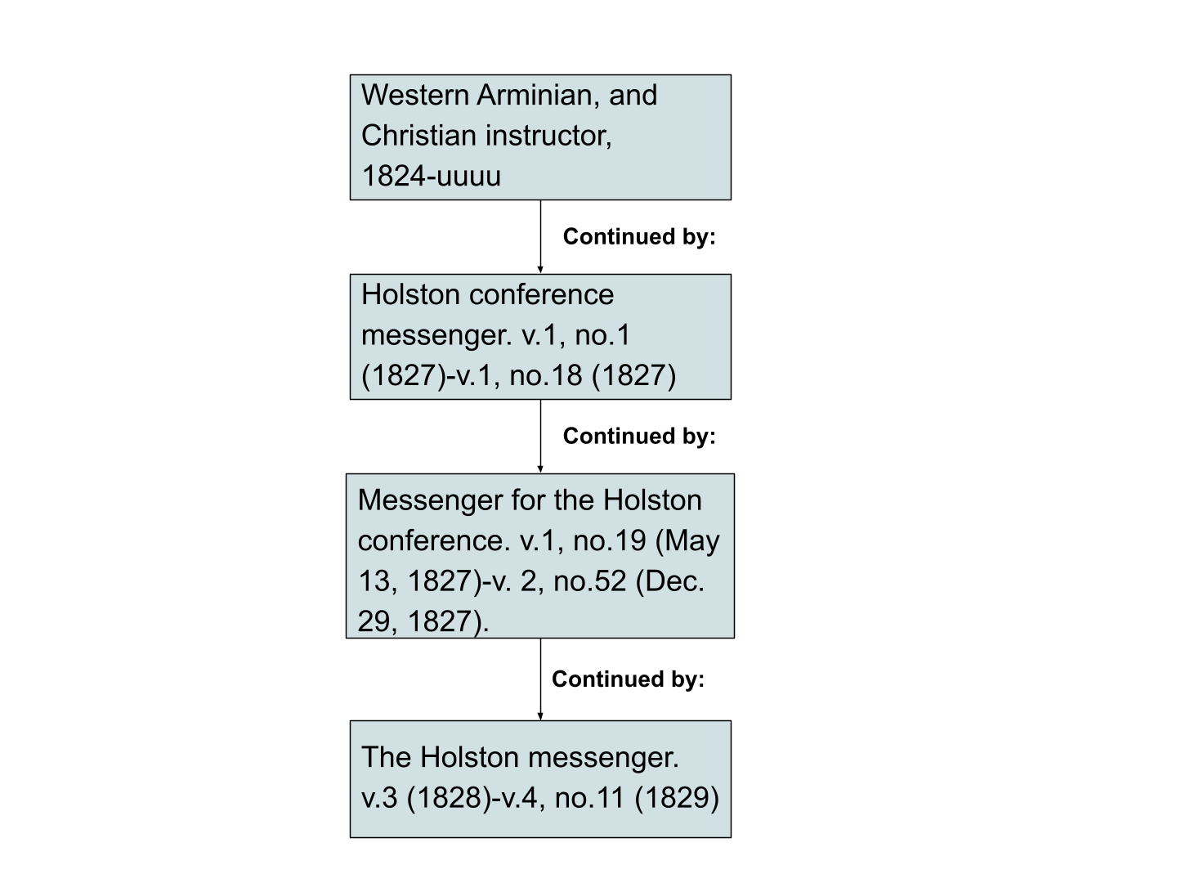
Notes:
Visually mapped, this example looks pretty straight forward, but getting here in BIBFRAME from the MARC data is going to take significant legwork.
The link: https://docs.google.com/drawings/d/1ac0KkBFrS7DTbKijGre3JxSpDP_7uGBC8ZlkK-jnifo/edit?usp=sharing

Slide 18
CAPTURING SEQUENTIAL RELATIONSHIP DATA BEYOND 780/785
Legacy data: “Changed back to”
A former title vs. a former entity
BIBFRAME Specs mapped 785 08 (Changed back to) to ContinuedBy
We found some records changed back to multiple entities (former titles)
Recommendation:
Mapping includes Continued in part by?
Legacy records with “Changed back to”: some converted into indicator 0 or 1 and some still using indicator 8
Fail to comply with the WEM-lock
Recommendation:
Stop using “Changed back to” for new descriptions
Notes:
We want to end by noting that library content standards such as RDA move us toward Bibliographic records as entity descriptions. In comparison, the older concept of a title changing back to a former iteration (i.e., 785 08) now appears quaint and anachronistic. While this indicator coding does exist within some legacy library data, it should not be applied within entity descriptions created today. Instead we should focus on aligning MARC and BIBFRAME descriptions with LRM, focusing on title changes as changes in works.

Slide 19
Interoperability & context for next steps
The relationships we are able to extract programmatically from MARC are not necessarily the same as what we might hope to achieve with native BIBFRAME cataloguing
Notes:
One thing that kept coming up during our work was the importance of standardization and expressing relationships as accurately and action-ably as possible. What we want is to maintain the detailed relationships we’ve encoded in MARC when converting it to BIBFRAME, but we also want to ensure that when we create new serial descriptions in BIBFRAME, that we’re leveraging the power of expressing relationships in linked data to their fullest. To this end, we believe careful consideration of community applications & the creation of best practices guidelines are going to be critical to support data use and interchange in the future.

Slide 20
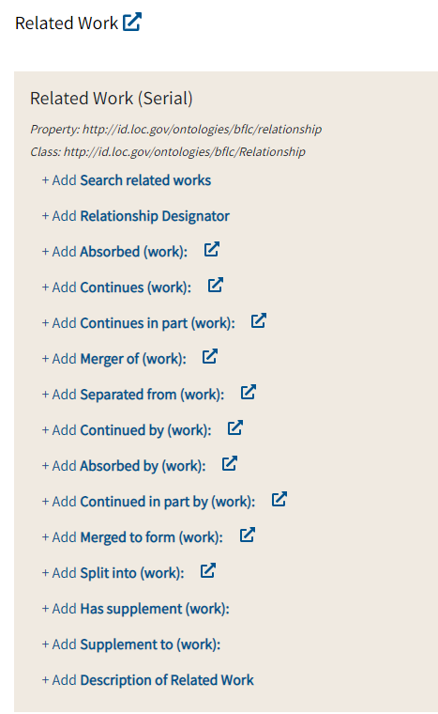
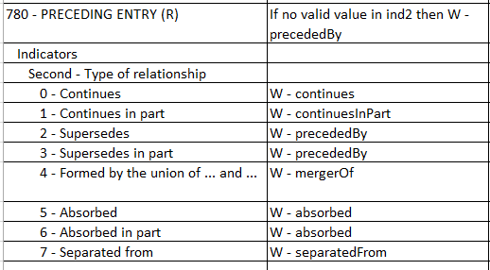
Modelling choices and Interoperability: MARC2BF vs Sinopia
Notes:
Thinking about this in the context of current tools at our disposal, on the left here we see the library of congress’s MARC to BIBFRAME conversion specifications for 780 field (with stars beside those we are recommending updating …), while on the right we have the related works module from the PCC Serials cataloguing template in the Sinopia Bibframe editor. Notably there are different practices for relationships used … this should be considered so that outputs for bf created through conversion are in alignment with relationships created natively (so much as possible)
This also speaks to the need for collaboration between communities of practice working on BIBFRAME implementation, for example, Sinopia, Share-VDE, LC, PCC, … Interoperability is crucial for interchange, so it’s timely that the PCC is setting up a BIBFRAME Interoperability Group, which aims to bring together diverse groups working on BIBFRAME implementation.

Slide 21
NEXT STEPS
Define Specifications
Work with Share-VDE developers to implement relationship assignments and define creation logic where 1-1 relationships aren’t present
Iterative Improvements
Review updated dataset, identifying new issues or areas requiring improvements; work with Share-VDE to implement improvements
Ontology Updates
Advocate for ontology development for BIBFRAME along with updates to conversion specifications
Further Investigation
Further analysis of the use of RDA Unconstrained properties along with BIBFRAME as needed
Notes:
So wrapping up quickly, where do we go from here? Our next steps include working with Share-VDE developers to implement our suggested relationship revisions and define logic for creating more complex relationships. Like most Share-VDE projects we expect this work to be iterative, involving review, testing and refinement. Final steps will involve investigating other linked data ontologies where gaps exist in BIBFRAME and advocating for BIBFRAME ontology and conversion spec updates if data review deems them necessary.

Slide 22
THANK YOU!
Abigail Sparling Serials Metadata Librarian
University of Alberta Library
ajsparli@ualberta.ca
Ian Bigelow Head, Cataloguing Strategies
University of Alberta Library
bigelow@ualberta.ca
Charlene Chou Head, Knowledge Access
New York University Libraries
Charlene.Chou@nyu.edu
Everett Allgood Serials Cataloger
New York University Libraries
everett.allgood@nyu.edu

Slide 23
CREDITS
With many thanks to others working on this on the SEIWG!
Presentation template by SlidesCarnival

