Slide 1
In Search of Name Identifiers: Assigning ISNI to Named Entities in Digital Collections
Nicole Smeltekop, Elisa Landaverde, Lisa Lorenzo, Lucas Mak
Michigan State University Libraries
ALCTS Heads of Cataloging Departments Interest Group, ALA Annual, June 24, 2019, Washington, D.C.
Notes:
Hi everyone, I’m Nicole Smeltekop and I’ll be talking today about the MSU Libraries’ project to add ISNIs to names in our digital repository collections.

Slide 2
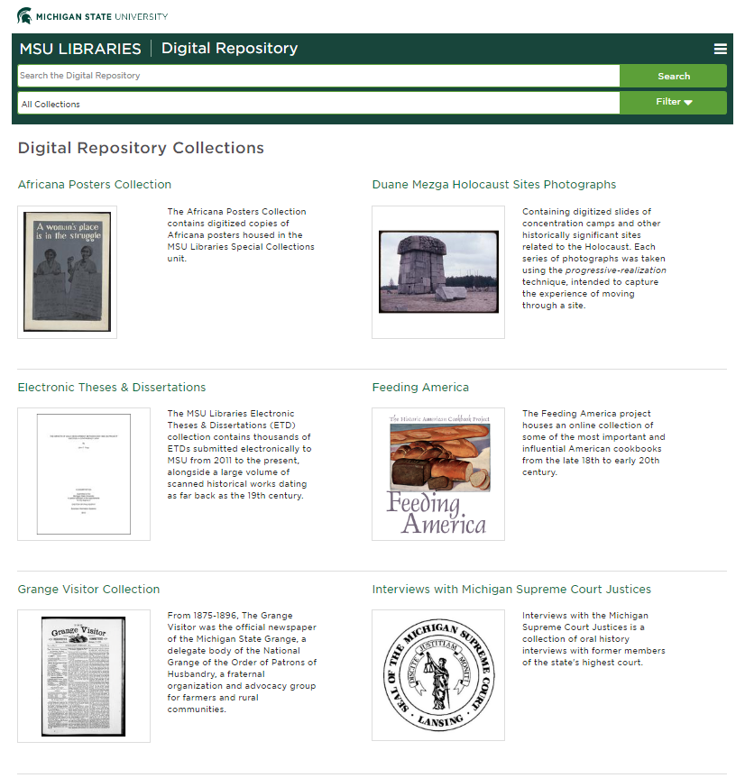
MSUL Digital Repository
Notes:
The Michigan State University Libraries digital repository is the home of numerous collections of digitized materials in a variety of formats. Our largest collection is our electronic theses and dissertations, but the collection also includes photographs, recorded interviews, cookbooks, posters, maps, and journals.
We use Islandora as our content management system and have an in-house program that allows us to batch ingest our metadata and material.
The repo is run by our repository team, comprised of metadata librarians, programmers, and web developers.

Slide 3
Metadata Team
Comprised of 4 librarians with varying time assigned to the unit
Formed in 2016
Primary work is creating/converting metadata to MODS and Dublin Core for the digital repository
Various initiatives to improve our metadata over the last 3 years:
MSU MODS Application Profile
Upgrading our records to MODS 3.7 (in progress)
Streamlined workflows for metadata creation with various units of the library
Store XSLTs and source metadata on a local GitLab
Source metadata formats: CSV spreadsheets, XML, MARC files, EAD files
Notes:
The metadata team is an unit by itself but works very closely with others on the repository team. We also work on other non-repository projects.
We were formed in 2016 with the addition of two new hires. At MSU, we have a 25% secondary assignment, and my secondary is with the metadata team.
Our primary work is converting metadata from various formats into MODS and Dublin core for the digital repository.
Throughout the last three years, we’ve taken opportunities to further enhance our metadata and make it more predictable. We created a MSU MODS Application profile that details our requirements and instructions for our local flavor of MODS.
We are also currently in the process of upgrading our MODS records to version 3.7.
And we’ve streamlined our workflows so that any of us can pick up projects others have started. This includes storing our XSLTs in GitLab as well as our source metadata. This ensures that any edits to the XSLTs can be handled by anyone on the team.

Slide 4
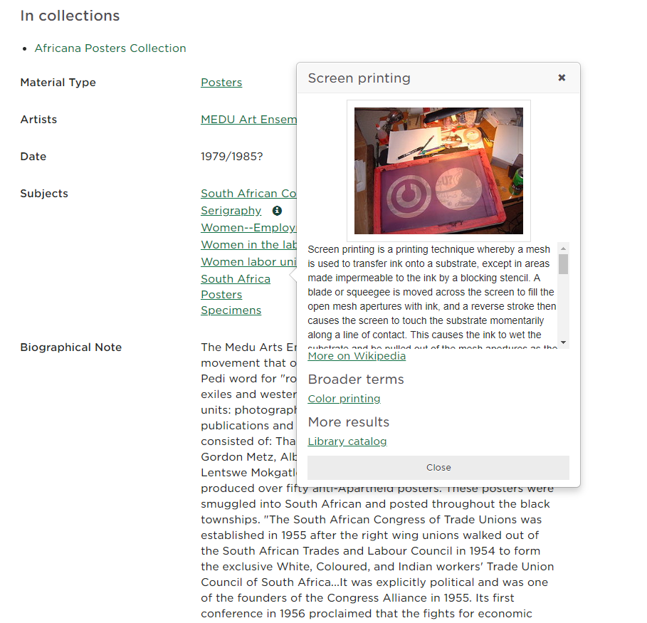
Linked data initiatives in our digital repository
Addition of URIs to names, subject headings, and genres (FAST, NAF, LCSH, Getty TGN, Getty AAT)
Schema.org in JSON-LD for SEO & accessibility info
Knowledge cards
Query Wikidata and DBpedia for data points such as an abstract and photo
Query FAST for broader and narrow terms
Provide subject searches in catalog, PubMed, and JSTOR
Notes:
We’ve also embarked on a few projects to prepare our records for linked data.
We’ve added URIs to our names, subject headings, and genre headings. We use terms from various sources, including FAST, NAF, LCSH, TGN, and AAT.
We also add JSON-LD metadata to our object pages. We create it by running an XSLT that converts portions of our MODS XML records into schema.org in JSON-LD.
We’ve also added “knowledge cards” to our subjects (topical, geographic, and names). These cards pull data from Wikidata and Dbpedia to add context to the terms. The XSLT that runs this also queries FAST to find broader and narrower terms used in the digital repository and notes them. The cards also include a subject search in the catalog, PubMed, and JSTOR to allow users to more easily find information across our collections.
Wikidata includes LC URIs in quite a lot of their entries, so we use LC URIs to query Wikidata. Querying via URIs is not only faster, it’s also much more predictable, and therefore preferable to string text searching.

Slide 5
Adding URIs
We are a NACO participating library, so it’s relatively easy for us to create new records in the LC Name Authority File
However, not all of the team has undergone NACO training
Repository includes many collections that are not cataloged and fall outside the normal NACO workflow (e.g. slides, individual issues of serials, etc.)
ISNI seemed like a low-bar option for minting URIs for
Items not individually cataloged
Names can’t be established under NACO
Notes:
We are a NACO participating library, so provided the material is being cataloged, we can fairly easily create name authority records and generates URIs. However, part of our collection includes items that are cataloged at the collection level, and described in the digital repository at the item level. These include journals, newspaper, and image collections.
Names can’t be established under NACO if we don’t have differentiating information to distinguish them. Though RDA allows the last resort like $c (Author/Interviewee/[any role] of [Title of item in hand], the access point looks silly. Unlike NACO that requires a unique string, ISNI doesn’t care if multiple identities share the same text string (we only need to assert that they are not the same (“no relation”))

Slide 6
MSU ISNI Experience
ISNI introduction
MSU was a participant in the PCC ISNI Pilot
Focused on API testing
Started minting URIs for names in digital repository in Fall 2018
Used web interface
Training used video tutorials and other materials available on PCC ISNI Pilot Wiki
Practice run on the “Accept” (testing) database
Assigned >200 ISNIs in Production database since Sept 2018
Notes:
ISNI is an ISO standard for identifying creators. Typically, ISNIs are created by batch upload of other databases, including VIAF, national libraries, and publishers.
There are three ways to interact with the ISNI database for catalogers: the web interface, a WinIBW client desktop application, and the API.
MSU was already part of the PCC ISNI pilot that focused on API testing of ISNI. After wrapping up the API testing, we changed our course a little bit and started adding ISNIs for names in our digital repository.
The PCC has a pilot wiki that includes training materials. After finishing the training and practicing in the testing database, we starting adding ISNIs to the production server using the web interface. To date, we’ve added a little more than 200 ISNIs.

Slide 7
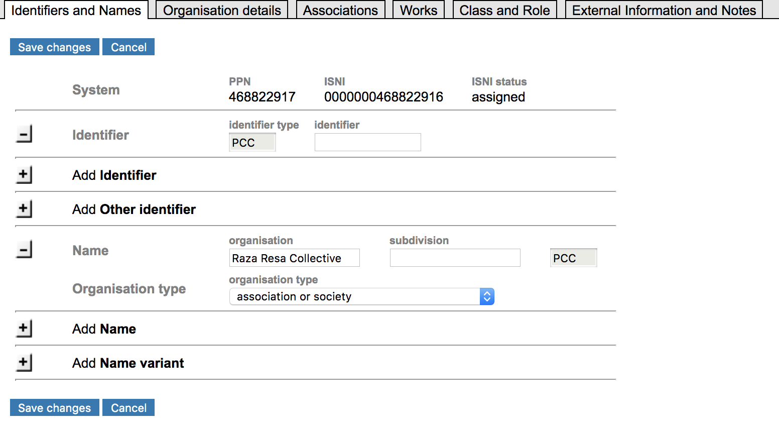
Our experiences adding to ISNI
Notes:
The first step in our process was running an XSLT to identify name entities that don’t include URIs. We then created ISNIs for those entities.
ISNIs only require as much data as needed to differentiate an entity from another person or organization. We typically include any differentiating information found on the piece in hand, such as name variants. In the example shown here, we’ve also included Michigan State University as a related organization since the Collective is a student organization on campus. We also include a link to the digital repository item and any other websites we find in our search for more information.

Slide 8
Adding the URIs to the Digital Repository
Source metadata is in various formats, so where to store the ISNIs have varied from collection to collection
Spreadsheets
ArchivesSpace
MARC records
Store ISNIs in <mods:nameIdentifier> sub-element under <mods:name>
Introduced in MODS 3.6
Updated XSLTs to capture ISNIs into <mods:nameIdentifier>
Notes:
Because we always work from our source metadata, we needed a way to add ISNIs there. Our source metadata is in various formats including spreadsheets, ArchivesSpace finding aids, and MARC records.
In our XSLTs, we map the ISNI to the <mods:nameIdentifier> subelement that was introduced in MODS 3.6. As we’ve been upgrading our MODS records to 3.7, we’ve been adding this instruction to capture the ISNIs in our MODS records.

Slide 9
Adding ISNIs to MARC records
Speakers in sound recordings
Conflict with established identities in NAF or identities already in WorldCat
Lack of contextual information for interviewers or speakers → no info to qualify a name
Sometimes local and obscure speakers
NACO does not allow undifferentiated NAR under RDA
ISNI allows same text string to represent different identities
Can use “not related/no relation”
To differentiate from other identities
To force successful assignment
Notes:
One example of cataloged records we’ve included in this project is our oral history collection. Many times, the transcript is all that we have for information about the person and the name has a conflict in NAF or Worldcat. We also have situations where the name is very local and obscure and we don’t really have anything else other than the name itself.
NACO doesn’t allow undifferentiated authority records under RDA. However, in ISNI, you can make an assertion of “not related/no relation” to establish an entity as different from an existing one. We’ve found this to also be helpful in forcing successful assignment. If there is not enough differentiating data or the data is too sparse per the algorithm, the database creates a provisional ISNI rather than assigning one.

Slide 10
Changes to Downstream Metadata Processes
JSON-LD
MODS to schema.org elements using XSLT
Captures ISNI from <mods:nameIdentifier> or other URIs from @valueURI depending on availability
Subject Knowledge Card
Uses SPARQL queries to identify related Wikidata entries using subject URIs in MODS
To add ISNI from <mods:nameIdentifier> as an additional query attempt
Notes:
As mentioned earlier, our JSON-LD metadata pulls from our MODS records. This JSON-LD metadata includes URIs from the MODS nameIdentifier element.
For our knowledge cards, we are adding ISNIs from <mods:nameIdentifier> element as an additional query point of top of LC & FAST URIs from the @valueURI attribute

Slide 11
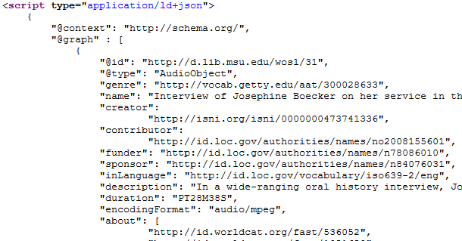
JSON-LD with ISNI
Notes:
This is a sample JSON-LD for one of our oral history recordings. ISNI was created and carried over to the JSON-LD serialization for the interviewee, which is tagged as “creator” here (Schema.org does not have “interviewee”)

Slide 12
Issues & Challenges
ISNI in MARC
Authority vendor processing
Matched to NAR with the same text string
Wrong LC URI inserted
MARC 600/610 2nd indicator coding
Cannot use “7” & $2 combination
ISNI is not in “Subject Heading and Term Source Codes” or “Name and Title Authority Source Codes” but “Standard Identifier Source Codes”
Subdivisions
ISNI URI does not correspond the whole subject string
Repeat the name by itself plus $1 ISNI URI for downstream processes?
Notes:
We have come across issues and challenges for using ISNIs.
Like many libraries, we have a vendor who matches our names and subjects to a URI in our marc records. However, many of our collections have people with common names, so it’s relatively common to have incorrect matches with LC NAF. So in the example on the screen, we created the ISNI entry for the name and put it in $1. Our authority vendor matched the string to an existing personal name NAR and inserted the LC URI in $0. So $1 and $0 are pointing to two different identities
For the 600 and 610 fields, ISNI is not listed in the term source codes lists. Connexion will throw an error if value from the “Standard Identifier Source Codes” list is used. Therefore, $2 isni cannot be used.
If we add subdivisions to a name with ISNI assigned (e.g. [Name] $v Interviews) we cannot add the ISNI URI in $1 as the URI only represents the name not the whole subject string. Do we want to repeat the name by itself with the ISNI URI in $1 in order to include the ISNI URI for downstream processes? This one question we’re currently grappling with.

Slide 13
Issues & Challenges
ISNI in MODS
<mods:publisher> does not have <mods:nameIdentifier> sub-element
<mods:publisher> has @authority, @authorityURI, and @valueURI since version 3.7
Can’t use them for ISNI because ISNI is RWO URI
Repeat publisher name in <mods:name> to allow storing ISNI URI in <mods:nameIdentifier>
Notes:
In MODS, we’ve run into some constraints. Per PCC Task Group on URIs in MARC, ISNI URI is to be captured in $1 which means ISNI is considered as a real world object (RWO) URI. While MODS:nameIdentifier is created to capture RWO URI per MODS guideline, MODS:publisher element does not have a mods:nameIdentifier sub-element or something like it. Although the publisher has authority, authorityURI, and valueURI attributes, they don’t allow for ISNI usage because ISNI is not an authority but a RWO URI.
To circumvent this, we are repeating the publisher name in a MODS name element to allow for ISNI inclusion in our metadata.

Slide 14
Where we are
XSLT to identify named entities that don’t have any URIs
Create ISNIs for those entities
Incorporate newly assigned ISNIs into source metadata
Includes updating OCLC & local catalog records with ISNI URIs in $1
Regenerate MODS (version 3.7) and reingest into digital repository
Notes:
Though we have assigned a few ISNI for names in newly digitized journal issues, our ISNI assignment work has been focusing on legacy data. The first step in our process was running an XSLT to identify name entities that don’t include URIs. We then created ISNIs for those entities.
We currently in the process of incorporating the newly assigned ISNIs into our source metadata. We have completed updating some collections, including some spreadsheet metadata and MARC data. ArchivesSpace experimentation is waiting for me when I return from ALA. We updated many of our XSLTs to include ISNIs and upgraded our records to MODS 3.7 and added them to our digital repository.

Slide 15
Questions?
Nicole Smeltekop, Special Materials Catalog Librarian
Elisa Landaverde, Metadata Librarian & LGBTQ+ Curator
Lisa Lorenzo, Metadata Librarian
Lucas Mak, Metadata & Catalog Librarian

