Slide 1
A Survey of Description: Exploring Subject Access for Diverse Communities Using Python and R

Slide 2
Impetus & Overview of Methodology
Presuppositions:
Inadequately described resources are effectively lost in a library's collection
There are issues with LCSH that can impede subject access, particularly for resources related to historically marginalized communities and identities
Developed a method for evaluating subject headings across a library's collection using sample data:
468,100 MARC records
Limit to records with an LCC classification (050) and at least one LCSH (650 _0)
Compiled a list of LCSH relating to 1) African-Americans; 2) LGBTQIA+; 3) Women; 4) Indigenous peoples

Slide 3
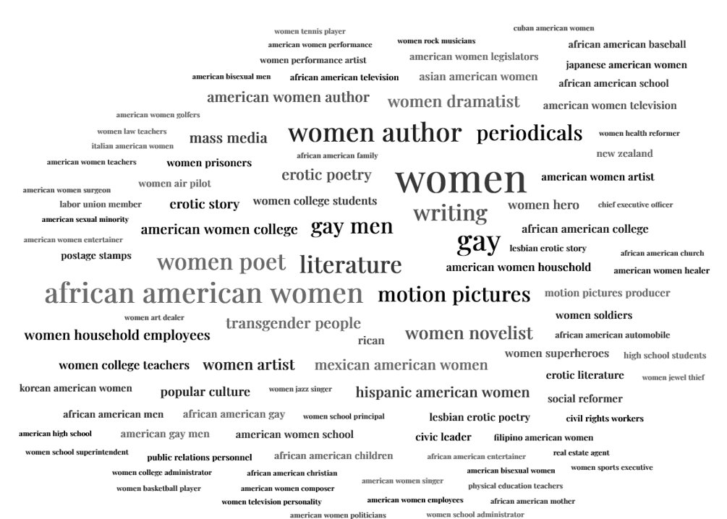
Selected LCSH

Slide 4
Diagram of Workflow

Slide 5
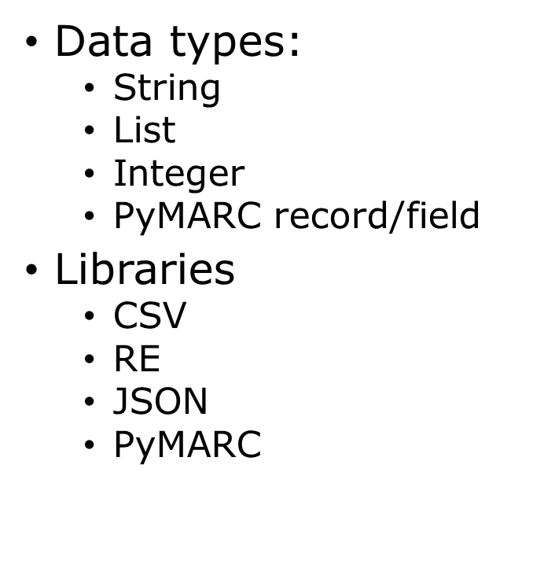
Python

Slide 6
PyMARC

Slide 7
Python 650 field decision tree

Slide 8
PyMARC
with open('demo-records.mrc', 'rb') as fh: reader = MARCReader(fh) for record in reader: row = [] lcsh = []
if record['650']: subjects = record.get_fields('650') for f in subjects: subj = str(f) ind_2 = subj[7] if ind_2 == '0':
subj_formatted = subj[8:] no_sub_0 = subj_formatted.split('$0')[0] lcsh.append(no_sub_0) num = len(lcsh) if num != 0: row.append(json.dumps(lcsh)) else: row.append('NULL') else: row.append('NULL')

Slide 9
R
R (programming language)
Popular language for statistical computing and creating graphical representations of data
Effective tool for cleaning "messy" data
RStudio
Open source software for interacting with R code in a graphical user interface (GUI)

Slide 10
R (cont.)
TidyVerse
A collection of packages designed for common data science tasks
Regular Expressions (RegEx)
Useful for parsing complicated text strings and identifying patterns

Slide 11
R (cont. 2)
Clean
Remove NULL entries for LCC and LCSH
Remove symbols from LCC
Organize
Format LCSH from JSON body to individual strings
Group/split LCSH by record
Analyze
Identify records with selected subject headings
Create graphs to show significant relationships
Utility vs. Exploration

Slide 13
Sample Findings

Slide 14
Sample Findings (cont.)
Cooccurrences of LCSH w/ "Indigenous peoples"- related LCSH
Cooccurrences of LCSH w/ "Women"-related LCSH

Slide 15
Questions?
DOI: 10.1080/01639374.2022.2090042
GitHub repo: https://github.com/bpclark2/Core-Forum-2022

