Slide 1
Increasing collections discoverability through interdepartmental collaboration
Rachel Berman Turner
turnerr@binghamton.edu
Assistant Head of Cataloging/Metadata
Binghamton University Libraries

Slide 2
Background about the Libraries: Special Collections
Special Collections has three faculty librarians, a University Archivist, and many different collections that students, professors, and scholars use
Reinhardt collection
Civil War collection
Link Collection
More than 30 other collections that have been processed at least in part
Notes:
This presentation will walk through a current project to make SC collections more discoverable. The project involves 3 department: SC, Cataloging/Metadata and Digital Initiatives
So, starting with some background about SC:

Slide 3
Background about the Libraries: Cataloging/Metadata
The Cataloging/Metadata Department
Currently has two catalogers capable of handling complex Special Collections material
Two more catalogers who can do certain easier projects for Special Collections
Migrated to Alma last year
Notes:
Due mainly to a number of retirements, the cataloging/metadata department will essentially be cut in half by the fall
Certain easier projects, such as move book locations from one place to another and do copy cataloging for more contemporary collections
The libraries migrated from aleph to alma last year. While we are still getting used to Alma, there are certain functionalities that made this project of discoverability easier, which we will see in a few minutes

Slide 4
Background about the Libraries: Digital Initiatives and Resource Discovery
Has some crossover with Library Technology
All told, there are four people who would possibly work on this redesign
The head of the department
Digital Web Designer
Digital Scholarship Librarian
Systems Specialist
Notes:
The staff members working on the website redesign would potentially come from both DI and Library Technology, as there is overlap in the staffing of these departments
At this time, I am not sure who will actually work on the redesign; so far there have been meetings between the Head of DI and the Head of SC

Slide 5
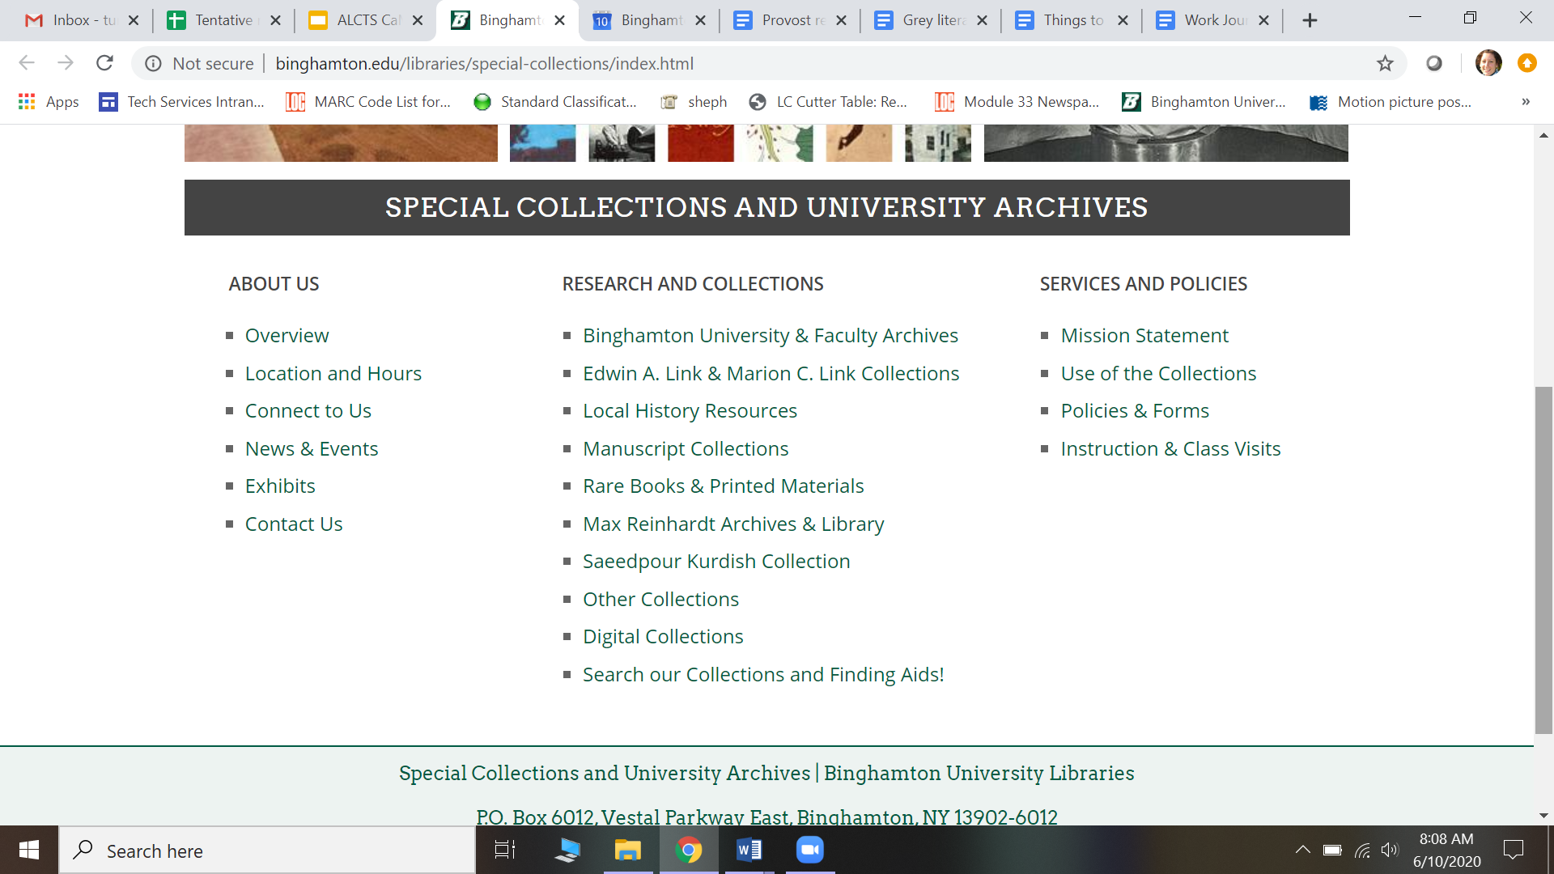
What started the project?
Notes:
The SC website is in the beginning stages of a redesign: this is the current website
shows some collections, but not all

Slide 6
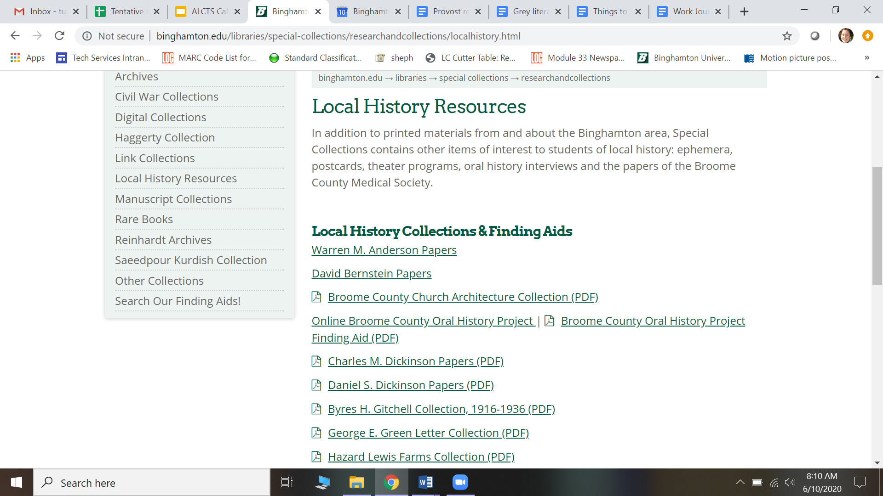
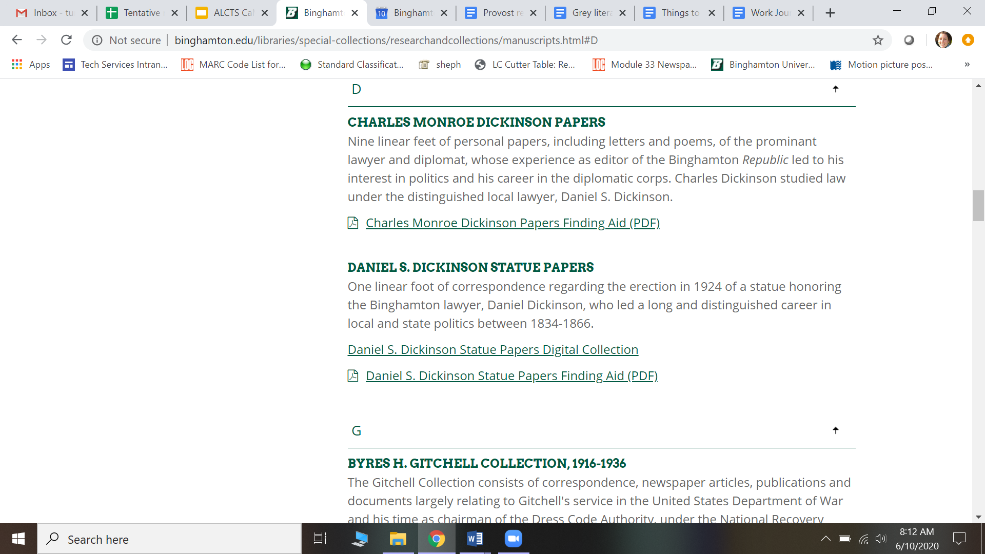
Notes:
There is quite a bit of Duplication (use Daniel S. Dickinson statue papers as an example -- Local History and Manuscripts)
Some collections have PDFs (as you see in the above Charles Dickinson papers), and some are only online using ArchivesSpace, such as our collection of Anitec material, which you will not even find on the website; the only way to know we have it is to use the search our finding aids option (on the left in red) to search ArchiveSpace. So, you’d have to already know we had this collection
Despite most collections having traditional PDFs attached, the “search our finding aids” option takes you to ArchivesSpace, not a page with the PDFs, which you might expect, since most collections you see on the website have PDF finding aids, but as we see they don’t all have links to archivesspace. On top of which, the ArhivesSpace landing page is not very intuitive

Slide 7
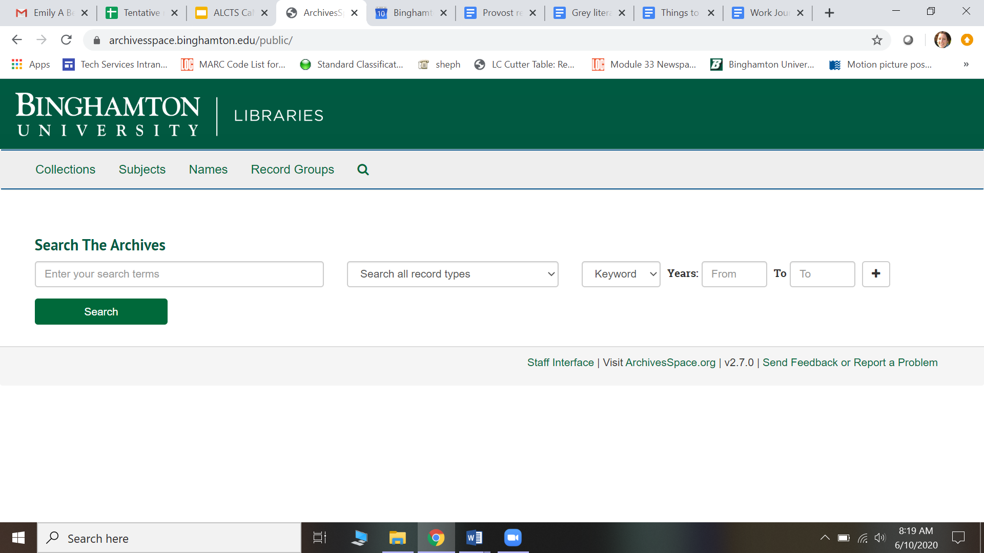
Notes:
Not very intuitive: need to sort of already know what collection you are looking for, since you don’t land on the collections page, but on a search box. You have to realize that if you are looking for a list of our collections, it is on the top left.

Slide 8
First thoughts about the project
Have a flatter website
Takes away the duplication
Standardize the look and feel
Embed a search function that would search library website and ArchivesSpace
Collapse list of collections (why are Reinhardt and Kurdish Collections singled out) and have them all be links in ArchivesSpace
Notes:
SC decided they want to have a flatter website. This means taking away the duplication so there is less material to sift through
Standardize the look and feel of the website, so it is more navigable
If we could embed a search function that searched essentially the regular library and SC, things would be more discoverable
If broader categories were made for the lists of collections (for example, why are Reinhardt and Kurdish Collections singled out) each collection could be housed on just one page and linked to ArchivesSpace. So, for example, if we were to have a category called “named collections,” the Link and Reinhardt and Kurdish Collections could be listed on this page, and not singled out, which leads to busier looking pages
Busier pages are harder to navigate, which makes things less discoverable

Slide 9
Where Cataloging/Metadata fits in
Discoverability became a common theme
Are the collections themselves discoverable?
Have they been cataloged?
How much of a backlog is there?
Pulled Cataloging/Metadata into the discussion to see if there was a way to make the Special Collections collections themselves more discoverable
Notes:
In discussing the website redesign, DI and SC realized they were constantly thinking about the theme of discoverability
The purpose of the redesign was to make it easier for researchers to find things. But how could they find things that aren’t there to begin with? Began to ask questions like are the collections themselves discoverable?
What about the uncataloged SC materials?
Our SC, like all SCs, has a lot of backlog; is there a way to let researchers know this material is even there?
DI and SC asked to meet with me to see how the Cat/Met department could contribute to the discoverability of SC materials

Slide 10
Cataloging/Metadata contributions
Create collection level records for everything in Special Collections
Staffing shortage means we need to make records everyone can do
Allows for ALL collections to be accessible in some fashion:
For collections that are completely processed and accessioned
For collections that are partially processed
For collections that have been accessioned but not processed
For collections that have not been accessioned
Notes:
Because there is a staffing shortage there are not enough people who know how to catalog things like letters and playscripts
Our best bet is to therefore create collection level records, which require fewer complicated elements like specific subject headings. The records can be broad but still valuable
Collection level records will let us represent ALL of the SC collections in at least some way:
For the collections that are completely processed and accessioned -- we can Make a record that encompasses any material that will not be individually cataloged, such as papers and photographs. This saves time and allows for catalogers of all capabilities to work on this
For collections that are partially processed -- we can Make a more general record based on what we know from the items that have been processed
For collections that have been accessioned but not processed -- we can Work with the Special Collections librarians and University Archivist to determine what to put in the record
For collections that have not been accessioned -- we will Work with same people to create very broad records based on information they provide
These collection level records, by increasing the number of people who can work on them, reducing the amount of time we have to spend on cataloging a specific collection, allow us to catalog more material to make it discoverable; in addition, by cataloging ALL of the collections in some fashion, we increase the discoverability of SC materials. Even if the collection level records are not very specific, at least a researcher will know what a general collection is about and be able to request access. This is especially helpful for collections that have not been processed or accessioned, as at least at the end of this project researchers will be able to request access to some of their material.

Slide 11
Practicalities of collection level records
To these collection level bib records we will attach holdings for:
Any physical items
Boxes of material
E-portfolios
Links ArchivesSpace on Special Collections website
Digitized material in Rosetta
This is possible because we migrated to Alma and Primo
Notes:
Collection level records also give us the opportunity to be very practical in terms of attaching and displaying content
So, to these bib records we will attach holdings for physical items, such as Boxes of material like letters and photographs
We can also essentially attach links; these are called e-portfolios, and they will display in Primo (the discovery layer) as links to other resources that are part of these collections. In this case, we plan to have a link to the finding aids in ArchivesSpace on the SC website, and to any digitized material in the collections in our repository Rosetta.
We are able to present our data this way because we migrated to Alma and Primo, which allow for electronic links to be attached to bibliographic records for physical material, and they display in a way that is user friendly, we will see shortly

Slide 12
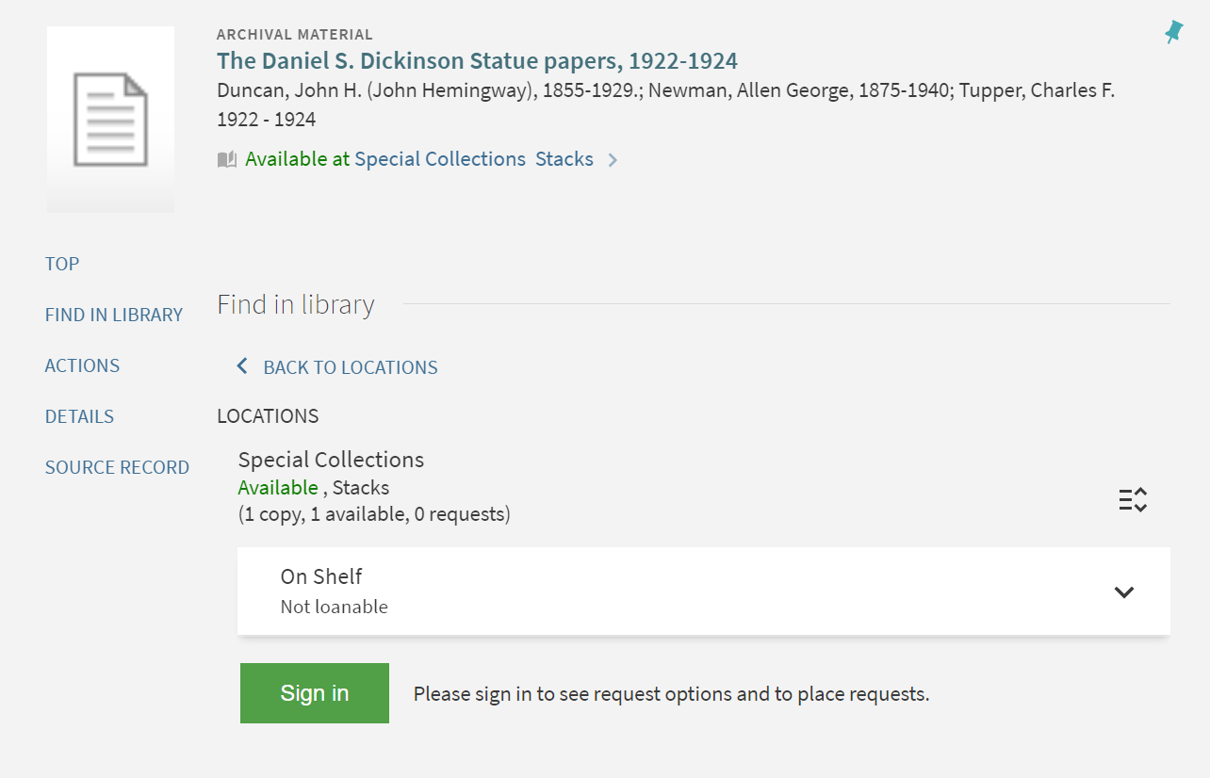
Notes:
Here’s an example of a collection level record in Primo
No link to finding aid and the collection is in ArchivesSpace so we want to link to that
No link to the digitized material in Rosetta
We could greatly increase the collection’s discoverability by adding these via e-portfolios in Alma

Slide 13
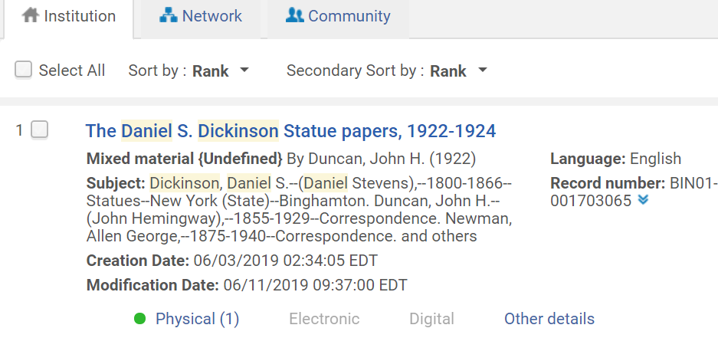
Notes:
This is the collection level record in our Alma sandbox
You can see that there is one physical holding, but no electronic holding (the electronic tab is greyed out)
We are going to add e-portfolios to this bib record, so that the links so up in Alma. this will make all aspects of the collection discoverable in one spot and therefore easier to find

Slide 14
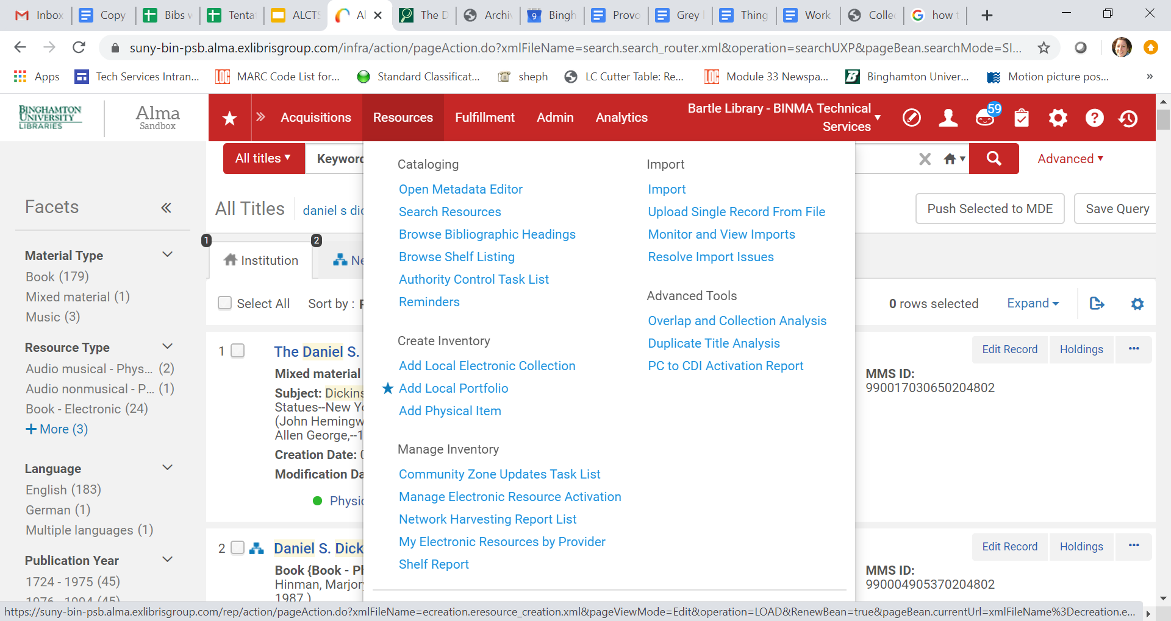
Notes:
So, to add an e-portfolio:
Go to Resources, add local portfolio (starred), and click on it

Slide 15
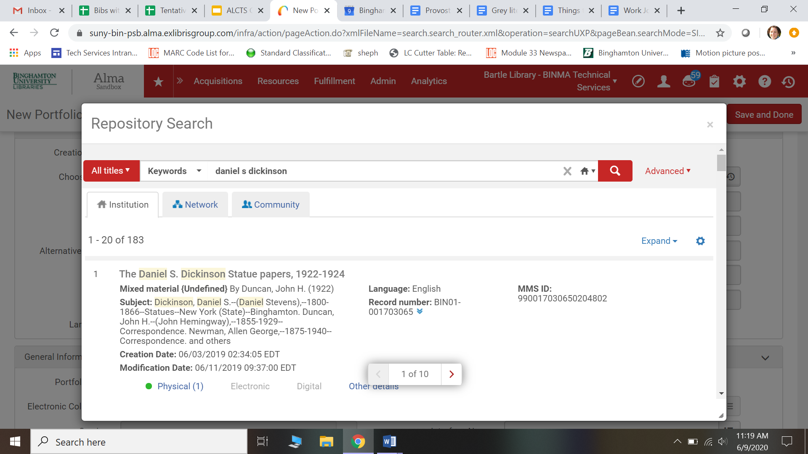
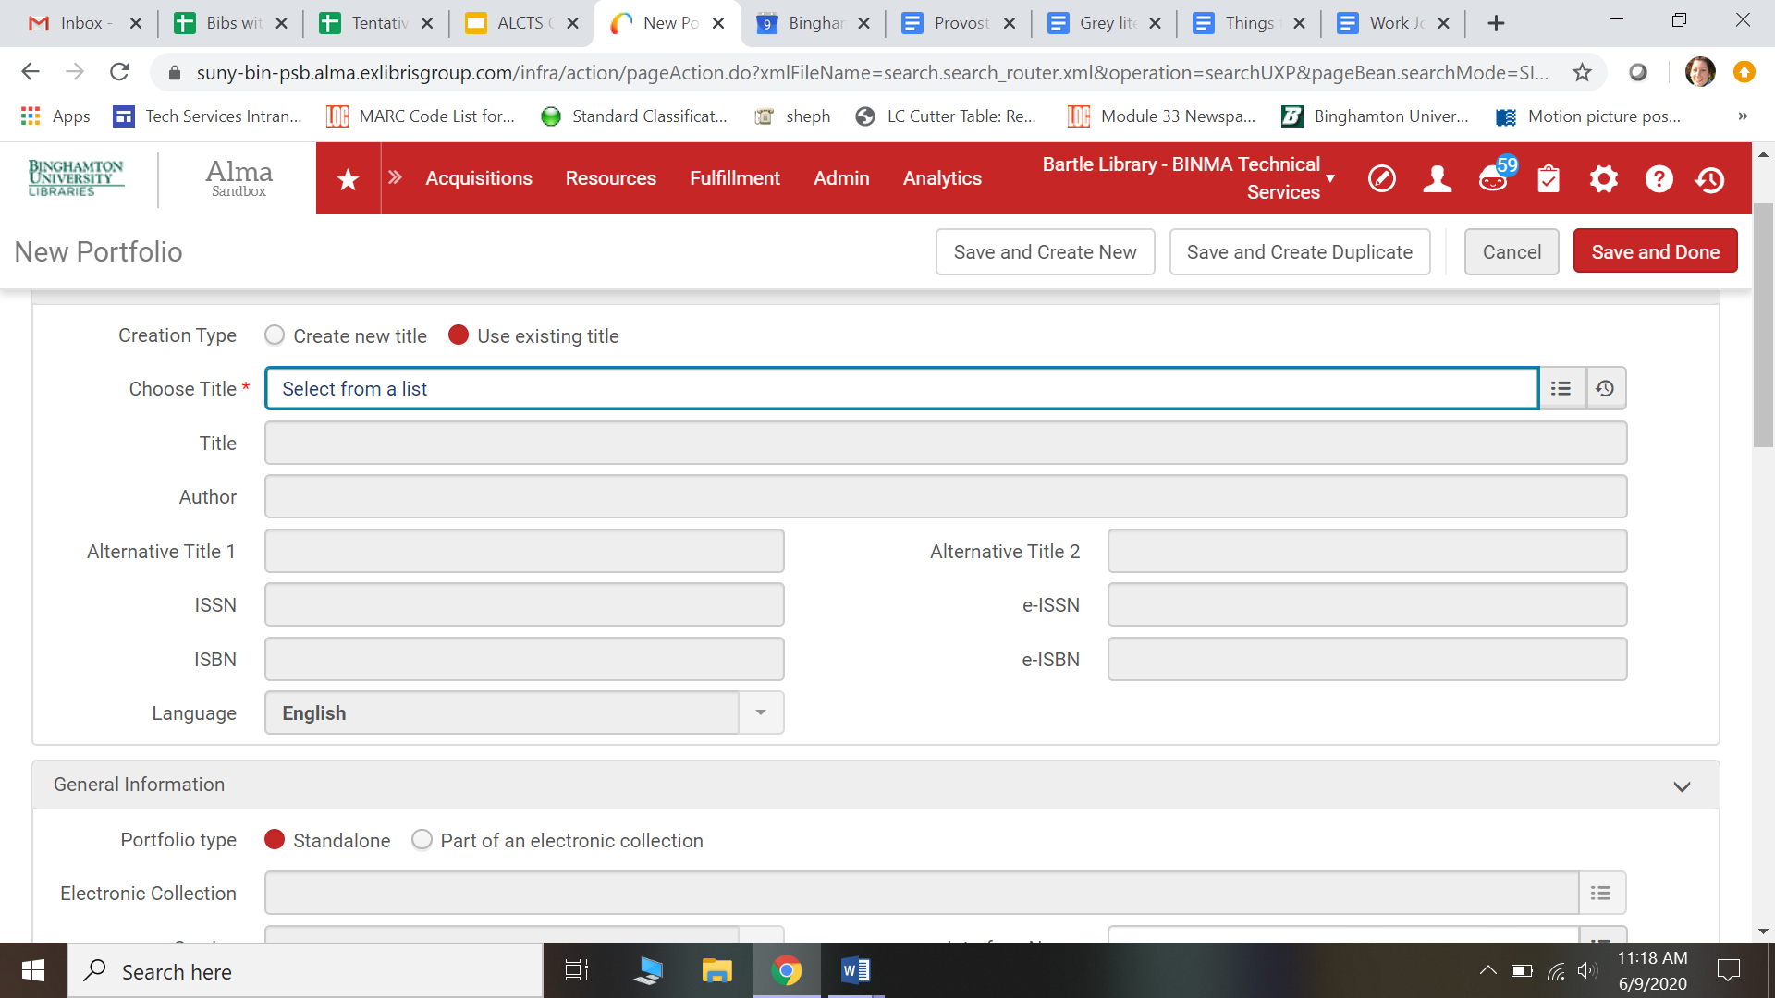
Notes:
Click on Use existing title for Creation Type:
Choose title: select from a list
You get the screen on the right. Type in the name of the record you want to add the e-portfolio to: in this case, Daniel S Dickinson statue papers.
Click on the record you want (the first one). And it populates the original screen like so:

Slide 16
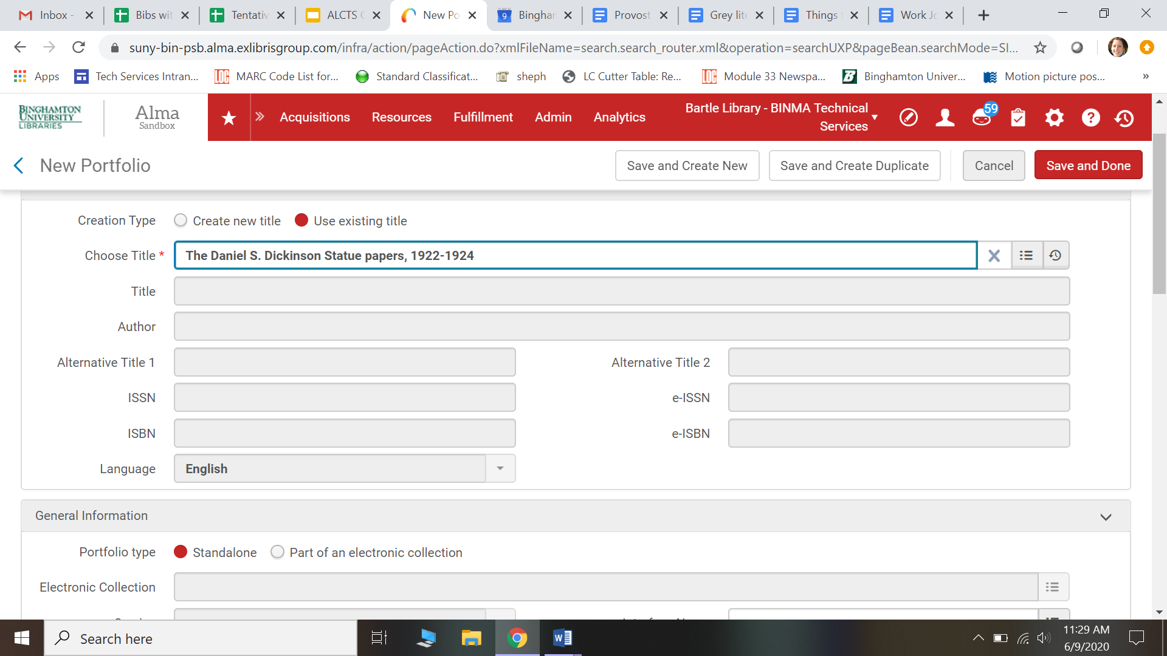
Notes:
You can see the choose title now has the bib record we want
The rest of the fields are greyed out; you can’t change them

Slide 17
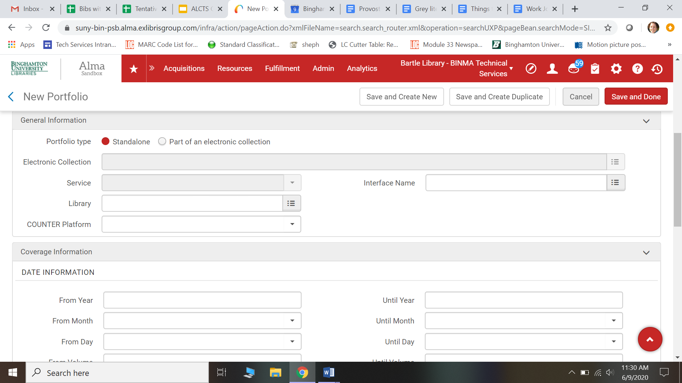
Notes:
Scroll down the screen, and under general information you’ll see portfolio type. Choose standalone
You can enter in other information, such as the date information if you wish. The other field you should fill out is farther down the screen:

Slide 18
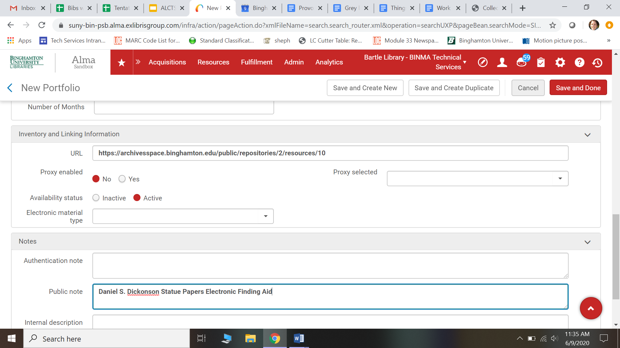
Notes:
You need to put the URL of the site you are linking to
As an example here, I’ll put the URL for the ArchivesSpace finding aid for the daniel s dickinson statue papers
In the public note field, type in how you want the link to display in the discovery layer (Primo)
Click save and done

Slide 19
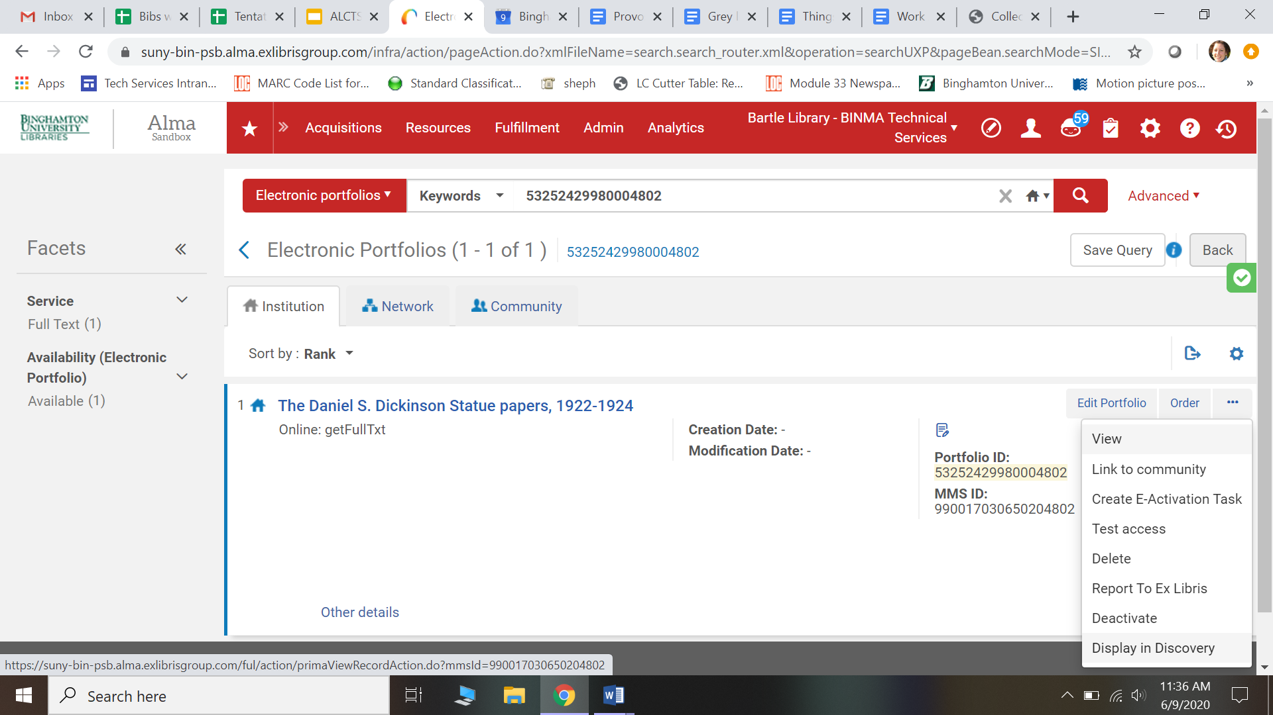
Notes:
You’ll end up on this screen
Click on the ellipses (...) on the right, and go down to choose display in discovery.
This will take us to the Primo page the user will see, so we can see how the e-portfolio we made will look to the public

Slide 20
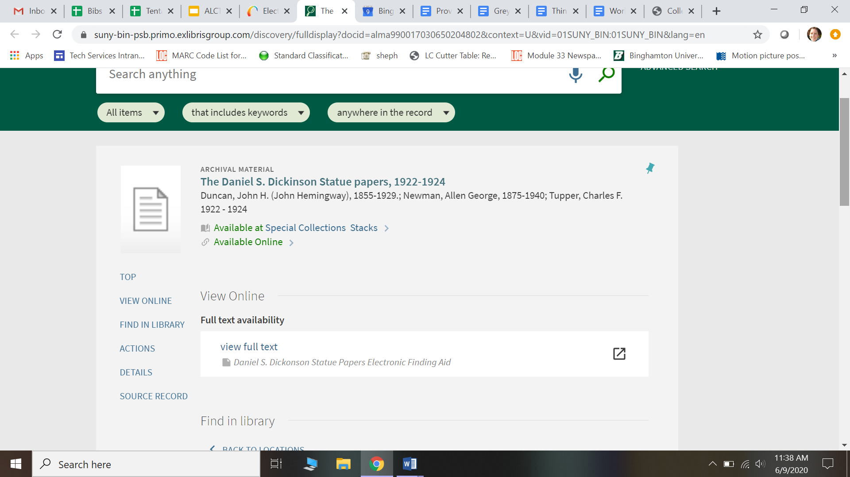
Notes:
Now you can see that there are two options: available in SC stacks, and available online
The available online link just takes you down the page to the view full text Daniel S. Dickinson Statue Papers Electronic Finding Aid link we just made using the e-portfolio. You can see this is the language we used in the public note, so that patrons can tell what this links to
If we click on view full text, it takes us to...

Slide 21
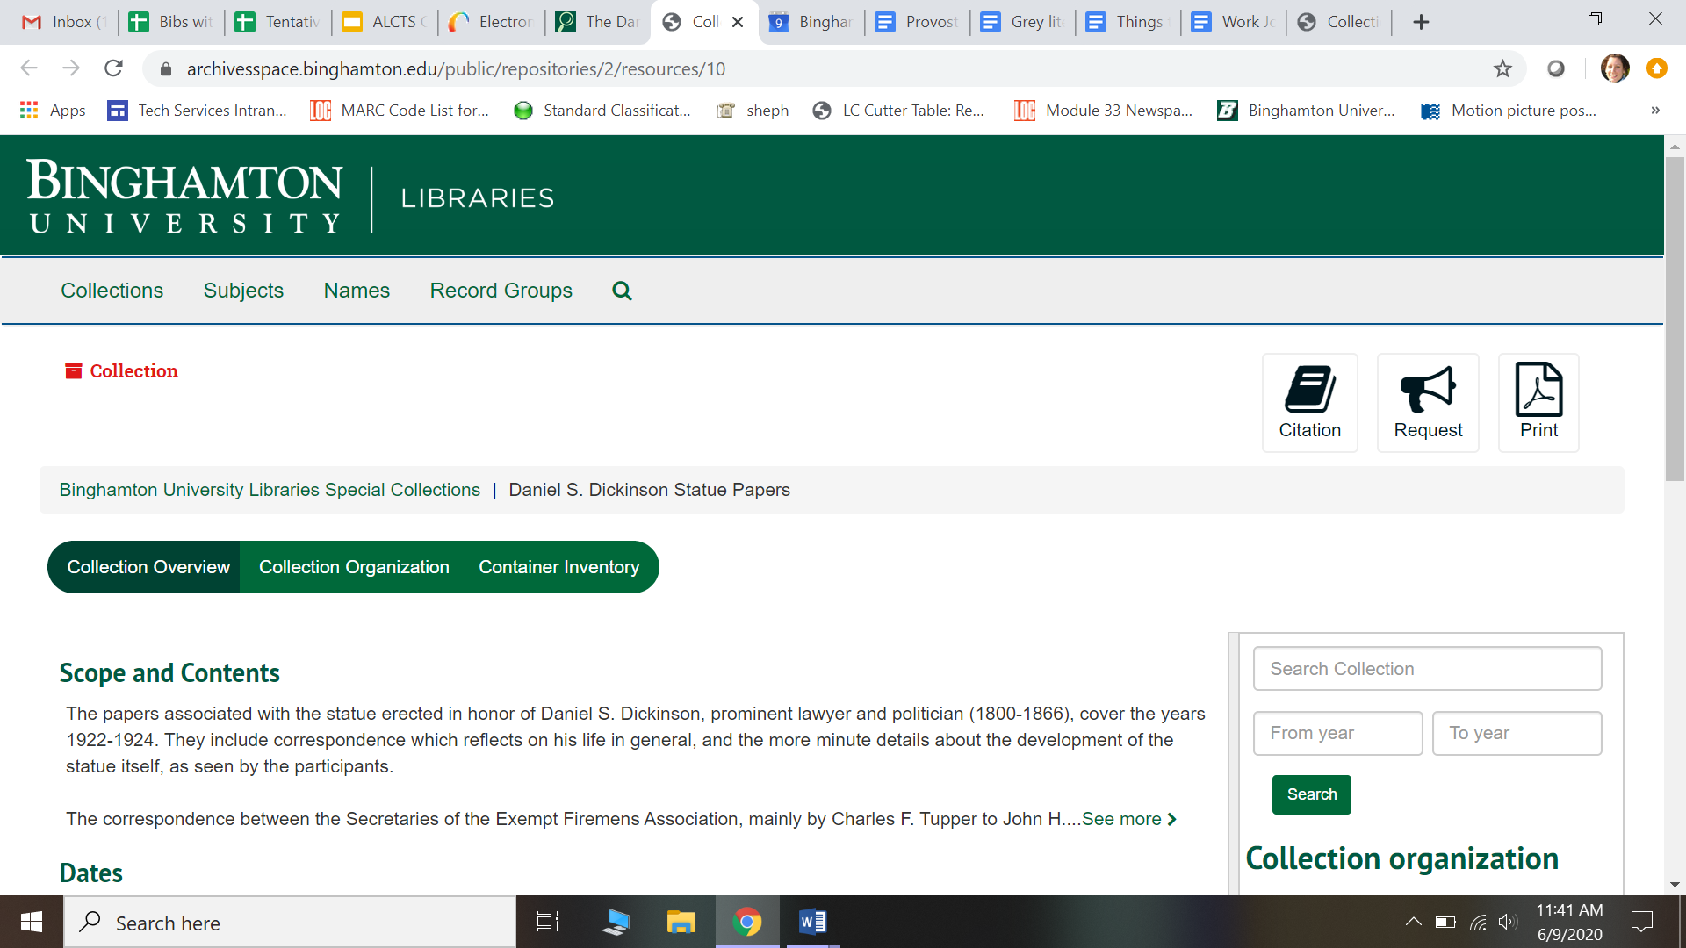
Notes:
The finding Aid in ArchivesSpace, just like we wanted it to
We would do the same process to add an e-portfolio with the link to digitized material in Rosetta. It would display the same way in Primo, with the language we chose for the public note, and then when a patron clicked on the link they would be taken to the Rosetta page
In this way, all of the aspects of the SC collection, the catalog record, the physical items, and links to the finding aids and digitized material, would be in one place for the user to find, making the collection more discoverable

Slide 22
Discoverability is the point and collaboration is key
Special Collections working with Digital Initiatives to redesign the website
To make it more navigable
Special Collections working with Cataloging/Metadata Department to make collection level records
To make everything discoverable
Cataloging/Metadata working with Digital Initiatives to ensure access to digitized materials from collections
Ability of Alma to have physical items and e-portfolios on same record and display well in Primo

