Slide 1
Authority Control and the Occult: Ethical Expectations for the NACO Contributor
Guy Frost, Georgia NACO Funnel Coordinator
Founder of the New Age Movements, Occultism, and Spiritualism Research Library
Valdosta State University
gfrost@Valdosta.edu

Slide 2
My Background
Founded a Contemporary Pagan Archive in 2016
New Age Movements, Occultism, and Spiritualism Research Library (NAMOSRL)
NAMOSRL is a Library with individual archival collections; located in the University Archive at Valdosta State
Began with 5 collections (64 linear feet)
Currently 39 named collection (physical and digital)
Work in NACO and SACO is voluminous

Slide 3
Events of Note Regarding Religious Freedom
1921 - Margaret Murray publishes The Witch-Cult in Western Europe
1951 - Repeal of the Witchcraft Act of 1735
1954 - Gerald Gardner publishes Witchcraft Today
1960s - Raymond Buckland is credited with bringing Garderian to the United States
1960s - Counterculture blossoms
1968 - Church and School of Wicca founded by Gavin and Yvonne Frost first federally recognized Wiccan church
1986, 1989 - Wicca is recognized as a religion in Dettmer v. Landon

Slide 4
Salient Components to the Movements
Oath Bound Secrecy
No religious protections (Employment, etc.)
Discrimination / Ostracization
Life threats / Harassment
Sound Familiar?
"And Ye Harm None, Do What thou Wilt" - in all its variations

Slide 5
Characteristics of the Demographic
Practitioners chose a Craft Name to go by
Multiple Craft names can be chosen distinguished by function (public and non-public)
Craft names often are chosen based on the primary deity they identify with - as more religious adherents find their creative work in the archives setting, the more conflicts will occur
Outer Court and Inner Court allows "weeding" of those not serious and adds a layer of protection and privacy
Publishers, Distributors, Writers, etc. query individuals on their preference
Some individuals use their real name, initials, or Craft name

Slide 6
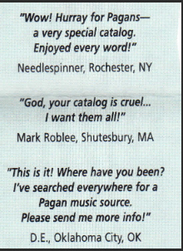
Practitioners Protecting Identities
Taken from Serpentine Music Productions' sales catalog, each individual was queried for permission to use the quote and what form of name to be used: real name or initials
Practitioners requested use of Craft name
Key Concept: Practitioner "chooses" how they want to be represented

Slide 7
Practitioner Requests
The term Witch has been "reclaimed" by women (and some men)
If they call themselves a Witch, we should too
Some people use only initials and conflicts in the NACO file require decisions
Contact them or their publisher
Provide examples (my name is a good choice)
Explain in detail what you are doing and how you would "like their help"
Use buzz words (e.g., Library of Congress, form of name used in catalogs, etc.)
Provided as many links as necessary (authorities.loc.gov until it lasts; or id.loc.gov)

Slide 8
Example:
245 $c … ; translated by M.T.
Religious sect(s) is uncertain
Biographical information is limited
Choice made: contact the publisher requesting help from M.T. in a detailed email - Creator makes decision of how they want to be represented
100;0_; $a M. T. $q (M. Trzcinska)

Slide 9
Other Practitioners Requests
Some individuals want to be associated with their public Craft name AND real name
M. Macha NightMare (Aline O'Brien)
Has creative work under both names
Wants the names to be associated
500;1_; $w r $i Real identity: $a O'Brien, Aline
500;0_; $w r $i Alternate identity: $a M. Macha NightMare
Currently identifies as a Witch at Large
Note, however, she prefers that no one know what M. stands for - not added to authority record

Slide 10
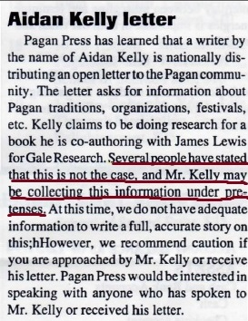
Ramifications
Aidan Kelly - Author, Poet, Musician, Editor and co-founder of NROOGD, Covenant of the Goddess, and other
1970s - Kelly publishes a history of Neopaganism and Wicca that outed many practitioners
- retribution was swift and harsh
20 years later - people remember
2022 - religious practitioners do not want to be associated with anything he's a part of

Slide 11
Linked Data
Nodes instead of MARC fields and subfields - It's closer than you think
Nodes allow machine actionable identifiers to be imported into your Discovery Layer

Slide 12
Systems Outside of Library Catalogs
Source: Canadian Music Centre : https://cmccanada.org/ Canadian Music Centre' (CMC)
Notes:
https://cmccanada.org/

Slide 13
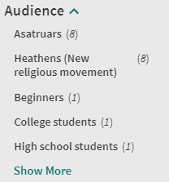
Demographics in Use
Many libraries are experimenting with new MARC fields in their Catalog
Facets allow for the broad subjects to be filtered
Creator Characteristics (386 field) would allow users that are members of a sect to select works by other members of the sect
Future Systems could populate the 368 $c and 374 fields from authorities

Slide 14
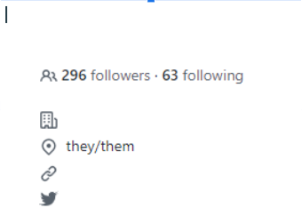
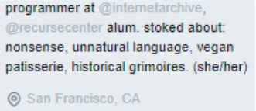
Changes in Self Identification
2015 - Twitter
2018 - Github
Notes:
Creative Work is instance-specific

Slide 15
What Demographics to use in Authorities
A single identifying demographic can reveal a plethora of other demographic data
What should be included?
Everything that is public - If it's already discoverable on Google, recording it adds value to the entity's record as nodes; omitting it is not protecting them; no harm done
Deceased individuals may have their real identities revealed - add the 400 or link them together if individual has creative works under both
Anything you entity wants to include - establish a dialogue
Exclude anything you entity wants to exclude

Slide 16
In sum
As NACO contributors, we are obligated to protect the identities of people we are describing
At the same time, we should embrace the changes in MARC that link data and our patrons will want

