Slide 1
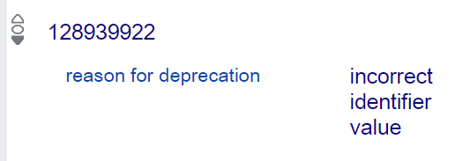
Troubleshooting Linked Data Authority Records
Paul Frank
NACO Program
Policy, Training, and Cooperative Programs Division
Library of Congress
Cannot identify with: n 2007043886: Darvāzahʹghārī, ʻAlī
Notes:
When accessing or referencing linked data resources, catalogers or metadata librarians may encounter statements that seem incorrect. Sometimes linked data authorities for entities, particularly individuals and organizations, contain factual errors. How can these potential issues be assessed? Can individuals provide constructive feedback to the organization that hosts the authority record(s)? This session will discuss these issues, and how best practices may differ for different platforms and data sources.

Slide 2
Troubleshooting … Authority Records
The good old days … the NACO common goal … the NACO cottage industry
What types of factual errors are there?
Conflation of identities
Duplication of identities
Factual errors within an authority record

Slide 3
Conflation of Identities
Intentional
Undifferentiated personal name records
Some corporate bodies
Unintentional
How many polymaths can there be?
Cataloger’s best intentions
667, 672, 673, 675 notes
Resolved internally, in one file

Slide 4
Duplication of Identities
Unintentional in almost every case
Polymaths don’t exist
Cataloger’s best intentions
667, 672, 673, 675 notes
Resolved internally, in one file

Slide 5
Factual Errors Within One Authority Record
AACR2 vs. RDA
WWW knocking at the door
Cataloger’s best intentions
Resolved internally, in one file
Members provide feedback to the organization or institution that hosts the authority record(s)
All pretty simple and straightforward …

Slide 6
Where We Are Now
Working in multiple files, not just one
NACO
Wikidata
ISNI
ORCID
Making manual assertions in those files … while …
Algorithms are doing the same thing

Slide 7
Where We Are Now
Assertions as Factual Errors – the box is open
Proliferation and replication of errors
The NACO chicken/egg story about dates
Challenging when working locally … but
Detrimental to information integrity
Have we become Google-ized?
Have we lost our cottage industry curation ability?

Slide 8
Best Practices – how and what?
Let’s not let go of what worked before
A lot of faith in that statement
We can bring the same skill set to linked data
Corrections in one file can, over time, distribute to others
Deprecation in one file can also lead to deprecation in other files
Wikidata example

Slide 9
Best Practices -- how and what?
Go to the source
Spoke (NACO)
Hub (Wikidata, VIAF)
Data providers have a vested interest in credible and accurate data (just like NACO catalogers do)
But this all needs to play out over time
Keep in mind that the goals are the same, it is just the arena that is larger

Slide 10
Troubleshooting Linked Data Authority Records
Thank you!
Paul Frank
pfrank@loc.gov

