Slide 1
Children’s Board Books: the Coating Conundrum
Amanda Satorius
Preservation Science Specialist
Preservation Research and Testing Division
Library of Congress
Notes:
Intro: name, job, project intro

Slide 2
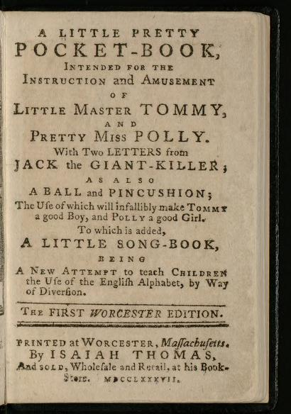
Brief History
Modern genre of children’s literature started about the 18th c.
20th c. brought cloth books and board books
Library of Congress houses over 500,000 children's books and periodicals
Image: http://hdl.loc.gov/loc.rbc/juv.05880
Notes:
The concept of children’s literature has changed over time along with the way children’s childhood and education were viewed in society. Prior to the 18th century, books were written to instruct in religious and moral concepts. Starting in the 18th c, the modern concept of literature specifically written for children, not only to teach, but to entertain them began, not without pushback of course. As literacy rates increased (and infant mortality rates decreased) demand for age appropriate books that were durable increased in kind.
20th century brought screen printed cloth books, until the World wars led to rationing of cloth. Board books rose out of necessity and demand, as they were easier for children to handle.
LC – at this point probably over 600,000 items including maps, visual and audio media and secondary material
Image: generally considered to be the First children’s book printed. A little pretty pocket-book : intended for the instruction and amusement of little Master Tommy, and pretty Miss Polly : with two letters from Jack the giant-killer, as also a ball and pincushion, the use of which will infallibly make Tommy a good boy, and Polly a good girl : to which is added, A little song-book, being a new attempt to teach children the use of the English alphabet, by way of diversion. 1787. Reprint of the London edition originally published by John Newbery in 1744.

Slide 3
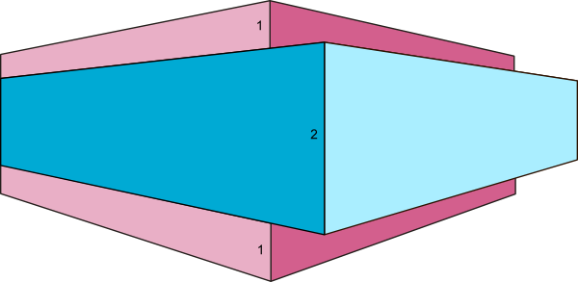
Modern Structure
Paperboard – white or gray board
White laminate surface - matte or gloss
Additional materials for touch-and-feel and accentuated details.
Image: https://www.callawind.com/board-book-printing-basics

Slide 4
Background
Library of Congress phased reopening plan considerations
REALM*
COVID-19 research**
What is the virus lifespan on the surface of specific materials?
How is risk of transmission mitigated?
Sanitization
Distancing
Surface rest time between use
What materials are present within various collections?
What are the concerns about handling of these collections?
*https://www.oclc.org/realm/home.html
**https://blogs.loc.gov/preservation/2021/06/assessing-the-impact-of-sanitizing-products-on-collection-items/
Notes:
REALM (REopening Archives, Libraries, and Museums) project and that LC was on the Scientific and Operations Advisory Group - a research project conducted by OCLC, the Institute of Museum and Library Services, and Battelle to produce and distribute science-based COVID-19 information that can aid local decision making regarding operations of archives, libraries, and museums.
https://www.oclc.org/realm/home.html
Putting the Research question into context
https://blogs.loc.gov/preservation/2021/06/assessing-the-impact-of-sanitizing-products-on-collection-items/
Guardians of memory blog plug

Slide 5
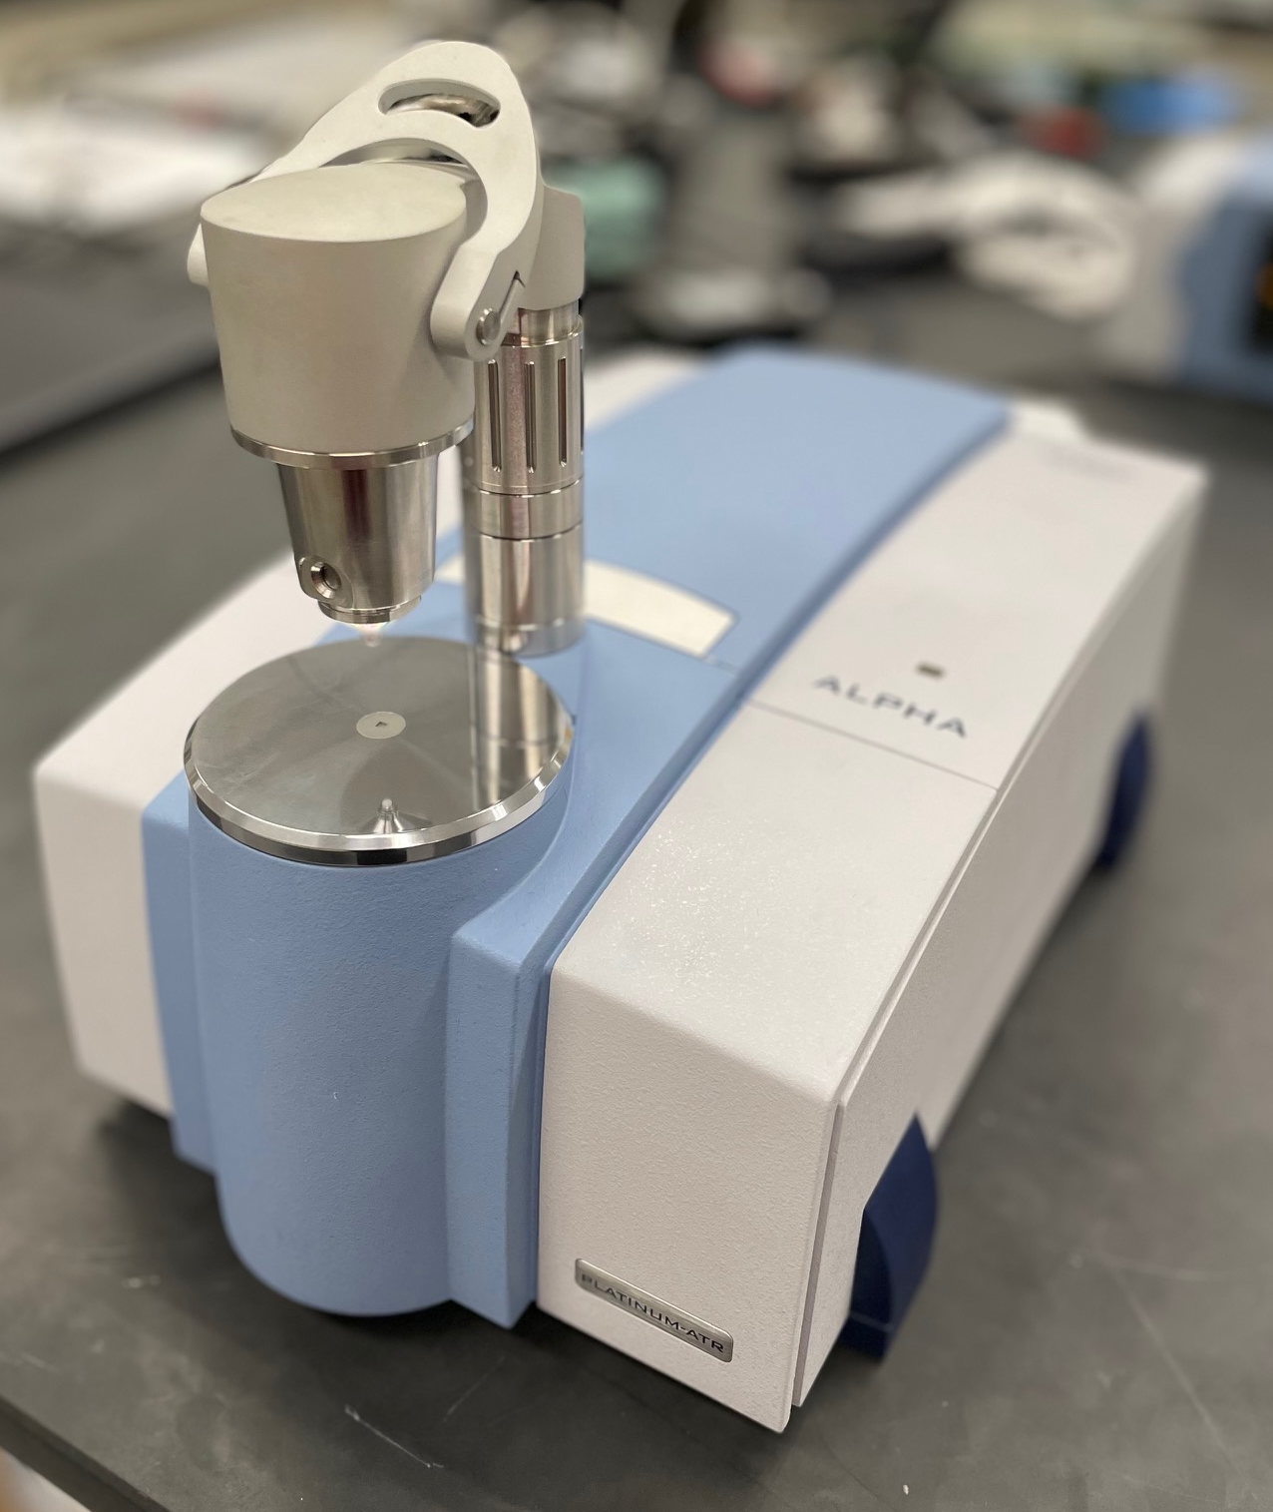
Methodology
Collection material
ER-FTIR
Bruker Alpha Spectrometer
KBR beamsplitter
DLaGTs detector
RockSolidTM Interferometer
64 scans
4 cm-1 resolution
Background for ER-FTIR: Gold reference standard
Reference polymer samples
ATR- and ER-FTIR
Bruker Alpha Spectrometer
KBR beamsplitter
DLaGTs detector
RockSolidTM Interferometer
64 scans
4 cm-1 resolution
ER-FTIR: Gold reference standard
ATR-FTIR: Diamond crystal
Notes:
Fourier-Transform Infrared Spectrometer with an external reflectance (ER-) and and Attenuated Total Reflectance (ATR) module attached. This instrument uses Infrared light to vibrate bonds within a material and provides organic and polymeric composition. This technique is great for differentiating polymers and any additives. Explain in depth differences between ER and ATR and lack of reference databases available online. Discuss scattering.

Slide 6
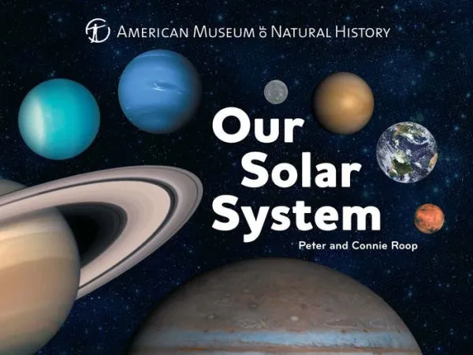
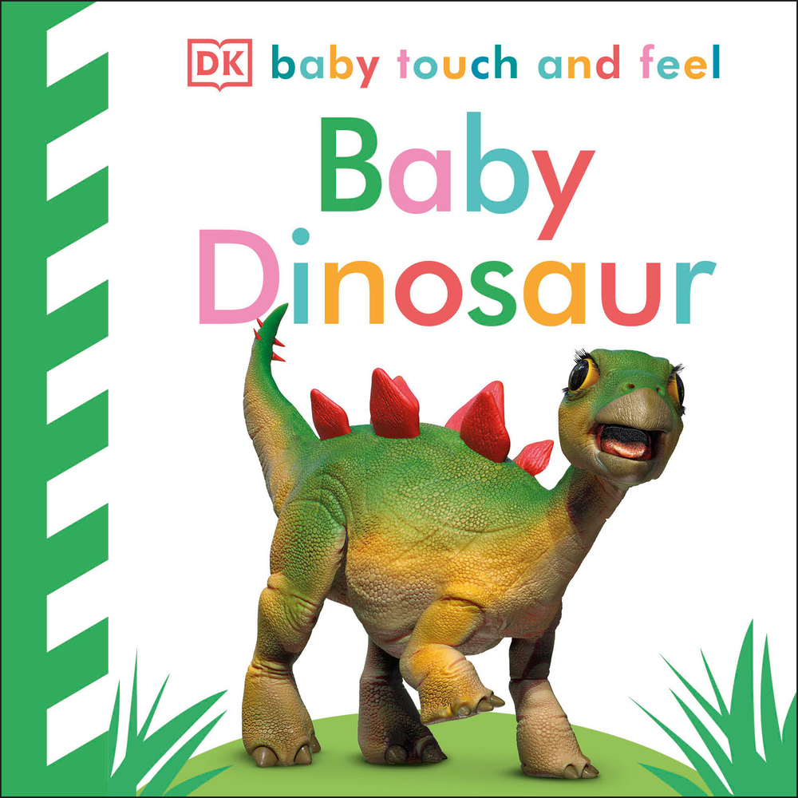
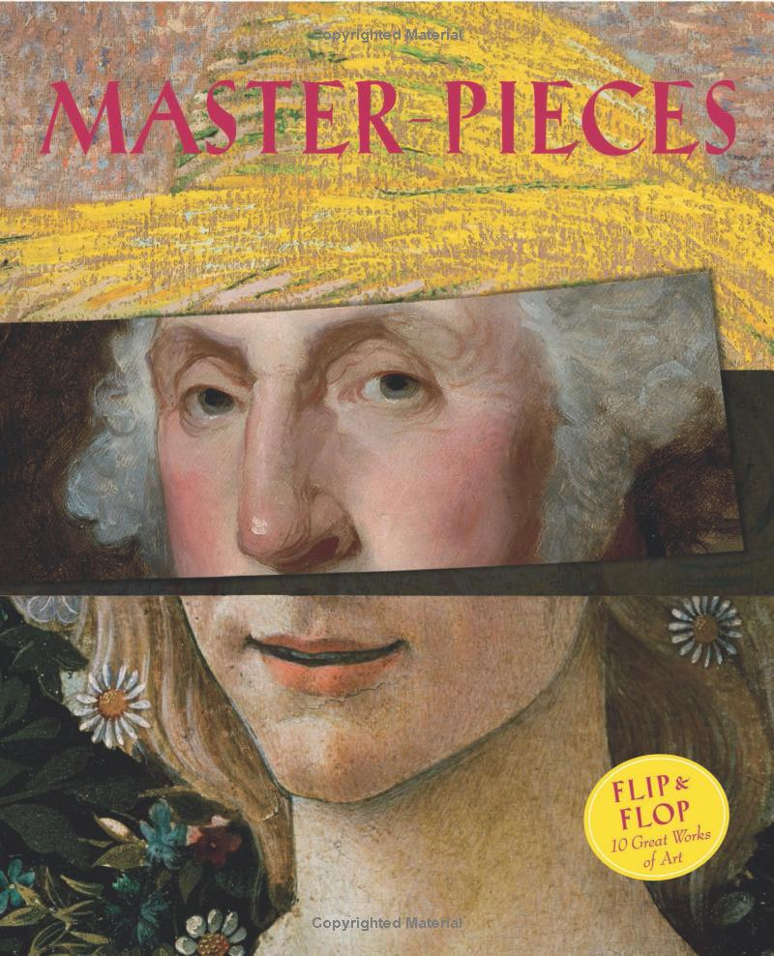
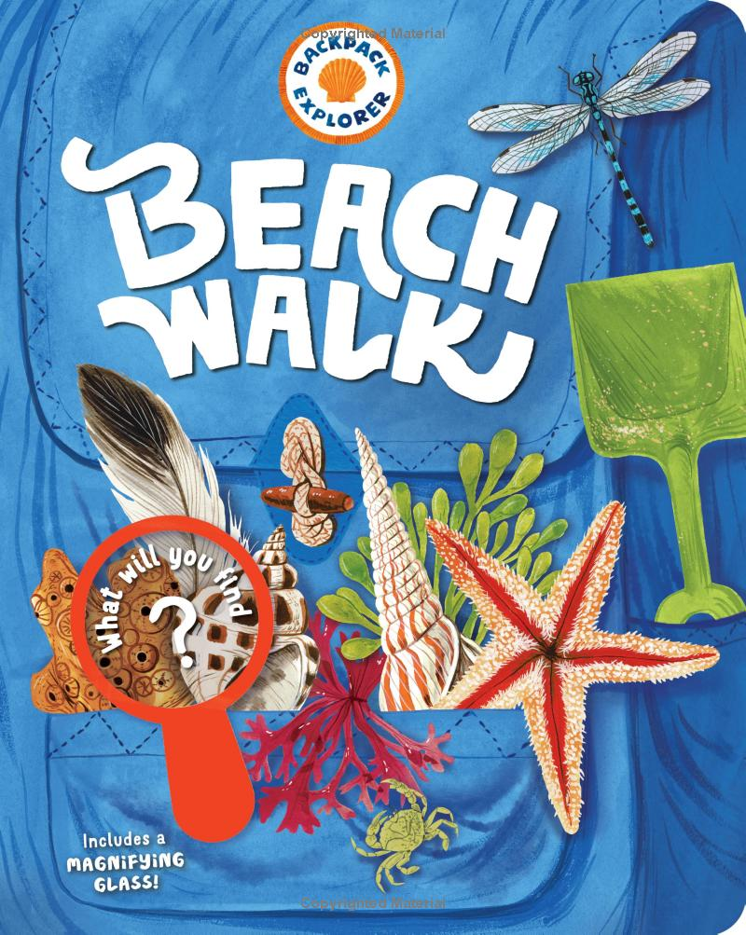
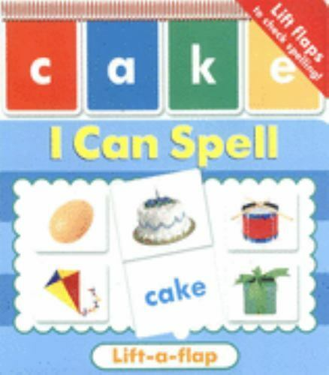
Collection Material
60+2 collection materials with a date range 2002-2019
Notes:
-What kind of books are we looking at
62 books pulled from the General collection were analyzed, dating between 2002-2019. A variety of styles were chosen as well, with touch and feel sections, variation in coating within the same book, Books with flaps, etc.
(60 initially tested as well as two titles that were used for Pandemic related testing, “Big Kid Bed” (BKB) and “Ciao Baby” (CB))

Slide 7
Considerations
COVID
Limited reference information specifically on children’s board books
Limited information on construction and production of board books
Limited sample set
Multiple coating types in one book
External Reflectance FTIR spectral features
Notes:
-Considerations for result interpretations
Preservation of board books extends to their withstanding heavy use, but not necessarily long term storage. They are viewed as a commodity and meant to be replaced when worn out. But with budgetary considerations, that is becoming less possible for many public libraries due to budgetary constraints. As a result, limited imformation on full materiality is not easily found, but has to be extracted from commercial information on board book publisher websites.
As a result of the shutdown, limited samples of polymers were able to be used for comparative purposes. ABS
Acrylic
Polyester
Polystyrene
PVC
HDPE*
Polypropylene
LDPE*
Multiple coatings as well as multiple polymer blends were found within books and book components.
External Reflectance FTIR spectral features contain Restrahlen scattering effects**

Slide 8
Preliminary Results
Plastic Determined | # of Books out of 60 | Percent (%) Presence Determined**
ABS | 12 | 20.0
Acrylic | 36 | 60.0
Polyester | 9 | 15.0
Polyethylene | 5 | 8.3
Polypropylene | 23 | 38.3
Polystyrene | 9 | 15.0
PVC | 1 | 1.7
Notes:
Greater than 100% due to polymer combinations
ABS - Acrylonitrile butadiene styrene, Lego bricks
Acrylic – lenses and acrylic nails
Polyester – clothing blend material/tarp
Polyethylene – food containers/plastic bags
Polypropylene – packaging/living hinge materials(Caps) and medical and laboratory equipment
Polystyrene - styrofoam
PVC - pipes

Slide 9
Plastic Combination Determined | # of Books out of 60 | Percent (%) Presence Determined
Polyester + acrylic | 1 | 1.7
Polypropylene + acrylic | 2 | 3.3
Polypropylene | 5 | 8.3
Acrylic + PVC | 1 | 1.7
Acrylic | 14 | 23.3
Polystyrene + Acrylic | 6 | 10.0
Polyester | 3 | 5.0
Polypropylene + (ABS or Polystyrene) | 6 | 10.0
Acrylic + ABS | 9 | 15.0
Polystyrene | 1 | 1.7
Polypropylene + polystyrene + Acrylic (?) | 3 | 5.0
Polypropylene + polyester + polyethylene | 3 | 5.0
Polyester + ABS | 1 | 1.7
Polypropylene + ABS | 1 | 1.7
Polypropylene + polyethylene (?) | 2 | 3.3
Polypropylene + polyester | 1 | 1.7
ABS | 1 | 1.7
Notes:
It seems that the most common coating polymer is acrylic both alone and in combination with other plastics. The most common combination seemed to be acrylic and ABS, with the addition of polystyrene and polypropylene.

Slide 10
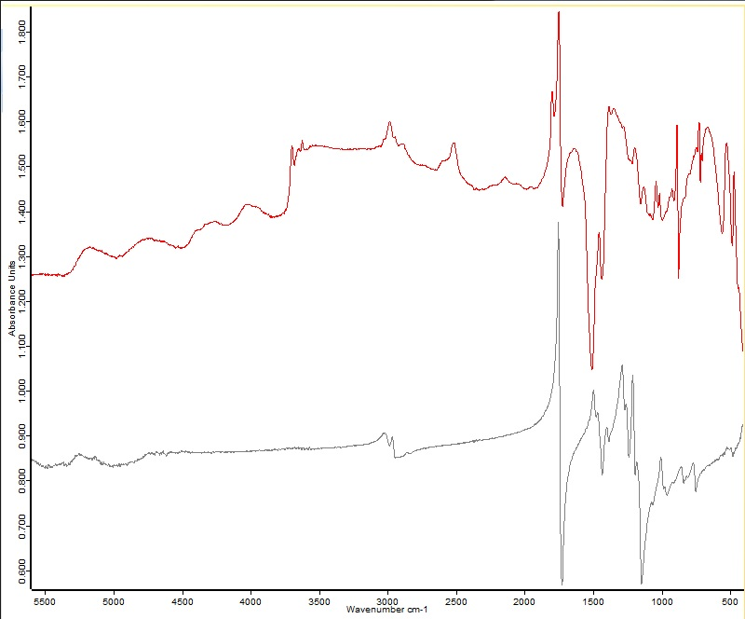
Book QA113.M93585_2015_Copy1 (red) coating was identified as acrylic (reference spectra, grey).
Notes:
Note the spectral features from scattering, but also additional peaks from the paperboard (Kaolinite, cellulose)

Slide 11
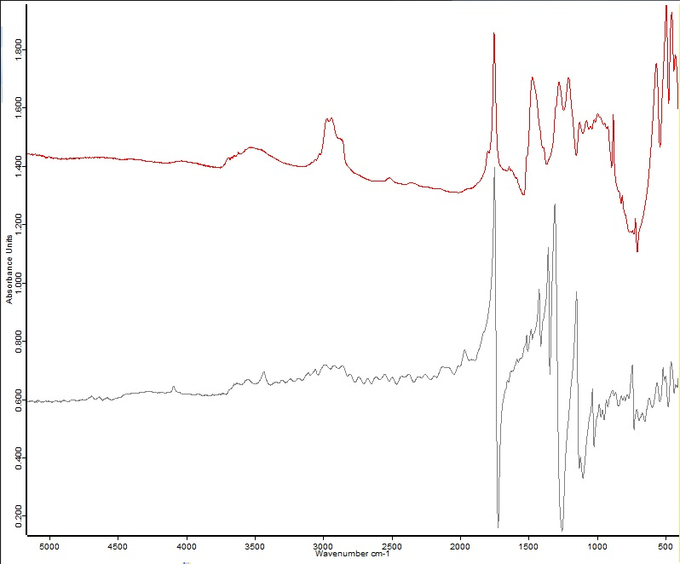
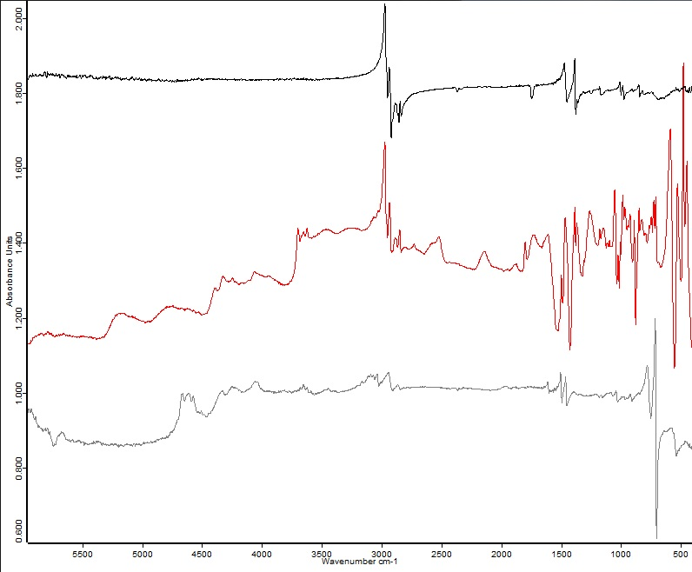
Book QC495.5.S485_Copy 1 (red) coating was identified as polyester (reference polyester coating, grey).
Book QC495.5.C6414545_2012_Copy1 (red) coating was identified as a polypropylene (reference, black) and polystyrene (reference spectra, grey) combination.
Notes:
It seems that the most common coating polymer is acrylic both alone and in combination with other plastics. The most common combination seemed to be acrylic and ABS, with the addition of polystyrene and polypropylene.

Slide 12
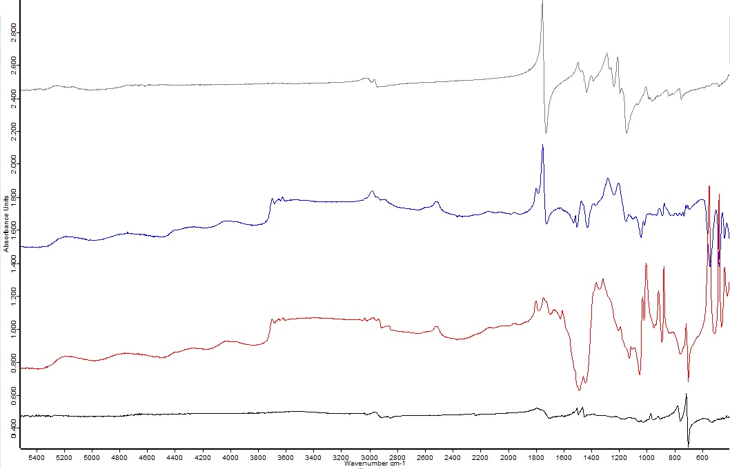
Big Kid Bed
“Big Kid Bed” spectra of the cover (blue) and an internal page (red) with the acrylic (grey) and ABS (black) reference spectra.
Notes:
Review interpretation of spectra Cioa baby we will look at next.

Slide 13
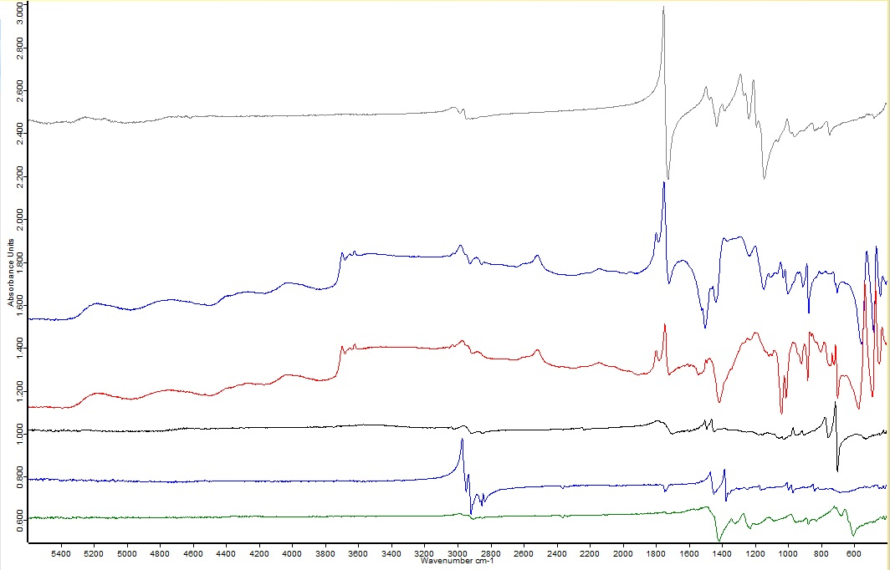
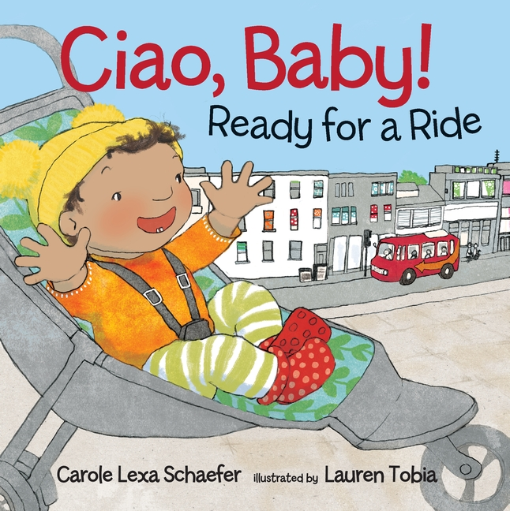
Ciao Baby
“Ciao Baby” spectra of the cover (blue) and an internal page (red) with the acrylic (grey), ABS (black), PVC (green) and Polypropylene (blue) reference spectra.
Notes:
Review interpretation of spectra

Slide 14
Future Research
Comparative study of reference material destructive and non-destructive analysis to confirm non-contact collection item material identification.
Full historical review of the production of children’s board books compared to modern methods and materials.
Notes:
A lot of excitement of under researched books which has led to the desire to complete further, more in-depth research on this subject.
Increase total number of books analyzed
Increase reference material
Expand date range of material
Cross compare and look at book type/material identification/
Aging study component to answer long term preservation concern questions
Complete a full historical review of board books and board book construction from the 20th-21st century.
Add in an aging study to determine most at risk material

Slide 15
Thank You
Special thanks to Dr. Fenella France, Dr. Andrew Forsberg and Carrie Beyers
Email: PRTD@loc.gov if you have any further questions!

