Slide 1
23 June 2018
Demonstrating the Production Value of Linked Data Services
John Chapman (OCLC, Inc)
Xiaoli Li (University of California, Davis)
Linked Library Data Interest Group
ALA Annual Conference 2018
#ALAAC18

Slide 2
Agenda
Why did we pursue this, and who is involved?
What does it do?
Current and next phases
Partner experience
What does this mean for the future?
Notes:
Xiaoli – Feel free to rename/reconfigure your sections

Slide 3
Why?--Efficient, impactful workflows
Today
Searching
Copy cataloging
Original cataloging
Authorities
In the future
Amplified searching
Adding relationships
Entity management
Identity Management, library-sourced vocabularies

Slide 4
Who
American University
Brigham Young University
Cleveland Public Library
Cornell University
Harvard University
Michigan State University
National Library of Medicine
North Carolina State University
Northwestern University
Princeton University
Smithsonian Library
Temple University
University of California, Davis
University of Minnesota
University of New Hampshire
Yale University

Slide 5
WHAT

Slide 6
What
Developed an Entity Ecosystem for:
- Creation and editing of new entities
- Connecting entities to the Web
Built a community of users who can:
- Create/Curate data in the ecosystem
- Imagine/propose workflow uses
- Together, and with OCLC - iteratively improve the prototype
Provided services to:
- Reconcile data
- Explore the data

Slide 7
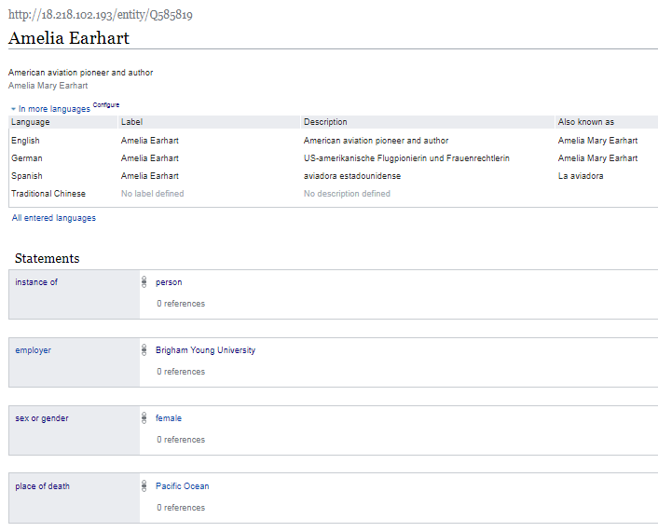
Some New Vocabulary Required

Slide 8
Item URL
Additional labels, descriptions, and aliases, in other languages.
Label
Item Identifier
Description
Aliases
Property
Statement
Rank
Value
Claim

Slide 9
Tools: Manual data entry

Slide 10
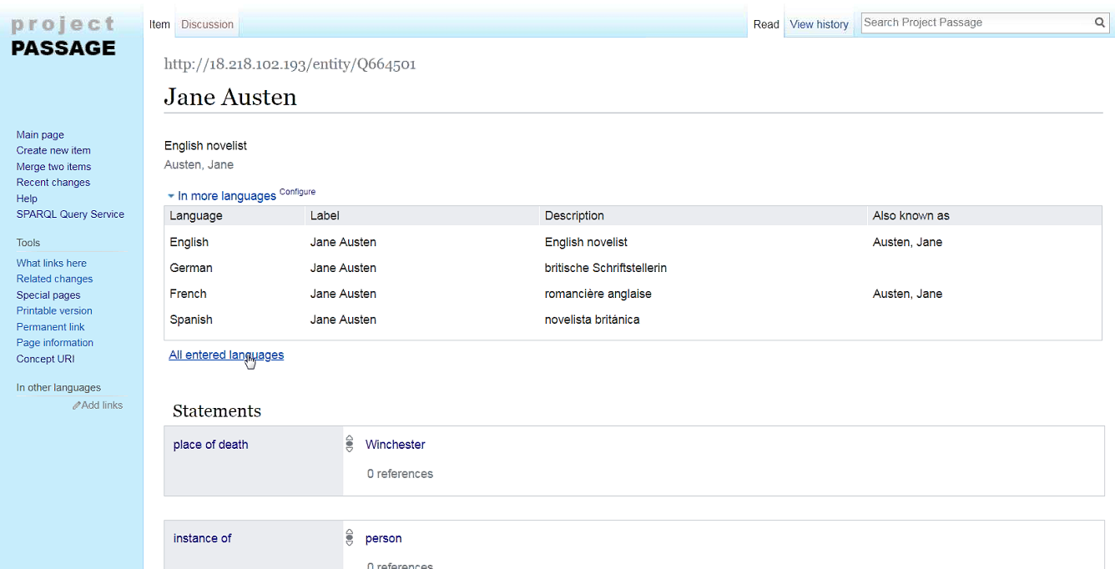

Slide 11
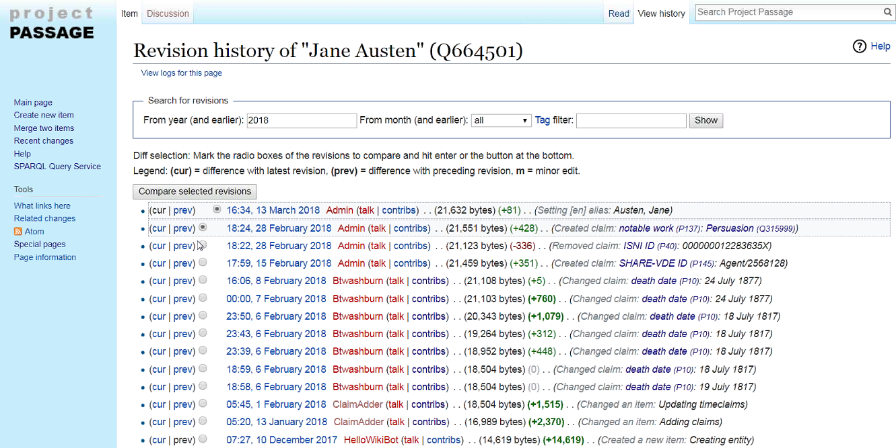

Slide 12
Tools: Explorer
Notes:
From the Query UI, things to demo:
From the examples list select the simple query to search for people
Use the autosuggest to show how to change the query to search for dogs, or cats
Use the autosuggest to show QA uses (people born between 1800 and 1880 that lack a death date)

Slide 13
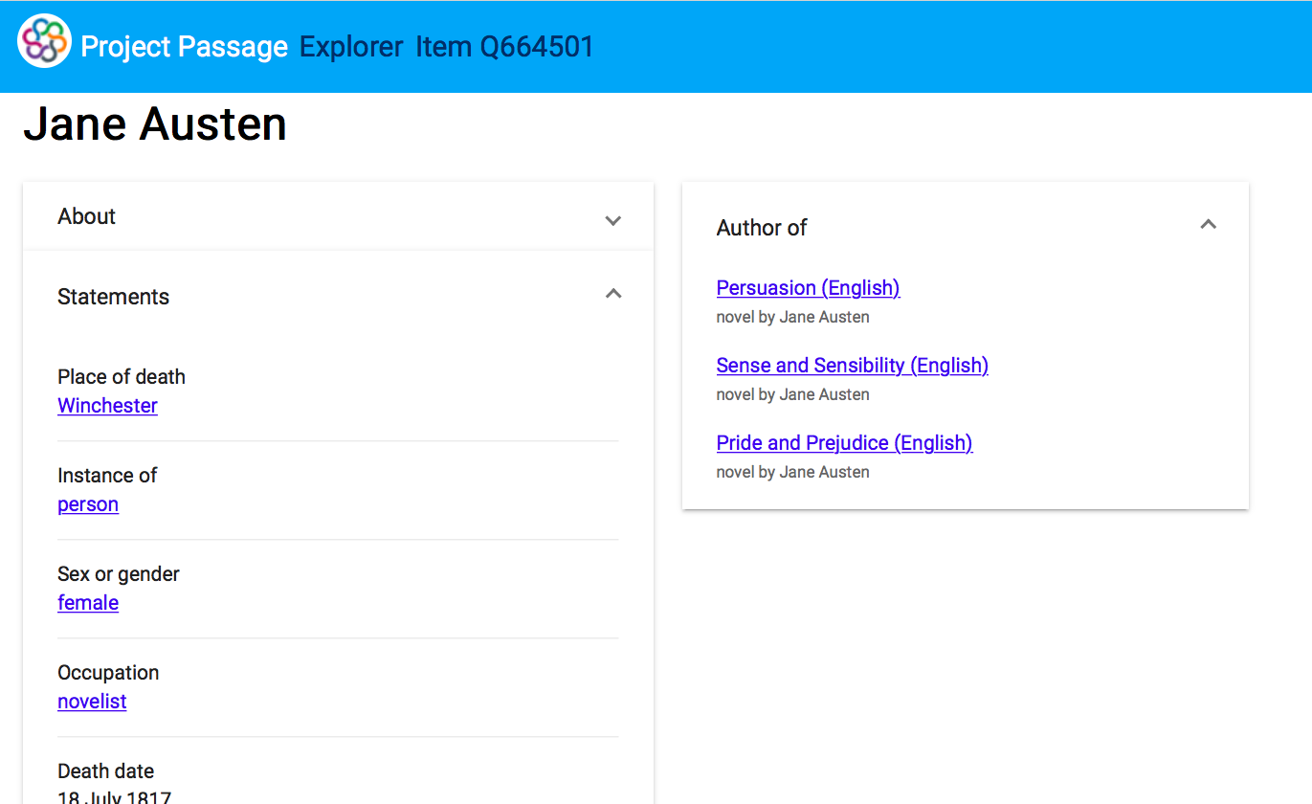
Notes:
From the Query UI, things to demo:
From the examples list select the simple query to search for people
Use the autosuggest to show how to change the query to search for dogs, or cats
Use the autosuggest to show QA uses (people born between 1800 and 1880 that lack a death date)

Slide 14
Challenges encountered | Steps taken / next steps
The Mediawiki-based API was not sufficient for reconciliation | Provided an OpenRefine API for matching by class and properties
The Prototype’s data model for dates is capable but not user friendly | Documented techniques for entering dates, mapping to LC's EDTF patterns
The prototype UI doesn't highlight connections to more information on the web | Prototype a UI that uses Passage data to connect to Dbpedia, Geonames, etc.
Autosuggested links aren't working well for personal names in indirect order | Add more aliases to the Wikibase to improve autosuggest matching, based on headings in VIAF
Need new and different ways to handle creative works, translations, and editions | Provided guidance and examples, beginning with works and translations

Slide 15
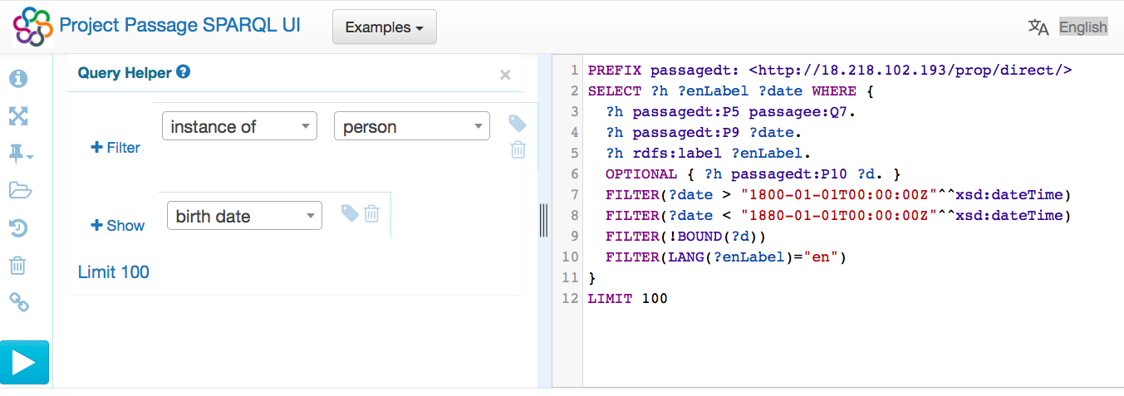
Tools: SPARQL Endpoint
In this example SPARQL query, items describing people born between 1800 and 1880, but without a specified death date, are listed.
Notes:
From the Query UI, things to demo:
From the examples list select the simple query to search for people
Use the autosuggest to show how to change the query to search for dogs, or cats
Use the autosuggest to show QA uses (people born between 1800 and 1880 that lack a death date)

Slide 16
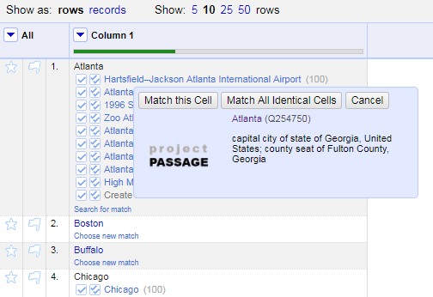
Tools: OpenRefine integration
Notes:
Why OpenRefine? Because it is popular, powerful, and ubiquitous. Though it might not be as commonly used with those managing MARC data? Something for us to learn more about.

Slide 17
PARTNER PARTICIPATION
Notes:
Xiaoli – feel free to rename this

Slide 18
UC Davis’s Experiences
We joined the pilot in November 2017
Four people (three catalogers) are part of the project team
We have participated in the use and evaluation of the editing tool and the user interface

Slide 19
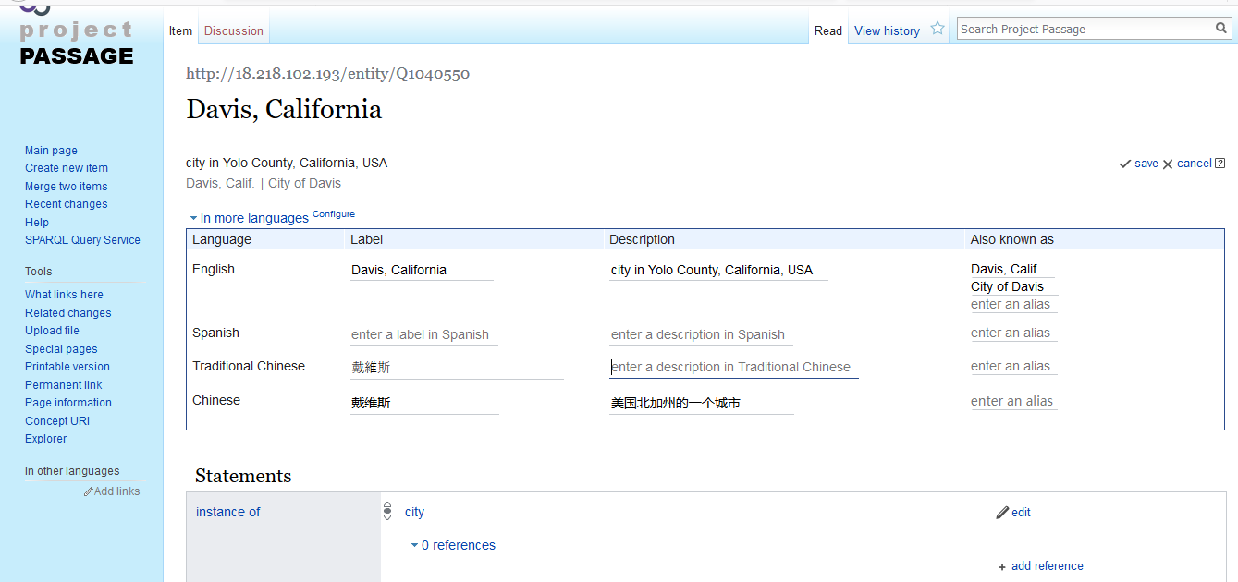
Place Entity

Slide 20
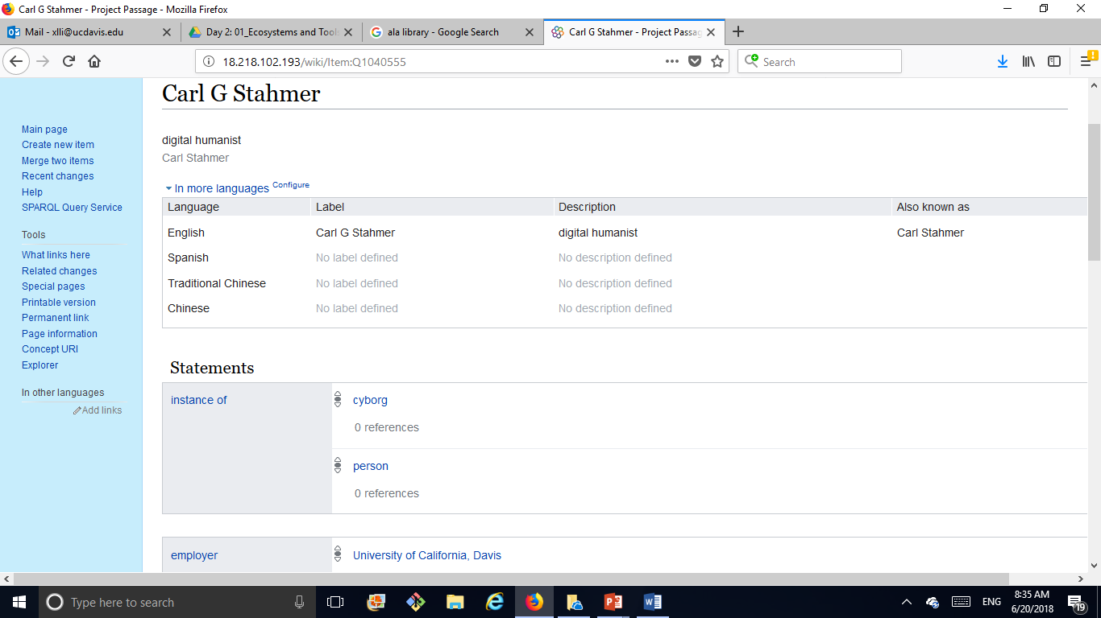
Person Entity

Slide 21
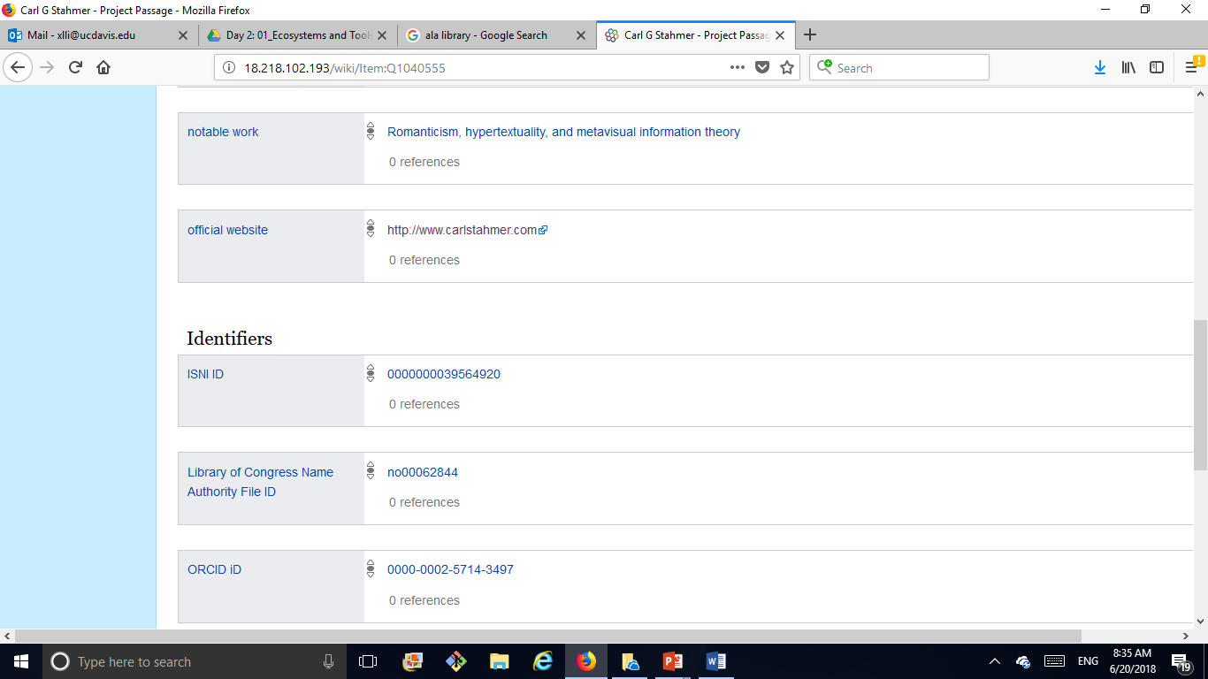

Slide 22
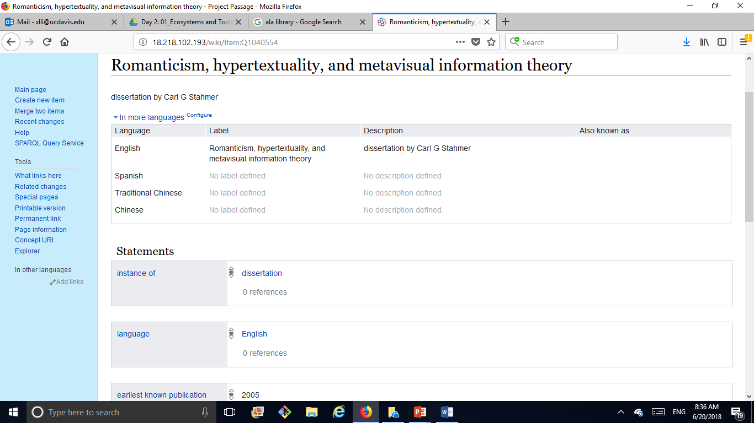
Resource Entity # 1

Slide 23
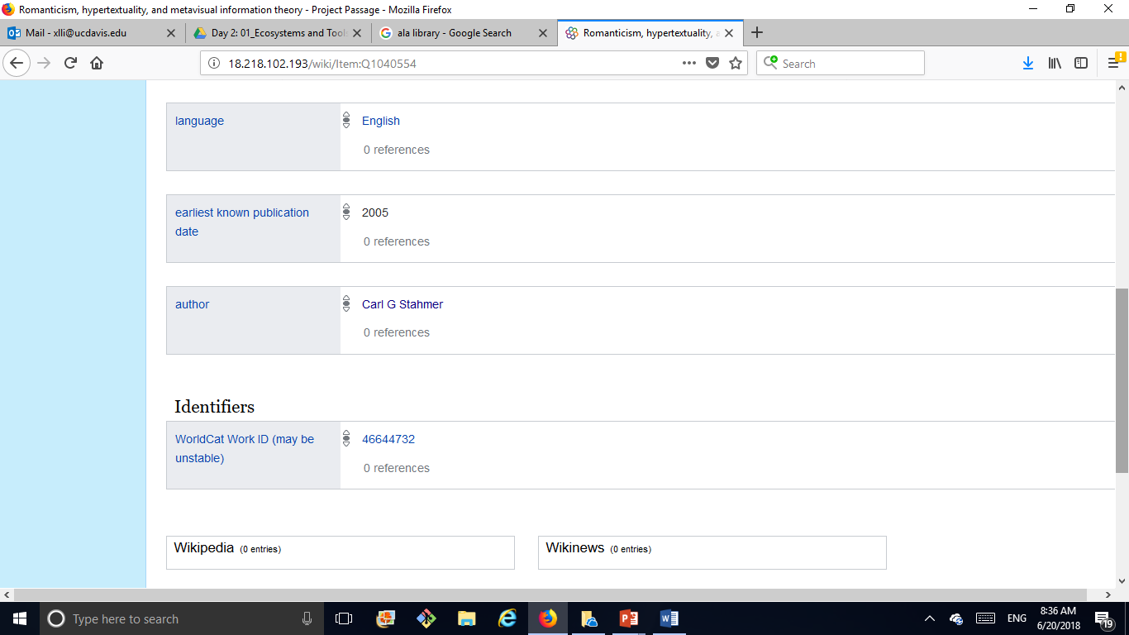

Slide 24
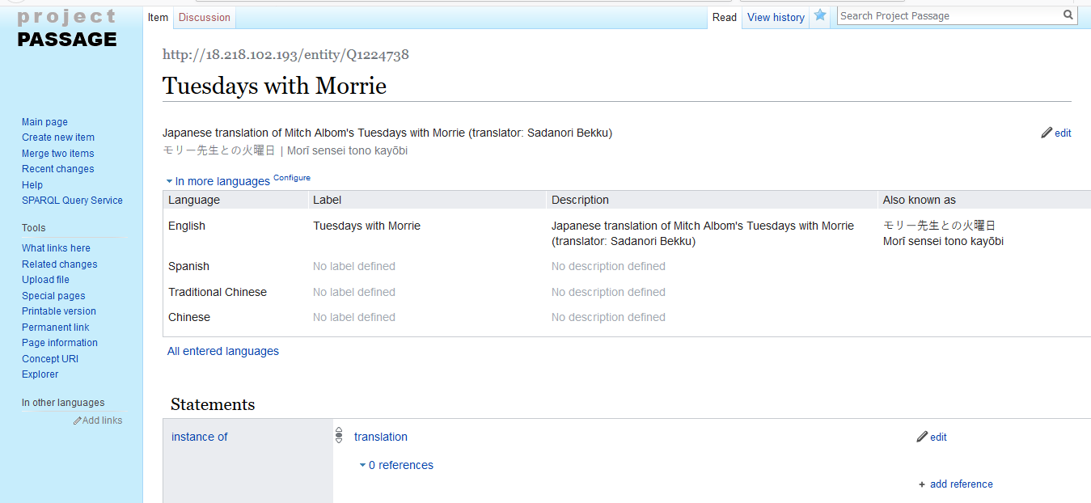
Resource Entity #2

Slide 25
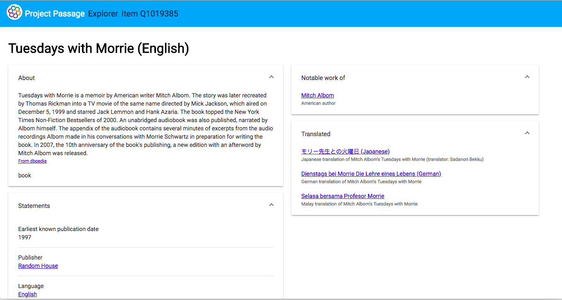
Project Passage Explorer

Slide 26
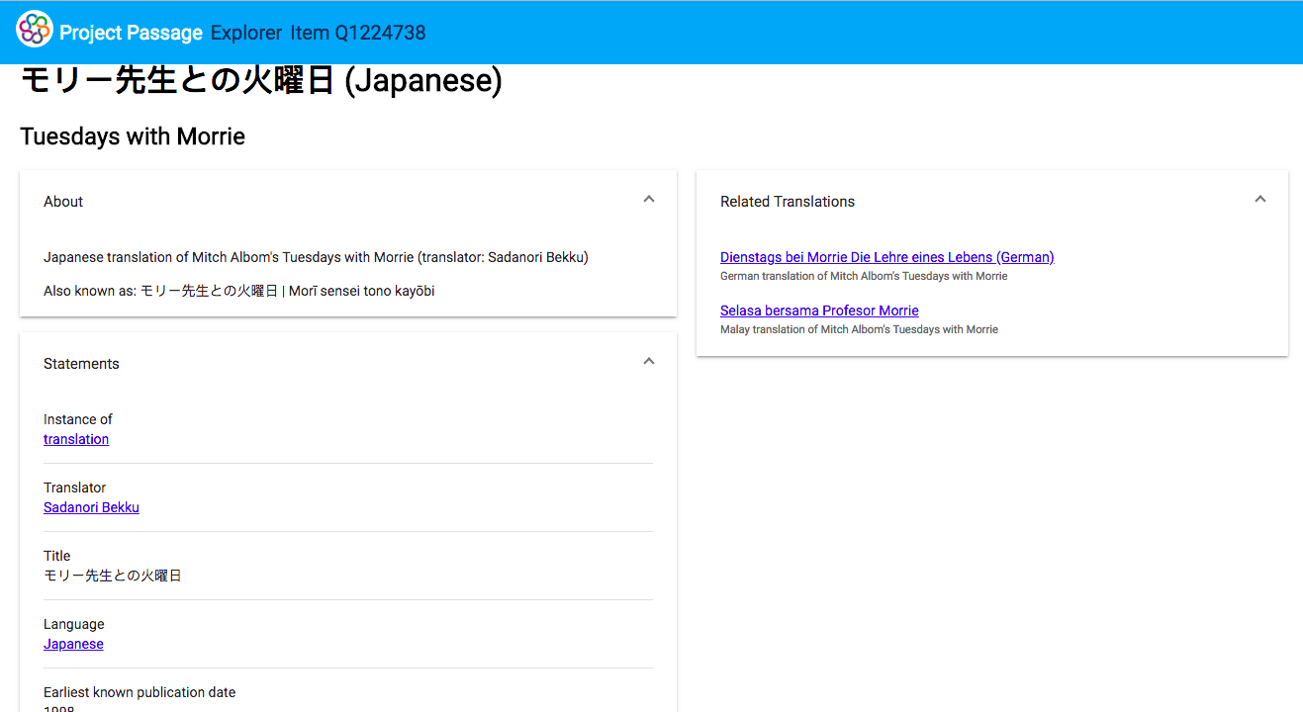

Slide 27
What Does This Mean to US Now?
Sandbox
Community
We can create linked data without the need to know about URIs, triples, etc.
Wait, how much information should we provide for an entity? What is the correct predicate to use? Is there any structure or rule?

Slide 28
What Does This Mean in the Future?

Slide 29
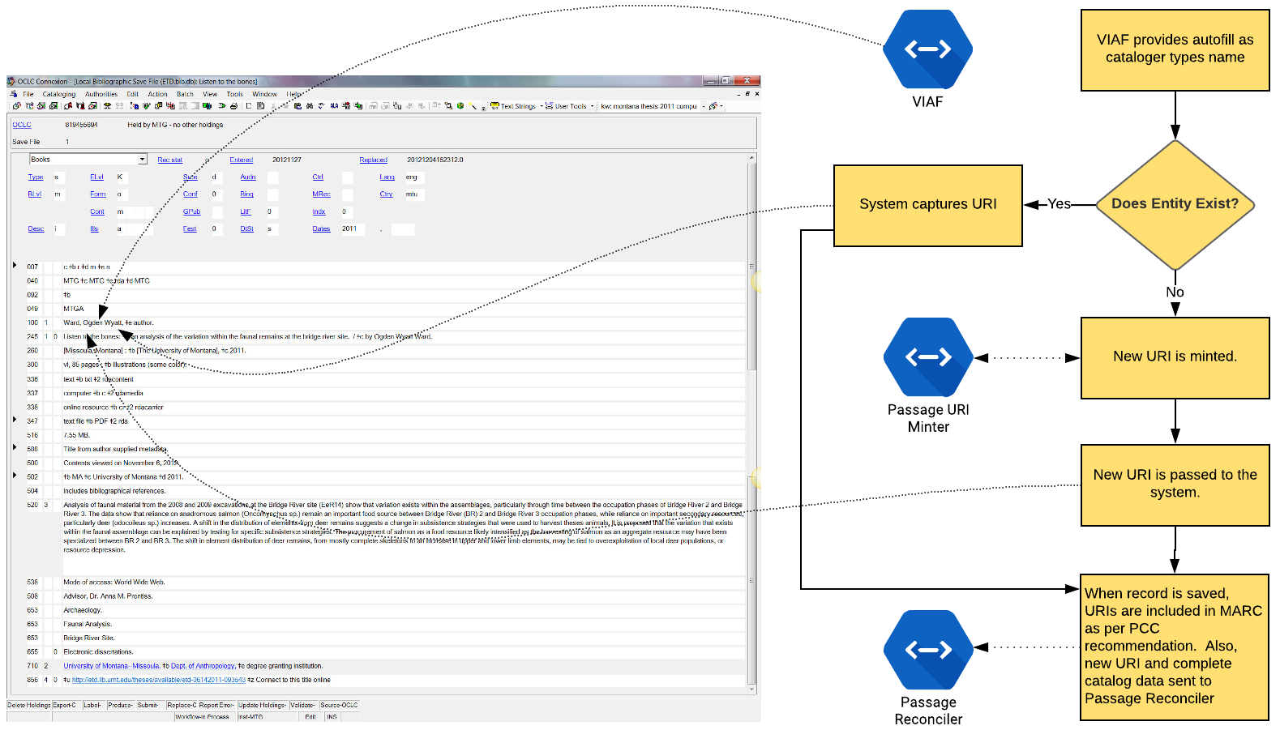
Cataloging Use Case
Stahmer, Carl G. “UC Davis Linked Data Implementation.” May 2, 2018. PowerPoint Presentation.

Slide 30
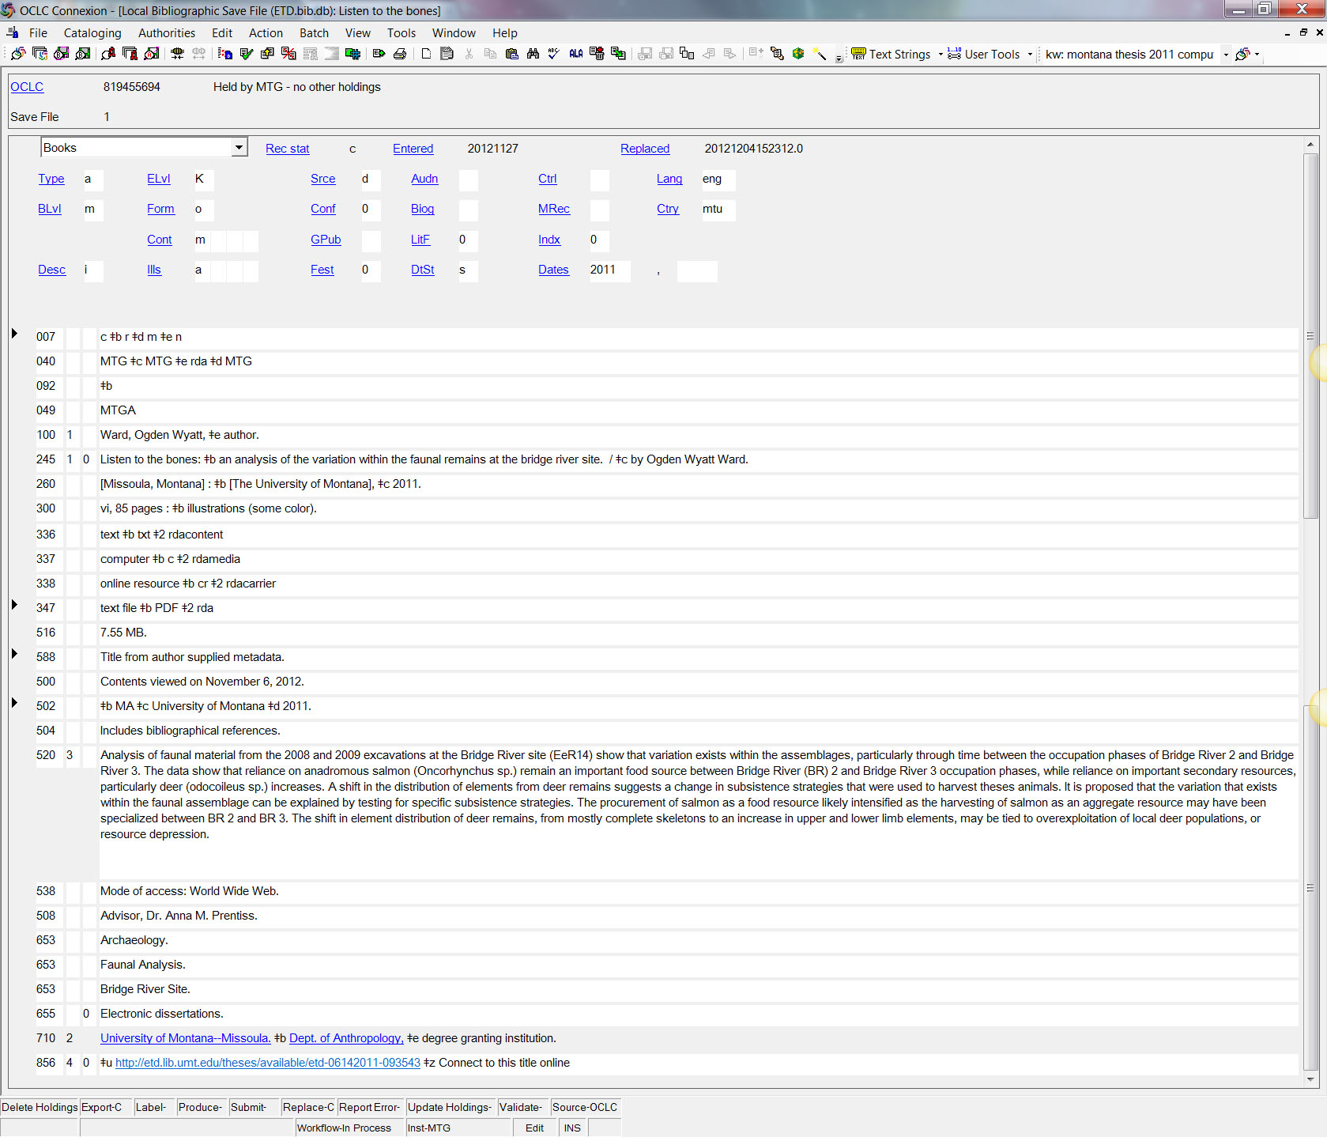
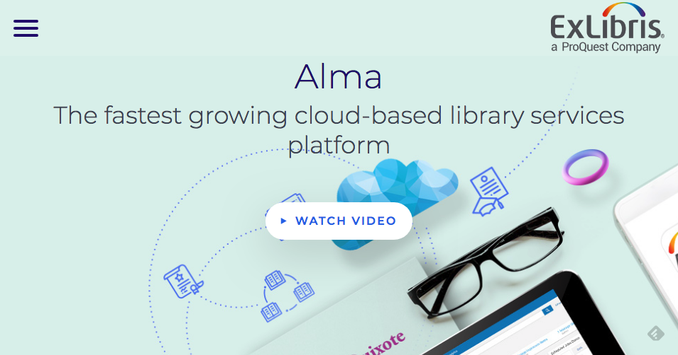
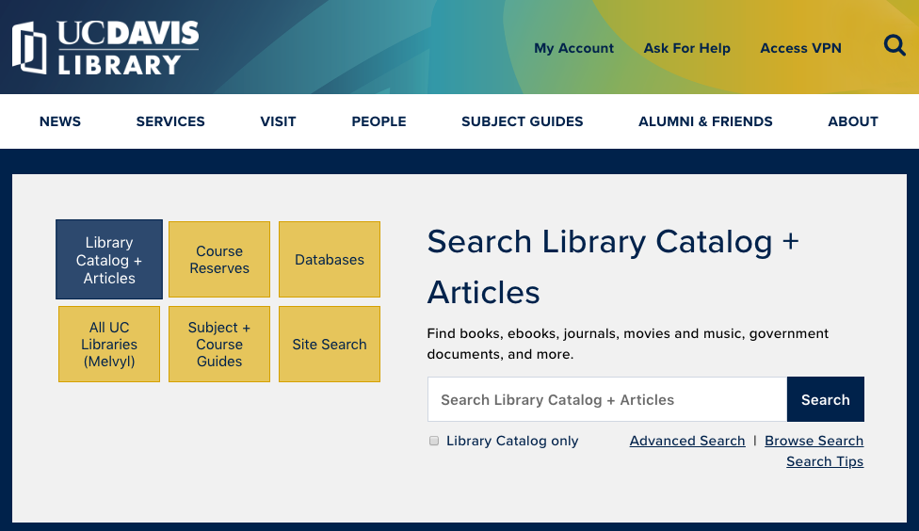
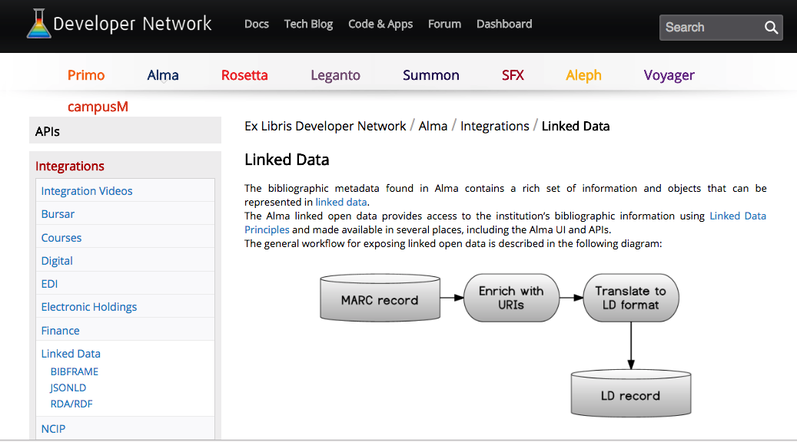
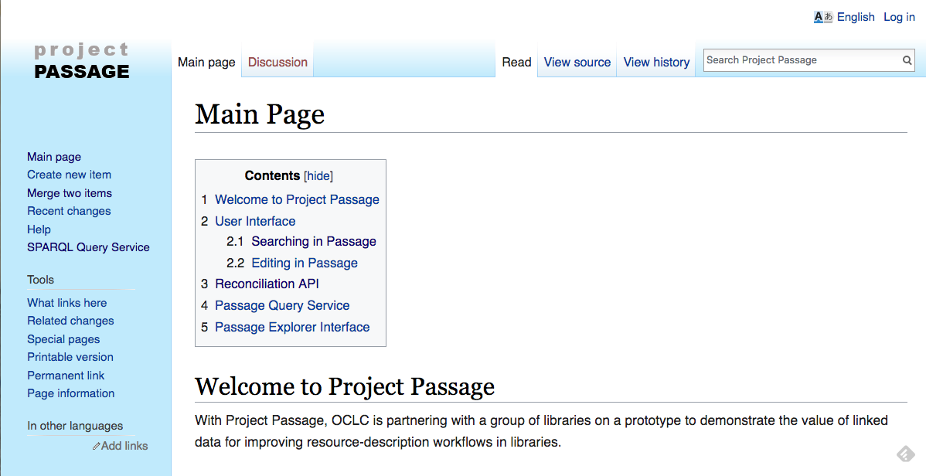
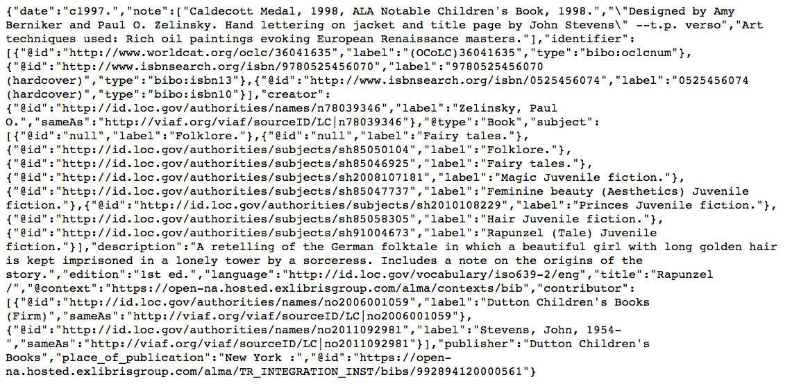
Discovery Use Case
Connexion MARC to ALMA
Stahmer, Carl G. “UC Davis Linked Data Implementation.” May 2, 2018. PowerPoint Presentation.

