Slide 1
Libraries Supporting Graduate Students on Alternative Career Paths: How & Why
Barbara Rochen Renner and Lee Richardson
Health Sciences Library
ACRL Academic Library Services for Graduate Students Interest Group
American Library Association Annual Meeting
June 22, 2019

Slide 2
Alternative Academic Careers
The first use of the term Altac (or Alt-ac):
2009 Twitter conversation between Bethany Nowviskie and Jason Rhody,
used “ ‘alt-ac’ as a shorthand for alternative academic”¹
In Nowviskie’s words:
a pointed push-back against the predominant phrase, 'nonacademic careers.' 'Non-academic' was the label for anything off the straight and narrow path to tenure — even if that position were, say, in an academic library, a writing center, a university-affiliated research group or cultural heritage organization. I felt it diminished humanities scholars who continued to use their skills in and around the academy, and I was concerned that it discouraged grad students from contemplating new paths. ²
¹https://jitp.commons.gc.cuny.edu/the-marriage-of-the-digital-humanities-and-alt-ac-positions/
²http://nowviskie.org/2010/alt-ac/

Slide 3
Why PhDs Might Pursue an Altac or Non-academic Career
Fewer tenure-track positions/more contingent faculty positions
But, contingent faculty positions generally have
Low pay
No stability
No benefits
Opportunities to utilize skills in other areas of academia, industry and other disciplines
Resources with supporting statistics on last slide
Notes:
Higher education is using less tenure and tenure-track faculty and using more contingent positions. There is also a low number of full-time non-tenure positions which means fewer job with good benefits and pay. Most of the laborforce is part-time. There are more graduates than tenure-track positions. That is true for all disciplines, although there is a lot of variation across the disciplines.

Slide 4
Taboo
Students may be afraid to share that they don’t want to work in academia
“If a rotation student comes in saying they want to be a science writer, they’re not staying [in my research group].”¹ – Senior faculty member
Professors want to clone themselves
“It’s my JOB to create more people like me.”¹ – Senior faculty member
¹https://chroniclevitae.com/news/598-the-conferencegoer-what-some-faculty-really-think-about-nonacademic-careers
Notes:
Some students are afraid to tell their advisor, supervisor or others that they don’t want to work in academia when they graduate. While there are understanding, supportive faculty and mentors, it’s also true that some faculty feel they are wasting their time with a student who won’t be just like them.

Slide 5
Why Should Libraries Care?
Phenomenon happening on all campuses, across most disciplines
Began in Humanities, initially most acute in Humanities & Social Sciences, now a significant issue in STEM
Altacs can be found in libraries. Some of the first altac positions were bibliographers
Can contribute to the conversations and the work of campus groups
Can learn more about where altacs work on campuses and what their information support needs are
Students and graduates need resources to help them explore career options
Library is a ‘safe’ place to explore resources
Some students are afraid to tell their advisor they don’t want to work in academia
Notes:
Our focus has been on institutions in the United States. But this phenomenon is happening on all campuses all over the world. Some librarians are altacs. Because of that, we can participate in these conversations as ‘one of them.’ Because students may not want to talk openly about considering non-academic careers, they need a safe, private way to access information to learn more about the issues and explore their options. The library can be a neutral place for this.

Slide 6
Altac at UNC
Formal work began at UNC in 2010.
In 2013, with UNC Institute for the Arts and Humanities funding, Altac Working Group organized to discuss career opportunities for altacs.
Invited librarian and altac, Barbara Renner, to be part of the group.
Librarians have a promotion and reappointment process similar to tenure.
Group operated from 2013 to 2016, dissolving when most group leaders left UNC, although some work continued through 2017.
http://altac.web.unc.edu/
Notes:
Our formal work began in 2010, when Donna and Anne developed a proposal for the 2011 Academic Plan Steering Committee (about which we also wrote in a 2010 column in the Chronicle of Higher Education) calling for the development of policies and systems to more effectively leverage the contributions of altac administrator-scholars such as ourselves. The URL on this slide is for the altac group website. It is no longer being maintained but still has useful information.
Most altacs are in positions where there’s not a career path with ranks in the way faculty have.

Slide 7
UNC Altac Group:
Met with campus leaders, administrators, and Board of Trustees over two years to receive and share information, including contributions of altacs, and raise visibility of altac issues.
Included Head of Library HR to learn more about professional librarian ranks and appointment and promotion procedures.
Identified and surveyed ~140 UNC altacs on workplace experiences, scholarship, teaching, and other professional work.
Documented scholarly and professional service work by members of the Altac Working Group.
Built inventory of ~100 campus professional development/support resources to assess availability to altacs and to work for inclusion of altacs.
http://altac.web.unc.edu/
Notes:
For the survey, of the 140 altacs, 60% were women. The survey had a 78% response rate.

Slide 8
UNC Altac Group, continued
Helped create The Richard Bland Fellowship Professional Pathways Program supporting doctoral student exploration of non-faculty career paths
$5000 mentored summer internship
Begun 2015 and continuing today
Hosted social/networking/public forum event for all campus altacs plus selected campus leaders, administrators and Board members
Created a credit scholarly seminar (Altacs in Academe) 2014-2017
Published about the group’s work
http://altac.web.unc.edu/
Notes:
The scholarly seminar was part of Carolina Seminars, scholarly discussions on a variety of topics. Members of the group published in campus resources, in the Chronicle of Higher Education and other national publications.

Slide 9
Library Guide
Created for just-in-time need
Unveiled at 2-day campus-wide altac event
Local target audience (UNC altacs) involved in development
Audience both local (UNC) and beyond
Feedback: include jobs boards!
Challenges:
Updating (now; when national conversation was exploding ~ 2013-2015)
Findability: Where to locate on libraries’ website(s) and how to publicize
Non-UNC: instructions for licensed resources
https://guides.lib.unc.edu/altac
Notes:
Altacs provided input on what should be in the library guide at regular altac group meetings. A library science graduate student worked with Barbara Renner to create the guide. He presented the guide at the 2-day campus event and gathered more feedback at this event. Some resources were actually added to the guide at the event.

Slide 10
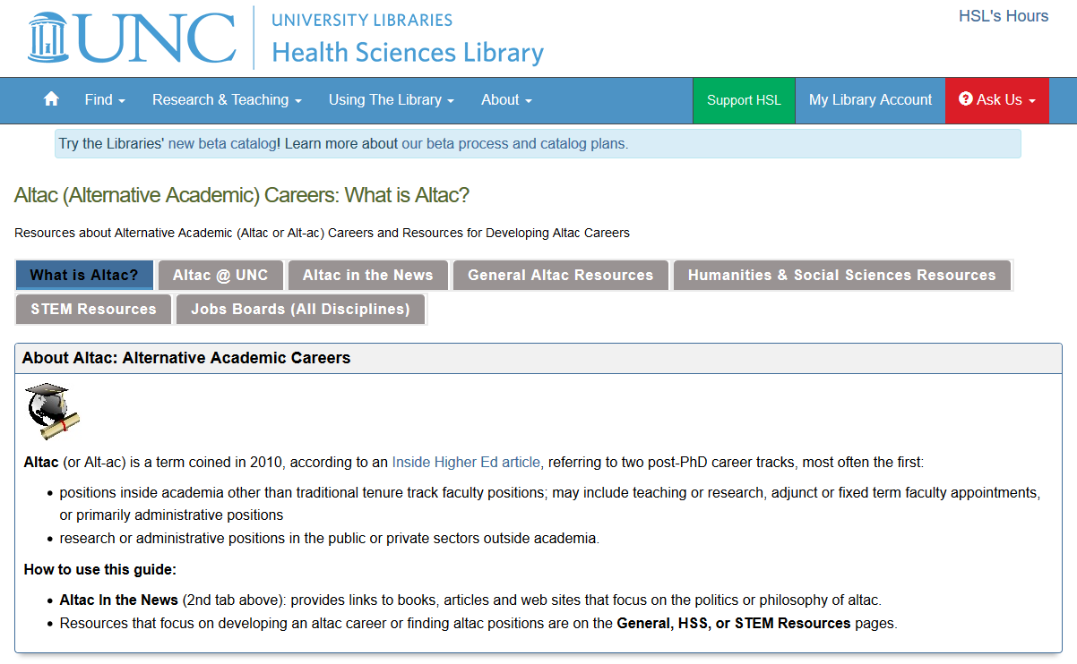
Notes:
Brings together resources
National conversation and campus conversation
Resources to help students understand issues and what to consider when pursuing various career options

Slide 11
Thank you! Questions!
Barbara Rochen Renner, PhD
Library Services Evaluation Specialist and Liaison, Allied Health Sciences brrenner@email.unc.edu
Lee Richardson, MLIS
Information Discovery and Metadata Librarian
richarlm@email.unc.edu
https://guides.lib.unc.edu/altac

Slide 12
Why Pursue a Non-Academic Career: Statistics
American Association of University Professors
Annual Report on the Economic Status of the Profession
https://www.aaup.org/report/annual-report-economic-status-profession-2018-19
National Science Foundation
Survey of Earned Doctorates
https://www.nsf.gov/statistics/srvydoctorates/
Integrated Postsecondary Education Data System
Use the Data
https://nces.ed.gov/ipeds/use-the-data
U.S. Government Accountability Office
Contingent Workforce
https://www.gao.gov/products/GAO-18-49/
Supporting statistics for Slide 3

