Slide 1
Authority Maintenance for Finding Aids
Authority Control Interest Group
February 16, 2021
Miloche Kottman | mkottman@ku.edu | University of Kansas Libraries

Slide 2
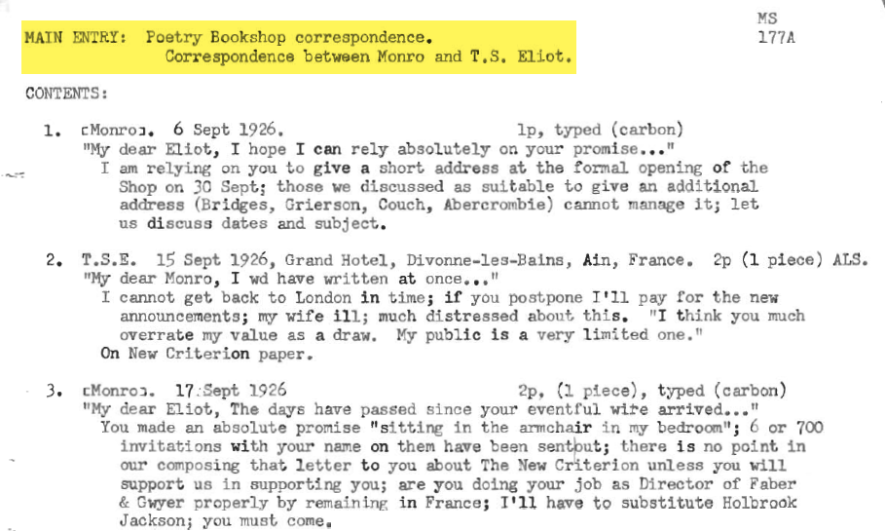
Brief history of finding aids at KU
Paper – typed on typewriter
Paper – typed on word processor
Scanned paper into MS Word
Converted to EAD
Notes:
For those that are unfamiliar with finding aids: Finding aids are documents created by archivists to aid researchers in navigating an archival collection. They usually consist of an inventory and description of the materials in the collection. In additional, at minimum, the source and/or creator of the collection is included as a “heading” in the record. A fuller description will include additional headings to bring out prominent, name, place, and subject headings.
Like most archives, the University of Kansas started with paper finding aids. Here’s an example of one that was obviously typed on a typewriter when you used the letter “L” as the number “1”.

Slide 3
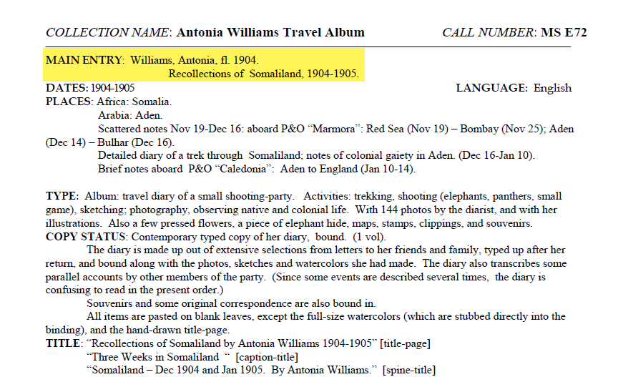
Brief history of finding aids at KU
Paper – typed on typewriter
Paper – typed on word processor
Scanned paper into MS Word
Converted to EAD
Notes:
This is an example of one that was probably done on an early word processor. Any authority maintenance performed on these type of records would require re-typing the document and/or putting up with white-out.

Slide 4
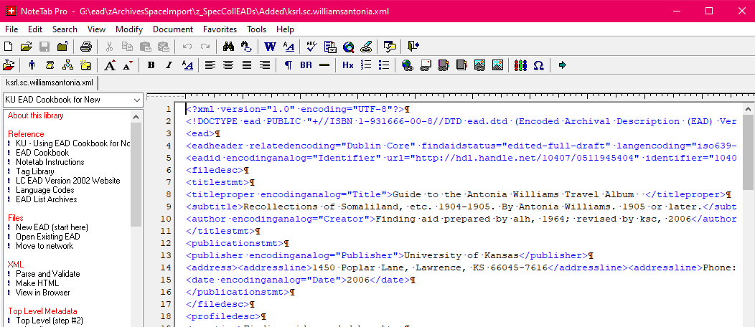
Brief history of finding aids at KU
Paper – typed on typewriter
Paper – typed on word processor
Scanned paper into MS Word
Converted to EAD
Notes:
In late 2004, we were finally at a point where we could put our finding aids online. To do this we scanned our over 2,500 paper finding aids and converted the scans to MS Word documents. We used the information in these documents to have students copy/paste information into an Encoded Archival Description template using NoteTab Pro. Authority maintenance could more easily be done on a record-by-record basis in this system but there wasn’t an easy way to find and fix multiple records using the same headings in an efficient manner.
So, really no authority maintenance was done on our finding aids and the scanning project introduced even more issues to our data due to poor OCR scans, lack of standardization, students pasting information in the wrong fields/tags or not pasting information at all, etc.

Slide 5
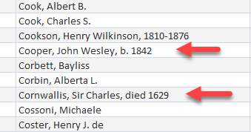
Scope of authority maintenance issues
Out of date LC headings
Never set up correctly in the first place headings
Mis-tags, e.g. coded as a 110 but it’s a personal name
Duplicates
Notes:
We implemented ArchivesSpace in 2014 and though we started working on database cleanup projects as soon as we completed importing all of our finding aids, which by then was over 3,500 records, prior to the pandemic, we had not got around to working on the agent records which are really just personal, corporate and conference name heading records.
So, how bad was our authority heading problem? There were plenty of out of date LC headings, e.g. b. instead of a dash like in the Cooper heading. Or headings that were not set up correctly in the first place, for example the “sir” and “died” in the heading for Cornwallis.

Slide 6
Scope of authority maintenance issues
Out of date LC headings
Never set up correctly in the first place headings
Mis-tags, e.g. coded as a 110 but it’s a personal name
Duplicates
Notes:
Due to how the students entered the information in the EAD record, there were several mis-taggings introduced.

Slide 7
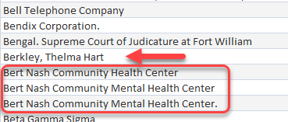
Scope of authority maintenance issues
Out of date LC headings
Never set up correctly in the first place headings
Mis-tags, e.g. coded as a 110 but it’s a personal name
Duplicates
Notes:
For example the heading for Thelma Berkley was coded as a corporate body. There were also a lot of duplicates added to ArchivesSpace when we imported our records due to headings being entered incorrectly and because in the early days of ArchivesSpace, the program itself wasn’t able to catch duplicates. ArchivesSpace has since fixed this issue.

Slide 8
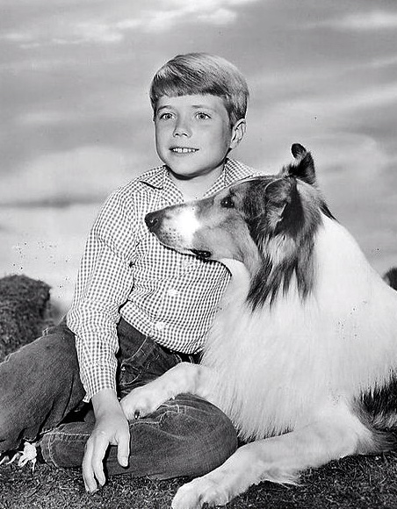
ArchivesSpace to the rescue
Web-based so could use personal computers
Catalogers already trained to do authority work
Staff just needed training in ArchivesSpace terminology and how to use the system
Queries were run via ODBC connection to ArchivesSpace to get reports of corporate and name headings
Notes:
When it looked like a shelter-in-place order was likely to be issued, cleaning up authority headings in ArchivesSpace was one of the first projects we thought of for our catalogers.
This was a perfect project for some of our non-manuscript processors:
Since ArchivesSpace is web-based program, staff were able to work on the project from their personal computers
Our catalogers know how to establish authority headings using RDA guidelines and are used to identifying and resolving conflicts between the NAF and our local authority file
Staff just needed some training and documentation in how to use ArchivesSpace and a mapping of terms they were familiar with to what it was called in ArchivesSpace.
So, prior to being sent home, I was able to run queries in MS Access via an ODBC connection with ArchivesSpace similar to how we run queries against our Voyager database to get reports of all the corporate and name headings in ArchivesSpace and a train a couple staff members the mechanics of adding, editing and merging headings in ArchivesSpace.

Slide 9
Authority control in ArchivesSpace
Notes:
So what are the maintenance capabilities of ArchivesSpace?
Every heading used in a resource record (consider it as a hyped up bib record) must have an agent or subject record (except for free-floating subdivisions used after name headings, but that’s a different discussion). In the staff module, the agent and subject records can be retrieved just by clicking on them in the resource record. So, clicking on the George Docking heading opens this agent record

Slide 10
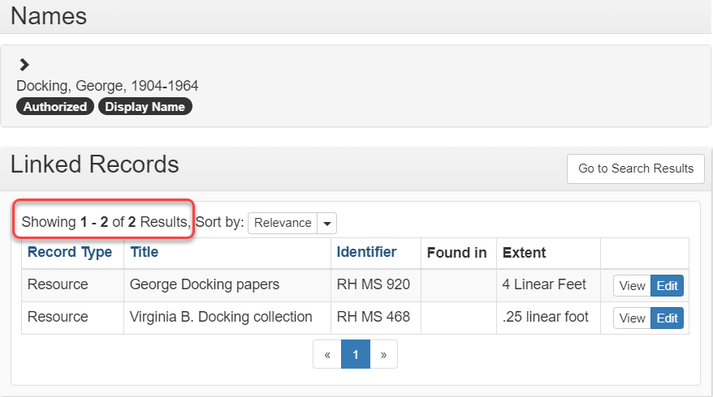
Authority control in ArchivesSpace
Notes:
So, clicking on the George Docking heading opens this agent record which not only shows the name heading and cross references if they exist, but also shows all the other records in the database that are using the heading.

Slide 11
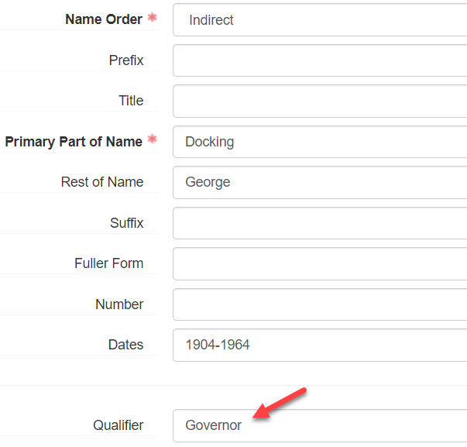
Insta-Update!
Notes:
Editing an agent or subject record will automatically update all the “linked” resource records. For example, if I add the qualifier Governor to the George Docking agent record

Slide 12
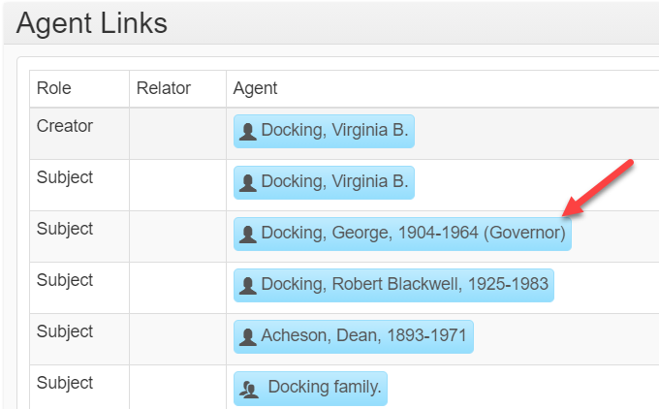
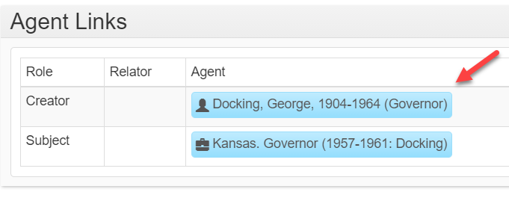
Insta-Update!
Notes:
it adds the qualifier to the name displayed in both of the linked records.

Slide 13
Creating a record
Notes:
Creating records in ArchivesSapce is pretty intuitive if you are familiar with creating authority records. You can create one from scratch by filling in the appropriate boxes

Slide 14
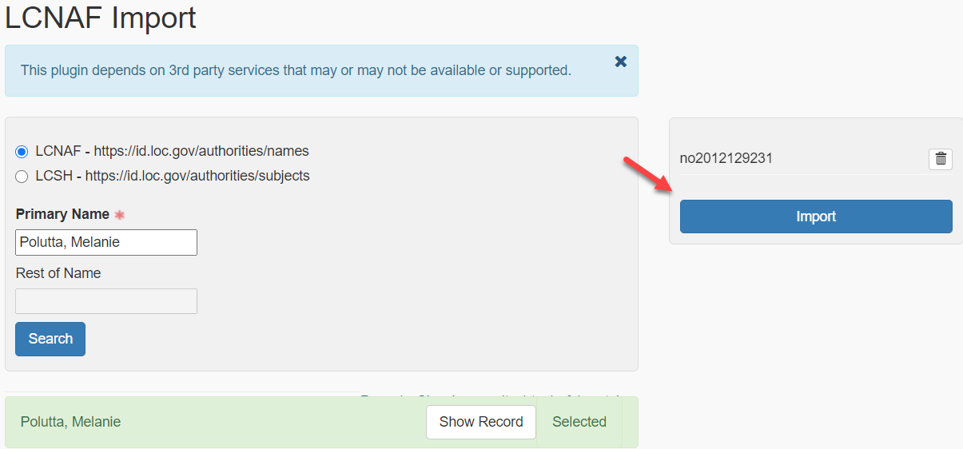
Creating a record
Notes:
or, there is a plug-in that allows you to import LCNAF or LCSH records from ID.LOC.GOV.

Slide 15
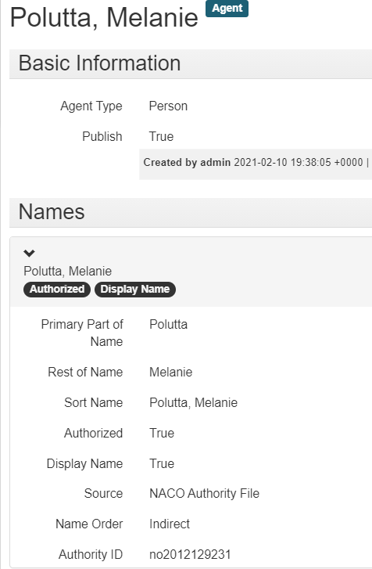
Creating a record
Notes:
This is what the record looks like after importing.

Slide 16
Merge records
Notes:
ArchivesSpace’s merge feature allows you to pick and choose the fields from each record that you want in the final record.

Slide 17
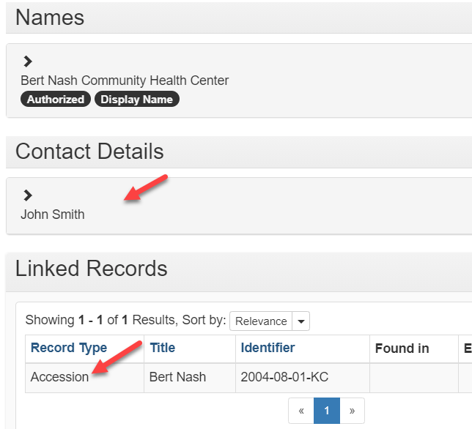
Merge records
Notes:
In this example, the incorrect form of name, Bert Nash Community Health Center, has contact details that should be retained and it is linked to an accession record.

Slide 18
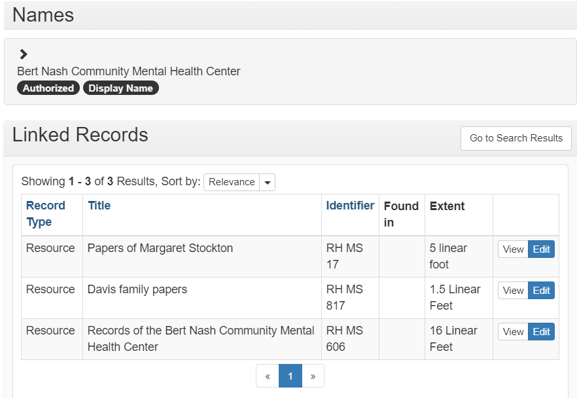
Merge records
Notes:
The correct form of name is linked to three resource records which does not have contact information.

Slide 19
Ta-Da!
After
Before
Notes:
After performing the merge function the three linked resource records are joined by an accession record and the contact information is included.

Slide 20
The End
Information about ArchivesSpace can be found at the website:
https://archivesspace.org/
My contact information:
Miloche Kottman | mkottman@ku.edu | University of Kansas Libraries
Notes:
Work on the 2,700 corporate bodies has been completed and we are more than 2/3s of the way through the 4,911 personal names.
If you are interested in ArchivesSpace, there is more information on their website and here again is my contact information.

