Slide 1
Representative Expression Elements in Authority Records
Robert L. Maxwell
Authority Control Interest Group
27 September 2022
Notes:
I was asked to speak a few minutes today on Representative Expression elements in authority records. Since this is a new concept that will be coming with “official” RDA, perhaps some of you are wondering just what a representative expression is.

Slide 2
Representative expression: RDA glossary definition
Notes:
It’s usually helpful to refer to the RDA glossary, so here it is: “An expression that is considered a canonical source of data for identifying a work.”
Perhaps this raises more questions than it answers. Let’s break this up a bit.
First, the definition is talking about expressions and works, which means we’re squarely in the FRBR (now LRM, the IFLA Library Reference Model) WEMI, Work-Expression-Manifestation-Item framework.
Thinking in those terms, first of all, we’re talking about an expression, but one that has a special relationship to its work: it is a “canonical source of data”. What does this mean?
RDA doesn’t explain, but LRM does talk quite a lot about it.

Slide 3
Representative expression attribute: LRM
An attribute of the WORK entity
Definition:
“An attribute which is deemed essential in characterizing the work and whose values are taken from a representative or canonical expression of the work”
Notes:
LRM speaks in terms of Representative expression attributes and has little to say about representative expressions per se.
[read slide]
In other words, it is an attribute of an expression that seems particularly important to users when they think about the work.

Slide 4
Representative expression attribute: LRM
Strictly speaking, all expressions are equal as realizations for the work
Database users, however, often consider certain characteristics of particular expressions as inherent in the work
These characteristics may be thought of as best representing the intention of the creator of the work
This may be an attribute of a particular expression deemed to best represent the work (more than one can be recorded)
It is not necessary to identify a particular expression as the “representative expression”
Notes:
LRM further explains: (from LRM 5.6, and other parts of LRM)

Slide 5
Representative expression attribute
Some examples
Textual works: possible representative expression attributes might be language or content type
Shakespeare’s Hamlet (a work) might be thought by most users as an English-language work and a text (content type). “English” and “text” might be representative expression attributes of Hamlet
Other expressions are possible—perhaps a spoken word version of Hamlet in French—but users likely still think of the work as being an English-language text
Musical works: possible representative expression attributes might be key or medium of performance
Mozart’s flute concerto no. 1 in G major (a work) would probably be thought by most users as for “flute” (medium of performance) and in “G major” (key)
Other expressions are possible—perhaps an arrangement for clarinet in C major—but users likely still think of the work as being in G major and for flute
This sort of expression attribute is what RDA means when it uses the term “canonical”
Notes:
Note: Work does not have language or content type or key or medium of performance as attributes.

Slide 6
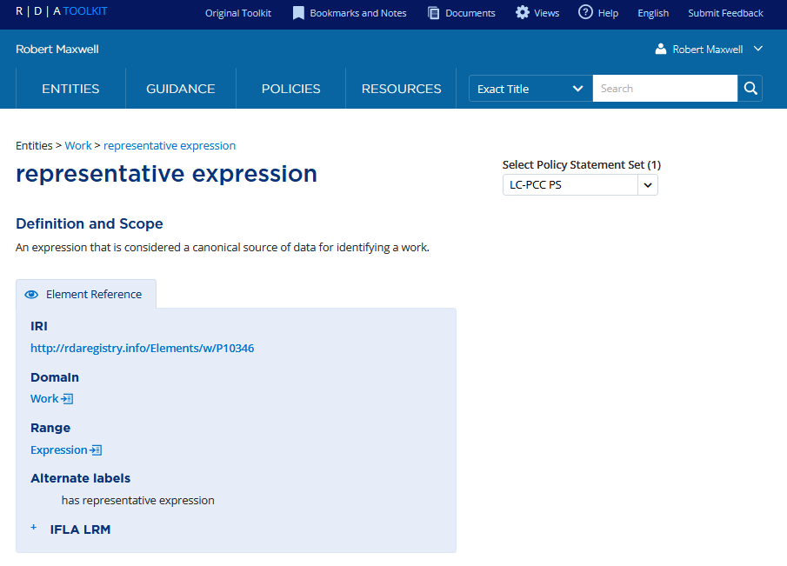
RDA: Declaring an expression to be “the” representative expression?
Notes:
Although LRM has a few references to “representative expression” per se as a possibility (that is, picking out an expression as “the” representative expression), it mostly concentrates on “representative expression attributes” which can be recorded as attributes at the work level.
RDA does define a relationship called “representative expression” as seen here, so we need to talk about it for just a moment. Again, the glossary definition defines this as “an expression that is considered a canonical source of data for identifying a work.” We’ve seen on the previous slide what it means by “canonical” and RDA here contemplates picking one or more expressions as “canonical” and recording a special relationship using this relationship element between the record or description of the work entity and a description (record) of that expression.
We’ve already seen that LRM tells us that it’s not necessary to identify a particular expression as the “representative expression,” and there are lots of practical reasons for this. Who gets to decide which expression is “the” representative expression? What about works such as Homer’s Odyssey for which “the” original expression no longer exists? The Greek text of the Odyssey exists in thousands of manuscripts, each a different expression of the work, and this work originated as a series of oral expressions which no longer exist because they were never recorded as sound.
So for practical reasons, although RDA does allow for this relationship to be declared, we’re going to concentrate on the representative expression attributes—or “elements” as they are called in RDA, rather than this relationship. Although policies will continue to evolve, it seems unlikely to me that PCC will encourage recording this relationship between a work and an expression record. In contrast, PCC will likely encourage and will almost certainly authorize recording representative expression elements (attributes) as a part of a description of a work.

Slide 7
RDA Attribute Elements (Official text). Work (Selected)
Category of work
Coverage of content
Dissertation or thesis information
Extension plan
Frequency
History of work
Nature of content
Note on metadata work
Note on work
Numbering of part
Recording source
Scope of validity
System of organization
Notes:
Let’s begin with looking at non-representative expression attribute elements in official RDA.
There has been some reorganization of the attribute elements with the advent of the official LRM-based RDA. A few have been moved from Work to Expression, or Manifestation to Work. The basic principle remains the same, however: the elements are discrete: there is no overlap between the elements used to describe a work and those used to describe an expression. (Principle of Entity-Relationship data structure, also behind Linked data structures).
This list of attribute elements here s not complete. Nor does it include “relationship elements” or subelements of broader elements.
Renamed elements:
Category of work (was Form of work)
New elements:
Extension plan (new)
Frequency (moved from Manifestation)
ISSN (moved from Manifestation) (Note: this is now a relationship element)
Key title (moved from Manifestation) (Note: this is now a relationship element)
Note on metadata work (new)
Numbering of part (was 24.6, a relationship instruction)
Recording source (new, but taken from source instructions in current RDA)
Scope of validity (new)
Removed from work attributes:
Medium of performance
Key
Intended audience
Redefined as relationship elements:
Coordinates of cartographic content
Date of work
Place of origin of work

Slide 8
RDA Attribute Elements (Official text). Expression (Selected)
Aspect ratio
Award
Capture information
Category of expression
Colour
Content type
Designation of version
Details of … elements and subelements
Duration
Extent of expression
Form of notation
Format of notated music
Intended audience of expression
Interactivity mode
Key of expression
Language of expression
Medium of performance of choreographic content
Medium of performance of musical content
Note on expression
Projection of cartographic content
Scale
Summarization of content
Notes:
This list does not include “relationship elements” or subelements of broader elements.
Please note: key and medium of performance were work-related elements in original RDA. They have become expression-related elements in official RDA.
New elements:
Category of expression (new)
Extent of expression (new)
Intended audience of expression (new, replaces current Work element Intended audience)
Interactivity mode (new)
Key of expression (from Work)
Medium of performance of choreographic content (new)
Medium of performance of musical content (from Work: medium of performance – this new expression element combines and replaces current RDA “medium of performance” and “medium of performance of musical content”)
Title of expression (new)
Removed from expression attributes
Accessibility content (now manifestation)
Colour content (now manifestation)
Sound content (now manifestation)
Supplementary content (now manifestation)
Changed to relationship elements:
Date of expression
Identifier for expression
Illustrative content
Deleted elements:
Performer, narrator, and/or presenter [removed from RDA in 2015 but still in table of contents]
Artistic and/or technical credit [removed from RDA in 2015 but still in table of contents]
Note also that the “Details of …” elements, while in Official RDA, are expected to be removed from RDA in a future revision.

Slide 9
The problem
Entity-relationship principles require strict boundaries between the entities in terms of the attributes that can be used to describe them
The new Toolkit is quite clear about what the domain of each element is
This means that a given element can only be used to describe an instance of its named domain
This is necessitated by requirements of linked data structures
But people don’t necessarily think of the bibliographical universe in these terms
In particular, database users—including catalogers—often associate attributes of expression with works

Slide 10
The problem
Under original RDA it was inappropriate to include language or content type in a description (a.k.a. authority record) for a work and under the (new) official text it will also be inappropriate to record intended audience because none of these is (or will be) an element that can be used to describe a work entity:
046 ## $k 1865 $2 edtf
100 1# $a Carroll, Lewis, $d 1832-1898. $t Alice's adventures in Wonderland
336 ## $a text $2 rdacontent
377 ## $a eng
380 ## $a Novels $a Fantasy fiction $a Nonsense fiction $2 lcgft
385 ## $a Children $2 lcdgt
400 1# $a Carroll, Lewis, $d 1832-1898. $t Alice in Wonderland
Notes:
It’s inappropriate to record language or content type for a work because it truly is incorrect—a work is a highly generalized concept and must include all expressions, including expressions in any language and in any content type. We could argue about whether or not intended audience is appropriate at the work level, but in official RDA a decision was made that it wasn’t.

Slide 11
The problem
Catalogers clearly want to record this type of information in descriptions of works and they’re not wrong to want to, though original RDA didn’t allow it. From the current NAF:
046 ## $k 1967-09 $l 1969-01
130 #0 $a Ballantonian (Bloomington, Ind.)
370 ## $g Bloomington (Ind.) $2 naf
377 ## $a eng
380 ## $a College student newspapers and periodicals $2 lcsh
510 2# $w r $i Sponsoring body: $a Indiana University College
670 ## $a The Ballantonian records, 1967-1969 $b (The Ballantonian; weekly liberal arts review run by Indiana University students and sponsored by the English Department; journal ran from September 1967 to January 1969)

Slide 12
Representative expression elements Works with textual aspects
Colour content of representative expression
Content type of representative expression
Date of representative expression
Extent of representative expression
Intended audience of representative expression
Language of representative expression
Script of representative expression
Notes:
This problem is effectively solved with the introduction in official RDA of attributive representative expression elements to be used in descriptions of works. (summarize)
These are the available Representative expression elements in official RDA for a work with textual aspects.

Slide 13
Representative expression elements Works with notated music aspects
Content type of representative expression
Date of representative expression
Duration of representative expression
Extent of representative expression
Intended audience of representative expression
Key of representative expression
Medium of performance of choreographic content of representative expression
Medium of performance of musical content of representative expression
Script of representative expression
Notes:
These are the available Representative expression elements in official RDA for a work with notated music aspects. (summarize)
There are also other representative expression elements available for works with moving image, audio, and cartographic or other aspects.

Slide 14
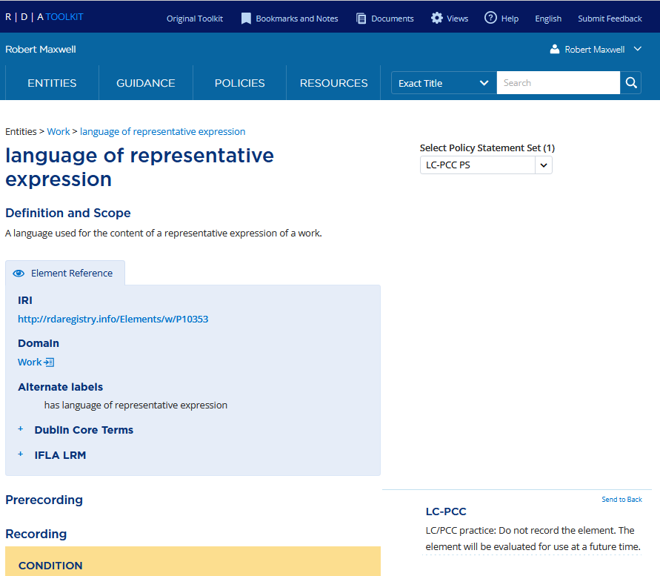
LC-PCC Policy
Recommended change:
LC/PCC practice: Cataloger's judgment to record. Apply the option when needed to break a conflict.
Notes:
The initial policy in the official toolkit for all the representative expression elements is “Do not record the element”. This was never intended as the permanent policy; it was inserted as a placeholder while PCC discussions took place (involving the PCC RDA Communications Committee and the PCC Standing Committee on Standards). These discussions have taken place and it is proposed to change these to say (read slide), with different nuances for particular representative expression elements. This will require working out details with the NACO nodes to allow recording representative expression elements in MARC records, but I believe this will be in place in time for PCC implementation of official RDA.
Contact me if you’d like to see the documentation of the PCC RDA Communications Committee on this issue: see https://www.loc.gov/aba/pcc/rda/communications-committee/ and https://docs.google.com/spreadsheets/d/1vDPelYCMCtdEc4iahZ0bx_9r7AoH1B6boi_yAflvJ-8/edit?pli=1#gid=0

Slide 15
MARC coding
Representative expression elements are recorded in work-level descriptions (authority records)
All representative expression elements except Key of representative expression and Medium of performance of musical content of representative expression are recorded in MARC field 387
Notes:
Read slide, then:
Note: as of September 27, 2022 the NACO nodes haven’t implemented 387 yet. Implementation has been proposed.
Note: coding for Extent of representative expression and Medium of performance of choreographic content has not been determined yet.

Slide 16
MARC coding: 387 subfield codes
$a - Aspect ratio of representative expression (R) $b - Color content of representative expression (R) $c - Content type of representative expression (R) $d - Date of capture of representative expression (R) $e - Date of representative expression (R) $f - Duration of representative expression (R) $g - Intended audience of representative expression (R) $h - Language of representative expression (R) $i - Place of capture of representative expression (R) $j - Projection of cartographic content of representative expression (R) $k - Scale of representative expression (R) $l - Script of representative expression (R) $m - Sound content of representative expression (R)
$0 - Authority record control number or standard number (R) $1 - Real World Object URI (R) $2 - Source of term (NR) $3 - Materials specified (NR) $6 - Linkage (NR) $7 - Data provenance (R) $8 - Field link and sequence number (R)
Notes:
See https://www.loc.gov/marc/authority/ad387.html and https://www.loc.gov/marc/bibliographic/bd387.html
Note: There is no provision (yet) for Extent of representative expression, pending larger discussions of recording extent in official RDA.

Slide 17
MARC coding: key and medium of performance
Representative expression elements are recorded in work-level descriptions (authority records)
Key of representative expression is recorded in MARC field 384, first indicator 2, subfield $a.
Medium of performance of musical content of representative expression is recorded in MARC field 382, first indicator 2 (for full medium of performance) or 3 (for partial medium of performance). Subfield coding for MARC field 382 has not changed.
There is no provision (yet) for Medium of performance of choreographic content of representative expression.
Notes:
Coding from https://www.loc.gov/marc/mac/2022/2022-04.html; recheck when officially published.

Slide 18
MARC coding example: text
046 ## $k 1865 $2 edtf
100 1# $a Carroll, Lewis, $d 1832-1898. $t Alice's adventures in Wonderland
380 ## $a Novels $a Fantasy fiction $a Nonsense fiction $2 lcgft
387 ## $c text $2 rdacontent
387 ## $g Children $2 lcdgt
387 ## $h eng
400 1# $a Carroll, Lewis, $d 1832-1898. $t Alice in Wonderland
Notes:
Here’s an example of recording representative expression elements in a MARC work authority record for a familiar work

Slide 19
MARC coding examples
Work
046 ## $k -07
100 1# $a Homer. $t Odyssey
380 ## $a Epic poetry $2 lcgft
387 ## $c text $2 rdacontent
387 ## $h grc
Expression
046 ## $k 1907 $2 edtf
100 0# $a Homer. $t Odyssey. $l Greek $s (Allen)
336 ## $a text $2 rdacontent
377 ## $a grc
381 ## $a Allen
500 1# $w r $i Editor: $a Allen, Thomas W. $q (Thomas William), $d 1862-1950
530 #0 $w r $i Related work: $a Scriptorum classicorum bibliotheca Oxoniensis
Expression
046 ## $k 1504 $2 edtf
100 0# $a Homer. $t Odyssey. $l Greek $s (Manuzio)
336 ## $a text $2 rdacontent
377 ## $a grc
381 ## $a Manuzio
500 1# $w r $i Editor: $a Manuzio, Aldo, $d 1449 or 1450-1515
Notes:
This example clearly shows how representative expression elements in the work record were derived from elements of expression records. The original language of Homer’s Odyssey was Greek and the original content type was text (technically speaking the original content type was spoken word, but since no recording was made, for cataloging purposes that original expression never existed. The first surviving content type was text and that’s what people think of when they think of the Odyssey). The elements “Text” and “Greek” in the work record to the upper right were derived from what was recorded in expression records that were judged to be representative or canonical.

Slide 20
MARC coding examples: key and medium of performance
046 ## $k 1913 $2 edtf
100 1# $a Debussy, Claude, $d 1862-1918. $t Syrinx
380 ## $a Art music $2 lcgft
382 0# $a flute $n 1 $s 1 $2 lcmpt
382 2# $a flute $n 1 $s 1 $2 lcmpt
046 ## $k 1994 $2 edtf
100 1# $a Mozart, Wolfgang Amadeus, $d 1756-1791. $t Concertos, $m violin, orchestra, $n K. 211, $r D major
380 ## $a Concertos $2 lcgft
382 0# $b violin $n 1 $a orchestra $e 1 $r 1 $t 1 $2 lcmpt
382 2# $b violin $n 1 $a orchestra $e 1 $r 1 $t 1 $2 lcmpt
383 ## $a no. 2
383 ## $c K. 211 $d Köchel6 $2 mlati
384 0# $a D major
384 2# $a D major
046 ## $k 1890 $2 edtf
100 1# $a Glazunov, Aleksandr Konstantinovich, $d 1865-1936. $t Mechty
380 ## $a Chamber music $2 lcgft
382 0# $a horn $n 1 $a piano $n 1 $s 2 $2 lcmpt
382 2# $a horn $n 1 $a piano $n 1 $s 2 $2 lcmpt
383 ## $b op. 24
384 0# $a D♭ major
384 2# $a D♭ major
Notes:
Key and Medium of performance were attributes (elements) of the Work entity in original RDA. and thus could appropriately be recorded in authority records for musical works (unlike the textual work examples, for instance, of recording language in a work record, there were not mistakes.) In official RDA these elements have become attributes of the Expression entity (“key of expression” and “medium of performance of musical content”). It will no longer be appropriate to record these two elements in records for musical works (vs. in records for expressions of musical works). However, their equivalent representative expression elements can be recorded in work records, and usually only require a change to the indicator values to indicate that they are representative expression elements, as shown here.
Looking at the Debussy example, an authority record describing an arrangement (an expression) of Syrinx for clarinet would record the expression element “Medium of performance of musical content” as “clarinet” using 382 first indicator “0” in an expression record for that arrangement, and it would be linked to this work-level authority record, which shows that that representative medium of performance is the original one, flute. This could potentially be quite useful in providing context to users, if we design our systems intelligently.
Note that in some cases key and medium of performance representative expression elements may be included in the authorized access point for the work (see the Mozart example).

Slide 21
Thanks!
Robert L. Maxwell
robert_maxwell@byu.edu

