Slide 1
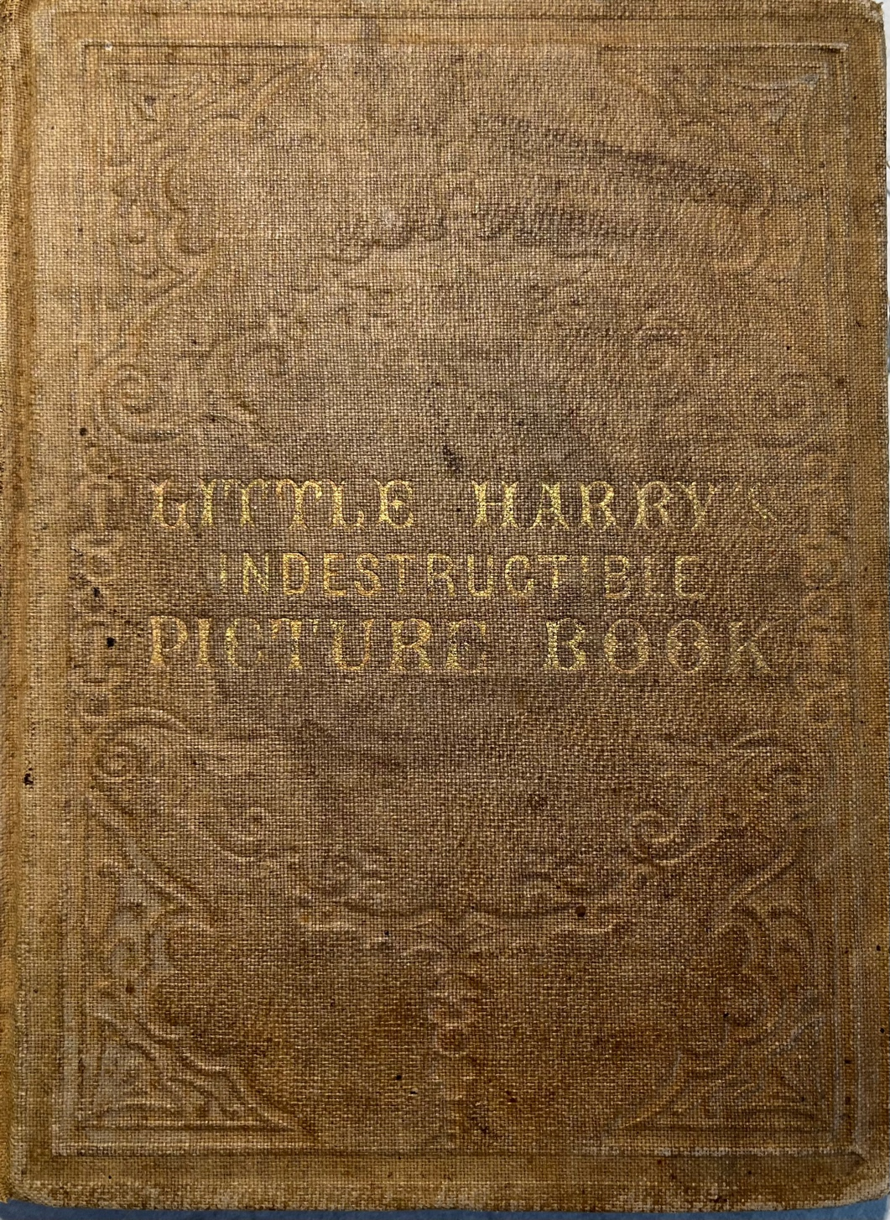
Indestructible Books
Presented by Jackie Coleburn
Rare book cataloger
Library of Congress
jacol@loc.gov

Slide 2
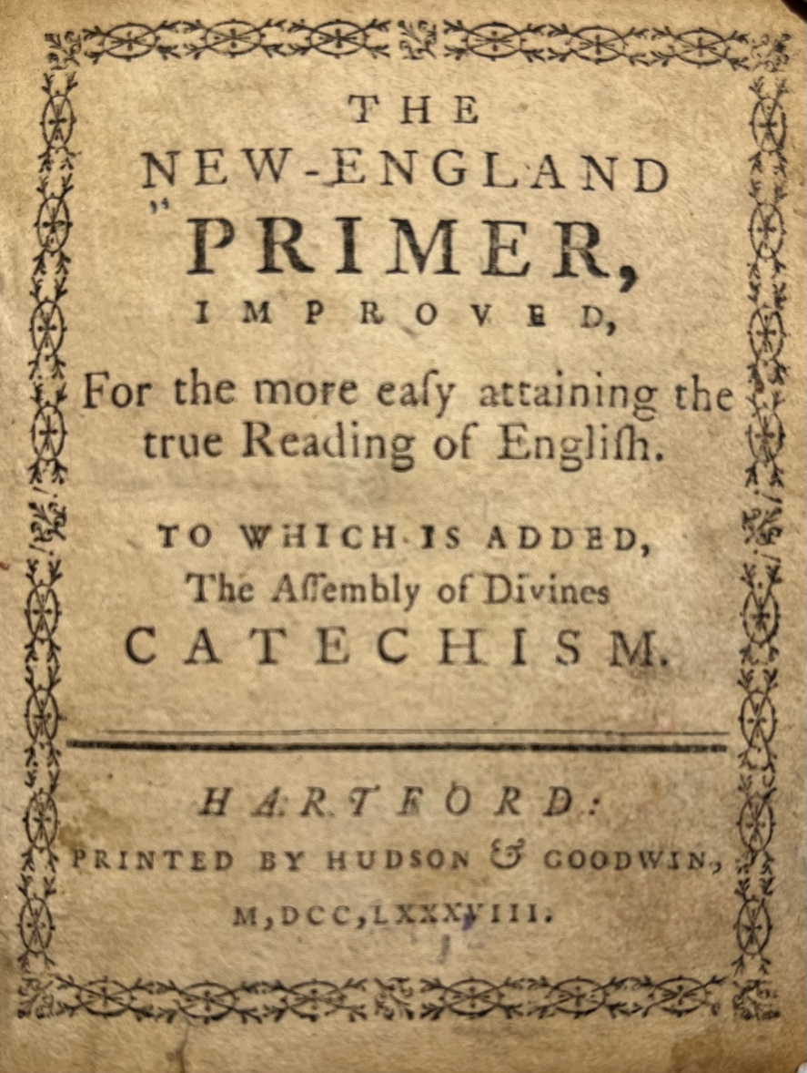
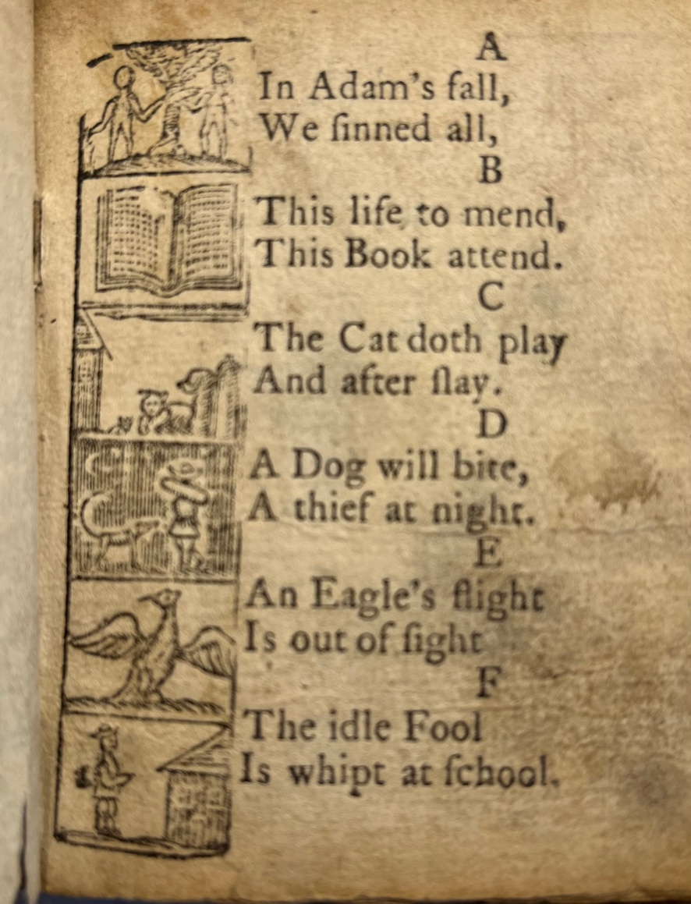
New -England Primer, Improved.
Hartford, Connecticut, 1788

Slide 3
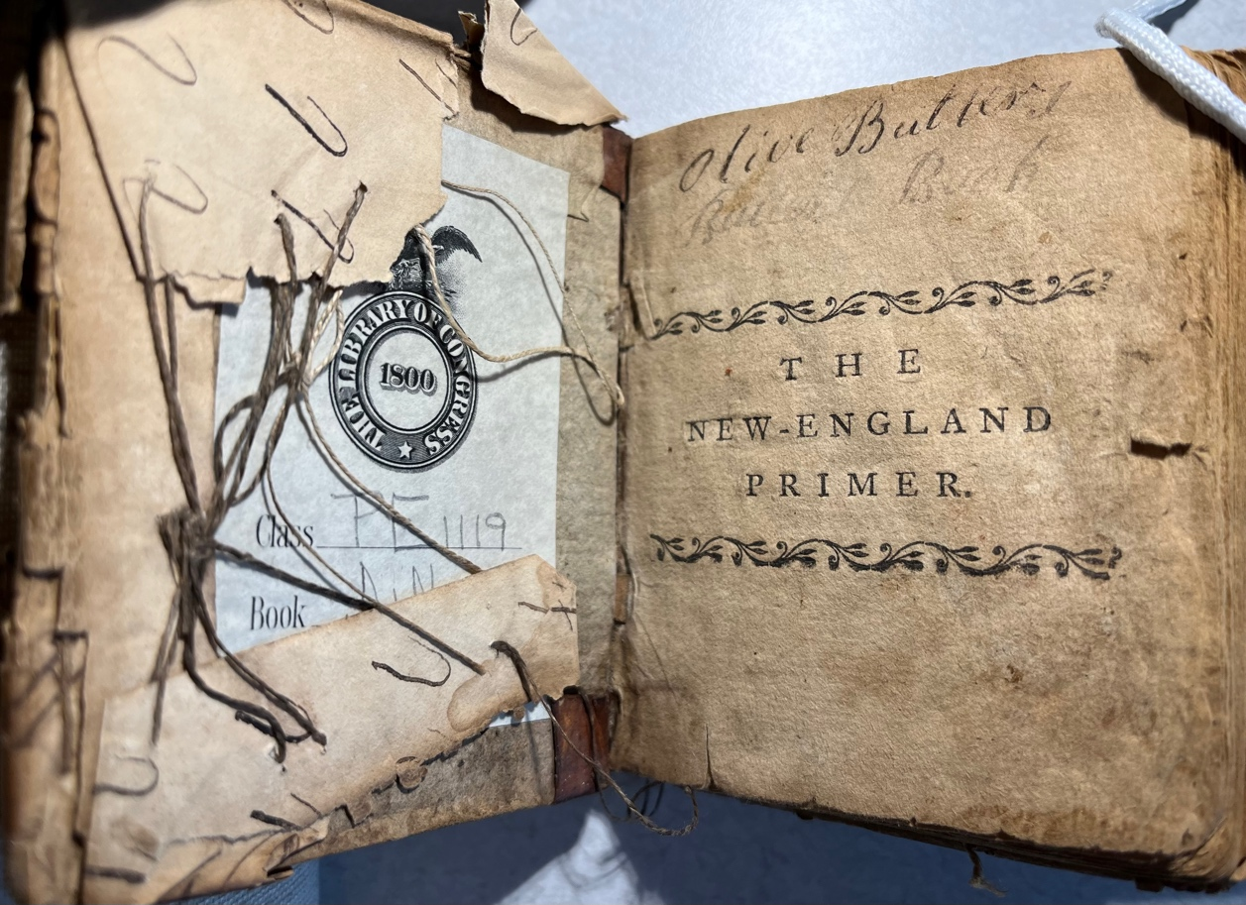
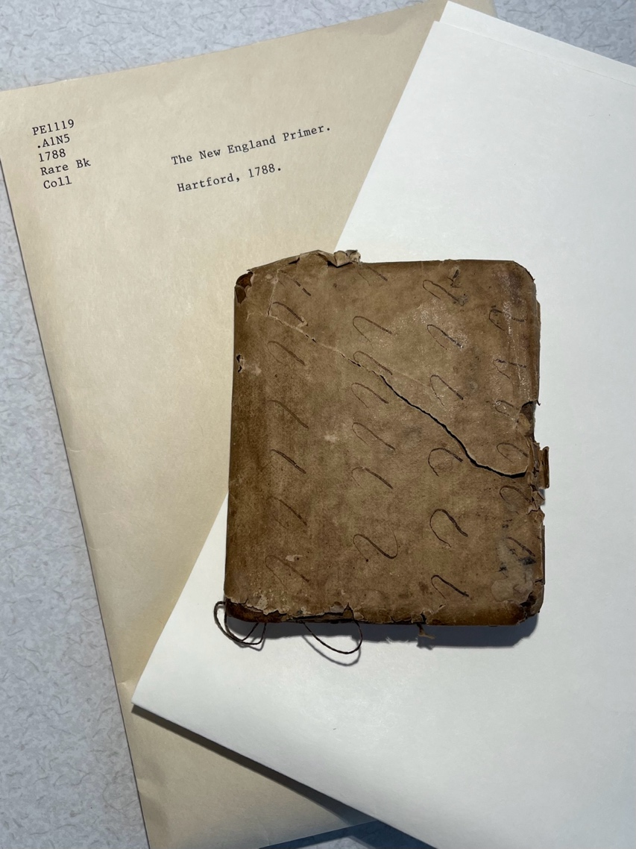
The primer, in its paper cover, preserved in the rare book stacks today.
Paper cover stitched onto the 1788 New England Primer by a former owner.

Slide 4
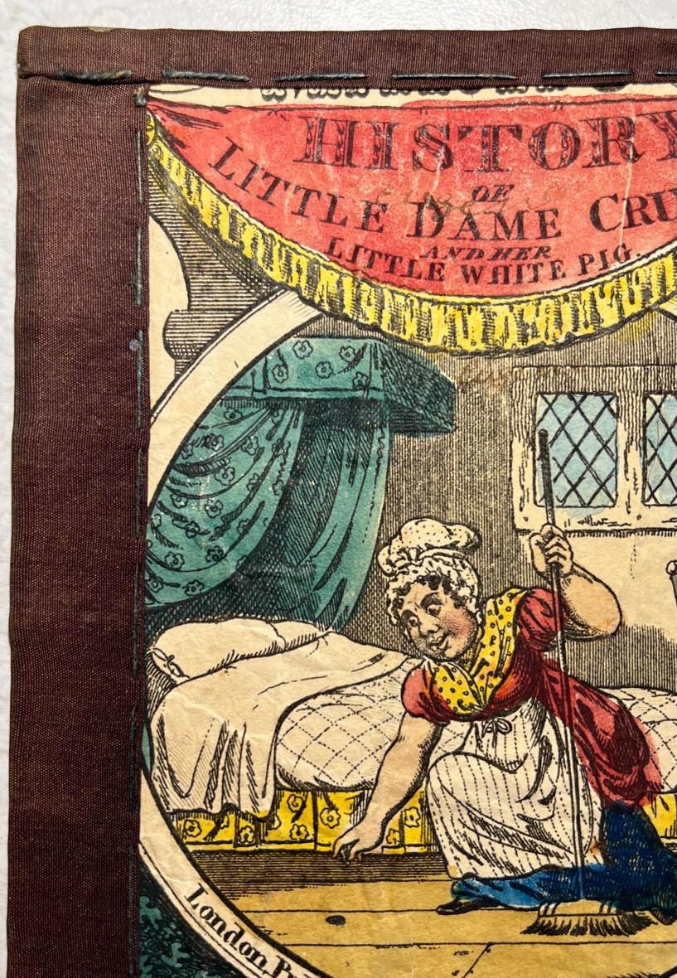
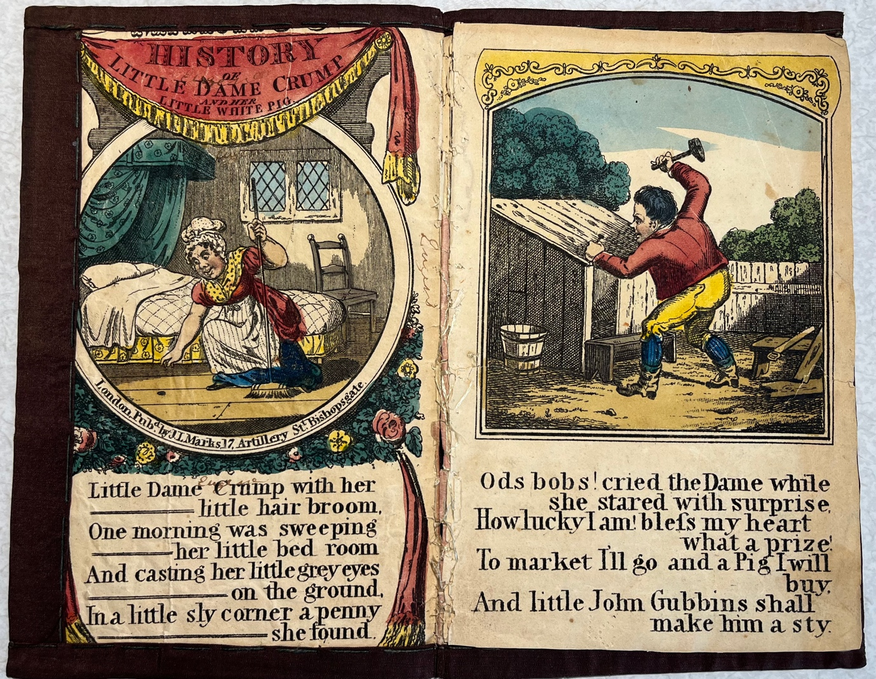
History of Little Dame Crump and her Little White Pig, 1822.
A closer look at the cloth cover stitched onto the toy book.

Slide 5
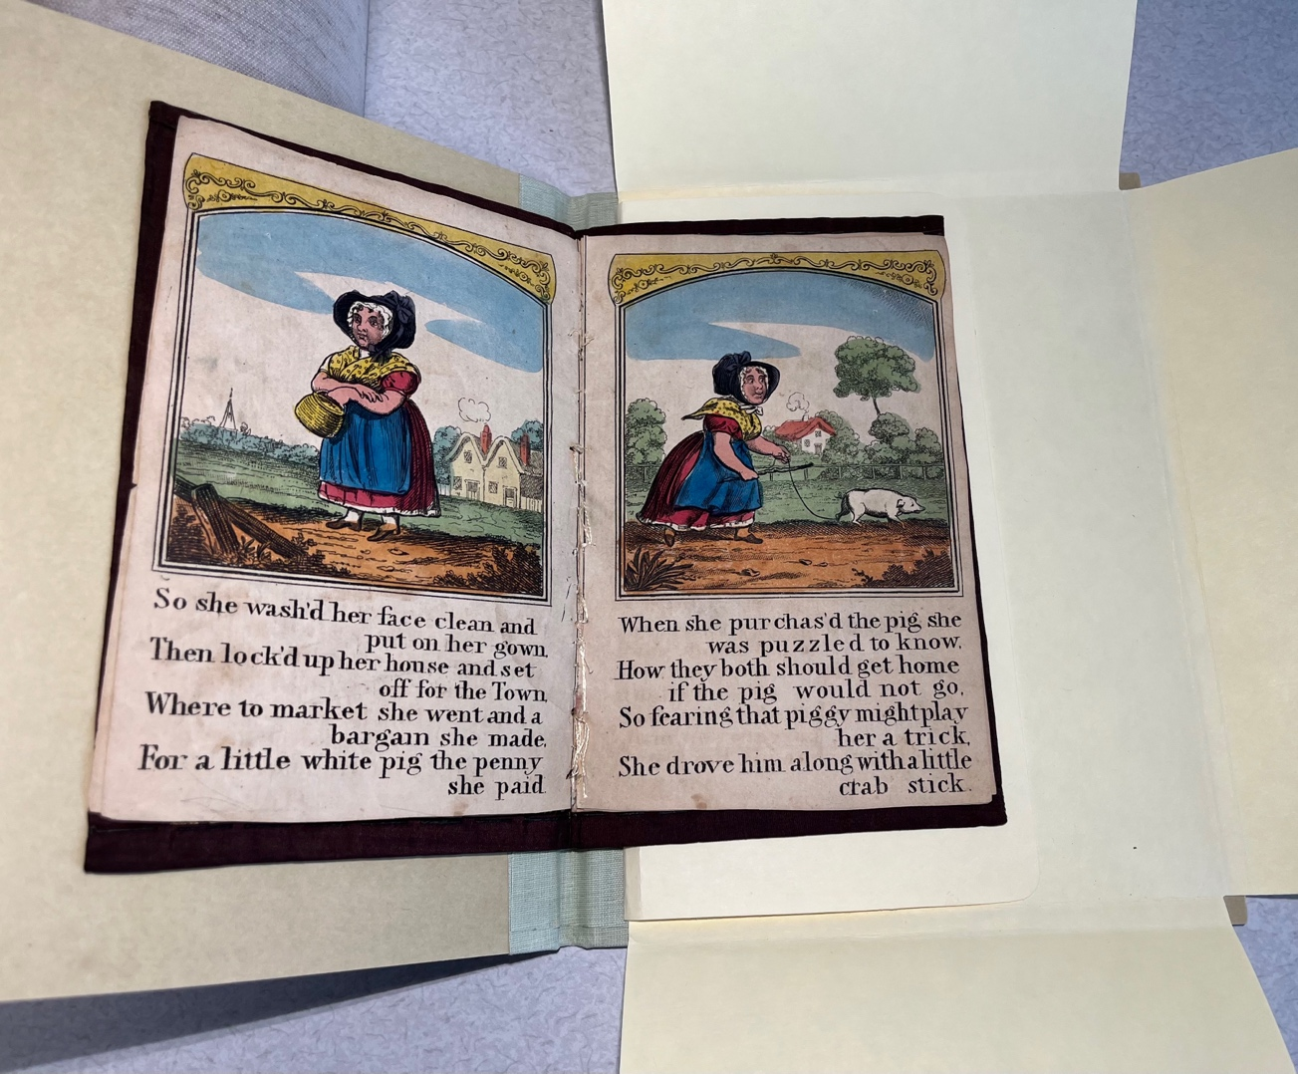
Little Dame Crump heads home with her little white pig. The toy book, in its hand-made cloth cover, is shelved safely in an acid-free pamphlet binder.

Slide 6
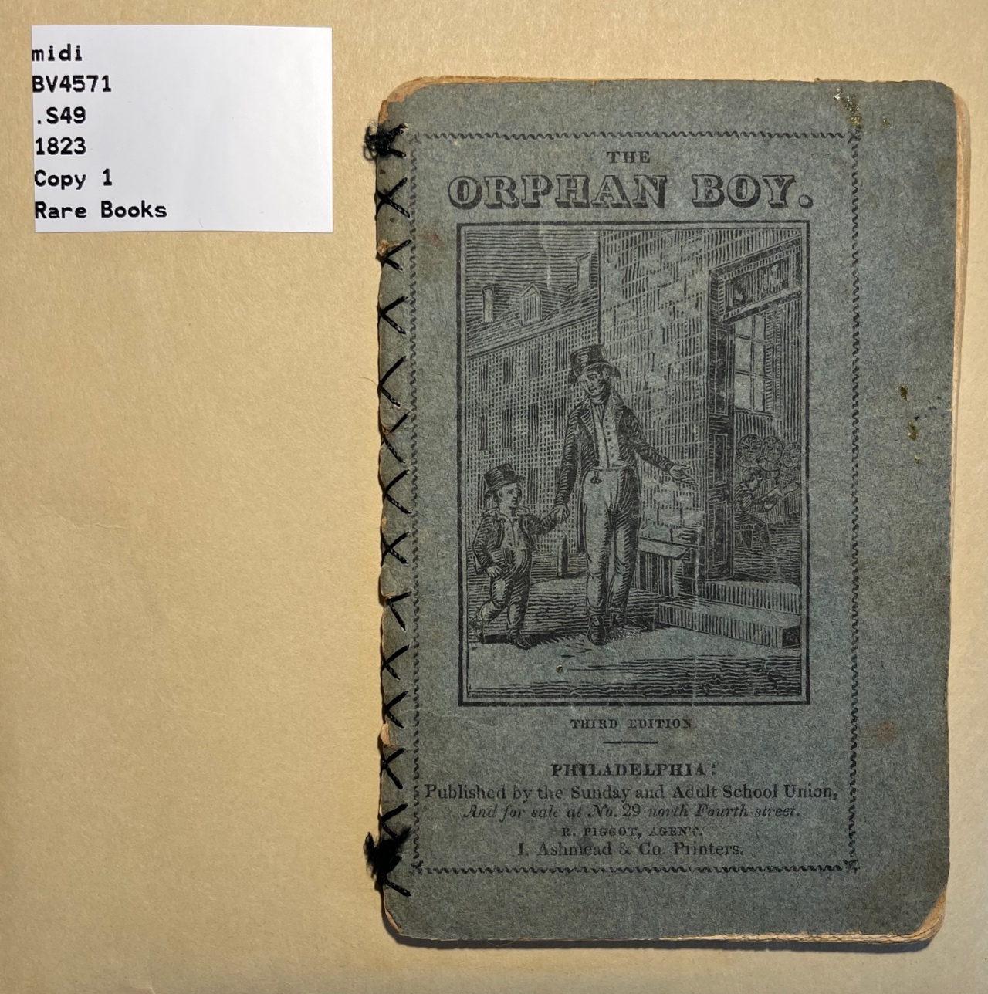
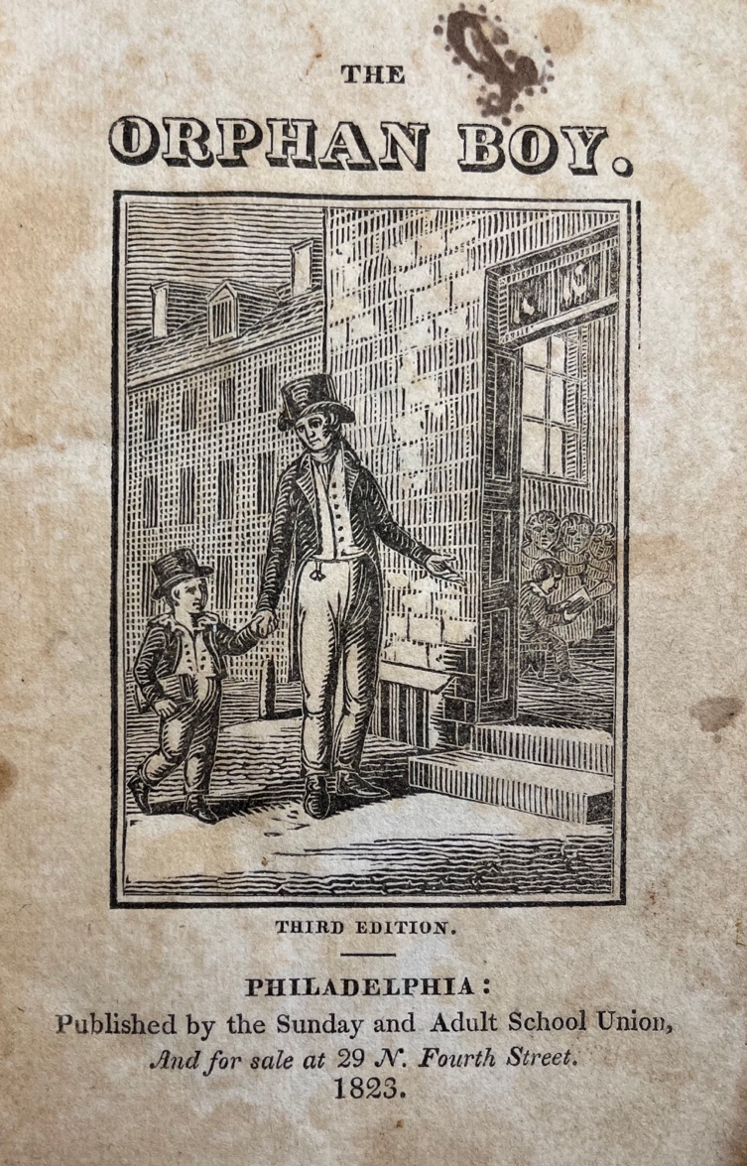
The Orphan Boy.
Philadelphia, 1823.
A Sunday school publication stitched together with needle and thread. Now, shelved in a protective envelope in the stacks.

Slide 7
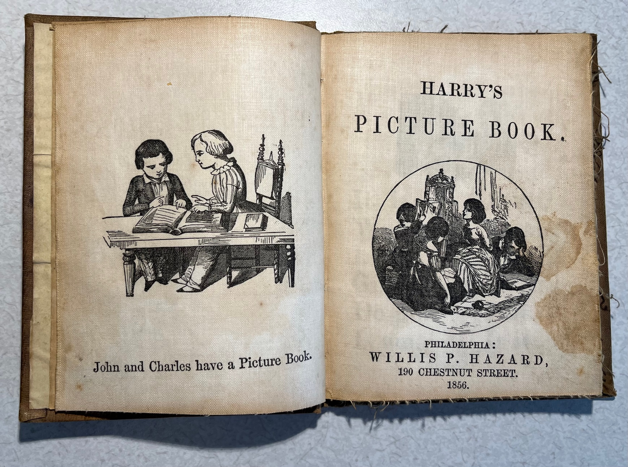
Little Harry’s Indestructible Picture Book.
Philadelphia, 1856.
Printed on “indestructible” linen.

Slide 8
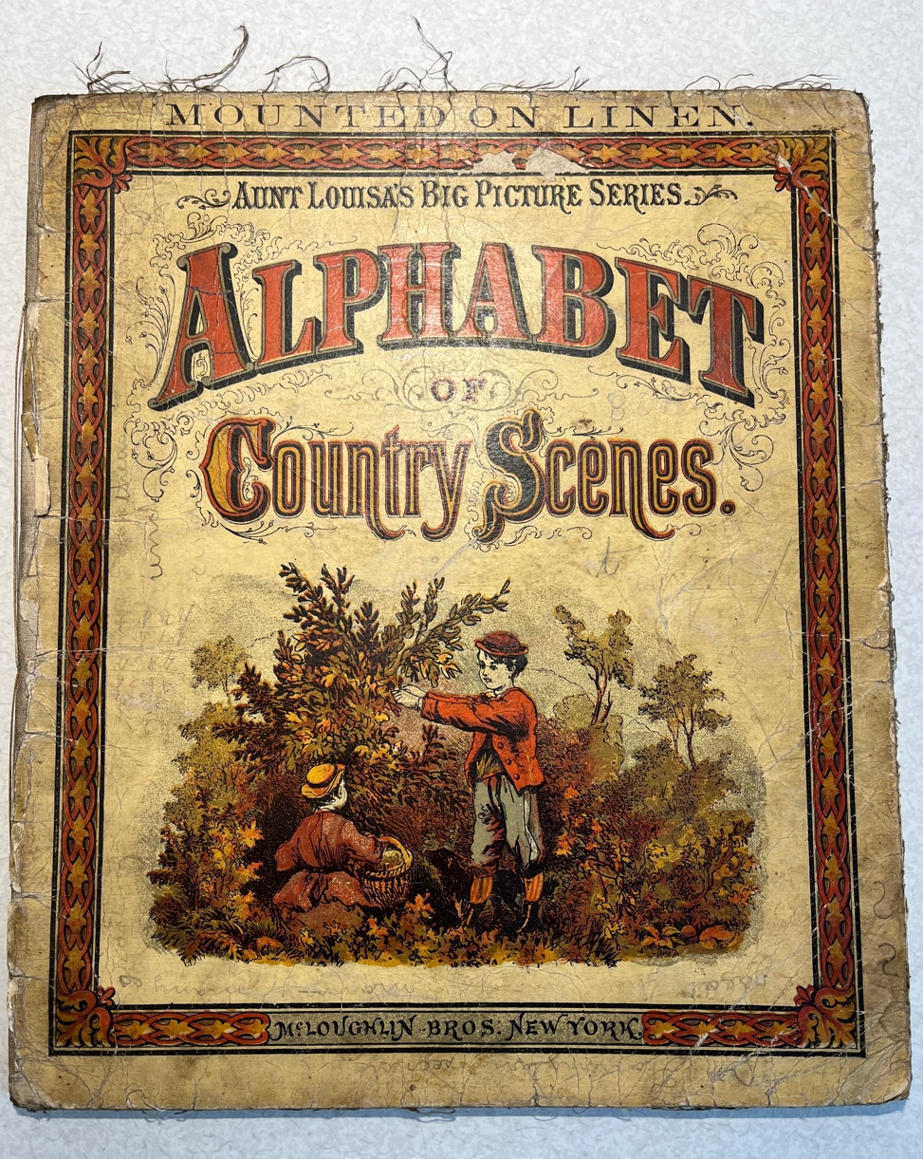
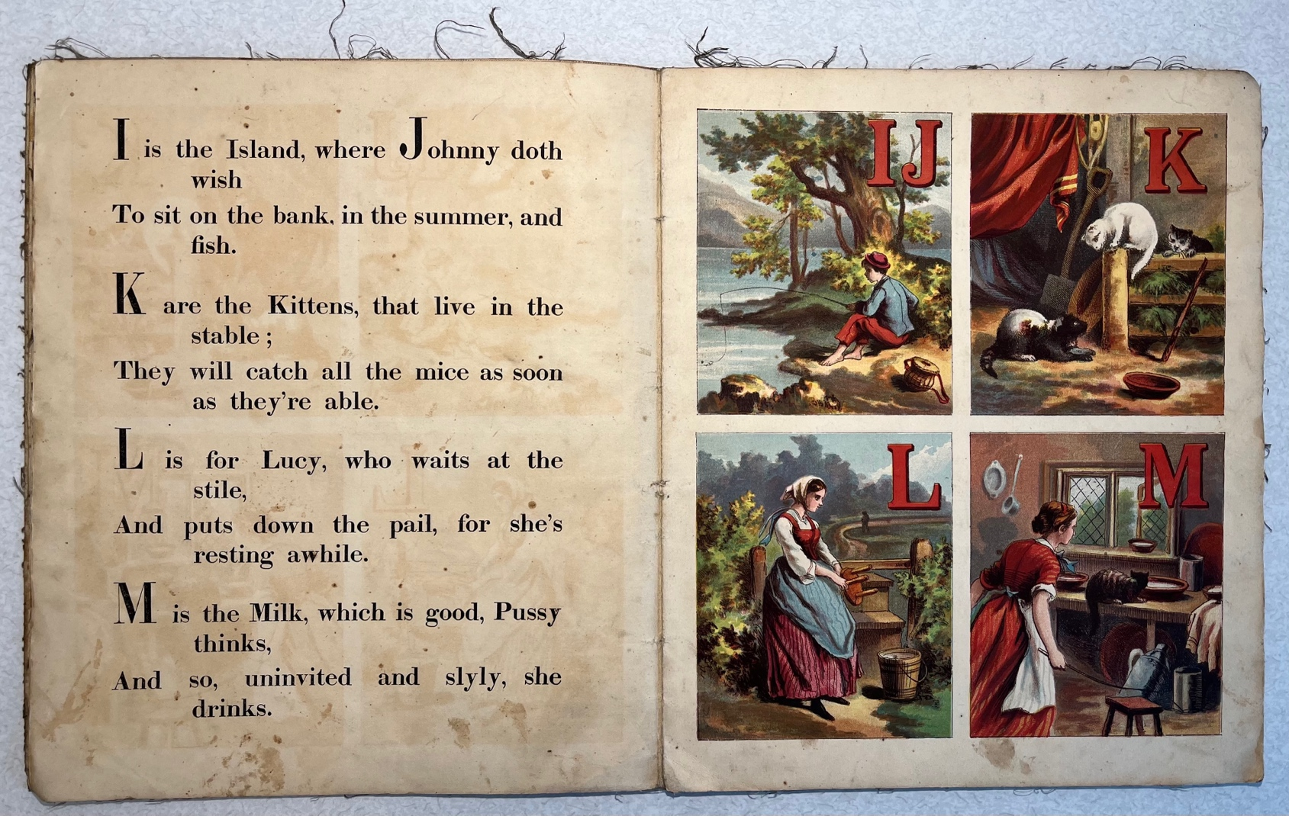
Alphabet of Country Scenes.
New York, 1873.
Paper pages mounted on linen.

Slide 9
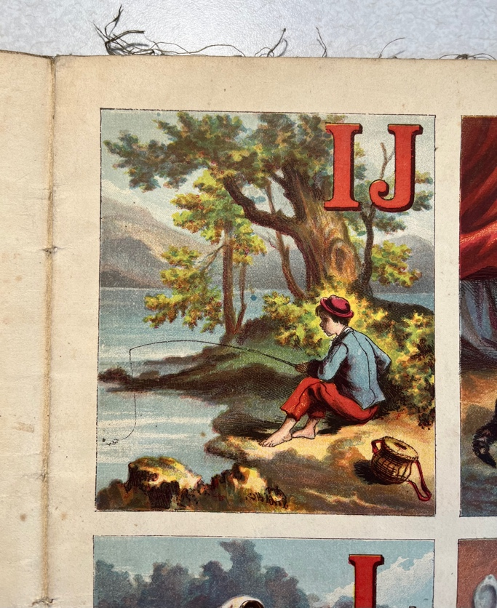
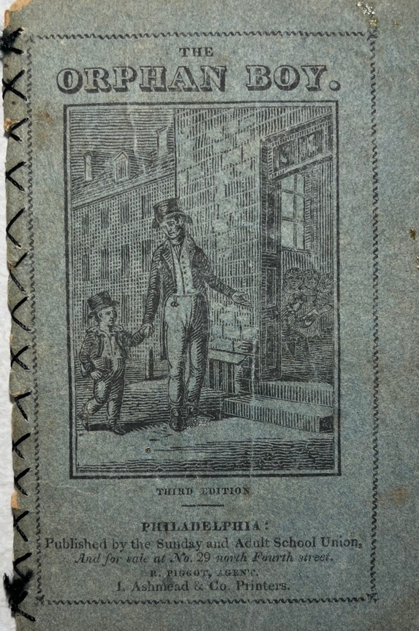
“A parent or a teacher has only his lifetime; a good book can teach forever” – Louis L’Amour.

