Slide 1
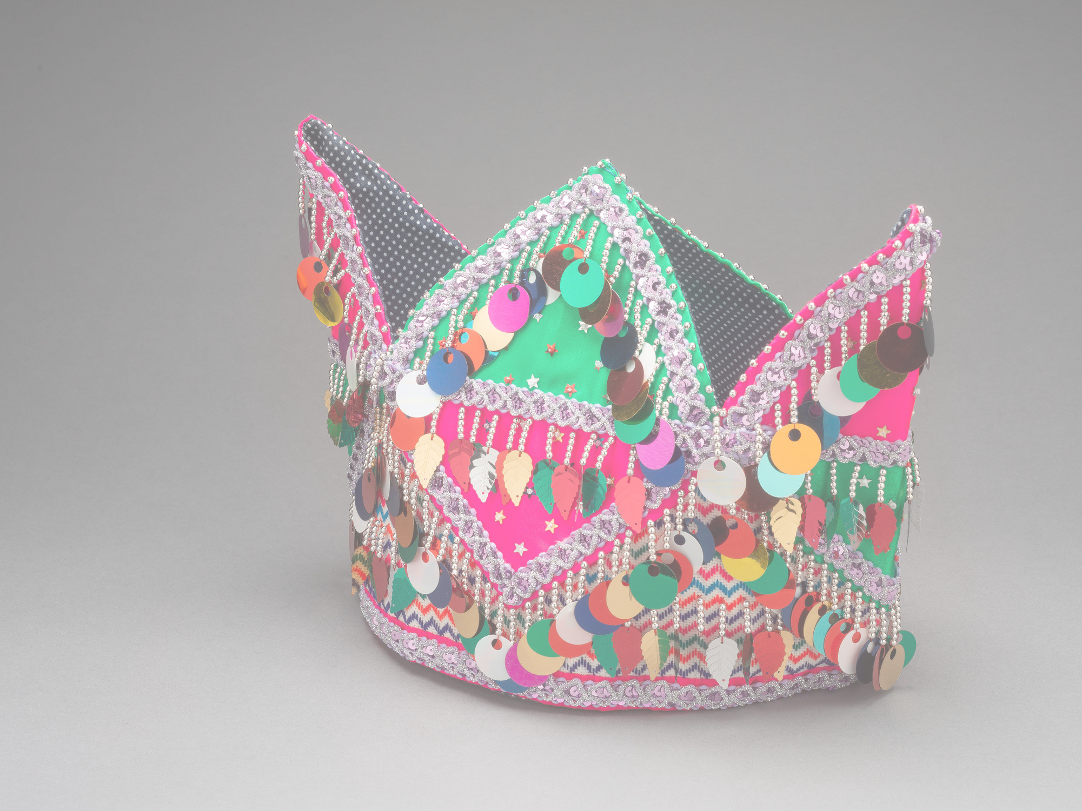
Words Matter: Supporting a Community Archive Through Inclusive Cataloging
Presented by:
Elyse Fox, Digital Initiatives Librarian, Sacramento State
Lynn Drennan, Manuscript & Archives Coordinator, Sacramento State
(with contributions by): Pachia L. Vang, Hmong Textile Specialist, Culture through Cloth
HMong New Year Hat, SEACRCC-4260A. MSS-2005/65, Southeast Asia Community Resource Center Collection

Slide 2
Land Acknowledgement
We are mindful in acknowledging that the land that Sacramento State is located on was and continues to be occupied by the indigenous people of this area, the Miwok, Maidu, and Nisenan. Recognizing their culture that is rich with spiritual ties to the land and waters that resonate with their traditions, we are humbled and take this opportunity to thank and honor those indigenous people of this area.

Slide 3
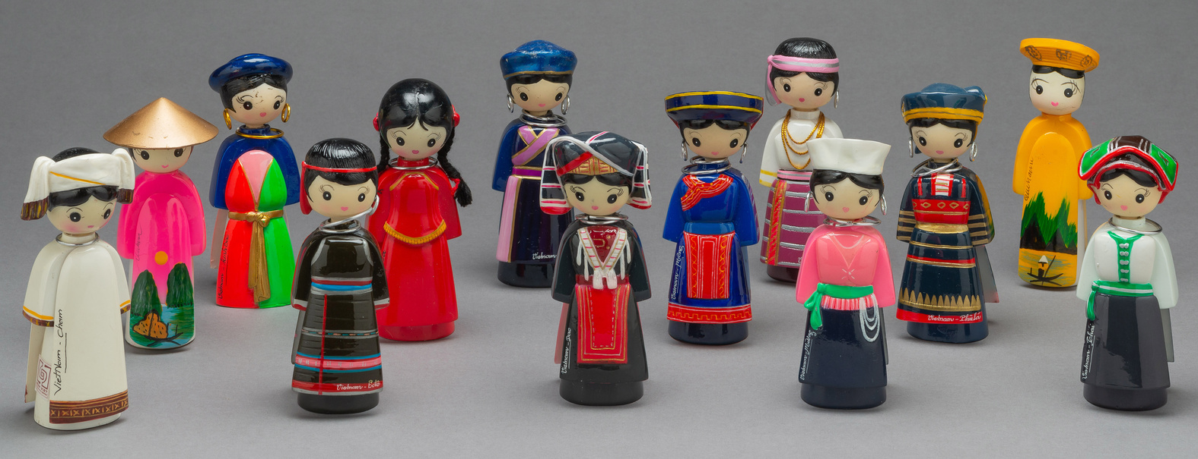
Agenda
Collection of Vietnamese dolls, SEACRCC-3350A. MSS-2005/65, Southeast Asia Community Resource Center Collection
About the collection
Digitization grant
Inclusive cataloging best practices
Cataloging plan/workflow
Outcomes
Reflection

Slide 4
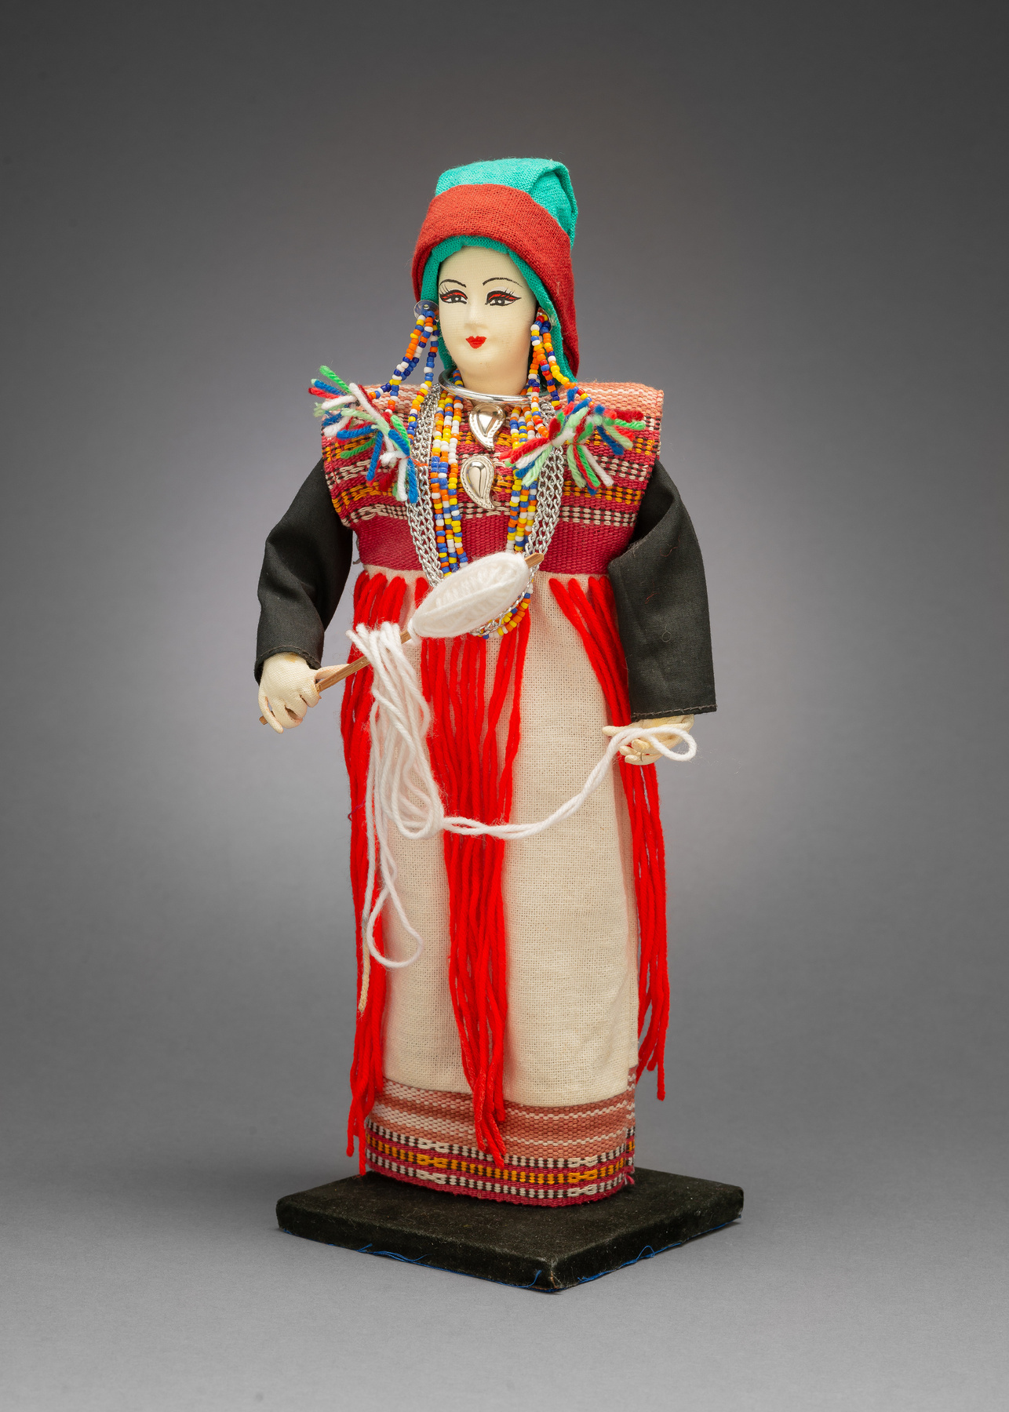
About the collection
1970’s Southeast Asian war refugees start arriving in the US
Refugee Educators Network, Inc. (REN) develops the Southeast Asia Community Resource Center (SEACRC)
SEACRC’s goal was to provide educational support
Karen Doll, SEACRCC-3099A. MSS-2005/65, Southeast Asia Community Resource Center Collection

Slide 5
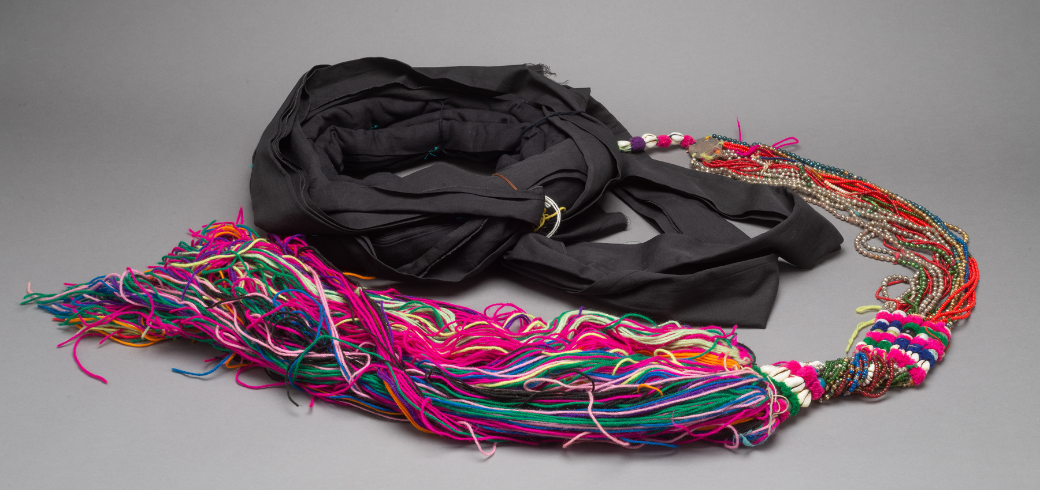
About the collection
Collection gifted to CSU, Sacramento Library in 2006
Center collected materials for over 20 years
Armenian, Cambodian (Khmer), Chinese, HMong, Karen, Khmu, Korean, Lahu, Lao, Mien, Russian, Thai, Ukrainian, and Vietnamese
Lisu Turban, SEACRCC-4266A. MSS-2005/65, Southeast Asia Community Resource Center Collection

Slide 6
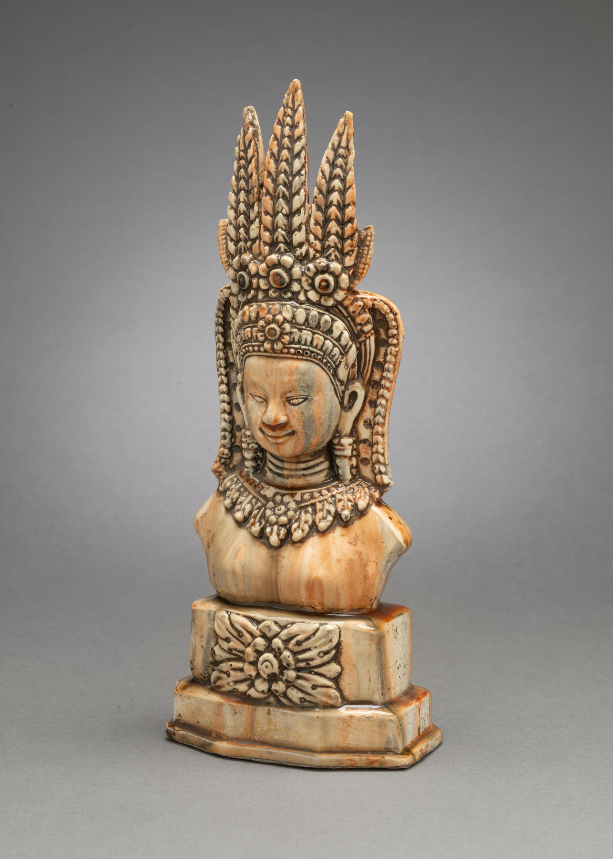
About the grant
Grant funding for photographic digitization of artifacts of SEACRC
Metadata cataloging for artifacts
Funding for the hire of a subject expert
Purchase of appropriate housing for artifacts
Cambodian Buddha statue, SEACRCC-3259A. MSS-2005/65, Southeast Asia Community Resource Center Collection

Slide 7
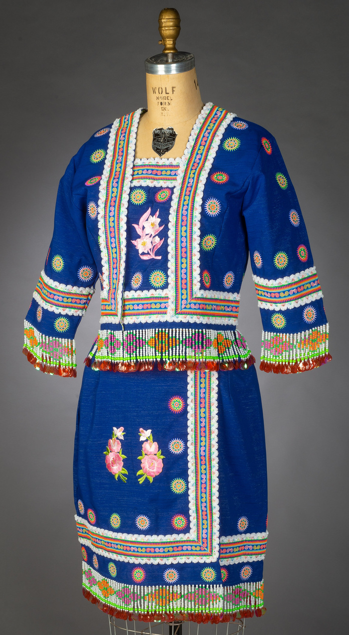
Inclusive Cataloging Best Practices
Emerging trend in libraries and archives
Traditional cataloging standards still lean towards a Western framework for description
Inclusive Metadata Toolkit under development by the Inclusive Metadata Task Force (DLF: Cultural Assessment Working Group)
Requires organizational shifts, operational workflows, professional and personal development (Frick & Proffitt, 2022)
HMong Woman's Outfit, Thailand, SEACRCC-4053A. MSS-2005/65, Southeast Asia Community Resource Center Collection

Slide 8
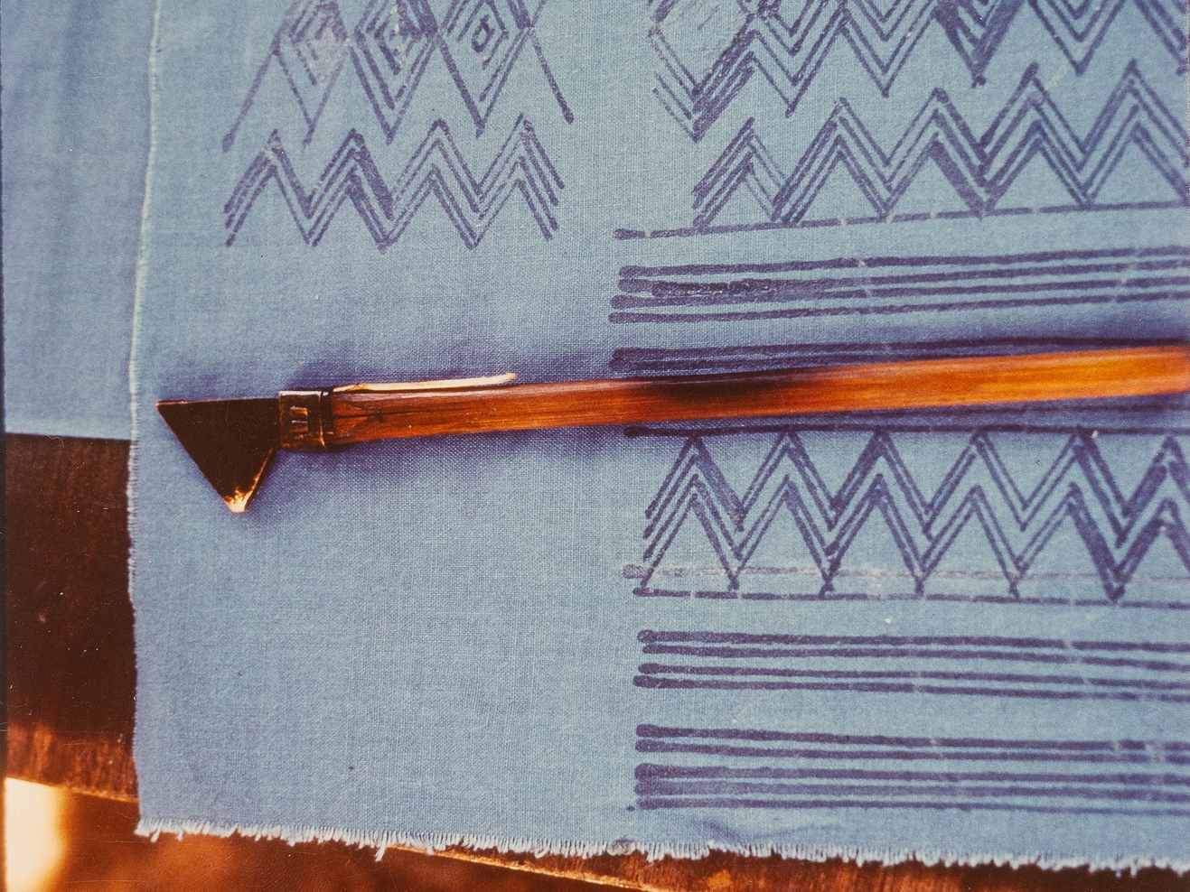
Descriptive Guidelines
Identify:
Locations
Cultural customs
Traditional dress
Provide contextual information
Significance of textile patterns, colors of fabric, textile making techniques
Meaning and use of artifacts
Translate English terms to their native language
Translate/transcribe writing
Note errors in original title supplied by the Southeast Asia Community Resource Center
(In background): Detail of Batik Design, SEACRCC-3720P. MSS-2005/65, Southeast Asia Community Resource Center Collection

Slide 9
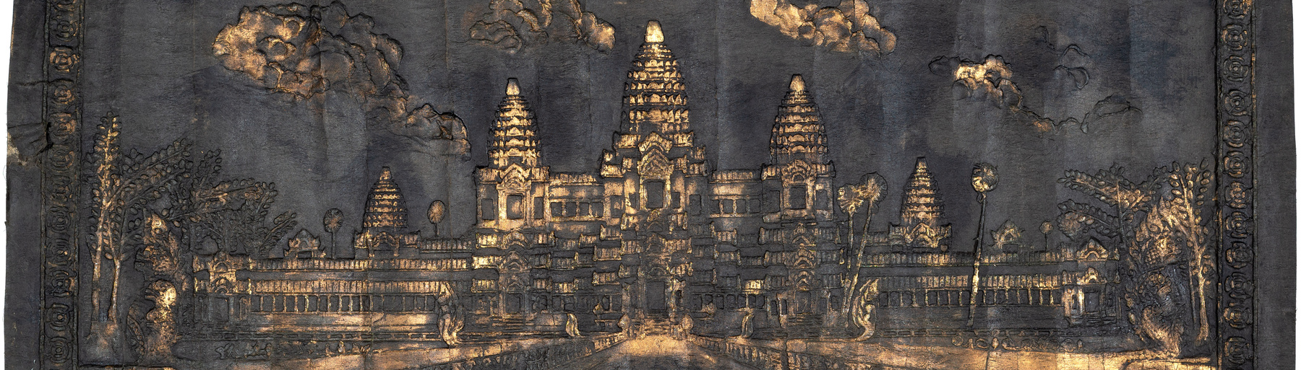
Workflow
Collaborate via Google Drive folder:
Subject expert: populates metadata spreadsheet with notes/descriptions >
Metadata specialist: generates robust descriptions based on supplied information >
Subject expert: reviews published descriptions and comments in spreadsheet
Angkor Wat Temple, Cambodia, SEACRCC-4482A. MSS-2005/65, Southeast Asia Community Resource Center Collection

Slide 10
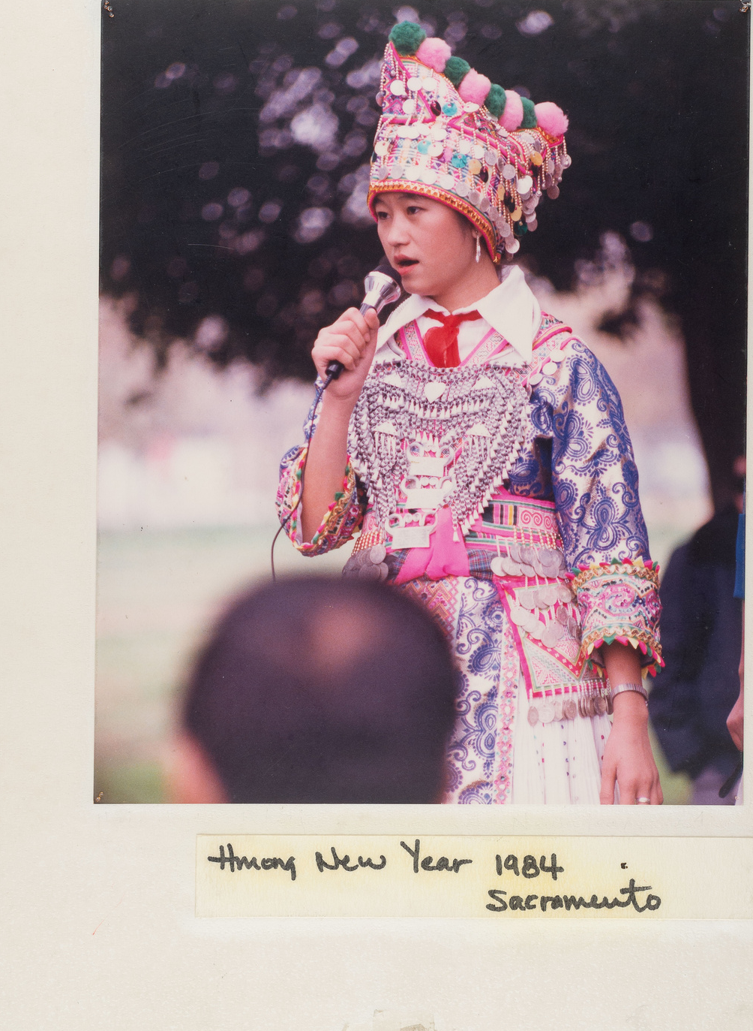
Outcomes
Multilingual terms in descriptions, subject access points use authority files and local controlled terms: SEACRCC-4236A
HMong vs. Hmong
Contextual information added to descriptions: SEACRCC-3183A
Corrections to original titles: SEACRCC-3775A
White HMong Girl Sings at HMong New Year Celebration in Sacramento, California, SEACRCC-3668P. MSS-2005/65, Southeast Asia Community Resource Center Collection

Slide 11
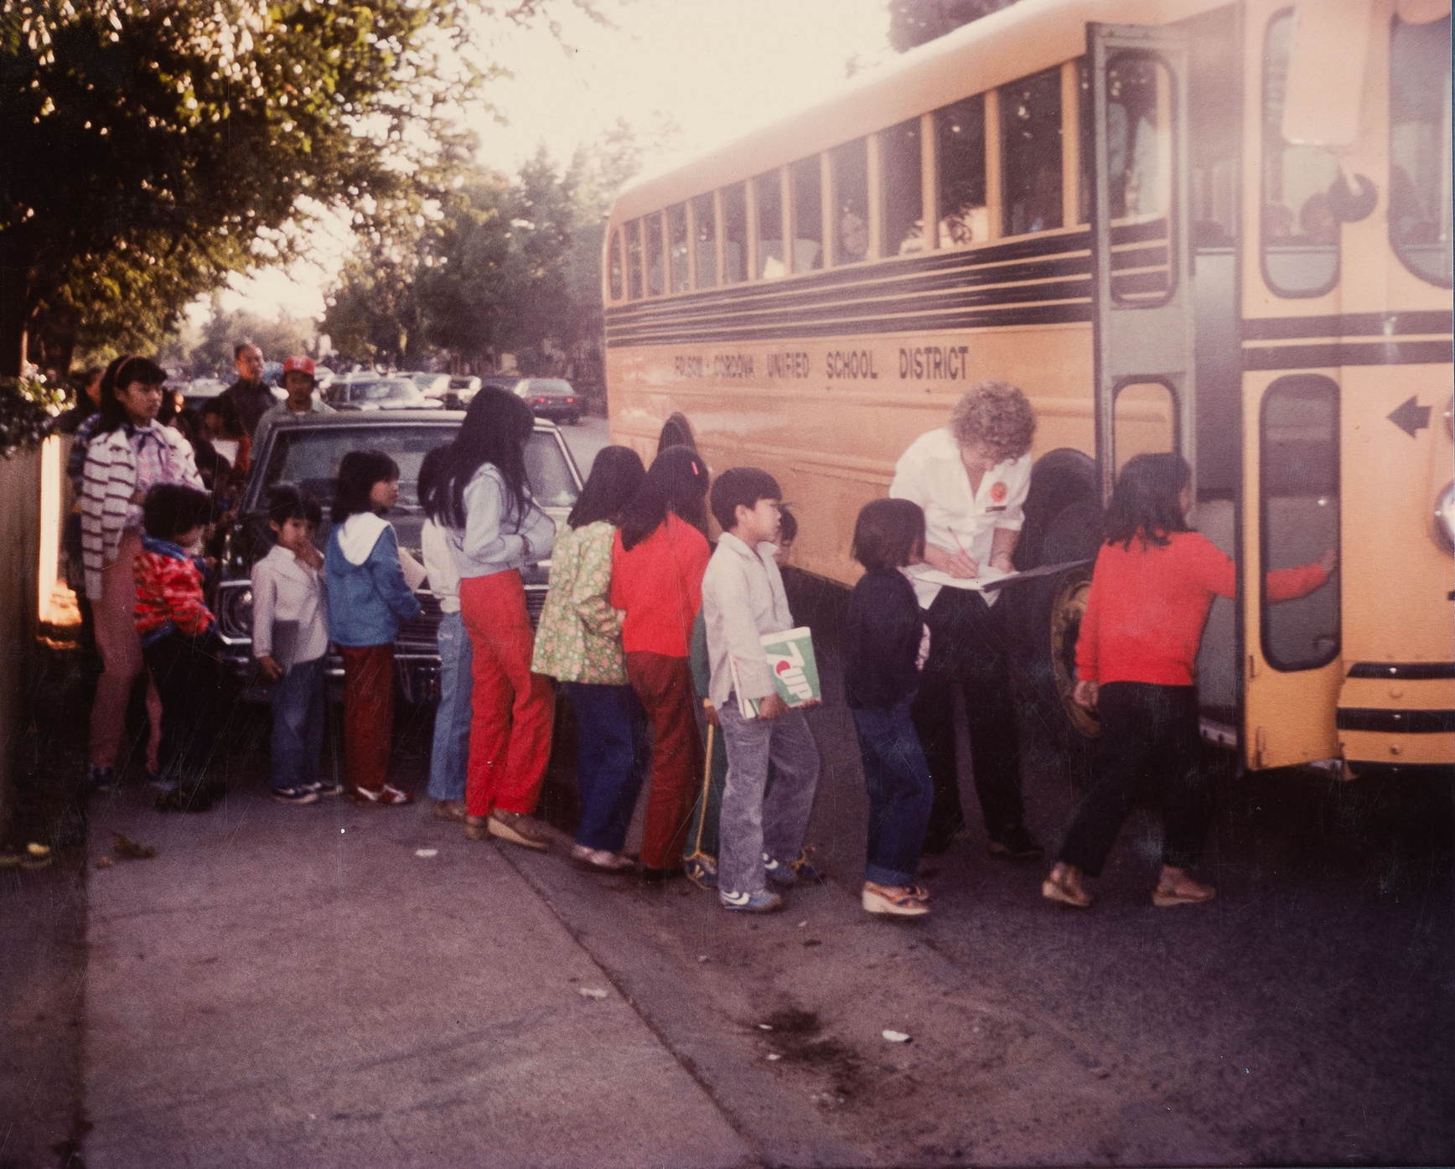
Cataloging Reflection
Leverage Linked Open Data to support multilingual search and retrieval
Revise formatting of non-Western Names
Children Board School Bus in Rancho Cordova, California, SEACRCC-3686P. MSS-2005/65, Southeast Asia Community Resource Center Collection

Slide 12
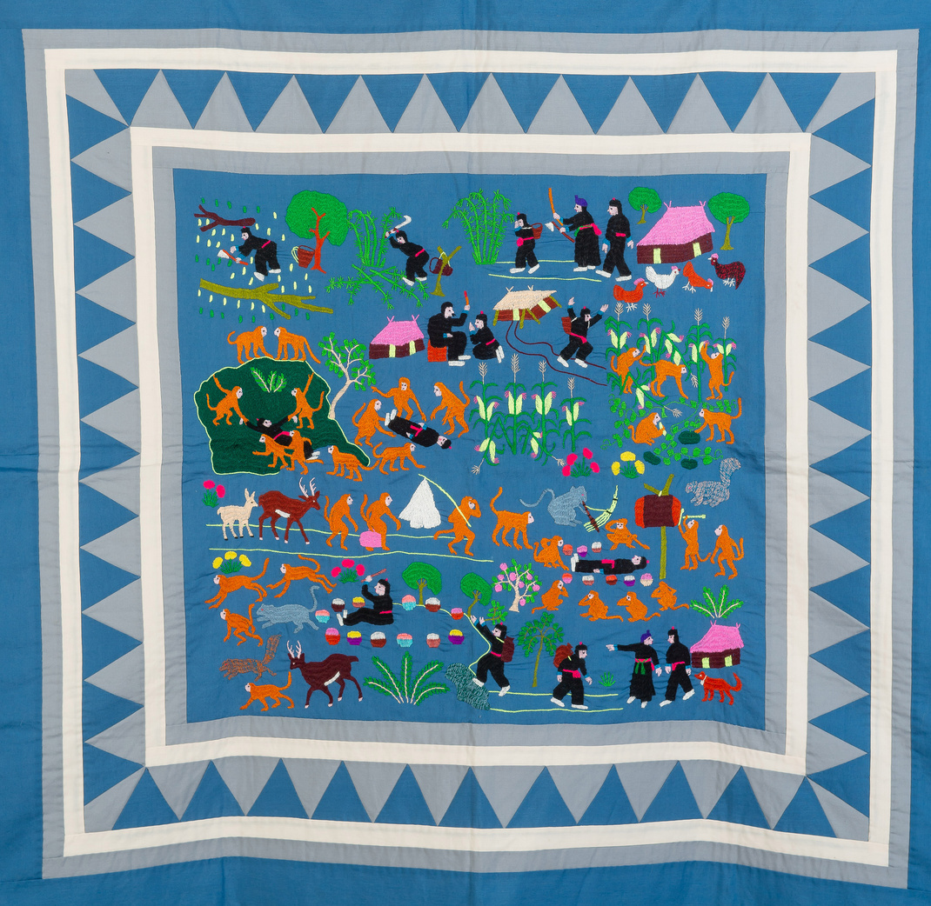
Project Reflection
"Projects like these are instrumental to empowering communities like mine because they give people access to their histories...our history is dispersed and complex...[digital collections like this allow for diasporic communities, like the HMong, to form collective communities online.]”
- Pachia L. Vang, Subject Expert, Southeast Asia Community Resource Center Collection: Artifact and Photograph Digitization Project
HMong Paj Ntaub, Monkey's Funeral Folktale, #1, SEACRCC-4125A. MSS-2005/65, Southeast Asia Community Resource Center Collection

Slide 13
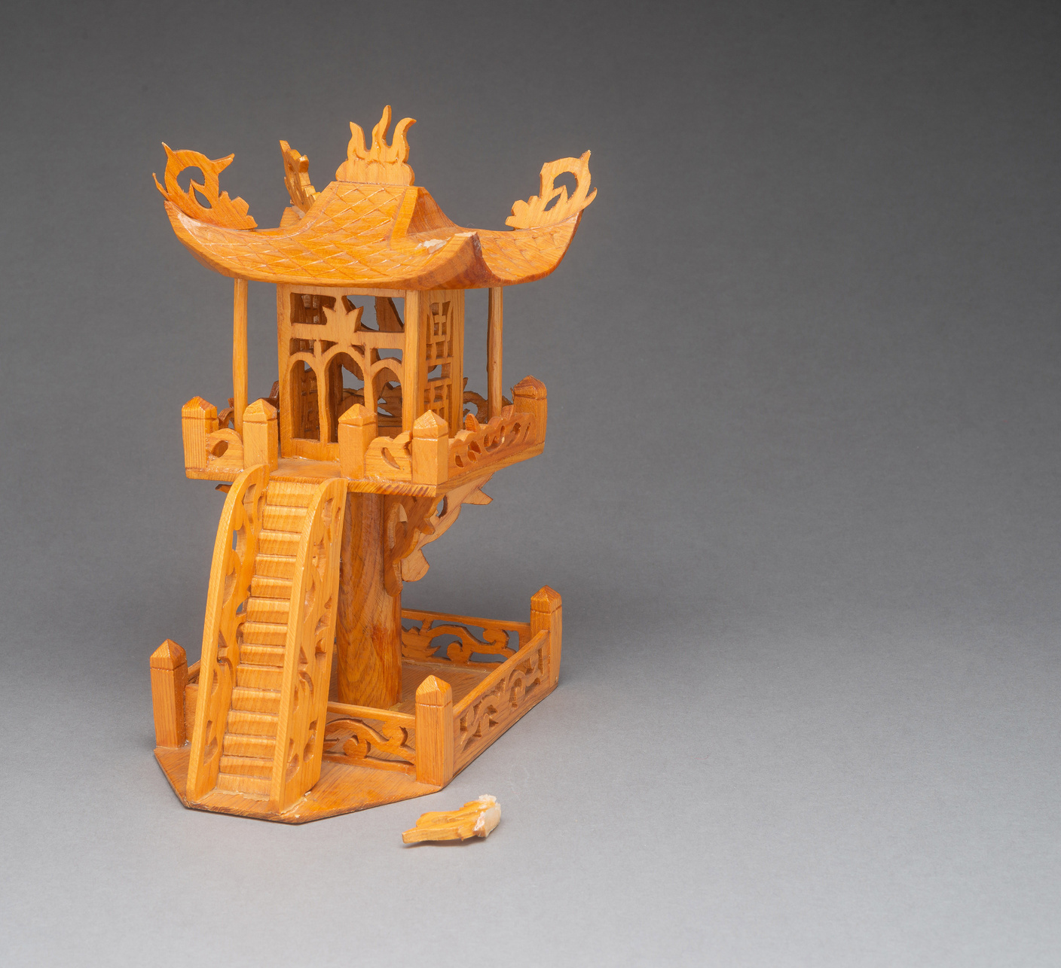
Contact
THANK YOU!
Elyse Fox
elyse.fox@csus.edu
Lynn Drennan
drennanl@csus.edu
This presentation is shared under a
CC-BY-NC-SA 4.0 license
Miniature Vietnamese One-foot Temple, Hanoi, Vietnam, SEACRCC-3832A. MSS-2005/65, Southeast Asia Community Resource Center Collection

