Slide 1
olac Video Game Genre Vocabulary

Slide 2
Setting the stage for the need of a video game genre vocabulary
January 2015 - CAPC (OLAC Cataloging Policy Committee) Established a working group charged with researching and writing a white paper documenting the need for video game genre terms
The Policy & standards division (psd) of the library of congress acknowledged that video games do indeed have genre terms that are specific to the format and that they would be definitely be appropriate As lcgft genre terms.
HOWEver PSD could not give a timeline as to when they could take on a video game lcgft project

Slide 3
CAMMS SAC GFIS Working Group on video game genre vocabulary
Summer 2016 - CAMMS/SAC/GFIS/Video game working group was established with the charge of developing a vocabulary for video game genre terms
Research to identify viable genre terms
Create authority records for these genre terms based on literary warrant and cite the references in the authority records
Investigate feasibility of publishing the vocabulary independently if LC was unable to commit to an lcgft project
January 2017 to JANUARY2018 - multiple follow up Communications with PSD staff – BECAUSE of limited staff resources and other priorities they were unable to advise as to if and when a video game genre lcgft project could be undertaken by lc

Slide 4
PROPOSAL SUBMITTED TO OLAC Executive board
at this point, ALTHOUGH it would have been optimal for the video game genre terms to be folded into the lcgft vocabularies, the working group felt it made sense to investigate an alternative approach (as was mentioned in the original charge of the working group)
The olac executive board was presented with a proposal that asked for olac to take “ownership” of the video game vocabulary that had been developed and to “publish” the vocabulary.
OLAC’s decision to publish the video game genre vocabulary was predicated on the fact that many audiovisual catalogers have long looked to OLAC to provide resources that support the cataloging of a variety of AV formats.
Best Practices for Cataloging DVD and Blu-Ray Discs Using RDA and MARC21
Best Practices for Cataloging Video Games Using RDA and MARC21,
Although the genre vocabulary and the associated marc records are a different type of resource than olac had published in the past, the olac board recognized that the vocabulary could become an extremely valuable olac resource and hopefully be widely adopted.

Slide 5
PROPOSAL accepted
Applied for a marc source code registering olac as the “owner” and “publisher’ of A video game genre vocabulary
This ALLOWS for olac‘s video game vocabulary to be used in subfield $2 in a 655 Marc tag
655 7 Fantasy video games $2 olacvggt
THE vocabulary is now available on the olac website along with other OLAC CATALOGING RESOURCES
the complete file of the authority records in marc format is now available for libraries to download into their ILS systems COURTESY OF MARCIVE, INC.
INCLUDEs OTHER ANCILLARY DOCUMENTS

Slide 6
RESEARCH PHASE
Began with Gaming sites
in order to amass a large initial list of potential terms since video game users are familiar with these genre terms as applied to specific games
Vetted through the list we created
to determine the feasibility of each term, Grouped like terms together and also excluded a number of terms
Assigned the terms on the working list we created to the various members of the video game genre working group
in order to research each term and identify Literary sources as well as additional credible gaming sources for them

Slide 7
SOME OF THE LITERARY SOURCES CITED
Egenfeldt-Nielsen, S. Understanding video games, 2016
The Routledge companion to video game studies, 2014
Carreker, D. The game developer's dictionary, 2012
Encyclopedia of video games, 2012
Writing for video games genres, 2009
Apperley, T.H. Genre and games studies, in Simulation & gaming, 2006
Gunn, E.A.A. A taxonomy of video games and AI, in AI and Games Symposium, 2009
Encyclopedia of information science and technology, 2015
Rogers, S. Level up!, 2014

Slide 8
more about the sources cited
we found a number of articles regarding science fiction video games in the literary journal, Science Fiction Studies.
take a minute to browse the 670's to see the different flavor of resources we used depending on the genre term
Gaming sites
Mobygames.com
Encyclopedia Gamia – a gaming wiki
Notes:
Regarding the journal Science Fiction Studies - I remember being pleasantly surprised . I was familiar with the journal because of all of the articles written over the years about science fiction books but it just never dawned on me until I was doing the literature search that it now concerns itself with science fiction video games as well!

Slide 9
Authority records
Used Library of congress lcgft manual as A guide for creating the authority records
Citation of sources – aimed for at least three sources for each term
Broader term references (see also references)
Related terms references (see also references)
“USED FOR” references (see references)
Scope notes

Slide 10
SAMPLE AUTHORITY RECORD
Beat 'em up video games
UF Beat them up video games
UF Brawler video games
BT Fighting video games
RT Hack and slash video games
Scope Note: Video games in which gameplay focuses on “hand to hand combat, sometimes allowing players to use parts of the environment as weapons.” Players often must engage with multiple enemies at one time to fight their way through levels.

Slide 11
SAMPLE AUTHORITY RECORD Continued
SOURCE: eColwell, J. Needs met through computer game play among adolescents, in Personality and individual differences, 2007: $b page 2075 (Children reported knowledge of, and experience of playing, a wide variety of games and game types. Racing games (e.g. cars racing), puzzle games (brainteasers), role play games (the player can take on another identity), shoot ‘em up games (shooting and killing using a variety of weapons) and beat ‘em up games (punching and/or kicking), sports games (e.g. golf simulations), and platform games (usually running and jumping onto platforms) were all mentioned)
SOURCE: The Routledge companion to video game studies, 2014: $b page 226 (Regardless of the chosen root, no one can argue that the tree of fighting games only sprang fully-grown through the success of Street Fighter II (Capcom, 1991) and Mortal Kombat (Midway, 1992). A related but different sub-genre can be found in the beat ’em up, whose formula had been prefigured by Kung-Fu Master (Irem, 1984) and established by Double Dragon (Technos, 1987), in which the player advances through levels while battering down scores of weak enemies in hand-to-hand combat)
SOURCE: Carreker, D. The game developer's dictionary, 2012: $b page 29 (Beat ‘em up: a genre of video games in which characters engage in multiple opponents in martial arts-style combat, and often more than one at a time)

Slide 12
SYNDETIC structure of the video game thesaurus
All the genre terms fit into a Hierarchical structure
Top Hierarchical term is Video games
All terms reference a broader term
Whether it’s video games or an intermediate broad term i.e. shooter video games

Slide 13
OLAC WEBSITE
http://www.olacinc.org

Slide 14
http://www.olacinc.org/video-game-vocabulary

Slide 15
VOCABULARY resources available on the OLAC website http:/www.olacinc.org/olac-video-game-vocabulary
Guidelines For OLAC Video Game Genre Terms (Olacvggt)
ALPHABETICAL LIST OF OLAC VIDEO GAME GENRE TERMS
TEXT VERSION OF THE OLAC Video Game Genre Terms (Olacvggt) MARC Authority Records
ACTUAL MARC Authority Records to download (MARC-8 format)
ACTUAL MARC Authority Records to download (UTF-8 format)
Power Point slide presentation about the OLAC Video Game Genre Vocabulary
Contact information

Slide 16
Guidelines For OLAC Video Game Genre Terms (Olacvggt)
explains some of the fixed codes in the authority records
Identifies the olac source code to use in 655 7 $2
655 7 RACING GAMES $2 OLACVGGT
provides direction on how to apply the terms in a bibliographic record

Slide 17
ALPHABETICAL LIST OF OLAC VIDEO GAME GENRE TERMS
Provides A QUICK REFERENCE TO ALL THE TERMS CONTAINED IN THE VOCABULARY

Slide 18
TEXT VERSION OF THE OLAC VIDEO GAME GENRE TERMS (OLACVGGT) MARC AUTHORITY RECORDS
allows CATALOGERS THE ABILITY TO LOOK OVER THE ACTUAL AUTHORITY RECORDS BEFORE LOADING THEM INTO THEIR ILS SYSTEMS.
Lets CATALOGERS EXAMINE THE CONTENT THAT IS CITED AS LITERARY WARRANT FOR THE USE OF THE TERM

Slide 19
MARC Authority Records to download
THE MARC AUTHORITY RECORDS ARE OFFERED IN TWO DIFFERENT FORMATS FOR LIBRARIES TO CHOOSE FROM
Marc-8
Utf-8 (uNICODE)
the option to load the marc records into an ils system gives libraries the means to exercise authority control measures for the terms

Slide 20
Traffic to the oLAC website
Google analytic statistics indicate the following traffic to the different olac Video game genre vocabulary resources on the OLAC WEBSITE during the period October 4, 2018 thru june 17, 2019:
OLAC Video Game VOCABULARY GENERAL page – 1,602
ALPHABETICAL LIST OF OLAC VIDEO GAME GENRE TERMS – 1,293
TEXT VERSION OF THE OLAC Video Game Genre Terms (Olacvggt) MARC Authority Records - 509
MARC AUTHORITY RECORDS DOWNLOADED – ???
Guidelines For OLAC Video Game Genre Terms (Olacvggt) - 476

Slide 21
RETROSPECTIVE IMPLEMENTATION AT MOUNT PROSPECT PUBLIC LIBRARY
MOUNT PROSPECT PUBLIC LIBRARY ONLINE CATALOG
https://mtpros.ent.sirsi.net/client/en_US/default/search/results?te=&lm=VIDEO_GAMES&dt=list
Notes:
When we catalog new video games we use information from the insert to help us determine the appropriate genre headings to apply. However, since we have 2,200 video games, it wasn’t feasible to refer to the insert information when it came time to assign genre terms to our individual titles. Instead, we used the gaming site Moby games to help us determine appropriate genres to add to the bibliographic records.

Slide 22
655 _7 Action adventure video games. $2 olacvggt
655 _7 3D video games. $2 olacvggt
655_7 Open world video games. $2 olacvggt
655_7 Video games. $2 olacvggt

Slide 23
655 _7 Platform video games. $2 olacvggt
655 _7 Action adventure video games. $2 olacvggt
655 _7 2D video games. $2 olacvggt
655_7 Video games. $2 olacvggt

Slide 24
655 _7 Action adventure video games. $2 olacvggt
655 _7 First person shooter . $2 olacvggt
655 _7 Vehicular combat video games. $2 olacvggt
655 _7 Wargames (Video games) $2 olacvggt
655_7 Video games. $2 olacvggt

Slide 25
655 _7 Fantasy video games. $2 olacvggt
655 _7 Action video games. $2 olacvggt
655 _7 Platform video games. $2 olacvggt
655 _7 Third person video games. $2 olacvggt
655_7 Video games. $2 olacvggt

Slide 26
http://metadataregistry.org
OLAC VIDEO GAME GENRE VOCABULARY
IS ALSO AVAILABLE THROUGH THE
OPEN METADATA REGISTRY
The Metadata Registry provides services to developers and consumers of controlled vocabularies and is one of the first production deployments of the RDF-based Semantic Web Community's Simple Knowledge Organization System (SKOS)

Slide 27
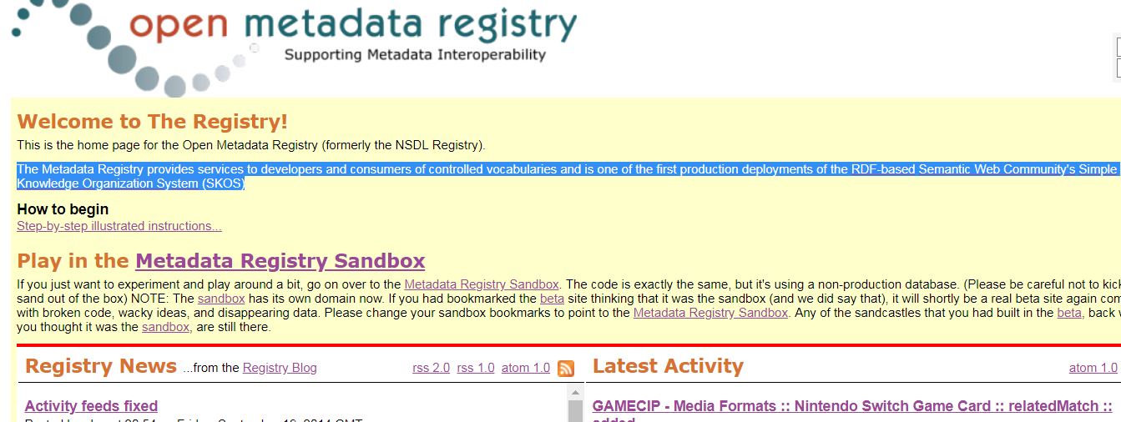

Slide 28
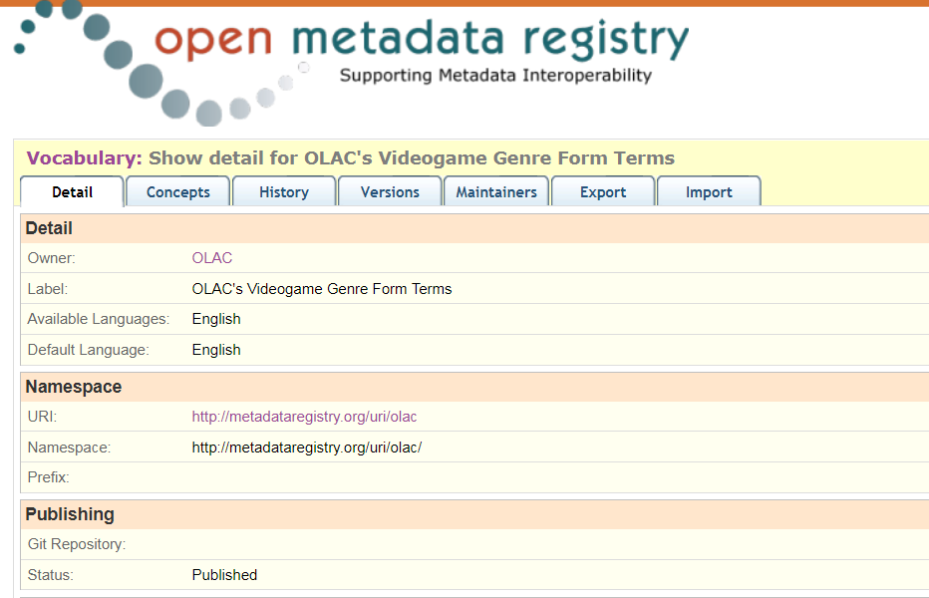

Slide 29
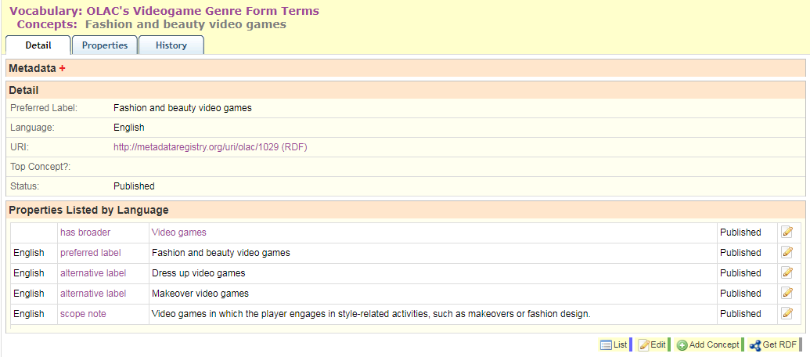
Notes:
Here’s an example of an individual term: you can see the preferred labels and alternative labels and scope notes all of which had to be copied and pasted manually.
Each has a unique URI and every term has a broader term except Video games itself because it is the top term. Individual terms can be downloaded as SKOS-RDF

Slide 30
Notes:
The entire vocabulary can be exported as SKOS-RDF or a CSV file. You can also generate an XSD file which restricts a simple type xs:string to just the terms in this vocabulary.

Slide 31
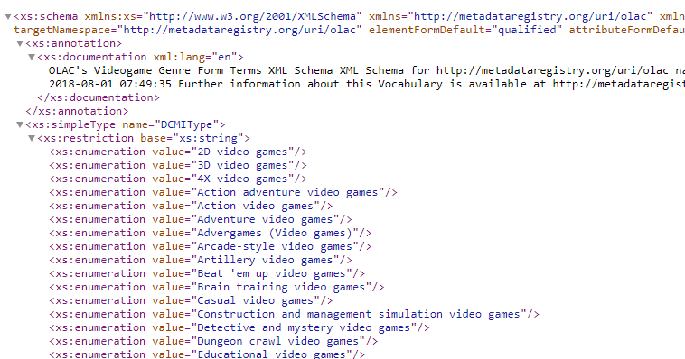
Notes:
One thing to note is that all terms in this vocabulary are enumerated here with no respect to the structure of the vocabulary, so if you were trying to build an XML document that would let a user drill down from broader terms to narrower terms, this XSD might not be sufficient. But it’s still a very cool feature that the Registry offers.

Slide 32
ALCTS/CAMMS/SAC/GFIS/Video game genre working group
Rosemary Groenwald, Chair, Mount Prospect Public Library
Jay L. Colbert, University of Utah
Eduardo Fojo, Florida International University
Julia Frankosky, Michigan State University
Netanel Ganin, Library of Congress
Rachel Jaffe, University of California, Santa Cruz
Charles Lemme, Hussey Mayfield Memorial Public Library
Neil Robinson, University of Michigan
George Wrenn, Humboldt State University
Rosemary Groenwald
rosemary@mppl.org

