Slide 1
Becoming FADGI: Creating a Compliant Digital Imaging Workspace
By: Bethann Rea
ALA Core IG – Digital Conversion
March 11th, 2022

Slide 2
Today's Topic
With budget cuts, changing work environments, and staffing shortages, digitization experts face continuous challenges when advocating for upgrades to imaging labs. This presentation will provide guidance for implementing new equipment, as well as examples of space planning projects. This case study will refer to standards from the Federal Agencies Digital Guidelines Initiative (FADGI) to further illustrate the decision-making process.

Slide 3
What is FADGI?
Federal Agencies Digital Guidelines Initiative
Still Image Working Group
Audio Visual Working Group
The current guidelines for still imaging were approved in 2016.
FADGI uses a star-rating system for determining image specifications and parameters to meet the desired rating.
Figure 1: Star-rating chart for bound volumes that are rare or special materials found. (FADGI, 2016)

Slide 4
A Little History
Digitization Lab without a dedicated supervisor for three years.
Equipment ready for lifecycle.
Workspace needed to be refreshed.
Additional calibration and further adoption of national standards for imaging needed.
Figure 2: Department photo of BetterLight Camera taken July 2018.
Figure 3: Department photo of the Digitization Lab taken November 2021.

Slide 5
Creating A Plan
What equipment will best serve the collections at my institution?
Should I consider any software upgrades? Are there open-source or facility supported options?
Evaluation the workspace.
What upgrades need to happen versus considerations for the future?
Figure 3: Department photo of Metis taken in August 2020.

Slide 6
Equipment & Software
Implementation of calibration software with a schedule and procedures for staff
Work with IT team to select equipment and software that can be supported over time and fit within the institution's established lifecycle.
When upgrading the workspace, you should balance ergonomics and technology.
Figure 5: Department photo of imaging workstation taken November 2021.

Slide 7
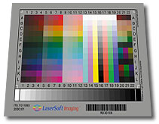
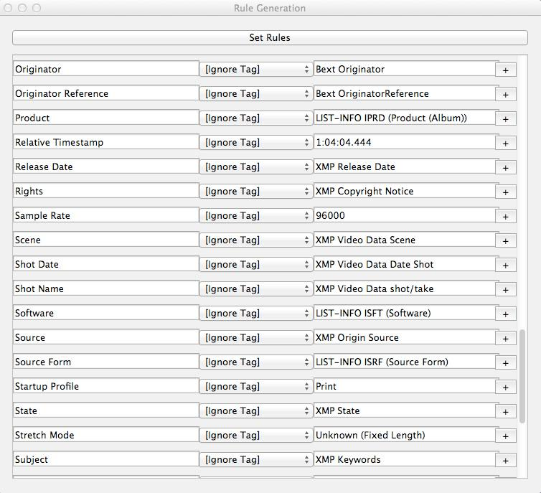
Committing to Calibration & QC
Targets Monitors Quality Control
Figure 6: IT8 Color Target (LaserSoft Imaging, 2008)
Figure 7: Color calibration tool. (Datacolor, 2022)
Figure 8: MDQC software for checking embedded metadata. (AVP, 2022)

Slide 8
The Imaging Environment
Considerations for our Digitization Lab:
Curtains
Lightning
Wall color
Request for blackout curtains denied by Facilities Team in 2018. Room has a dimmable lightning system with zones.
Proposal made to repaint the Digitization Lab during 2020-2021 budget cycle.
Figure 9: Image of GTI Standard Gray Neutral 8 paint. (GTI, 2019)

Slide 9
Painting Project: Winter 2021 - 2022
Figures 10 & 11: Department photos of the digitization lab during construction and painting in January 2022.

Slide 10
Reopening the Digitization Lab
Figures 12 & 13: Department photos of digitization lab after completion of painting project in January 2022.

Slide 11
References
AVP. (2022).MDQC. https://www.weareavp.com/products/mdqc/
Better Light Inc. (2012). Better Light Large Format Digital Photography - the world's Finest Digital Camera System. Better Light Large Format Digital Photography. https://www.betterlight.com/
DataColor. (2022). Our best monitor calibration tool ever: Datacolor. SpyderX. https://spyderx.datacolor.com/
Digital Transitions. (2022). IXH 150mp camera system. DT Heritage. https://heritage-digitaltransitions.com/dt-ixh-150mp-cultural-heritage-camera-by-phase-one/
GTI Graphic Technology, Inc. (2019). Neutral gray paint - GTI graphic technology inc. Standard Neutral Gray Paints. https://www.gtilite.com/wp-content/uploads/2019/03/Neutral-Gray-Paint_2pg_Screen.pdf
LaserSoft Imaging. (2022). LaserSoft imaging targets for color calibration. LaserSoft Imaging. https://www.silverfast.com/show/it8-targets/en.html
METIS. (2022). Metis systems - high quality scanners for industry and cultural institutions. METIS DRS 1520 DCS. https://www.metis-group.com/
Rieger, T. (Ed.). (2016). Technical Guidelines for Digitizing Cultural Heritage Materials: Creation of Raster Image Files. http://www.digitizationguidelines.gov/guidelines/FADGI%20Federal%20%20Agencies%20Digital%20Guidelines%20Initiative-2016%20Final_rev1.pdf
Sherwin-Williams. (2022). Williams paints, stains, supplies and Coating Solutions. Sherwin-Williams. https://www.sherwin-williams.com/

Slide 12
Questions
Contact Information:
Bethann Rea
Digital Collections Management Librarian, Penn State University
baz5008@psu.edu
Figure 14: Department photo of PhaseOne Camera taken August 2020.

