Slide 1
The Semantic Web: rdf Identifiers & Namespaces
By Rhonda Super
Continuing Resources Work Group
April 24, 2014
Updated May 30, 2015

Slide 2
Linked data
Linked Data refers to data published in accordance with principles designed to facilitate linkages among datasets, element sets, and value vocabularies.
W3C. Library Linked Data Incubator Group Final Report. Downloaded March 15, 2014 from http://www.w3.org/2005/Incubator/lld/XGR-lld-20111025/

Slide 3
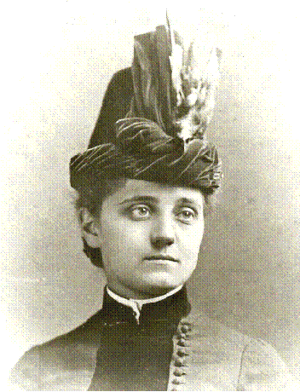
Linking resources
Web resources (information resources such as documents, images, etc.) can be linked to people, places, ideas, (non-information resources) and the relationships between them.
is the author of
Jane Addams

Slide 4
Four principles of Linked data
The four principles of Linked Data as set forth by Tim Berners-Lee are as follows:
Use Uniform Resource Identifiers (URIs) as names for things.
Use Hypertext Transfer Protocol (HTTP) URIs so that people can look up those names.
When someone looks up a URI, provide useful information, using the standards (RDF, SPARQL).
Include links to other URIs so that they can discover more things.
Hart, Glen & Dolbear, Catherine. (2013). Linked Data: A Geographic Perspective. Boca Raton: CRC Press, p.107.

Slide 5
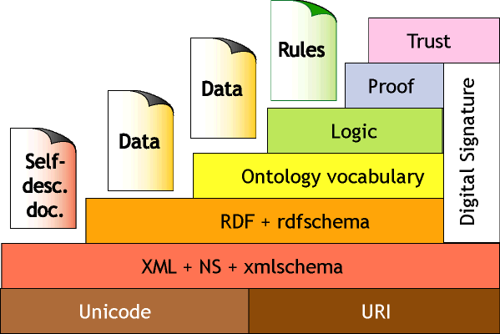
RESOURCE Description Framework
Resource Description Framework (RDF) is a model consisting of layers of technology used to implement linked data on the Semantic Web.
Berners-Lee, Tim. Architecture. World Wide Web Consortium.
Downloaded January 30, 2014 from: http://www.w3.org/2000/Talks/1206-xml2k-tbl/slide10-0.html

Slide 6
RDF
Resource Description Framework (RDF), is a standard used to express linked data which specifies relationships between things -relationships that can be used for navigating between, or integrating, information from multiple sources.
W3C. Library Linked Data Incubator Group Final Report. Downloaded March 15, 2014 from http://www.w3.org/2005/Incubator/lld/XGR-lld-20111025/
Notes:
The basic building block in RDF is a simple statement called a triple.
Its aim is to be both a “conceptual framework” (a way of looking at things) and an actual language for describing Web resources independently of any particular domain or subject area. The purpose of this is to allow applications that exchange machine-understandable information on the Web to interoperate more easily with each other. Since we are dealing with the Web, this framework needs to be scalable, so that it still works with any amount of data; flexible, expressive enough to encode any sort of information we might need to talk about; and yet simple, so that it is easy for anyone to read, write, or query it.
Hart, Glen & Dolbear, Catherine. (2013). Linked Data: A Geographic Perspective. Boca Raton: CRC Press, p.71.

Slide 7
Linking open data Cloud diagram
Linking Open Data cloud diagram, by Richard Cyganiak and Anja Jentzsch. http://lod-cloud.net/

Slide 8
URLs, URIs & IRIs
Uniform Resource Locators (URLs) always access information resources – things that live on the web: documents, images, etc.¹
A URL is a type of URI, which points to the actual location (or the web address) of a resource, including the file name and extension (such as .html or .php) of a web resource.²
¹W3C. Library Linked Data Incubator Group Final Report. Downloaded March 15, 2014 from http://www.w3.org/2005/Incubator/lld/XGR-lld-20111025/
²Tharani, Karim. (2014). Linked Data in Libraries: A Case Study of Harvesting and Sharing Bibliographic Metadata with BIBFRAME, p.8. Downloaded May 30, 2015 from:
https://ejournals.bc.edu/ojs/index.php/ital/article/download/5664/pdf
Notes:
Unique identifiers are assigned to resources and the relationships between them which are depicted in an RDF graph.
Being more generic, the use of URIs (as opposed to URLs) in Linked Data provides persistency and flexibility of not having to change the names and references every time resources are relocated or there is a change in server technology. For example if an organization switches its underlying web--‐scripting technology from Active Server Pages (ASP) to Java Server Pages (JSP), all the files on a web server will bear a different extension (e.g., .jsp) causing all previous URLs with old extension (e.g., .asp) to become invalid. This technology change, however, may have no impact if URIs are used instead of URLs because the underlying implementation and location details for a resource are masked from the public. Thus the URI naming scheme within an organization must be developed independent of the underlying technology.
Tharani, Karim. (2014). Linked Data in Libraries: A Case Study of Harvesting and Sharing Bibliographic Metadata with BIBFRAME, p.8. Downloaded May 30, 2015 from:
https://ejournals.bc.edu/ojs/index.php/ital/article/download/5664/pdf
Use one of the best practices on how to name URIs to promote stability, usability, persistence, and longevity.

Slide 9
URLs, URIs & IRIs
A URI serves as a persistent name or handle for a resource and is ideally independent of the underlying location and technology of the resource. ¹
Uniform Resource Identifiers (URIs) are used to identify non-information resources, information resources, AND THE RELATIONSHIPS between them.
An URI can be created to refer to anything that needs to be referred to in an RDF statement.
Internationalized Resource Identifiers (IRIs) are URIs that use the extended set of natural-language scripts supported by Unicode.²
¹Tharani, Karim. (2014). Linked Data in Libraries: A Case Study of Harvesting and Sharing Bibliographic Metadata with BIBFRAME, p.8. Downloaded May 30, 2015 from:
https://ejournals.bc.edu/ojs/index.php/ital/article/download/5664/pdf
²W3C. Library Linked Data Incubator Group Final Report. Downloaded March 15, 2014 from http://www.w3.org/2005/Incubator/lld/XGR-lld-20111025/
Notes:
Unique identifiers are assigned to resources and the relationships between them which are depicted in an RDF graph.

Slide 10
internationalized resource identifier
The notion of IRI is a generalization of URI (Uniform Resource Identifier), allowing non-ASCII characters to be used in the IRI character string. IRIs are specified in RFC 3987 [RFC3987]. ¹
Every absolute URI and URL is an IRI, but not every IRI is an URI. ²
¹ W3C. Schreiber, Guus & Raimond (editors). RDB 1.1 Primer. Downloaded April 5, 2014 from http://www.w3.org/TR/rdf11-primer/ .
² W3C. Cyganiak, Richard, DERI, Wood, David, 3 Round Stones, Lanthaler, Markus, Graz University of Technology (editors). RDF 1.1 Concepts and Abstract Syntax: W3C Recommendation 25 February 2014. Downloaded March 8, 2014 from http://www.w3.org/TR/2014/REC-rdf11-concepts-20140225/#dfn-recognized-datatype-iris

Slide 11
International Resource Identifiers
Uniform Resource Identifiers (URIs) are now International Resource Identifiers (IRIs)
Linked Data uses IRIs as globally unique identifiers for any kind of resource, analogously to how identifiers are used for authority control in traditional librarianship.
W3C. Library Linked Data Incubator Group Final Report. Downloaded March 15, 2014 from http://www.w3.org/2005/Incubator/lld/XGR-lld-20111025/
Notes:
As of February 25, 2014, with the update to the RDF Primer, URIs became officially IRIs by W3C. However, they are often still called URIs.

Slide 12
Rdf resource
RDF defines a resource as anything that is identifiable by a [unique identifier called a] URI reference (URIref).
These identifiers are formed using the HTTP protocol.
The LC Name Authority URI for Jane Addams:
http://id.loc.gov/authorities/names/n79104234
Manola, Frank & Miller, Eric. (2004, February 4). RDF Primer. World Wide Web Consortium, (Massachusetts Institute of Technology, European Research Consortium for Informatics and Mathematics, Keio University). Accessed September 26, 2011, from http://www.w3.org/Consortium/Legal/2002/copyright-documents-20021231

Slide 13
UrIref
A URI/IRI reference (or URIref) is a URI/IRI, together with an optional fragment identifier at the end.
Manola, Frank & Miller, Eric. (2004, February 4). RDF Primer. World Wide Web Consortium, (Massachusetts Institute of Technology, European Research Consortium for Informatics and Mathematics, Keio University). Accessed September 26, 2011, from http://www.w3.org/Consortium/Legal/2002/copyright-documents-20021231

Slide 14
Anatomy of a Uri ref
Library of Congress Name Authority File (NAF) URI for Jane Addams:
http://id.loc.gov/authorities/names/n79104234
Protocol: http://
URI: id.loc.gov/authorities/names/
Fragment identifier: n79104234
Notes:
In RDF vocabularies, such as RDFS, OWL, or SKOS, fragment identifiers are used to identify resources in the same XML Namespace, but are not necessarily corresponding to a specific part of a document. For example http://www.w3.org/2004/02/skos/core#broader identifies the concept "broader" in SKOS Core vocabulary, but it does not refer to a specific part of the resource identified by http://www.w3.org/2004/02/skos/core, a complete RDF file in which semantics of this specific concept is declared, along with other concepts in the same vocabulary.
Wikipedia. Fragment identifier. Downloaded March 27, 2014 from http://en.wikipedia.org/wiki/Fragment_identifier

Slide 15
Absolute Uriref
An absolute URIref refers to a resource independently of the context in which the URIref appears.
The Library of Congress Name Authority File (NAF) absolute URI for Jane Addams:
<http://id.loc.gov/authorities/names/n79104234>

Slide 16
relative Uriref
A relative URIref is a shorthand form of an absolute URIref, where some prefix of the URIref is missing, and information from the context in which the URIref appears is required to fill in the missing information.

Slide 17
relative Uriref Example
For example, the relative URIref
“otherpage.html”
when appearing in a resource
“http://www.example.org/index.html”
would be filled out to the absolute URIref “http://www.example.org/otherpage.html”

Slide 18
relative Uriref
A URIref consisting of just a fragment identifier is considered equivalent to the URIref of the document in which it appears, with the fragment identifier appended to it.
For example, within http://www.example.org/index.html, if #section2 appeared as a URIref, it would be considered equivalent to the absolute URIref http://www.example.org/index.html#section2.
Manola, Frank & Miller, Eric. (2004, February 4). RDF Primer. World Wide Web Consortium, (Massachusetts Institute of Technology, European Research Consortium for Informatics and Mathematics, Keio University). Accessed September 26, 2011, from http://www.w3.org/Consortium/Legal/2002/copyright-documents-20021231

Slide 19
relative Uriref Example
The Library of Congress Name Authority File (NAF) relative URI for Jane Addams:
n79104234
Notes:
http://id.loc.gov/authorities/names/n79140423

Slide 20
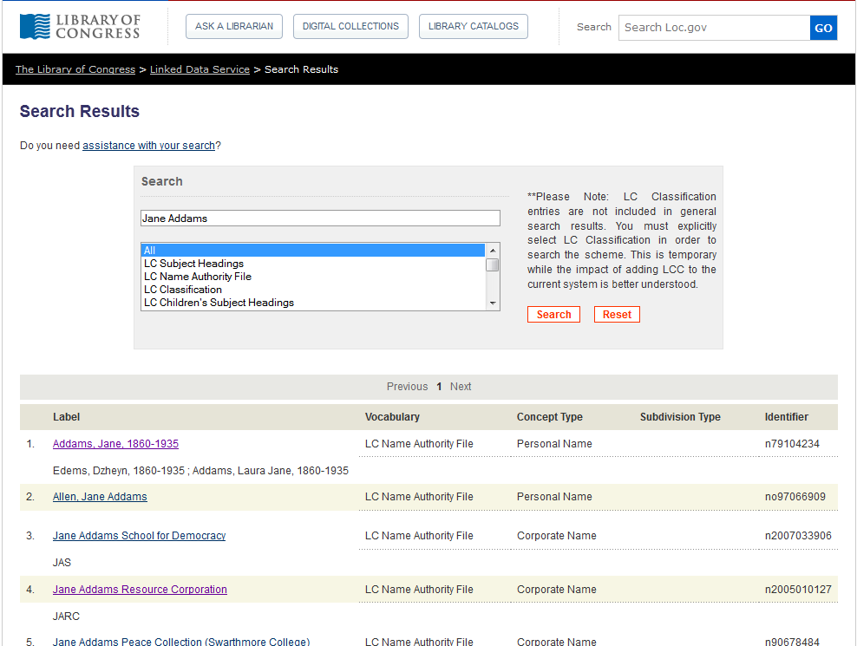
Relative Uriref Example
Notes:
http://id.loc.gov/search/?q=Jane+Addams&q=&q=memberOf%3Ahttp%3A%2F%2Fid.loc.gov%2Fauthorities%2Fnames%2Fcollection_NamesAuthorizedHeadings

Slide 21
URI Aliases
URIs that refer to the same non-information resource are called URI aliases.
Aliases for Jane Addams:
VIAF IRI for Jane Addams:
http://viaf.org/viaf/12382490
Library of Congress IRI for Jane Addams:
http://id.loc.gov/authorities/names/n79104234
Bizer, Chris, Richard Cyganiak, Richard & Heath,Tom. How to Publish Linked Data on the Web. Downloaded April 27, 2014 from http://wifo5-03.informatik.uni-mannheim.de/bizer/pub/LinkedDataTutorial/ .
Notes:
http://id.loc.gov/authorities/names/n79140423

Slide 22
empty uriref
A URIref without a URI part is considered a reference to the current document (the document in which it appears). So, an empty URIref within a document is considered equivalent to the URIref of the document itself.
Manola, Frank & Miller, Eric. (2004, February 4). RDF Primer. World Wide Web Consortium, (Massachusetts Institute of Technology, European Research Consortium for Informatics and Mathematics, Keio University). Accessed September 26, 2011, from http://www.w3.org/Consortium/Legal/2002/copyright-documents-20021231

Slide 23
URNs
URNs are a subtype of URI used for things like identifying books by their ISBN number, e.g. urn:isbn:0143034650.
Tauberer, Joshua. (2008, January). What is RDF and what is it good for? Downloaded April 5, 2014 from http://www.rdfabout.com/intro/ .
Notes:
Uniform Resource Names, intended to be persistent location independent resource identifiers.
http://cgi.di.uoa.gr/~pms509/2012-2013/lectures/introduction-to-rdf.pdf

Slide 24
A triple Statement using LC Authorities and Vocabulary
The basic building block of RDF is a simple statement called a triple, comprised of a subject, a predicate, and an object.
Jane Addams is the author of Newer Ideals of Peace.
<http://id.loc.gov/authorities/names/n79104234> < http://id.loc.gov/vocabulary/relators/aut > “Newer Ideals of Peace”^^xs:string .
<http://id.loc.gov/authorities/names/n79104234>
< http://id.loc.gov/vocabulary/relators/aut >
“Newer Ideals of Peace”^^xs:string .
Notes:
A triple statement written in RDF XML format.

Slide 25
Rdf graph
An RDF graph is a set of triples. Subjects and objects on the graph are nodes. The predicate is represented as an arch which takes the form of an arrow between the subject and object. The arrow always points from the subject to the object.
Arch
Node Node
Mikael Nilsson, Mikael, Powell, Andy, Johnston, Pete, & Naeve, Ambjörn. (2008). Dublin Core Metadata Initiative. Accessed July 12, 2011 from http://dublincore.org/documents/dc-rdf/#sect-2.
Subject
Object
Predicate
Notes:
RDF is a graph technology.
Nodes are IRIs, literals, or blank nodes. Blank nodes may be given a document-local identifier called a blank node identifier.

Slide 26
Rdf IS A graph Technology
Hull House
Settlement Houses
Creator
Is a
Nobel Prize Winners
Jane Addams
Recipient
Creator
Twenty Years at Hull House
Inferred
Is a
Recipient
Emily Greene Balch
Buildings
Is a
Creator
Recipient
Is a
WomenNobel Prize Winners
Recipient
Newer Ideals of Peace
Creator
Creator
Alice Hamilton
U S National Register of Historic Places
Creator
Women at The Hague
Nobel Prize Domain
Author Domain
Building Domain
Notes:
“Is a” should be read as “Is an instance of” . Dotted arrows imply an inferred relationship.

Slide 27
Predicates
Predicates are RDF URI references and can be interpreted as either a relationship between the two nodes or as defining an attribute value (object node) for some subject node.

Slide 28
RDF Graphs
Subject
Predicate
Object
Entity
Attribute
Value
Node
Arc/Edge
Node
Resource
Property
Value

Slide 29
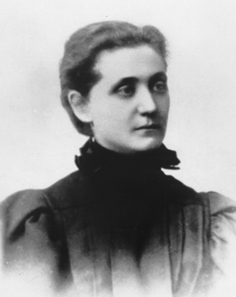
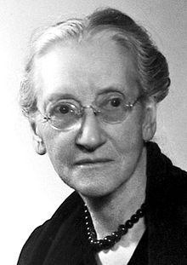
Example of a property
An example of a property from the Friend-of-a-Friend (FOAF) vocabulary for the triple statement:
Jane Addams knows Emily Greene Balch
Subject
Object
Predicate
http://xmlns.com/foaf/0.1/knows
http://id.loc.gov/authorities/names/n79140423
http://id.loc.gov/authorities/names/n50017609

Slide 30
Example of a rdf:langString literal
When a URI/IRI is not used to identify the object of a triple statement, it is called a literal. Only objects can be literals.
Property (hasBirthDate )
http://id.loc.gov/authorities/names/n79140423
September 6, 1860@en
rdf:langString
LC Authorities Uniform Resource Identifier (URI) for Jane Addams as a subject in a triple statement
Typed Literal used as the object of a triple statement
Notes:
Literals in RDF graphs tend to be depicted as rectangles rather than spheres, which denote nodes.
Objects do not have to be URLs/IRIs. When an object does not take the form of an identifier, it is called a Literal. Only objects can be literals.

Slide 31
referent
The resource denoted by a URI/IRI is called its referent.
Resource/Referent
IRIs
VIAF IRI for Jane Addams:
http://viaf.org/viaf/12382490
Library of Congress IRI for Jane Addams:
http://id.loc.gov/authorities/names/n79104234
=
Jane Addams

Slide 32
Full triples notation (RDF/XML)
A full triples notation requires that URIrefs are written out completely, in angle brackets.
Jane Addams knows Emily Greene Balch.
<http://id.loc.gov/authorities/names/n79104234> < http://xmlns.com/foaf/0.1/knows> <“http://id.loc.gov/authorities/names/n50017609 > .
<http://id.loc.gov/authorities/names/n79104234>
< http://xmlns.com/foaf/0.1/knows>
<http://id.loc.gov/authorities/names/n50017609> .

Slide 33
serialization
Serialization is the process of putting an RDF graph into a data format to publish it on the Web. There are several different RDF formats. W3C has standardized two syntaxes (RDF/XML and RDFa [Resource Description Framework-in-attributes]), and there are other nonstandard serialization formats that offer advantages in certain circumstances.
Hart, Glen & Dolbear, Catherine. (2013). Linked Data: A Geographic Perspective. Boca Raton: CRC Press, p.71.

Slide 34
Namespace
A namespace is a way of providing a unique qualifier (a name) which unites all the elements and attributes of a single data set under one naming scheme.
A namespace is created for an XML markup language by creating a URI.
The namespace URI follows the form of the HTTP protocol. Namespaces ARE case sensitive!

Slide 35
Camelcase Convention of URIs
The XML specification requires that URIs do not contain embedded spaces.
The InterCap or CamelCase convention is used.
An identifier “sub class of” is written:“subClassOf”
URI for the DC term “Bibliogrpahic Citation”
http://purl.org/dc/terms/bibliographicCitation

Slide 36
namespaces
Namespaces are used to uniquely identify mark up elements.
A namespace is just a way of identifying a part of the Web (space) which acts as a qualifier for a specific set of names. By qualifying tag names with the IRIs of their namespaces, anyone can create their own tags and properly distinguish them from tags with identical spellings created by others.
A convention that is sometimes followed is to create a Web page to describe the markup language (and the intended meaning of the tags) and use the IRL of that Web page as the IRI for its namespace. However, this is just a convention, and neither XML nor RDF assumes that a namespace URI identifies a retrievable Web resource.
W3C®. (2014, February 25).RDF 1.1 Concepts and Abstract Syntax. Downloaded April 5, 2014 from http://www.w3.org/TR/2014/REC-rdf11-concepts-20140225/#dfn-recognized-datatype-iris
Notes:
In RDF vocabularies, such as RDFS, OWL, or SKOS, fragment identifiers are used to identify resources in the same XML Namespace, but are not necessarily corresponding to a specific part of a document. For example http://www.w3.org/2004/02/skos/core#broader identifies the concept "broader" in SKOS Core vocabulary, but it does not refer to a specific part of the resource identified by http://www.w3.org/2004/02/skos/core, a complete RDF file in which semantics of this specific concept is declared, along with other concepts in the same vocabulary.
Wikipedia. Fragment identifier. Downloaded March 27, 2014 from http://en.wikipedia.org/wiki/Fragment_identifier

Slide 37
namespaces
Namespace IRIs and namespace prefixes are not a formal part of the RDF data model. They are merely a syntactic convenience for abbreviating IRIs.
The term “namespace” on its own does not have a well-defined meaning in the context of RDF, but is sometimes informally used to mean “namespace IRI” or “RDF vocabulary”.
W3C®. (2014, February 25).RDF 1.1 Concepts and Abstract Syntax. Downloaded April 5, 2014 from http://www.w3.org/TR/2014/REC-rdf11-concepts-20140225/#dfn-recognized-datatype-iris
Notes:
In RDF vocabularies, such as RDFS, OWL, or SKOS, fragment identifiers are used to identify resources in the same XML Namespace, but are not necessarily corresponding to a specific part of a document. For example http://www.w3.org/2004/02/skos/core#broader identifies the concept "broader" in SKOS Core vocabulary, but it does not refer to a specific part of the resource identified by http://www.w3.org/2004/02/skos/core, a complete RDF file in which semantics of this specific concept is declared, along with other concepts in the same vocabulary.
Wikipedia. Fragment identifier. Downloaded March 27, 2014 from http://en.wikipedia.org/wiki/Fragment_identifier

Slide 38
W3C Namespaces
W3C namespace definitions for major layers of the Semantic Web following W3C standard of using qnames:
Namespace for identifiers in RDF: rdf:
URI: http://www3.org/1999/02/22-rdf-syntax-ns#
Namespace for identifiers used for the RDF schema language: rdfs:
URI: http://www3.org/2000/01/rdf-schema#
Namespace for identifiers used for the OWL ontology language: owl:
URI: http://www3.org/2002/07/owl#
Allemang, Dean & Hendler, Jim. (2011). Semantic Web for the Working Ontologist. 2nd ed. p.38.
Notes:
Any URI in one of these namespaces (e.g. http://www3.org/2000/01/rdf-schema#subClassOf or rdfs:subClassof for short) refers to a particular term that the W3C makes some statements about in the RDFS standard. But the term can also be dereferenced – that is, we can look at the server www.w3.org. There is a page at the location 2000/01/rdf-schema with an entry about subClassOf, giving supplemental information about this resource.
From the point of view of modeling, it is not necessary that it be possible to dereference this URI, but from the point of view of Web integration, it is critical that it is.
Allemang, Dean & Hendler, Jim. (2011). Semantic Web for the Working Ontologist. 2nd ed. p.38.

Slide 39
w3C standard namespaces for web technologies
The prefix xml is by definition bound to the namespace name: http://www.w3.org/XML/1998/namespace.
Namespace for XLM schema definitions: xsd:
The prefix xmlns is used only to declare namespace bindings and is by definition bound to the namespace name http://www.w3.org/2000/xmlns/.
W3C.Bray, Tim, Hollander, Dave, Layman, Andrew, Tobin, Richard. (2005, August 16).Namespaces in XML 1.1 (Second Edition). Downloaded April 13, 2014 from http://www.w3.org/TR/xml-names11/ .
Notes:
Although the term namespace URI is widespread, the W3C Recommendation refers to it as the namespace name.
http://en.wikipedia.org/wiki/XML_namespace
The application server name space consists of references to objects that the application server uses. A name space binding is a reference to a particular object. Because the name of an object in the name space does not change, you can change the names of the resources that your applications use, and the applications can still connect to those resources.
https://publib.boulder.ibm.com/infocenter/iseries/v5r4/index.jsp?topic=%2Frzamy%2F50%2Fadmin%2Fappsvrnsbind.htm
Nearly all programming models allow the name of an element or attribute node to be retrieved as a three-part name: the local name, the namespace prefix, and the namespace URI.

Slide 40
Dublin core namespaces
The DCMI namespace URI for the collection of all DCMI properties, classes and encoding schemes (other than the properties in the Dublin Core Metadata Element Set, Version 1.1 [DCMES], the classes in the DCMI Type Vocabulary [DCMI-TYPE] and the terms used in the DCMI Abstract Model) is: http://purl.org/dc/terms/
The DCMI namespace URI for the collection of classes in the DCMI Type Vocabulary [DCMI-TYPE] is: http://purl.org/dc/dcmitype/
The DCMI namespace URI for the collection of DCMI terms used in the DCMI Abstract Model is: http://purl.org/dc/dcam/
The DCMI namespace URI for the collection of legacy properties that make up the Dublin Core Metadata Element Set, Version 1.1 [DCMES] is: http://purl.org/dc/elements/1.1/
Dublin Core Initiative. DCMI term declarations represented in RDF schema language. Downloaded April 12, 2014 from http://dublincore.org/schemas/rdfs/
Notes:
In accordance with the DCMI Namespace Policy [NAMESPACE], DCMI identifies metadata terms with Uniform Resource Identifiers (URIs) in the four DCMI namespace URIs listed on this slide. These namespace URIs are redirected by the server http://purl.org to RDF schema files on the server http://dublincore.org.
As of 2006-08-28, DCMI identifies these RDF schemas to browsers as being of type "application/rdf+xml". Not all browsers associate a default action with "application/rdf+xml", so users of some browsers may be offered a choice of actions. DCMI plans to improve this situation by putting into place "conditional redirects" to redirect most users from http://purl.org to the documentational Web page "DCMI Metadata Terms" [TERMS].
As the DCMI vocabularies grow and evolve, the PURL redirects are revised to point to successive updated RDF schemas. All historical changes in DCMI vocabularies are recorded in the document "DCMI Metadata Terms: A complete historical record" [HISTORY] and an up-to-date snapshot of latest versions is maintained in the file "DCMI Metadata Terms" [TERMS].
Dublin Core Terms and Core Elements
http://dublincore.org/documents/2012/06/14/dcmi-terms/

Slide 41
Qualified Names(QName)
Some triples can be represented using an abbreviated form of a namespace called an XML qualified name (or Qname).

Slide 42
Parts of a QName
A QName contains a prefix that has been assigned to a namespace URI, followed by a colon, and then a local name.
QName: dc:creator
Prefix: dc
Local name:creator
Namespace URI: http://purl.org/dc/elements/1.1/creator
Frank Manola, & Miller, Eric. (2004, Feb. 10). RDF Primer. Accessed October 29, 2011 from http://www.w3.org/TR/rdf-primer/

Slide 43
Dublin Core Qname Examples
dc:title
http://purl.org/dc/terms/title
dcterms:format
http://purl.org/dc/terms/format
dcterms:subject
http://purl.org/dc/terms/subject
dc:creator
http://purl.org/dc/elements/1.1/creator

Slide 44
Forming an absolute Iri ref from a QName
The full (absolute) IRIref is formed from the QName by appending the local name to the namespace IRI assigned to the prefix.
Frank Manola, & Miller, Eric. (2004, Feb. 10). RDF Primer. Accessed October 29, 2011 from http://www.w3.org/TR/rdf-primer/

Slide 45
Parts of a QName
QName: rdf:type
Namespace URI:
http://www.w3.org/1999/02/22-rdf-syntax-ns#type QName: dc:creator
Namespace URI: http://purl.org/dc/elements/1.1/creator

Slide 46
Internal and external rdf links
Internal RDF links connect resources within a single Linked Data source. The subject and object URIs are in the same namespace.
External RDF links connect resources that are served by different Linked Data sources. The subject and object URIs of external RDF links are in different namespaces.
Klyne, Glenn & Carroll, Jeremy J.(editors). Resource Description Framework (RDF): Concepts and Abstract Syntax. Copyright © 2004 World Wide Web Consortium, (Massachusetts Institute of Technology, European Research Consortium for Informatics and Mathematics, Keio University). Accessed September 25, 2011 from http://www.w3.org/Consortium/Legal/2002/copyright-documents-20021231

Slide 47
Rdf vocabularies
An RDF vocabulary is a collection of IRIs intended for use in RDF graphs.
W3C standards provide definitions of terms intended for use globally in implementing RDF.

Slide 48
Rdf vocabularies
Examples of RDF terms reserved for use in RDF graphs are type, Class, subClassOf, inverseOf, etc.
http://www.w3.org/1999/02/22-rdf-syntax-ns#type
is the RDF syntax URI for the concept of "is a”
Tauberer, Joshua. (2008, January). What is RDF and what is it good for? Downloaded April 5, 2014 from http://www.rdfabout.com/intro/ .

Slide 49
URI Dereferencing
Dereferencing is the process of looking up a URI/IRI on the Web in order to get information about the referenced resource.
Notes:
The act of retrieving a representation of a resource identified by an URI is known as dereferencing that URI.

Slide 50
Dereferencing URLs
According to web architecture standards, the HTTP 200 OK response to requests is to be used for URLs denoting information resources only.
RDF uses URIs for non-information resources.

Slide 51
Two ways to dereference a uri/iri
The solution is that there are two ways of derefencing, and they have to do with the way the URI/IRI is formed.
One is to use a “Slash URI/IRI, or what is known as a “303 URI”. It takes the form: http://id.loc.gov/authorities/names/n79104234
Notes:
This is the IRI for the LC authority name file for Jane Addams.

Slide 52
Steps in dereferencing a SLASH/303 URI
Dereferencing a HTTP Slash URI that identifies a real-world object or abstract concept involves four steps:
The client performs a HTTP GET request on a URI identifying a real-world object or abstract concept.
If the client is a Linked Data application and would prefer an RDF/XML representation of the resource, it sends an Accept: application/rdf+xml header along with the request. HTML browsers would send an Accept: text/html header instead.
The server recognizes that the URI identifies a real-world object or abstract concept. As the server cannot return a representation of this resource, it answers using the HTTP 303 See Other response code and sends the client the URI of a Web document that describes the real-world object or abstract concept in the requested format.
Notes:
When a linked data application client sends a request to a server, it lets the server know in what format it would like the information returned by sending an Accept: application/rdf+xml header if it is requesting the information in RDF XML format.

Slide 53
Steps in dereferencing a slash/303 URI
The client now performs an HTTP GET request on this URI returned by the server.
The server answers with a HTTP response code 200 OK and sends the client the requested document, describing the original resource in the requested format.
Heath, T. & Bizer, C. (2011). Linked Data: Evolving the Web into a Global Data Space (1st edition). Synthesis Lectures on the Semantic Web: Theory and Technology, 1:1, 1-136. Morgan & Claypool. Accessed June 26, 2011 from http://linkeddatabook.com/editions/1.0/.

Slide 54
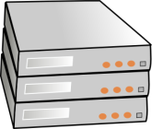
303 redirect
Client sends request to server
Server sends 303 redirect + URI of the resource requested (Referent)
Client sends request for the resource located at the URI returned by the server
Server sends the resource describing the Referent to the client.

Slide 55
HASH URI/IRI
The second method of dereferencing a URI/IRI, is a “Hash URI/IRI” which takes the form:
http://id.mereamaps.gov.me/topo#00012
In this method, the HTTP protocol strips away the fragment identifier (the part after the “#”), The client sends a HTTP GET request to the server based on the part of the URI before the “#”.
Notes:
This means that the URI as a whole cannot be directly retrieved from the server, so there might not be a Web document describing the object available.

Slide 56
HASH URI/IRI
The server then returns the whole RDF/XML file for all the data available from the URI/IRI.
The client then runs its own code to search for
URIs/IRIs which include the wanted fragment identifier.
Hart, Glen & Dolbear, Catherine. (2013). Linked Data: A Geographic Perspective. Boca Raton: CRC Press, p.108-109.

Slide 57
SLASH vs HASH
The disadvantage of the Slash/303 method is that the client had to make two requests and the server had to respond twice.
The disadvantage of the Hash method is all RDF triples that share the same URI up to the # will be returned, which could be a big overhead if the dataset is large.
Hart, Glen & Dolbear, Catherine. (2013). Linked Data: A Geographic Perspective. Boca Raton: CRC Press, p.108-109.
Heath, T. & Bizer, C. (2011). Linked Data: Evolving the Web into a Global Data Space (1st edition). Synthesis Lectures on the Semantic Web: Theory and Technology, 1:1, 1-136. Morgan & Claypool. Accessed June 26, 2011 from http://linkeddatabook.com/editions/1.0/.
Notes:
303 URIs, on the other hand, are very flexible because the redirection target can be configured separately for each resource. There could be one describing document for each resource, or one large document for all of them, or any combination in between. It is also possible to change the policy later on.
As a result of these factors, 303 URIs are often used to serve resource descriptions that are part of very large data sets, such as the description of an individual concept from DBpedia, an RDF-ized version of Wikipedia, consisting of 3.6 million concepts which are described by over 380 million triples [32] (see Section 3.2.1 for a fuller description of DBpedia).
Hash URIs are often used to identify terms within RDF vocabularies, as the definitions of RDF vocabularies are usually rather small, maybe a thousand RDF triples, and as it is also often convenient for client applications to retrieve the complete vocabulary definition at once, instead of having to look up every term separately. Hash URIs are also used when RDF is embedded into HTML pages using RDFa (described in Section 2.4.2.2). Within the RDFa context, hash URIs are defined using the RDFa about= attribute. Using them ensures that the URI of the HTML document is not mixed up with the URIs of the resources described within this document.
It is also possible to combine the advantages of the 303 URI and the hash URI approach. By using URIs that follow a http://domain/resource#this pattern, for instance, http://biglynx.co.uk/vocab/sme/Team#this, you can flexibly configure what data is returned as a description of a resource and still avoid the second HTTP request, as the #this part, which distinguished between the document and the described resource, is stripped off before the URI is dereferenced [98].
Heath, T. & Bizer, C. (2011). Linked Data: Evolving the Web into a Global Data Space (1st edition). Synthesis Lectures on the Semantic Web: Theory and Technology, 1:1, 1-136. Morgan & Claypool. Accessed June 26, 2011 from http://linkeddatabook.com/editions/1.0/.
Hart & Dolbear recommend using 303 redirects (Slash URIs) when the dataset to be queried is large, particularly when the application does not demand many repeated queries. Hash URIs are more suitable for early testing or prototyping purposes, as the server does not need to be configured to perform the 303 redirects, or when the RDF is embedded in HTML Web pages using RDFa (Resource Description Framework-in-attributes), helping to keep the HTML document’s URI separate from the URIs of the RDF resources.
Hart, Glen & Dolbear, Catherine. (2013). Linked Data: A Geographic Perspective. Boca Raton: CRC Press, p.108-109.

Slide 58
Associated description
Associated description refers to the description of a non-information resource that a client obtains by dereferencing a specific URI identifying this non-information resource.

Slide 59
Dublin core associated description
DCMI Metadata Terms
http://purl.org/dc/terms/abstract
VIAF IRI for Jane Addams:
http://viaf.org/viaf/12382490
Notes:
Dublin Core Initiative. DCMI Metadata Terms . Downloaded April 12, 2014 from http://dublincore.org/documents/2012/06/14/dcmi-terms/

Slide 60
references
Allemang, Dean & Hendler, Jim. (2011). Semantic Web for the Working Ontologist. 2nd ed. Amsterdam: Elsevier.
Berners-Lee, Tim. Architecture. World Wide Web Consortium. Downloaded January 30, 2014 from: http://www.w3.org/2000/Talks/1206-xml2k-tbl/slide10-0.html
Dublin Core Initiative. DCMI term declarations represented in RDF schema language. Downloaded April 12, 2014 from http://dublincore.org/schemas/rdfs/
Hart, Glen & Dolbear, Catherine. (2013). Linked Data: A Geographic Perspective. Boca Raton: CRC Press.
Heath, T. & Bizer, C. (2011). Linked Data: Evolving the Web into a Global Data Space (1st edition). Synthesis Lectures on the Semantic Web: Theory and Technology, 1:1, 1-136. Morgan & Claypool. Accessed June 26, 2011 from http://linkeddatabook.com/editions/1.0/.

Slide 61
references
Klyne, Glenn & Carroll, Jeremy J.(editors). Resource Description Framework (RDF): Concepts and Abstract Syntax. Copyright © 2004 World Wide Web Consortium, (Massachusetts Institute of Technology, European Research Consortium for Informatics and Mathematics, Keio University). Accessed September 9, 2011 from http://www.w3.org/Consortium/Legal/2002/copyright-documents-20021231
Manola, F. & Miller, E. (2004). RDF Primer. W3C. Accessed June 26, 2011 from http://www.w3.org/TR/rdf-primer/#basicconcepts
Mikael Nilsson, Mikael, Powell, Andy, Johnston, Pete, & Naeve, Ambjörn. (2008). Dublin Core Metadata Initiative. Accessed July 12, 2011 from http://dublincore.org/documents/dc-rdf/#sect-2.
Miličić, Vuk. (2011, July 16). Problems of the RDF model: Literals Accessed September 22, 2011 from: http://milicicvuk.com/blog/2011/07/16/problems-of-the-rdf-model-literals/
Tauberer, Joshua. (2008, January). What is RDF and what is it good for? Downloaded April 5, 2014 from http://www.rdfabout.com/intro/ .

Slide 62
references
Tharani, Karim. (2014). Linked Data in Libraries: A Case Study of Harvesting and Sharing Bibliographic Metadata with BIBFRAME. Downloaded May 30, 2015 from:
https://ejournals.bc.edu/ojs/index.php/ital/article/download/5664/pdf
W3C.Bray, Tim, Hollander, Dave, Layman, Andrew, Tobin, Richard. (2005, August 16).Namespaces in XML 1.1 (Second Edition). Downloaded April 13, 2014 from http://www.w3.org/TR/xml-names11/ .
W3C. Cyganiak, Richard, DERI, Wood, David, 3 Round Stones, Lanthaler, Markus, Graz University of Technology (editors). RDF 1.1 Concepts and Abstract Syntax: W3C Recommendation 25 February 2014. Downloaded March 8, 2014 from http://www.w3.org/TR/2014/REC-rdf11-concepts-20140225/#dfn-recognized-datatype-iris
W3C. Library Linked Data Incubator Group Final Report. Downloaded March 15, 2014 from http://www.w3.org/2005/Incubator/lld/XGR-lld-20111025/

Slide 63
references
W3C. Schreiber, Guus & Raimond (editors). RDB 1.1 Primer. Downloaded April 5, 2014 from http://www.w3.org/TR/rdf11-primer/ .
W3C. Cyganiak, Richard, DERI, Wood, David, 3 Round Stones, Lanthaler, Markus, Graz University of Technology (editors). RDF 1.1 Concepts and Abstract Syntax: W3C Recommendation 25 February 2014. Downloaded March 8, 2014 from http://www.w3.org/TR/2014/REC-rdf11-concepts-20140225/#dfn-recognized-datatype-iris

