Slide 1
Not stuck in a drawer: Successfully implementing a strategic plan
Jennifer Nutefall, University Librarian
Nicole Branch, Associate University Librarian for Learning & Engagement
Santa Clara University
Image courtesy of Flickr user liz west.
Notes:
Good morning – or afternoon, and welcome to our webinar about successfully implementing your strategic plan

Slide 2
Introductions
Jennifer
Nicole
Notes:
I’m Jennifer Nutefall, University Librarian at SCU. I’ve been the UL since 2012 and in the last seven years we have gone through 2 strategic planning processes. When I arrived I heard from a number of my staff about how they felt reports were worked on and then just put in a drawer and I wanted to make sure that didn’t happen

Slide 3
Share in the chat box:
Why did you sign up for today’s webinar?
What are the challenges you’re experiencing (or anticipating) to implementing your strategic plan?
Notes:
JN
So as we get started, we’re interested to know why you signed up for this webinar, and what the challenges you’re experiencing – or anticipating – to implementing your strategic plan. Take a minute and put your responses in the chat box

Slide 4
Challenges
Translating major goals into actionable steps
Determining how the plan will be tracked
Identifying who is in charge of making sure objectives are accomplished
Communicating the status of the plan
Motivating and supporting staff members to make change
Notes:
Jennifer’s personal story
So I’ve worked in four different institutions and I’ve listen out here some of the major challenges I’ve seen. This is especially difficult when days, weeks, or months are devoted to the planning process and you’re invested in making the goals a reality.
At SCU we had a task force along with an outside facilitator help us put together our first strategic plan. And what I felt after that was a sense of uncertainty. I knew activities were taking place and we were making strides, but what was the best way to track it? What you’ll hear throughout our presentation today is examples of what we’ve done and how it might work for your institution.
Nicole: Back up and talk about the planning process itself etc
Change is a really big part of the strategic planning process

Slide 5
Goals
Think more strategically about how to implement a strategic plan in their local context
Translate major strategic goals into concrete and scaffolded actions
Develop strategies to monitor and communicate the success of strategic plans

Slide 6
Kotter’s 8 stage process
Establishing a sense of urgency
Creating the guiding coalition
Developing a vision and strategy
Communicating the change vision
Empowering employees for broad-based action
Generating short-term wins
Consolidating gains and producing more change
Anchoring new approaches in the culture
Kotter, John. (1996). Leading Change. Boston, Harvard Business School Press.
Notes:
NB
Strategic plans are fundamentally about organizational change
Applying a change framework to strategic planning process can be helpful
This is one that we’re going to apply in talking about our work
There are other change processes – use the one that’s right for you!
We’re going to touch on all of them but focus more on ones that intersect with strategic plan implementation

Slide 7
Stage 1: Establishing a sense of urgency
Sources of complacency
Notes:
NB
So stage 1 is establishing a sense of urgency and is crucial to gaining the needed cooperation.
Kotter states that “with complacency high, transformation usually goes nowhere because few people are even interested in working on the change problem.”
Managers and leaders need to counteract insider myopia with external data – whether that is financial data, customer satisfaction/dissatisfaction, and being more upfront about problems and issues.
For the library, part of the sense of urgency was the arrival of a new University Librarian– it was a disruption to the regular flow of work and what people were used to. But additionally I was asking questions that no one had asked before and pushing people towards new ways of work that many were uncomfortable with.

Slide 8
Examples of Urgency
Financial
Changes in library leadership
Institutional changes (university leadership, degrees and programs, etc.)
Demographic changes
Higher Education Landscape
Public trust/perception

Slide 9
Poll- What urgency do see for strategic planning in your library?
Financial
Changes in library leadership
Institutional changes (university leadership, degrees and programs, etc.)
Demographic changes
Higher Education Landscape
Public trust/perception
Other?

Slide 10
Stage 2: Creating the guiding coalition
Create the team
Create trust and develop a common goal
Key characteristics
Across departments
Staff and Librarians
Variety of perspectives
Different lengths of tenure
Image courtesy of Flickr user Florence Ivy.
Notes:
JN
Kotter’s second stage is to create your guiding coalition. In other words, who in on your planning and implementation team?
When I put together the library’s strategic planning team in 2012 the facilitator I worked with talked to me about how I should look for the “high potentials” in the library – people who wouldn’t hesitate to talk, would do homework or work outside the meetings, know what other areas of the library were doing or should be doing, and had subject expertise. In other words who would contribute the most, be collaborative, and able to think differently about the library.
Other things to take into consideration are representation across areas, across work types (librarians and staff) and varying lengths of tenure. It can be very valuable to have a historical perspective of the library and different actions that were taken – or not taken
When it comes to implantation, you also need a team. At SCU the library’s management group is charged with implementing the plan, collaborating with others throughout the library, and providing quarterly updates

Slide 11
Stage 3: Developing a vision and strategy
SCU Library
Vision
The Library is a vibrant and vital center for learning, inspiring both intellectual pursuits and community engagement.
Notes:
JN
Stage 3 is developing a vision and strategy. You need to have a clear vision and strategy so your staff knows what they’re working toward and projects that be evaluated for how they fit into the plan.
So before we began our plan we created new mission and vision statements. The facilitator lead the task force in brainstorming the library’s future – you can see a graphic of that here as we started grouping items together.
A key question that focused us was imaging the library winning an award in 5 years – what would we win it for?

Slide 12
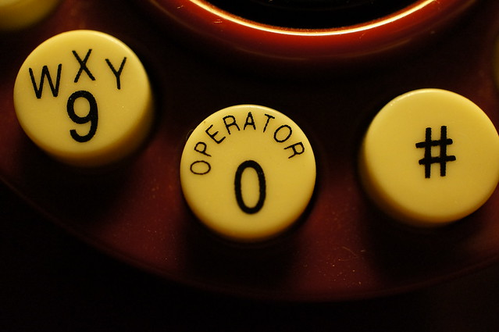
Stage 4: Communicating the change vision
How do you communicate about not only the plan itself, but also the implementation of it?
Make the plan visible with clear priorities and objectives
Image courtesy of Flickr user Charlene N Simmons.
Notes:
NB
How do you communicate that this can be done?
Breaking the plan down into priorities and goals enables easy communication about the plan as well as providing staff with clear guidance about how to participate in developing the plan.

Slide 13
Strategic Plan Structure
Priorities ->Goals->Objectives->Measures of Success
Priorities Make the plan visible by providing easy to share and remember theme areas
Goals Make the plan actionable by providing clear actions that staff members can take
Objectives Allow for scaffolding of achievement of the goal and for assigning point people to monitor and lead action items.
Measures of Success provide a means to check in on the plan and document progress.
Notes:
JN
The structures of strategic plans vary so I want to outline how ours was organized. We have 5 overarching priorities, under which are goals and objectives. Then for each objectives we have measures of success to know if we’ve been successful at implementing that objective

Slide 14
Strategic Priorities
Inspire a Culture of Engagement
Redefine and Transform Collections
Empower an innovative and responsive staff
Cultivate Dynamic Teaching and Learning
Cultivate a Climate of Assessment
Notes:
NB
Priorities are large theme areas that can be communicated easily

Slide 15
Example Goals: Redefine & Transform Collections
Goal 1: Articulate a vision for collection development and management in the library.
Goal 2: Expand the presence of Archives & Special Collections in our community.
Goal 3: Demonstrate our strong commitment to Open Access.
Notes:
NB
Goal move toward more actionable areas for everyone involved

Slide 16
Develop a Communication Strategy
Website
Printed brochure
Updates at key meetings
Integrated in ongoing activities (performance reviews, hiring processes, etc.)
Notes:
NB
Develop a strategy for making the plan available

Slide 17
Stage 5: Empowering employees for broad-based action
Barriers to Empowerment
Employees understand the vision and want to make it a reality, but are boxed in
Formal structures make it difficult to act
A lack of needed skills undermines action
Bosses discourage actions aimed at implementing the new vision
Personnel and information systems make it difficult to act
Source: Kotter, J. (1996). Leading Change. p.102
Notes:
JN
In order to be successful you need to empower employees for broad-based action.
Communicate a sensible vision to employees: If employees have a shared sense of purpose, it will be easier to initiate actions to achieve that purpose
Make structures compatible with the vision: Unaligned structures block needed action
Provide the training employees need: Without the right skills and attitudes, people feel disempowered
Align information and personnel systems to the vision: Unaligned systems also block needed action
Confront supervisors who undercut needed change: Nothing disempowers people the way a bad boss can
What can you do to overcome these barriers to empowerment?
Organizational readiness
Structural changes
Increased opportunities for professional development
Leadership committee

Slide 18
Poll- What barrier to empowerment might you need to address?
Formal structure make it difficult to act
Lack of needed skills
Bosses discourage action
Personnel and information systems
Other
Notes:
JN

Slide 19
Stage 6: Generating short-term wins
Role of short-term wins
Three characteristics of a good short-term win
Provide evidence that sacrifices are worth it
Reward change agents with recognition of their work
Help fine-tune vision and strategies
Undermine cynics and resisters
Keep bosses on board
Build momentum
It’s visible
It’s unambiguous
It’s clearly related to the change effort
Notes:
NB
Stage 6 is generating short-term wins, and I’m sure you’re not surprised to see this.
Short term wins help build necessary momentum and for those driving the change, the wins offer an opportunity to relax and celebrate. These wins can also undermine the efforts of cynics and major league resisters.

Slide 20
Assigning Leads
Tracking the plan
Assign co-leads to focus on each priority and develop measures of success
Assign action leads for each objective to monitor progress
Library management group devotes a meeting each quarter to discussing the status of the plan
Notes:
NB
Key part of short term is breaking down the change process into manageable steps. Not only does this help scaffold the change process for staff, but it provides a means of consistently monitoring the progress on your plan.

Slide 21
Monitoring the Plan
Break each objective into manageable actions
Scaffold the change process
“Stoplight” monitoring
Provide room to pivot and adjust
Stoplight image
Image courtesy of Flickr user moonjaz.
Notes:
NB

Slide 22
Measures of Success
Objective 1: Broaden the role of the library in the Open Access ecosystem.
Measure of success: The library dedicates stable and significant funding to support Open Access initiatives that are targeted at undergraduate learners.
Measure of success: SCU librarians participate in regional and national service opportunities related to OA

Slide 23
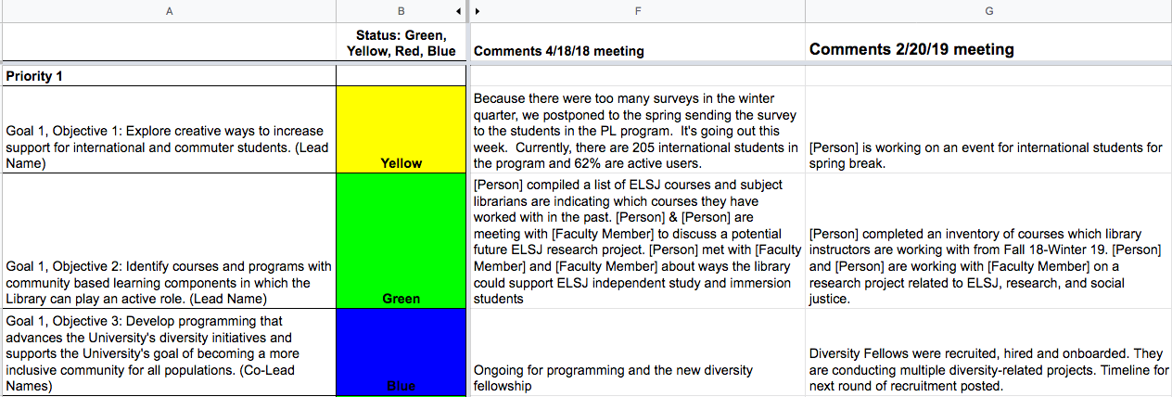
Tracking the Plan
Notes:
NB

Slide 24
Stage 6: Generating short-term wins
Examples of library’s short-term wins
Created an Undergraduate Diversity Fellows Program
Crafted a Collection Development Philosophy
Implemented an event for international students
Redesigned instructional classrooms
Increased teaching with Archives & Special Collections materials
Advanced conversations with faculty & departments around OA
Notes:
NB
So the library had a number of short term wins over the first few years.
A major win, though it took 2 years, was a complete redesign of the first floor. The library joined with academic technology and information technology to gather data over eight months to make recommendations on the redesign. We gathered student input through multiple methods including a campus-wide survey.
As part of our strategic plan, one of our priorities was to create a culture of engagement. One of the objectives was to create and implement a personal librarian program, which we have done for international and transfer students. Also as part of that priority we had a goal to Initiate sustainable partnerships across campus which lead to an increase in partnerships with departments and organizations on academically oriented events.
For our strategic plan priority to develop a staff for the 21st century library, we wanted to recognize outstanding contributions and celebrate success and create an awards and recognition program, which is now in its 4th year.
Another wins include how we reallocated vacant positions to areas of need, and listening to feedback which led us to open the building a ½ hour earlier and add a popular reading collection

Slide 25
Stage 7: Consolidating gains and producing more change
What Step 7 looks like in a successful, major change effort:
More change, not less
More help
Leadership from senior management
Project management and leadership from below
Reduction of unnecessary interdependencies
At SCU
Completed our 2013-2018 plan in 3 years
Revised the plan and created new goals and objectives
Be conscious of continual change and its impact on staff and workload
Being mindful of other things that come in and how that impacts staff
Impact of larger administrative changes at SCU
Notes:
JN
In libraries, as elsewhere, change is a constant. And everyone needs to understand that whatever you’re implementing is part of a continual change effort. So what does building on short terms wins look like?
More change, not less: The guiding coalition uses the credibility afforded by short-term wins to tackle additional and bigger change projects
More help: Additional people are brought in, promoted, and developed to help with all the changes
Leadership from senior management: Senior people focus on maintaining clarity of shared purpose for the overall effort and keeping urgency levels up
Project management and leadership from below: Lower ranks in the hierarchy both provide leadership for specific projects and manage those projects
Reduction of unnecessary interdependencies: to make change easier in both the short and long term, managers identify unnecessary interdependencies and eliminate them
I’ve listed here some of the ways we’ve been able to consolidate gains and produce more change. And one of them is to be conscious of continual change its impact on staff and workload. You do want to celebrate your successes, especially if it’s the completion of a big project, to give staff a sense of closure and then a new beginning

Slide 26
Stage 8: Anchoring new approaches in the culture
Comes last, not first
Depends on results
Requires a lot of talk
May involve turnover
Makes decisions on succession crucial
Notes:
JN
Anchoring change in a culture
Comes last, not first: Most alternations in norms and shared values come at the end of the transformation process
Depends on results: New approaches usually sink into a culture only after it’s very clear that they work and are superior to old methods
Requires a lot of talk: Without verbal instruction and support, people are often reluctant to admit the validity of new practices
May involve turnover: Sometimes the only way to change a culture is to change key people
Makes decisions on succession crucial: If promotion processes are not changed to be compatible with the new practices, the old culture will reassert itself
The strategic plan started with the question of if the library won an award in five years what would we win it for. And planted the seed for our application for the ACRL Excellence in Academic Libraries Award

Slide 27
Kotter’s 8 stage process
Establishing a sense of urgency
Creating the guiding coalition
Developing a vision and strategy
Communicating the change vision
Empowering employees for broad-based action
Generating short-term wins
Consolidating gains and producing more change
Anchoring new approaches in the culture
Kotter, John. (1996). Leading Change. Boston, Harvard Business School Press.
Notes:
Strategic plans are fundamentally about organizational change
Applying a change framework to strategic planning process can be helpful
This is one that we’re going to apply in talking about our work
There are other change processes – use the one that’s right for you!
We’re going to touch on all of them but focus more on ones that intersect with strategic plan implementation

Slide 28
Questions?
Thank you!
Jennifer Nutefall, jnutefall@scu.edu
Nicole Branch, nbranch@scu.edu

