Slide 1
An Introduction to The Semantic Web and Why BIBFRAME
By Rhonda Super
ACCM April 7, 2015
rasuper1@ad.library.ucla.edu
Notes:
We are leaving MARC and transitioning into RDA in order to make our bibliographic information accessible on the Semantic Web.
“…the role of the national library is increasingly moving from a focus on ‘stored knowledge’ to one where ‘smart knowledge’ is paramount.” Libraries will increasingly be linking and connecting to content, which means that local collections will need to be placed within a larger national, and even international, context.
Jisc. (2015, March 17). Report: A national monograph strategy roadmap. Downloaded March 30, 2015 from: http://www.jisc.ac.uk/reports/a-national-monograph-strategy-roadmap.

Slide 2
Web 2.0 and information resources
Web 2.0 uses HTTP protocol to retrieve information resources.
Everything that lives on the Web is an information resource:
Documents
Images
Audio Files
Video Files

Slide 3
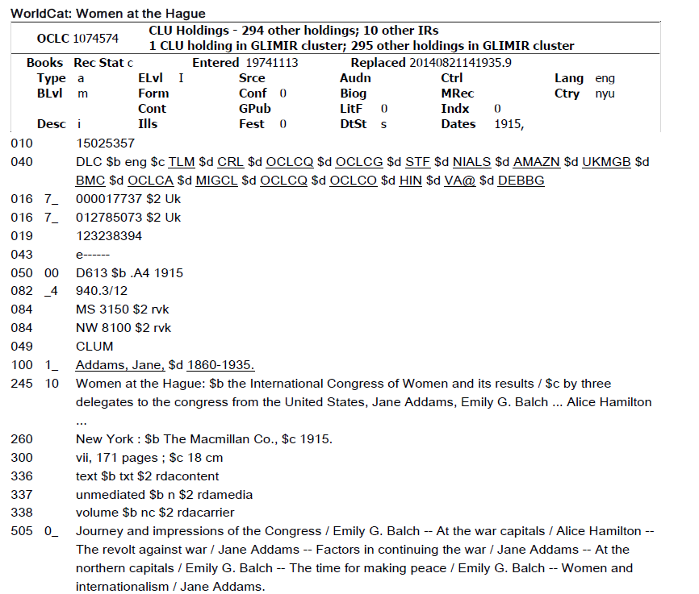
MARC RECORD

Slide 4
non-information resourceS & Web 3.0
All “real-world objects” that exist outside of the Web are non-information resources. Examples of non-information resources are:
People
Places
Abstract Concepts
Relationships
The Semantic Web (Web 3.0) allows the hyper linking between information resources, non-information resources and the relations between them.
Notes:
The Semantic Web is a collaborative effort led by then World Wide Web Consortium (W3C) to provide a framework that allows data to be shared and reused across application, enterprise, and community boundaries.
W3C. What is the Semantic Web? Downloaded February 12, 2014 from http://www.w3.org/2001/sw/

Slide 5
Goal of the semantic web
The goal of the Semantic Web is to move from a Web of Documents to an open accessible, inter-connected Web of Data using Linked Data.
Make data available free of proprietary software, single social networks, or web application!
Bauer, Florian and Kaltenböck, Martin. (2012). Linked Open Data: The Essentials. Downloaded December 30, 2014 from: http://www.reeep.org/LOD-the-Essentials.pdf, p.25.
Notes:
The goal of the Semantic Web is to move from a Web of Documents to an open inter-connected Web of Data by doing the following using Open Linked Data:
Provide valuable, agreed-upon information in a standard, open
format.
Provide mechanisms to link individual schemas and vocabularies
in a way so that people can note if their ideas are “similar” and
related, even if they are not exactly the same.
Bring all this information to an environment which can be
used by most, if not all of us. (Make data available free of
proprietary software, single social networks, or web application.)
Bauer, Florian and Kaltenböck, Martin. (2012). Linked Open Data: The Essentials. Downloaded December 30, 2014 from: http://www.reeep.org/LOD-the-Essentials.pdf, p.25.

Slide 6
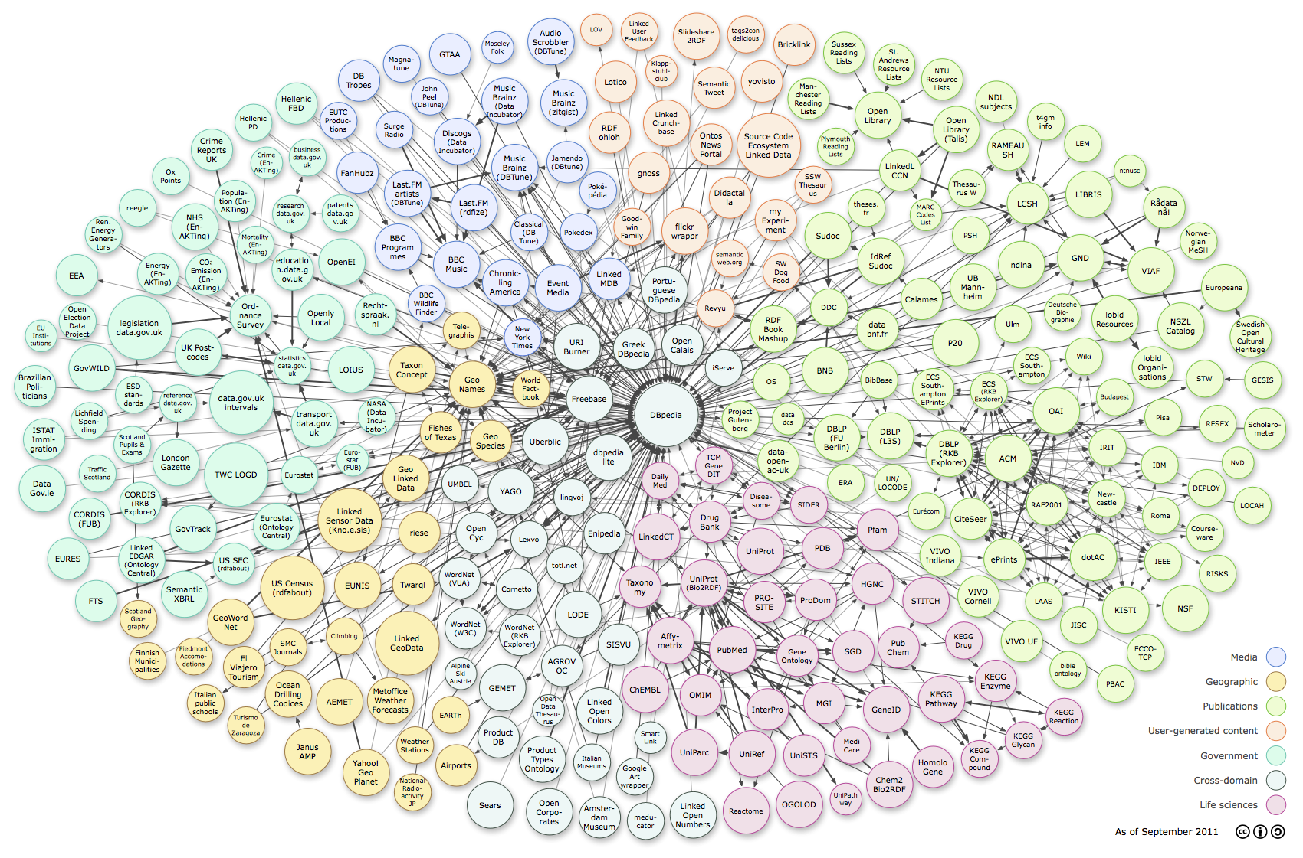
Linking open data Cloud (LOD) diagram
Richard Cyganiak, Richard, and Jentzsch, Anja. Linking Open Data cloud diagram Downloaded February 12, 2014 from http://lod-cloud.net/versions/2011-09-19/lod-cloud_colored.html
Notes:
The LOD project is a community activity started in 2007 by the AW3C’s Semantic Web Education and Outreach (SWEO) Interest Group (www.w3.org/wiki/SweoIG) whose goal is to made data freely available to everyone.
The collection of Linked Data published on the Web is referred to as the LOD Cloud.
Open-content projects as diverse as encyclopedias and dictionaries, government statistics, information regarding chemical and biological collections and endangered species, bibliographic data, music artists and information about their songs, and academic research papers are all available using the same data format and reachable using the same API.
The LOD cloud has doubled in size every 10 months since 2007.
More than 40% of the Linked Data in the LOD cloud is contributed by governments (mainly from the United Kingdom and the United States), followed by geographical data (22%) and data from the life sciences domain (almost 10%).
Life sciences (including some large pharmaceutical companies) contribute over 50% of the links between datasets. Publication data (from books, journals, and the like) comes in second with 19%, and the media domain (the BBC, the New York Times, and others) provides another 12%.
The original data owners themselves publish one-third of the data contained in the LOD cloud, whereas third parties publish 67%. For example, many universities republish data from their respective governments in Linked Data formats, often cleaning and enhancing data descriptions in the process.
Wood, David, Zaidman, Marsha, and Ruth, Luke. (2014). Linked Data: Structured Data on the Web. Shelter Island, NY: Manning, p. 14.

Slide 7
Linked Data
Linked Data relies on HIGH-QUALITY METADATA MANAGEMENT in order to enhance data usage.
What do cataloging & metadata information specialists do: CREATE HIGH-QUALITY METADATA to enhance usage (access) of information resources.
Bauer, Florian and Kaltenböck, Martin. (2012). Linked Open Data: The Essentials. Downloaded December 30, 2014 from: http://www.reeep.org/LOD-the-Essentials.pdf, p.27.
Notes:
Linked Data refers to a set of best practices and techniques for publishing and connecting structured data on the Semantic Web using international standards of the W3C.
Data that conforms to these practices and techniques are also called Linked Data.
Wood, David, Zaidman, Marsha, and Ruth, Luke. (2014). Linked Data: Structured Data on the Web. Shelter Island, NY: Manning, p.4-5.
The four Linked Data principles proposed by Tim Berners-Lee are:
Use URIs as names for things
Use HTTP URIs so that people can look up those names
When someone looks up a URI, provide useful information, using the standards (RDF, SPARQL)
Include links to other URIs so people can discover those things
Berners-Lee, Tim. (2009, June 18). Linked Data. Downloaded December 26, 2014 from http://www.w3.org/DesignIssues/LinkedData.html.

Slide 8
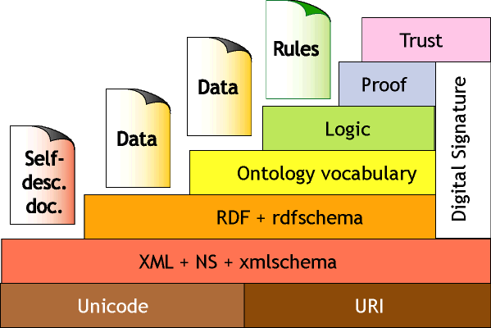
RESOURCE Description Framework
Resource Description Framework (RDF) is a model consisting of layers of technology used to implement Linked Data on the Semantic Web.
Tim Berners-Lee. Architecture. World Wide Web Consortium.
Downloaded January 30, 2014 from: http://www.w3.org/2000/Talks/1206-xml2k-tbl/slide10-0.html
Notes:
The Semantic Web relies on the combination of the following technologies:
Explicit metadata: They allow web pages to carry their meaning on their sleeves (openly, publicly),
Ontologies: They describe the main concepts of a domain and their relationships,
Logical reasoning: it makes it possible to draw conclusions from combining data with ontologies.
Media Map. State-of-the-art Situation. Downloaded February 12, 2014 from http://mediamapproject.org/project_situation.html

Slide 9
RDF is a graph technology
Hull House
Is a
Settlement Houses
Nobel Prize Winners
Creator
Recipient
Jane Addams
Creator
Inferred
Is a
Twenty Years at Hull House
Recipient
Emily Greene Balch
Creator
Buildings
Is a
Recipient
Is a
WomenNobel Prize Winners
Newer Ideals of Peace
Recipient
Creator
Creator
Alice Hamilton
U S National Register of Historic Places
Women at The Hague
Nobel Prize Domain
Author Domain
Building Domain
Creator
Chart by Rhonda Super, 2014
Notes:
The basic building block of RDF is a simple statement called a triple, comprised of a subject, a predicate, and an object. A set of triples is called an RDF Graph.
“Is a” should be read as “Is an instance of”. Solid arrows imply a relationship from a subject to an object. Dotted arrows imply an inferred relationship. The predicates denote the relationship between a subject and an object. Arrows denoting predicates point away from the subject and towards the object.

Slide 10
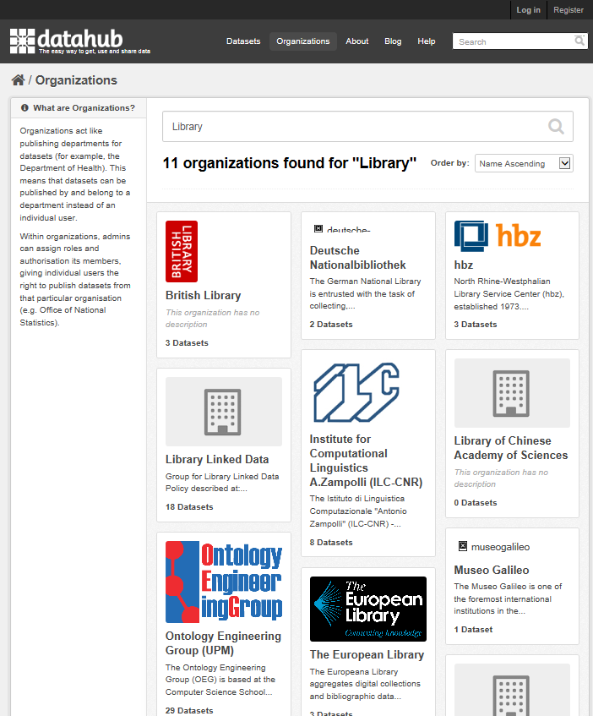
LIBRARIES CONTRIBUTING DATASETS
Notes:
About the Datahub
The Datahub provides the means to freely search data, register published datasets, create and manage groups of datasets, and get updates from datasets and groups you're interested in.
Accessed April 5, 2015 from:
http://datahub.io/organization?q=Library&sort=name+asc

Slide 11
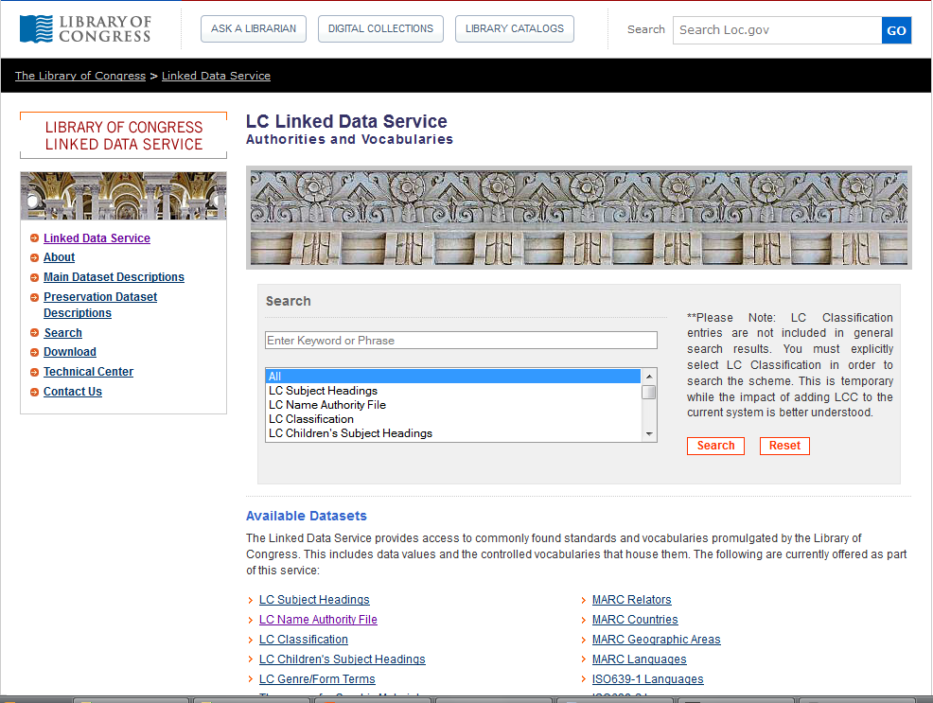
Library of congress authorities and vocabularies
Notes:
The Library of Congress provides unique identifiers for their authorities and vocabularies through their LC Linked Data Service.

Slide 12
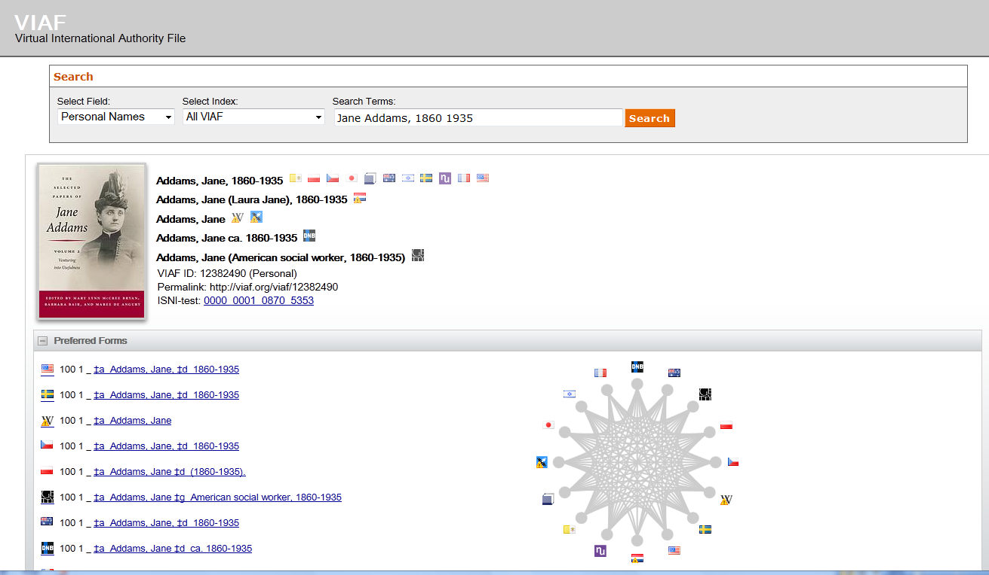
VIRTUAL INTERNATIONAL AUTHORITY FILE (VIAF)
Notes:
OCLC administers the Virtual International Authority File which links the authority files of National Libraries and other authority files, such as the Getty.

Slide 13
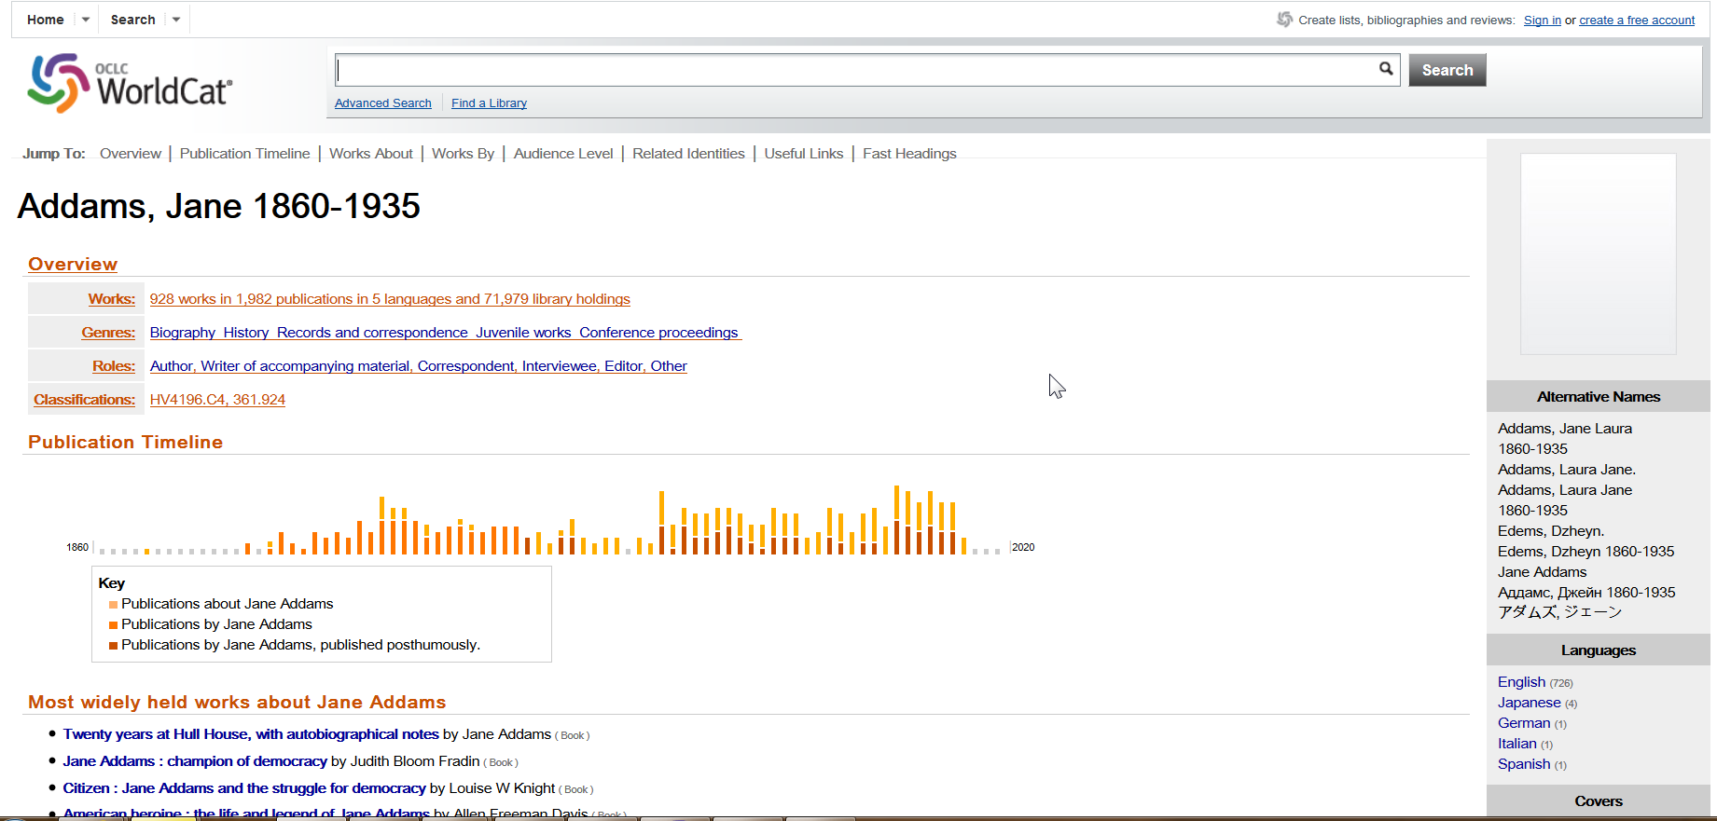
Worldcat
Notes:
OCLC uses these links in their WorldCat Discovery services, formerly WorldCat Identities to provide an array of information in a user friendly interface.

Slide 14
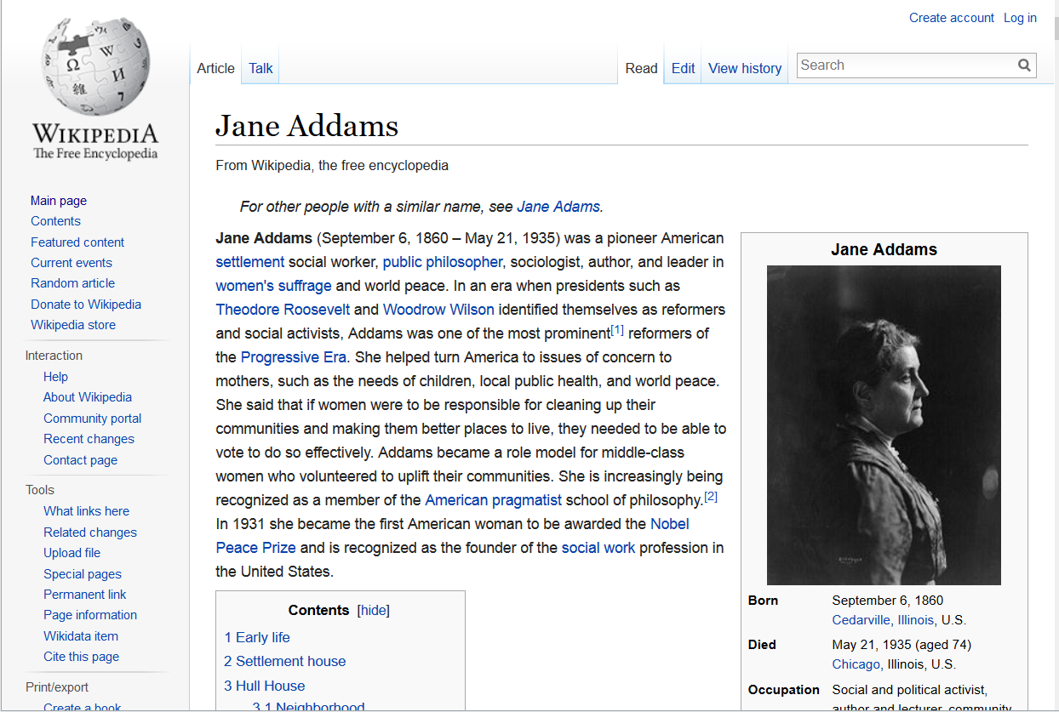
Jane Addams Wikipedia Page
Wikidpedia. (2014). Jane Addams. Downloaded February 12, 2014 from: https://en.wikipedia.org/wiki/Jane_Addams
Notes:
Scrolling down a Wikipedia page brings you to …

Slide 15
Authority control on Wikipedia page
Notes:
the authority control links.

Slide 16
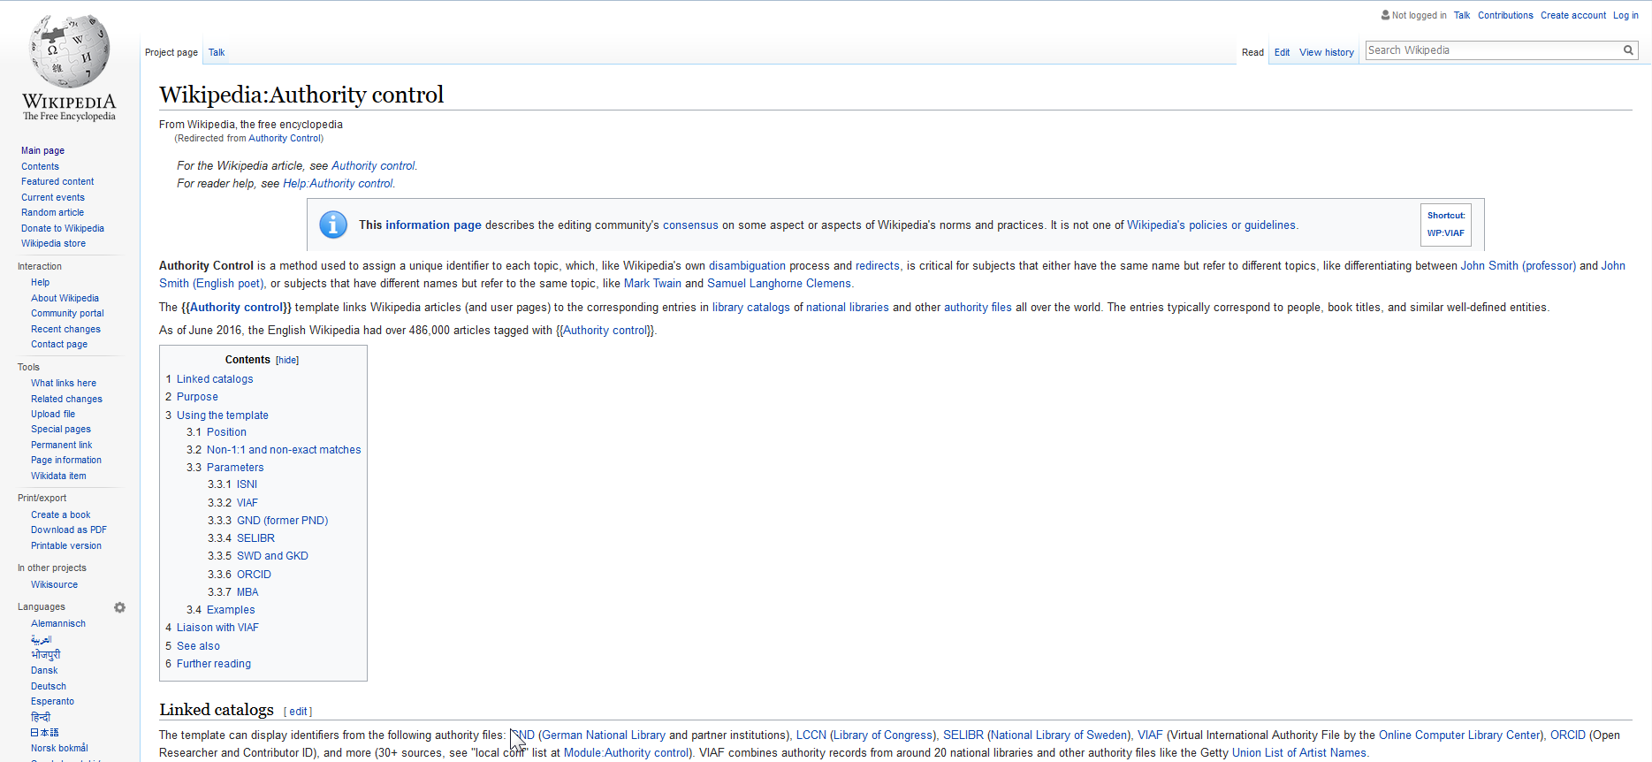
Wikipedia authority control policies
Wikipedia articles link to library catalogs and other authority files world wide through the use of authoritative identifiers (VIAF, LCCN, etc.)
Notes:
This page describes the editing community’s consensus of norms and practices for adding authority control to Wikipedia articles. Click on the slide to access the link to the page.

Slide 17
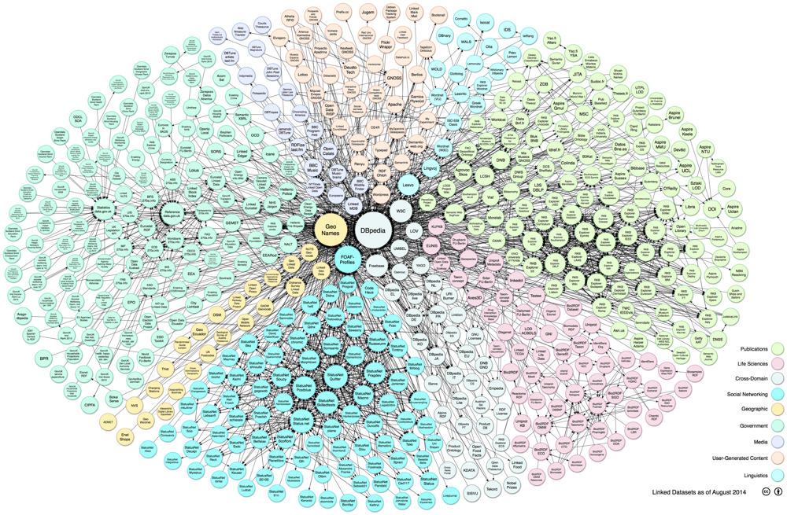
LOD Cloud
Schmachtenberg, Max, Bizer, Christian, Jentzsch, Anja, and Cyganiak, Richard. (2014). Linking Open Data cloud diagram. Downloaded March 22, 2014 from: http://lod-cloud.net/
Notes:
This Linked Open Data (LOD) Cloud represents the linked vocabularies in Dbpedia, the Linked Data version of Wikipedia.

Slide 18
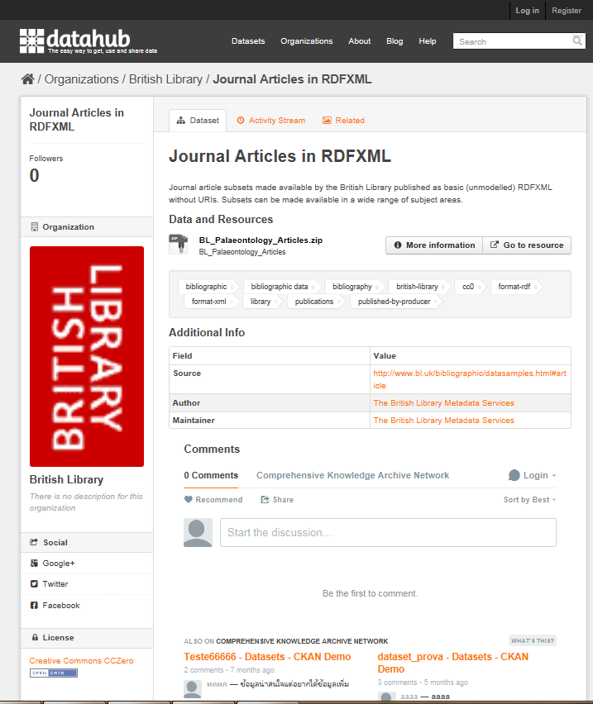
LIBRARIES CONTRIBUTING DATASETS
Notes:
Datahub provides information on libraries contributing datasets to the Linked Open Data Cloud.

Slide 19
MARC RECORD
Notes:
Transforming a MARC record such as this one into RDF XML results in …

Slide 20
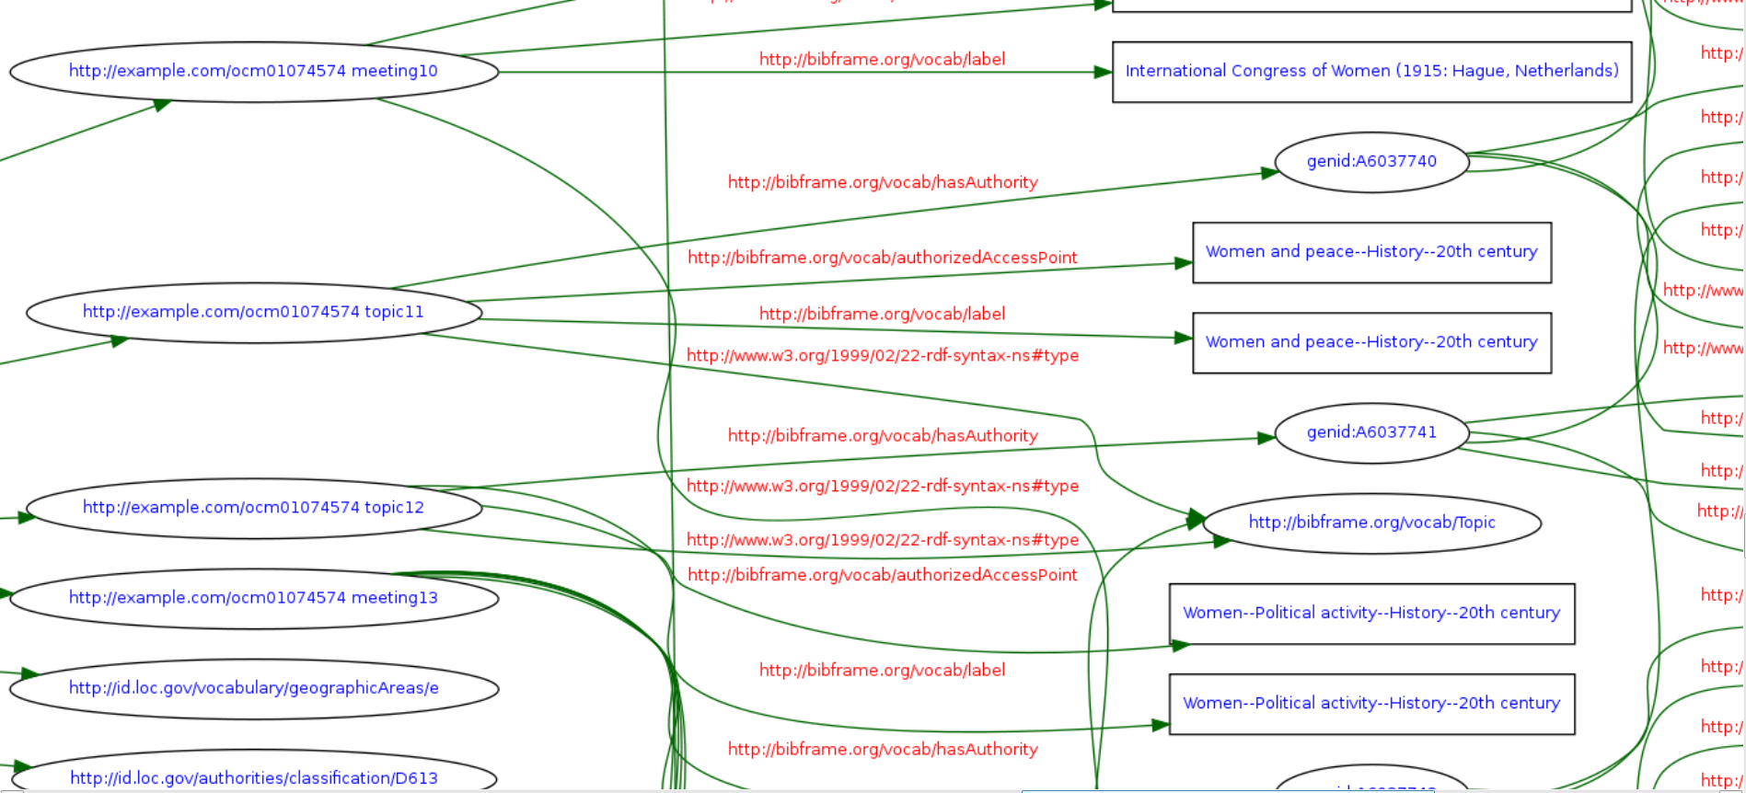
Rdf graph of a marc record
Notes:
a graph form of the information in the MARC record, visually showing the relationships between information nodes in the record.

Slide 21
references
Bauer, Florian and Kaltenböck, Martin. (2012). Linked Open Data: The Essentials. Downloaded December 30, 2014 from: http://www.reeep.org/LOD-the-Essentials.pdf.
Berners-Lee, Tim. Architecture. World Wide Web Consortium. Downloaded January 30, 2014 from: http://www.w3.org/2000/Talks/1206-xml2k-tbl/slide10-0.html
Cyganiak, Richard, and Jentzsch, Anja. Linking Open Data cloud diagram. Downloaded February 11, 2014 from http://lod-cloud.net/versions/2011-09-19/lod-cloud_colored.html
Jisc. (2015, March 17). Report: A national monograph strategy roadmap. Downloaded March 30, 2015 from: http://www.jisc.ac.uk/reports/anational-monograph-strategy-roadmap.
Library of Congress Linked Data Service. Authorities and Vocabularies. Downloaded February 11, 2014 from http://id.loc.gov/ .

Slide 22
references
Media Map. State-of-the-art Situation. Downloaded February 12, 2014 from http://mediamapproject.org/project_situation.html
OCLC WorlCat Identities. Addams, Jane 1860-1935. Downloaded February 15, 2014 from http://www.worldcat.org/identities/lccn-n79104234/ .
Schmachtenberg, Max, Bizer, Christian, Jentzsch, Anja, and Cyganiak, Richard. (2014). Linking Open Data cloud diagram. Downloaded March 22,2014 from: http://lod-cloud.net/
Virtual International Authority File (VIAF). Addams, Jane, 1860=1935 downloaded February 11, 2014 from http://viaf.org/viaf/12382490/#Addams,_Jane,_1860-1935.
Wikidpedia. (2014). Jane Addams. Downloaded February 12, 2014 from: https://en.wikipedia.org/wiki/Jane_Addams

Slide 23
references
W3C. What is the Semantic Web? Downloaded February 12, 2014 from http://www.w3.org/2001/sw/
Wood, David, Zaidman, Marsha, and Ruth, Luke. (2014). Linked Data: Structured Data on the Web. Shelter Island, NY: Manning.

Slide 24
Resources
Bibflow
Bibflow is the blog for the University of California, Davis and Zepheira two-year project to investigate how research libraries should adapt practices, workflows, software systems, and partnerships to support evolution to RDA and Bibframe. Its official title is "Reinventing Cataloging: Models for the Future of Library Operations". Findings from the project are posted on the blog and comments are welcomed.
BIBFRAME
This site provides general information about the Library of Congress’ initiative for the future of bibliographic description. Access presentations, FAQs, and links to working documents. In addition to being a replacement for MARC, BIBFRAME serves as a general model for expressing and connecting bibliographic data to the networked world.
BIBFRAME Vocabulary
This page describes the BIBFRAME Vocabulary. It is comprised of the RDF properties, classes, and relationships between and among them. The site offers a model view, a category view, and a list view.

Slide 25
Resources
Bibliographic Framework as a Web of Data: Linked Data Model and Supporting Services
This document is an introduction to BibFrame, the linked data model developed to integrate the rich bibliographic resources found in library and cultural institutions into the linked open data network. The model consists of four main classes: Creative Work, Instance, Authority, and Annotation. The document gives examples of serializing BibFrame using the RDF model and XML format.
British Library Collection Metadata – Data Services
This page links to the data services provided by the British Library including free access to datasets in a variety of formats (RDF-DC or linked data), and provides access to MARC records via Z39.50 for non-commercial use as well as to other resources. The page also links to information regarding The British National Bibliography.
British Library Data Model - Book
This is a graph displaying the British Library’s data model for a monograph.
British Library Data Model - Serial
This is a graph displaying the British Library’s data model for a serial.

Slide 26
Resources
British National Bibliography (BNB) - Linked Open Data
This Datahub page provides access to the British National Bibliography (BNB) published as Linked Data by the British Library, linked to external sources including VIAF, LCSH, Lexvo, GeoNames, MARC country, and language, Dewey.info, RDF Book Mashup.
CKAN is a free, open-source software tool for managing and publishing collections of data used by national and local governments, research institutions, and other organizations. Using search and faceting, users can browse and find the data and preview it using maps, graphs.
DBPedia Wiki
DBPedia is a crowd-sourced community effort to extract structured information from Wikipedia and make this information available on the Web. DBpedia provides the ability to query against Wikipedia, and to link the different data sets on the Web to Wikipedia data. This Wiki provides information about the DBpedia datasets, ontology, downloads, use cases, interlinking, online access, etc.

Slide 27
Resources
EUCASES
The purpose of this collaborative Research Project is to develop a unique pan-European law and case law Linking Platform transforming multilingual legal open data into linked open data after semantic and structural analysis. The web based EUCases Linking Platform will provide services linking EU law and case law with legislative acts and court decisions of six EU member states: Austria, Bulgaria, France, Germany, Italy and United Kingdom.
FAST Linked Data
FAST (Faceted Application of Subject Terminology) is an enumerative, faceted subject heading schema derived from the Library of Congress Subject Headings (LCSH). The purpose of adapting the LCSH with a simplified syntax to create FAST is to retain the vocabulary of LCSH while making the schema easier to understand, control, apply, and use. The schema maintains upward compatibility with LCSH, and any valid set of LC subject headings can be converted to headings. The site provides access to searchFAST, a user interface that simplifies the process of heading selection, and to a Web interface for FAST Subject selection available at FAST.
Free Your Metadata
Use this site to match metadata with controlled vocabularies connected to the Linked Data cloud, enrich unstructured description fields using the named entity extraction tool OpenRefine extension, learn how to check for errors and correct them, and publish metadata in a sustainable way. The site provides information on relevant publications.

Slide 28
Resources
LC Linked Data Service: Authorities and Vocabularies
The Linked Data Service provides access to commonly found standards and vocabularies promulgated by the Library of Congress. This includes data values and the controlled vocabularies that house them.
Linked Data - Connect Distributed Data Across the Web
This site provides a home for and pointers to resources from across the Linked Data community. Access the Linking Open Data Cloud Diagram, datasets available with dereferencable URIs, datasets with dereferencable URIs that are in addition also available as RDF dumps, guides and tutorials regarding linked data, a glossary, blogs, tools, and more.
Legal XML
This set of PowerPoint slides gives an overview of the move towards integrating legisltative and legal documentaion into the Semantic Web using Akoma Ntoso parlimentary standards, XML, and FRBR concepts.

Slide 29
Resources
MarcEdit
MarcEdit is a free Marc editing tool. Use the tool to download a MARC record and transform it into an RDF/XML serialization of the record. The tool also can be used to perform MARC database maintenance. MarcEdit includes a tool for querying registered xslt crosswalks and downloading them for use with MarcEdit.
OCLC Linked Data Research
Use this page to access information regarding the linked data research and development currently conducted by OCLC including outputs, the linked data survey, events, WorldCat data set, Library Linked Data Incubator Group, FAST, VIAF, Dewey Summaries as Linked Data, terminology services, and more.
OpenRefine
OpenRefine (formerly Google Refine) is a tool for working with data. Use it to clean data, transform data from one format into another, extend data with web services, and link it to databases like Freebase.

Slide 30
Resources
Publishing the British National Bibliography as Linked Open Data
This paper describes the development of a linked data instance of the British National Bibliography (BNB) by the British Library. The focus is on the development of an RDF (Resource Description Framework) data model and the technical process to convert MARC 21 Bibliographic Data to Linked Data using existing resources.
RBMS Controlled Vocabularies
Access controlled vocabularies for use in Rare Book and Special Collections Cataloging which enable the retrieval of special collections materials by form, genre, or by various physical characteristics that are typically of interest to researchers and special collections librarians, and for relating materials to individuals or corporate bodies. The vocabularies are developed and maintained by the Bibliographic Standards Committee of the Rare Books and Manuscripts Section (ACRL/ALA).

Slide 31
Resources
RDF Book Mashup
The RDF book mashup demonstrates how Web 2.0 data sources like Amazon, Google or Yahoo can be integrated into the Semantic Web. The RDF book mashup makes information about books, their authors, reviews, and online bookstores available on the Semantic Web which can be used by RDF tools to link to other Semantic Web data.
RDF Validation Service
Use the W3C validator tool on this page to parse RDF/XML documents. A 3-tuple (triple) representation of the corresponding data model as well as an optional graphical visualization of the data model will be displayed.
Report of the Stanford Linked Data Workshop, 27 June – 1 July 2011
Stanford and the Council on Library and Information Resources conducted a workshop to explore the prospects for a large scale, multi-national, multi-institutional prototype of a Linked Data environment for discovery of and navigation among academic information resources. Two additional goals identified during the workshop were building a common understanding and identifying opportunities and challenges to be confronted in the preparation of a prototype and its operation. This is the report of the workshop.

Slide 32
Resources
Stanford Linked Data Workshop Technology Plan
This is a plan for a multi-national, multi-institutional discovery environment built on
Linked Open Data principles. This model includes the basic functions of generating, harvesting, and iteratively reconciling URIs as well as consumption of Linked Data. This model also postulates dramatic changes to the creation, adoption, editing, and maintenance of metadata records for bibliographic holdings as well as scholarly information resources licensed for use in research institutions; there are indicators of revisions in this Plan to the classic cataloging services (and other operations of research libraries’ technical services divisions – acquisitions, serials control, inventory control and circulation, auditable financial transactions, etc.) as well as metadata generation and distribution by scholarly journal publishers and their service providers.
The Relationship between BIBFRAME and OCLC’s Linked-Data Model of Bibliographic Description: A Working Paper
This is a PDF of Carol Jean Godby’s paper describing the relationship between OCLC’s and the Library of Congress’ linked data initiatives.

