Slide 1
The openWEMI Idea
kcoyle@kcoyle.net
June, 2022
CC-BY

Slide 2
WEMI
Work
Expression
Manifestation
Item
Notes:
Group 1 of FRBR. FRBR surfaced 2 things from library cataloging practice that I think are remarkable: the insight that created "things" have within them a gradation from their essence to their physical being. The other thing is that FRBR brought out relationships between bibliographic items, like "translation of" and "revision of". Neither of these has been fully implemented in library data. WEMI, though, is the aspect of FRBR that has caught the attention of many metadata developers outside of the library tradition.

Slide 3
Timeline of FRBR/LRM
1990
Stockholm meeting (IFLA)
1992
Terms of reference completed
1994
First draft for comment
1998
Final draft
2009
Current draft
2013
RDA implemented with FRBR concepts
2016
LRM
2018
RDA implements LRM
Notes:
The main point here is to understand the technology environment as FRBR was being developed. And I note that LRM, while later, contains many of the same concepts.

Slide 4
2 primary influences, both from the 1990's
Relational database design
Object-oriented data design
Notes:
The FRBR Review Group explicitly acknowledged that they were influenced by relational database design. Later work, include FRBRoo and LRM, have made use of object-oriented design concepts.

Slide 5
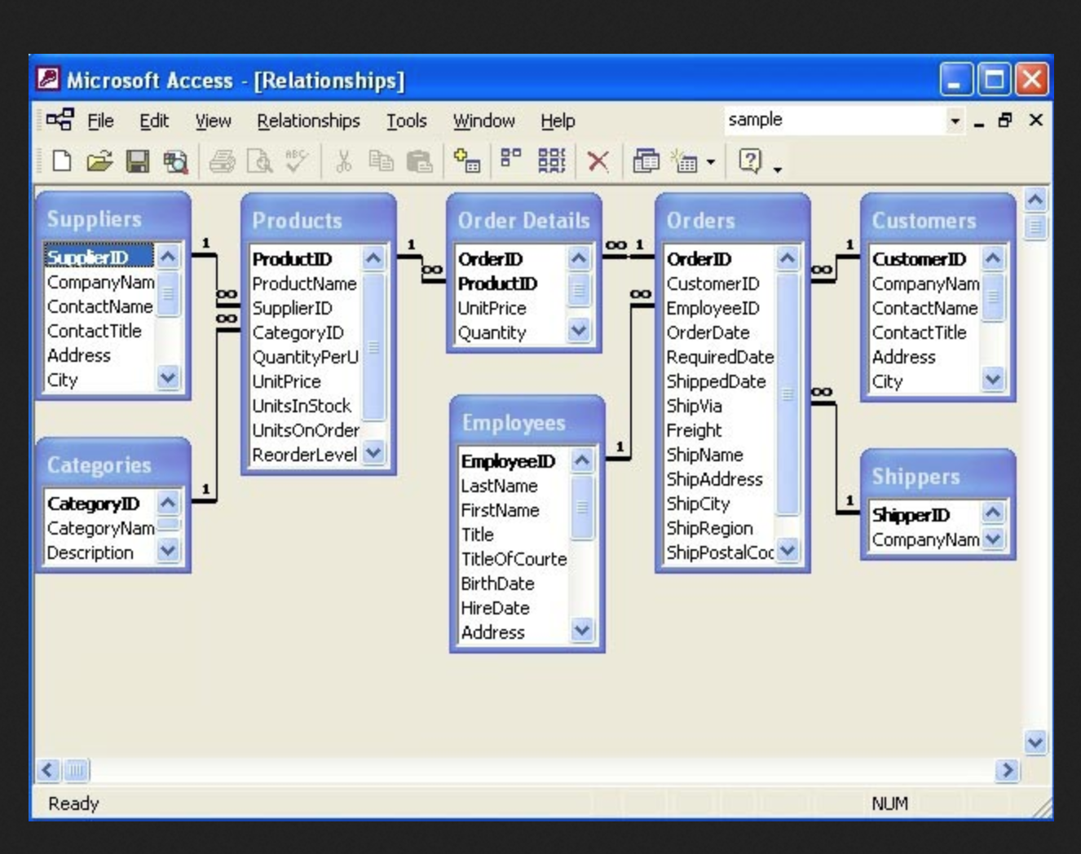
Relational Database Design
Boxes here are called "tables"
Notes:
In relational database design the goal is to disassemble the data into separate tables with no overlap. Each table represents a “thing” in the data, as you can see here.

Slide 6
Object-oriented design
(called a "class")
the object
the data elements
the methods
Notes:
Unified Modeling Language
In OO design, the object (or class) defines the data elements that are data elements for that class. Again, these boxes of data elements are separate. Although the term for each box is a “class” – and RDF uses a concept of class – they are very different things. I’ll get to that soon.

Slide 7
Some general principles of RDBMS/OO
Objects/tables do not overlap
Each data element is valid for only one object/table
Avoid redundancy
Data elements and relationships are fixed by the model – no ad-libbing!
Notes:
This is great if your data is well-defined and neat. No ambiguity. This was 30 years ago, before online sharing of vocabularies and data was possible.

Slide 8
FRBR-LRM WEMI
Notes:
This is the WEMI that we have all encountered before. It encompasses both relational database concepts and in its later incarnation, those of object-oriented design. It is strictly linear, each “thing” linking to the next thing, and no way to jump between them if you need to, and no obvious way to extend the model. In the documentation, each box defines the data elements that are allowed in that box. Both models include the attributes or elements that are valid for each “box”.

Slide 9
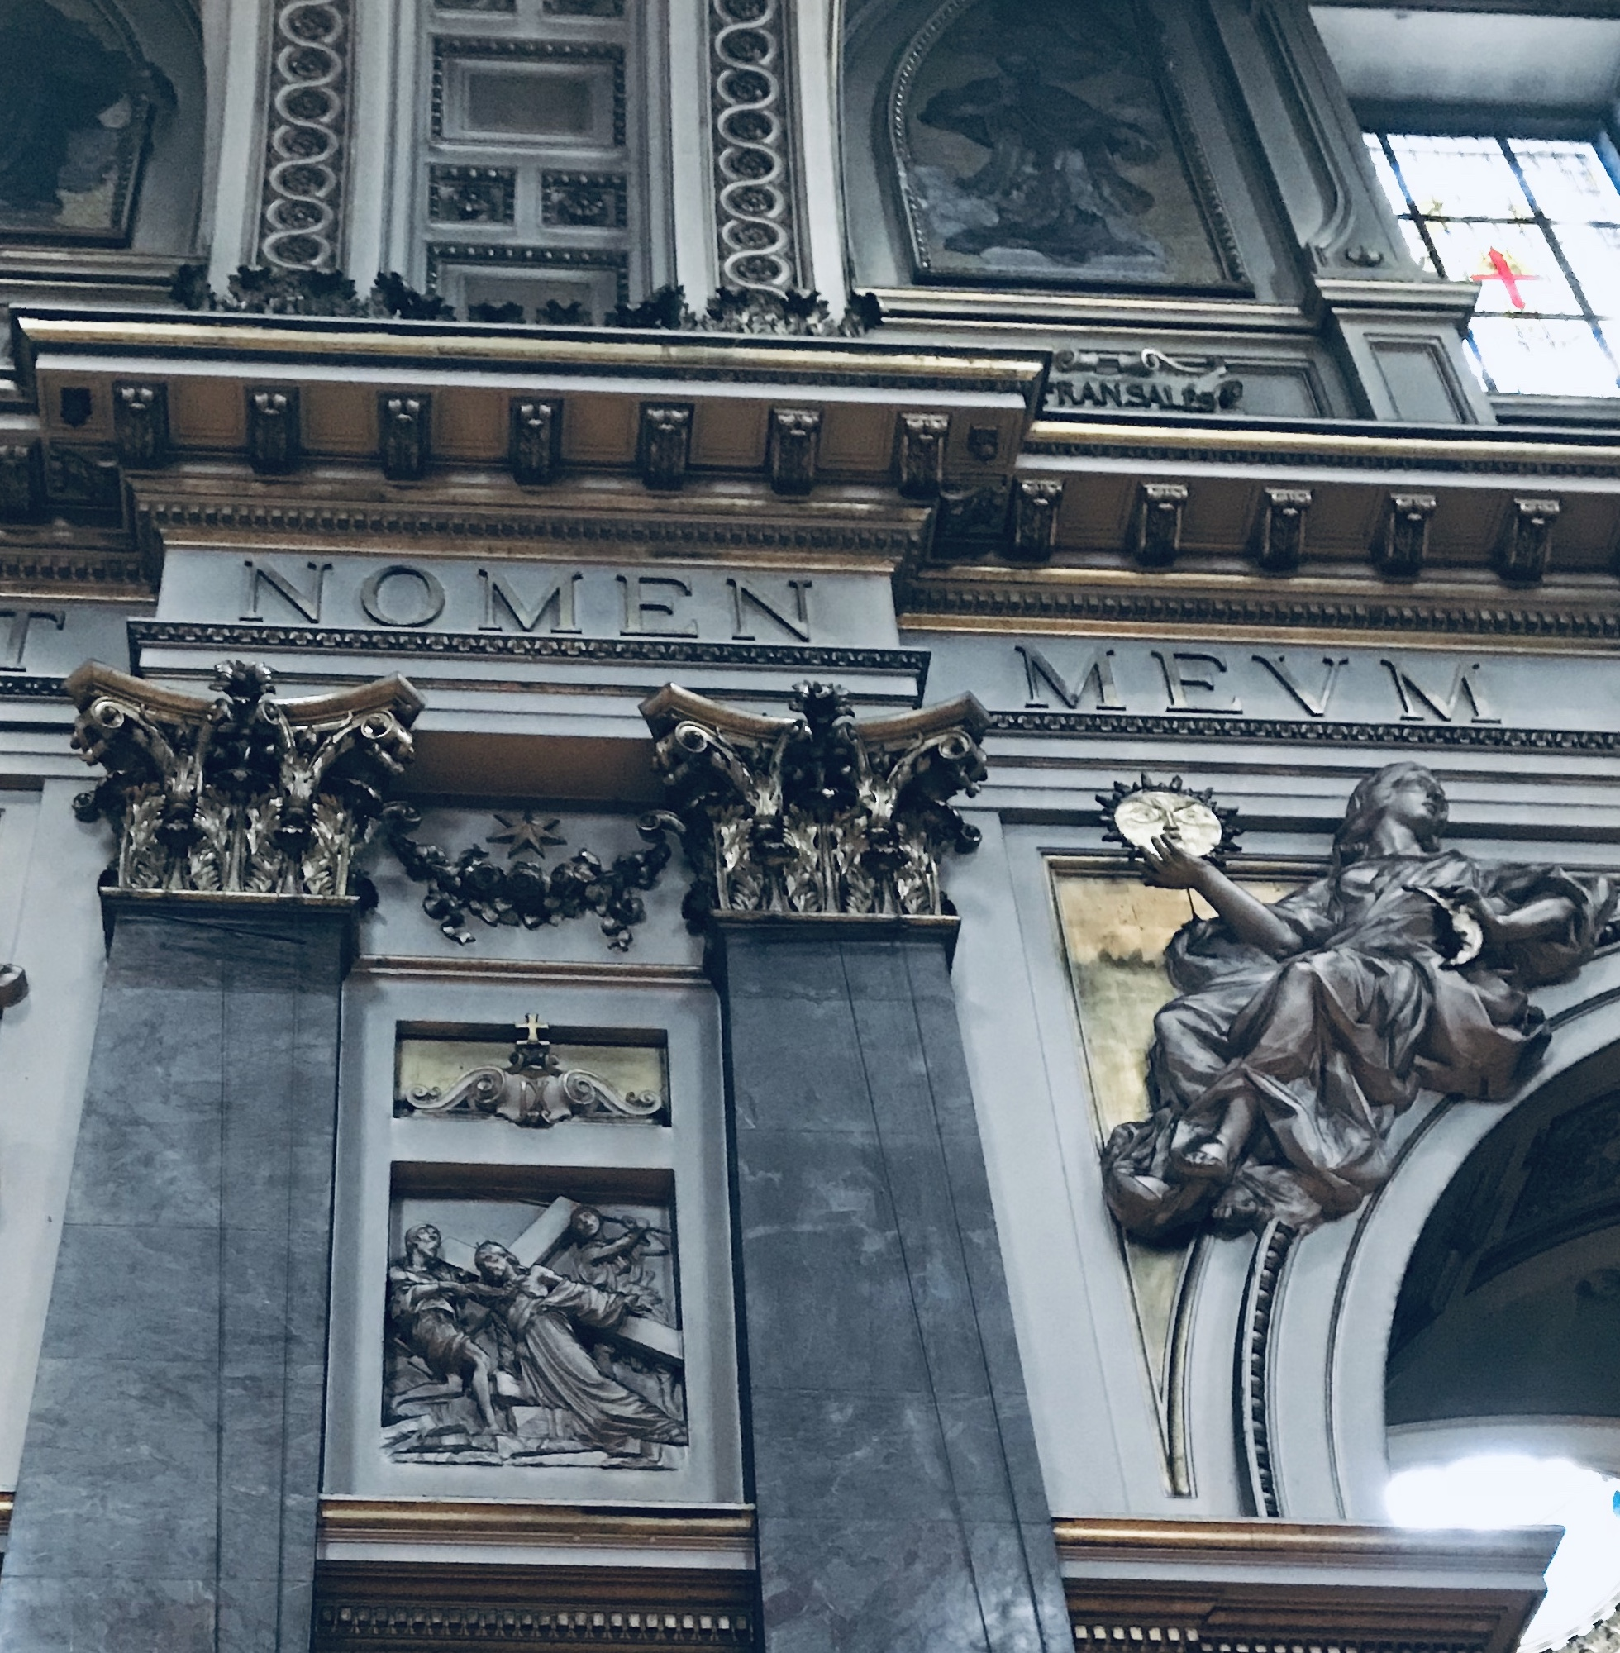
Library Reference Model (LRM)
Notes:
A key aspect of the object-oriented classes is that the class defines the data elements that are valid for that class, and no element is valid in more than one class. In this case you have more than one entity that can have language as a data element and therefore these are defined as three different elements, as you can see from their identifiers.
Also, WEMI entities are defined as disjoint. It is because of this that they cannot share a single element like “language”. You can see that in the FRBR and LRM documents

Slide 10
openWEMI in the era of RDF
RDF class concepts
Classes do not define properties; properties define classes
Classes are not disjoint
Notes:
Not object-oriented, not relational DB. Classes in RDF are semantic, not structural. (example later)
Also in RDF, the class does not define the properties that can be used, and therefore there is no restriction on whether a data element (called “property” in RDF) can be used with more than one class, and the thing that you are describing can belong to more than one class. You can be a librarian, a golfer, a parent, and a knitter – you don’t have to be just one.
Disjoint is an option here, where in RDBMS and OO it is not.

Slide 11
Sample of non-traditional uses of WEMI concepts
FaBiO – FRBR-aligned Bibliographic Ontology
Akoma-Ntoso – Use of FRBR entities to describe legal document versions
FRIR – Functional Requirements of Information Resources
The Music Ontology
Colon classification
Fast Fashion Ontology
Notes:
There are examples of folks that have discovered and used WEMI for their purposes. These resemble the library model but also differ from it in important ways. This was my original impetus for thinking about a more general approach to defining a less constrained model – one that can easily accommodate non-library uses. I ran into these interesting uses of WEMI outside of FRBR – outside of “bibliographic records”
What is interesting is that people from rather far-flung information areas have found WEMI useful for their purposes. As we’ll see, these examples use WEMI but not as defined in the original FRBR model.
Each of these is a vocabulary, some of which are not yet actionable, but some are being used today. And “used” means that they must be implemented as code.

Slide 12
FRBR/WEMI as code
Notes:
IFLA has not provided the FRBR/LRM vocabulary as code, saying instead that it is a CONCEPTUAL model. But as you can see here and with the use of LRM in the RDA vocabulary, it’s not much use in a non-code form.

Slide 13
(at vocab.org)
Notes:
2005, with a group in the UK who were designing an RDF-based library catalog
IFLA did not create a metadata model for FRBR (they continue to insist that FRBR/LRM is a conceptual model, even though RDA embodies it in code -- ?) so this is still the only one available and it is defined as an RDF vocabulary
The Core here is all of the classes (all three FRBR groups) and the properties that are relationships between them, like from Work to Expression, etc. And the bibliographic relationships like “translation of”
Added some classes, like Endeavour, that included the entire bibliographic item – aka all of WEMI – something that IFLA stated clearly was not part of the FRBR model.
This is used by FaBiO, Music Ontolgy and others – in part because there is nothing else.

Slide 14
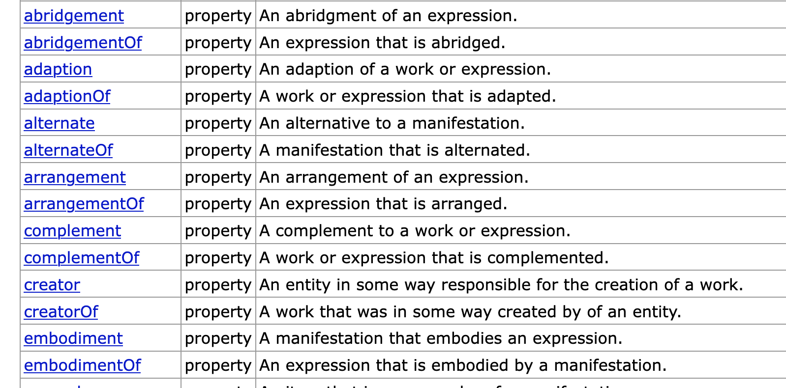
Notes:
It also includes the primary bibliographic relationships, although I have not seen these used in the wild.

Slide 15
Notes:
It followed FRBR closely and therefore imitated precisely the model there including that the “things” of WEMI had no overlap between them, and the relationships were those linear ones in the diagram.
Those using it unfortunately inherit some of the less desirable aspects of FRBR, like WEMI entities being disjoint. Admittedly, some of the folks using this vocabulary have ignored parts that are inconvenient and have created working vocabularies that would be erroneous if strict frbrcore were applied.

Slide 16
FaBiO – FRBR Aligned Bibliographic Ontology
The intellectual or artistic content of a
distinct creation
FRBR Work
subclass of
…restricted to works that are published or potentially publishable, and that contain or are referred to by bibliographic references, …
FaBiO Work
subclass of
subclass of
subclass of
essay
report
Scholarly work
Notes:
This is part of the CiTO (citation indexing) vocabulary, and is a vocabulary for describing academic publications. FaBiO Work is defined as a sub-class of FRBR work – a more specific kind of work. Subclassing is a way to retain the general concepts but have them be specific to your use case. (FRBRcore – in a few minutes)

Slide 17
FaBiO – FRBR Aligned Bibliographic Ontology
Notes:
You can see how more flexibility is needed. In actual FRBR you cannot have an item without a manifestation, nor a manifestation without an expression. FaBiO found a need to add relationships to allow this. In part this could be the nature of the resource being described, but it also allows for missing information that might be filled in later. RDF is very open about the fact that you don’t always have all of the information at a single moment in time, but may need to build your data as you go along. RDF says that it’s ok if you don’t have everything in your data at a given time, you are allowed to provide it at a later date, if at all. (don’t’ expect catalogers to be omniscient)
Another reason: What if you just have a work and an item? As for original art works. Or Work/Manifestation?

Slide 18
The Music Ontology
Notes:
Once again, this creates a more specific class for the work – a musical work. In traditional library practice, this would be a form, but this allows you to have a general work, a musical work, and this is how one defines a more specific type in the RDF world.

Slide 19
The Music Ontology
FRBR Work
FRBR Expression
subclass of
subclass of
MusicWork
MusicExpression
Notes:
Once again, this creates a more specific class for the work – a musical work. In traditional library practice, this would be a form or genre code, but this allows you to have a general work, a musical work, a music expression, etc.

Slide 20
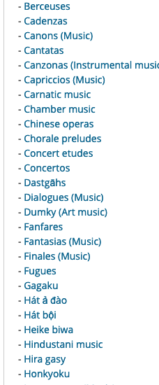
The Music Ontology
Notes:
Once again, this creates a more specific class for the work – a musical work. In traditional library practice, this would be a form, but this allows you to have a general work, a musical work, and this is how one defines a more specific type in the RDF world.

Slide 21
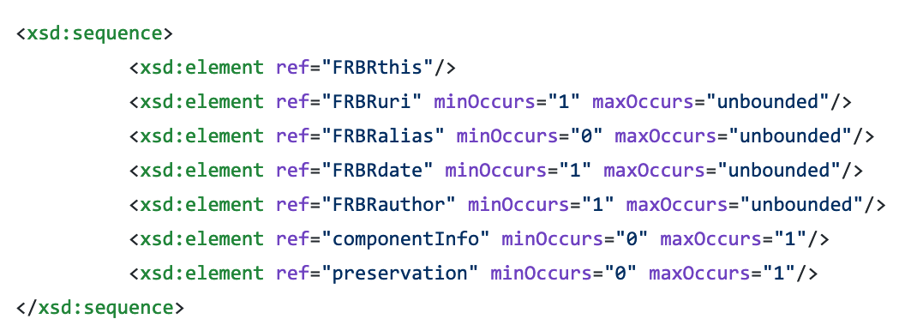
Akoma-Ntoso – an XML schema for legal documentation
Notes:
A legal document is a work, but there are many different expressions and manifestations of that work as it goes through the legislative process. The WORKFLOW of a law or other official document. WEMI holds these together. This does not look at all like the other examples because it is not in RDF but in XML. Still, it needs a broad definition of WEMI if it is going to be coherent as a vocabulary.
Where in published resources what are gathered together into a Work are publications that each stand alone, in this case the expressions and manifestations are VERSIONs and, once the process is complete, may not be retained. But during the process this helps keep it all straight.

Slide 22
Functional Requirements of Information Resources
Notes:
I can’t explain this one well but I’ll give you a link to the article. These are datasets, derived from the same dataset, and you could run comparison algorithms to determine which are derived from others. Comparing datasets mathematically. This is a way to organize a family of datasets, and keeping track of which ones are equivalents or are derivative. Conceiving of them as manifestations of a work makes organization possible.

Slide 23
Ranganathan's Colon Classification _ Book numbers
FRBR
Work
Expression
Manifestation
Item
CC
Classification number
Language, Form
Year of publication, volume, supplement (parts)
Copy number
Notes:
This is an analysis of Ranganthan’s library classification from the 1930’s, showing how his book "call number" can represent WEMI – some of this is true in LCC and DDC but not as specifically as this. It would be interesting to try to apply WEMI to library classification and to subject headings. I’m not sure it would be useful, but it might be interesting.

Slide 24
Fast Fashion Ontology
FRBR
Work
Expression
Manifestation
Item
FFO
style
item
stock-keeping unit
piece
Notes:
This was another use of WEMI that varies greatly from the library model. This was done for the system of a fashion industry company. It begins with the designer’s idea for a style, to an actual design, then the manufacture of that, and then individual pieces that are sold. It’s a stretch, but stretching is good.

Slide 25
Bring on openWEMI

Slide 26
“raw” WEMI
Work
Expression
Manifestation
Item
Notes:
Removing as much of the baggage as possible

Slide 27
“raw” WEMI
Work
Expression
Manifestation
Item
From most general to most specific ->
Notes:
It still has the logic from Work to Item

Slide 28
Work
Expression
Manifestation
Item
The concept of creation
The creation
expressed
The creation made manifest
The specific instance of a creation

Slide 29
openWEMI as a diagram
openWEMI:Work
openWEMI:Expression
openWEMI:Manifestation
openWEMI:Item

Slide 30
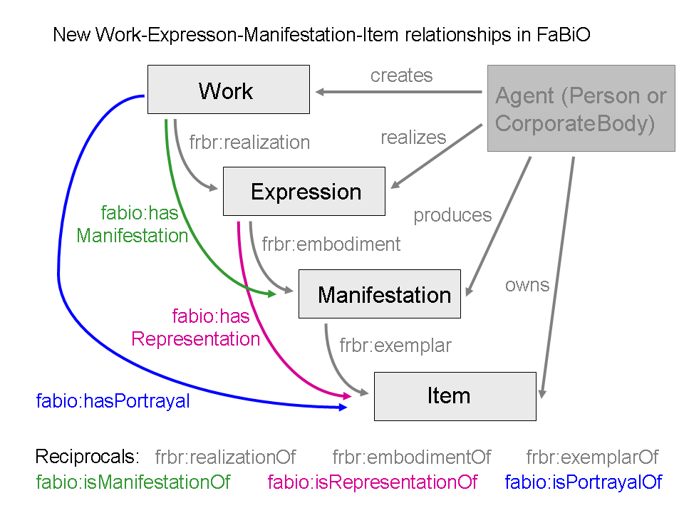
openWEMI as a diagram
openWEMI:Work
openWEMI:Expression
openWEMI:Manifestation
openWEMI:Item

Slide 31
openWEMI* * h/t Adrian Pohl
any entity can be iterative (e.g. a work of a work)
any entity can have relationships/links to any other entity
no entity has an inherent dependency on any other entity
any entity can be used alone or in concert with other entities
no entities are disjoint
anyone can define additional entities or subclasses
individual profiles using the model may recommend or limit attributes and relationships, but the model itself will not have restrictions

Slide 32
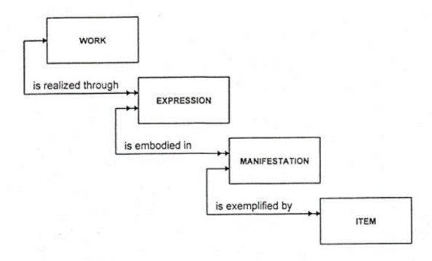
openWEMI:work
openWEMI: expression
openWEMI: manifestation
openWEMI: item
Etc.
FaBiO Work
Music Work
Akoma Work
FRIR Work

Slide 33
“The scream”
Work
:artWork1
dct:title
dct:creator
“Edvard Munch”
Aat:type
Manifestation
Oil on canvas
size
8 ½ x 11
Item
location
Oslo wing
notes
“AOK”

Slide 34
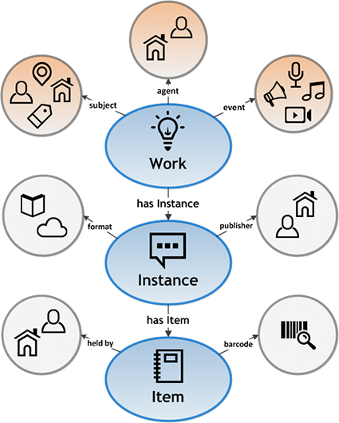
BIBFRAME
Work
Exp’n
Manif’n
Item

Slide 35
An idea of an outline
Four classes
Work
Expression
Manifestation
Item
It has these properties which define the primary relationships between WEMI:
expresses (range: Work)
manifests (range: Work or Expression)
instantiates (range: Work or Expression or Manifestation)

Slide 36
Now a Dublin Core Working Group
Join the mailing list (low traffic) to keep up to date:
https://lists.dublincore.org/mailman/listinfo/openwemi
Work is being done on github:
https://github.com/dcmi/openwemi

Slide 37
Other possibilities
A super-class, like the FRBRcore “Endeavour”
WEMI as SKOS concepts
Etc. (See https://github.com/dcmi/openwemi/issues)
Add others if you see some
Notes:
Working group will consider various possibilities, and will provide a vocabulary as quickly as possible.

Slide 38
Thank you and links
https://github.com/dcmi/openwemi/bibliography.md
http://purl.org/spar/fabio/
http://www.akomantoso.org/ (also: https://github.com/oasis-open/legaldocml-akomantoso/)
http://tw.rpi.edu/media/2012/02/07/d641/EX_ISSI-2011-09-0138.R1_McCusker.pdf (FRIR)
http://musicontology.com/specification/
https://jlis.it/index.php/jlis/article/view/361 (Colon Class)
Peroni, S., and Vitali, F., Interfacing fast-fashion design industries with Semantic Web technologies https://doi.org/10.1016/j.websem.2017.06.001
http://vocab.org/frbr/core (broken, use archive.org)
http://kcoyle.blogspot.com/2019/01/frbr-without-fr-or-br.html
http://kcoyle.net/beforeAndAfter/c10-978-0-8389-1364-2.pdf
https://journal.code4lib.org/articles/16491
kcoyle@kcoyle.net
CC-BY

