Slide 1
Designed for Accessibility: MARC Records for the National Library Service for the Blind and Print Disabled
Anita Kazmierczak, Head, Bibliographic Control Section, National Library Service for the Blind and Print Disabled.
March 2022

Slide 2
MARC records accessibility in the making
NLS receives feedback and accessibility requirements from patrons and Network libraries
NLS listens and learns and constantly improves accessibility of NLS catalog
NLS’s Bibliographic Control Section designs MARC records that address patron accessibility needs
NLS MARC is an ongoing design process
New formats demands influenced NLA MARC records (print to web)
NLS maintains the highest quality of accessibility and will introduce new tags to continuously improve

Slide 3
MARC record accessibility tags are a hidden treasure behind the discoverability of library collections
MARC vs MARC partners
NLS MARC must serve ALL readers NLS MARC must follow ALL national standards NLS MARC must support ALL network libraries NLS MARC must support circulation vendors NLS MARC must support book production
NLS MARC must support BARD

Slide 4
STANDARDS
PATRONS
MARC
MATRIX
BOOK
PRODUCTION
CIRCULATION VENDORS
NETWORK LIBRARIES
BARD

Slide 5
M A R C 21 NLS EDITION
Cassette Record - RC

Slide 6
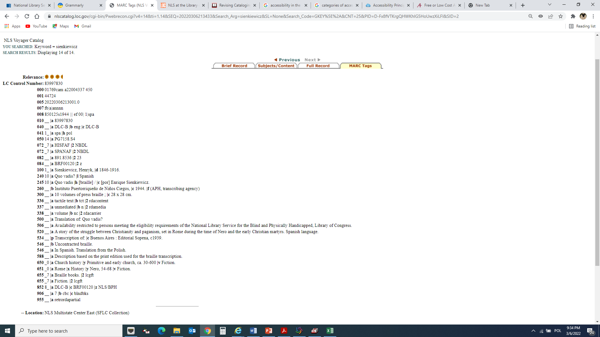
Braille Record - BR
M A R C 21 NLS EDITION

Slide 7
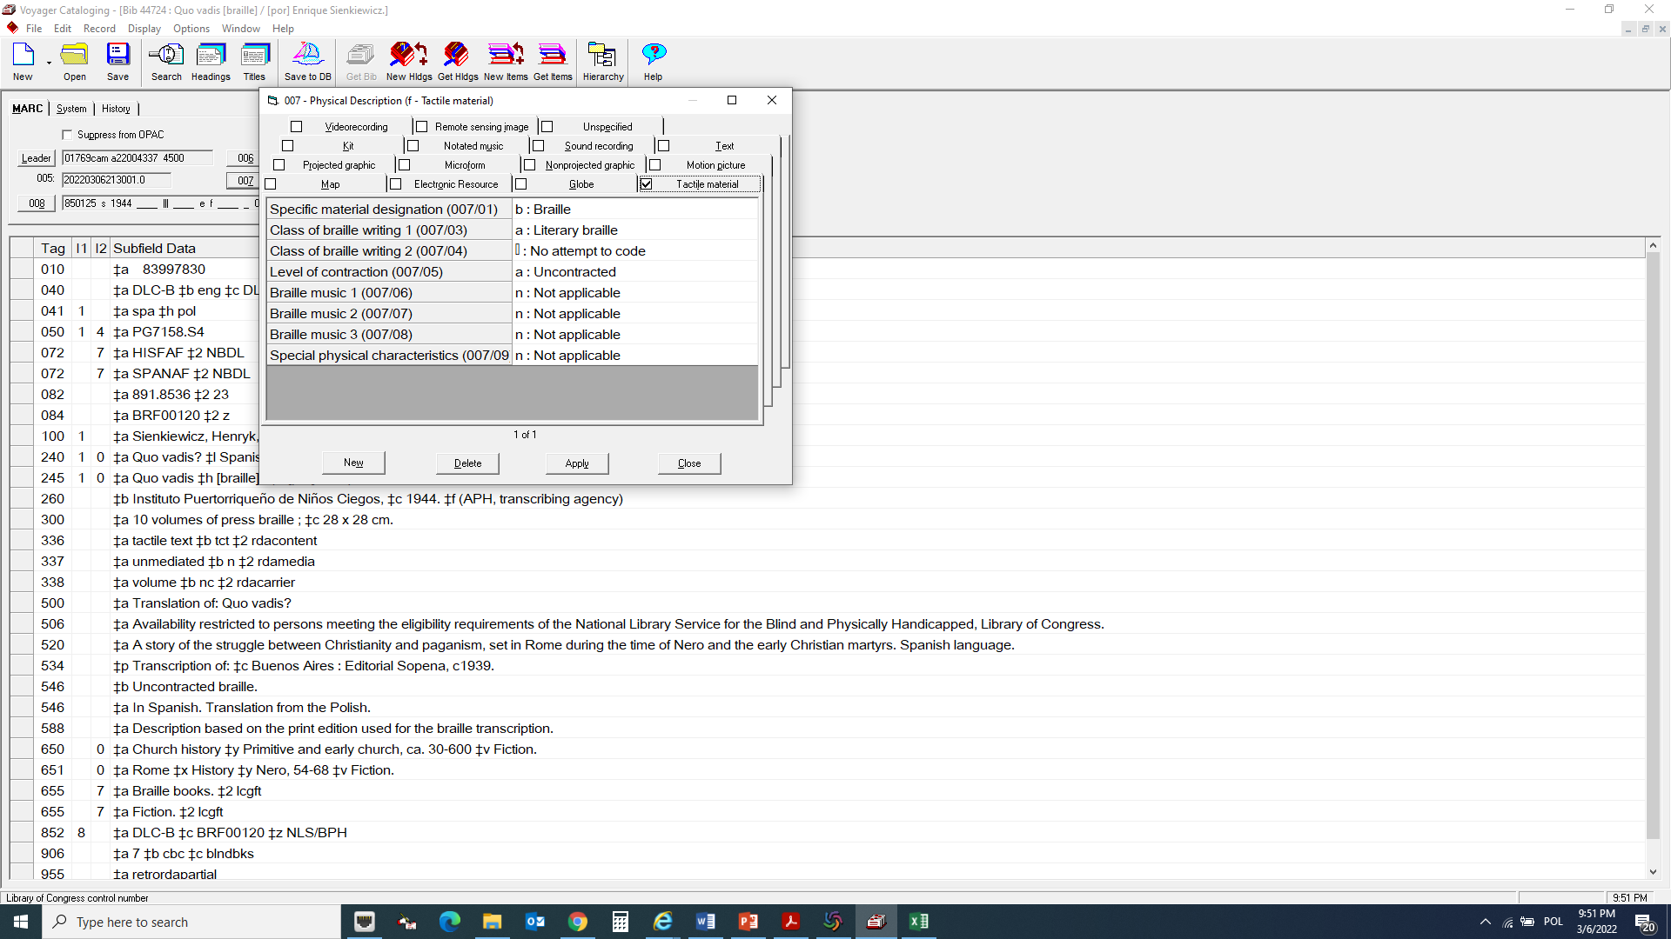
Braille Record - BR
M A R C 21 NLS EDITION

Slide 8
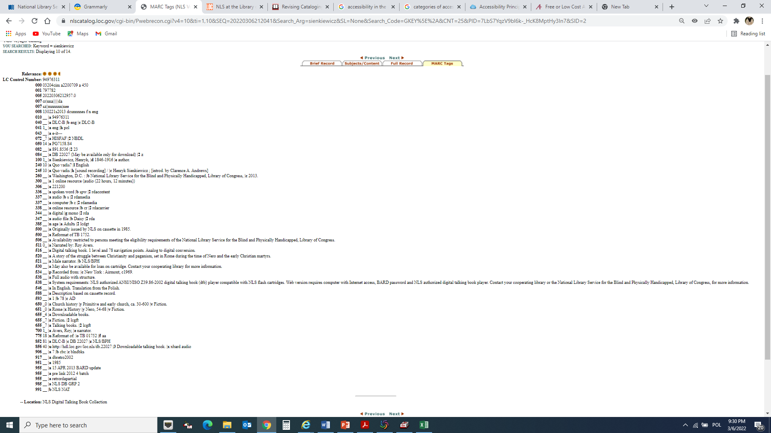
M A R C 21 NLS EDITION
Digital Talking Book Record - DB

Slide 9
BARD view

Slide 10
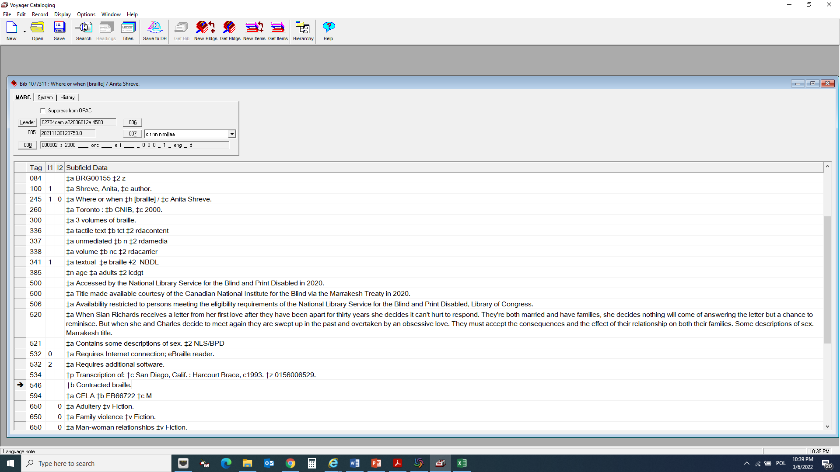
New Accesibility MARC Tags
Braille Record - BR
DRAFT braille MARC21 RECORD with new accesibility tags
In 2022 NLS will add to the MARC records new accessibility tags
341 Accessibility Content
532 Accessibility Note

Slide 11
STANDARDS
341/532
4XX
511/700
PATRONS
506
ALL MARC21
072
041/546
521
516
MARC
MATRIX
341/532
341/532
516
BOOK
PRODUCTION
CIRCULATION VENDORS
041
260
007
260
084
072
4XX
538
856
306
9xx
511/700
520
521
341/532
538
341/532
538
072
NETWORK LIBRARIES
655
072
BARD
516
082
856
084
4XX
084
520
590
260
506
520
521
856
520

Slide 12
And that brings us to the end. I’d like to thank you for your time and attention today.
If anyone would like more information or has questions, please feel free to contact NLS/BCS team
BCS contact:
bcs@loc.gov
Bibliographic Control Section Head contact:
ahoffman@loc.gov
NLS website:
https://www.loc.gov/nls/
NLS catalog:
https://nlscatalog.loc.gov/webvoy.htm

