Slide 1
Making the Most of Discovery: Navigating Limits for User-centered Discovery Layer Configuration
Jennifer Martin ALA Annual 2019 CaMMS Catalog Form & Function Interest Group Meeting June 22, 2019

Slide 2
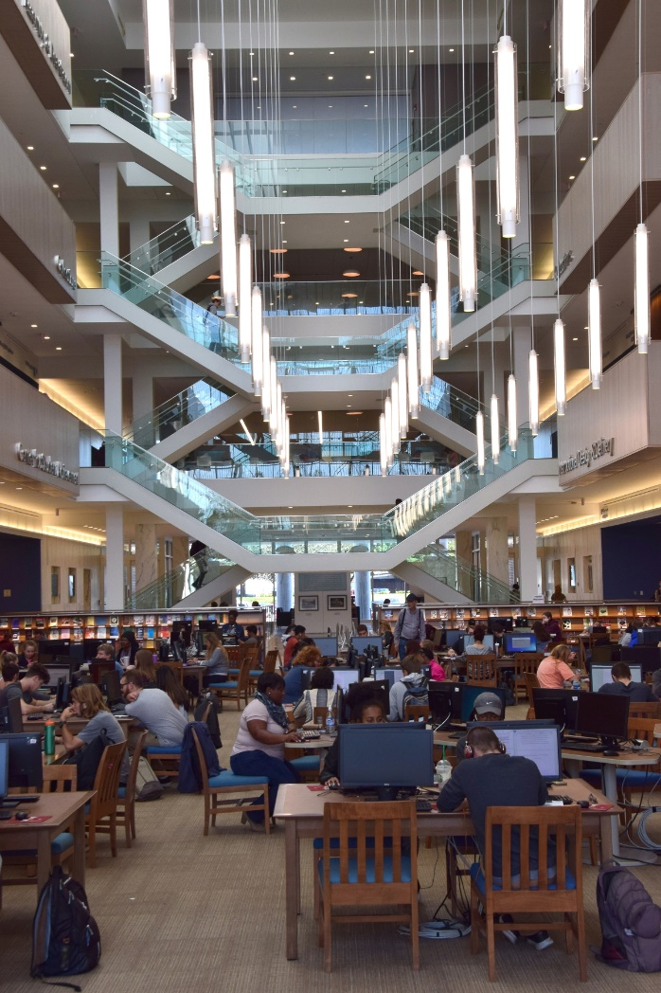
Background
Salisbury University is a public regional comprehensive university serving about 8500 undergraduate and graduate students, with about 450 faculty
SU is located in Salisbury, MD, on Maryland’s Eastern Shore
SU Libraries has about 15 faculty librarians and 15 FTE library staff
Notes:
Public regional comprehensive; 8500 students; 450 faculty
SU Libraries has 15 faculty librarians, 15 FTE staff

Slide 3
History
2011
SU starts using WorldCat Local as our discovery layer
2018
Summer: SU transitions from WorldCat Local to WorldCat Discovery
Fall: we start implementing changes to make the interface more user friendly
Notes:
Started w/WorldCat Local in 2011, and decided to transition to Discovery in summer 2018, because Local was no longer being supported. Discovery and Local share settings, so the actual work to transition was minimal, but we decided to use the change as a catalyst to try to improve the search experience. Had not really looked critically at settings etc. for quite a while

Slide 4
Goals
Make materials easier to find
Reduce user confusion

Slide 5
Our Process
I identified problem areas (August 2018)
Reference librarians listed their pain points (December 2018)
Library staff identify bugs (ongoing)
Prioritized list of improvements
Notes:
Started with me identifying several areas which could be improved, such as doing a comprehensive update of our knowledge base holdings
We met with the reference librarians in December 2018 to discuss the pain points they had found during the semester—at this point, we discussed my ideas with them, and then prioritized everything
Have also had several display issues come up as bugs at various points throughout the past year

Slide 6
Challenges
WorldCat Discovery has minimal configurability
Limited staff availability and time
Notes:
Because of the limited configurability, we often have to deal with the status quo (trying to find a creative workaround), rather than actually being able to make direct changes we’d like to
A single librarian (me) is primarily responsible for all maintenance and configuration of the discovery layer, and that is far from my only job responsibility. Other librarians are willing to make suggestions but too busy to contribute much more than that

Slide 7
Completed Work
Updated holdings in the knowledge base (work in progress)
Enabled getting copies of any feedback sent to OCLC using the feedback form (have not gotten any, to date)
Submitted an enhancement request for adding something to the interface which notifies the user when the library holds multiple editions of a work (https://tinyurl.com/EditionsEnhancement)
Submitted tickets to have various interface problems/bugs fixed, as identified by library staff
Changed library links in our header
Notes:
Our knowledge base holdings had not been comprehensively reviewed for at least 3 years, if ever. Ended up being more complicated than I expected.
Turned on the option to get copies of feedback, but it has not been used yet
Asked OCLC to add something to the interface which would let users know that the library holds multiple print copies, along the lines of the recent different formats notification they put in
Problems/bugs: having “check at circulation desk” for availability changed to “requested” or “lost,” and have the full item location display in the search results list (rather than just library and call number)—last deemed not a bug by OCLC
Changed links by request of the reference librarians

Slide 8
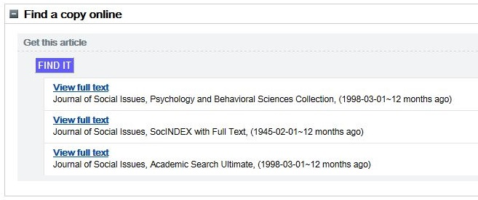
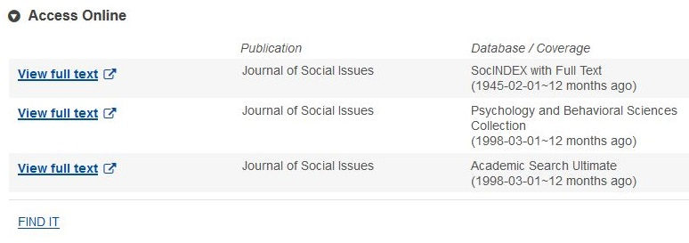
Our “Find It” button (link resolver)
WorldCat Local
WorldCat Discovery
Notes:
Our link resolver has been labeled “find it” for a very long time, and is known as the “find it button” among librarians and staff and is taught that way to students.
In local, this was an actual button (see left).
In Discovery, it was demoted to a plain link (see right). This did not sit well with our reference librarians, who wanted it more visible.
As you can see, OCLC’s links from their own link resolver do show, but we generally advise that patrons use our link resolver (through Find It) as the final arbiter of whether we have online access to something. Though hopefully as the OCLC knowledge base gets further cleaned up, we will have fewer and fewer false links in OCLC.

Slide 9
Improved our “Find It” link
Changed “Find It” link to all caps to make it marginally easier to spot
Put in an enhancement request asking for the ability to further customize the link (https://tinyurl.com/LinkResolverEnhancement)
Notes:
Originally, “Find It” had only had the first letter of each word capitalized. We changed it to all caps to make it stand out at least a little more.
Also put in an enhancement request asking to be able to actually customize the display beyond just the text, to allow us to once again make it more prominent.

Slide 10
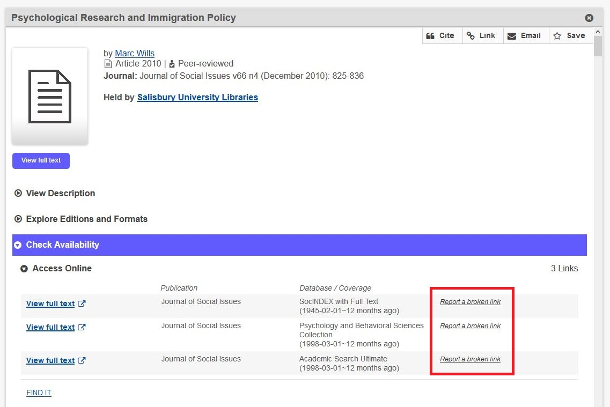
Enabled broken link reports
Reports can come from:
actual broken links
database problems
confusion over the landing page of the link
Solutions have included:
changing knowledge base selections
reporting link resolver issues to OCLC
removing bad links from our local catalog
asking for vendors to correct their metadata
Notes:
Enabling puts “Report a broken link” next to each OCLC-generated link, and users can click the link to generate a report which gets emailed to me
Can be actual broken links, but also database problems (such as being unable to access the linked material due to paywalls or 404 errors) or confusion over the landing page of the link (such as when it takes them to a search results page rather than the item directly)
This has led me to recognize and therefore fix multiple linking problems, including wrong collections being activated in the knowledge base as well as OCLC link-resolver errors (via bug reports). Sometimes the cause is bad metadata, which goes all the way back to the vendor and therefore may or may not be fixed.

Slide 11
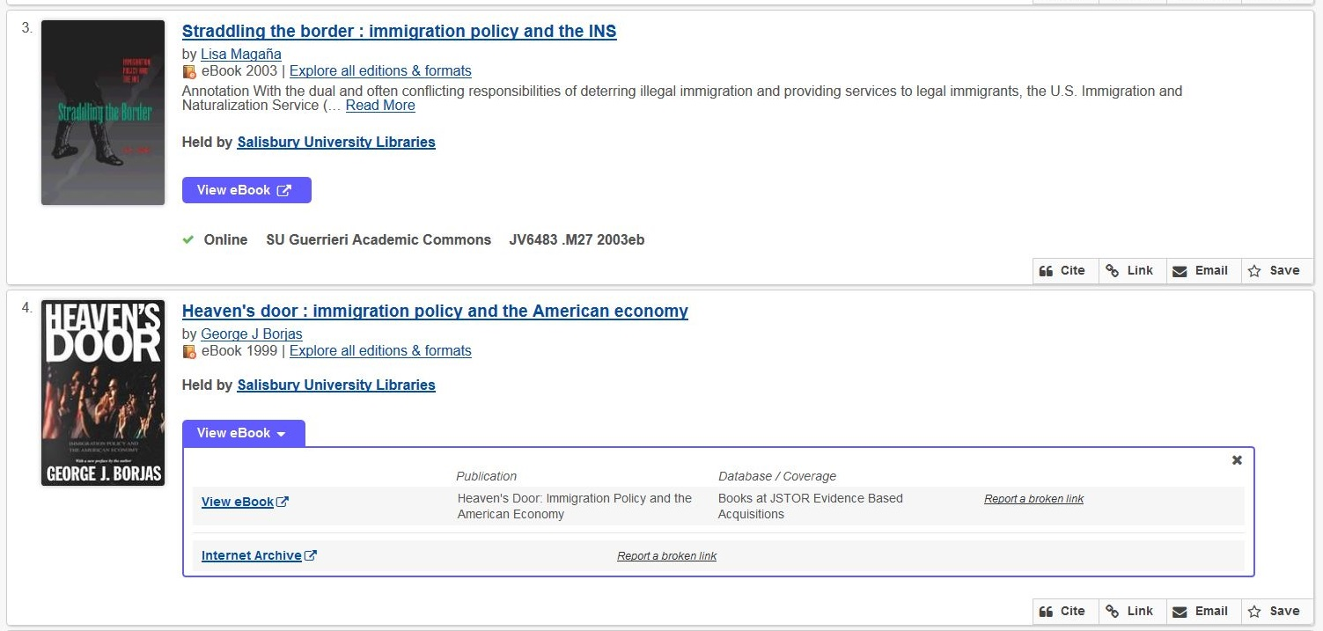
Changed the display of links to online content in the results list
Notes:
Adjusted the results list so that all OCLC links show to users by default rather than just the first in the list
Used to all look like the top one, even if there were multiple links; now that’s only if there’s only a single link
Users didn’t necessarily realize that there was more than one link available, so if the first link was broken, they’d just assume they couldn’t get to the content at all

Slide 12
Future Work
Complete the knowledge base update
Add a print holdings collection to the knowledge base so that our article-level holdings accurately reflect our temporal coverage
Submit additional enhancement requests
“From” field on the email-a-record feature
The ability to customize the zero results screen (to allow us to present search tips)
Ability to decide which sort options to display to users
Perform user testing on questions such as which databases should be searched by default, what the default sort options should be, etc.

Slide 13
Recommendations
Take advantage of all possible avenues of feedback
Talk with your reference and circulation departments
Make sure coworkers know that you will address issues if they bring them up
Focus on incremental progress
Notes:
-Take advantage of all possible avenues of feedback—if you make it easy to give feedback, people will, but if they have to search for contact info, you’ll probably never know about their problem, e.g. all the broken link reports which I never heard a peep about until I turned on that feature
-Talk with your reference and circulation departments—as the frontline in helping users, they generally are quite aware of what problems are being frequently encountered
-Make sure coworkers know that you will address issues if they bring them up—we had a few outstanding issues which were the work of minutes to change but which had never been mentioned before the meeting, e.g. changing what links were in the Discovery page header
-Focus on incremental progress—“better” will help your users more than waiting to be able to do things “right”; small wins which can be done now

