Slide 1
Treasurer’s Report Membership Information Session and Virtual Membership Meeting
2020-2021 ALA CD# 13.2
2021 ALA Virtual Annual Conference
Sunday, June 27, 2021
2021 ALA Virtual Annual Conference
Maggie Farrell, ALA Treasurer

Slide 2
Topics for Discussion
Membership Value
Preliminary FY22 Budget Timetable
Budget Directives
Overview
Annual Estimates of Income
Draft 5-Year Financial Plan
FY20 Audit
Operating Agreement Workgroup Update

Slide 4
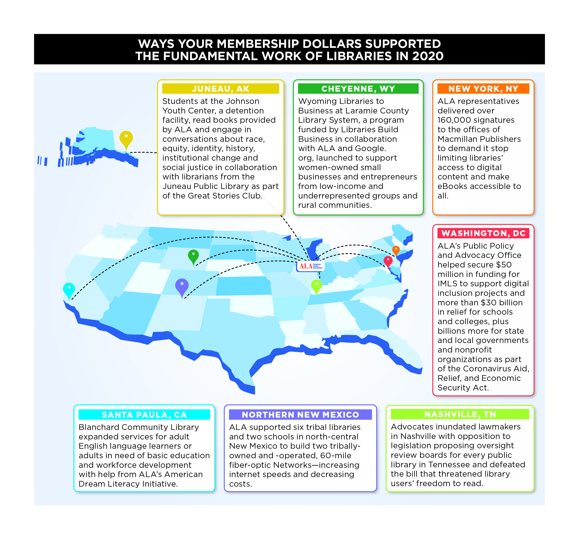

Slide 5
FY22 Budget Timetable
2nd Review of FY22 draft budget
Council approve FY22 AEI
Final budget review/approval Fall
Budget directives by BARC and EB
Notes:
This is the second review of the draft FY22 budget.
BARC, Finance & Audit, and the Executive Board reviewed the 1st draft in April
This meeting will be the second look at the FY22 budget.
We will also look at the Annual Estimates of Income with the goal to set the budgetary ceiling for ALA. BARC, F&A, and the Executive Board will consider this as well and bring to Council for their approval.
Of note, during April, BARC, F&A, and the Executive Board provide some guidance for ALA management as work continued on the FY22 budget process.
Next slide…

Slide 6
Budget Directives
Bring forward a final balanced FY22 budget
Build a contingency fund to manage unexpected events and include a budget line to reflect it
Examine financial projections for LibLearnX and Annual 2022 for a pragmatic forecast and provide data supporting the assumptions
Align expenditures with revenue projections (understanding division conference cycle)

Slide 7
Preliminary FY22 Budget Overview
American Library Association
Statement of Revenues and Expenses - Total ALA
 |  |  |  |  |  | ($,000)
 | 2019 Actual | 2020 Actual | 2021 February Close | 2021 Budget | 2021 Projection | 2022 Budget
Revenues
General Fund | 27,020 | 18,598 | 9,193 | 21,735 | 19,970 | 28,245
Divisions | 13,435 | 15,004 | 4,725 | 11,167 | 9,928 | 13,558
Round Tables | 687 | 494 | 347 | 572 | 572 | 502
Grants and Awards | 7,310 | 21,776 | 553 | 5,470 | 5,470 | 4,326
Total Revenues | 48,453 | 55,872 | 14,819 | 38,944 | 35,941 | 46,632
Expenses
General Fund | 31,397 | 28,340 | 11,240 | 21,519 | 21,461 | 29,322
Divisions | 14,151 | 14,306 | 4,333 | 12,291 | 9,725 | 13,889
Round Tables | 512 | 238 | 93 | 349 | 349 | 462
Grants and Awards | 6,916 | 5,604 | 3,108 | 5,500 | 5,500 | 4,326
Total Expenses | 52,975 | 48,488 | 18,775 | 39,659 | 37,035 | 47,998
Note: GF revenue includes FY22 $1.5 million Endowment Fund Transfer with Terms

Slide 8
Preliminary FY22 Budget Overview (continued)
Statement of Revenues and Expenses - Total ALA
Net Rev/(Exp) From Operations
General Fund | (4,376) | (9,741) | (2,047) | 216 | (1,491) | (1,076)
Divisions | (717) | 698 | 392 | (1,124) | 203 | (331)
Round Tables | 176 | 256 | 253 | 223 | 223 | 41
Grants and Awards | 395 | 16,172 | (2,555) | (30) | (30) | (0)
Subtotal Net Rev/(Exp) From Operations | (4,522) | 7,384 | (3,956) | (715) | (1,094) | (1,367)
Paycheck Protection Program (PPP) loan relief | 0 | 0 | 0 | 0 | 0 | 1,000
Total Net Rev/(Exp) From Operations | (4,522) | 7,384 | (3,956) | (715) | (1,094) | (367)
 |  |  |  |  |  | 175 | Travel (or other) Expense reductions
 |  |  |  |  |  | 455 | Executive Office & AED Expense reductions
 |  |  |  |  |  | 630 | Total Expense reductions
 |  |  |  |  |  | 263 | FY22 Contingency

Slide 9
Annual Estimates of Income
Per Article IX, Finances, Section 1 of ALA's Bylaws: Annual estimates of income shall be based upon the unexpended balance remaining from the previous year plus anticipated revenues for the next budget year. BARC is charged with reviewing and approving the Annual Estimates of Income.
 |  | TOTAL ALA
 |  | ($,000)
ALA Net Assets (projected at end of FY 2021) |  | $ 27,231
FY 2022 Budgeted Revenues
General Fund |  | 28,245
Divisions |  | 13,558
Roundtables |  | 502
Grants & Awards |  | 4,326
Endowment |  | (794)
TOTAL |  | 45,837
FY 2022 Annual Estimates of Income |  | $ 73,068
Notes:
The annual estimate of income represents the net assets of the association as a whole and the estimated revenue for FY 22. The annual estimate of income is defined in ALA bylaws as the net assets of the association plus the anticipated revenue for the upcoming fiscal year.
The annual estimate represents how much money the association could spend. It is far beyond what will be spent in FY 22 based on the revenue and net assets just over $73M

Slide 10
Draft Five Year Financial Plan
Increase and retain membership inc. stakeholders and partners
Diversify and increase revenue streams
Continuing Education – increase and coordinate
Examine conferences
Streamline and align internal operations
Benchmarking
EBD#3.32

Slide 11
FY20 Audit Update
FY20 Budget completed
Annual Audit currently underway

Slide 12
Operating Agreement WG Update
EBD#10.15
Relationship between ALA and Divisions
Last revision – 1989
Focus on our unity and strengths
Facilitate collaboration and innovation
Members always the core
Support shared operations and values
Role of the Overhead Rate
Future consideration of Roundtable relationship
Request to extend Work Group for one additional year
Notes:
defines the relationship between ALA and Divisions
Last revision – 1989
The WG is also taking into consideration the Strategic Pivot Plan with its focus on strengthening collaboration and coordination among Divisions as well as increasing revenue streams.
The WG will rewrite the policy with the goal of simplifying the details.
The WG is beginning to examine the Overhead Rate to understand how it currently fosters or stifles innovation, collaboration, and/or competition.
The WG will seriously examine if the Overhead Rate should be eliminated in an effort to encourage collaboration and to truly function as one budget to foster the one ALA focus.
Of central consideration is how to share the supporting/operational costs of ALA as well as funding initiatives that advance ALA’s values.
The Roundtable relationship will also be considered possibly recommending inclusion within the Operating Agreement or development of a separate policy. However, some aspects of a proposed policy would apply overall to ALA.
The WG is requesting an extension to its charge with all members continuing the work and gathering member feedback.

Slide 13
Discussion
Handy List of References:
Draft FY22 Budget – EBD#3.28
Draft Five Year Financial Plan – EBD#3.32
Pivot Plan – CD#36
Operating Agreement Work Group website
ALA Treasurer’s Page inc. Financial Learning Series
Notes:
If you keep this slide – it needs to be updated with the docs/numbers

