Slide 1
Revamping workflows and enhancing communication
How Mississippi State University Libraries improved electronic resources processing
Bonnie Thornton, Assistant Professor, Mississippi State University Libraries
Preston Salisbury, Assistant Professor, Mississippi State University Libraries

Slide 2
Introduction & Outline
Project Background
Implementation
Adjustments
Acquisitions
Cataloging
Systems
Conclusion

Slide 3
Target Project Background
Mississippi State University
About 22,000 students
Almost 1,500 Faculty
Almost 5,000 Employees
Multiple campuses and extension sites
Mississippi Library Partnership
Shared catalog
Non-shared e-resources
OPAC confusion & Patron complaints
MSU Systems → ILS provider → Discovery XML (DiXML) Target creation

Slide 4
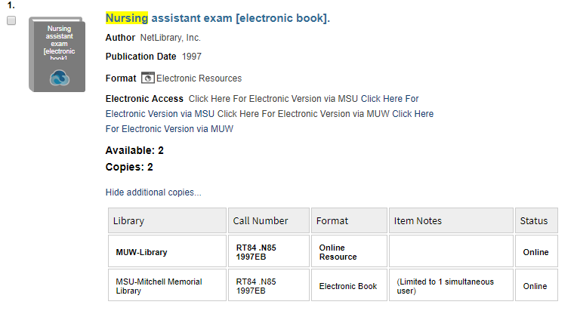
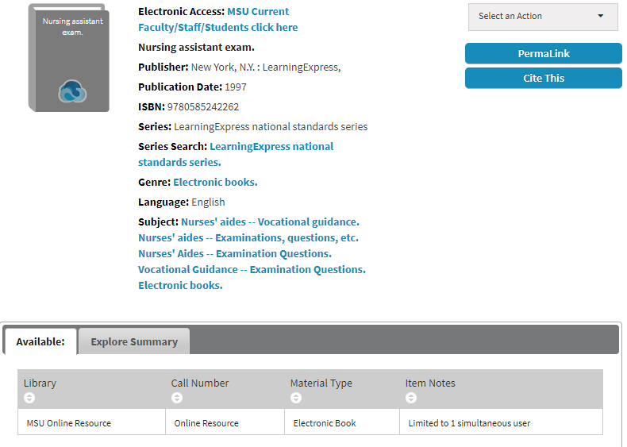
Before & After

Slide 5
Acquisitions
Minimal change in workflow
Selection & ordering processes the same
Loading of NOA into e-book spreadsheet
Duties absorbed due to staff changes
Passed on to cataloging

Slide 6
Cataloging
Batch edit of previous records
Field and tag adjustments for copy catalog application
Task-level application for MARCedit to use for record editing going forward
Access phrasing edits for patron convenience and altered OPAC display
Edited text File → Systems

Slide 7
Systems
File edited and uploaded into target once notified
No delta updates ☹
Loading of EBSCO records remains the same
Less time editing since records are held in Target instead of Workflows

Slide 8
Lessons learned
Preparation is key
Involve ALL workflow stakeholders and departments
Minor edits = major changes for patron satisfaction
good opportunity for workflow review

Slide 9
QUESTIONS?
bthornton@library.msstate.edu
psalisbury@library.msstate.edu

