Slide 1
Library of Congress Subject Headings: A Post-Coordinated Future
Amy Phillips
Cataloging Policy Specialist
Policy, Training, and Cooperative Programs
Library of Congress
amphillips@loc.gov

Slide 2
Summary
Highlights
Common Concerns in the Library Profession

Slide 3
Summary
“The chief of Policy, Training, and Cooperative Programs at the Library of Congress, Judith Cannan, asked Nancy Cooey and Amy Phillips to assess the merits of pre-coordinated versus post-coordinated subject cataloging. Such an assessment had not been made since 2006. The original report was issued in 2022 and a revised version was published in Cataloging & Classification Quarterly in April 2023.”
Precoordinated subject heading creation impact on catalogers
Precoordinated subject headings’ impact on users
Postcoordination and discoverability

Slide 4
Definitions
“Pre-coordination is the assignment of subject headings in a semantic string to bibliographic records. This task is done primarily by professional cataloging librarians due to the level of training required to do this work effectively.”
“Post-coordination is the assignment of subject headings individually in a catalog record such that terms are not semantically related to one another. Post-coordination is also the term used to describe what most users do when they combine headings or keywords while searching for materials in a catalog.”

Slide 5
Pre-coordinated assigned subject:
Painting, French–France–Paris
Post-coordinated search Post-coordinated assigned subjects
Paris AND paintings Paintings
Paris (France)
Painters, French

Slide 6
LC Staff Survey on Subject Cataloging Report by Kate Ritchie and Rosa Alicea
Training Improvements Needed
51% Training was not extensive enough; could have used more time to master new concepts, cataloging tools, reference sources, etc.
Constructing new subject heading strings
56% Somewhat difficult
Proposing new subject headings
41% Somewhat difficult
Notes:
LC STAFF SURVEY ON SUBJECT CATALOGING REPORT Submitted by Kay Ritchie and Rosa Alicea October 25, 2006

Slide 7
2023 Catalogers’ Workload
“The application of post-coordinated subject headings reduces the time and effort it takes to produce catalog records. The rules governing pre-coordinated subject strings do not need to be considered and points of access can be easily created by listing all relevant subject areas for the resource being described. Reducing the time and expertise needed to produce catalog records is of great advantage to libraries and their patrons. Many libraries have experienced decreases in funding while simultaneously experiencing increases in cataloging demands.”
See Andrew MacEwan and Adele Pease, FAST Forward: Adopting the Faceted Application of Subject Terminology Vocabulary (London: British Library, 2023).

Slide 8
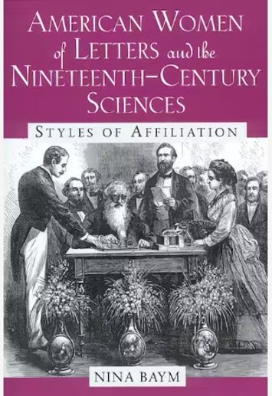
User experience
Pre-coordinated subject headings​
​
American literature–19th century–History and criticism​
Literature and science–United States–History–19th century​
Women and literature–United States–History–19th century​
American literature–Women authors–History and criticism​
Women in science–United States–History–19th century​
Science–United States–History–19th century​
Women scientists–United States​
Science in literature​
Post-coordinated subject headings​
American Literature—19th century​
Science​
Women​
Criticism
Image of book cover for American Women of Letters and the Nineteenth-Century Sciences: Styles of Affiliation by Nina Baym​

Slide 9
Linked Data
Pre-coordinated subject headings are not linked data friendly. They link from one record to another.
Construction industry—Arizona—Management
LC’s Linked Data Service has created stable URIs for subject and name authority records. They can be used outside of the catalog to discover meaningful relationships to other data.
Construction industry
http://id.loc.gov/authorities/subjects/sh85031360
Arizona
http://id.loc.gov/authorities/names/n79034873
Management
http://id.loc.gov/authorities/subjects/sh85080336

Slide 10
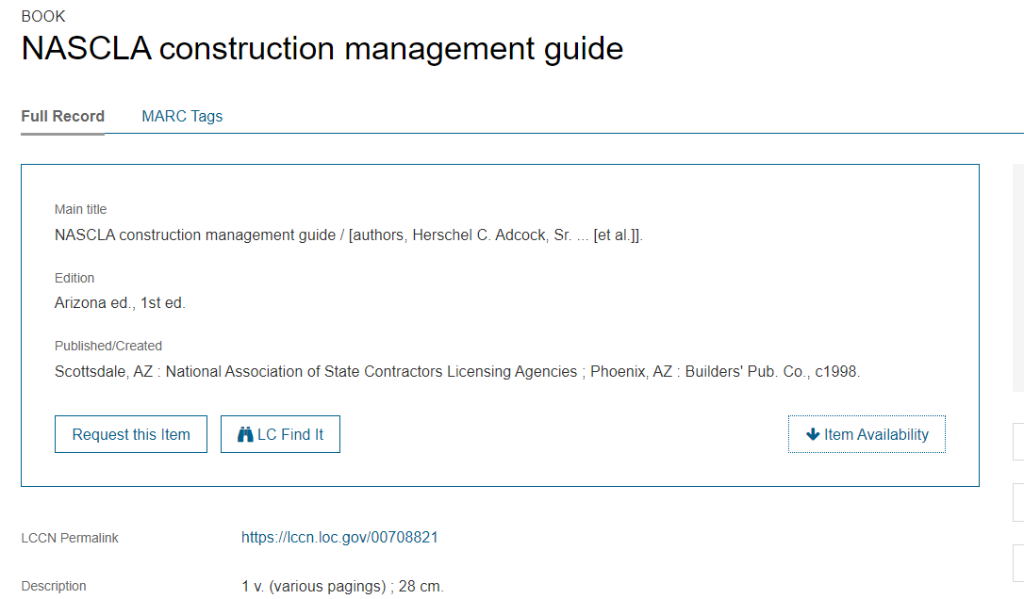
Pre-coordinated subject heading

Slide 11
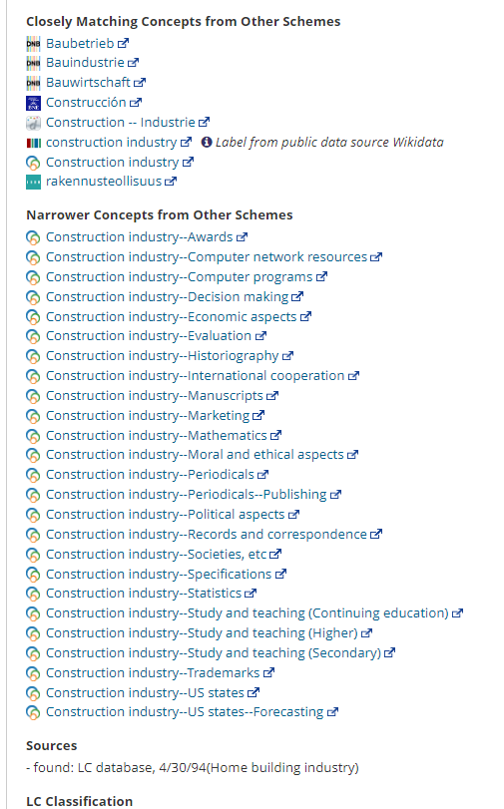
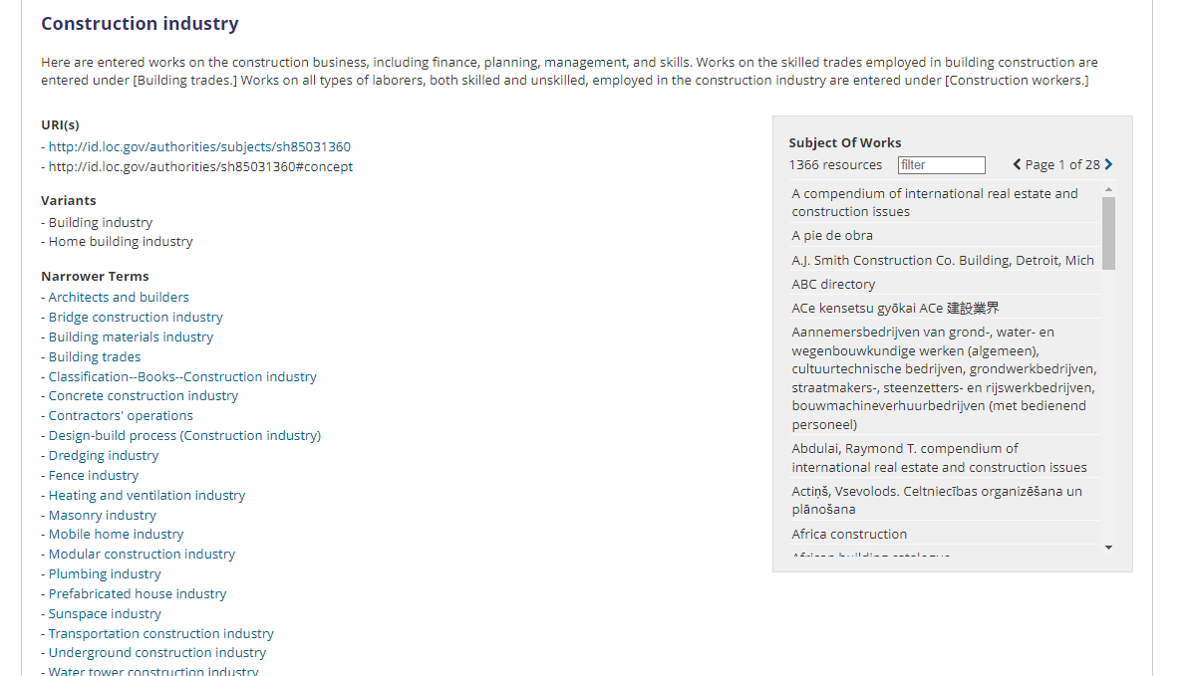

Slide 12
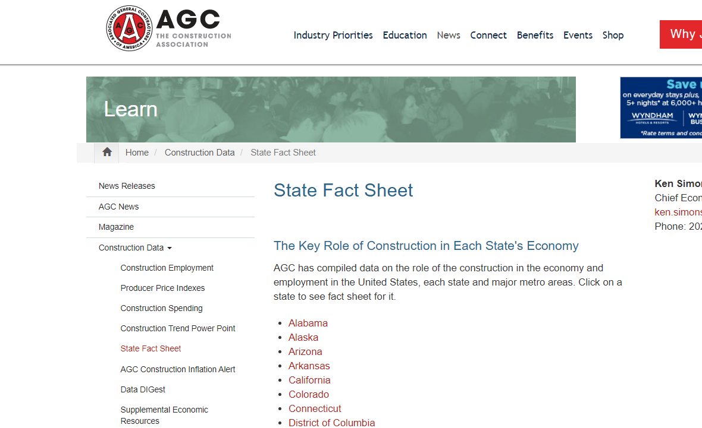
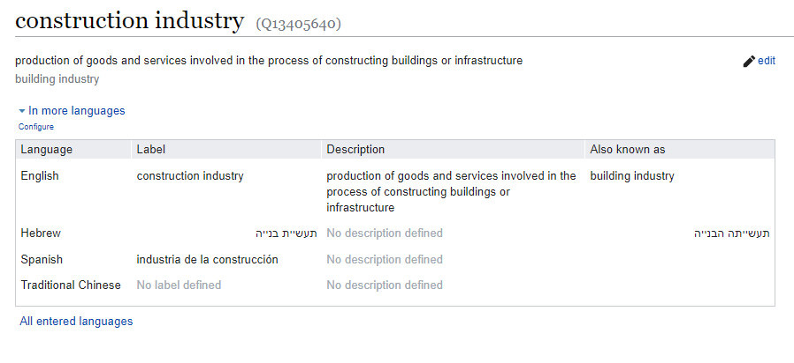

Slide 13
Common Concerns in the Library Profession: From Catalogers to Researchers
Time
Training
Confidence
Notes:
Training “People want to receive training in a variety of ways: there were comments about office hours; in-person training; month-long training courses similar to NACO; and mentoring.” Confidence“Sometimes, it was confidence that could be resolved through more training and experience, such as knowing where to find all documentation, or having more examples that people could use in their work.”
https://www.loc.gov/aba/pcc/saco/documents/SACO%20Training%20Needs%20Assessment%202023.pdf

Slide 14
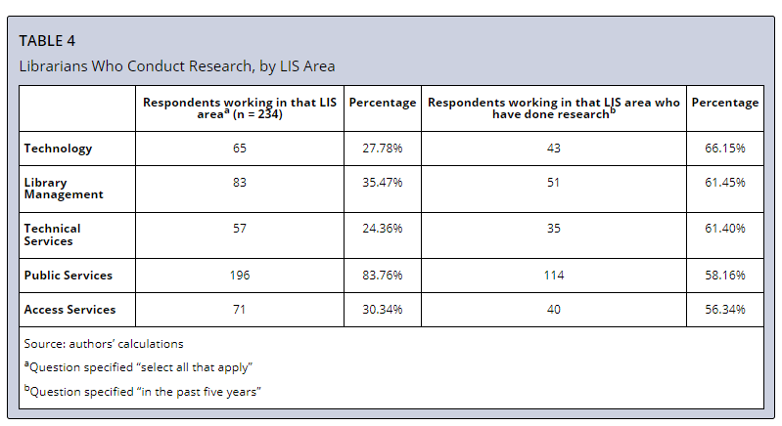
“Community College Librarians’ Research and Publication Practices”
Notes:
https://crl.acrl.org/index.php/crl/article/view/26096/34018

Slide 15
Thank you!
Questions or Concerns?
policy@loc.gov
Notes:
https://www.loc.gov/aba/pcc/saco/documents/SACO%20Training%20Needs%20Assessment%202023.pdf

