Slide 1
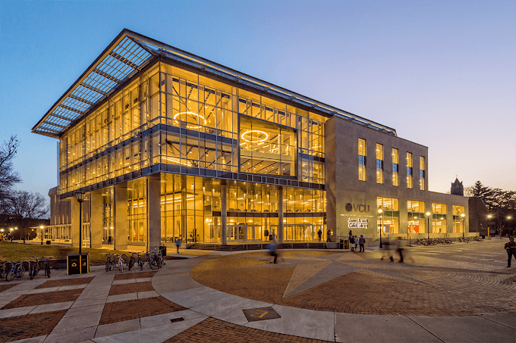
Who, What, Where: Establishing Good Communicative Workflows in a Hybrid Cataloging Environment
Rachel Berman Turner, Senior Metadata Strategy Librarian, Virginia Commonwealth University

Slide 2
Background
WHO
Myself
Catalogers
WHAT
Documentation issues
Inconsistency in training
WHERE
Home
Onsite
Hybrid
Notes:
I started working in the RAMS department at VCU is September of 2022. At that point, the department was less than a year old, but the people in it had been working in different aspects of Technical Services for a number of years.
Over the years, the departments within Technical Services shifted multiple times, and department heads came and went.
For a number of years the department head was interim, and while the interim head did a great job, an interim position does not always have the same capacity to move a department forward, or make final decisions, as a permanent department head.
All of this led to Technical services employees doing different jobs over the years, being trained on multiple things, sometimes in different ways from each other. The bottom line was that, while everyone did a really good job adapting, there was a lack of consistency among procedures.
This led to documentation issues. With everyone often in a state of adaptation (and somewhat of triage, after losing catalogers and the department head), documentation was not kept current, nor thought of as a priority.
Consequently, everyone did their jobs well, but the workflows and processes were not written down anywhere. Or, they were written down, but in a generalized way and over time catalogers adapted the workflows to suit their needs, without discussing updating the documentation.
Some of the things I just mentioned happen pre-pandemic, such as the loss of the department head. Others happened during the pandemic, such as the department reconfiguration to RAMS. In the midst of such flux, the pandemic only added to the changing environment.
Some people were only comfortable working from home at the beginning of the pandemic, and their schedules have changed to become set this way; they mostly work from home.
Some people come in 2 days a week, some come in 3
And some prefer to come in every day
With this new hybrid environment, where everyone has their own schedule (which sometimes changes too, if people want to deviate from their schedules one week and change their wfh days), communication has become increasingly difficult. A lot of standardization and collective understanding that was starting to be established after the loss of positions and shift in departments has kind of gone out the window, and people try to figure out how to work effectively in this new environment.
So I really came into a department that needed to finish establishing itself, to reestablish communication lines, and to figure out a common, standardized way forward together.

Slide 3
Some consequences
WHO
Catalogers have been taught what to do by various people over the years
WHAT
Workflows are from first iterations of Alma
Standardized projects, but:
Individualized fixes
Harder to ask clarifying questions in a hybrid environment
Notes:
A consequence of this changing environment is that catalogers have been taught the same things by various people over the years. This leads to inconsistency in practice, which people often don’t even know about. So, everyone thinks they are following the same procedures, when in fact they may be doing things differently. Doing things differently leads to differences in alma: the holding and item records done by one person may look different than those done by their colleague. This doesn’t necessarily mean someone is doing something wrong, just that they were taught different local practices. Of course, this makes our catalog look a bit strange to users, who benefit from consistency.
Another consequence of the changes Technical Services staff have gone through is that the same workflows have been used since VCU migrated to alma. VCU migrated about 10 years ago; they were one of the first adopters of alma.
In the years since, alma has changed a great deal and added a lot of functionality. These new features mean there are easier ways to do our cataloging work, more effective ways to structure our workflows, and that we have increased capabilities to do things that didn’t exist when VCU first migrated.
However, because catalogers have been in holding patterns, or just trying to figure out how to incorporate new duties, or dealing with a pandemic, VCU cataloging has not been able to take advantage of these new alma features. In many cases, we are still doing things the way we did 10 years ago, which is often not the best approach anymore.
Establishing good communication will allow for newer workflows, more appropriate for present day alma, do be effectively disseminated
The lack of consistent communication can also be felt in the ways projects are being approached.
Because things have been in such flux, and especially with the new hybrid work environment, simply giving people the same projects without establishing consistent and standardized communication lines does not lead to uniform project outcomes
Because, as we discussed, much documentation is dated or incomplete, catalogers have had to come up with their own ways of fixing problems or finding workable solutions that enable them to complete their projects. With no clear path to communicating these issues and fixes out, the result has been that the same project is completed in different ways, leading to inefficiencies and sometimes slightly differing outputs.
Another problem arising from this is that, because people are somewhat dispersed, clarifying questions are not always asked. An example of this is when catalogers are working on a shared project and someone notices the holdings will need to be updated based on their work. Rather than asking HOW the holdings should be updated, they may make a decision themselves. Which is fine! Except that these individual decisions had not been being discussed in a central place, so people would sometimes make different decisions.
For example, step 9 here says “as needed.” Well, who determines that? This could mean different things to different people, and without a central place to ask questions people could treat this phrase differently in their work
So, arriving at VCU, understanding the background and observing the consequences, I was given the opportunity to address them; my supervisor had already come up with some solutions, and then I am trying to implement others (this is obviously an ongoing process).

Slide 4
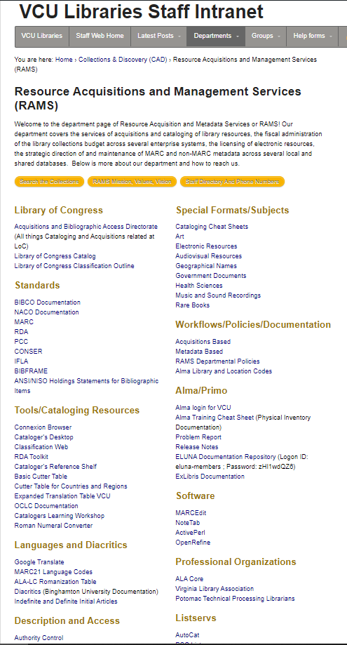
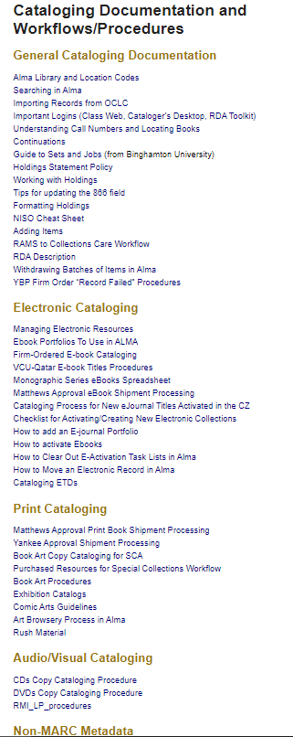
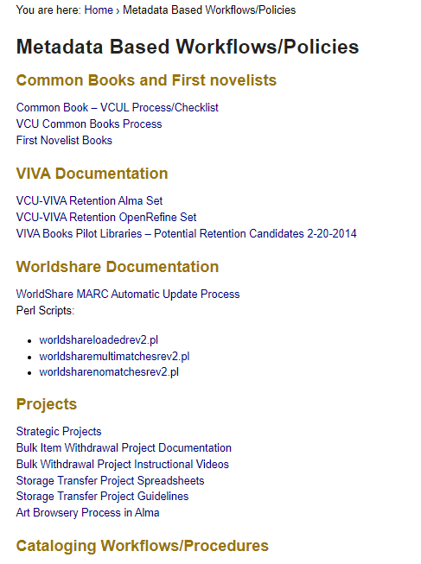
A solution
WHAT: New intranet page
Notes:
The first solution we implemented when I got to VCU was to create a central, comprehensive intranet page
My supervisor pointed out to me that there had been 4 places with documentation pertaining to the new department. She wanted one place RAMS employees could go to find resources they need to aid their work.
So, i created the intranet page you see here, incorporating all of the relevant information from the 4 previous places.
It is deep, and still a work in progress as we refine the organization to suit everyone’s needs, but it is already working as a one stop shop
It is also helpful to people outside of the department, who work in cataloging adjacent jobs, such as Inventory Management, since they often need to do things like refer to holdings documentation or follow some of our workflows through, to see where an item should be at a certain point in it lifecycle. They may have an item in hand, and need to trace where it came from and where is should be going, and our documentation helps with this.

Slide 5
More solutions
WHO
All catalogers
WHAT
Individual meetings to learn work styles
Biweekly cataloging meetings
Restructuring existing meeting type
Review projects and ways to approach them
Address workflow/documentation issues
WHERE
Zoom
In person
Notes:
After getting started on the intranet, I tried to simultaneously add more immediate communication channels
I reached out to each cataloger to have at least one initial meeting, just to learn how each individual person does things
This gave me a feel for how consistent, or not, practice is in the department, and what kinds of work people prefer, and how they work
Understanding how each person works is crucial, i think, in understanding how to effectively communicate projects and workflows to each individual.
I have subsequently met with each cataloger at least once more; the frequency of meetings depends on the person, and whether they like that “face to face,” talk things through interaction, or whether they prefer to just be left alone with their work and just email questions as they arise
The pop in method also works, either in person when our schedules coincide, or via last minute zoom meetings
Another communication method I instituted is biweekly cataloging meetings
These are for anyone who catalogs, so catalogers, others in my dept who work in acquisitions, but do initial record searches, and any cataloger in another department, like the continuing resources cataloger.
These are via zoom, so all can attend no matter where they are, and according to their comfort level; not everyone is comfortable meeting in person yet
Before I started at VCU, there were biweekly meetings run by a different librarian, but they were mainly informational; the librarian used the meetings to report out any updates or announcements they had found.My understanding is that the focus was not on communal learning or discussion; the meetings were not a main source of communication for the catalogers, but a more traditional meeting format.
I have changed this a bit. These meetings are now full of questions that engender back and forth conversations, and thus become another way we all communicate
We use these meetings to discuss ongoing projects, and the different ways people are doing them, which often leads to a shared understanding of how everyone does their projects, so that people can see other ways of doing things. If they like someone else’s method better, they can adapt it for themselves. If it is decided we want to standardize a project procedure, we can do so here.
Our discussion also often result in the realization that documentation needs to be written or updated, and because we are all together I can ask for a volunteer to do so, and then I review the documentation when they are finished and add it to the intranet.
The meetings have become a reliable and regular way for all catalogers to communicate with each other.

Slide 6
Even more solutions
WHO
Copy catalogers, faculty catalogers, supervisor, all separately
WHAT/WHERE
Documentation (on the fly)
On the intranet and google shared drive
Over-Communication
Meet with people in structured and unstructured ways
Double check understandings of the situation with others
Re-shuffle and individualize wfh projects
Notes:
While the meetings are a good place for official communication, I have also made it a practice to have an open relationship with the catalogers, so that as we discuss something in passing documentation is kind of mentioned and created on the fly.
For example, I was talking to someone in passing, from another department, about our Rush cataloging process, and they mentioned that their department does the Marking, which I had not known. This led me to check with people in my dept about the process, and then I quickly wrote up the documentation and put it on the intranet and in the shared google drive.
The document was the result of a few quick conversations, and really only served as a written record of something people knew already how to do, but there was nothing for people to refer to, and this way communication on how to catalog and process Rushes is available asynchronously, which is very helpful in a hybrid environment.
I have also taken the approach of over-communication. This can lead to repetition, but in a hybrid environment I think hearing things more than once can’t hurt, and communicating things in multiple venues means that everyone should hear the same information at least once
So, I have those structured, set cataloging meetings, which themselves may duplicate information because various catalogers have other weekly and biweekly meetings with members of the department to discuss issues.
I also have the unstructured communication pathways I mentioned, in which I meet with individual people as issues arise, or we just have a chat in passing when we’re both in the office. These informal communication channels allow for additional information to be conveyed, and for me to make decisions if necessary about something. At the next biweekly meeting I will then bring up the issue I discussed with someone individually and bring it to the group’s attention, so that everyone is on the same page.
This way. While there may be many communication pathways as I talk to people individually, all the information gets back to the group at a designated point
Another way I over communicate is by double checking my understanding of projects and workflows. After having my own conversations with catalogers, I will bring up discussed points in a cataloging meeting to make sure my understanding of the conversation was correct, and we’re all on the same page. I also meet with the people who create or assign projects in various settings, and I double check my understanding of the projects with them to ensure my understanding is correct. This way if someone asks me a question I am at least confident in my understanding of the situation.
Something else that we’ve been working on, which really helps because doing things this way means that you only have to worry about one person’s understanding of something, is to re-shuffle and individualize projects. By doing this, we are making communication needs less complex, as fewer people need to know certain information, and communication channels can be smaller. This leads to less confusion, easier standardization, and cleaner communication lines.

Slide 7
Working with other departments
WHO
RAMS members and other departments
WHAT/WHERE
Virtual and in person trainings
Good communication between departments is very important
Cataloging course
Going to be in person as attendance allows
Notes:
In order to free up some time for the catalogers, and to make communication easier and more effective, I have started training other departments on certain cataloging functions. We are going over things like how to add items to an existing holding and how to properly update and format a holding that has had items moved or withdrawn.
When you are doing cross-departmental training like this, good communication is very important. However, with a hybrid environment traditional face to face communication is not always possible. What I have done is worked with my colleagues to determine how they seem to best absorb the new information and determine whether we need to meet in person or if we can meet via zoom. For groups that are small enough, we meet in person if at least one person wants to, and there are no strong objections.
I have done some training via zoom when the other person wants to be able to follow along on my screen, while also easily working on there’s.
Soon, I might have to test out a hybrid environment, and we’ll see how well this works.
I am going to be giving a cataloging course, and anyone who wants to attend is welcome. At least one person has reservations about being in person. So, I will do a hybrid session for the classes they want to attend. This will mean limits on what the virtual attendee can do; they won’t be able to participate fully. But my hope is that it will be enough that they will learn the subject matter.
If it really doesn’t work, I will rethink how to offer the course, and we can either have multiple sessions, or use ebooks for practicums instead of physical books

Slide 8
Working with other departments
WHO
Other departments
WHAT/WHERE
Develop workflows using in person meetings
Then communicate with catalogers virtually
Creating working/project groups
Try to choose people with the best background for the task, but also consider how often they are on site
Notes:
While I am very flexible with trainings, I have found that setting foundational meetings with other departments, to establish relationships and workflows, is best done in person
Of course, everyone involved in these meetings is asked what they prefer, but at least here everyone has always wanted to meet in person when we first start discussions and interdepartmental workflows and procedures. It has historically been easier to talk things out that way; it is easier to read people. And, if we end up needing to look at spaces, that is instantly possible.
Then, I communicate any discussion points or products with the catalogers virtually.
I will meet with them individually via zoom, or most often we talk about any new workflows or procedures, or updates to existing ones, in a cataloging meeting. At the same time, we might also talk about how our part of this work affects the other departments
Something we are currently discussing is creating interdepartmental working and/or projects groups
So, we are doing things like deciding who will catalog SCA material
How to work with the department in charge of technology and maintaining the Primo VE interface so that the cataloging portion of Primo is also assessed and addressed
How to work with Collections Care on projects
As we discuss these projects and creating different types of groups, we are not only thinking about people’s skill sets and work preferences but also how often they are on site, and how their schedules match up with the people/departments they will be working with
We want to make sure that they will all be on site together as needed, everyone feels they can meet over zoom as necessary, etc.

Slide 9
Looking forward
WHO
All catalogers
WHAT
Delegating documentation
Group email address
Virtual interdepartmental working meetings
Individualizing projects for clearer communication and more agency
WHERE
Virtual environments
Notes:
As we get a handle on how to communicate well in a hybrid environment, we are looking forward to determine how to make the most of asynchronous communication and online communication
For example, I am starting to delegate the responsibilities of documentation to others, to work on in their own time, and I can evaluate it on my own. We can then meet via zoom if necessary, or maybe comments in the document will suffice.
In this way, being in a hybrid environment does not impede good communication, since people can work together in various locations
Another thing we are doing is increasing the number of shared email addresses we have.
People used to be able to pop into offices as needed with questions. If the person didn’t know the answer, you would just go to someone else. Email is more cumbersome, since sending numerous emails to various people takes time.
A way to get around this is to create group email addresses for different workflows. That way, everyone involved in a workflow will have access to the same question or notification, and the person who has time to do it first or knows the answer can claim it. In the absence of being able to pop in on people, this can be effective
We are also trying out virtual working meetings, so that we can work interdepartmentally without having to try to sync up schedules
And finally, as i discussed before, we are individualizing projects. This will simplify communication needs, and also give cataloger more agency. Expanding this practice in the future will help the department maintain good communicative workflows.
So, as we see in the WHERE here, we are really looking for ways to make work more friendly for an online environment. Rather than trying to force people to somehow again accommodate an in person model, we are leaning towards more asynchronicity and virtual solutions

Slide 10
Further Reading
https://www.techtarget.com/searchhrsoftware/tip/Best-practices-to-build-a-sustainable-hybrid-work-model
https://hbr.org/2021/05/how-to-do-hybrid-right
https://www.forbes.com/sites/forbescommunicationscouncil/2022/01/07/strategies-for-successful-communication-in-a-hybrid-work-world/?sh=3e52a891428e
https://www.linkedin.com/pulse/how-communicate-engage-employees-hybrid-workplace-tineke-a-keesmaat
Trevor, J., & Holweg, M. (2022). Managing the New Tensions of Hybrid Work. MIT Sloan Management Review.
Gratton L. Redesigning Work : How to Transform Your Organization and Make Hybrid Work for Everyone. The MIT Press; 2022.
Farque P. The Successful Hybrid Team : What the Best Hybrid Teams Know About Culture That Others Don’t (but Wish They Did). John Wiley & Sons, Incorporated; 2022.
Hill A, Hill D. Work from Anywhere : the Essential Guide to Becoming a World-Class Hybrid Team. Wiley; 2021.
Notes:
As we get a handle on how to communicate well in a hybrid environment, we are looking forward to determine how to make the most of asynchronous communication and online communication
For example, I am starting to delegate the responsibilities of documentation to others, to work on in their own time, and I can evaluate it on my own. We can then meet via zoom if necessary, or maybe comments in the document will suffice.
In this way, being in a hybrid environment does not impede good communication, since people can work together in various locations
Another thing we are doing is increasing the number of shared email addresses we have.
People used to be able to pop into offices as needed with questions. If the person didn’t know the answer, you would just go to someone else. Email is more cumbersome, since sending numerous emails to various people takes time.
A way to get around this is to create group email addresses for different workflows. That way, everyone involved in a workflow will have access to the same question or notification, and the person who has time to do it first or knows the answer can claim it. In the absence of being able to pop in on people, this can be effective
We are also trying out virtual working meetings, so that we can work interdepartmentally without having to try to sync up schedules
And finally, as i discussed before, we are individualizing projects. This will simplify communication needs, and also give cataloger more agency. Expanding this practice in the future will help the department maintain good communicative workflows.

