Slide 1
Using RDA in Sinopia
Theodore Gerontakos
Head, Metadata and Cataloging Initiatives Unit, Cataloging and Metadata Services
Jian Ping Lee
Chinese Cataloging & Metadata Librarian, Tateuchi East Asia Library
Benjamin Riesenberg
Metadata Librarian, Cataloging and Metadata Services
2021-02-01

Slide 2
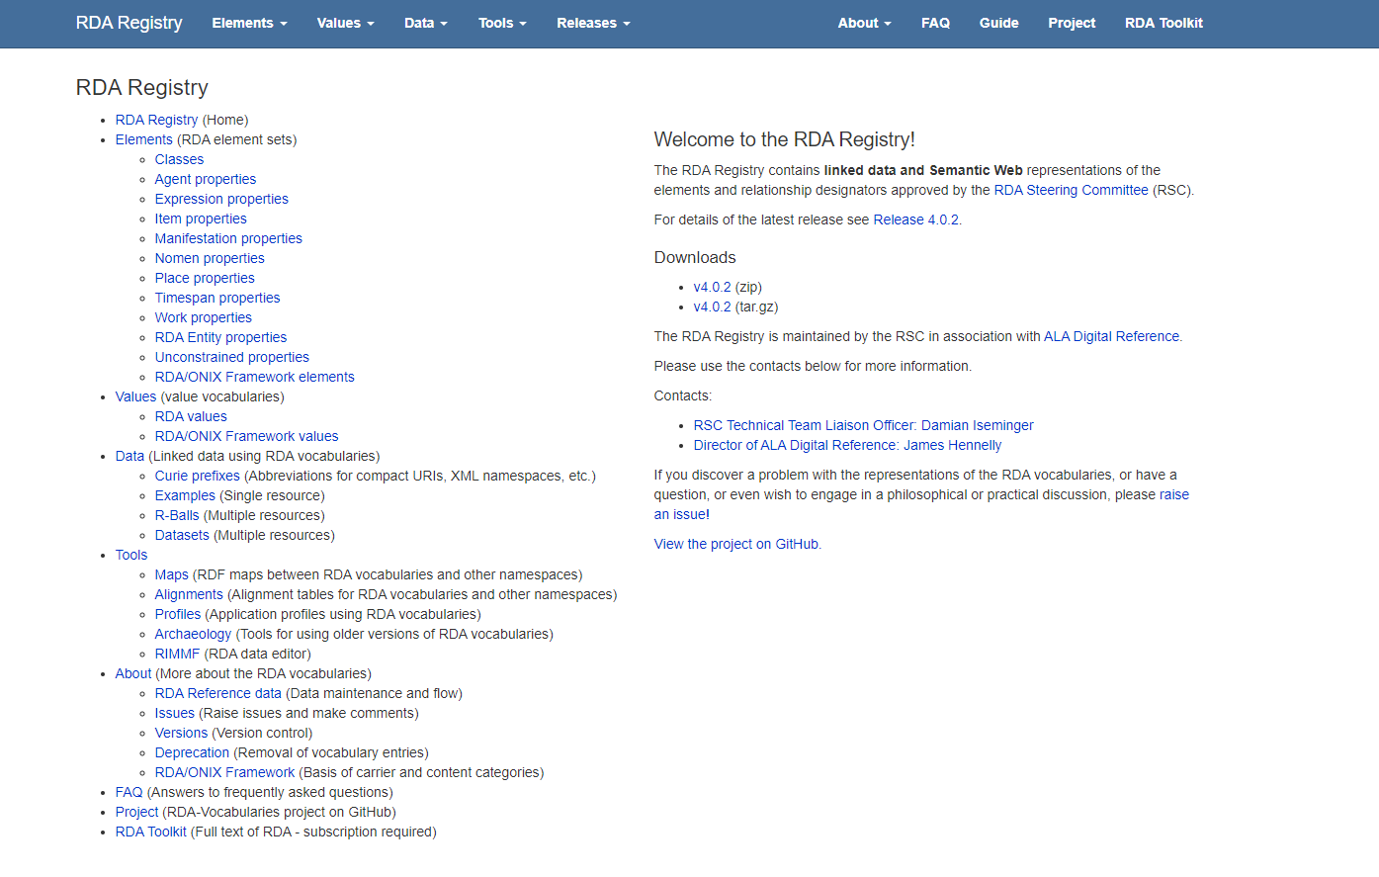
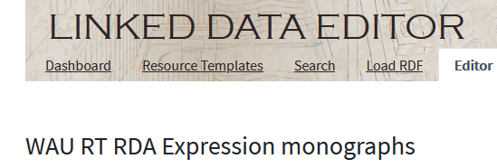
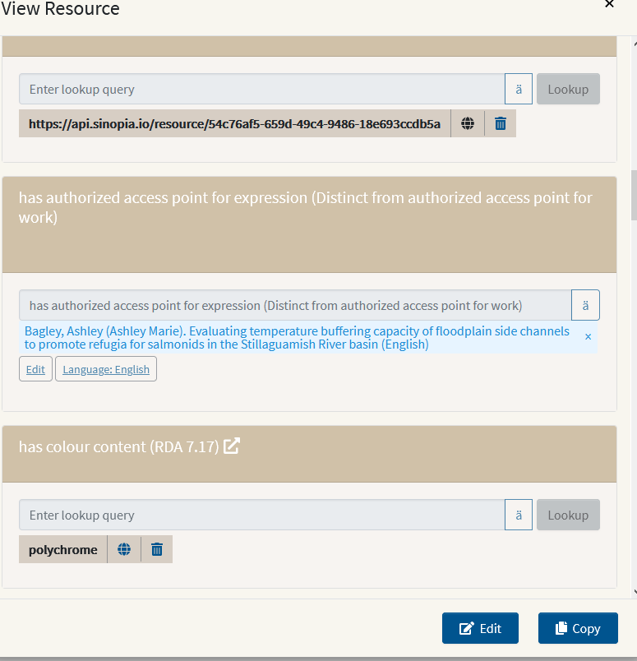
Motivations for Using the RDA Registry to Represent RDA Bibliographic Descriptions
Notes:
Motivations behind RDA-RDF Sinopia Application Profiles at the University of Washington Libraries

Slide 3
RDA-BIBFRAME Incompatibility
Photo by Zac Harris on Unsplash

Slide 4
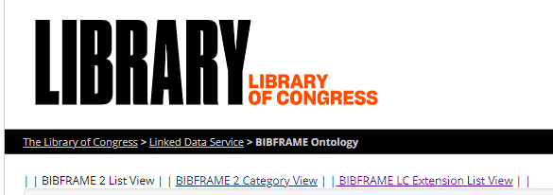
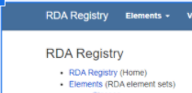
Institutional Experience at the University of Washington Libraries
RDA Cataloging Content Standard (2017 version)
BIBFRAME and BFLC
RDA-RDF
Photo by Cookie the Pom on Unsplash
Notes:
Based on institutional experience with RDA cataloging content standard, and a number of ontologies for describing library materials, including both RDA-RDF and BIBFRAME 2.0, it become clear to us that RDA and BIBFRAME are not as compatible as we would like them to be.

Slide 5
MARC-to-BIBFRAME Conversion
The University of Washington Libraries has been doing data analysis of BIBFRAME conversions of our RDA metadata since around 2014
Took detailed looks at data produced by the following converters:
Library of Congress BIBFRAME converter available on GitHub: https://github.com/lcnetdev/marc2bibframe2
ExLibris uses their own version of the LC converter, which outputs essentially the same data. This BIBFRAME data can be locally exported through our ILS, Alma
We were concerned to find that the converted data lost a lot of the RDA metadata included in the original MARC 21 records
We have reviewed the conversion specifications for the Library of Congress conversion
There were bugs to work out, but that wasn’t where most losses were coming from
Notes:
-Since the BIBFRAME conversions of MARC data became available, the University of Washington Libraries has been analyzing the BIBFRAME conversions of RDA-based MARC records. We were concerned to find that the converted data lost a lot of the RDA metadata included in the original MARC 21 records. This is still the case for the converters used by the Library of Congress/Ex Libris, and Casalini’s converter to their own flavor of BIBFRAME.
-We have reviewed both converted data and the conversion specifications and XSLT for the Library of Congress conversion. There have been bugs to work out, but we found the conversion process was not the source of the concerning losses we were seeing.
-There is simply no way to represent the current (2017) RDA rules using BIBFRAME without significant losses.

Slide 6
Expressing RDA Descriptions in BIBFRAME
It remains true that BIBFRAME cannot represent the current (2017) RDA rules without significant losses
3R introduces even more complexity to RDA
Depending on how the PCC writes its new application profiles, 3R could widen that gap
The PCC published rudimentary BSR-to-BIBFRAME and CSR-to-BIBFRAME mappings in 2016, which we expanded a bit locally in our RDA-Core-to-BIBFRAME document.
These mappings enabled us to quantify the data losses we were seeing from MARC 21 record conversions
We wanted to fill out this mapping further to examine incompatibilities between BIBFRAME and RDA before we committed to BIBFRAME as a data model
The University of Washington Libraries recently published an updated RDA resource-entity (WEMI) properties to BIBFRAME 2.0.1 mapping
Notes:
-Any attempt at representing bibliographic data conforming to RDA (2017) content standard using the BIBFRAME ontology will inevitably fail to render all of the RDA (2017) statements a cataloger has made.
-The impending implementation of 3R will introduce new complexities to the RDA standard. Depending on how the PCC writes its corresponding application profiles, 3R could greatly widen the gap between BIBFRAME and RDA.
-At the outset of LD4P2, we at the University of Washington Libraries had created an expanded version of the PCC’s BSR and CSR-to-BIBFRAME mappings, called RDA-Core-to-BIBFRAME. These mappings enabled us to quantify the data losses we were seeing in individual converted MARC records. We wanted to expand this mapping further, to closely examine the incompatibilities between BIBFRAME and RDA before we committed to BIBFRAME as a data model. We expanded our local RDA-to-BIBFRAME mapping efforts as a part of our participation in LD4P2, and recently published the RDA resource-entity (WEMI) properties to BIBFRAME 2.0.1 mapping.

Slide 7
Expressing RDA Descriptions in BIBFRAME
Based on our conversion data analysis and RDA-to-BIBFRAME mapping efforts, we know that the BIBFRAME ontology cannot adequately express RDA cataloging metadata
Over 30% of the RDA properties we mapped lost specificity when mapped to BIBFRAME
BIBFRAME does not represent many required relationships between WEMI entities and Agents in machine-readable format (nearly 25%)
BIBFRAME lacks a class that mirrors LRM Expressions
BIBFRAME renders many RDA properties as notes, with literal values indicating the type of note
These significant losses are problematic because RDA is the existing content standard for bibliographic description in academic libraries
Notes:
-Our analysis of MARC-to-BIBFRAME data, and our extensive mapping efforts, have shown us that the BIBFRAME ontology cannot adequately express RDA (2017) cataloging metadata, and is even less equipped to represent data using the new RDA
-Theo will cover the main shortcomings of BIBFRAME as a container of RDA later, but in general, we have discovered that over 30% of the RDA properties we mapped lost specificity when mapped to BIBFRAME. We discovered that BIBFRAME does not represent approximately 25% of the required relationships between WEMI entities and Agents (BF:Contributions) in machine-readable format, creating poor linked data as a result. As you know, BIBFRAME lacks a class that mirrors the LRM Expression. BIBFRAME also renders many RDA properties as notes, with literal values indicating the type of note.
-These losses are significant. They’re also problematic, because RDA is the existing content standard for bibliographic description in academic libraries. This data model cannot support our standard.

Slide 8
Opportunity
Photo by Kelly Sikkema on Unsplash

Slide 9
Sinopia’s Built-In Potential for RDA/RDF
Sinopia’s only limitation on ontologies expressed in application profiles (now “resource templates”) at the outset of LD4P2 was that they needed to be expressed in RDF. What an opportunity!
“Translation of entered data to RDF should support translation to classes and predicates from any RDF-based ontology or vocabulary”--Functional Requirements for Sinopia Phase I Work Cycle (Minimum Viable Product).
We thought about using BIBFRAME. We had concerns about:
Incompatibility with our content standard
Whether it would be able to keep up with the evolution of cataloging content standards
Notes:
-In Sinopia, we were not forced to use the BIBFRAME ontology. As we were becoming familiar with what the Sinopia environment would look like, and what was required for application profiles, we were happy to discover that Sinopia’s only limitation as far as the ontologies and vocabularies used in its application profiles was that they needed to be expressed in RDF. What an opportunity! We paused to consider our options.
-We thought about using BIBFRAME, since it seemed the thing to do. We considered the issues we had discovered with the ontology and its inability to fully represent RDA (2017), and also wondered whether BIBFRAME would be able to keep up with the evolution of cataloging content standards such as RDA into the future. We tried to think of something better.

Slide 10
Our Interest in RDA/RDF Application Profiles
The University of Washington Libraries had been interested in representing RDA cataloging data as linked data for many years.
Notes:
We had created a rudimentary form for creating RDA-in-RDF a number of years ago, and liked the idea of trying to do that on a larger scale in the Sinopia environment

Slide 11
“RDA is a fully-fledged data model in its own right. What if we tried using classes and properties from the RDA Registry to build our Sinopia profiles?”
Notes:
We knew that RDA was a fully-fledged data model in its own right. We thought, “What if we tried using classes and properties from the RDA Registry to build our Sinopia profiles?”

Slide 12
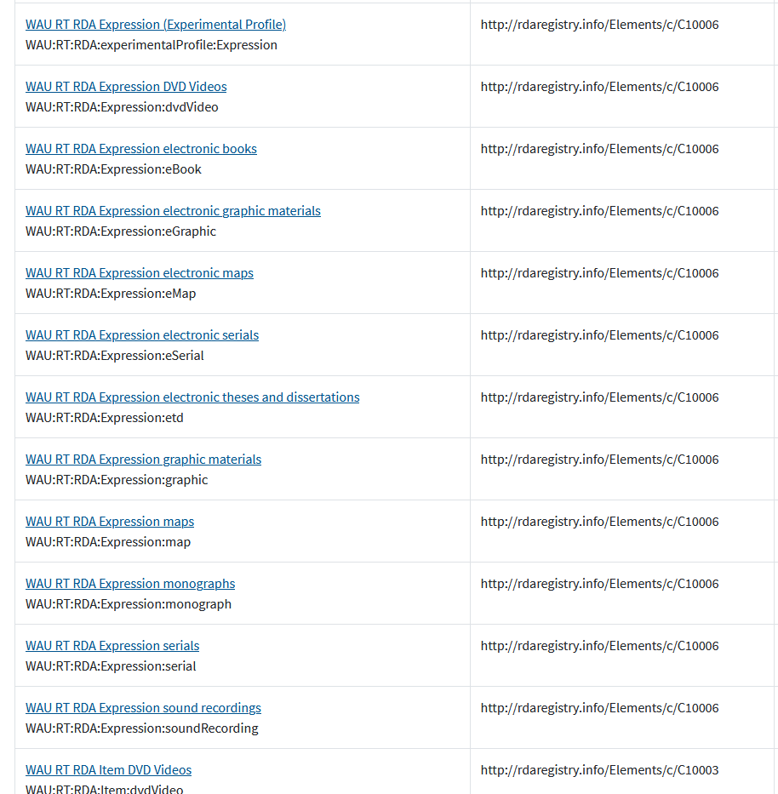
Sinopia Application Profiles
We chose the RDA Registry because:
RDA-in-RDF can represent RDA metadata without the losses inherent in cataloging RDA in BIBFRAME
We thought it would be a good intellectual contribution to the project, in addition to contributing our current catalog as SVDE-BIBFRAME data and publishing an RDA-to-BIBFRAME mapping
Notes:
We decided to go with the RDA Registry because it can express RDA descriptions (2017 and 3R) losslessly(seamlessly).
We also thought it would be a good intellectual contribution to the project, along with contributing our current catalog as SVDE-BIBFRAME data and publishing our expanded RDA-to-BIBFRAME mapping
[End, transition to Ben]

Slide 13
Implementation
John Loo, CC BY 2.0
via Wikimedia Commons
Notes:
What is implementation?
Practical, technical considerations
And how our adoption of RDA/RDF as our data model for Sinopia work affected them
I’ll use the generalized term “template” here--I use this to mean:
Encoded information passed to the Sinopia Linked Data Editor
For a given resource type (instance of rdfs:Class), properties that can be used, constraints on values for those properties
[[Brief explanation of “LD4P,” “LD4P2” if not already given]]

Slide 14
RDA/RDF
Properties by rdfs:domain
rdac:Work - 590
rdac:Expression - 524
rdac:Manifestation - 400
rdac:Item - 136
A property-heavy data model
Notes:
One primary characteristic of our data model shaped many aspects of our workflows and products...obvious?
That primary characteristic is the large number of properties in RDA/RDF

Slide 15
{ “Profile”: {
“title”: “WAU Profile RDA” ...
“resourceTemplates”: [ { ...
“propertyTemplates”: [ { ...
pull
commit
push
pull
commit
push
...
TEAM MEMBER 1
TEAM MEMBER 2
TEAM MEMBER 3
TEAM MEMBER 4
Notes:
Workflow for designing, improving, outputting Sinopia templates, 01
We encoded our templates outside of the profile editor
We used text-editing and other tools instead
Note that Sinopia now uses the Linked Data Editor for creating and editing templates as well as description sets
This decision wasn’t necessarily a result of the data model
But you could certainly make the argument that creating all those property templates in a GUI would be more time-consuming than encoding them using text-editing tools and reusing encoding where possible.
We also took a collaborative approach, as I believe most if not all LD4P2 cohort institutions did
Cohort institutions used GitHub to store and shared encoded templates
Use of git and GitHub benefitted us as it allowed us to work collaboratively
Multiple team members could make changes to property constraints and push those changes to a single remote version, changes could be kept in sync

Slide 16
Template Design
Iterative Improvement
“I asked the most-expert cataloger(s) in each format to give me detailed input on [RDA elements] they needed to assemble the starting lists of properties for each profile.”
A feedback form (and many emails) allowed for specific feedback regarding resource templates, including specific requests for changes to property implementation.
Notes:
Workflow for designing, improving, outputting Sinopia templates, 02
This collaborative approach was taken for both initial design and ongoing improvements
Sets of properties and property constraints were divided up for initial creation of templates
A feedback form allowed all team members to view cataloger feedback, claim issues, follow up and make template changes as needed
We weren’t unique in this, it seems that most if not all LD4P2 cohort institutions developed Sinopia templates in teams
While we can point to the large number of properties as a source of complexity in templates requiring more labor for design and maintenance--each property may need unique constraints
But BIBFRAME templates can feature comparable complexity due to the larger number of resource classes and the need for templates to describe each

Slide 17
{ “Profile”: {
“title”: “WAU Profile RDA” ...
“resourceTemplates”: [ { ...
“propertyTemplates”: [ { ...
“usedInProfile”: [ “monograph”, “dvdVideo”
“etd” , “map” ] ...
transformation scripting
monograph resource templates
dvdVideo resource templates
etd resource templates
map resource templates
Notes:
Workflow for designing, improving, outputting Sinopia templates, 03
We landed on a workflow using a single source file from which to output all templates for all formats
This was helpful for us
Our very long lists of properties for each of the RDA resource entities, and the value constraints for those, only needed to be maintained in one place, not multiple locations
Changes were only made in the single source
So for example changes to a single property’s constraints affecting templates for multiple formats could be made in a single step
We did this with a simple mechanism to state which format template(s) a particular property should be present in
Combined with its location in a list of properties for a particular resource, this mechanism ensured that properties were output as needed

Slide 18
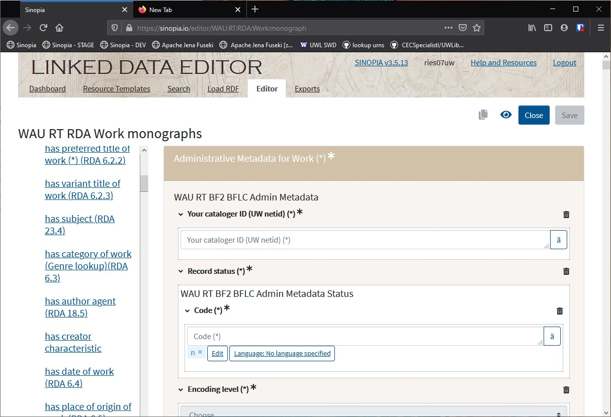
Template
Functionality
and Cataloger
Feedback
https://sinopia.io/
Notes:
How did the data model affect the functionality of templates?
How did our templates function?
What kind of feedback did we receive from catalogers?
OUR TEMPLATES ARE EXTREMELY LONG
This makes them somewhat less than user-friendly
WHY so long?
All properties available for use in a template are displayed to users--if we think something might be needed, even for an “edge case,” we put it in
Shout-out to Sinopia developers
The left nav seen in the UI here is quite helpful in navigating property lists more quickly as you can see
BUT this is an interesting point--it is much more challenging to build tools that support multiple data models--selection of a base data model affects things like user interface!

Slide 19
Work
Where in the WEMI am I?
Cataloging a piece in hand, versus creating a description set with statements on multiple resources
Expression
Manifestation
Item
Notes:
How did the data model affect the use of templates for catalogers?
Cataloger feedback had a lot to do with length of templates! But also...
Our project team was excited about implementing RDA/RDF in Sinopia because it would allow catalogers to create distinct description sets for RDA entities
This also came with challenges
Knowledge of data model was needed
The ability to know which elements (properties) belonged with which resource
Of course BIBFRAME template users must have experienced the same thing, but it was interesting to note the challenges here despite strong RDA knowledge among cataloging staff
Even though we use RDA guidance extensively to generate MARC data, cataloger feedback indicated that descriptive work in MARC doesn’t often require a clear knowledge of which element or field/subfield value is associated with which entity
RDA knowledge and experience for use creating MARC data did not necessarily all translate to facility with creating RDA/RDF data

Slide 20
RDA/RDF
<resource> a rdac:Work ;
<prop01> <value01> ;
<prop02> “value02” ;
<prop03> <value03> .
Flat data
Notes:
What are some implementation challenges when converting RDA/RDF to BIBFRAME?
You’ll hear much more about data models from the next presenter, but I’ll mention one practical consideration for data-conversion that is related to the primary characteristic of RDA that I’ve been focusing on today
This workflow is still under-development, but we have already learned some valuable lessons
Property-heavy RDA/RDF makes for “flat data”
Starting with a resource--RDA Work--we make statements
Those statements are simply a list of property/value pairs, either IRI or literal values

Slide 21
BIBFRAME
<resource> a bf:Work ;
<prop01> [ <prop02> <value02> ;
<prop03> [ <prop04> “value04” ] ] .
<resource> a bf:Work ;
<prop01> [ <prop02> <value02> ;
<prop03> [ <prop04> “value04” ] ] .
*Blank node value, nested blank node value
Nested data
Notes:
BF data, on the other hand, has a more complex nested structure
We make statements on the resource, and oftentimes the value for a statement is a “blank node”--a linked data resource which has no identifier outside the local context, no IRI
But because it is a resource, it is possible to make additional statements about it
Starting with a resource--BIBFRAME Work--we make statements
Our first statement (prop01) has a blank node value, indicated in this syntax by the left square bracket
We then need to make statements about this blank node (prop02)
Those statements are “inside” our first value
Then, instead of continuing to make statements about our bf:Work resource, we make another statement on our blank node
We even make statements on values which are inside values which are inside other values

Slide 22
<rda_work_001> a rdac:Work ;
rdaw:P10223 "Heimweh nach Prag"@de .
# has preferred title of work
<bf_work_resource_001> a bf:Work ;
bf:title [ a bf:Title ;
bf:mainTitle "Heimweh nach Prag"@de ] .
Notes:
Looking at how this plays out concretely in data-conversion
Instead of simply reproducing a similar list of property-value pairs, we need to create a more complex data structure, and combine and place RDA values accurately within that structure

Slide 23
<rda_manifestation_001> a rdac:Manifestation ;
rdam:P30176 "Bayless Books"@en ;
rdam:P30011 "1983"^^xsd:gYear ;
rdam:P30088 "Seattle"@en .
# has name of publisher
# has date of publication
# has place of publication
<bf_instance_001> a bf:Instance ;
bf:provisionActivity [ a bf:Publication ;
bf:agent [ a bf:Agent ;
rdfs:label "Bayless Books"@en ] ;
bf:date "1983"^^xsd:gYear ;
bf:place [ a bf:Place ;
rdfs:label "Seattle"@en ] ] .
Notes:
This need to accurately combine values creates additional challenges during data conversion
We are still addressing this in our data-conversion testing

Slide 24
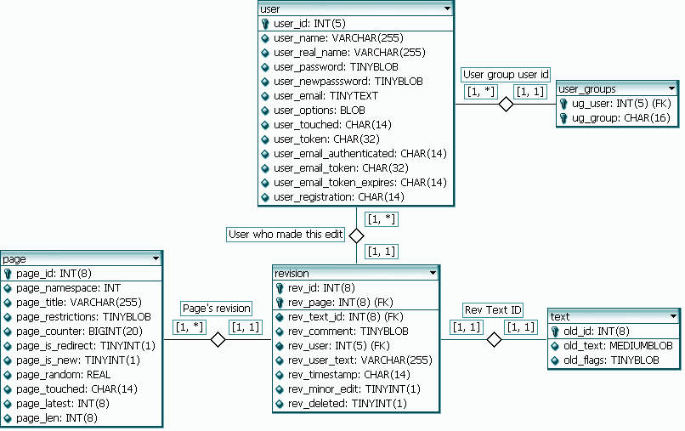
Next up: More on data models
User:AutumnSnow, CC BY-SA 3.0
via Wikimedia Commons
Notes:
Now Theo will discuss the RDA/RDF data model in greater detail

Slide 25
Using RDA in Sinopia, part 3:
RDA and BIBFRAME

Slide 26
Why BIBFRAME in this presentation?
This presentation: “RDA in Sinopia”
Sinopia: a BIBFRAME environment
Notes:
Besides BF incompatibility with RDA that MOTIVATED us...

Slide 27
Good citizens?
Help Sinopia accommodate multiple models
Create/store RDA-RDF data in Sinopia
Contribute to the pool of BIBFRAME data
Convert RDA to BIBFRAME
Upload to Sinopia
RDA-RDF side-by-side with BIBFRAME in Sinopia
Contribute to a fluency across data models

Slide 28
RDA-2-BIBFRAME
Loss of data
Two causes:
Values can be retained but semantics get lost
RDA and BIBFRAME have a different core entity set
Notes:
The meaning of the values is unclear in BIBFRAME derived from RDA
RDA has many more properties; although BIBFRAME is rich in classes, allowing for impressive typing of entities, it cannot accommodate the semantic richness of the RDA properties

Slide 29
Causes rephrased
Problem 1:
“Values can be retained but semantics get lost”
Relationships and attributes are fully developed in RDA
Problem 2:
“RDA and BIBFRAME have a different core entity set”
4 main RDA entities (W-E-M-I) cannot accurately map to 3 in BIBFRAME (W-I-I)

Slide 30
We mapped “RDA” to BIBFRAME
What is RDA?
“old” RDA (RDA 2017)
“new” RDA (RDA 3R)

Slide 31
RDA properties not clearly defined in our mapping
We mapped a mixture of RDA 2017 and 3R to BIBFRAME
Set 1: RDA 2017 properties
Set 2: RDA 3R properties
Our set: a subset of (RDA 2017) ∪ (RDA 3R)
...with a preference for RDA 2017

Slide 32
Many RDA properties mapped
RDA we mapped:
4 RDA entities: Work, Expression, Manifestation, Item
1,610 properties
66 properties were left unmapped (mostly 3R properties)

Slide 33
Problem 1 (3:40)
Relationships and attributes are fully developed in RDA

Slide 34
RDA inherited relationships from FRBR
FRBR RDA 2017 Reproduction (17 types) Equivalent (29 types) Successor (8 types) Sequential (40 types) Supplement (24 types) Accompanying/augment/supplement (4 types) Complement (21 types) Accompanying/complement (29 types) Summarization (6 types) Derivative/based on/summary (4 types) Adaptation (14 types) Derivative/based on/adaptation (43 types) Transformation (10 types) [absorbed in derivative relationships] Imitation (7 types) Derivative/based on/imitation (12 types) Whole/Part (19 types) Whole/Part (18 types) Abridgement (3 types) Derivative/based on/abridgement (4 types) Revision (3 types) [absorbed in Derivative relationships] Translation (2 types) Derivative/based on/translation (6 types) Arrangement (music) [absorbed elsewhere] Alternate (2 types) [absorbed in manifestation relationships] Reconfiguration (3 types) [absorbed in item relationships] Derivative/based on (86 types) Referential (2 types) Accompanying (79 types)

Slide 35
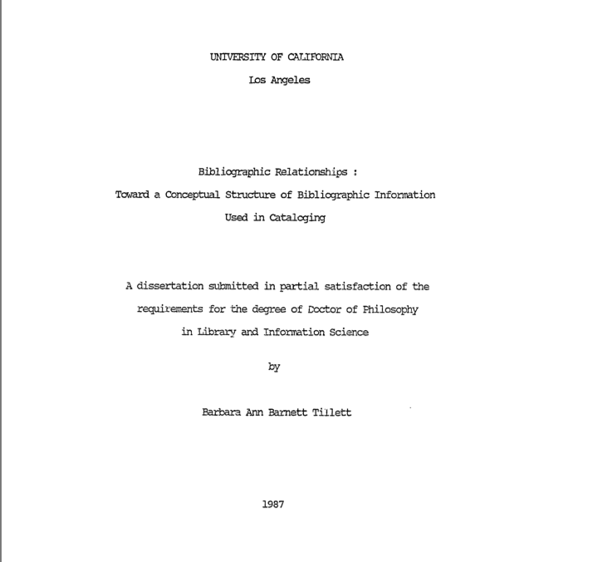
FRBR inherited them from 1990s library science
Let’s say “the 90s” began in 1987

Slide 36
BIBFRAME does not love the 90s
FRBR RDA 2017 BIBFRAME
Reproduction (17 types) Equivalent (29 types) hasEquivalent (3 types) Successor (8 types) Sequential (40 types) precededBy/succeededBy (14 types) Supplement (24 types) Accompanying/augment/supplement (4 types) supplementaryContent (1 type) Complement (21 types) Accompanying/complement (29 types) Summarization (6 types) Derivative/based on/summary (4 types) Adaptation (14 types) Derivative/based on/adaptation (43 types) Transformation (10 types) [absorbed in derivative relationships] Imitation (7 types) Derivative/based on/imitation (12 types) Derivative/based on (86 types) hasDerivative/derivativeOf (7 types) Abridgement (3 types) Derivative/based on/abridgement (4 types) Whole/Part (19 types) Whole/Part (18 types) hasPart/partOf (6 types) Revision (3 types) [absorbed in Derivative relationships] Translation (2 types) Derivative/based on/translation (6 types) translation/translationOf Arrangement (music) [absorbed elsewhere] Alternate (2 types) [absorbed in manifestation relationships] Reconfiguration (3 types) [absorbed in item relationships] Referential (2 types) referenced/referencedBy (2 types) Accompanying (79 types) accompaniedBy/accompanies (9 types) bf adds: dataSource + eventContent/eventContentOf

Slide 37
Number of relationships quantified
FRBR: approximately 140
RDA approximately 356
BIBFRAME: approximately 42
Doesn’t tell the whole story but is an important difference

Slide 38
Example 1: property generalization
This RDA-RDF assertion:
<http://example.edu/work1047> <http://rdaregistry.info/Elements/w/P10131> <http://example.edu/work19> .
[http://rdaregistry.info/Elements/w/P10131 = “is radio adaptation of work”]
...becomes the following triple in BIBFRAME:
<http://example.edu/work1047> <http://id.loc.gov/ontologies/bibframe/derivativeOf> <http://example.edu/work19> .

Slide 39
Example 2: property generalization
This RDA-RDF assertion:
<http://example.edu/work1111111> <http://rdaregistry.info/Elements/w/P10132> <http://example.edu/work1999999> .
[http://rdaregistry.info/Elements/w/P10132 = “is television adaptation of work”]
...becomes the following triple in BIBFRAME:
<http://example.edu/work111111> <http://id.loc.gov/ontologies/bibframe/derivativeOf> <http://example.edu/work1999999> .

Slide 40
BIBFRAME cannot accommodate the RDA relationships
Many properties to one property (RDA to BIBFRAME)
rda:isRadioAdaptationOfWork rda:isTelevisionAdaptationOfWork rda:isfreeTranslationOfWork rda:isMusicalSettingOfWork bf:derivativeOf rda:isAbstractOfExpression rda:isArrangementOf etc etc etc

Slide 41
Many RDA properties to one in bf occurs with these properties
is dramatized as work (RDA 24.5) has sequel work (RDA 24.5)
is replaced in part by work (RDA 24.5) is adapted in verse as work (RDA 24.5)
is adapted as motion picture work (RDA 24.5) has cadenza work (RDA 24.5)
is variations based on work (RDA 24.5) is modified by variation as work (RDA 24.5)
is cadenza composed for work (RDA 24.5) is libretto for work (RDA 24.5)
has incidental music work (RDA 24.5) is remade as work (RDA 24.5)
is set to music as work (RDA 24.5) is adapted as novel work (RDA 24.5)
is adapted as radio program work (RDA 24.5) has right ascension and declination (RDA 7.4.4)
is adapted as television program work (RDA 24.5) is adapted as video work (RDA 24.5)
is abstracted in work (RDA 24.5) is indexed in work (RDA 24.5)

Slide 42
...and with these...
is adapted as choreography work (RDA 24.5) has errata work (RDA 24.5)
has illustrations work (RDA 24.5) is adapted as motion picture screenplay work (RDA 24.5)
is adapted as screenplay work (RDA 24.5) is adapted as television screenplay work (RDA 24.5)
is adapted as video screenplay work (RDA 24.5) is adapted as radio script work (RDA 24.5)
is freely translated as work (RDA 24.5) is description of work (RDA 23.5)
is complemented by work (RDA 24.5) is screenplay for work (RDA 24.5)
is incidental music for work (RDA 24.5) is abstracted as work (RDA 24.5)
is augmented by work (RDA 24.5) is summarized as work (RDA 24.5)
has catalogue work (RDA 24.5) has concordance work (RDA 24.5)
has addenda work (RDA 24.5) is adapted as libretto work (RDA 24.5)

Slide 43
...and with these...
is work reviewed in (RDA 23.5) is work critiqued in (RDA 23.5)
is work commentary in (RDA 23.5) is imitated as work (RDA 24.5)
is work described in (RDA 23.5) is expanded as work (RDA 24.5)
is work evaluated in (RDA 23.5) is work analysed in (RDA 23.5)
has prequel work (RDA 24.5) has appendix work (RDA 24.5)
has guide work (RDA 24.5) is abridgement of work (RDA 24.5)
is abstract of work (RDA 24.5) is dramatization of work (RDA 24.5)
is verse adaptation of work (RDA 24.5) is motion picture adaptation of work (RDA 24.5)
is novelization of work (RDA 24.5) is radio adaptation of work (RDA 24.5)
is television adaptation of work (RDA 24.5) is screenplay based on work (RDA 24.5)

Slide 44
...and with these...
is motion picture screenplay based on work (RDA 24.5) is television screenplay based on work (RDA 24.5)
is video screenplay based on work (RDA 24.5) is radio script based on work (RDA 24.5)
is video adaptation of work (RDA 24.5) is digest of work (RDA 24.5)
is analysis of work (RDA 23.5) is adaptation of work (RDA 24.5)
is free translation of work (RDA 24.5) is parodied as work (RDA 24.5)
is absorbed in part by work (RDA 24.5) is errata to work (RDA 24.5)
is guide to work (RDA 24.5) is appendix to work (RDA 24.5)
is illustrations for work (RDA 24.5) is evaluation of work (RDA 23.5)
is adapted as work (RDA 24.5) is preceded by work (RDA 24.5)
has screenplay work (RDA 24.5) has motion picture screenplay work (RDA 24.5)

Slide 45
...and with these...
is musical setting of work (RDA 24.5) has radio script work (RDA 24.5)
has television screenplay work (RDA 24.5) has video screenplay work (RDA 24.5)
has libretto work (RDA 24.5) is paraphrased as work (RDA 24.5)
is abridged as work (RDA 24.5) is split from work (RDA 24.5)
is digested as work (RDA 24.5) is screenplay for motion picture work (RDA 24.5)
is screenplay for television program work (RDA 24.5) is screenplay for video work (RDA 24.5)
is script for radio program work (RDA 24.5) is addenda to work (RDA 24.5)
is review of work (RDA 23.5) is summary of work (RDA 24.5)
is catalogue of work (RDA 24.5) is concordance to work (RDA 24.5)
is critique of work (RDA 23.5) is choreographic adaptation of work (RDA 24.5)

Slide 46
...and with these...
is expanded version of work (RDA 24.5) is remake of work (RDA 24.5)
is paraphrase of work (RDA 24.5) is commentary on work (RDA 23.5)
is libretto based on work (RDA 24.5) is based on work (RDA 24.5)
is augmentation of work (RDA 24.5) is abstracts for work (RDA 24.5)
is indexing for work (RDA 24.5) is imitation of work (RDA 24.5)
is parody of work (RDA 24.5) is replacement in part of work (RDA 24.5)
is absorption in part of work (RDA 24.5) is musical theatre adaptation of work (RDA 24.5)
is opera adaptation of work (RDA 24.5) is adapted as musical theatre work (RDA 24.5)
is adapted as opera work (RDA 24.5) has music work (RDA 24.5)
is music for work (RDA 24.5) has video music work (RDA 24.5)

Slide 47
...and with these...
is music for video work (RDA 24.5) has television program music work (RDA 24.5)
is music for television program work (RDA 24.5) has radio program music work (RDA 24.5)
is music for radio program work (RDA 24.5) is music for motion picture work (RDA 24.5)
has motion picture music work (RDA 24.5) has choreography work (RDA 24.5)
is choreography for work (RDA 24.5) is adapted as video game work (RDA 24.5)
is video game adaptation of work (RDA 24.5) is adapted as graphic novel work (RDA 24.5)
is graphic novelization of work (RDA 24.5) is subject work of
is description of item (RDA 23.5) is analysis of item (RDA 23.5)
is evaluation of item (RDA 23.5) is review of item (RDA 23.5)
is critique of item (RDA 23.5) is commentary on item (RDA 23.5)

Slide 48
...and with these...
is description of manifestation (RDA 23.5) is analysis of manifestation (RDA 23.5)
is evaluation of manifestation (RDA 23.5) is review of manifestation (RDA 23.5)
is critique of manifestation (RDA 23.5) is commentary on manifestation (RDA 23.5)
is description of expression (RDA 23.5) is analysis of expression (RDA 23.5)
is evaluation of expression (RDA 23.5) is review of expression (RDA 23.5)
is critique of expression (RDA 23.5) is commentary on expression (RDA 23.5)
is oratorio adaptation of work (RDA 24.5) is adapted as oratorio work (RDA 24.5)
is inspired by (RDA 24.5) is inspiration for (RDA 24.5)
has commemoration (RDA 24.5) is commemoration of (RDA 24.5)
is description of person (RDA 23.5) is description of corporate body (RDA 23.5)

Slide 49
...and with these...
is description of family (RDA 23.5) has transformation
is transformation of is description of agent
is description of collective agent has transformation by style
is transformation by style of has transformation by genre
is transformation by genre of has transformation by policy
is transformation by policy of is critique of RDA entity
is description of RDA entity is evaluation of RDA entity
is review of RDA entity is lyrics for work
has lyrics work has text work
is text for work has spoken word work

Slide 50
...and these:
has sounds work is spoken word for work
is sounds for work has regional version
has carrier version is language version of
is regional version of is carrier version of
is serialized version of is static version of
has special issue is special issue of
is description of place is description of timespan
has epoch (RDA 7.6) has coverage of content (RDA 7.3)

Slide 51
And there are many more!
Those were just relationships and some attributes for instances of rda:Work.

Slide 52
Do we care?
we can minimize the problem
we can invent some workarounds
no matter what:
rda-to-bibframe will result in loss of data
bibframe-to-rda will result in peculiar rda:
broad categories of relationships will be used

Slide 53
Problem 2 (8:25)
4 main RDA entities (W-E-M-I) cannot accurately map to 3 in BIBFRAME (W-I-I)
RDA BIBFRAME
Work Work Expression Manifestation Instance Item Item

Slide 54
rda:Expression
BIBFRAME does not have an equivalent for rda:Expression.
rda-to-bibframe:
What do we do with Expression descriptions in bibframe?
bibframe-to-rda
How do we create RDA Expressions from BIBFRAME data?

Slide 55
2 viable options, rda-to-bibframe
1 RDA Work + 1 RDA Expression = 2 BF Works
1 RDA Work + 1 RDA Expression = 1 BF Work

Slide 56
1 RDA Work + 1 RDA Expression = 2 BF Works
RDA
Work
BIBFRAME
Work 1
bf:expressionOf
bf:hasExpression
RDA
Expression
BIBFRAME
Work 2
RDA
Manifestation
BIBFRAME
Instance
RDA
Item
BIBFRAME
Item

Slide 57
1 RDA Work + 1 RDA Expression = 1 BF Work
This is what we’d expect to see in original BF
RDA
Work
BIBFRAME
Work 1
RDA
Expression
RDA
Manifestation
BIBFRAME
Instance
RDA
Item
BIBFRAME
Item

Slide 58
Workarounds
Library of Congress: BIBFRAME Hub (June 2019)
Share-VDE: Superwork (January 2019) becomes Opus (February 2020)
Not in the BIBFRAME specification

Slide 59
What we did in our mapping
1 RDA Work + 1 RDA Expression = 2 BF Works
Related the expression-work to the work-work using bf:expressionOf

Slide 60
Taniguchi’s conclusion
We concur with Taniguchi’s conclusion:
“The distinction between RDA Work and Expression disappears or cannot be properly managed if metadata created with RDA is converted to BIBFRAME schema or if metadata is created with BIBFRAME schema from the outset.”
Shoichi Taniguchi (2017). “Examining BIBFRAME 2.0 from the Viewpoint of RDA Metadata Schema”, Cataloging and Classification Quarterly, 55:6, p.410. DOI:10.1080/01639374.2017.1322161.

Slide 61
More Taniguchi
“...we should use the RDA schema that is registered in RDA Registry to create metadata in accordance with RDA, and then convert the metadata created in that way to BIBFRAME Metadata when necessary.”
Taniguchi (2017), p. 411.

Slide 62
RDA 3R implementation is near
Why use RDA 3R within a metadata context not aligned with RDA?
arduous to learn
expensive
Should we squeeze RDA-3R into MARC?
Should we squeeze RDA-3R into BIBFRAME?

Slide 63
RDA: the most comprehensive ontology for library data
Direct descendant of FRBR
Aligned with LRM
LRM consolidates the FR family of models (FRBR, FRSAD, FRAD)

Slide 64
We can produce adequate BIBFRAME from RDA
Why not use RDA as our data of record?
Derive BIBFRAME when needed
Similar to the University of Washington Sinopia workflows described earlier

Slide 65
BIBFRAME use expanding
BIBFRAME is used more often than RDA-RDF
BIBFRAME has been adopted by large institutions:
Library of Congress
Stanford
LD4 organizations
[others]
When we want BIBFRAME, we can create BIBFRAME

Slide 66
Data model fluency in the 2020s
Proficiencies and tools that allow us to move across data models:
Metadata professionals
Metadata platforms
However, no matter what, there are some things that can’t be done:
High quality RDA data “in” will not result in high quality BIBFRAME data “out”
High quality BIBFRAME data “in” will not result in equally high quality RDA data “out”

Slide 67
What can we do? part 1 (14:20)
Discard RDA?
Drop LRM?
Forget about FRBR and the 90s?

Slide 68
What can we do? part 2
Create shareable RDA application profiles?
PCC would be an ideal organizer for this
Is University of Washington Libraries the only PCC institution that favors RDA?
However: what are the applications for which we’ll write application profiles?

Slide 69
What can we do? part 3
Explore applications of RDA
Sinopia
Improve the conversion of RDA-to-BIBFRAME
RIMMF
RIMMF4 (R4) is an attempt to model changes to RDA introduced by the LRM and 3R project.
Wikibase instances
Test RDA in Wikibase
Library services platforms, like Alma
Alma Profiles for RDA data? RDA options for the Alma Metadata Editor?
Metadata editors
MarcEdit
A new editor? A pilot?
Add ons for diverse text editing, scripting environments, databases, etc.
oXygen XML editor?
eXit-db?
Visual Studio Code?
Eclipse?
Sublime Text?
Atom?
Notes:
I will not have time to elaborate on Sinopia/RIMFF/Wikibase etc. All the bullets beneath those are “for show.”

Slide 70
End (17:40) (19:50)
END
END
QUESTIONS?
COMMENTS?
IDEAS FOR RDA APPLICATION?

