Slide 1
Multiplicity: amending e-serials duplication in WorldCat
ALCTS Electronic Resources Interest Group
Notes:
Hi everyone and thank you to the Electronic Resources Interest Group for giving us an opportunity to present today.
Summary of presentation:
Duplication in our library catalogs and databases has long been a standing
quality issue that affects discovery for users. It’s understandable how
frustrating it can be for catalogers and users alike to deal with large
sets of results that represent the same resource. The WorldCat database has
been susceptible to such duplications due to the various methods available
for adding bibliographic data. During a continuing resources session at the
ALA Midwinter Meeting in Seattle it was brought to our attention the issues
faced with e-serials duplication. We had also received recommendations from
a member library on a possible metadata element that can help us identify
potential duplicates for e-resources. The OCLC Metadata Quality team took
into consideration the thoughts surrounding the problem, to find ways in
removing some of these serial duplicates. After an initial data analysis,
OCLCE records were identified as a large subset of these duplicates. Script
languages such as Perl and the creation of merging macros were used to
automate the detection and merging of these records. The results of the
project helped us identify 713,783 OCLCE serial record candidates, we
approximately merged 157,000 duplicate sets. In the presentation, we will
provide a brief background on the project, discuss the scripts and macros
used for identification and merging of duplicates, and finally elaborate on
future efforts to remove duplicates in other sets of records by using what
we learned from the project. Attendees would find this presentation helpful
as it can give them insight on how they too can find ways to amend
duplication in their local systems.

Slide 2
Charlene Morrison
Database Specialist II, OCLC
Hayley Moreno
Database Specialist II, OCLC
Notes:
My name is Hayley Moreno and along with Charlene Morrison we are database specialists for the WorldCat Metadata Quality team at OCLC. Our job responsibilities focus on quality management for the behemoth that is the WorldCat database :)
Our presentation will focus on a project we have undertaken for the past couple of months that targets one of the biggest quality issues we face with WorldCat-duplicate bibliographic records.

Slide 3
Background
Notes:
For those in the room who aren't familiar with cataloging in WorldCat you may not be aware of the duplication issues faced by your colleagues in institutions that do this type of work. Ask any cataloger friend and they can tell you all about the frustration they face with duplication in the database. Believe us, we feel your pain! As staff that work with duplicates almost every day we are well aware of the issues faced by member libraries who have to deal with duplicates as they catalog.
There are several reasons why duplication occurs in WorldCat. As a data hub where metadata is coming from all types of systems and institutions such as vendors and libraries, there is bound to be duplication due to the metadata being sent to the database-being possibly incomplete, inaccurate, or following different practices in bibliographic description. Bibliographic records can have numerous errors such as a simple typo or different interpretation of the publisher statement.
When information varying between records that represent the same resource, internal OCLC programs like the detection and duplication resolution (DDR) software built to alleviate the duplication problems in WorldCat is not able to algorithmically merge duplicates that may seem obvious to the human eye. Libraries may experience similar challenges as they too can receive information from various sources.

Slide 4
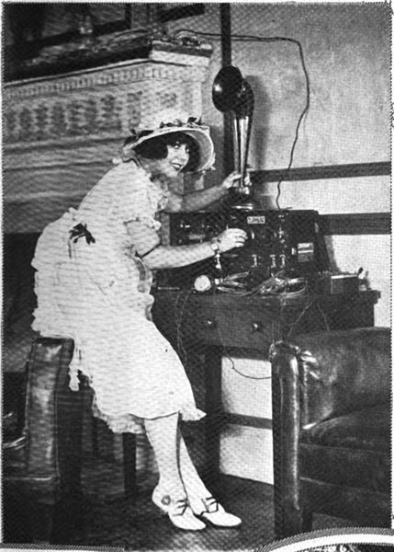
We do listen!
Virtual AskQC Office Hour Session-usage of the 776 MARC field to identify duplicates
2019 ALA Midwinter discussion on serial duplicates
Notes:
With duplication being an issue in WorldCat we get opportunities to hear the concerns of the public during events where we engage with other professionals. During one of our monthly webinars where library personnel attended to learn about a topic related to WorldCat Metadata Quality and asked our department questions. For those not familiar with the 776 MARC tag, it is used to input a citation of another record that represents a different available form of the resource in the bibliographic record. An example of this can be seen in a lot of electronic resources where a 776 field may be present for the print version of the resource.
A few months later during the ALA Midwinter Meeting in Seattle it was brought to our attention during a Q/A exchange the problems users were having with print ISSNs being in electronic serials records. These print ISSN are coded incorrectly in subfield a of the MARC tag 022, when they should be in subfield y as invalid.
After hearing both issues, we knew who the culprit of some of the cataloger's woes were and began thinking on how we can alleviate these problematic records.

Slide 5
Project parameters
Identify a target group of records
OCLCE
A utilitarian approach to automation
Do the most good with the least amount of harm
What is out of reach?
Anything too risky that required human interference (e.g. CONSER)
Notes:
After Seattle we took the feedback from librarians and began formulating parameters to help alleviate some of the duplicate issues with serials and at the same time would also correct the problematic print ISSN in online serials. We knew the records that needed to be targeted would be OCLCE as they have the issue of the ISSN and tend to have several duplicates in the database. For those not familiar with OCLCE records, they are generated through an automated process where a bibliographic record for an electronic resource is generated from a print resource.
We also needed to make sure that we approached the project with the intention of doing the most good with the least amount of harm since we would be creating automation tools to try and have these records merged. It's important that as you look into creating tools to help you automate a process that they are built with the intention of causing the least amount of damage since the goal is to have as little as possible human intervention. For this project we determined that the script and macro could process the duplicates using specific restrictions.
We also quickly realized that OCLCE records could be cataloged following CONSER standards. CONSER would be out of scope for the project as we could not allow the tools to manipulate those records as they adhere to higher standards of bibliographic description and couldn't control how the macro would merge them.

Slide 6
Tackling the problem
Identify the expertise needed for the project
Serial cataloging
Electronic resource cataloging
Perl
Macro language
Meetings for …
Data analysis
Tweaking tools as needed
Notes:
With parameters set for the records that would be worked on, it was time to assemble a team of experts that would be able to help us create the tools to automate the process as well as had an extensive cataloging knowledge of the records that were at play (we were the cataloging A-team). We recruited members of the Metadata Quality department that had serial and electronic resource cataloging experience since the records would represent the online version of the serial publications. We also included staff on the project that could write scripts and macros to do the sorting, merging, and correction of the print ISSNs in the OCLCE records.
Project meetings included everyone involved to discuss new developments and issues encountered as we merged. Our initial meetings consisted of data analysis for the OCLCE sets records to confirm that there were no issues of merging these records through automation. Later meetings consisted of issues we encountered when merging OCLCE records which required some of the scripts and macros used in the project to be modified to accommodate issues.

Slide 7
Scripts and Macros
Scripts and Macros
Scripts and Macros
Notes:
I'll now pass it on to Charlene to provide an overview of the tools built around this project...

Slide 8
Database scan
Editing macro
Perl script
Merging macro
Text files split
Notes:
Let's start with our workflow. This is a high level view of the workflow that we used. The results from the database scan were run through the Perl script. Those results were split into manageable files for staff to process. The sets were then run through the merging macro in Connexion and then the retained records were run through the editing macro in Connexion. Then we repeated the process.

Slide 9
Database scan
First scan:
BLvl
ELvl
Field 040 $c
Second scan:
Field 776 $w
Notes:
Photo by Markus Spiske on Unsplash
We used two scans to retrieve the desired records. The first pulled the records that were serials, with encoding level K, and were input through the OCLCE project. The second scan took those OCLC numbers or OCNs and matched them up with their 776 fields.
Other notes:
Broken into 2 scans because of the amount of data being pulled with the particular internal tool we were using.

Slide 10
Database scan output
OCLCE OCN 776 Field (CDF) data
236164435 TAG:776 IND:1 OCC:0 FIELD:<sc><d>Original</d></sc> <sw><d>(DLC) 93940050</d></sw><sw><d>(OCoLC)27997546</d></sw>
236165499 TAG:776 IND:0 OCC:0 FIELD:<sc><d>Microfilm</d></sc> <sw><d>(OCoLC)26024195</d></sw>
297114008 TAG:776 IND:08 OCC:0 FIELD:<si><d>Print version:</d></si> <st><d>Wen hui bao</d></st><sw><d>(OCoLC)171714284</d></sw>
Notes:
Here is an example from the output file that was returned. On the left side are the OCLCE OCNs in blue and to the right of each number is the corresponding 776 field, listing the original OCN, which we've highlighted in gray. This is the data that the Perl script used to compile the sets.

Slide 11
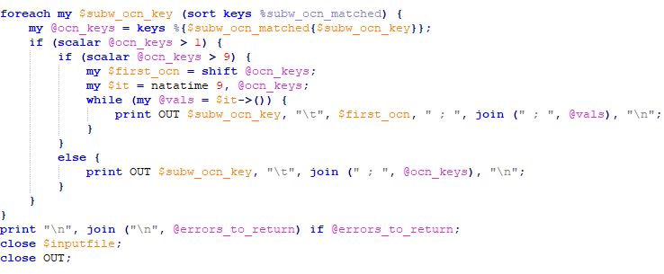
Perl script
Notes:
The Perl script, that our colleague Bryan Baldus created, was too large to fit on a slide or two so we are just showing you an example. The main script creates an output file with the original OCN followed by all of the duplicate OCLCE OCNs that were created from that original. The clean up script then deletes the original OCNs so we are only left with the duplicate OCLCE records.
Due to limitations of the merge software, sets are limited to no more than 10 OCNs at a time. This section of the script looks to see if there are over 10 OCNs in each set. If there are, the script breaks them into sets of less than 10, with the same retained OCN repeated in each set. Otherwise, it prints the sets as normal.
Other notes:
PERL script created by Bryan Baldus
OCLC Copyright (c) 2003-2018
Taking the output file from the database scan:
The first script checks the OCNs in field 776, subfield $w
Determines whether there is a valid online version OCN to add to the output file duplicates sets
It then matches up the online version OCNs, based on the shared OCN in field 776, subfield $w
In the resulting file, each line contains the shared OCN from field 776, a tab separator, and the duplicate OCLCE OCNs
The first script will also output any errors that it finds:
No OCN found in field 776
LCCN only
Unexpected formatting of OCN in subfield w
Standard number
Multiple OCNs in field 776

Slide 12
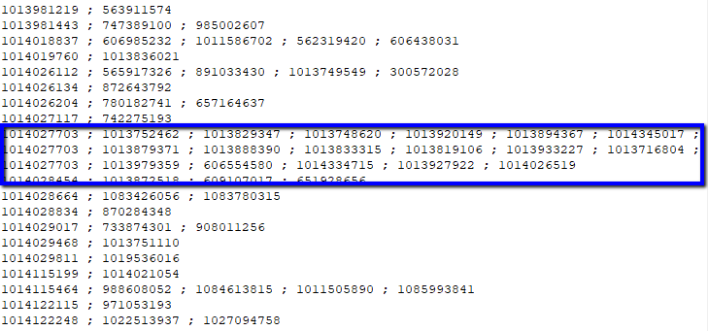
Perl script output
Notes:
Here is an example from the output file that the Perl script. Each line of OCNs is limited to 9 and you can see that there is one in the middle that shows how the script divided one of the longer sets into multiple lines using the same retained record.

Slide 13
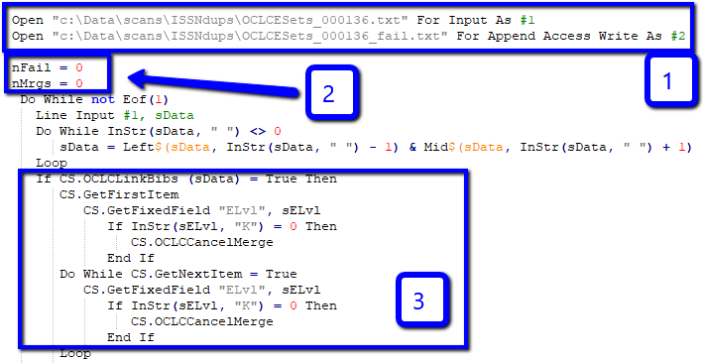
OCLCEMerge macro
Notes:
The duplicate sets were then run through the OCLCEMerge Macro, which was created for us by Robin Six. It verified the encoding level in each OCN and merged them as appropriate.
Input/Output: First, it opened the input file from the Perl script and an output file for any sets that failed to merge.
Count starts: Second, it started a count of the merges and failures.
Links/ELvL: Third, it retrieved the OCNs and linked them in the appropriate order.
Then, it evaluated the encoding level one last time to ensure one of the records had not been updated to full or CONSER during the space between when the sets had been gathered and when they were merged.
Other notes:
OCLCEMerge Macro created by Robin Six
OCLC Copyright (c) 2019

Slide 14
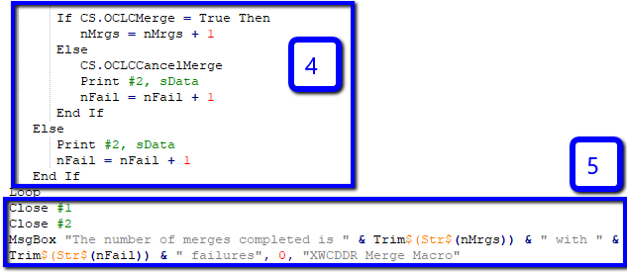
OCLCEMerge macro
Notes:
Merges/Writes: Fourth, the sets that could be merged were merged and those that failed were written to an output file.
Closes Files/Dialog box: When the macro had finished running though the file, the input and output files are closed and a dialog box would pop up letting staff know how many sets were merged and how many failed.
Other notes: OCLCEMerge Macro created by Robin Six
OCLC Copyright (c) 2019

Slide 15
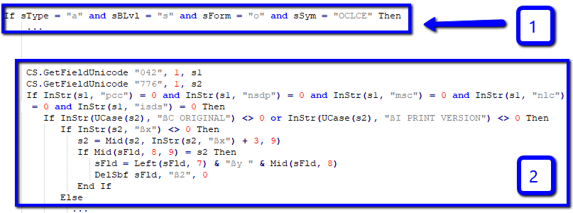
Editing macro
Notes:
After processing these sets, the retained records were run through an editing macro to clean them up. This macro was created for us by Robert Bremer.
OCLCE: First, it limited edits to OCLCE contributed online serial records.
ISSN: Second, corrected the ISSN in the OCLCE record by moving a print ISSN to 022 $y.
Other notes: Editing Macro created by Robert Bremer
OCLC Copyright (c) 2019
022 $x: If 776 $c or $i exists then it will look for $x
If $x retrieves, then it compares ISSN from 022$a to the ISSN it got from the 776$x
If equal, then changes 022$a to 022$y, then it deletes $2 was also carried over from the Print version

Slide 16
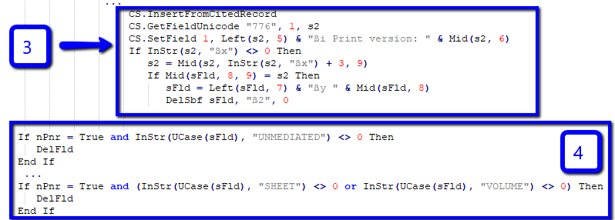
Editing Macro
Notes:
776/ISSN: Third, it filled in any minimal 776 field and then, if a $x was added with an ISSN, it would call the ISSN code to correct the ISSN in the 022 field if needed.
337/338: Fourth, it correct any rdamedia and rdacarrier terms that needed to be corrected.
Other notes: Editing Macro created by Robert Bremer
OCLC Copyright (c) 2019
776 field: The process of creating OCLCE records is based on older rules ($c original with $w).
Resulting records do not have other numbers you would normally have (LCCN, ISSN)
This is not how it would be done now with provider neutral guidelines. So the macro will re-build the 776 field by:
Taking the OCoLC #
Using it to create a new version of 776
Retrieves the 776 field it created
Adds $i info
Then reconsiders 776 $x
If same as 022 $a, then edit 022$a to 022$y
337/338: Edit fields 337 (rdamedia) and 338 (rdacarrier)
If the record is determined to be Provider Neutral, the macro will delete all print version rdamedia and rdacarrier information
macro will then supply the online version terms, i.e. computer and online resource
Previously, the macro notices a domain name in 856, like google.com or hathitrust.org, so that it considers the e-version record for provider-neutral processing (nPnr = True), then if 337 contains a normalized “unmediated” or 338 contains a normalized “sheet” or “volume”, the fields are deleted since they were carried over from the cloned print version. Once they are gone, then a more appropriate 337 with “computer” and 338 with “online resource” are added based on the coding in the record like any other record that is missing 337 and 338.

Slide 17
Where did the project lead us?
Notes:
Now let's take a look at the results of our first and second run, the limitations we encountered, and future of this project.

Slide 18
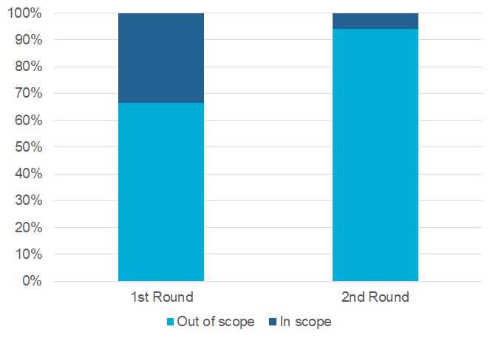
Results
Reduction of OCLCE e-serial records from 33% to 6%
Notes:
The results from our first two runs through the database show a reduction from 33% to 6% of the total number of OCLCE e-serial records. After running the sets through the second run we were left with less than 1% to manually review. The light blue portion of the chart represents that portion of the OCLCE records that were out of scope. Most of them are not duplicates but some of them might be, we just cannot merge them in the project as it currently stands. Some of the limitations we encountered include:
New records are continually being added. While is a concern is does make up a small amount of the duplicates. Software limitation: The software will not merge if the retained record would exceed the field limit imposed by the merge software (1000 fields).
Scan limitation where we are limited to retrieving the first 776 field only.
Stats:
There were about 713K OCLCE serial records in WorldCat (1st run).
After merging the 157K duplicate sets, we ended up with 478K OCLCE serial records (2nd run).
Round 1: OCLCE serial OCNs before merging: 713,783
Sets to merge: 156,197
True duplicate sets: 151,169
OCNs in duplicate sets: 267,410
OCNs merged: 238,824
OCNs with ISSNs in 022: 214,010
Round 2: OCLCE serial OCNs after merging: 474,961
Round 3: OCLCE serial OCNs after merging: 446,379
3291 duplicate records
New records added per month: Approximately 0.5% out of the whole pool of OCLCE serial records (2.2K out of 446K)

Slide 19
Future efforts and possibilities
Patterns
DDR merging
Script/macro enhancements
Different formats
Notes:
Photo by Alvaro Reyes on Unsplash
So where does this project lead? We will continue to process any new duplicates on an ongoing basis.
ISSN Center: We are currently working with the US ISSN Center to continue identifying patterns that we could apply these tools to and would love to have more feedback from our member libraries on any patterns they are seeing.
DDR: We are also taking what we learned to improve Duplicate Detection and Resolution or DDR, our automated merging software.
Tools: We are continuing to enhance the tools we've created based on what we learned in these past 2 runs.
Formats: We are looking to extend this project to other formats, not just e-serials.
… And with that, I will pass it back over to Hayley.
Notes:
DDR merging/Software
Removing the field limit that is currently coded in the merge software
Enhance software to allow OCLCE records to merge based on field 040$c
Macro enhancements (in testing)
OCLCEMacro – buffer input when merging to account for Connexion processing time
Script enhancements (just started)
Multiple OCNs - tweak the regular expression that looks for $w to account for multiple OCLC-based $w in the same field
Incorrectly formatted $w – If determined these are legitimate OCLC OCNs, the regular expression could be tweaked, or an additional regular expression pattern could be included, to allow these to be treated the same as OCNs with the proper $w prefix

Slide 20
Why is this important to me?
Improves discovery
Reduces cataloger’s time
Libraries, like OCLC, also receive data from various sources (e.g. vendors)
Notes:
Even though this project may seem very unique due to the nature of the problem we truly believe libraries and other organizations that harvest and deal with data outside of their local database could encounter similar issues, especially when we start to think about the promises of linked data where everything will be connected.
Duplication can really hinder discovery for anyone using a database and cause a lot of confusion regarding what record should really be used. We can improve discovery by deduplicating records, as then users no longer have to decide what record is best to choose or going through a long results list to see what each record has to offer.
For WorldCat users, such as catalogers, duplication can add a lot of time to your workflows. This project showcases our continued dedication and efforts towards alleviating duplication. We hope catalogers are encouraged by the work being done in OCLC to help improve the database you use for finding and exporting records to your systems.
Finally, as mentioned in the beginning of the presentation libraries and other organizations that deal with metadata coming from different sources may encounter duplication issues. Think about how your local database is receiving data from vendors, institutional repositories, or other systems used by different departments like special collections that may be using a separate database which interoperates with your catalog. There could be an opportunity for possible duplication to occur. Also, remember that we need to account for human error. There are people behind the catalog that are entering and sending data to your library's database. There can be times when a duplication occurs (e.g. not doing a thorough enough search in your local catalog to realize that the record already exist and then exporting to another bibliographic record to the system).
We hope this project can help in making you think about how to look into metadata elements that can identify duplication. Also, some of the tools used such as the Perl script or Connexion macros may be customized to work for your systems. Allowing you to also automate the removal of duplication.

Slide 21
Charlene Morrison
Hayley Moreno
Database Specialist II
Database Specialist II
morrisoch@oclc.org
morenoh@oclc.org
Notes:
With that we conclude our presentation. Thank you for listening and we can now take any question or comments about the project.

