Slide 1
Space Still Matters Advocating for Dedicated DH Library Spaces in a Virtual World
Dr. Pamella R. Lach (she/her/hers)
DH Librarian, DH Center Director, DH Initiative Co-Director
San Diego State University
Indigenous residence + land borrowing/occupying: Kumeyaay
plach@sdsu.edu // library.sdsu.edu/dh // @VisualizingPam
tinyurl.com/dh-space-matters

Slide 2
my guiding questions
How do we, as DH library folks, advocate for the creation and ongoing growth of dedicated library spaces now and after the pandemic?
How do we continue to demonstrate the importance of physical spaces even as we support and grow virtual services?

Slide 3
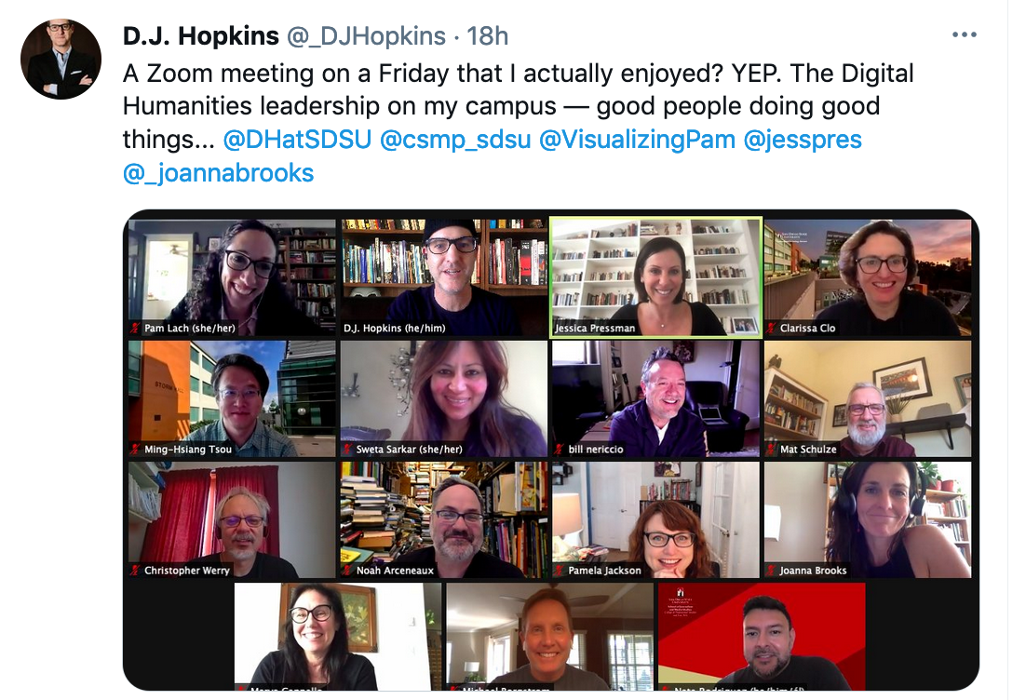
DH@SDSU
A group of folks committed to shared values that center humans and human interactions in the digital age, with special attention to anti-racism, social justice, & global diversity dh.sdsu.edu
Notes:
About SDSU: HSI residing on Kumeyaay land, part of the California State University (CSU)
DH@SDSU: grass-roots, faculty-led, cross-disciplinary initiative focused on anti-racism, global diversity, and social justice. Gained “Area of Excellence” status which produced a 5-faculty cluster hire
Library’s role: founding partner; gained faculty line (me) in the cluster hire; committed to developing our Digital Humanities Center

Slide 4
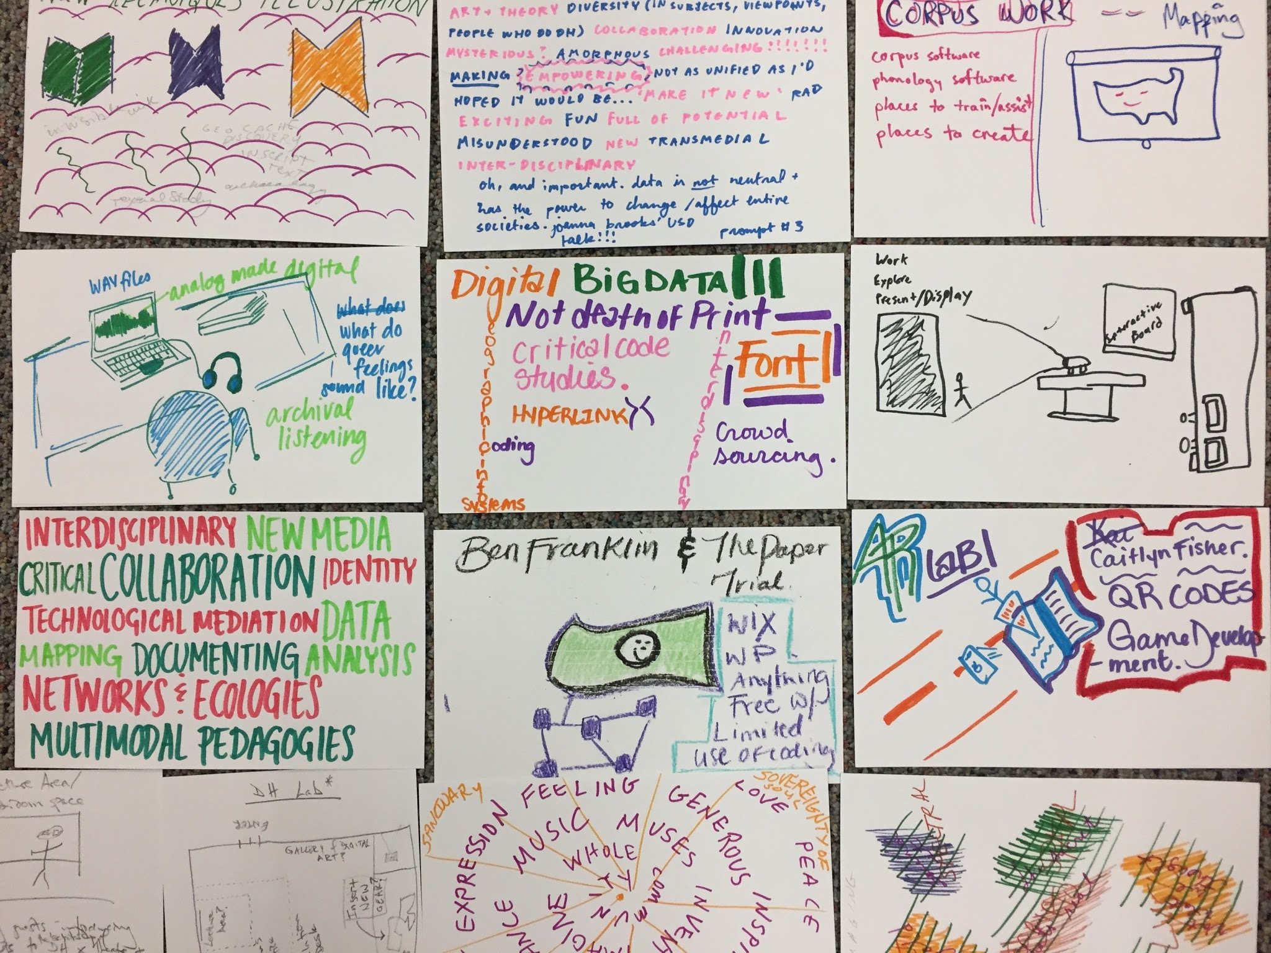
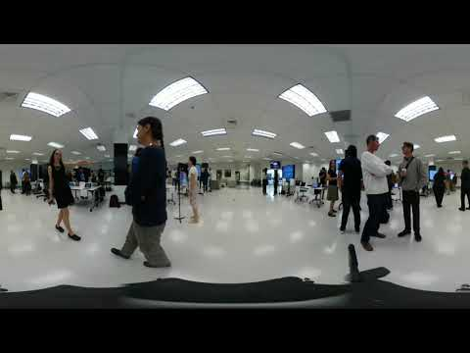
the early years: dhc creation and growth
Learn more:
Library Connect (2019) and ACRL 2019
Notes:
User- and value-centered iterative design process
Programmatic growth from one-off event venue to more coherent
Growth of space to incorporate digital studios (podcasting, e-lit, VR production) - next slide
Unsteady/uneven progress hampered by staffing shifts and facilities issues

Slide 5
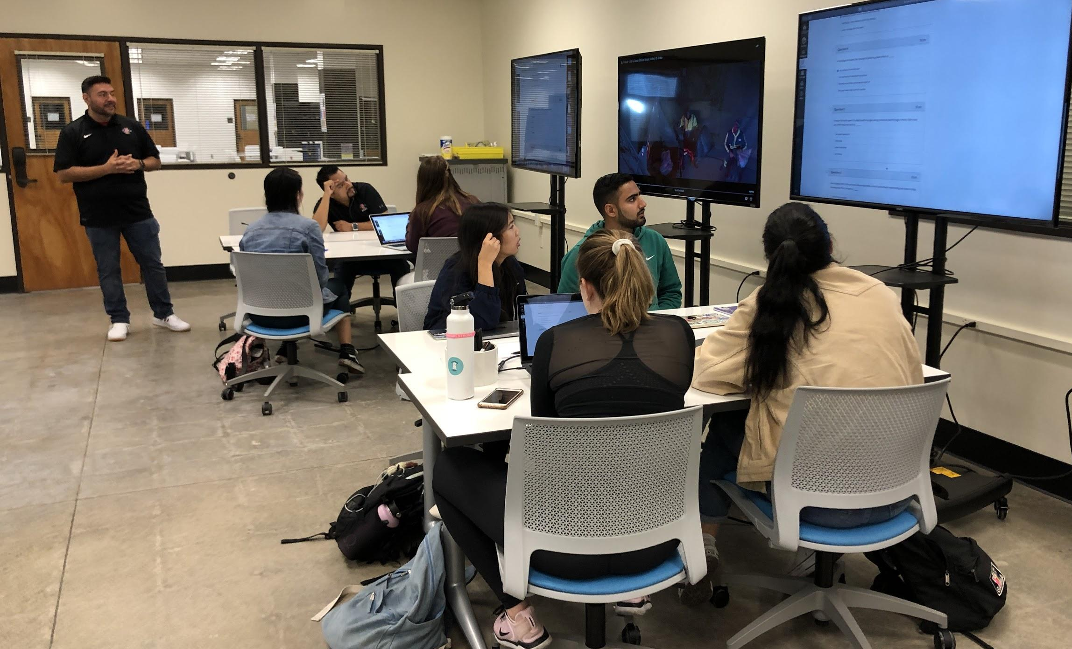
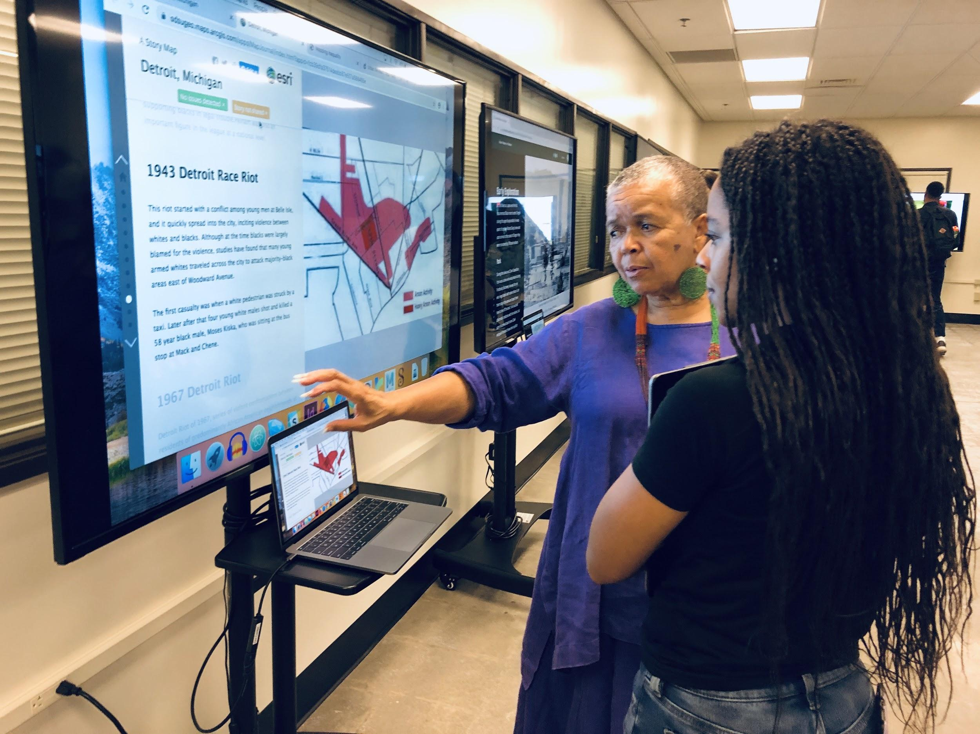
transformative spaces
Notes:
Growth of specialized spaces:
Digital studios for critical inquiry: E-Lit
Digital studios for critical production: Podcasting, AR/VR/New Media
Analog studio for critical reflection and unplugging
Flexible learning/doing space: helping faculty transform their pedagogy

Slide 6
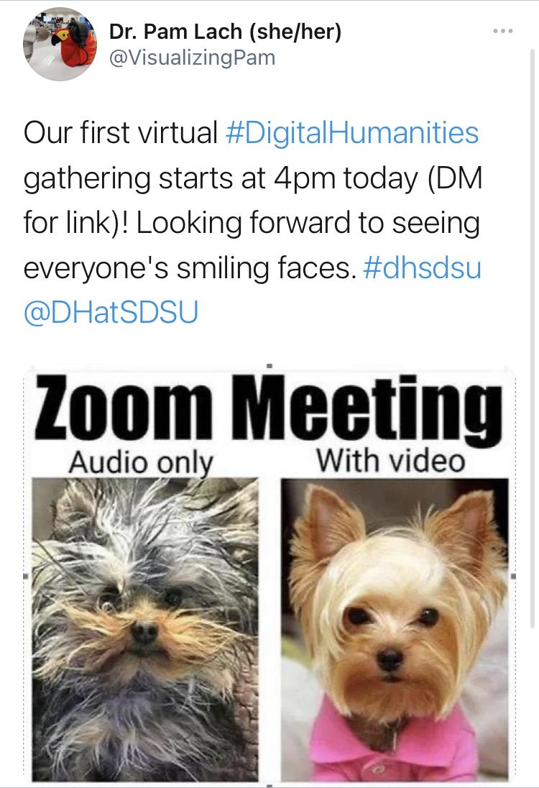
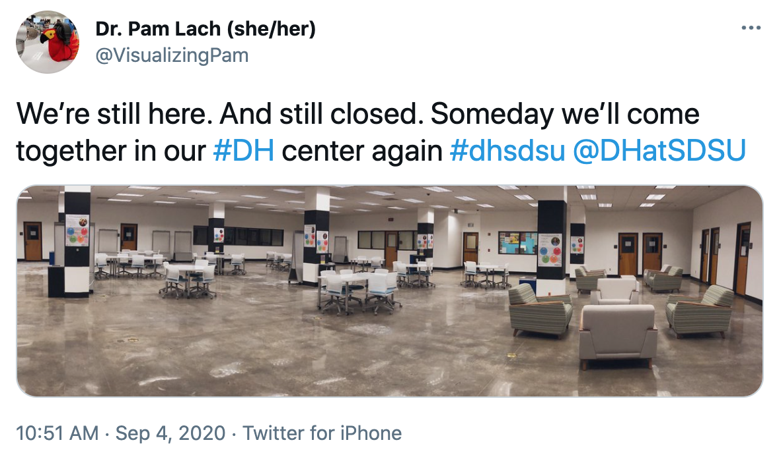
pandemic: work less, care more
Learn more: “Beyond Quarantine” CNI webinar (Sept 2020)
Notes:
Spring 2020: initial pivot to test out virtualization of programmatic services
AY 2020/2021: long-term virtualization during extended closure across entire CSU

Slide 7
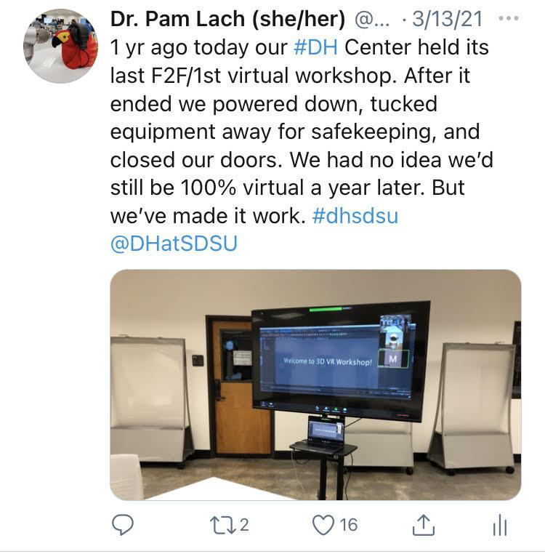
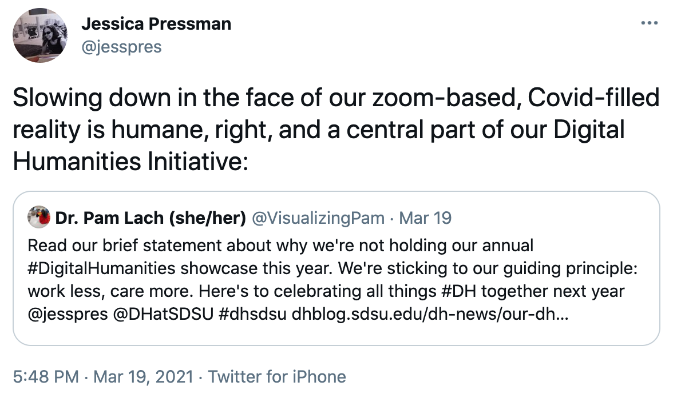
pandemic: work less, care more
Notes:
Indeed, the success of these efforts in some ways outpaced the impact of our face-to-face efforts. But all the while, we continue to maintain that space matters -- that there is something irreplaceable in bringing people together to explore, create, and critique the digital.
Pandemic interventions:
TeachDH website: https://teachdh.sdsu.edu
Tool tutorials: https://tinyurl.com/dhc-public-tutorials
Virtual programming: https://teachdh.sdsu.edu/programming/
NHC Podcasting Institutes (June 2020) (Winter 2020-2021): https://tinyurl.com/nhcwinterpodcast
Plus ongoing instruction partnerships and rise in consultations this year
Pandemic limitations:
Access to specialized equipment/studios (but no need currently?)
Staffing/hiring chill
Limits of recreating F2F community in a Zoom world: https://dhblog.sdsu.edu/dh-news/our-dh-showcase-statement
How to know if folks are falling off?

Slide 8
planning for an uncertain future
Transformational change is needed for post-pandemic work
Shifting campus needs → library reopening plan → DHC reopening possibilities
Budget constraints
Staffing/capacity limitations
Future crises: environmental, social, and public health
KC Green,”On Fire,” 2013, gunshowcomic.com/648
Notes:
Need to transform the space -- how we use it -- for post-pandemic realities (and returning to our core values) in such a way that we can continue to 1) demonstrate importance of space, 2) use the space in different, and perhaps better, ways that allow for greater responsiveness/flexibility/future pivots, 3) continue virtualization for future agile responses to crises. These are competing, and perhaps contradictory, goals?
Planning for an uncertain future - Reopening uncertainties writ large and for DHC. DHC considerations:
Social distancing in a flexible space
Staffing limitations to monitor social distancing
Plan for continued uncertainty through the end of the pandemic: no F2F events in F21 for sure
Should we/do we need to re-open and what do we gain/lose by not reopening?

Slide 9
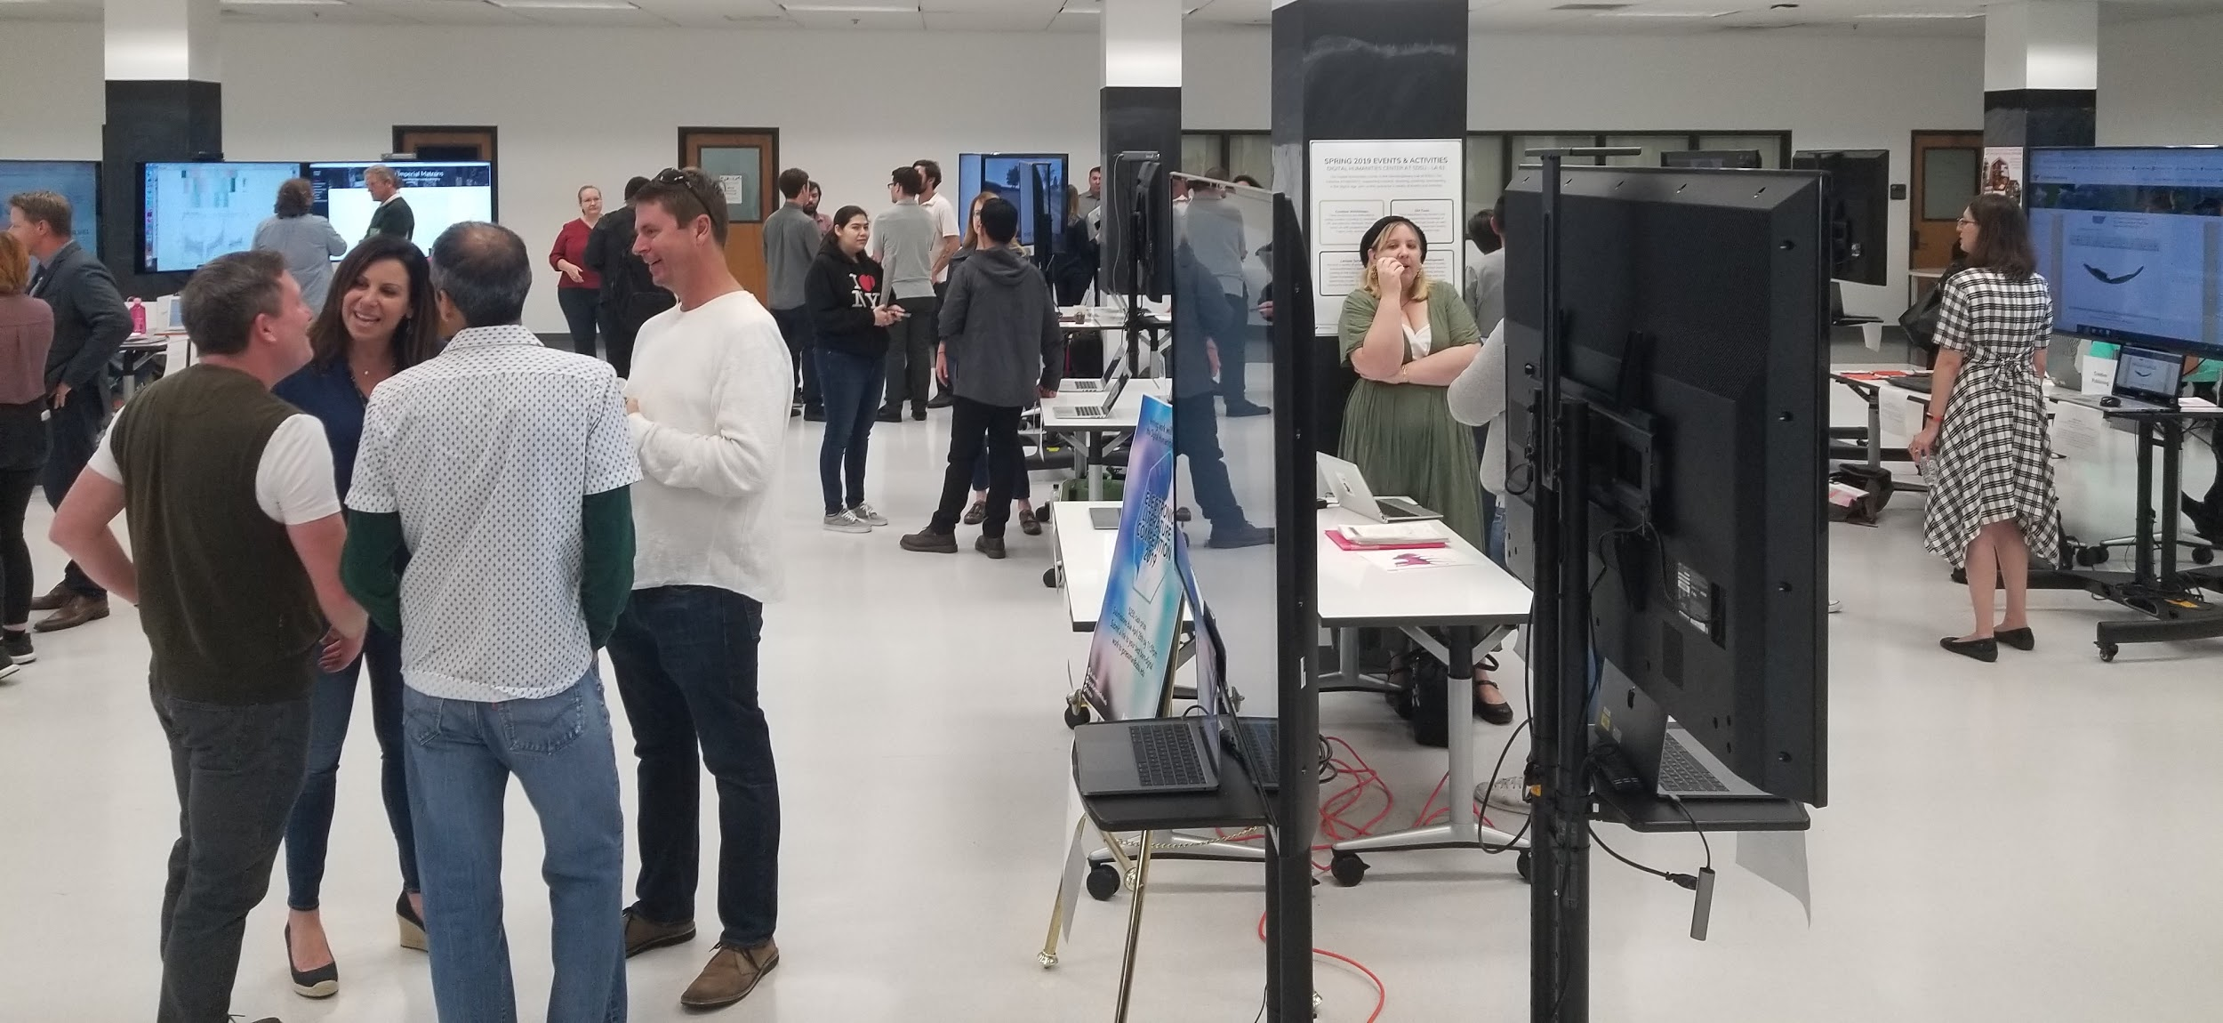
space matters more than ever
Despite successful virtualization, we continue to maintain that space matters
There is something irreplaceable in bringing people together to explore, create, and critique the digital

Slide 10
delicate balancing act
There are things we can’t do without the space...
...but we have limited capacity for managing it.
Virtualization (programs, services) will continue...
...but will that make us vulnerable to space grabs?
...or to losing the space completely?
What is the DH Center if it’s physically open -- even if just a study space -- but still operating virtually?
Notes:
Still want to advocate for a space that I can barely manage on my own -- we need the serendipitous interactions of being in the room together -- but struggling with the new realities of long term budget and staffing limitations

Slide 11
my questions, revisited
How do we, as DH library folks, advocate for the creation and ongoing growth of dedicated library spaces now and after the pandemic?
How do we continue to demonstrate the importance of physical spaces even as we support and grow virtual services?

Slide 12
possible strategies
Be explicit about what we can/can’t do virtually
Use the importance of space to argue for resources, supported by data, testimonials, and storytelling
Manage expectations about post-pandemic operations
Scale down/focus on doing less with greater impact
Build/update space for future resilience
Virtualize/hybridize to expand access, but consider invisible labor and other costs/losses
Return to core values for decision making/advocacy
Balance values against shifting landscape to re-conceptualize what’s possible, fix what wasn’t working

Slide 13
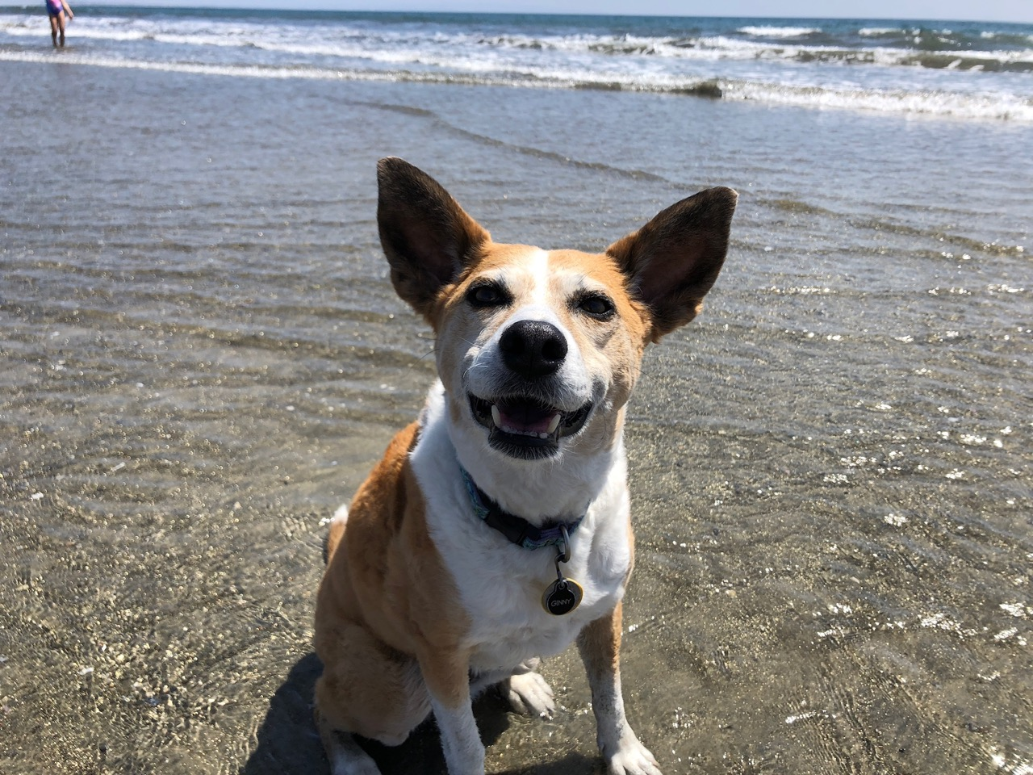
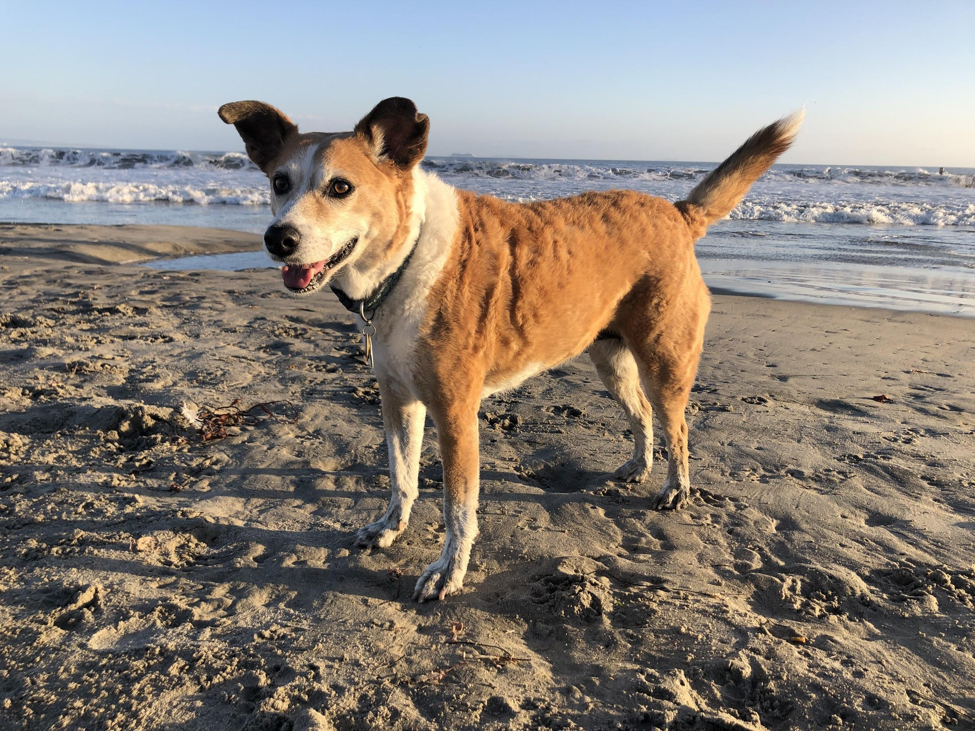
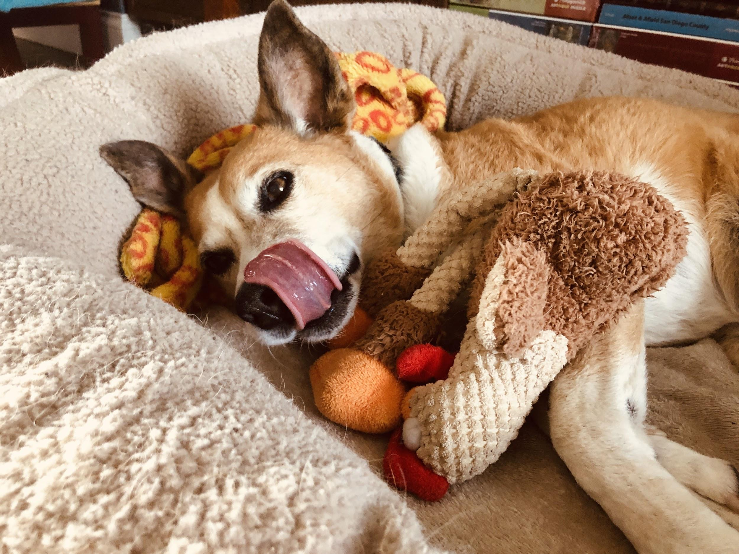
keep the conversation going

