Slide 1
Developing a data module for RCR instruction
ACRL ALSGSIG
ALA Midwinter Conference
January 26, 2019

Slide 2
Elliott Smith
Emerging Technologies & Bioinformatics Librarian
Koshland Bioscience, Natural Resources & Public Health Library
Amy Neeser
Research Data Management Program Manager
Research IT and Library Data Lab
Anna Sackmann
Science Data and Engineering Librarian
Kresge Engineering Library

Slide 3
RCR and graduate student services
Responsible Conduct of Research instruction:
is required for all NSF- and NIH-funded graduate students
offers opportunities for librarian outreach, instruction, and continuing engagement
aligns with institutional priorities and evolving liaison models

Slide 4
Responsible Conduct of Research (RCR)
RCR training requirement for researchers supported by NSF, NIH grants
For NIH grants: “…online instruction [alone] is not considered adequate...” (NOT-OD-10-019)

Slide 5
RCR in the Biosciences
at UC Berkeley
MCB 293C: RCR and Research Ethics
MCB 293D: Rigor and Reproducibility
MCB 293S: Foundations of Biostatistical Practice

Slide 6
RCR in the Biosciences
at UC Berkeley
MCB 293C: RCR and Research Ethics
MCB 293D: Rigor and Reproducibility
MCB 293S: Foundations of Biostatistical Practice

Slide 7
MCB 293D Topics
The reproducibility crisis
Data collection, organization and storage
Data and image analysis
Cell line authentication

Slide 8
MCB 293D Topics
The reproducibility crisis
Data collection, organization and storage
Data and image analysis
Cell line authentication

Slide 9
“Support Your Data” Module: Topics
Data support and RCR (Anna)
Planning, documenting, describing (Elliott)
Storage, backup, archiving, sharing (Amy)

Slide 10
“Support Your Data” Module: Techniques
Engage with humor
Focus on tasks File-naming, organization, description, storage, reuse
Active learning exercises
Real-world examples

Slide 11
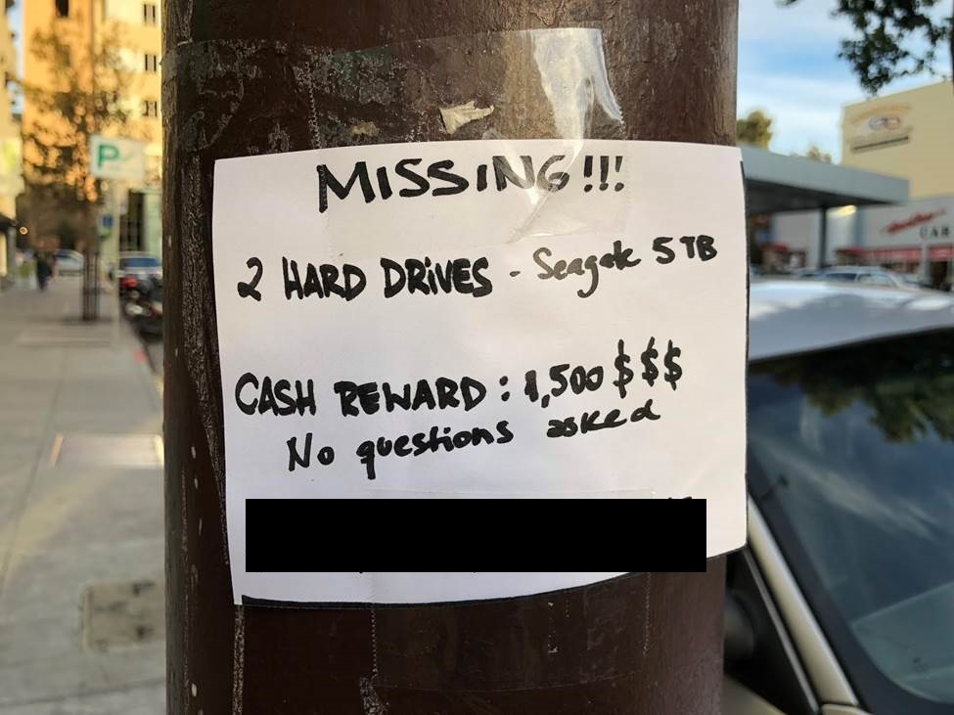
“Support Your Data” Module: Examples

Slide 12
Congruence with Evolving Liaison Models
Engagement throughout the research lifecycle
Support of patrons as information producers
Alignment with institutional research and teaching priorities
Collaboration to combine functional and subject expertise
From: Vine, 2018.

Slide 13
Resources
Hanson K, Surkis A, Yacobucci K. 2012. Data Sharing and Management Snafu in 3 Short Acts (Higher Quality). NYU Health Sciences Library. YouTube. https://www.youtube.com/watch?v=66oNv_DJuPc
Jaguszewski JM, Williams K. 2013. New roles for new times: Transforming liaison roles in research libraries. Washington, DC: Association of Research Libraries. https://www.arl.org/storage/documents/publications/nrnt-liaison-roles-revised.pdf
National Institutes of Health. 2009. Update on the Requirement for Instruction in the Responsible Conduct of Research. Notice NOT-OD-10-019. https://grants.nih.gov/grants/guide/notice-files/NOT-OD-10-019.html
National Science Foundation. 2009. NSF's Implementation of Section 7009 of the America COMPETES Act. Federal Register 74: 42126-42128. https://www.govinfo.gov/content/pkg/FR-2009-08-20/html/E9-19930.htm
Rockenbach B. 2018. What are we trying to build? Research Library Issues 294: 3-7. https://doi.org/10.29242/rli.294.1
Vine R. 2018. Realigning liaison with university priorities. C&RL News 79(8): 420-423, 458. https://doi.org/10.5860/crln.79.8.420
Wiley CA, Kerby EE. 2018. Managing research data: Graduate student and postdoctoral researcher perspectives. Issues in Science & Technology Librarianship 89. https://doi.org/10.5062/F4FN14FJ

Slide 14
Special thanks to:
Kortney Rupp
Science, Research & Engagement Librarian
Lawrence Livermore National Laboratory
(formerly Chemical Information Librarian, UCB)
Victoria Sharma
Program Manager
Responsible Conduct in Research
UC Berkeley

Slide 15
Thank you!
Questions?
Elliott Smith
esmith@library.berkeley.edu

Slide 16
Image credits
Slide 2: UC Berkeley Library
Slide 4: Chris Spielmann/National Cancer Institute
Slides 5-8: Keegan Houser/UC Berkeley
Slides 9-10: janneke staaks https://www.flickr.com/photos/jannekestaaks/14391223825
Slide 11: Amy Neeser

