Slide 1
Meta-Synthesis
The state of confusion
By Dr. Olga Koz, KSU Senior Research Support Librarian

Slide 2
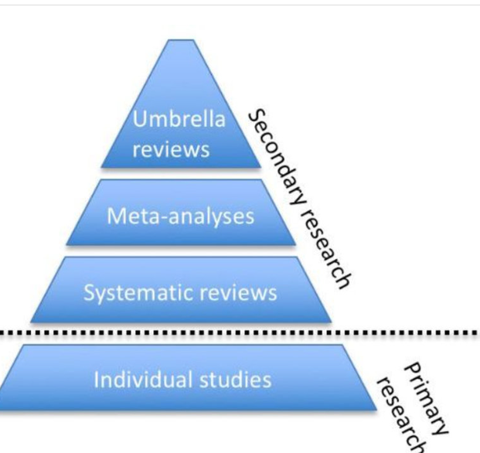
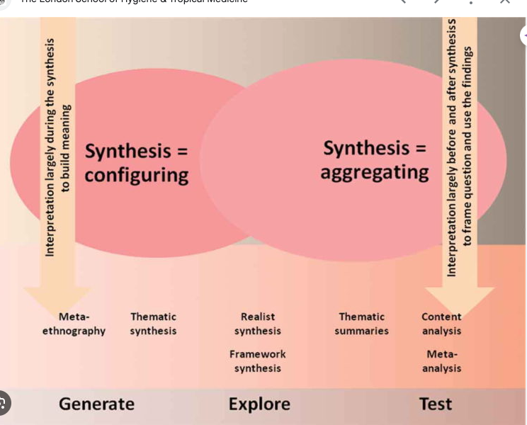
1 source of the confusion: classification of the types of meta-synthesis or qualitative meta-studies
London School of Hygiene & Tropical Medicine. Evidence Synthesis.
Fusar-Poli, Paolo & Radua, Joaquim. (2018). Ten simple rules for conducting umbrella reviews. Evidence-Based Mental Health. 21.

Slide 3
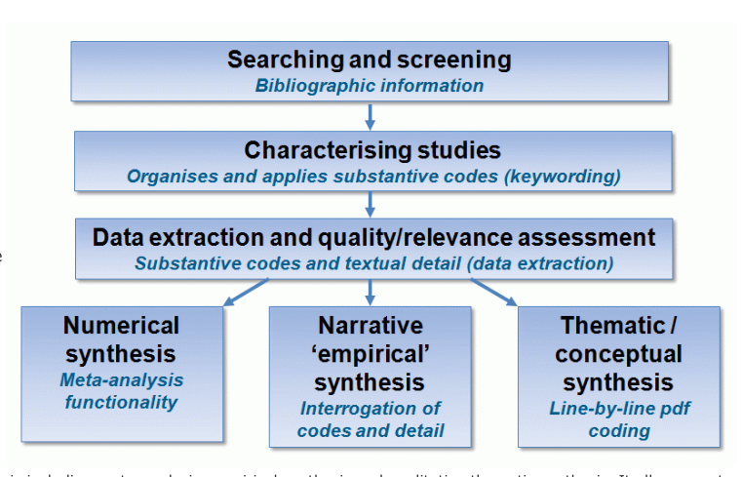
How problems with positioning and classification of meta-synthesis impact the protocol and searching phase.
ACRL Education & Behavioral Sciences Section: Demystifying Evidence Synthesis with speakers Hui-Fen Chang, Scott Marsalis and Amy Riegelman
EPPI Center

Slide 4
Systematic review vs. Meta-Synthesis
Systematic
Review = Systematic secondary data collection
Meta- Analysis = Quantitative Analysis
Meta-synthesis + Qualitative analysis
Mixed methods analysis of secondary data

Slide 5
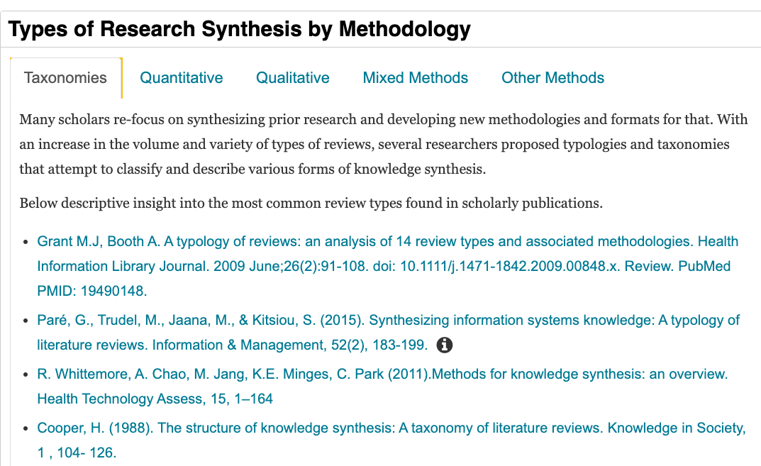
Source: https://libguides.kennesaw.edu/research_synthesis/meta-synthesis

Slide 6
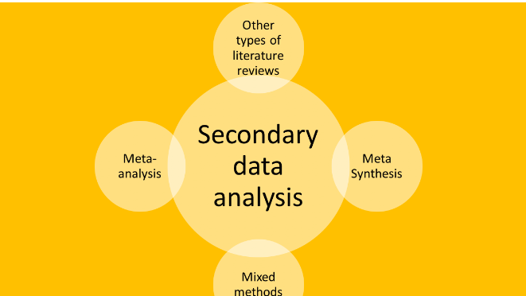
Network Analysis
Scoping/
Mapping
Critical Interpretive
Thematic Analysis
Meta-ethnography
Integrative Review
There are 13 meta-qualitative reviews (e.g., meta-interpretation, meta-study, thematic synthesis) (Sutton et al., 2019).
Content Analysis

Slide 7
Key Challenges in Searching

Slide 8
Should searching be based on QUAL research design and methods?
Research question, breadth, type, and position
QUAL research questions include concepts, not variables.
Concepts ambiguity
Searching by methods is not possible in some databases
Variability of reporting styles and methods used in qualitative research
The vast amount and richness of data produced in qualitative research
Searching techniques. “Translating” techniques that QUAL researchers use (purposeful sampling, snowballing, clustering, and text mining) into searching and information retrieval terms.
QUAL Systematic search processes are similar to quantitative reviews, including a study protocol, a framework/checklist to guide content, a PRISMA flow diagram to report searching, etc.
However, some use strategies that may be reflective of social constructivist, interpretive, or phenomenological, or ethnographic approaches.
Librarians should be a part of the conversation about not only data collection but analysis as well.

Slide 9
Meta-synthesis protocols or Review Process
The protocols used in systematic quantitative reviews are well developed (PRISMA, Cochrane), but very few examples of a qualitative systematic review protocol are available.
I am collecting examples of these protocols:
See the guide to Research Synthesis

Slide 10
Reference
The Guide to Research Synthesis by O. Koz includes all references
https://libguides.kennesaw.edu/research_synthesis

