Slide 1
Recording Gender in Name Authority Records
Recommendations from the PCC Ad Hoc Task Group
Amber Billey, Bard College
Nancy Sack, University of Hawai‘i at Mānoa
ACIG, ALA Midwinter 2018
Notes:
Thank you, Jodi, for inviting Amber and me to talk about our group’s guidelines for recording gender in name authority records.

Slide 2
First a little background
NAF in Voyager at UH
New and changed records are downloaded each week
The loader program reports errors in NARs
I correct (most of) the errors
Notes:
Before we get to the specifics, I want to provide a little background about how the PCC task group on recording gender in authority records came to be. At the University of Hawaii, where I work, the entire NAF resides in our Voyager ILS. Each week I use a program to download the new and changed authority records as well as those marked for deletion. The program identifies bibliographic access points that are deemed “safe” for automatic correction and it generates reports containing problems and potential problems in both bib and authority records, which I review manually.
Most of the problems turn out to be errors in authority records. For the past couple of years, I’ve been correcting them but I’m falling behind.

Slide 3
What kinds of errors do I find?
Incorrect thesaurus in subfield $2
370 Cremona (Italy) |2 edtf
374 Judges |2 lchs
Terms match references
370 University of Tokyo |2 naf
Terms match reference records
372 Workshops (Seminars) |2 lcsh
Term is not in cited thesaurus
372 Topography |2 lcsh
Descriptors included in 374 field
374 African American poets |2 lcsh
Incorrect subfield codes
370 Quezon City (Philippines) |e naf
Old-style geographic names
370 U.S. |2 naf
???
373 Freelance writer (Do South Magazine, Entertainment Fort Smith, state and national educational leadership publications)
Typos
372 Journalim |2 lcsh
373 Univeristy of Georgia |2 naf
374 Layers |2 lcsh
http://files.library.northwestern.edu/public/oclc/
Notes:
Here I’m listing only some of the errors I come across in just the 3XX fields (but the reports have included mistakes in every field of the record).
Sometimes the wrong thesaurus is coded in subfield |2. LCSH may be misspelled.
Terms coded NAF or LCSH match references in their respective authority records.
Terms are taken from LCSH reference records
Some terms, especially in 372 fields, are coded LCSH but they don’t match any LCSH term (even though we may wish they did).
Occupation terms include descriptors in violation of the Policy Statement to refrain from recording terms of occupation or profession that indicate the person’s gender, nationality, religion, etc. I would add geographic subdivision to the list of “don’ts” but that isn’t part of the PS.
Subfield codes are sometimes incorrect, especially in the 370 field.
Geographic terms coded NAF appear in forms that were specified under previous guidelines.
Some fields I come across simply defy categorization.
And, of course, there are lots of misspellings. All of the errors on this slide are from actual authority records and all but one type of error would be detected (and in some cases, even corrected) by the Authority Toolkit, developed at Northwestern. It is available for free download as a stand-alone program or it can be used in conjunction with the OCLC Connexion client.

Slide 4
Original RDA instruction 9.7.1.3
Record a gender with which a person identifies.
Record the gender of the person using an appropriate term from the list below.
Female Male not known
If none of the terms listed is appropriately or sufficiently specific, record an appropriate term or phrase
intersex
transsexual woman
Notes:
Now we’ll look specifically at gender. The RDA instruction for recording gender defines the term as “A gender with which a person identifies.”
This is part of the original RDA instruction for recording gender. Until two years ago, “male” and “female" were by far the most frequently recorded gender terms in NARs.

Slide 5
New RDA instruction 9.7.1.3
Record a gender of the person, using an appropriate term in a language preferred by the agency creating the data. Select a term from a standard list, if available.
Notes:
In February 2016 the RSC approved a proposal to eliminate the list of gender terms and to rewrite the instruction.
The instruction now reads: Record a gender of the person, using an appropriate term in a language preferred by the agency creating the data. Select a term from a standard list, if available.
The new instruction was welcomed as a positive change for a more inclusive vocabulary.

Slide 6
Data in 375 field
Male |2 mesh
male |2 lcgft
femlale
eng
sovietologists
Female |2 aat
Males |2 lcsh
male |2 iso5218
Boys |2 lcsh
Women |2 lcsh
Men |2 lcsh
Notes:
But it also meant additional “noise” in authority records. Suddenly all kinds of data appeared in the 375 field. Some of the terms were from standard lists. But often the definition of the term in the thesaurus cited did not correspond to the RDA instruction to record “a gender with which a person identifies.” In AAT, Female is defined as “the sex that normally produces eggs or female germ cells.” The LCSH record for Males has a scope note that reads: “Here are entered works on male organisms in general. Works on the human male are entered under Men.” Terms were identified as iso5218, a standard whose values are 0, 1, and 2 for not known, male, and female, and 9 for not applicable. The MeSH record for Male instructs catalogers not to use it.
Some of the terms, such as Boys, women, and Men, incorporate an age element. Singular and plural forms were both recorded. There were variations in capitalization. And there were the usual typos and coding mistakes. My error reports got longer and I was overwhelmed, so I wrote to the PCC list asking about consistency in recording gender. The post generated quite a few responses but there was no consensus on a solution.

Slide 7
Paul Frank to the rescue
PCC ad hoc task group on recording gender
Model for a future NACO working group
Goals of authority work
Consistency
Accurate representation
Notes:
I also wrote to Paul Frank to ask if the PCC had appointed a task group to develop best practices for recording 3xx fields in NARs because if there were such a group, I wanted to join it. And if no group existed, I wanted to know if PCC would consider creating one.
Paul’s response was to invite five of us—Amber Billey, Matthew Haugen, John Hostage, Adam Schiff, and me—to serve on an ad-hoc group to develop guidelines for recording gender in authority records. Paul expressed the hope that this ad-hoc group would serve as a foundation for a more official NACO working group in the future.
My primary concern all along was consistent data in NARs so I was hoping we could agree on a preferred thesaurus of gender terms. As the task group proceeded with its work, though, I came to appreciate that accurate representation is equally important.
And now Amber will dive into the ethical concerns regarding gender representation in NARs.

Slide 8
Gender, RDA style
literally embodied
easily defined
visually identified
female, male, or empty data
fixed, now and forever
But this has real-world ramifications

Slide 9
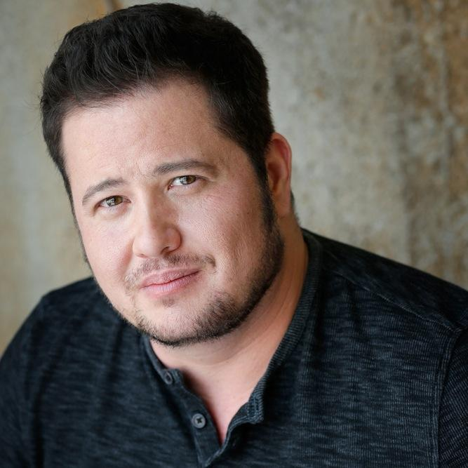
Fixed and linear.
Name heading: Bono, Chaz
Gender: female (1969-2008?) Gender: male (2008?-present)
Variant: Bono, Chastity

Slide 10
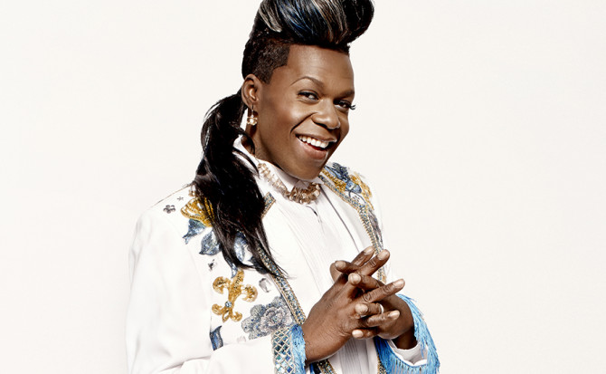
Miss-identification
Name heading: Big Freedia
Gender: female
Variant: Fredia, Big
Variant: Ross, Freddie

Slide 11
Rude.
Name heading: Bornstein, Kate, 1948-
Gender: transgender
Information found: born March 15,
1948, in Neptune, NJ as Albert Herman
Bornstein; underwent
sex-reassignment surgeries from
1985-1986
Notes:
http://id.loc.gov/authorities/names/n93121104.html

Slide 12
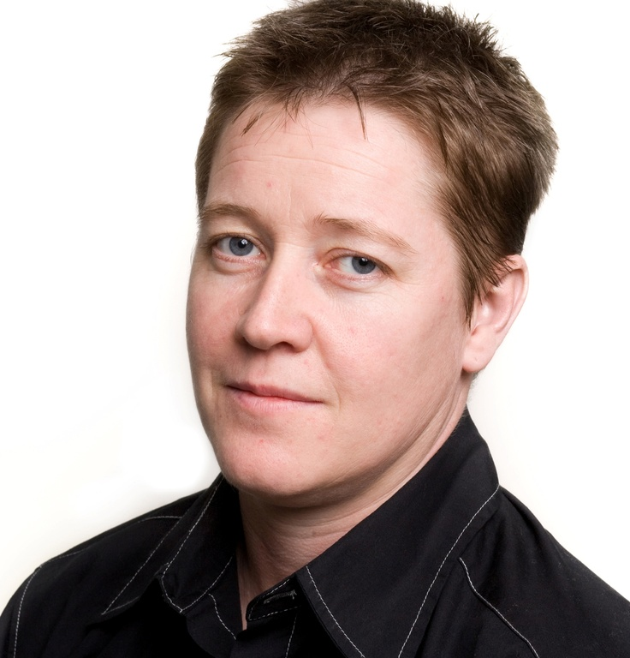
Outing. Forever.
Name heading: Coyote, Ivan E. (Ivan E[...]), 1969-
Gender: Transgender people Fuller Form of Personal Name: Ivan E[...]
(Thompson, p. 141)

Slide 13
Looking at trans* NARs
65% of NARs for trans* authors analyzed contained some form of outing information
Multiple 375 fields
Trans* terms used in the 375
Trans* identity indicated elsewhere in the NAR (670)
Thompson, K. J. “More Than a Name: A Content Analysis of Name Authority Records for Authors Who Self-Identify as Trans,” Library Resources & Technical Services 60, no. 3 (July 2016).

Slide 14
New instructions need
new best-practices.

Slide 15
New Best Practices
The committee produced a report on October 1, 2016.
The recommendations were well received at the PCC Policy Committee (PoCo) November 2016 meeting, and are still under review to work out the details for implementation.

Slide 16
Task Group Recommendation #1
Record information about gender as the person self-identifies and explicitly discloses, taking information from readily and publicly available sources such as:
Biographical information published on the resource
Biographical information provided by the publisher
Author’s personal website or social media profiles
Direct communication with the author
For non-contemporary persons use works by the person as well as biographies, obituaries, articles, etc. about the person

Slide 17
Task Group Recommendation #2
Record Males or Females in accordance with the term used by the person, or with gendered pronouns and/or inflected words used in the source
Do not assume gender identity based on pictures or names
Do not dig for given names or genders assigned at birth

Slide 18
Task Group Recommendation #3
For transgender/transsexual persons record the terms Transgender people or Transsexuals in accordance with the term used by the person

Slide 19
Task Group Recommendation #4
For well-known persons who publicly transition between male and female mid-life and have literary warrant for recording both genders, record both Males and Females and other terms as applicable.

Slide 20
Task Group Recommendation #5
Record gender terms based on information in the source.
For example, if a person claims to be a cisgender male, record Cisgender persons and Males. If a person just says “as a young boy…” or uses male pronouns then record Males, but do not assume he is cisgender or transgender

Slide 21
Task Group Recommendation #6
Record dates (375 $s and $t) associated with a gender only when the person explicitly provides dates of transition

Slide 22
Task Group Recommendation #7
Justify gender data recorded in the 375 field in a subfield $v or 670 field or both

Slide 23
Task Group Recommendation #8
Take into account the following considerations:
“Is there potential for this information to harm the [person] through outing or violating the right to privacy?
Is there an indication that the [person] consents to having this information shared publicly?
Will including this information help a library user in the search process?”*
*Thompson, KJ. “More Than a Name: A Content Analysis of Name Authority Records for Authors Who Self-Identify as Trans,” Library Resources & Technical Services 60, no. 3 (July 2016), p. 152.

Slide 24
Choice of vocabulary
Use LCDGT.
The LCDGT was developed specifically to describe demographic characteristics such as age,
gender, and nationality, so we selected LCDGT as the thesaurus that best suits the needs of
librarians. Its treatment of gender is consistent with the RDA 9.7.1.1 scope. Although LCDGT
specifies the use of plural labels, it still applies to resources by individuals within a demographic
group or class of persons. In addition to the terms currently available, more terms can be
proposed by catalogers.
The task group proposed 4 new terms (Cisgender people, Two-spirit people, Gender non-binary people, and Agender people); and 7 revisions to existing terms in the LCDGT. We are still waiting for those proposals to be accepted.

Slide 25
Next Steps
Survey the PCC membership about the recommendations
Watch your inboxes!
Review and incorporate feedback in revised recommendations
Advocate to update the LCDGT if necessary

Slide 26
“We have the opportunity to accurately represent
authors as they
choose to be known.”
(Thompson, p. 142)

Slide 27
Thanks!
Any questions?

