Slide 1
Library of Congress
Linked Data Service APIs

Slide 2
A BIT ABOUT id.LOC.GOV
Authorities (Names, Subjects, Countries, Organizations…)
Code lists to establish URIs for cataloging concepts
Links to other controlled lists (Getty, Wikidata)
External Vocabularies (American Folklife, Rare Books & Manuscripts …)
Contributor roles, publishing entities (derived from bibliographic data)
BIBFRAME Works, Instances
**Daily updates or as changed**

Slide 3
More ID.loc.gov
Why ID?
Assist in converting strings to URIs, so we can better control metadata and improve metadata change management.
Heavily used in BIBFRAME cataloging; lots of lookups instead of typing in literals
Heavily used by some to add URIs to MARC records.

Slide 4
Services beyond search
Atom Feeds
Label
Suggest2 / Suggest
Downloads
Activity Streams for label changes*
*coming soon

Slide 5
Atom feed
Why? Get the most recent uploads to the system
Example: https://id.loc.gov/authorities/subjects/feed/
Results: newest first:
<entry> <title>NFTs (Tokens)</title>
<link href="http://id.loc.gov/authorities/subjects/sh2021003705"/>
<author><name>Library of Congress</name></author>
<updated>2021-07-22T00:00:00-04:00</updated>
</entry>
Pattern: https://id.loc.gov/[authorities|vocabulary]/[scheme]/feed/[page]

Slide 6
Label Service
Why? Get URIs for your known, controlled terms
Exact Match, including punctuation
Searches the Main, Variant Labels
Returns one result, or none
Example: vernacular variant label:
https://id.loc.gov/authorities/names/label/馬克吐温, 1835-1910
Results :
https://id.loc.gov/authorities/names/n79021164.html
Pattern:
https://id.loc.gov/[authorities|vocabulary]/[scheme]/label/[term]

Slide 7
Label service …
Non-Browser usage:
Get just the URI/label at the command line (use “curl -I” or “wget -S”)
$> curl -I https://id.loc.gov/authorities/names/label/Jos%C3%A9
HTTP/2 302
date: Wed, 28 Jul 2021 18:35:44 GMT
x-uri: http://id.loc.gov/authorities/names/n87897445
x-preflabel: José

Slide 8
Label service …
Shortcut: add the extension you want for the format you want:
https://id.loc.gov/vocabulary/countries/label/Zimbabwe.nt

Slide 9
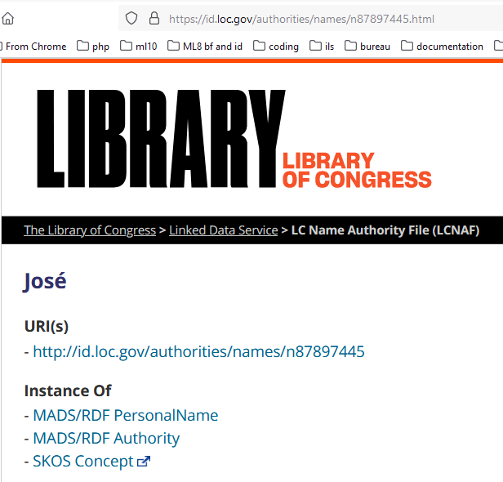
Label service …
Diacritic Sensitive:
https://id.loc.gov/authorities/names/label/Jose No results
https://id.loc.gov/authorities/names/label/José
Finds: https://id.loc.gov/authorities/names/n87897445.html

Slide 10
Suggest2
Why? Unknown labels, or too long to type out in a label search:
https://id.loc.gov/authorities/names/label/Jefferson, T. H. (Of the United States Army Mobility Equipment Research and Development Center)
Or:
https://id.loc.gov/authorities/names/suggest2/?q=Jefferson, T.
For typeahead applications; letter by letter search refinement.
Pattern: https://id.loc.gov/[authorities|vocabulary]/[scheme]/suggest2/?q=[term]

Slide 11
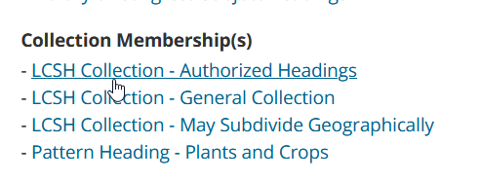
Suggest2 …
Additional Parameters:
Rdftype (CorporateName etc. from MADSRDF authority ontology)
Searchtype : Left-anchor search or keyword search
MemberOf: some resources are in collections across vocabularies, like LCSH Pattern headings
Also searches codes and tokens, not just labels.

Slide 12
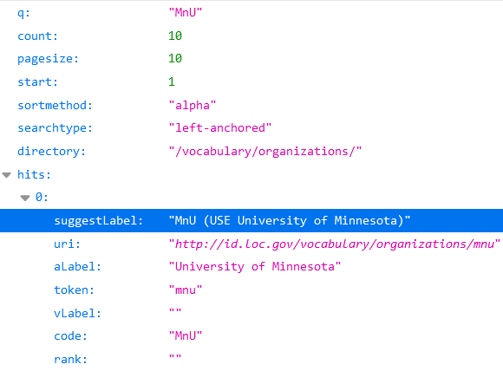
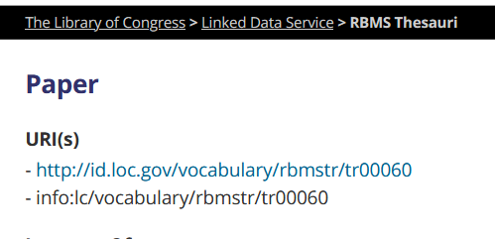
Suggest2 …
Codes search
https://id.loc.gov/vocabulary/organizations/suggest2/?q=MnU
Token Search, No scheme:
https://id.loc.gov/vocabulary/suggest2/?q=tr00060

Slide 13
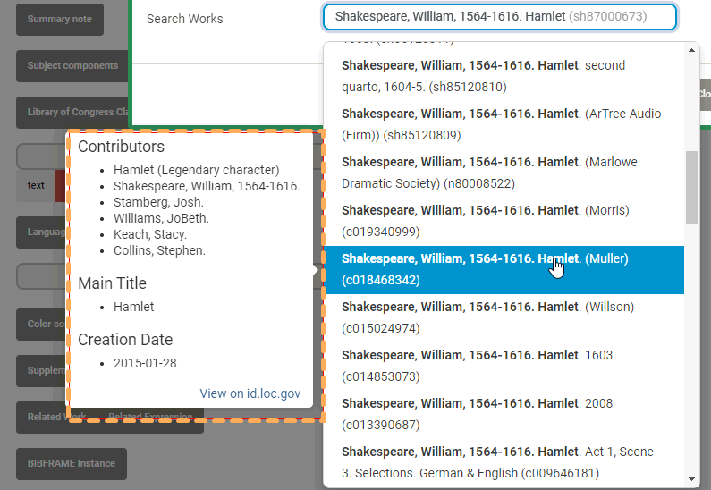
Suggest2 …
Handles multiple identical results:
https://id.loc.gov/resources/works/suggest2/?q=Shakespeare, William, 1564-1616. Hamlet
Editor lookup disambiguates them:

Slide 14
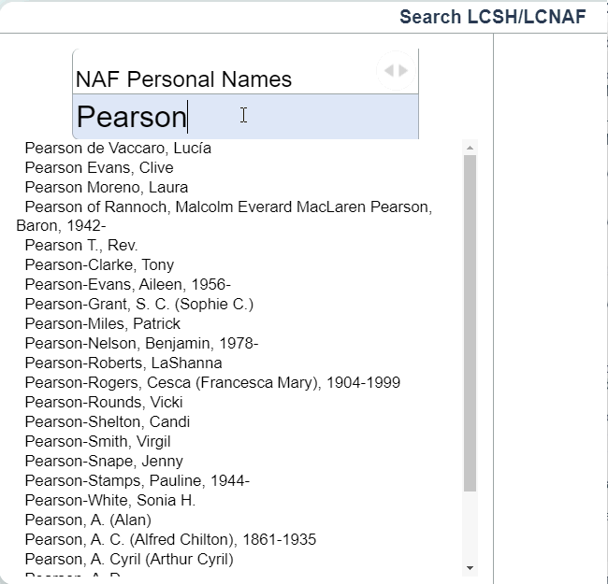
Suggest2 typeahead
Last Name only

Slide 15
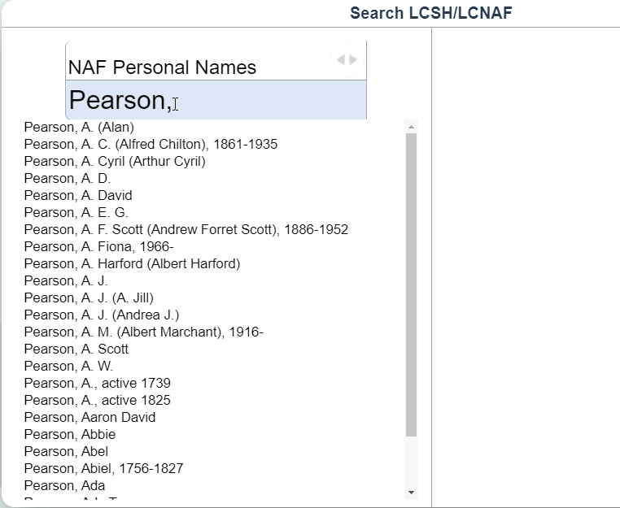
Suggest2 typeahead
Last Name plus comma

Slide 16
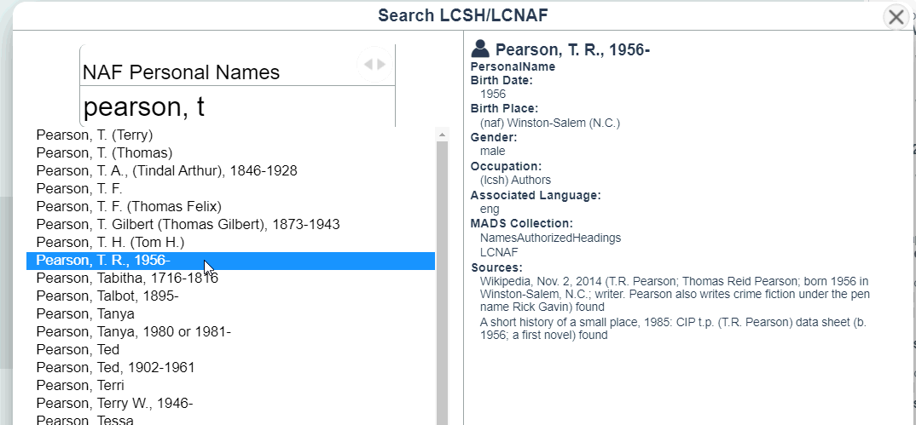
Suggest2 typeahead
Last Name, First Initial

Slide 17
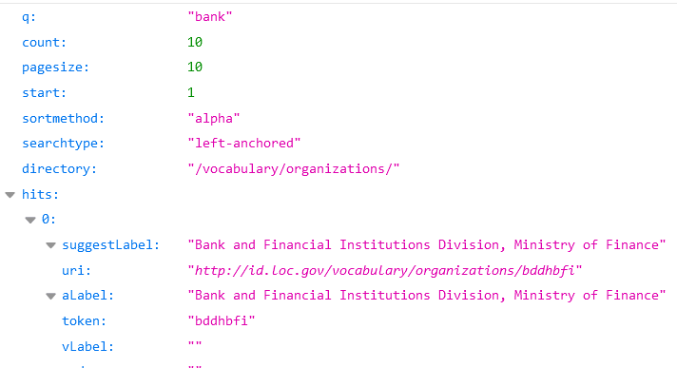
Suggest2 searchtypes
Left-anchored
https://id.loc.gov/vocabulary/organizations/suggest2?q=bank

Slide 18
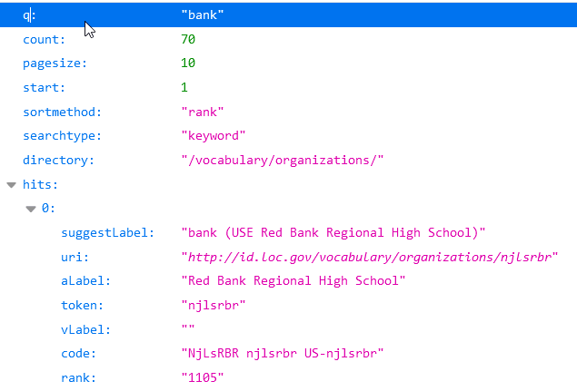
Suggest2 searchtypes
Keyword
https://id.loc.gov/vocabulary/organizations/suggest2?q=bank&searchtype=keyword

Slide 19
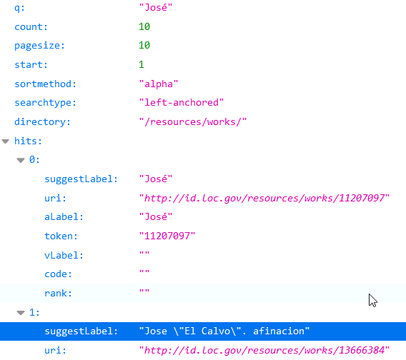
Suggest2 Diacritics
Diacritic Insensitive
https://id.loc.gov/resources/works/suggest2/?q=Jos%C3%A9

Slide 20
Suggest
Does not search codes or tokens; just Labels. May not handle results with more than one hit gracefully.
No keyword searching.
Left in place for any existing users; replaced by suggest2.

Slide 21
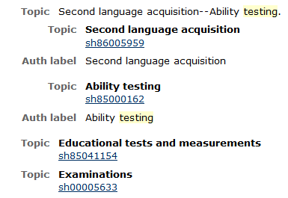
DisplayLabeL
Unadvertised label lookup for web displays of known URIS
https://id.loc.gov/authorities/subjects/sh86005959.displaylabel.html
<div id="…/authorities/subjects/sh86005959">
Second language acquisition
</div>
Javascript resolution results in the latest labels always showing:

Slide 22
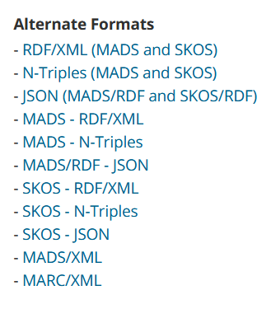
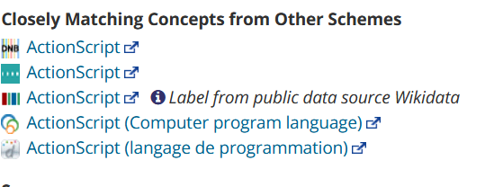
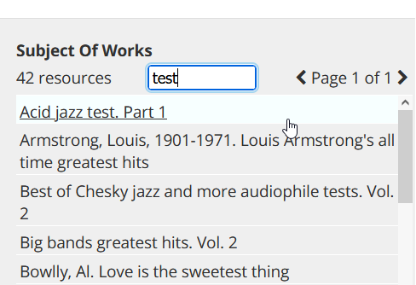
Resource level services
Individual resources have many formats and serializations listed at the bottom
External Links available
Subject Of / Contributor To
https://id.loc.gov/authorities/subjects/sh85069833.html
https://id.loc.gov/authorities/names/n00906685.html

Slide 23
Activity Streams
Activity Streams are JSON formatted notices of activity in a system:
Two kinds of activities to start:
Daily loads (deliver the Atom Feed as Activities)
Label changes within those loads
Systems may opt to only refresh their cache of main labels from ID, so they can take fewer updates
(this is coming soon).

Slide 24
Downloads
http://id.loc.gov/download/
New format: ndjson is “newline delimited” JSON, to allow streaming; each record is on a single line.
All the external links
Names file is very large.

Slide 25
Links
Help:
https://id.loc.gov/techcenter/
https://id.loc.gov/techcenter/searching.html
Editor code with working suggest2 typeaheads:
https://github.com/lcnetdev/bfe
https://github.com/lcnetdev/bfe2

Slide 26
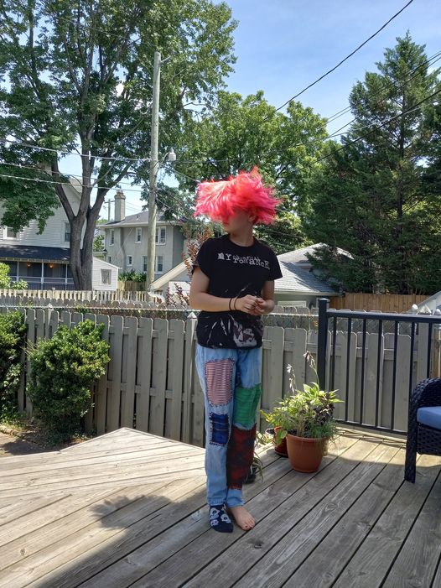
Thanks!
Nate Trail
LS/ABA/NDMSO
ntra @ loc . gov

