Slide 1
Where is the 043?
Retrospective Assignment of MARC Geographic Area Codes in Batch
Lucas Mak Michigan State University Libraries
ALCTS CaMMS Catalog Management Interest Group, ALA Annual 2018, June 23, 2018

Slide 2
Background
Objective
Help area studies librarians analyze collections in their respective areas by Geographic Area Codes (GAC) in catalog records
Problems
Catalog records lacking GAC
MARC 043 not yet created at time of cataloging
Minimal level cataloging
Catalogers not familiar with the practice of assigning GAC
GACs contained in catalog record may not be comprehensive
Until 2010, the Library of Congress (LC) assigned a maximum of three GACs to any one bibliographic record

Slide 3
Background
Library of Congress Subject Heading Manual
Appendix E governs the assignment of GAC
Heading is tagged 651 or contains a geographic subdivision ($z)
Location of individual named entities
Events, exhibitions, movements, etc.
And many more …

Slide 4
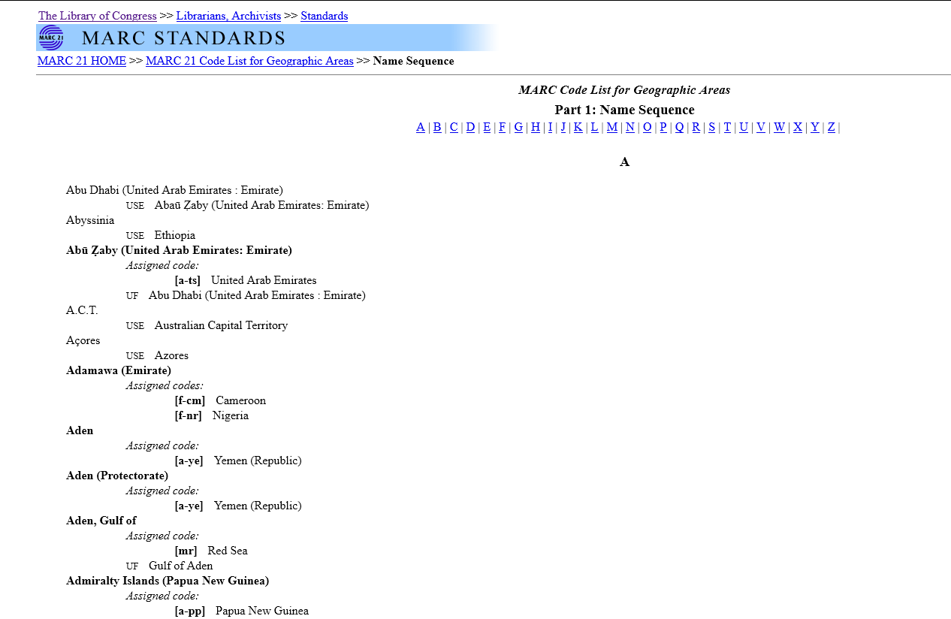

Slide 5
Background
GAC Code Structure
1st level
7 continents, regions larger than national level political entity, and oceans
e.g. Asia (a------), Pacific Ocean (p------)
2nd level
Regions or national level political entities located in 1st level areas
e.g. United States (n-us---), Great Britain (e-uk---)
3rd level
Frist order political subdivisions
Only available for Australia, Canada, China, Great Britain, and United States

Slide 6
Name-Code Conversion
Solution
Inserting GAC based on subject headings
MARC 651$a
Geographic subdivisions ($z)
Government bodies subordinate to a jurisdictional heading (610 10$a)
Non-jurisdictional corporate bodies (610 20)
Geographic qualifier of conference headings (610$c & 611$c )
Exclusions
Ethnic groups, nationalities, civilizations, etc.
False match possibility & matching efficiency

Slide 7
Name-Code Conversion
Countries with only 2nd level codes
Provincial/state and local level names in $z can be ignored
“Tokyo” (city) in $z Japan $z Tokyo
“Sabah” (state) in $z Malaysia $z Sabah
Countries with 3rd level codes
Local level places in $z can be ignored
Provincial/state level names will need to be converted
“Michigan” in $z Michigan $z Detroit

Slide 8
Name-Code Conversion
Conversion Table
Source of data
Name/code lists available on the LC GAC website
Tedious copy and pasting, time-consuming
id.loc.gov
LC has published the GAC data as linked data (http://id.loc.gov/vocabulary/geographicAreas)
Bulk download available (http://id.loc.gov/download/)
RDFXML, n-triple, and Turtle
Data conversion
RDFXML file into XML tables
Name-Code conversion table
United States → n-us--
Deprecated-Current Code conversion table
e.g. a-hk-- → a-cc-hk

Slide 9
Name-Code conversion table

Slide 10
Obsolete code conversion table

Slide 11
Name-Code Conversion
Default Processing Logic
1st geographic subdivisions ($z) matches as is
$z Ohio $z Cleveland → Matches “Ohio” to the conversion table
MARC 651$a, 610 10$a, 610$c, and 611$c
Does not have qualifier (e.g. Ohio), matches as is
Has qualifier (e.g. Cleveland (Ohio) or Cleveland, Ohio), extract qualifier for matching
MARC 610 20 (Corporate body names not entered under jurisdictional name
If $0 available, trace it to LC Linked Data Service
Matches MARC 370 $c (affiliated country) or $e (headquarters) to conversion table
Output
Converts deprecated GACs into current GACs (e.g. a-hk--- → a-cc-hk)
Keeps existing GACs in 043 if current
Dedups newly generated GACs against the existing 043
Only outputs unique GACs

Slide 12
Special handling in Name-Code Conversion
Special Patterns in Geographic qualifiers
Abbreviated state/provincial names (RDA Appendix B.11)
Vancouver (B.C.) in 651$a, “Portland, Me.” in 611$c
Multiple country/state/provincial names
Cumberland River (Ky. and Tenn.)
Type of place/jurisdiction
Chignik Lagoon (Alaska : Bay), Addison (Ohio : Township)
Intermediate place name
Albany (Berks County, Pa.)

Slide 14
Special handling in Name-Code Conversion
Non-jurisdiction geo names
May have their own special codes
River
$z China $z Yangtze River
Will output a-cc--- if only the first $z is considered
Its code should be a-ccg--
Reconstruct direct form from 65X$z and matching against conversion table
$z China $z Yangtze River → Yangtze River (China)
Regions, watersheds, metropolitan area, etc.
Most of the time, authority record is available for the base geo name only
Detroit Metropolitan Area (Mich.) → No authority record
Detroit (Mich.) → LCCN n 79045539
Remove geographic feature type from geo names and process it using logic for 651$a and/or match against conversion table

Slide 15
Special handling in Name-Code Conversion
Inconsistent Practices
Australia
Has 3rd level codes, e.g. Victoria (u-at-vi)
MARC 651 has states as geographic qualifier, e.g. Sydney (N.S.W.)
Geographic subdivision ($z) has Australia as the 1st $z and followed by local place name with state name as geographic qualifier in the 2nd $z
$z Australia $z Sydney (N.S.W.)
PRC China
Has 3rd level codes for:
Provinces, e.g. Shanxi Sheng (a-cc-sh)
Special cities, e.g. Beijing (a-cc-pk)
MARC 651 has
Provinces & country as qualifier, e.g. Taiyuan (Shanxi Sheng, China)
Country as qualifier, e.g. Beijing (China)
Geographic subdivision ($z)
$z China $z Taiyuan (Shanxi Sheng)
$z China $z Beijing

Slide 16
Special handling in Name-Code Conversion
Malaysia (SHM H810)
Has only 2nd level code (a-my---)
MARC 651 has
Province & country as qualifier, e.g. Kuching (Sarawak, Malaysia)
Geographic subdivision ($z)
$z Malaysia $z Kuching (Sarawak)
Korea (South) vs Korea (North)
Qualifier is dropped when qualifying a local place name (LC-PCC PS 16.2.2.4)
Seoul (Korea) -- $z Korea (South) $z Seoul
P'yŏngyang (Korea) -- $z Korea (North) $z P'yŏngyang
Needs an exhaustive list of Korean place names for matching
From LCNAF & LCSH files

Slide 18
XSLT Process
Abbrev. -> Full
MARC Records
MARC Records with GACs
Name -> Code
Deprecated -> Current Code
Korean Place Names

Slide 19
Outcome & Future Development
Nine million bibliographic records processed
1.4 million records have their 043 updated/added
Maintenance of conversion tables is required
New/changed/deprecated codes
New Korean place names in LCNAF & LCSH
Future development
Add 043 based on ethnic groups/nationalities in assigned LCSH
Technical assistance, American → United States
Pottery, Chinese—United States → China, United States

Slide 20
Acknowledgement
Dao Gong (System Librarian and ILS Administrator)
Created and tested an overlay procedure to update those 1.4 million bibliographic records

Slide 21
Questions?
Lucas Mak
Michigan State University Libraries
makw@msu.edu

