Slide 1
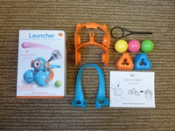
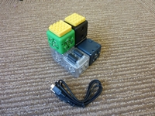
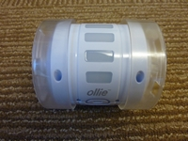
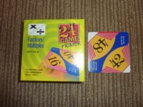
Using Images and Local Call Numbers when Cataloging STEM Materials, Kits and Curriculum Materials
Cynthia Hughes

Slide 2
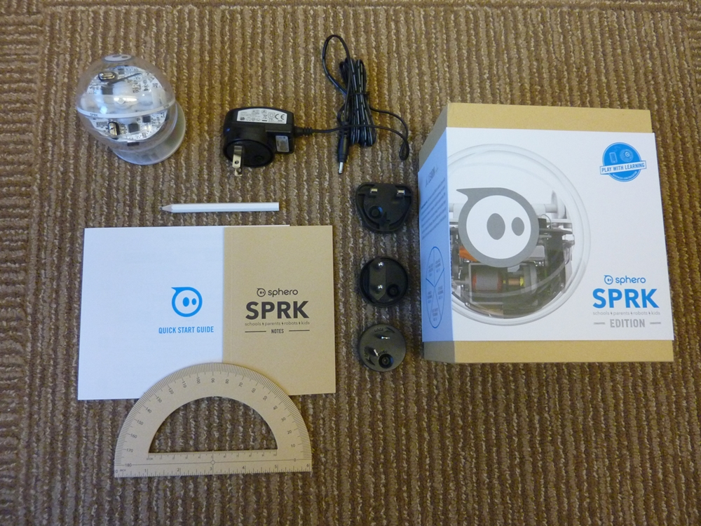
Using Images in Catalog Records
Why do it?
Ease of Circulation
Complex Contents: Keeping Track of Parts
Remote Users Can Better Understand Contents
Sometimes Items Hard to Describe
Which monster?
Notes:
Patrons lose parts, staff counts parts—replaces parts, hard to describe in catalog record…Of course, you can describe them but a picture is a lot easier to immediately recognize. INCORPORATING IMAGES SOLVES PROBLEMS: identifies missing parts at point of circulation; identifies correct content. SOMETIMES PARTS HARD TO DESCRIBE IN CATALOG RECORD but easier to visualize with an image. CAN BE HELPFUL WITH REALIA, BOARD GAMES, the LIBRARY OF THINGS—tools, cake pans, ETC. Lots of our curriculum materials are used by educators throughout the state. GAME BOARDS of similar size—how to distinguish which in which set? Some libraries WEIGH sets when returned to make sure all pieces included.
Easy to see which one belongs with which set if you have more than one kit with green monsters (which is improbable, I know).

Slide 3
ARTICLE PROVIDING MORE DETAIL ON THE PROCESS OF ADDING IMAGES TO CATALOGING RECORDS
Butler, M. & Kvenild, C. (2014). Enhancing Catalog Records with Photographs for a Curriculum Materials Center. Technical Services Quarterly. 31(2).

Slide 4
THINGS TO THINK ABOUT WHEN USING IMAGES IN CATALOG RECORDS
Take pictures on a neutral background.
Consider how to group contents, name files and store files before the start of the process.
Be consistent with naming.
Consider saving images to multiple places (desktop, shared drive, etc.)
Consider including an image of the original box.
Notes:
When I started, I often had 10 images or more but over time I have tried to reduced this as only 5 images display in the catalog record in our ILS. I have tried to simplify the images whenever possible.
Sometime we have to replace the original box because it is not sturdy enough to survive the use the item will get in the Lab School.

Slide 5
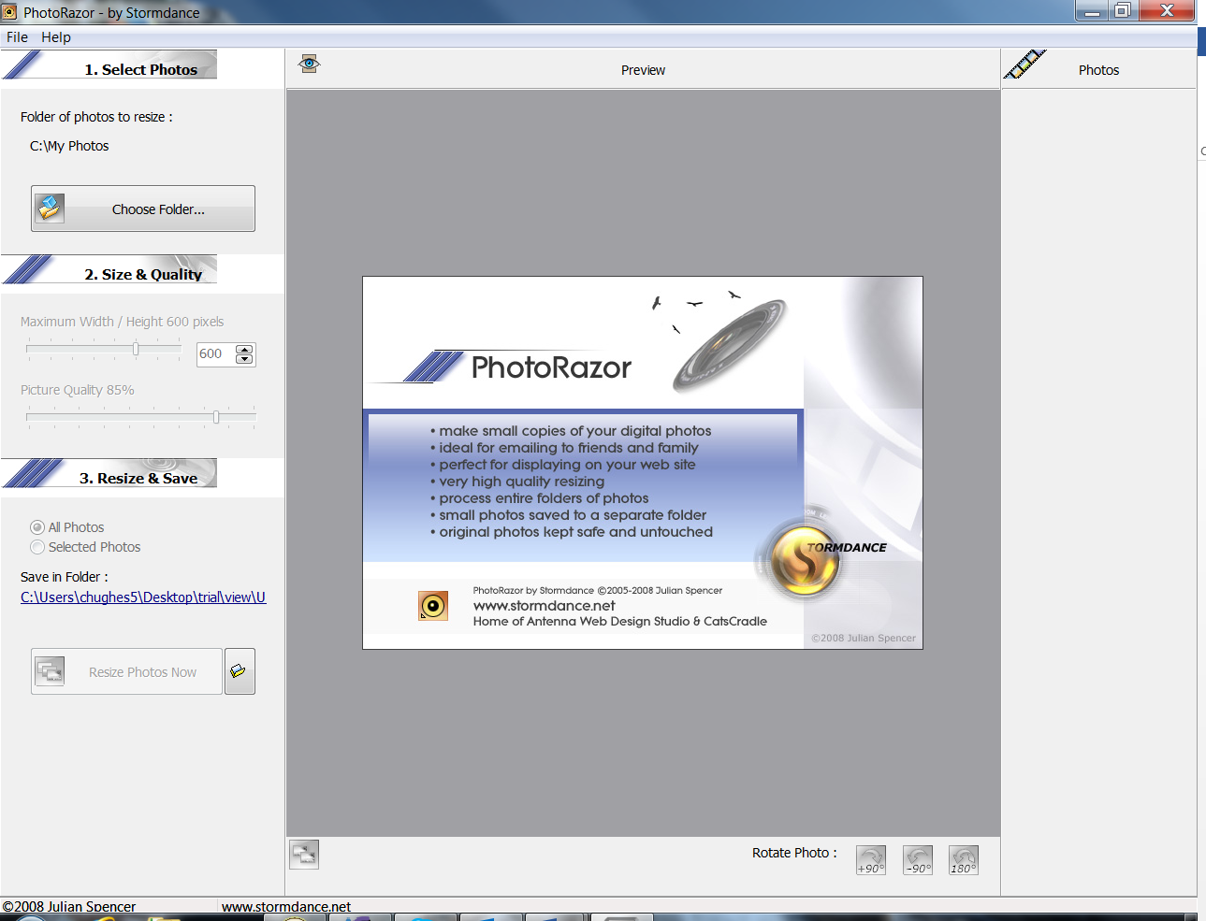
HOW WE ADD IMAGES
Take Picture of Parts with Digital Camera
Use PhotoRazor to resize images (free product)
Thumbnail 200 dpi
View 1000 dpi
Notes:
Size of images determined by our ILS

Slide 6
Use Excel to Keep Track of Saved Images
1000 dpi
200 dpi
Notes:
Importance of consistency of naming parts of whole…make sure each part is labeled consistently in both 856 and 962 (or whatever local field you use) fields. We use the barcode to label each kit uniquely; and use 001-00X for each part within that set.

Slide 7
MARC FIELDS TO USE TO ADD LINKS TO IMAGES
856 4 |uhttp://digital.uwyo.edu/kits/view/U181020191813/ 001_1000pix.jpg|zView Contents
962 URL:b6329044:007824:0:0:0:0:0:0|tContents|vn|uhttp://digital.uwyo.edu/kits/view/U181020191813/001_1000pix.jpg|ehttp://digital.uwyo.edu/kits/thumbnail/U181020191813/001_200pix.jpg
This is field is automatically generated in our ILS
Notes:
962 Field added when attaching the barcode to the record.

Slide 8
Inserting 962 MARC Field in ILS (Sierra)
Click on Media to add 962 field
Notes:
856 Field inserted in OCLC after record created but before exported; 962 Field inserted in ILS.

Slide 9
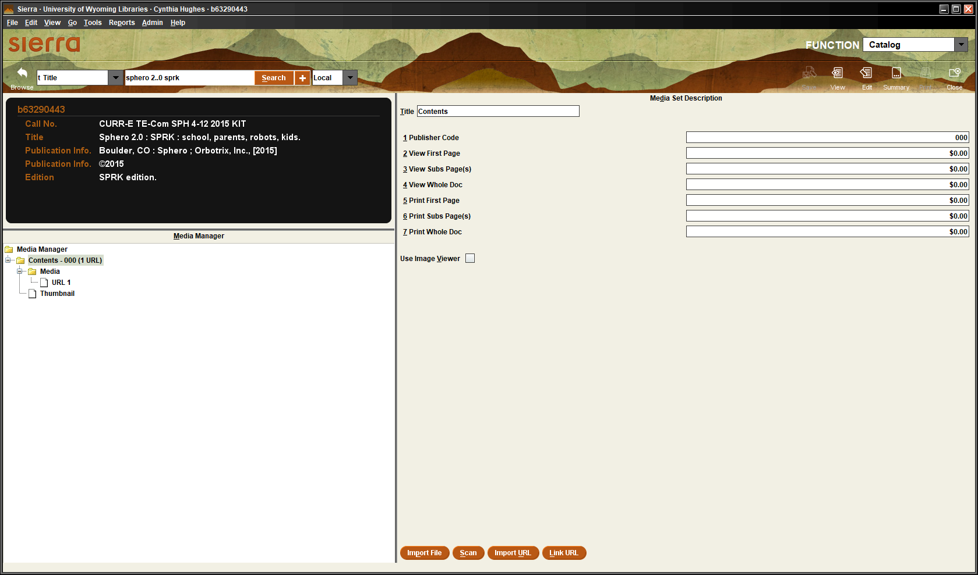
Image Title
Please Avoid Clicking “Use Image Viewer”: It WILL cause a problem if you do
Where you insert the link to URLs of each Image
Notes:
We found it a bit tricky to imbed images with our ILS (we use Sierra) with its Media Manager function. Essential: “Use Image Viewer” should not be used it is ties up the computer for a REALLY long time as it processes data. ‘
Important that Image Titles consistent on Excel Spreadsheet and image title used in record.
Copy the url from the Excel file. Need to do this for each separate image connected to the record.

Slide 10
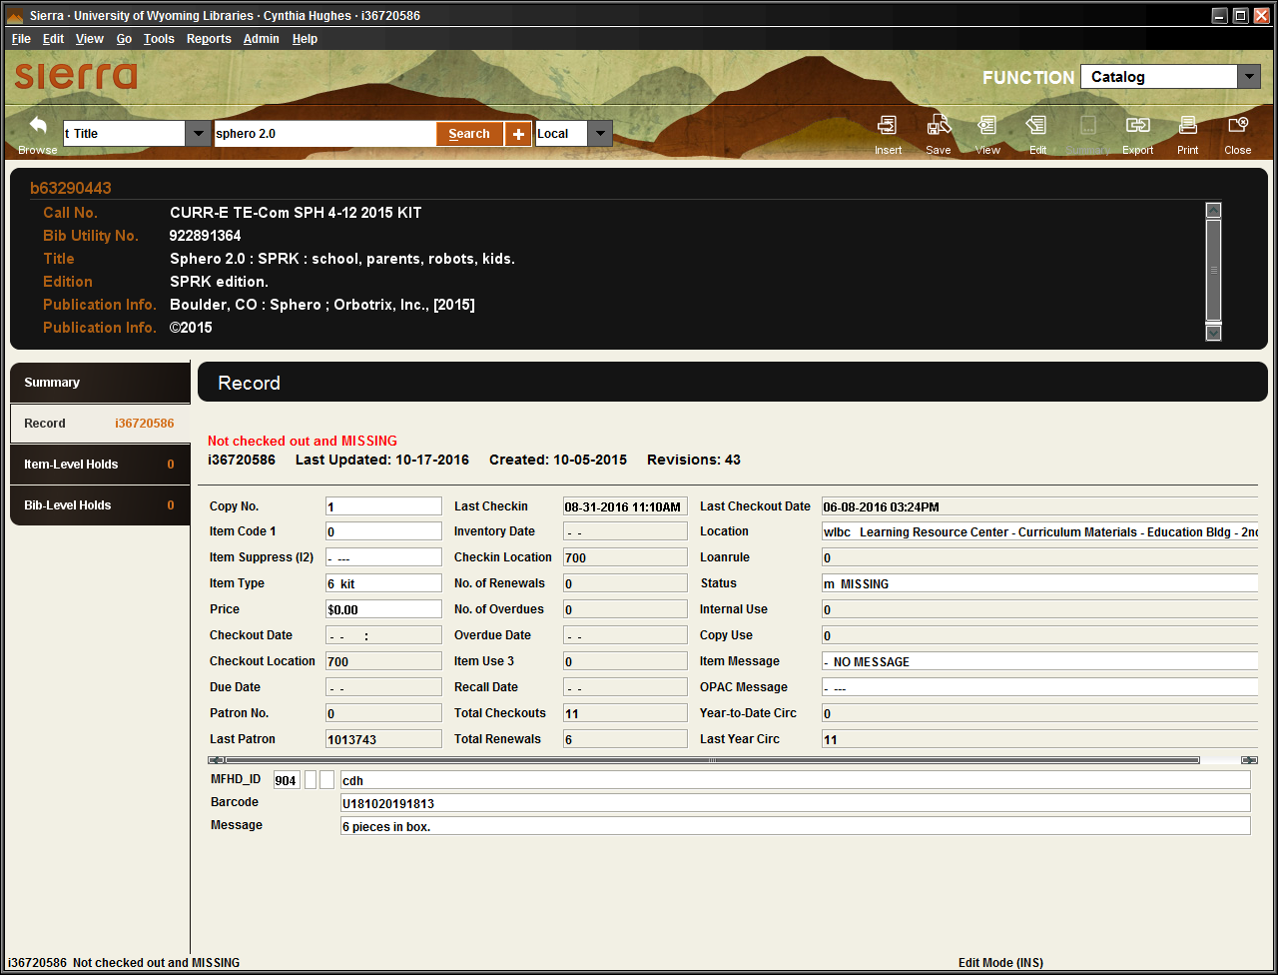
Noting number of pieces in a kit
Kit
# of Pieces
Notes:
In addition to the 300 and 505 fields listing contents, we also add a message that pops up when item is circulated so that the circulation staff knows how many pieces should be in the item. Redundancy provides one more reminder for circulation staff.
Item type also different in our ILS for kits than for books.

Slide 11
Example: Scientific Equipment
pH Sensor
Thumbnail (200 dpi) image
Link to View (1000 dpi) image

Slide 12
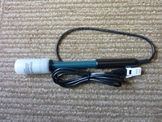
245 00 pH sensor /|cVernier.
500 User's manual available at: http://www.vernier.com/files/ manuals/ ph-bta.pdf.
4 |u http://digital.uwyo.edu/kits/view/U181019495563/001_1000pix.jpg |zView pH Sensor
962 000:000:URL:b6228997:007650:0:0:0:0:0:0|tpH Sensor|vn|uhttp://digital.uwyo.edu/kits/view/U181019495563/001_1000pix.jpg |ehttp://digital.uwyo.edu/kits/thumbnail/U181019495563/001_200pix.jpg
856 field
962 field
Notes:
.

Slide 13
Example: Board Game Code Monkey Island
Contents
Thumbnail (200 dpi) images
Thumbnail (200 dpi) images
View (1000 dpi) images
View (1000 dpi) images

Slide 14
MULTIPLE IMAGES FOR ONE RECORD
099 CURR-E|aTE-Pro|aCOD|a2-6|a2014|aKIT
00 Code Monkey Island :|b the game of programming, monkeys, & fun /|cauthored and designed by Raj Sidhu.
505 0 1 game board -- 10 boost in the bottle cards -- 16 fruit cards -- 54 guide cards -- Game guide -- 12 monkey figurines.
4 |uhttp://digital.uwyo.edu/kits/view/U181019843994/ 001_1000pix.jpg |zView Game Box
856 4 |uhttp://digital.uwyo.edu/kits/view/U181019843994/ 002_1000pix.jpg|zView Game Board
4 |uhttp://digital.uwyo.edu/kits/view/U181019843994/
003_1000pix.jpg |zView Boost in a Bottle Cards + 4 other 856 fields

Slide 15
Constructing Call Numbers
Dewey
Homegrown system (Using a 099 Marc Field): Examples: CURR-E LA-Rea SCH K-3 2005 KIT
J KIT STEM FRA
Textbook codes provided by a State Dept. of Public Instruction: Combination of audience, material type, subject and type of material
Example: CUR 9-69-401 Teacher’s Ed.
Notes:
Sometimes it makes more sense to create your own classification system. You might want to use a simplified Accession Number System (e.g. tools, kitchen equipment, recreational gear, etc.). USE 099 MARC FIELD. Our homegrown system: a 2-tiered subject heading system
DPI Example: http://www.dpi.state.nc.us/docs/textbook/adopted/tech-ed-7-12.pdf Probably not best for KITS but I include in case your curriculum materials are comprised of a lot of textbooks for homeschoolers, etc. If you had both Teacher’s Ed. And Student Ed. it would be helpful to distinguish between them in the Call Number.
Public Library Catalog Example for Kit for Fractions: http://ccsp.ent.sirsi.net/client/hppl/search/detailnonmodal/ent:$002f$002fSD_ILS$002f0$002fSD_ILS:2440595/nonmodal

Slide 17
Other Examples
Renewable Energy Kit
Dash and Dot (Robot)
Makey Makey (Electronic circuits)
Nomad 4 wheel drive off-road chassis
Lego Mindstorms Education EV3 Core Set
Sparkfun Inventor’s Kit
LilyPad design kit (e-Textiles)
Cubelets Twenty : Robot Construction System
Happy Atoms (Chemistry atom model set)
Beginner Robotic and Coding Maze Mat
24 Game : Algebra/Exponents 1, 2, 3, dot (Card game)

Slide 18
Thanks!
Questions? Please contact:
Cynthia Hughes
chughes5@uwyo.edu

