Slide 1
“Why Can’t You Just…”: Communicating with Scholars About Digital Library Labor
Laura Braunstein • @laurabrarian • lrb@dartmouth.edu
Digital Humanities Librarian, Dartmouth College

Slide 2
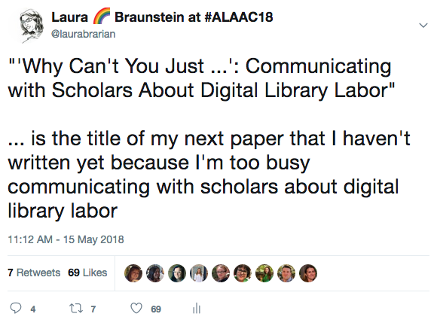

Slide 3
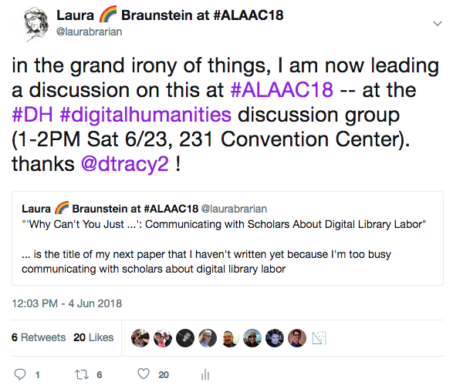

Slide 4
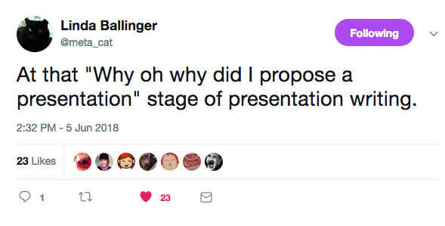
* Used with permission. Thank you @meta_cat!

Slide 5
Sam’s article: https://bit.ly/2MNqBOD Kevin’s article: https://bit.ly/2JVzKqy
“We are embedded in a chain of labour that stretches from my own individual subjective experience of work horizontally throughout the world of human life, and vertically through larger and larger abstractions of labour organization and management. We are right to speak up for the labour of all those who organize and make available documents, records, books, and all other kinds of information. But there is always a sense that the ignorance of all that labour that goes into one act of subjective discovery is simply a moral failing, that if only researchers or faculty would just smarten up then they would see all the labour that goes on around them.”
-- Sam Popovich, in response to Kevin Seeber

Slide 6
What can ACRL-DSS do, as a new section, to:
Make digital library labor visible?
Facilitate communication with scholars about digital library labor?

Slide 7
DLF Working Group on Labor in Digital Libraries
https://www.diglib.org/groups/dlf-working-group-on-labor-in-digital-libraries/
@laurabrarian
lrb@dartmouth.edu

