Slide 1
14th Berlin OA Conference
and
Plan S
Curtis Brundy – AUL Scholarly Communications and Collections

Slide 2
14th Berlin Conference
Aligning Strategies to Enable Open Access
Hosted by Max Planck Society
Organized by Max Planck Digital Library and OA2020
14th Conference Focus – Transformative Agreements
170 Participants from 37 countries

Slide 3
U.S. Participants
Bodo Stern - Howard Hughes Medical Institute
Curtis Brundy - Iowa State University
David Lewis - IUPUI University Library
Greg Eow – MIT Libraries
Raym Crow – SPARC
Jeffrey MacKie-Mason - UC, Berkeley
Ivy Anderson UC, California Digital Library
Günter Waibel - UC, California Digital Library
Rich Schneider - UC, San Francisco
Elliott Shore – CRL?

Slide 4
Conference Structure
Pre-session – Small group strategy session
Day 1
Urgency
Mechanics of Transformative Agreements
Achievements to Date
Day 2
Publisher Colloquy
Reaction, Strategy Discussion

Slide 5
Key Takeaways
1. Big Picture: China supports Plan S, OA2020, and wants to make transformative agreements with publishers
Nature “China backs bold plan to tear down journal paywalls”
https://www.nature.com/articles/d41586-018-07659-5
2. Local Level: Transition from Subscriptions to OA support in one renewal cycle

Slide 6
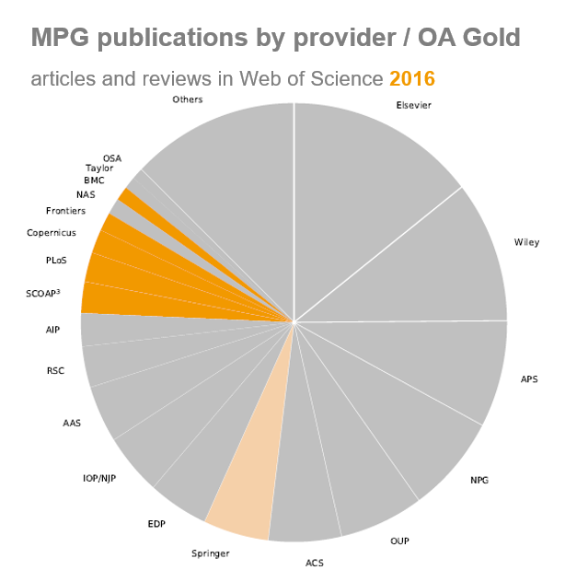
Subscriptions to
Open Access
MPDL
2016

Slide 7
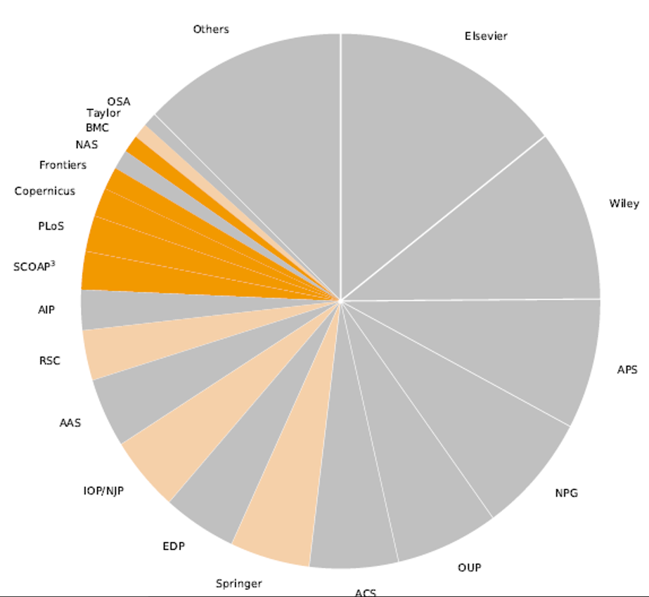
Subscriptions to
Open Access
MPDL
2018

Slide 8
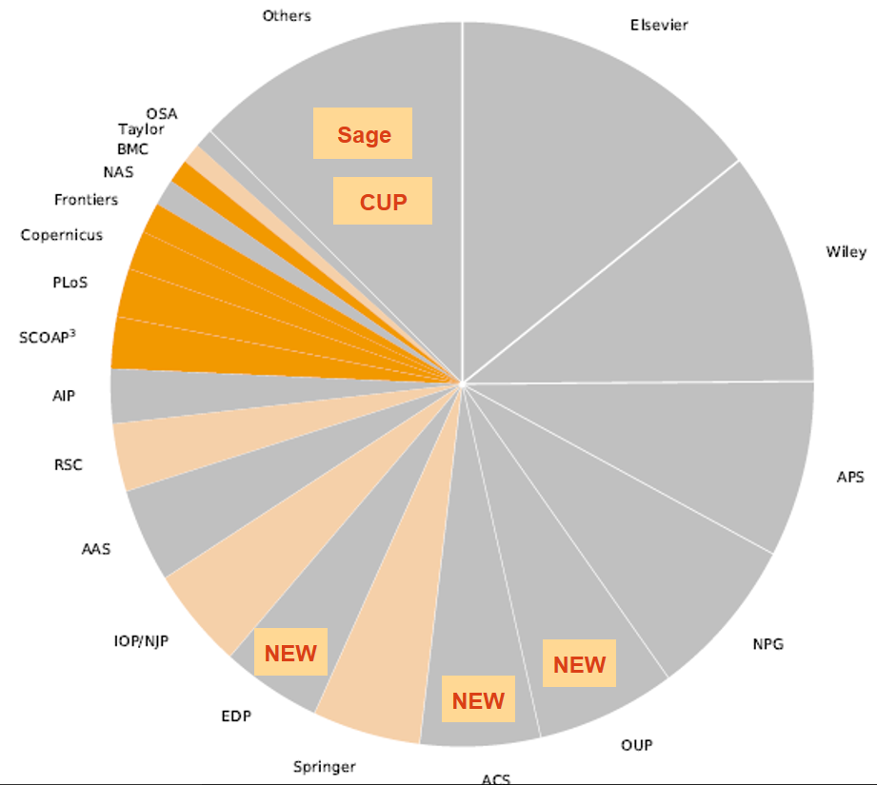
Subscriptions to
Open Access
MPDL
2019

Slide 9
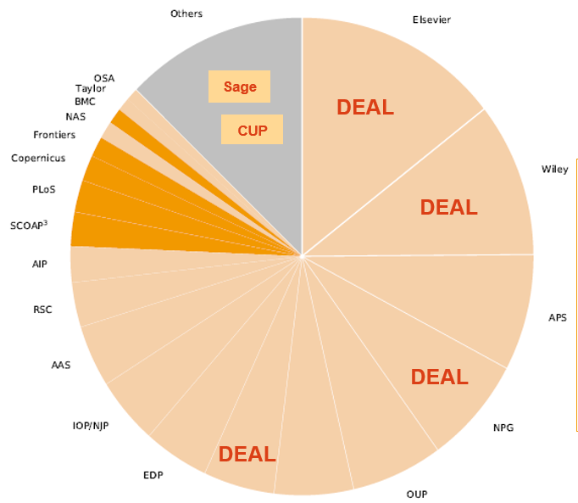
Subscriptions to
Open Access
MPDL
2020

Slide 10
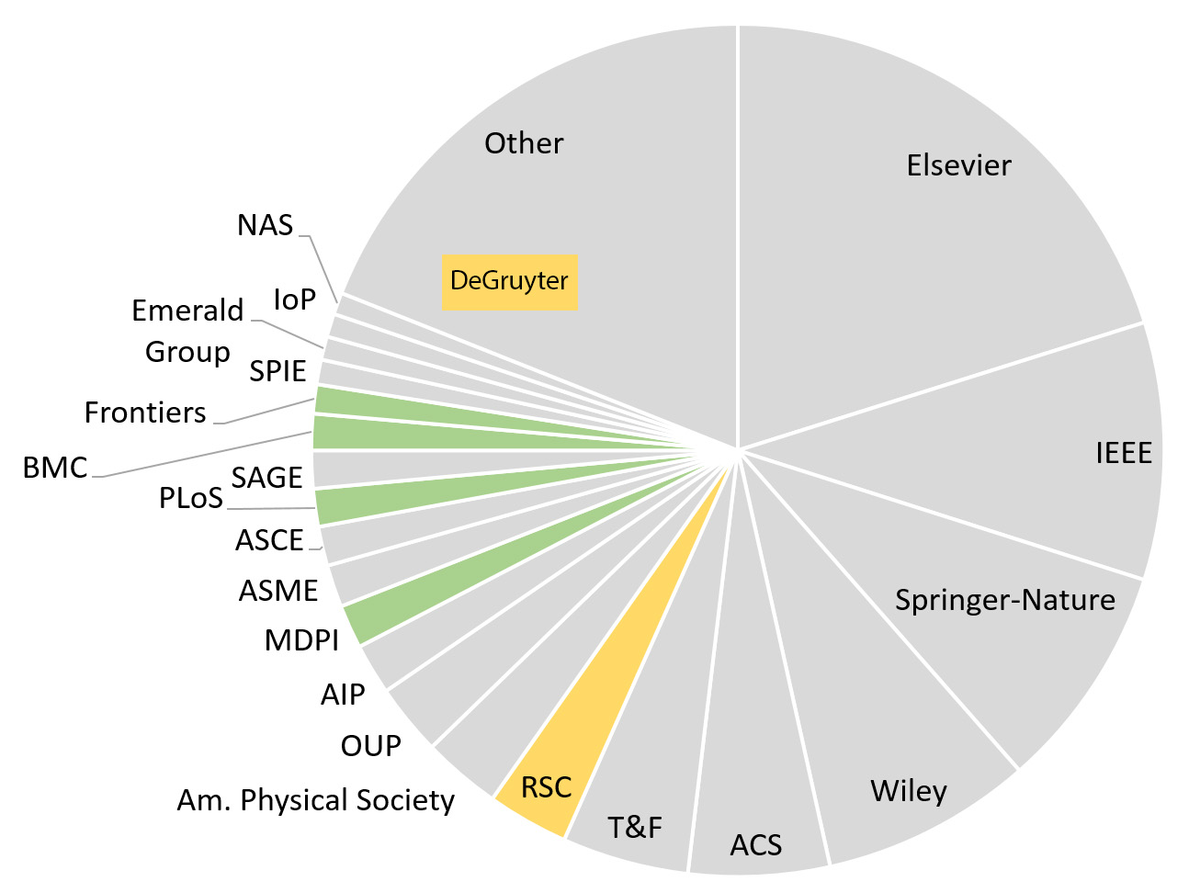
Subscriptions to
Open Access
ISU
2019

Slide 11
Plan S
Goal is to change publisher behavior, not researcher behavior

