Slide 1
Welcome to LAC/ Bienvenue à BAC : A new bilingual NACO partner Authority Control Interest Group (ALCTS LITA) Sarah Stacy and Hong Cui
Sunday, June 23 2019

Slide 2
Transition to NACO and Canadiana: Managing English and French files at LAC
Hong Cui
Notes:
Thanks Sarah. My name is Hong Cui. I am the information standard specialist at Standards and Systems team at LAC. In the past 2 and half years, I was involved in the technical requirements of new ILS OCLC WorldShare Management Services (WMS) authority module, and authority data migration in the Library System Renewal Project.
In my presentation, I will provide an overview of AMICUS authorities, the analysis we did prior to the transition, and data elements unique to LAC as a national library. If time allows, I will do a demo of linking English and French records in RM.

Slide 3
Transition Milestones
December 22, 2016: LAC officially joined NACO
2017: Analyzed the data and finalized the specs on authority module in Record Manager
August-December 2017: Canadiana number sub-project
February-August 2018: Internal Name Authorities sub-project
May 28-September 28, 2018: NACO Trainings
September 29, 2018: Canadiana Name Authorities in French officially released in WMS Record Manager
February 17, 2019: Canadian Subject Headings integrated into the Canadiana authority file
Notes:
I will start with the milestones in the transition to the WMS Record manager. LAC officially joined NACO in December 2016
In December 2017: OCLC delivered reports of LAC French records, and LAC English records against NAF, based on 4 extractions of LAC authorities from Jan. –Nov. In between the data extractions and analysis, OCLC and LAC also worked out the specs on authority development infrastructure in Record Manager, and the data definition of LAC French file. Between May and September, 2018: Dominique provided three rounds of NACO Trainings to LAC staff
September 29, 2018: Canadiana Name Authorities in French (shorter name Canadiana) officially released in WMS Record Manager;
In Record Manager Feb 2019 release: Canadian Subject Headings integrated into the Canadiana authority file

Slide 4
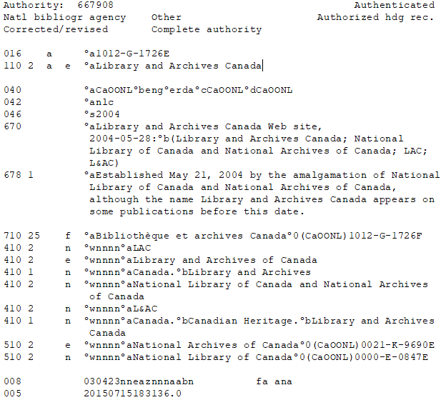
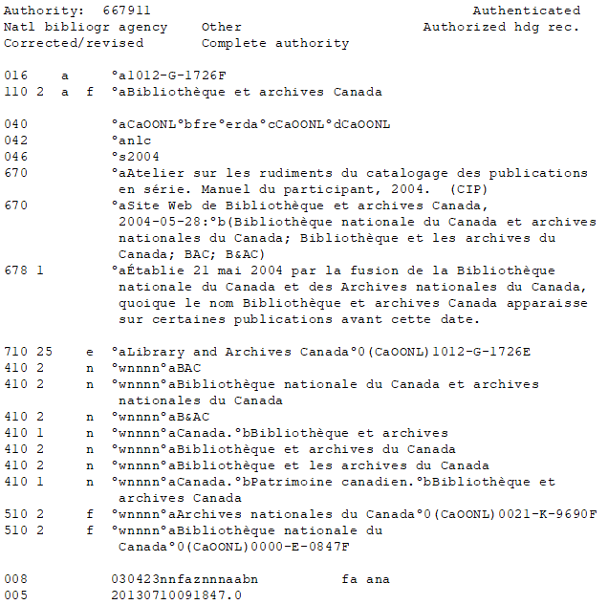
English and French Equivalent Records
Notes:
As Sarah said, we have been following bilingual cataloguing policy for 45 years. In AMICUS, English, French and language neutral name authority records resided in one file. LAC shared our records with library communities via the Canadiana Authorities website, VIAF, AMICUS Web, Z39.50, the MARC Records Distribution Services. It supported our mandate on providing access to Canada’s document heritage.
Here are the slides I stole from Sarah: Library and Archives Canada, and Bibliotheque et archives Canada. Both records have the same 016 Canadiana number, but different suffix E or F, to indicate English or French records; 710 heading linking fields (the 2nd indicator 5 is locally defined for equivalent relationships) with $0, linked the two records together; 042 authentication code “nlc” signified that LAC was the authentication centre.
Canadiana number was the system control number in $0 in both 5XX and 7XX fields.
In both records, 3 data elements are related to the language: the suffix of Canadiana number in 016, language of cataloguing in 040 $b, and 008/08, language of catalog. In the English record, the value is “e”, the French record, the value is “f”.

Slide 5
Language Neutral Records
Notes:
We considered headings language neutral, if these headings are applicable in both English and French cataloguing. The record itself can be catalogued in either English (040 $b eng) or French (040 $b fre), or language neutral (040 $b nnn). Here are two examples: English record: Henstra, Sarah, 1972- : she is the Governor General’s Literary Award winner in 2018 ; and French record, Tremblay, Michèle B. (Michèle Bergeron), 1939-
Both records coded 008/08 as b, valid for both English and French, there is no suffix in 016, and there is no 700 heading linking field
Following LAC bilingual cataloguing policy, LAC cataloguers create two bibliographic records (1 in English, 1 in French) if the item is in both official languages, or containing substantial portion of text in both official languages. When deriving bib records in the other language (equivalent records) in AMICUS, the derived records flipped the headings in 1XX and 7XX from the original ones to the equivalent headings via the equivalent relationships. The co-existence of English, French and language neutral records in one single file provided the capability for the system to manipulate the data and support the bilingual cataloguing.

Slide 6
LAC Data Elements in Canadiana/NAF
016: Canadiana Number
042: Authentication Code
7XX: Heading Linking Entry Fields
Notes:
In reviewing AMICUS data elements, we identified 016 and 7XX fields are unique to LAC, and we would like to keep in both Canadiana and NAF. Canadiana number was not system control number in AMICUS, but serves as the system-agnostic intellectual control numbers for permanent identification.
The capability to link equivalent records in 7XX fields helps us to continue providing equal access to records in both official languages.
In our discussion with OCLC, 016, Canadiana number, was defined as the mandatory field in Canadiana file in WMS. The functionality of using 7XX, to link equivalent records between NAF and Canadiana French file was also the core in the specs of OCLC authority infrastructure development in WMS Record Manager.
Sarah has covered details on our discussion with LC staff on our data elements. I will not repeat it here. LAC is very pleased that NACO allowed LAC to continue the use of 016 and 7XX fields in NAF.
The definition of “nlc” was also revised (in May) to include the usage in the authority format.

Slide 7
New Fields in Canadiana/NAF
065 Other Classification Number $2 fcps
151 Geographic Names
682 Deleted Heading Information (Automated in Canadiana History File)
Notes:
In addition to the data elements that we keep in both NAF and Canadiana File, we are very excited of learning new fields.
065 Other Classification Number. LC has updated Descriptive Cataloguing Manual Z1 to allow the use of this field. At this moment, we use 053 #4 for PS 8000 numbers in NAF; 065 in available in Canadiana file.
LAC used to use 151 only in subject file due to system restrain. Now we are using 151 in name files as well.
Record Manager inserts 682 field and the notes in Canadiana history file to indicate the record was replaced by a preferred record. It is pretty cool that In Canadiana name file, the
text is in French. « Cette notice d’autorité a été supprimée du fichier d’autorités de noms Canadiana en français ; utiliser $0… »
In the English subject file, the inserted text is in English

Slide 8
Adaptation of NACO Practice in NAF
008/07 Romanization scheme
008/08 Language of catalog
008/11 Subject heading system/thesaurus
040 $b language of cataloging
043 Geographic area code in corporate names
4XX $w Control subfields
665 History Reference
Notes:
We also recognized the NACO requirement on certain data elements, and we agreed to follow NACO practices in the fields listed here
008/07: Romanization scheme: we used to code “b” in English record as we follow ALA- LC Romanization tables in English records; and “a” international ISO standards in French records; now we follow the NACO practice using the fill character | - No attempt to code; it is also true to Canadiana file
008/08: bilingual usage: we used to code “e” for English records; “f” for French records or “b” can be used in both English and French, as you have seen in the previous slides. Now we are using blank as other NACO members in NAF, and “f” in Canadiana;
008/11: Subject heading system: LAC used to code as “n” not applicable; Now in French Canadiana file, we code “v” Répertoire de vedettes-matière; in NAF, we code “a”: LCSH
040: $b in AMICUS, we had $b eng, $b fre, or $b nnn; in NAF, we use $b eng only; in Canadiana, we use $b fre only
043: As we used 110 for jurisdiction names, we coded 043 field in 110 in AMICUS. Follow NACO practice, we are not using 043 in corporate bodies.
4XX: $w: NACO has a more simplified approach.
665: history reference: NACO uses 678 historical data field. We made the data correction to this field to follow NACO practice.

Slide 9
Canadiana Authorities in AMICUS
100: 499,957
110: 192,971
111: 18,442
130: 22,164
Notes:
At the time of authority freeze in AMICUS in September 2018, we had 733,534 records in total. Among them, about 10% (76,352 records) were upgraded or created in RDA since the implementation of RDA at LAC in late 2012.
There are 4 types of authority records in AMICUS: 100 personal names, 110, corporate bodies and geographic names; 111, meeting names, and 130 uniform titles.
In our query to AMICUS, we identified 15,146 place name records coded 110. In data migration, these records were extracted separately, and flipped to 151.

Slide 10
Canadiana Names: Language Profile
English: 83,824
French: 84,118
Language Neutral: 565,592
Notes:
As for the language profile, there were 83,824 English records; 84,118 French records; and 565,592 language neutral records based on the values of 008/08 position.
The French and language neutral records were migrated to WMS to form Canadiana Name Authorities in French (shorter name Canadiana); Canadiana functionalities appeared in RM on July 28, 2018, and fully released on September 29, 2018.

Slide 11
Canadiana English Records vs NAF
LAC English records Matched to NACO file (194,428)
Exact match in 1XX: 129,533
Match using normalization in 1XX: 2,608
Exact match to LC 4XX: 6,394
Normalized match to LC 4XX: 325
1xx headings are different
Date difference: 6,185
Text difference: 26,237
Indicator difference: 21,106
Tag difference: 22
1xx headings are different, but the LAC English headings match a 4XX heading in LC records
Date diference: 266
Text difference: 55
Indicator difference: 1,697
LAC English records not matched to NACO file (449,731)
LAC English records are in a VIAF cluster but does not contain a LC authority record: 285,090
LAC records are in VIAF, but not associated with authorities from any other name files: 154,458
LAC English records that are not associated with any VIAF cluster: 10,183
Notes:
OCLC had provided very detailed data reports on our French and English records.
In the analysis of LAC English records against NAF, we found out that we only had 30% of records matched to NACO records either as exact match, normalized match, or other matches, there are still 70% of records are unique to NAF.
You may notice the total number here is smaller than the slide before, it is because the analysis was based on the 2017 AMICUS authority file.
The findings demonstrated and confirmed our strength as a national library on describing Canadian entities, but also posed a big challenge on how to add our records into NACO. OCLC and LAC tested small batch loading into NACO file in Connexion in Feb. 2018. In our consultation to British Library on its transition to NACO, we also learnt that it took British Library 10 years to manually add their records into NAF. We decided to take the similar approach, to build an application to keep all AMICUS authority records in Internal name authorities

Slide 12
Internal Name Authorities
Notes:
The process ran from Feb. to August 2018. The final AMICUS authority records were loaded into the application after the authority freeze.
In the authority workflows, we search NACO, Canadiana, and Internal name authority file. By last week, there were 4468 records being migrated. (check again in June)

Slide 13
Canadiana Number
AMICUS
Integrated system generated control number in AMICUS;
Validation rule applies
Post-Transition
In house application to generate the Canadiana control number in bibliographic and authority formats;
Cataloguers copy and paste into either bibliographic or authority records;
No validations
Notes:
In Amicus, Canadiana number was system generated, and validation rules also applied. In WMS, we lost the capability to generate the number within the system. In Summer 2017, we started a sub-project Canadiana number generator to replicate the functionality in AMICUS.

Slide 14
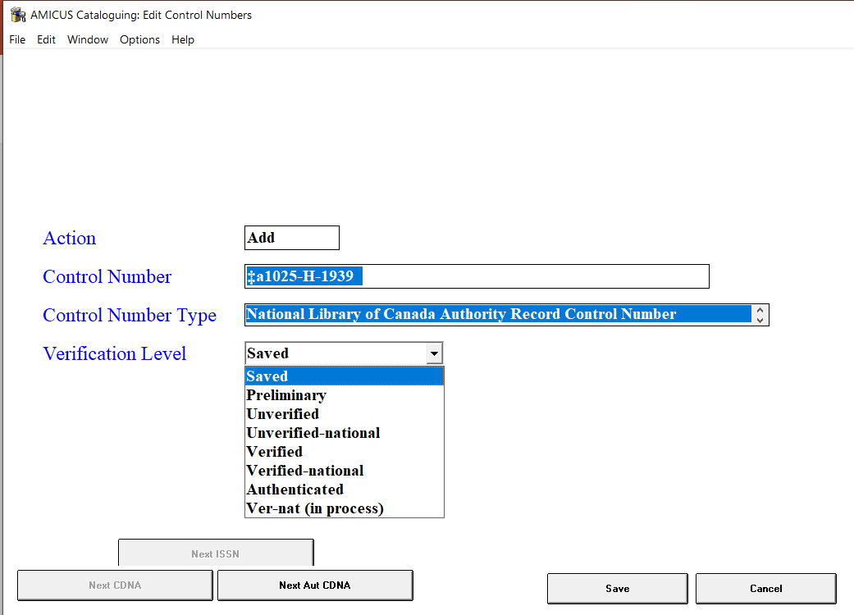
Canadiana Number (Contd)
Notes:
Here are the screenshots of the number generation in AMICUS, and the new application to generate both bibliographic and authority Canadiana numbers. This new application was deployed to cataloguers before we “go live” in December 2018.

Slide 15
Linking in Canadiana and NAF
https://bac-lac.worldcat.org/wms
Notes:
Now I would like to go to the Record manager cataloguing module to show our workflows. In this record OCN: 1082503041.
The heading in 110 is controlled against Canadiana file, as the language of cataloguing is coded as “fre” in 040 $b. When Canadiana names are used in subjects, we are using 2nd indicator “6”. This was the consensus we received from French library communities across Canada in the summer of 2017. In this record, both NACO and Canadiana names are controlled based on the 2nd indicator value.
To link the NACO record with the Canadiana record, I can search both headings in LC, and in Canadiana files; or simply click the hyperlink and edit the record.
In this Canadiana record, there is a dead link 700 1 7 Canada.$bGlobal Affairs Canada$0(CaOONL)1025E7425E $2lacnaf from the migrated AMICUS record.
Canadiana search 016: 1025E7425F Canada. Affaires mondiales Canada
Again, I can use the tab to go back to the bib record, and then click on the hyperlink to edit the NACO record, or search LC authorities to find the record:
LC: corporate name search Canada. Global Affairs Canada (no2016068839)
After evaluating both records, I am confident that they are the same entity with two official names. Now I can use Copy authority data and insert equivalence link. We can also follow the same workflows to insert See Also links.
The functionalities also apply to CSH.

Slide 16
Trainings
Record Manager Training
Train the Trainers
All Staff Training
NACO Training
Review of Policies and Procedures
Notes:
Our staff went through the full training of WMS Record Manager, including the authority module in October and November 2018, prior to the go live date.
Following the implementation, we are reviewing our cataloguing policies and procedures. We have shared the draft of the name authority manual with our NACO reviewers.
Now I will hand over to Dominique to talk more details of our NACO trainings.

Slide 17
Questions?

