Slide 1
072 MARC - Innovation with a National Impact
March 2024

Slide 2
- 072 – A little-known tag with a powerful impact on search and discovery. The National Library Services (NLS) customization of otherwise unutilized MARC tag to increase automated book selection for blind and print-disabled patrons, to speed up on-demand regional libraries’ circulation services, and to improve direct search and discovery in the NLS Catalog.
by Anita Kazmierczak, Head of Bibliographic Control Section,
National Library Service for the Blind and Print Disabled,
Library of Congress
MARCH 7, 2024

Slide 3
ABSTRACT
The 072 MARC tag, otherwise known as a Subject Category Code (LC) or Broad Descriptors (NLS), has been used by the National Library Service to, first and foremost, build a genre/subject bridge between the NLS Catalog and NLS BARD database. In recent years, NLS started publicizing and expanding the Broad Descriptors code list and utilization in MARC records. The little-known codes have become an essential key in a patron’s auto-select book and an effective and highly efficient support tool to optimize NLS Catalog search and discovery. This presentation will describe how, in just a couple of years, the 072 tag became one of the most exciting and helpful coded MARC tags that can relate and collaborate with searches across different MARC and non-MARC databases, how it can simplify on-demand patron search in regional libraries across the United States, and how it directly relates to readers and librarians high demand interests and topics. Additionally, it will explore how the 4-letter codes filled the space between the Library of Congress Subject Headings and Local Public Libraries themes and reader’s direct interest genres and how the 072 MARC tag can potentially consolidate three aspects of the library’s search and discovery: vocabulary control and standardization, local demand, and reader preference.
Keywords: MARC, access, discovery, tag 072, subject headings, broad descriptors, genres headings, Library of Congress Subject Headings, LCSH, subject category code, NLS, accessibility, reader auto-select, bibliographic description,

Slide 4
What is the 072 tag about?
Name: Subject Category Code
Repeatable MARC tag
Code for the subject category that is associated with the described item.
Can be repeated.
Subject Category Code Source Codes
https://www.loc.gov/standards/sourcelist/subject-category.html
*bisacsh = BISAC Book Industry Study Group Subject Codes ** bicssc – BIC Book Industry Communication Subject Codes

Slide 5
072 code describes and reflects the 650/655* tags
072
65X

Slide 6
NLS’s twist on 072 tags – creating accessibility metadata easily manageable across various discovery platforms
072 – Broad Descriptor list was created to accommodate specific but somewhat limited network libraries reader auto-select search and selection needs. 072 linked to BARD search criteria.
072 – tag initially complied only with 655 MARC tags (before 2021)
072 – international language codes added (mainly for Marrakesh Treaty titles and growing NLS foreign language collection) – ongoing as the collection grows and more languages are added to it (2021-23)
072 –popular topics based on public demand and patron search behavior were added, and 072 started to reflect 655 and 650 tags (2022)
072 – become searchable in the NLS Catalog! All codes are linked as a part of NLS Catalog OPAC modernization, the list became public and is available for download to all NLS/LC users and patrons (2022 winter) link below.
072 – NLS learned via Federal Research Surveys that public libraries highly if not exclusively rely on 072 to create an auto-select reading/discovery list for patrons across the country (2022)
072 – further expansion of codes, to contain many more genres and popular topics including everyone’s favorite COZYAF code to the list (2023 summer)
072 – most updated list published (200+) to include additional age groups to better categorize target audience within genres and topics (2024)
https://nlscatalog.loc.gov/vwebv/ui/en_US/htdocs/help/docs/NLSSubjects.pdf

Slide 7
NLS Broad Descriptors/NLS Subjects [072 _ 7] - I
LANG
2022
LANG
LANG
LANG
LANG
LANG
LANG
2023
2022
LANG
LANG
LANG
LANG
LANG
LANG
LANG
LANG
LANG
2022
LANG
LANG
LANG

Slide 8
NLS Broad Descriptors/NLS Subjects [072 _ 7] - II
LANG
LANG
LANG
LANG
LANG
LANG
LANG
LANG
LANG
LANG
LANG
LANG
2022
LANG
LANG
LANG
LANG
LANG
2023
2022
LANG
2022
LANG
LANG
LANG
LANG
LANG
LANG
LANG
LANG
LANG

Slide 9
NLS Broad Descriptors/NLS Subjects [072 _ 7] - III
LANG
LANG
2023
LANG
LANG
LANG
LANG
2023
LANG
LANG
LANG
LANG
LANG
LANG
LANG
LANG
LANG
LANG
LANG
LANG
LANG
LANG
LANG
2023
LANG
LANG
LANG

Slide 10
Accessibility and efficiency of 072 code
Code is metadata that increases discovery and access for all users
Codes are transferable between systems, discovery platforms and catalogs, and do not rely on MARC proficiency
Codes can be easily mapped and indexed, and added to every catalog MARC and non-MARC database
Codes are “translations” for lengthy and outdated subject headings and genre headings
Codes can be linked to users’/patrons’ reading preferences and create subscription profiles
Codes if linked in the catalog easy retrieval of material for patrons, easy on-demand requests within code sign-up
Codes are easy to understand and translate into reflecting Library of Congress subject of genre heading
Codes are self-explanatory to everyone don’t need a key to understand the meaning
Codes are on-demand creation, local practice is encouraged for every library – add to it!
Codes are an additional (alternative) option for Subject Search

Slide 11
072 Subject codes in the NLS Catalog – DISPLAY
Available to the PUBLIC
NLS CATALOG
072 matrix

Slide 12
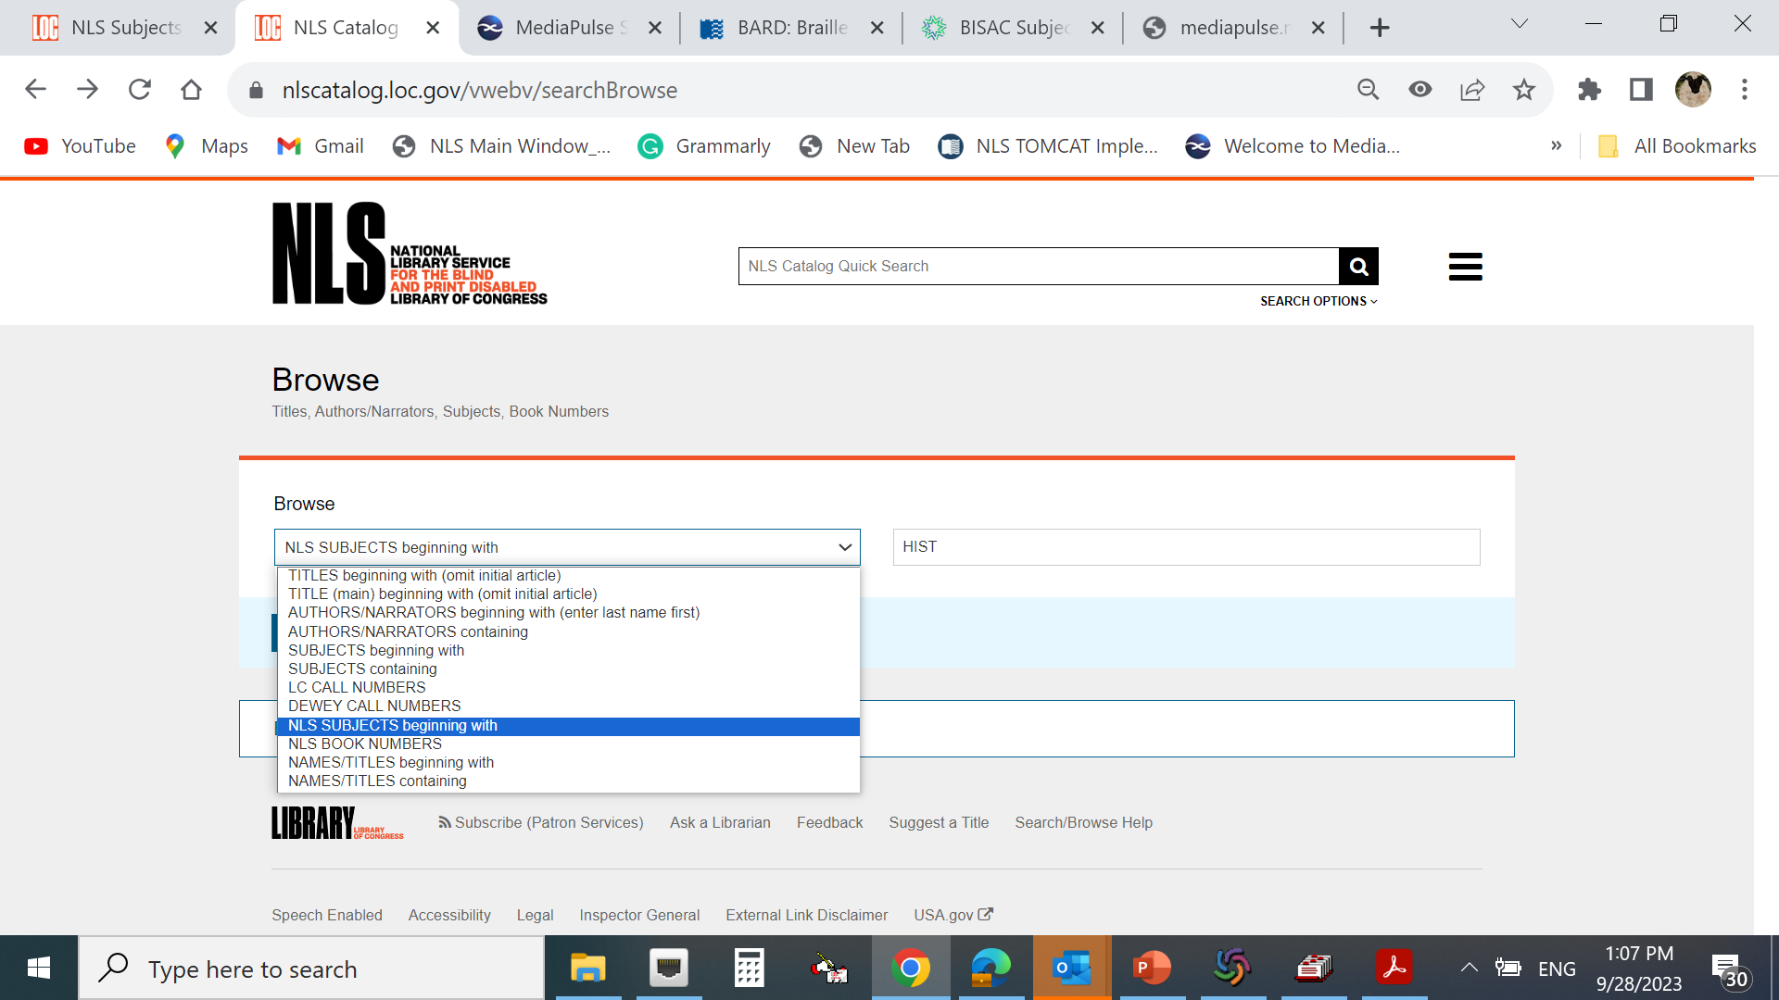
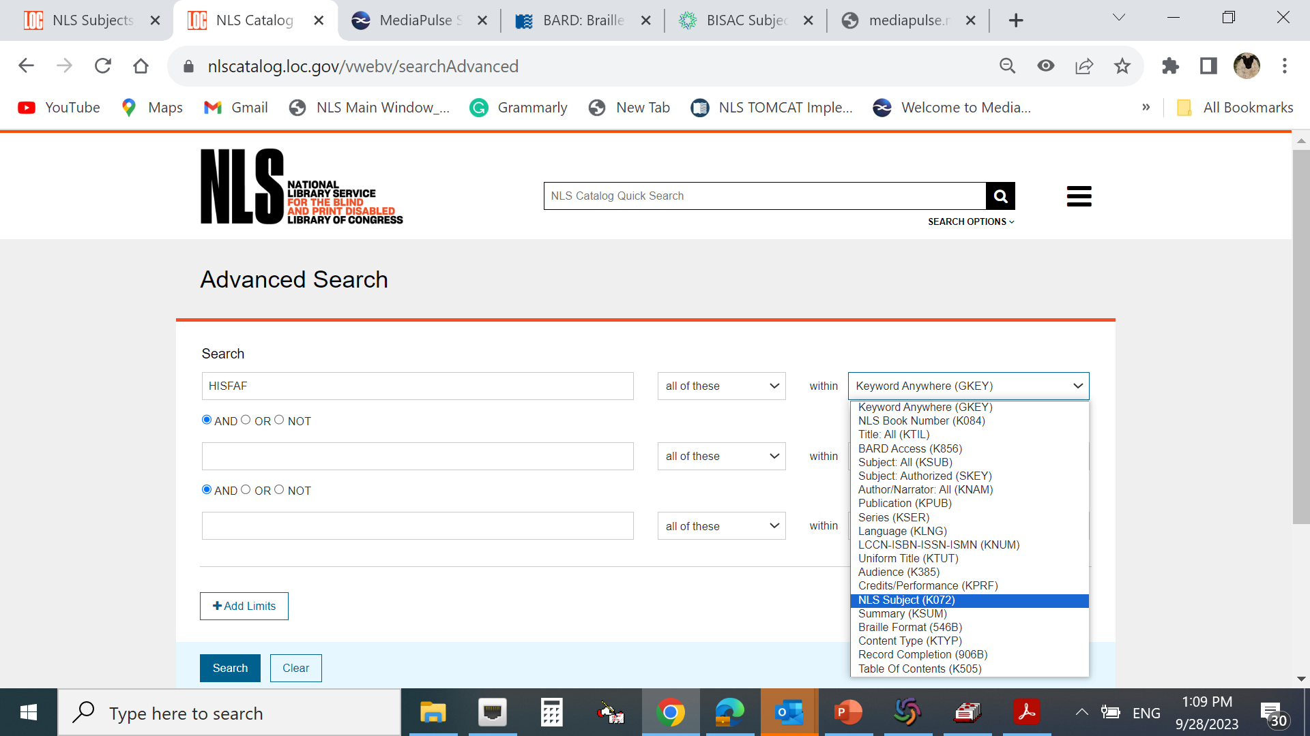
072 Subject codes in the NLS Catalog – SEARCH
Available to the PUBLIC
NLS CATALOG

Slide 13
072 Subject codes in BARD – SEARCH

Slide 14
072 Subject codes in BARD – DISPLAY

Slide 15
072s are coded versions of LCSH (650)
072
General
072s linked in BARD to preloaded search criteria
072s are indexed in the
OPAC to be one of
linked search categories
NLS Public
NLS Network
072s linked by circulation vendors and network libraries to the reader’s auto-select profiles
General
072s are coded versions of the LC genre headings (655)

Slide 16
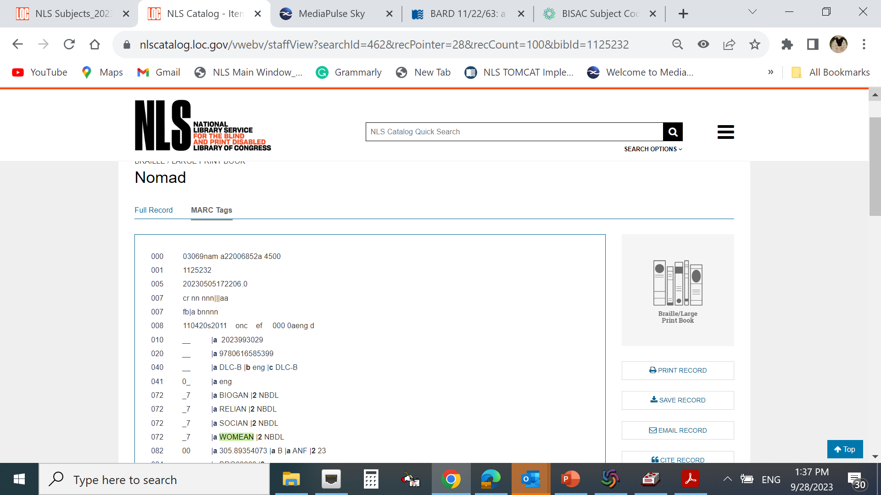
NLS 072 deconstructed
072
* Indicators
1st none
2nd “7”
* Subfields
$a Subject category code 4 LETTER
Audience and genre code 2 LETTER
AF – Adult Fiction
AN – Adult Nonfiction
JF – Juvenile Fiction
JN – Juvenile Nonfiction
$2 Source code $2 NBDL (NLS source code)

Slide 17
How to assign 072 efficiently – MARC Edit TASK automation is the key to adding 072 to the catalog record
=050 00$aPS3623.E393$bM53
=072 \7$aFAMIAF$2NBDL
=072 \7$aUEBC$2NBDL
=082 00$a813.6$aAFI$223
=650 \0$aCity and town life$vFiction.
=650 \0$aFamily secrets$vFiction.
=650 \0$aGrandmothers$xDeath$vFiction.
=650 \0$aHomecoming$vFiction.
=650 \0$aInterpersonal relations$vFiction.
=650 \0$aMagic$vFiction.
=650 \0$aRestaurants$vFiction.
=651 \0$aAlabama$vFiction.
=655 \7$aBraille books.$2lcgft
=655 \7$aDomestic fiction.$2lcgft
=655 \7$aFiction.$2lcgft
*Currently --- hybrid approach -- manual and auto-tag population

Slide 18
What is coming for 072
Expansion of the NLS Subject codes list (attached draft proposal)
Expansion of auto task to populate NLS codes and linked 655/650 to adequate code
Promotion of NLS Subject codes within NLS Network libraries to build new reading and search patrons’ profiles
Add new codes to BARD search criteria
Add NLS Subject codes as part of linked search criteria in the new Library discovery platform (LCAP, 2025)
NLS Subject Source code $2 NBDL will be added to Subject Category Code Source Codes https://www.loc.gov/standards/sourcelist/subject-category.html
Happy to share the NLS Subjects list

Slide 19
New NLS codes
Subject Code | Subject Name | Valid Combinations | YA addition
ADVE | Adventure | AF AN JF JN | YF YN
AFAM | African American Topics | AF AN JF JN | YF YN
AFRK | Afrikaans Language | AF AN JF JN | YF YN
ALBA | Albanian Language | AF AN JF JN | YF YN
ALGO | Algonquian Language | AF AN JF JN | YF YN
ANIM | Animals and Wildlife | AF AN JF JN | YF YN
ARAB | Arabic Language | AF AN JF JN | YF YN
ARME | Armenian Language | AF AN JF JN | YF YN
ARTS | Arts | AN JN | YF YN
ASAM | Asian American Topics | AF AN JF JN | YF YN
ASTR | Astronomy, Astronautics | AN JN | YF YN

Slide 20
Thank you for listening Happy cataloging!
Contact:
Anita Kazmierczak email : ahoffman@loc.gov

